Slide 1
Stormwater Manual wiki (June 1, 2022)
> 2300 pages
> 700 tables
About 4400 uploaded files (photos, pdfs, Word, etc.)
About 1500 images

Slide 2
Wiki issues and solutions
Too much information becoming overlapping, conflicting, disorganized
Consolidate information
Delete extraneous and outdated information
Organize the remaining information
Inconsistent information and guidance
Review pages for consistency
Delete, consolidate, update information
Finding information
Categorize information
Create multiple search pathways
Trainings and How-to-videos

Slide 3
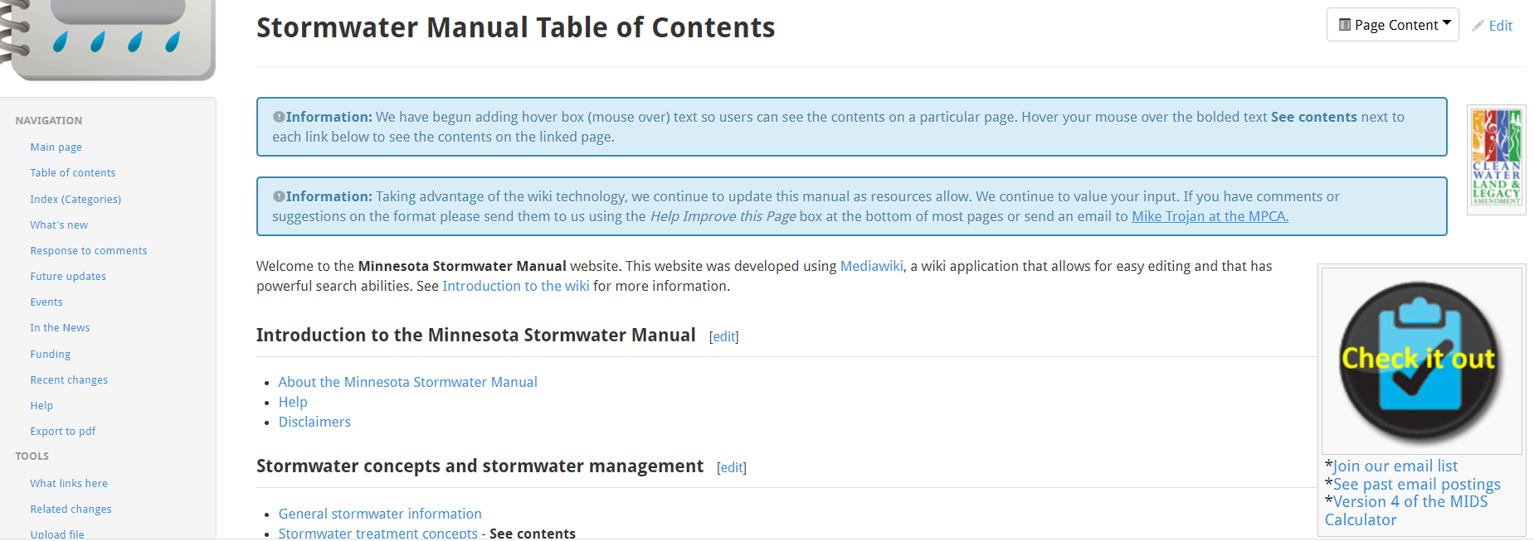
Organization solution: Organize and categorize information using the Category function in Mediawiki

Slide 4
Subcategories
Level 1
Level 2
Level 3
Structural practices
Filters
Nonstructural practices
Screening and straining
Settling
Pretreatment practices
Best management practices
Separators
Construction practices
Specifications
Design
Guidance and information
Construction
Models and modeling
Operation and maintenance
Case studies and examples
Assessment

Slide 5
Level 1 categories
Acknowledgements
Best management practices
Case studies and examples
General information, reference, tables, images
Management
Models and modeling
Pollutants
Regulatory
Technical information

Slide 6
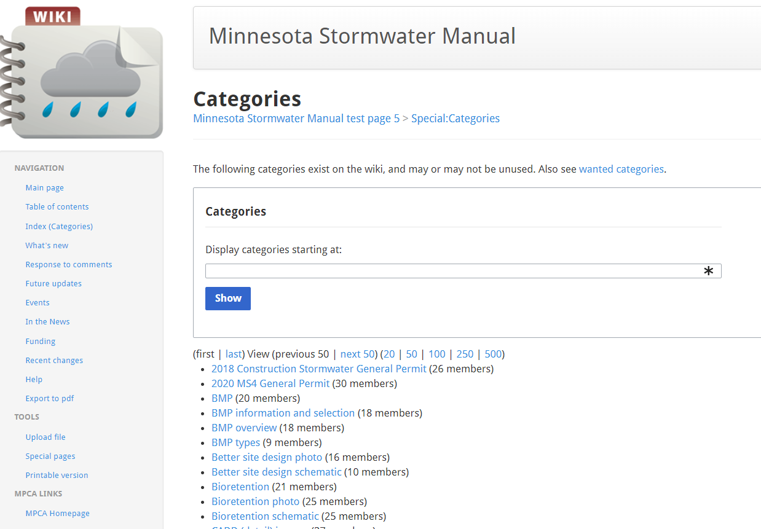

Slide 8
Level 2 categories – Best management practices
Structural practices
Nonstructural practices
Pretreatment practices
Construction practices
Specifications
Information and guidance
Models and modeling
Case studies and examples

Slide 9
Level 2 categories – Case studies and examples
Case studies
Examples

Slide 10
Level 2 categories – General information and reference
General information
References
Tables
Images
Archived

Slide 11
Level 2 categories - Pollutants
Bacteria and pathogens
Chloride
Metals
Nitrogen
Phosphorus
Organics
Sediment
Temperature
Trash
{Emerging contaminants}

Slide 12
Level 2 categories - Regulatory
Construction
Industrial
Municipal
{Non-stormwater}

Slide 13
Level 2 categories – Models and modeling
General model information
Specific models
Model applications and examples
Tables
Images

Slide 14
Level 2 categories - Management
Green infrastructure
General management information and guidance
Watershed scale and treatment train
{Primary treatment}
{Secondary treatment}
{What else?}

Slide 15
Level 2 categories – Technical information
Soils and media
Infiltration
Vegetation
Receiving waters
Cold climate
Regulatory
{What else?}

Slide 16
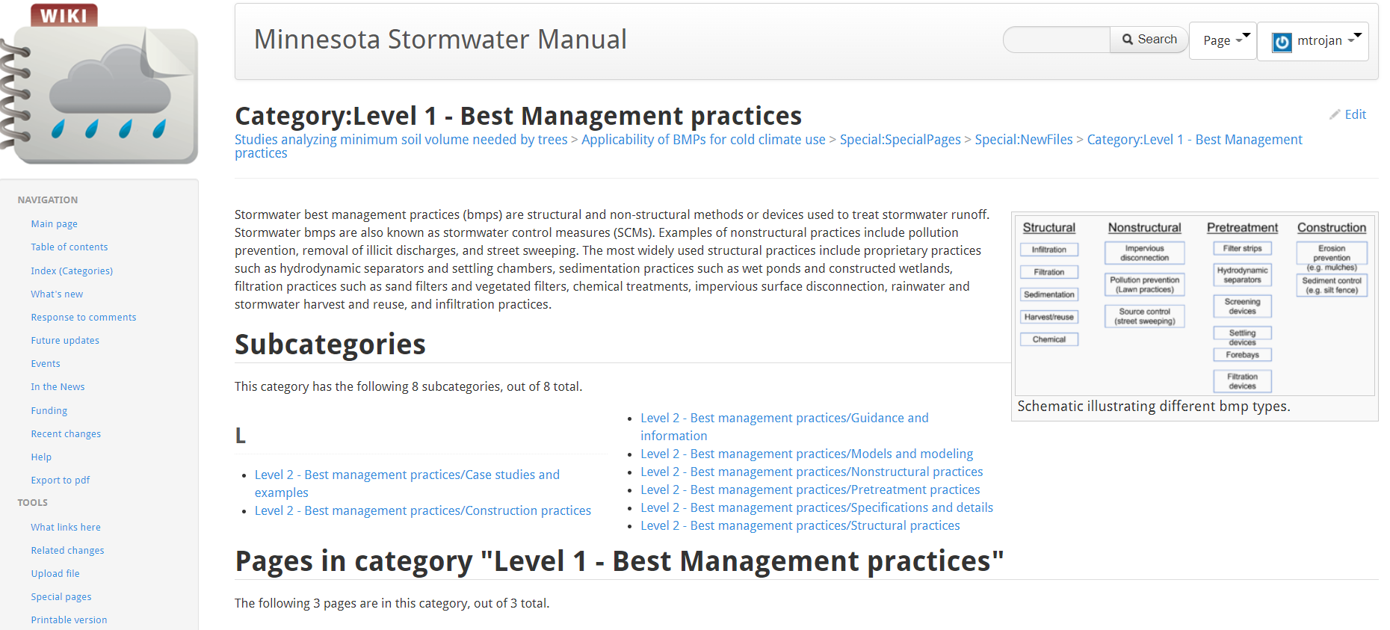

Slide 17
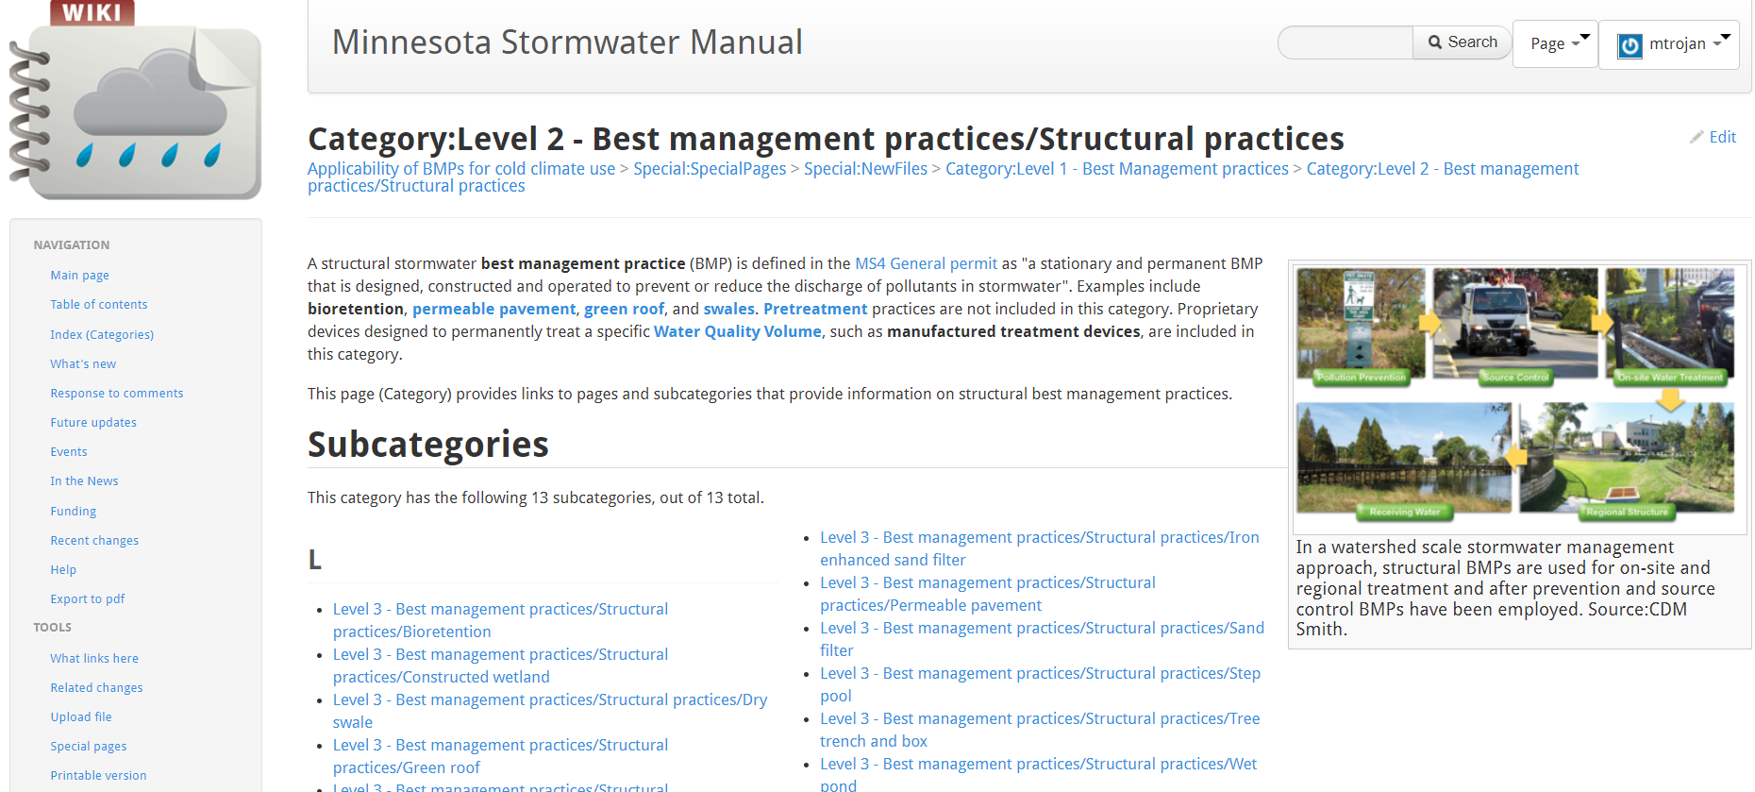

Slide 18
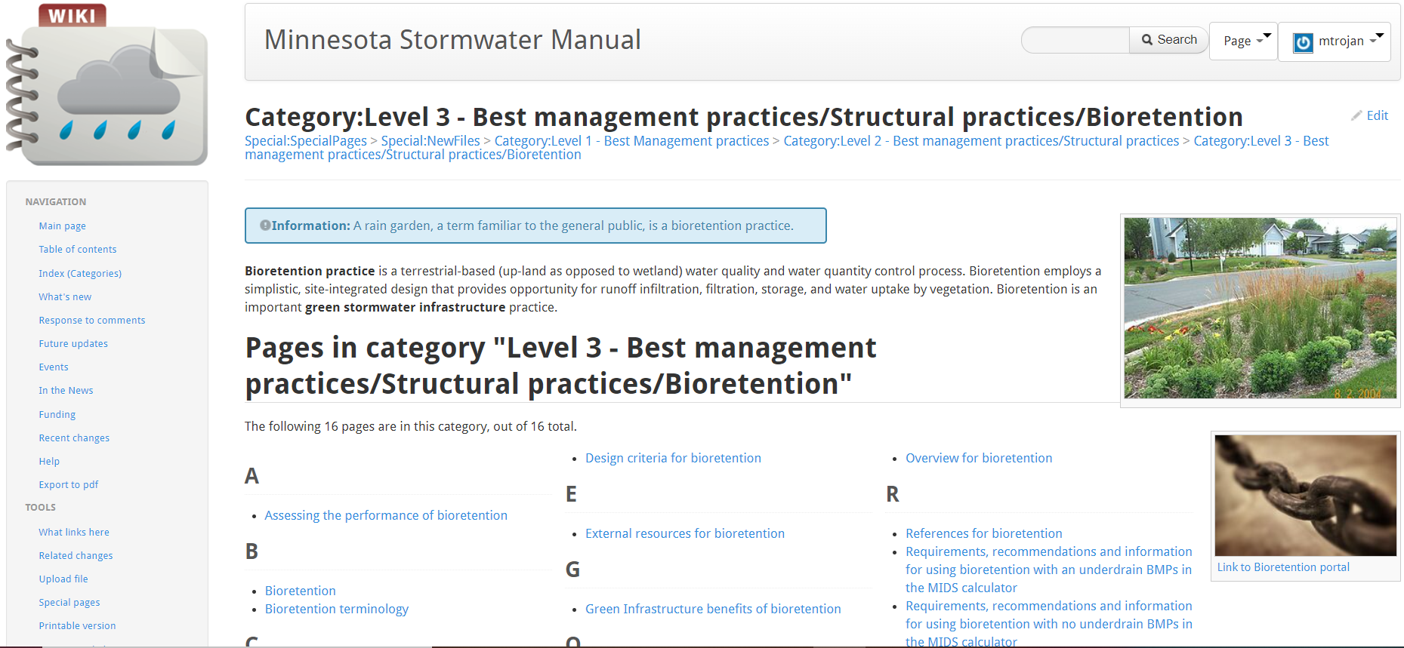

Slide 19
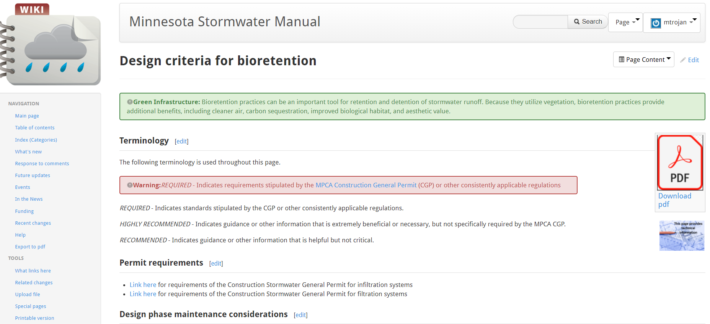

Slide 20
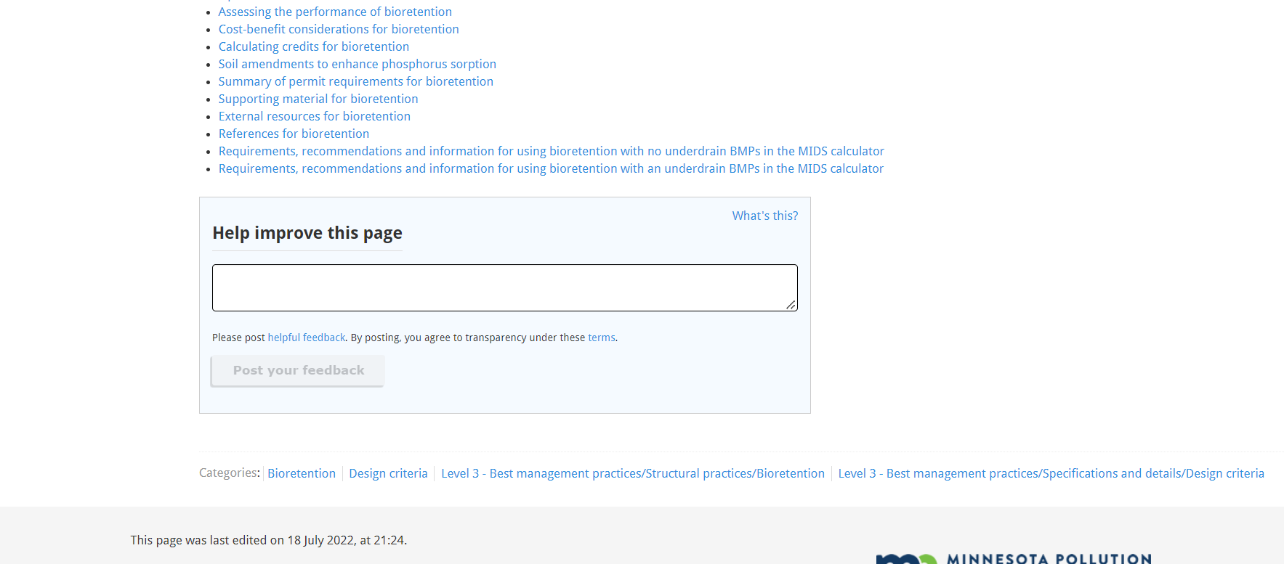

Slide 21
