Slide 1
2014-2016 Accelerated Implementation Grant Integrating Minimal Impact Design Standards Into Local Ordinance
St. Croix Communities Clean Water Project
Mike Isensee, Administrator
Middle St. Croix Watershed Management Organization misensee@mnwcd.org
651-330-8220 x22 www.mscwmo.org
Feb. 6, 2017

Slide 2
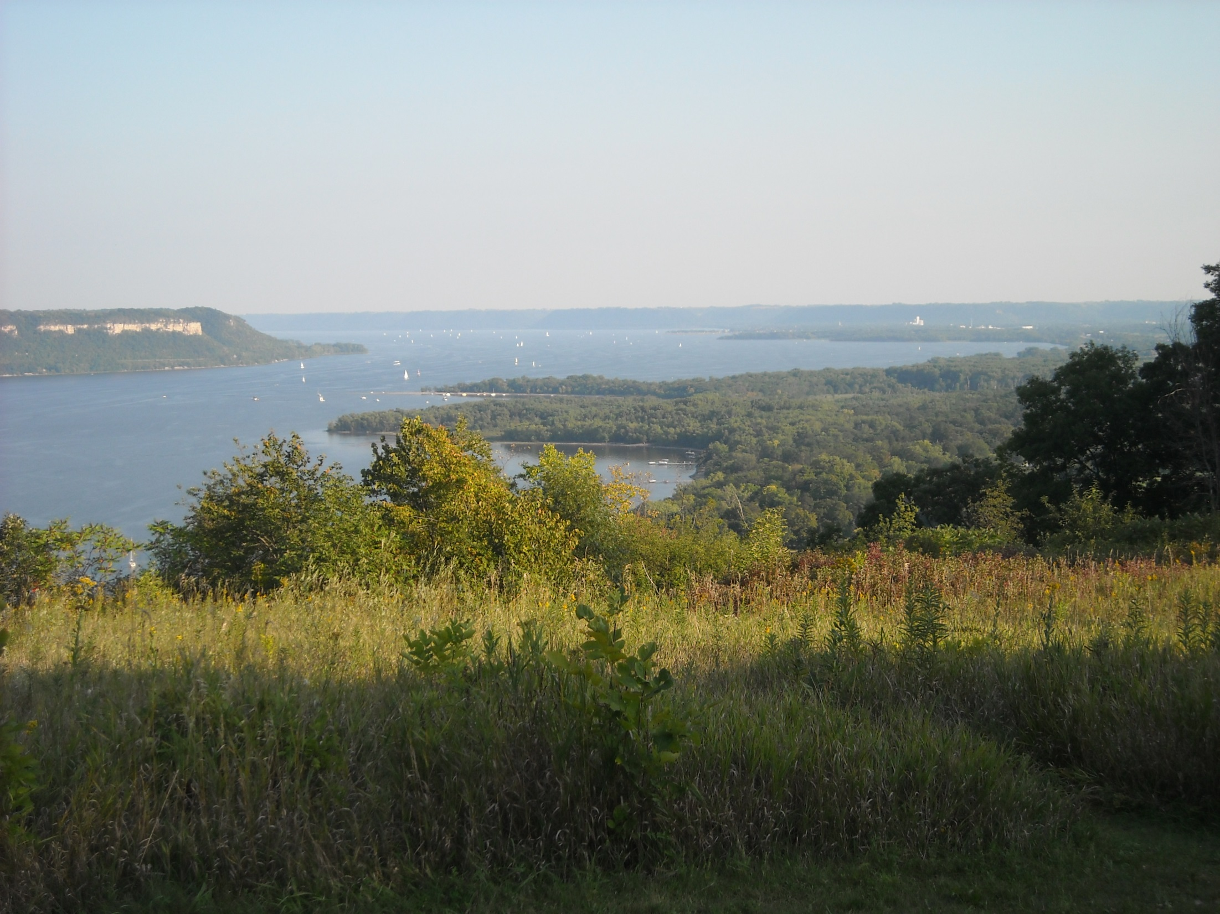
Project Overview
“Work with 13 communities in the St. Croix River Basin to voluntarily adopt ordinance and code revisions to incorporate Minimal Impact Design Standards (MIDS) in accordance with the St. Croix TMDL targets to integrate Low Impact Development (LID) as an effective means for achieving the phosphorous reduction goal of over 100 metric tons/year”
Notes:
Prioritization Work in coordination with member communities.
Priorities- Lily Lake, Lake St. Croix (direct Discharge North, Perro Pond/Perro Creek), Direct Discharge Southc
Partnerships

Slide 3
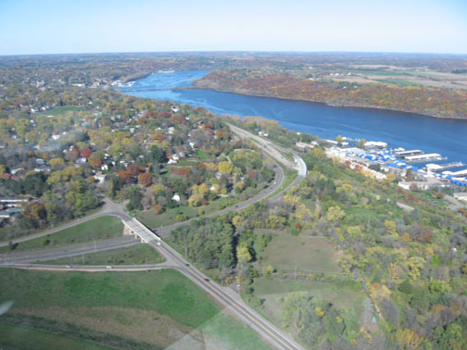
What are MIDS?
.
“MIDS are the next generation of stormwater management in Minnesota,
and emphasize keeping water where it falls to minimize rainwater runoff and subsequent pollution”
Notes:
Location, Area, Funding, Progress
Description of water resources (all discharging to the St. Croix River)

Slide 4
MIDS Legislation, 2009
“…develop performance standards, design standards or other tools to enable and promote the implementation of low impact development and other stormwater management techniques….” (MN Statutes 115.03 subd. 5c)

Slide 5
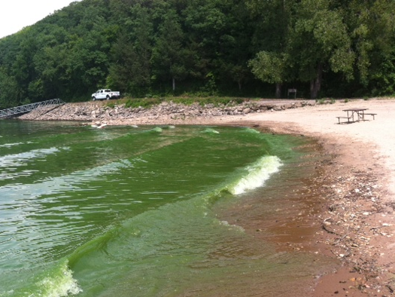
What are MIDS?
Consistent and flexible standards that are easier to implement at the local level to address the Lake St. Croix TMDL.”
Notes:
Lake St. Croix goal review

Slide 6
AIG Pre-Application Activities
Presentations to Local Officials on the NEMO Workshop on the Water
MIDS 2 hour introductory presentation and question and answers session.
Multiple presentations and meetings with community planning commissions and councils.
Notes:
The runoff not only carries pollutants from our yards and driveways but also nutrients and sediment contained in the streets.

Slide 7
Grant Application Highlights
Project corresponds with goals in the TMDL and 13 local water plans.
Address long-standing barriers to LID: 1. Standards in conflict with LID practices 2. Qualitative standards 3. Inconsistent credit for LID practices 4. No process for sites with restrictions

Slide 8
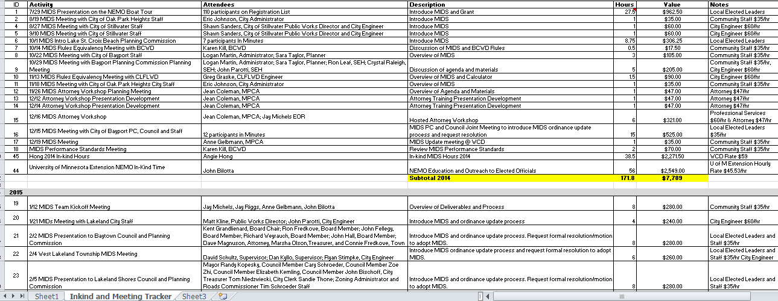
Grant Match
Bureau of Labor Statistics- Occupational Employment Statistics
Notes:
Historically, Stormwater management focused on:
Conveyance – getting the water off the site as quickly as possible and
Storage – holding ponds for flood control and water quality
Today, we are shifting towards
Infiltration and filtration – trying to mimic nature on the site

Slide 9
Outreach Activities
MIDS Legal Preview Workshop for Attorneys
Meetings with Community Staff to Introduce MIDS
Presentations to Community Planning Commissions
Presentations to Community Council
Notes:
9

Slide 10
Commitment to Adopt MIDS
Resolution to adopt MIDS at the end of the update process
Notes:
10
In 2008 - 2009 the National Academy of Sciences gathered a team of experts in the field of stormwater management and research and asked them to review current approaches to stormwater management. In 2009, they released a report called “Urban Stormwater Management in the United States” that called for a shift in stormwater management approaches.
A quote from the report reads -
“Past practices … have been ineffective at protecting water quality in receiving waters and only partially effective in meeting flood control requirements”

Slide 11
Ordinance Revision Process
Review and Redlines Ordinances
Meet with City Staff to Review and Revise
Request Engineering, Planning and Legal Review
Revise Based on Comments
Planning Commission Review and Revisions
City Council Review and Revisions (fi Necessary)
City Adoption of Final Ordinances

Slide 12
Final Report
Project Description
Outcomes
Evaluation
Appendicies
http://www.mscwmo.org/grant-reporting

Slide 13
Questions – misensee@mnwcd.org
“I am very passionate about protecting our natural resources, especially the St. Croix…..so visitors and residents can experience it’s beauty.” –Susan St. Ores, Mayor of Bayport, MSCWMO Board Member
-

