Slide 1
MIDS Calculator Use - Intermediate
Treatment trains
Working with specific BMPs
Challenging sites
Other applications
  TMDLs
  Green Infrastructure
Contact: Mike Trojan; mike.trojan@state.mn.us; 651-757-2790

Slide 2
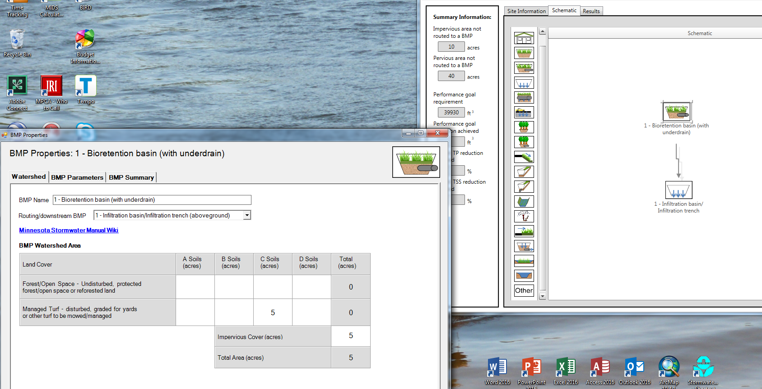
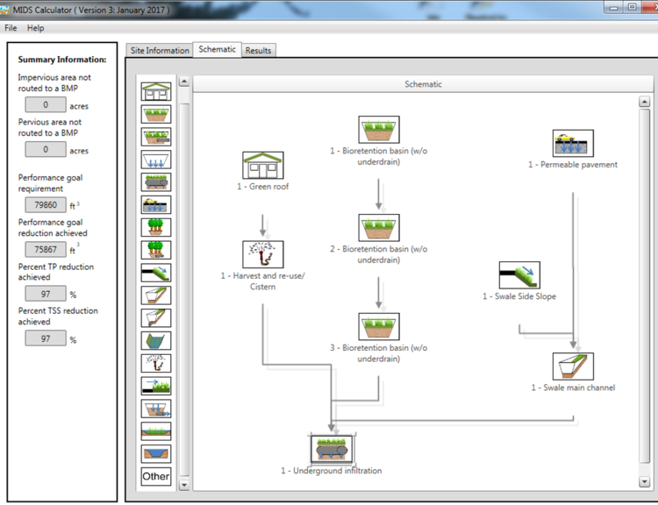
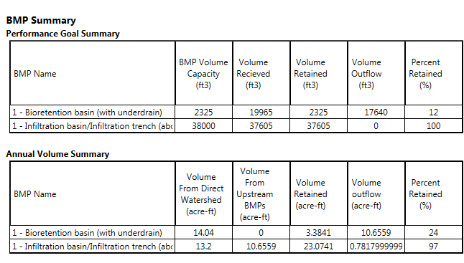
Treatment train
Route one BMP to another
Multiple BMPs used in series
Route excess water from one BMP to the next
Downstream BMP receives water from upstream BMP

Slide 3



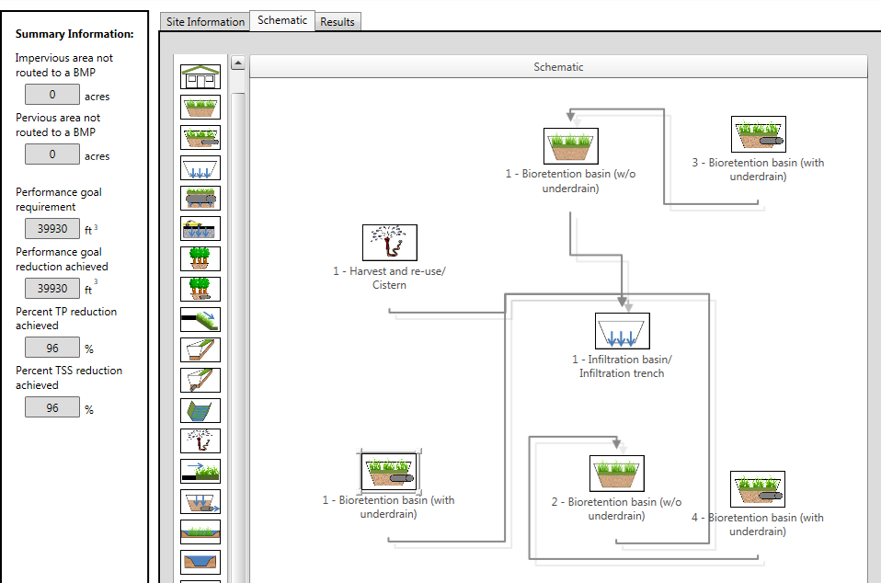

Problem – meet 1.1 retention requirement
50 acre site – 20 percent impervious; 40 acres residential; 5 acres commercial; 5 acres green space
25 acres turf on D soil; 15 acres turf on B soil (0.3 in/hr)
BMPs (see image below left for example routing)
  Rainwater harvest for 3 acres in park
  3 bioretention with underdrain BMPs (10000 ft² max each)
  2 bioretention no underdrain BMPs (10000 ft² max each)
  1 infiltration basin in commercial area(10000 ft² max)
Park
D soils
D soils
Commercial
One option

Slide 4

Bioretention with underdrain
Elevating the underdrain
Lining
Including a tree
Maximum 1.5 foot water depth
Phosphorus retention
  Media mixes C and D retain P; A and B leach P unless P content is <30 ppm
  Adding an amendment to attenuate phosphorus

Slide 5


Permeable pavement considerations
The area of permeable pavement must be included in the impervious acreage for the BMP
The impervious:permeable pavement area ratio cannot exceed 5:1 (e.g. for 1 acre of impervious, must have at least = 8712 of permeable pavement)
Volume credit for water stored beneath drain and infiltration during drawdown time
An effective BMP for retaining runoff

Slide 6
Harvest and reuse/cistern
Storage volume – ponds can store very large volumes, while cisterns typically are limiting to what volume can be retained
User-defined max irrigation rate can be 2 in/week on A soils. On other soils default is lesser of defined rate or PET
Offline systems – drained during winter
Can retain water for non-irrigation uses

Slide 7

Tree trench
Field capacity minus wilting point is available to plants
More ET for larger trees
Will get a warning and lose credit if soil volume per tree is below the recommended value
Phosphorus crediting is same as for bioretention
Note the ET credit

Slide 8

Green roof
Can have a conventional roof drain to a green roof, but the conventional roof area must be equal to or less than the green roof area
Maximum media depth is 4 inches
No phosphorus credit
Disconnection BMP
Can’t be used if you are trying to meet the Construction SW permit
On Watershed tab, must enter permeable acres that will be used as effective pervious area
Difficult to meet retention requirement with this BMP

Slide 9

Swales (with or without underdrain)
Side slope is routed to a swale main channel or with underdrain – treat as a single BMP (e.g. match lengths)
Have all impervious acres go to side slope(s) and none to main channel
Ways to increase infiltration
  Put in check dams
  Put in bioretention base
  Make swale longer

Slide 10
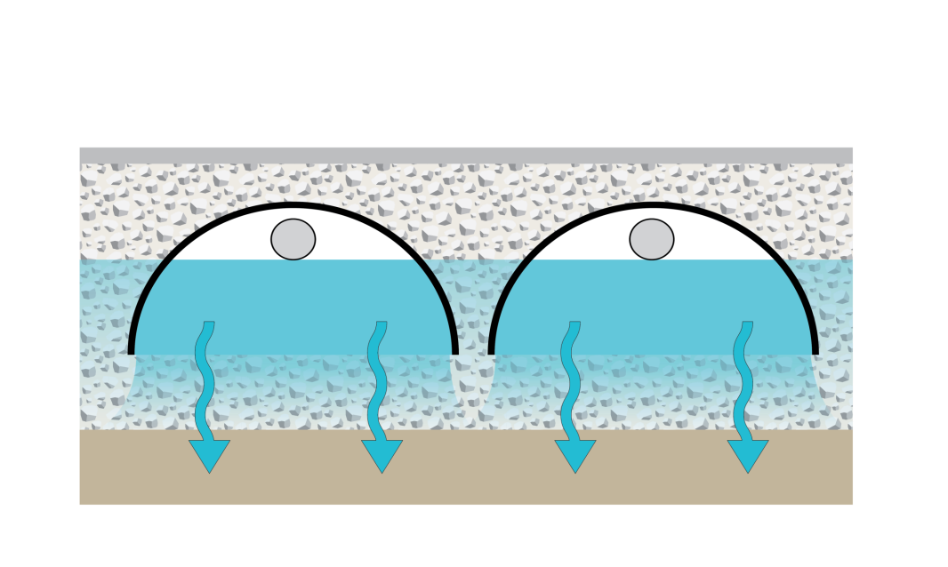



Underground infiltration
Along with infiltration basin/trench, the most effective retention BMP for highly permeable soils (A soils)
Must either know two values or go outside calculator to a spreadsheet to calculate these 2 values (equations were too difficult to incorporate into the calculator)
  Vp = underground pipe/storage volume
  Am = area of engineered media
Width of basin
Pipe/storage device volume (V_{P})
Overflow depth (D_{o})
Depth of media (D_{M})
Engineered media storage volume below pipes (V_{M})

Slide 11
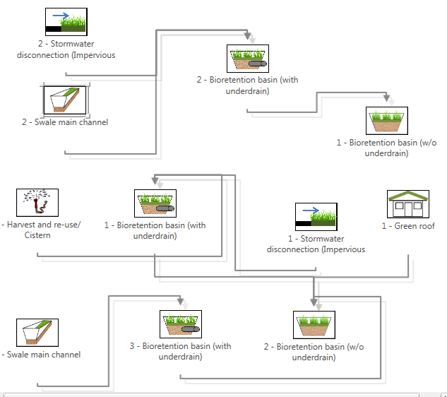
Problem – low permeability soils
50 acre site – 20 percent impervious; 40 acres residential; 5 acres commercial; 5 acres green space
35 acres turf on D soil; 5 acres turf on C soil (0.3 in/hr)
Individual bioretention max size = 10000 ft²
Can the goal be met with a realistic BMP scenario? If not, how can we maximize volume and P retention?
Park
C soils
D soils
D soils
Commercial
One option
D soils

Slide 12
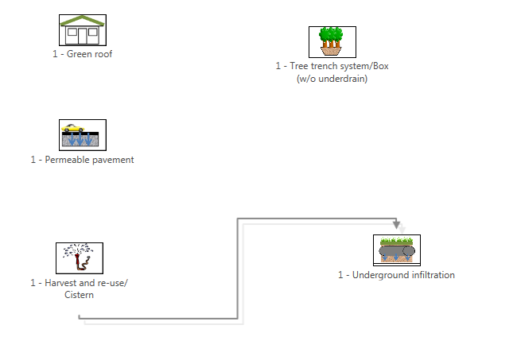
Problem: ultra-urban site
50 acre site – 90 percent impervious; all commercial/business
A soils (0.8 in/hr)
Can the retention goal be met with a realistic BMP scenario? If not, how can we maximize volume and phosphorus retention?
What BMPs work well for this scenario?
One option

