Slide 1

Minimal Impact Design Standards (MIDS) Calculator Training
WELCOME
November 13, 2013

Slide 2
Logistics
Facility Information
Introductions
Expectations of Super Users
  List with profile and contact information
  Willing and available to take e-mails, phone calls
  Share experiences; meet periodically
  Complete evaluations-contribute to FAQ
  Beta tester

Slide 3
Why MIDS?
40% of our water bodies in are impaired; old technology isn’t working
National Academy of Sciences Report

Slide 4
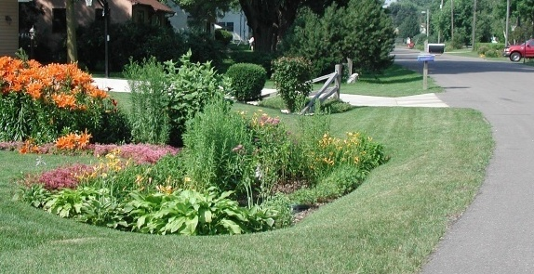
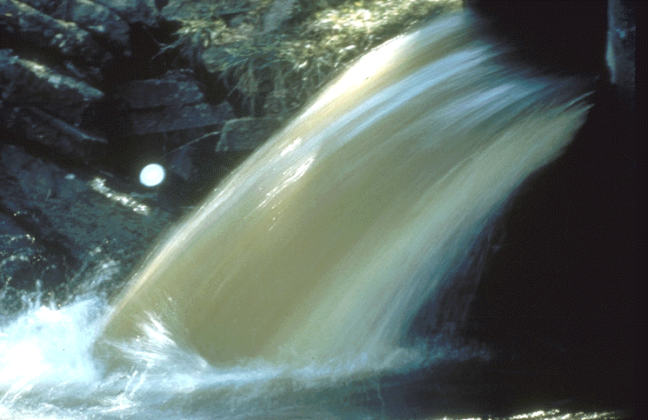
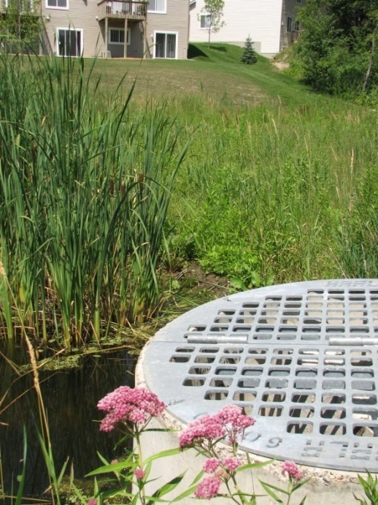
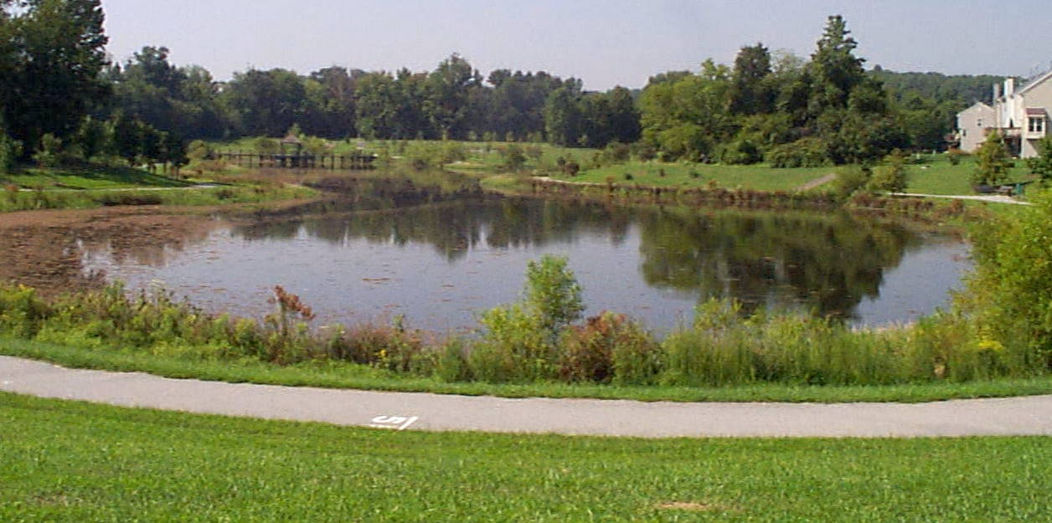
Stormwater Management
Infiltration
Conveyance
Filtration
Storage
Notes:
Historically, Stormwater management focused on:
Conveyance – getting the water off the site as quickly as possible and
Storage – holding ponds for flood control and water quality
Today, we are shifting towards
Infiltration and filtration – trying to mimic nature on the site

Slide 5
“Past practices…have been ineffective at protecting water quality in receiving waters and only partially effective in meeting flood control requirements”
Notes:
5
In 2008 - 2009 the National Academy of Sciences gathered a team of experts in the field of stormwater management and research and asked them to review current approaches to stormwater management. In 2009, they released a report called “Urban Stormwater Management in the United States” that called for a shift in stormwater management approaches.
A quote from the report reads -
“Past practices … have been ineffective at protecting water quality in receiving waters and only partially effective in meeting flood control requirements”

Slide 6
“Stormwater control measures that harvest, infiltrate, and evaportranspire stormwater are critical to reducing the volume and pollutant loading of small storms”
Notes:
6
The report also noted that:
“Stormwater control measures that harvest, infiltrate, and evapotranspire stormwater are critical to reducing the volume and pollutant loading of small storms”

Slide 7
MIDS Legislation
Legislation passed in 2008 – brings LID to the forefront:
  “…develop performance standards, design standards or other tools to enable and promote the implementation of low impact development and other stormwater management techniques….” (MN Stat section 115.03 subd. 5c

Slide 8
LID Defined in Statute
  an approach to storm water management that mimics a site’s natural hydrology as the landscape is developed. Using the low impact development approach, storm water is managed on site and the rate and volume of predevelopment storm water reaching receiving waters is unchanged. The calculation of predevelopment hydrology is based on native soil and vegetation. (MN Statute Section 115.03 subd. 5c

Slide 9
MIDS Work Group
Stormwater Steering Committee Work Group-January, 2010
Diverse group of stakeholders
  Cities
  Soil and Water Conservation Districts
  Builders Association
  Met Council
  Public Works
  Developers
  Watershed Districts
  MN Nursery and Landscape Association
  MN Department of Natural Resources
  MN Department of Transportation
  University of Minnesota
  Non Profits
  Board of Soil and Water Resources
  Engineers,
  MN Utilities Contractor Association
  MN Chapter of Landscape Architects
  Others

Slide 10
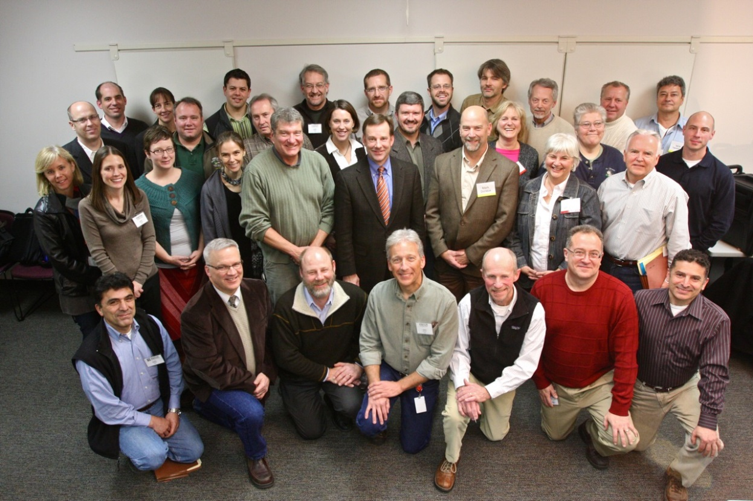
MIDS Work Group-Diverse Group of Stakeholders

Slide 11
Funding/Recommendations
Legislature gave funding to MPCA to create MIDS
  Three Master Contracts
Work group recommendations to MPCA
Consensus based approach

Slide 12
What is MIDS?
An attempt to bring Low Impact Development (LID) to the forefront
An effort to standardize benefits of water quality practices
A tool that can be used to help meet water quality regulations
A voluntary program

Slide 13
MIDS TOOLS
Best Management Practices:
  Permeable pavement
  Harvest and Reuse
  Swales
  Turf
  Trees
  Bioretention
  Green Roofs
  Iron Enhanced Sand Filter

Slide 14
MIDS TOOLS-Performance Goals
New Development, Redevelopment and Linear Projects
Design Sequence Flow Chart-
  Helps to assess site
  Includes site restrictions-flexible treatment options

Slide 15
MIDS TOOLS-Calculator
Began as Excel Spreadsheet
Added the Graphic User Interface
What you are here to learn about-focus of this workshop

Slide 16
Potential Applications
Green Step Cities-highest standard for stormwater practice
Blue Star Assessment (FMR)
Complete Streets-other voluntary initiatives
Clean Water Legacy grant applications (and other grant applications)

Slide 17
Potential Applications
MS4 Permit-MCM 5 – Post construction stormwater management
CSW Permit-permanent treatment
TMDL Load Reporting-credits that demonstrate measurable progress

Slide 18
MIDS Community Assistance Package
Federal 319 Grant to pilot MIDS
  Communities in the St Croix Basin
  Mini, short and long form for communities to adopt
  Policies-ordinances reference the credit calculator, BMPs and stormwater manual

Slide 19
Minnesota Stormwater Manual (Wiki version) and MIDS
All MIDS work products in Manual
  LINK: http://stormwater.pca.state.mn.us/index.php/Main_Page

Slide 20
Objectives/Goals of Calculator Training
Coming soon

Slide 21
Summary/Next Steps
Thank you for being a Super User!
  Expectations
USE IT!! -Report back to MPCA
Calculator in Manual-2014
Evaluation Form

