Slide 1
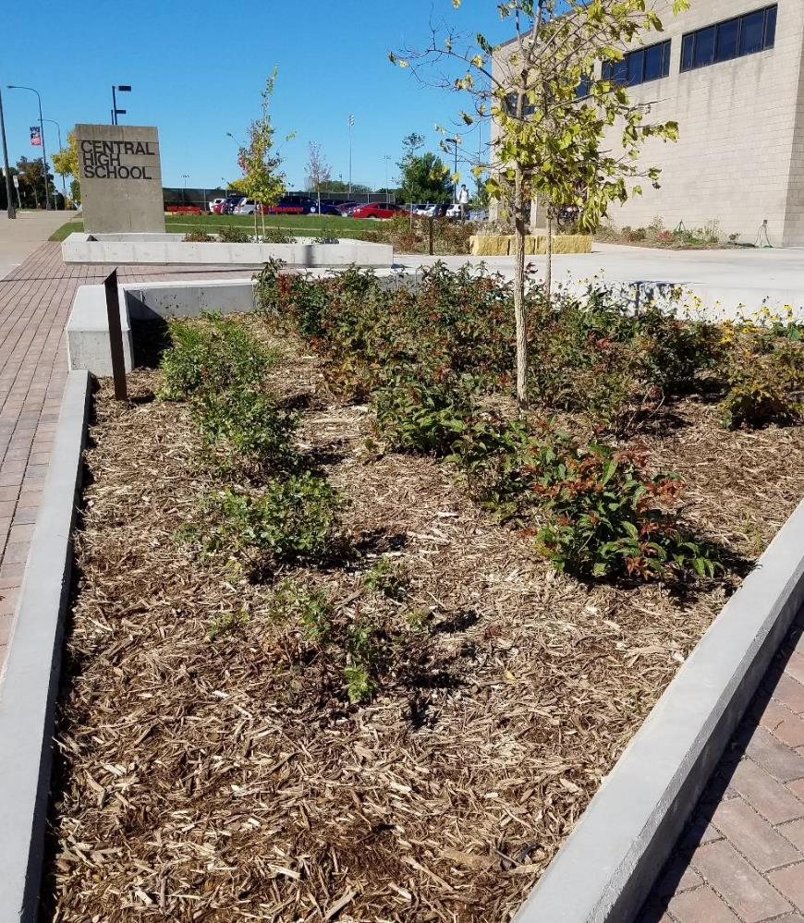
Projects and Practices Grants Nate Zwonitzer Water Resource Project Manager

Slide 2
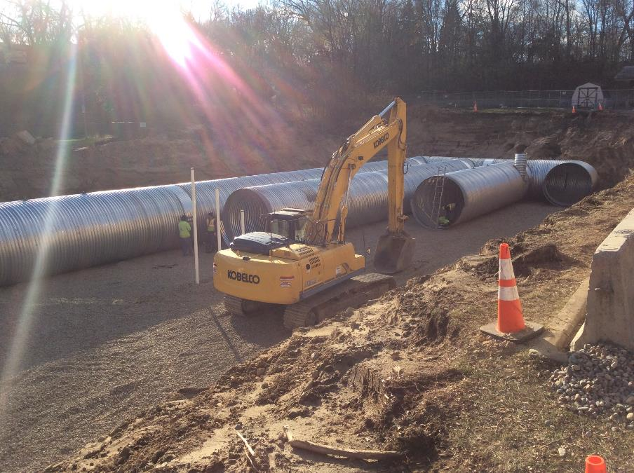
Irrigate, Infiltrate, Automate;
Upper Villa Park Stormwater Project

Slide 3
Partners
MN Clean Water Fund (BWSR)
Minnesota Pollution Control Agency
Capitol Region Watershed District
City of Roseville
B-Dale Club
SRF Consulting Group, Inc.
New Look Contracting, Inc.

Slide 4
The Project
Underground infiltration system below City of Roseville Park Softball Field.
Divert runoff from 250 acres of drainage in 36 inch pipe beneath existing softball field.
Assumed 80,000 cf of storage could remove 45 pounds at cost of $810K

Slide 5
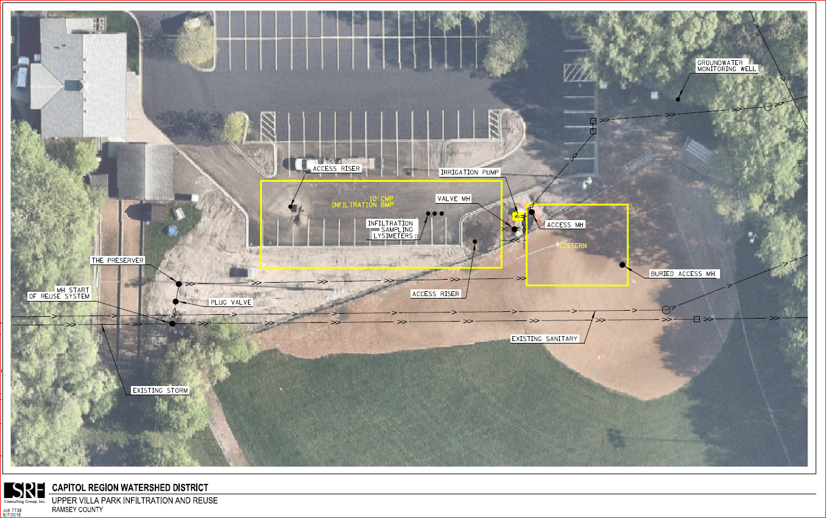
Final Layout
575 feet of 10 ft CMP (60,000 cf)
13,000 cf precast modular segmental cistern
The Preserver pretreatment baffle
OptiRTC valve
Pump and filter to reuse stormwater for irrigation

Slide 6
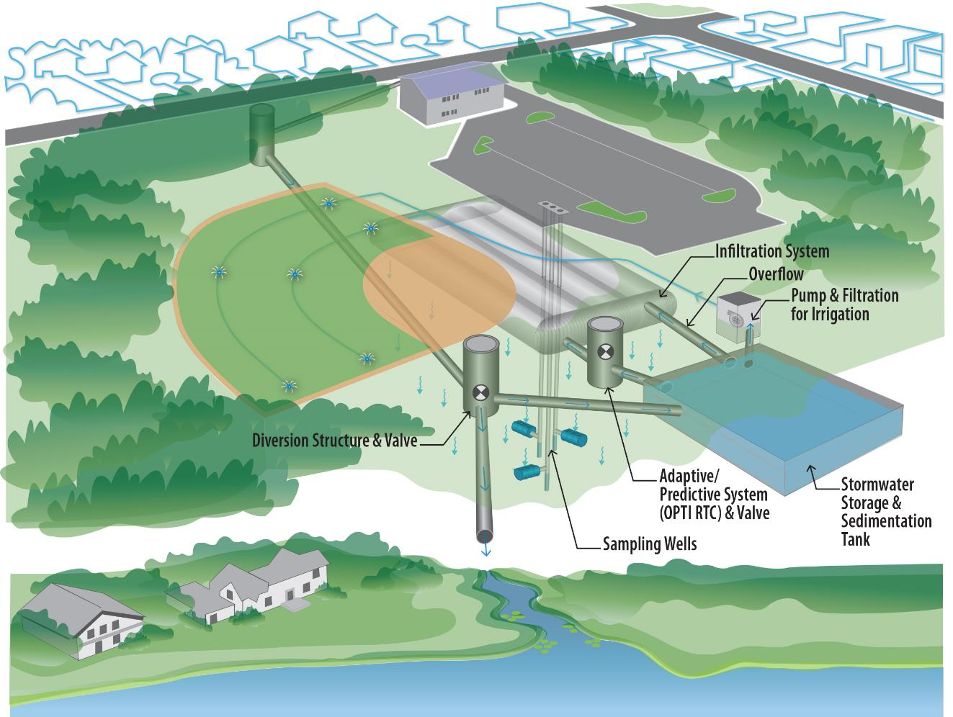

Slide 7
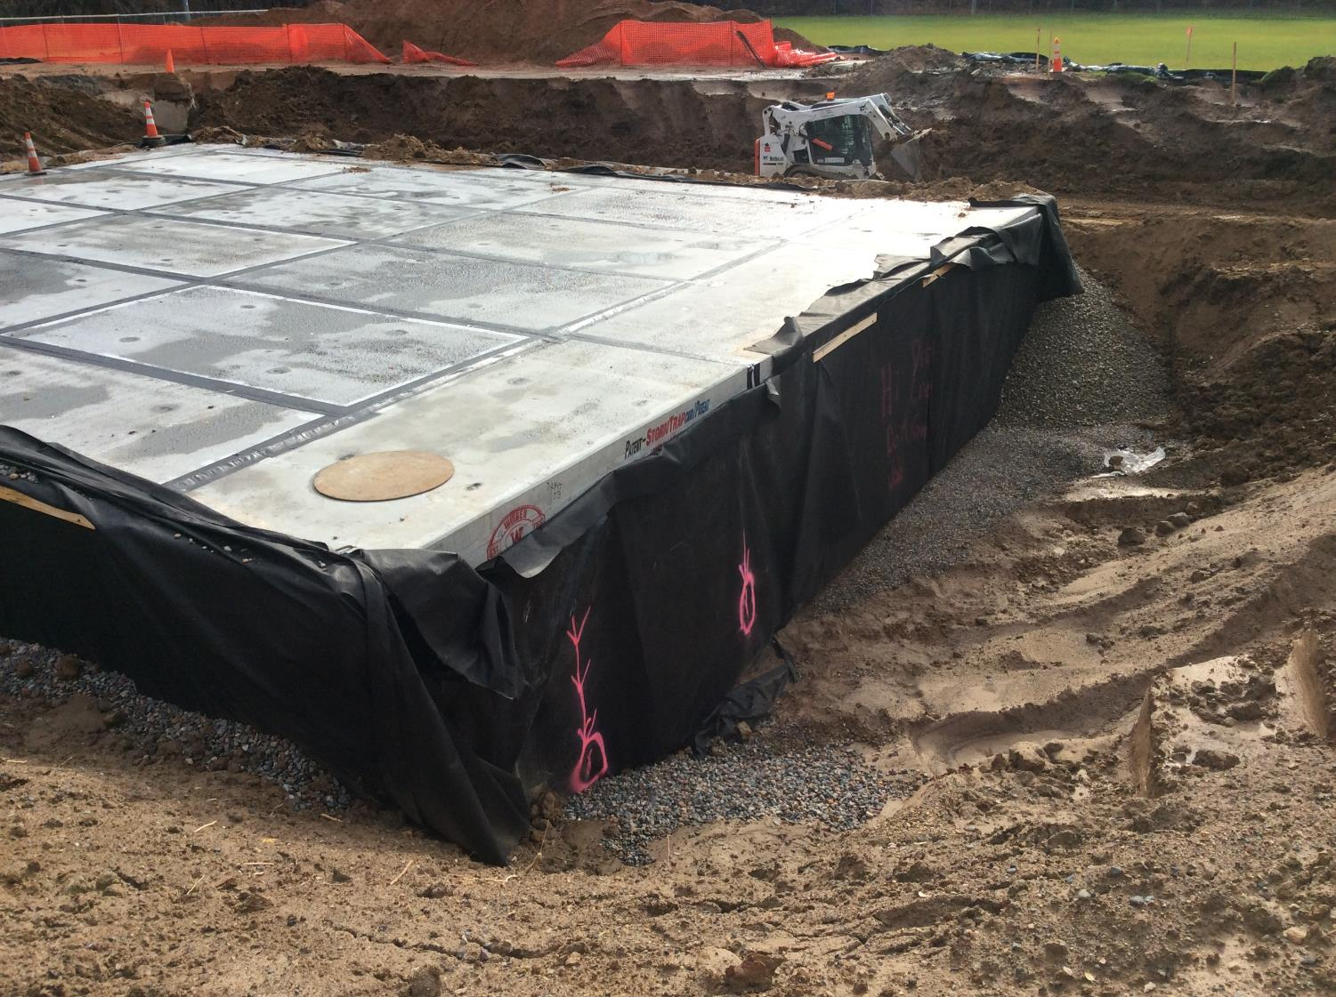

Slide 9
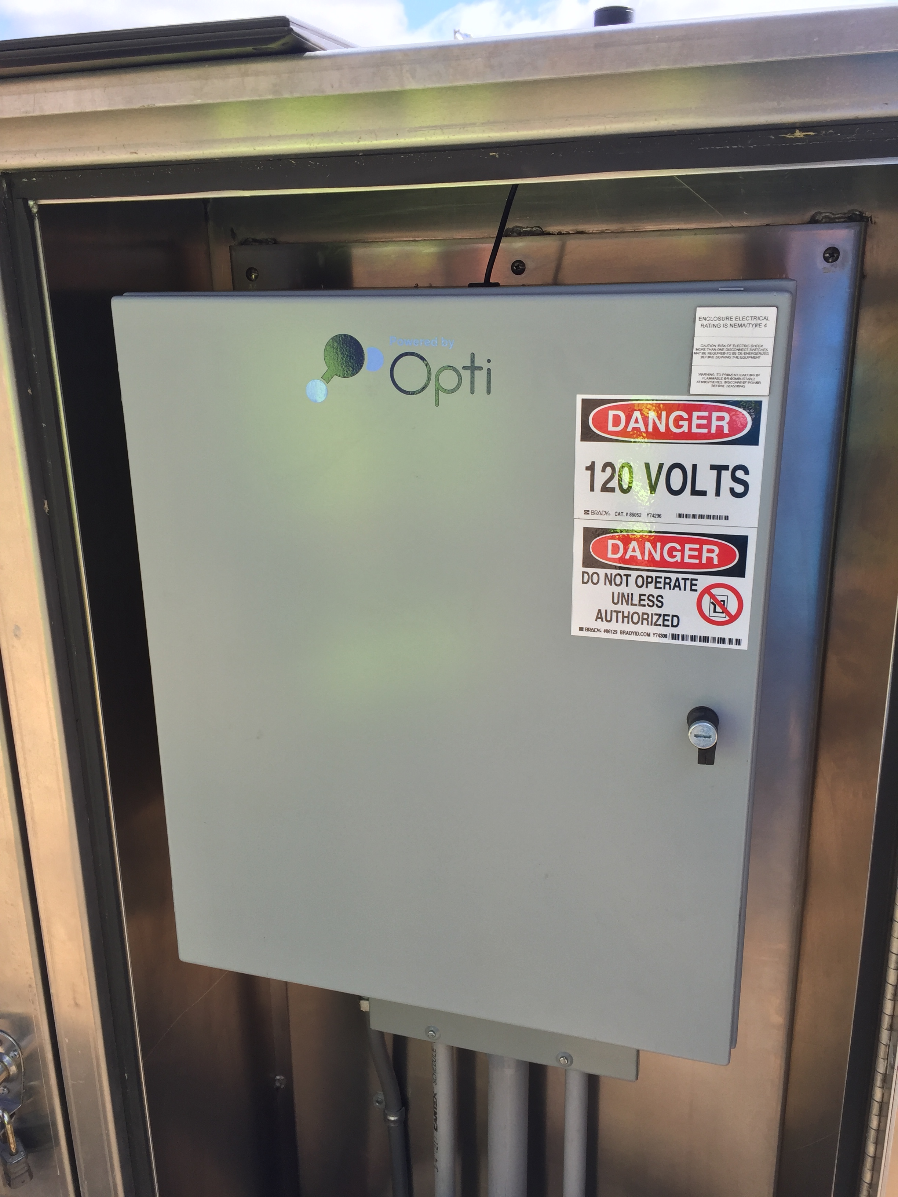
OptiRTC
Cloud based technology to actively manage stormwater retention
Level sensors in the cistern and infiltration system
CMP and concrete vault connected with actuated butterfly valve
Opti logic analyzes the NOAA forecasted precipitation and drains the cistern into the CMP in advance of a rain event

Slide 10
Project Funding
CRWD
Roseville
MPCA Grant
BWSR Grant
Project Total
$372,466 (31%)
$207,958 (17%)
$275,000 (23%)
$360,000 (30%)
$1,215,424
Upper Villa

Slide 11
Funding and Agreement Structure
MPCA
BWSR
Roseville
CRWD
Contractors
Upper Villa

Slide 12
Project Agreements
BWSR CRWD: standard BWSR agreement.
MPCA CRWD: standard MPCA agreement.
Roseville CRWD: Cooperative construction agreement. Agreement outlined project roles, funding, and long-term O&M.
Upper Villa

Slide 13
Grant Admin Timeline
2014: BWSR Grant Agreement & MPCA Grant Extension
2015: Roseville-CRWD Cooperative Construction Agreement
Nov, 2015-June, 2016: Project Implementation
December 2016 Project Verification and Closeout
2012: MPCA Grant Agreement
Upper Villa

Slide 14
Central High school: Sending Stormwater to detention

Slide 15
Partners
MN Clean Water Fund (BWSR)
Transforming Central Committee
Capitol Region Watershed District
St. Paul Public Schools
292 Design Group
EOR, Inc.
LS Black Constructors, Inc.

Slide 16
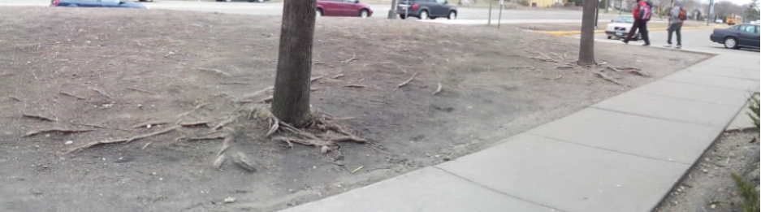
Existing Conditions
Central High School

Slide 17
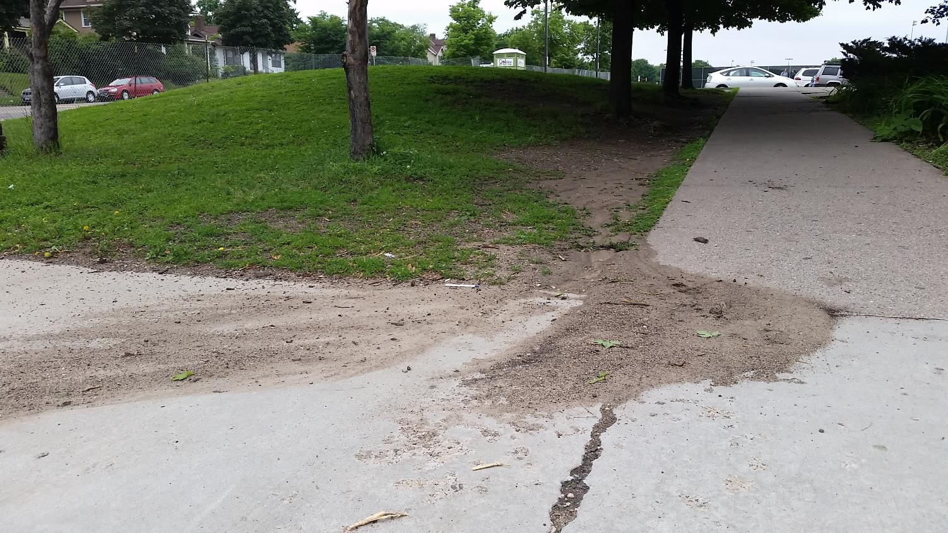
Existing Conditions
Central High School

Slide 18
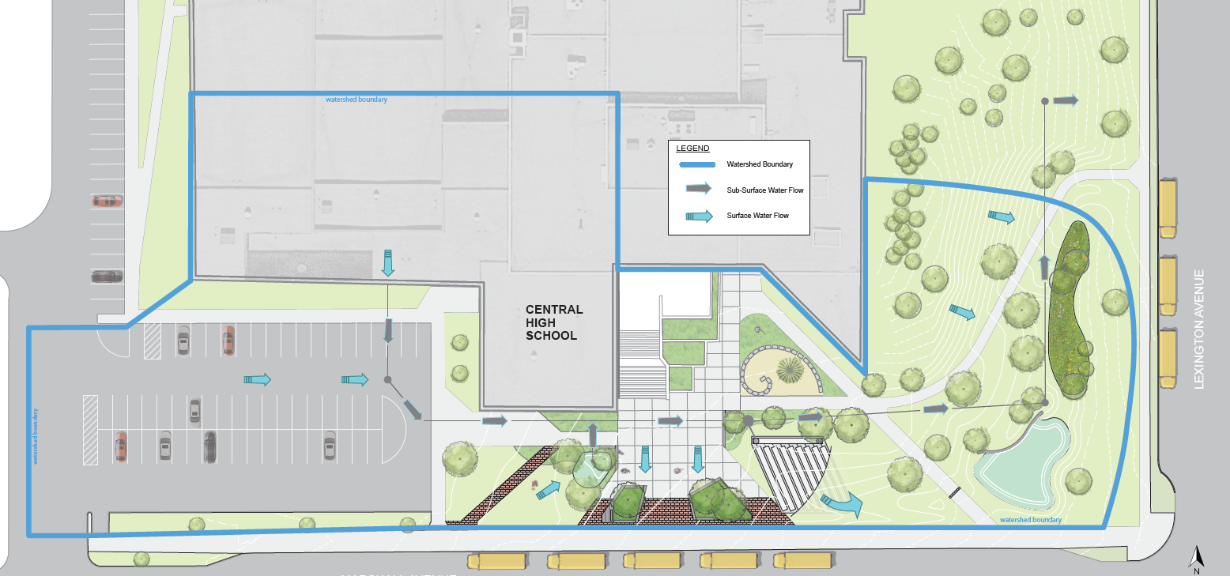
Site Plan
Central High School

Slide 19
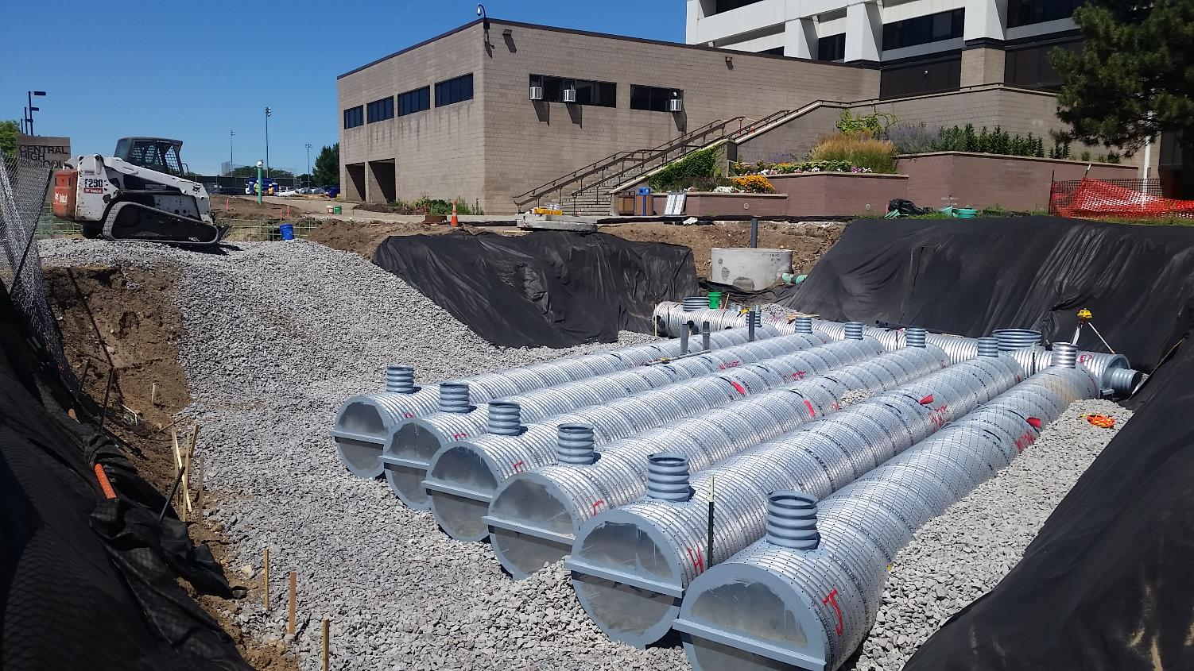
Central High School

Slide 20
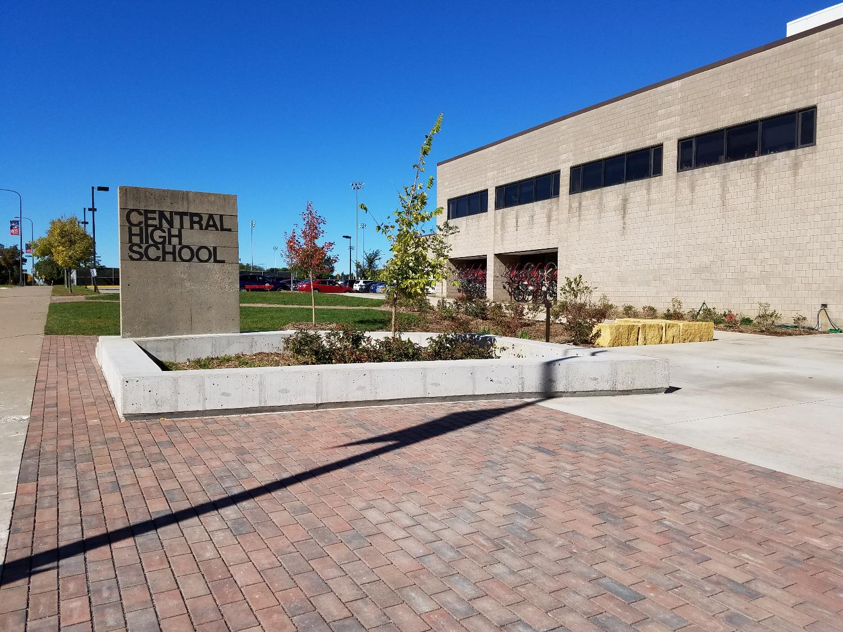
Central High School

Slide 21
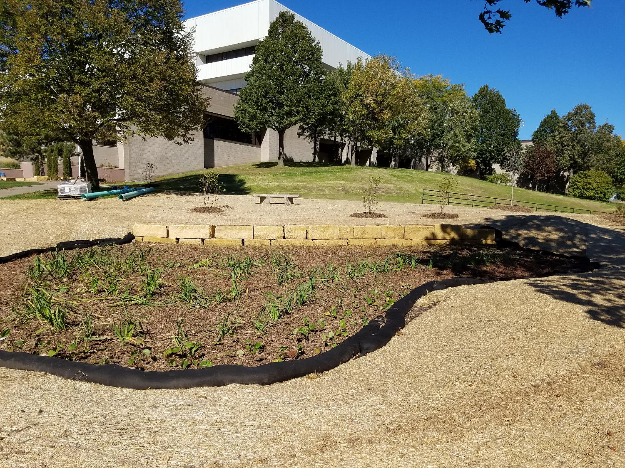
Central High School

Slide 22
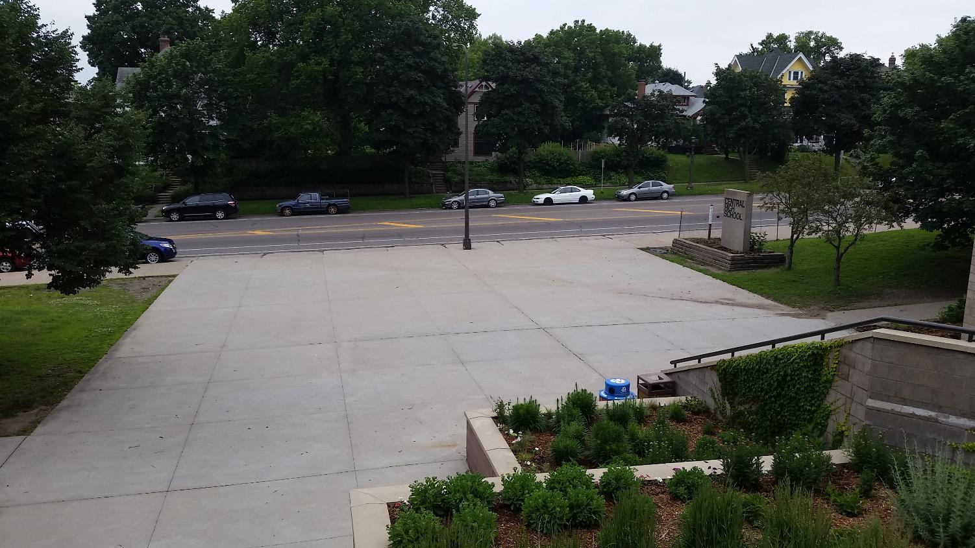
Central High School

Slide 23
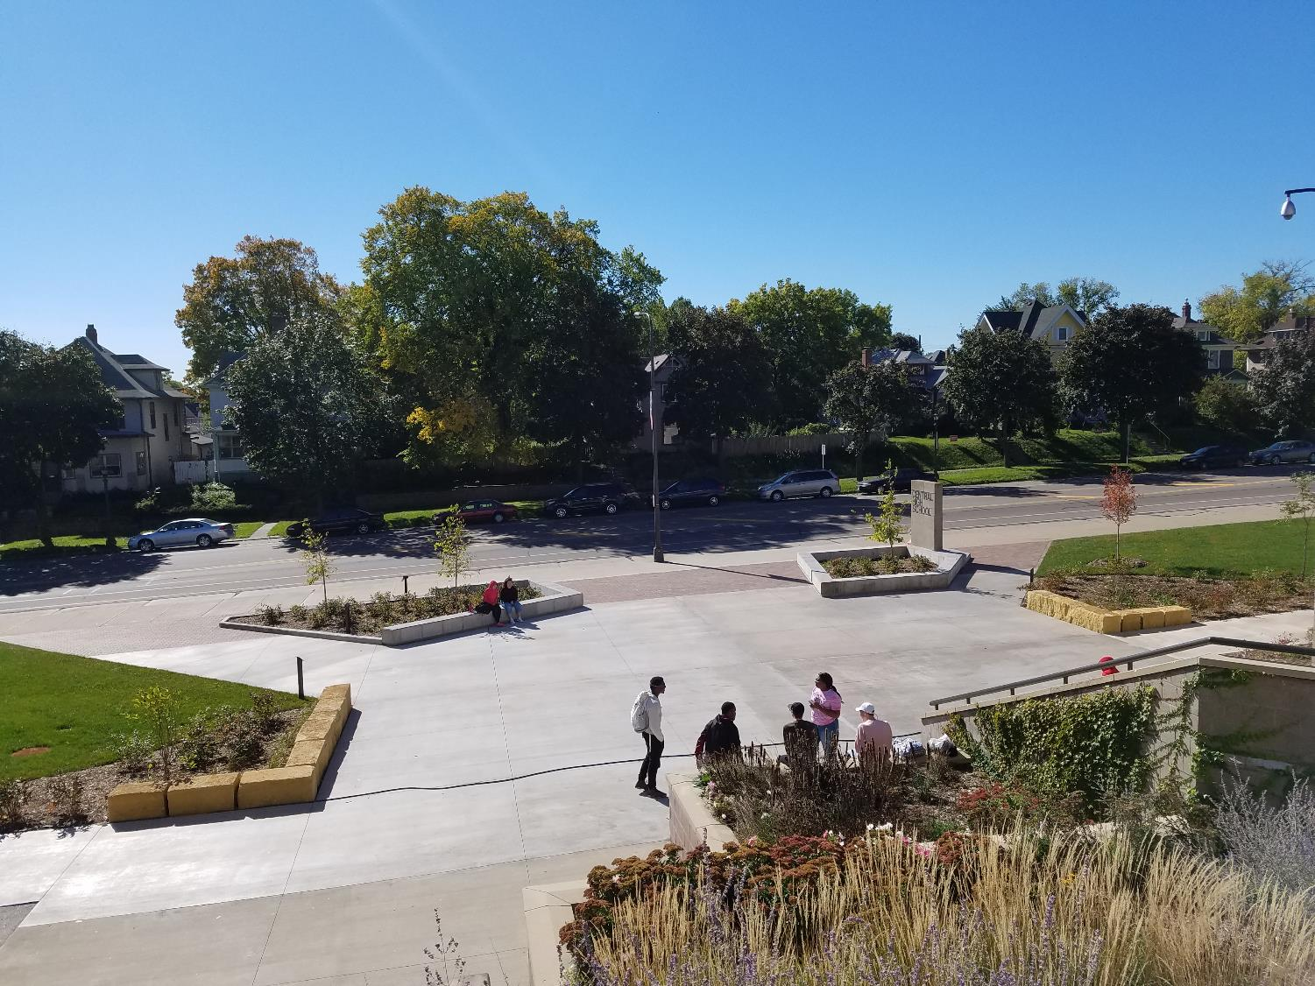
Central High School

Slide 24
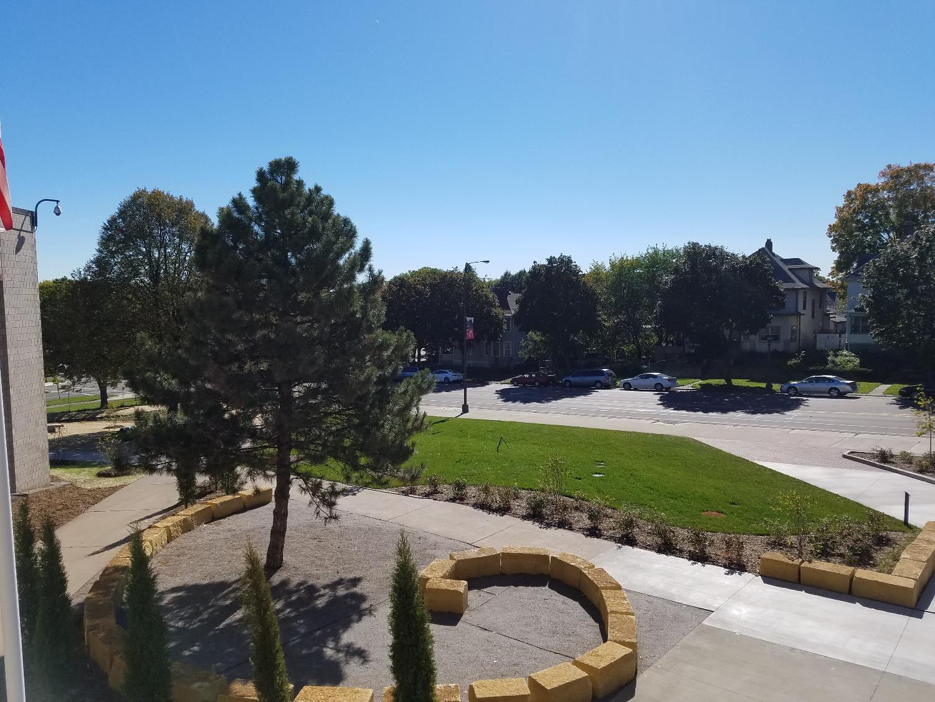
Central High School

Slide 25
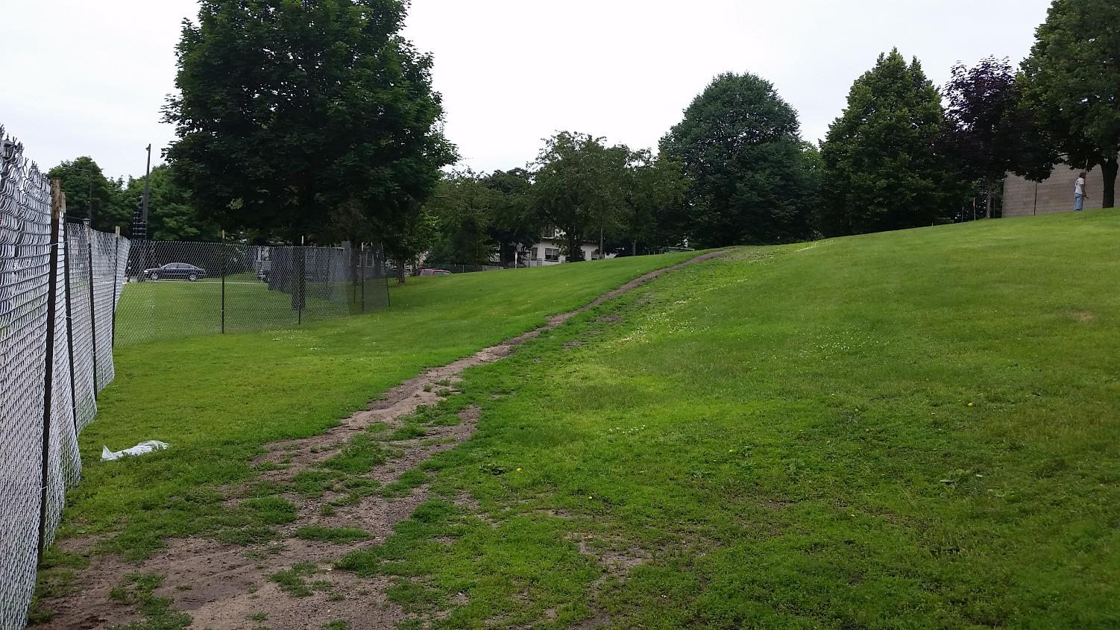
Central High School

Slide 26
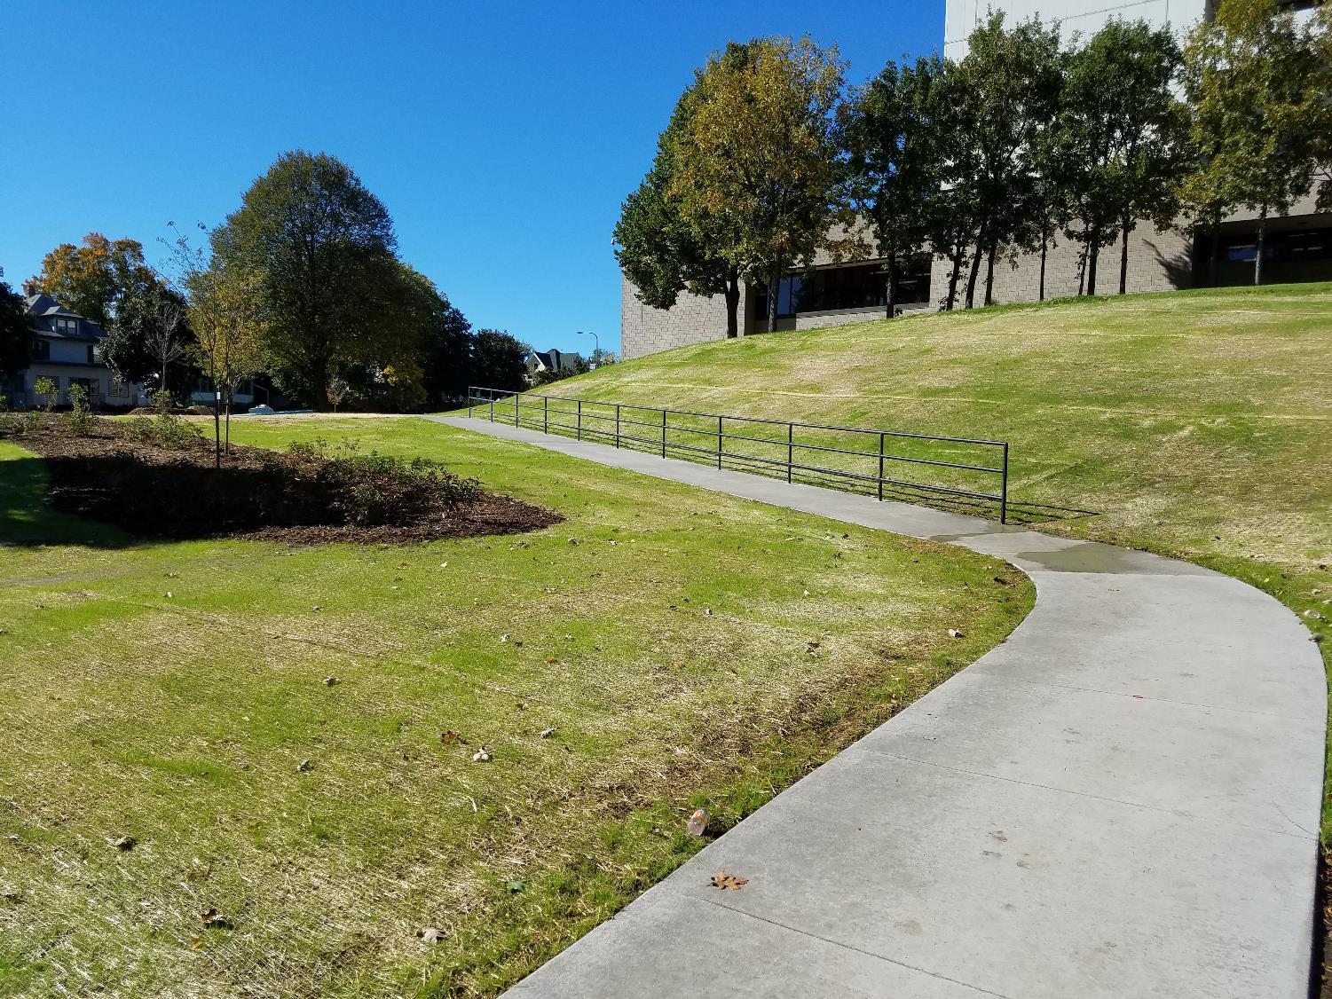
Central High School

Slide 27
Central High School

Slide 28
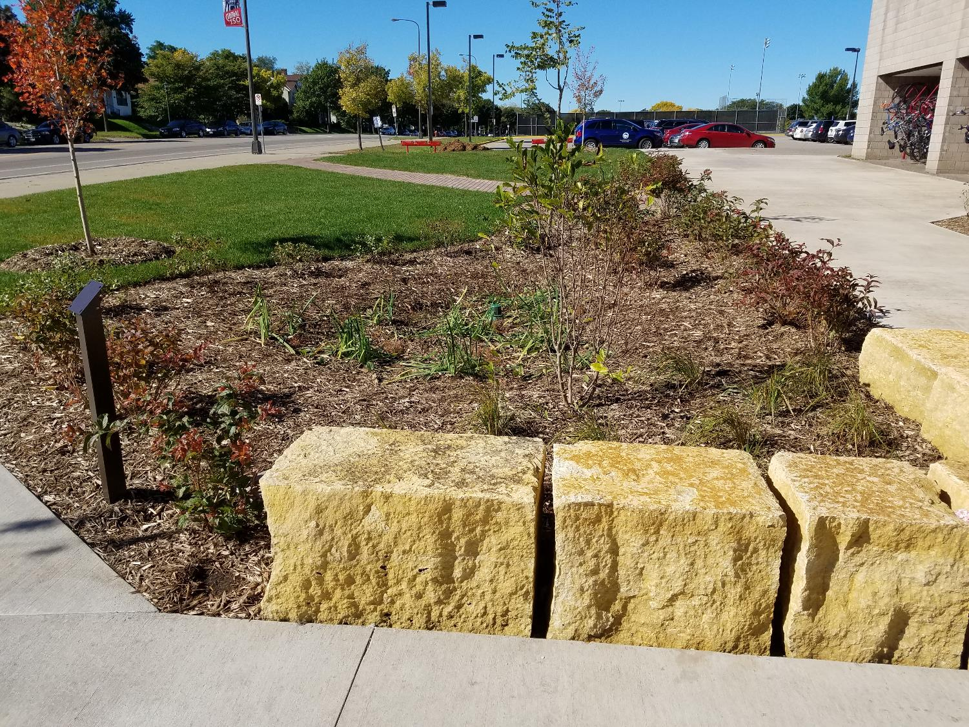
Central High School

Slide 29
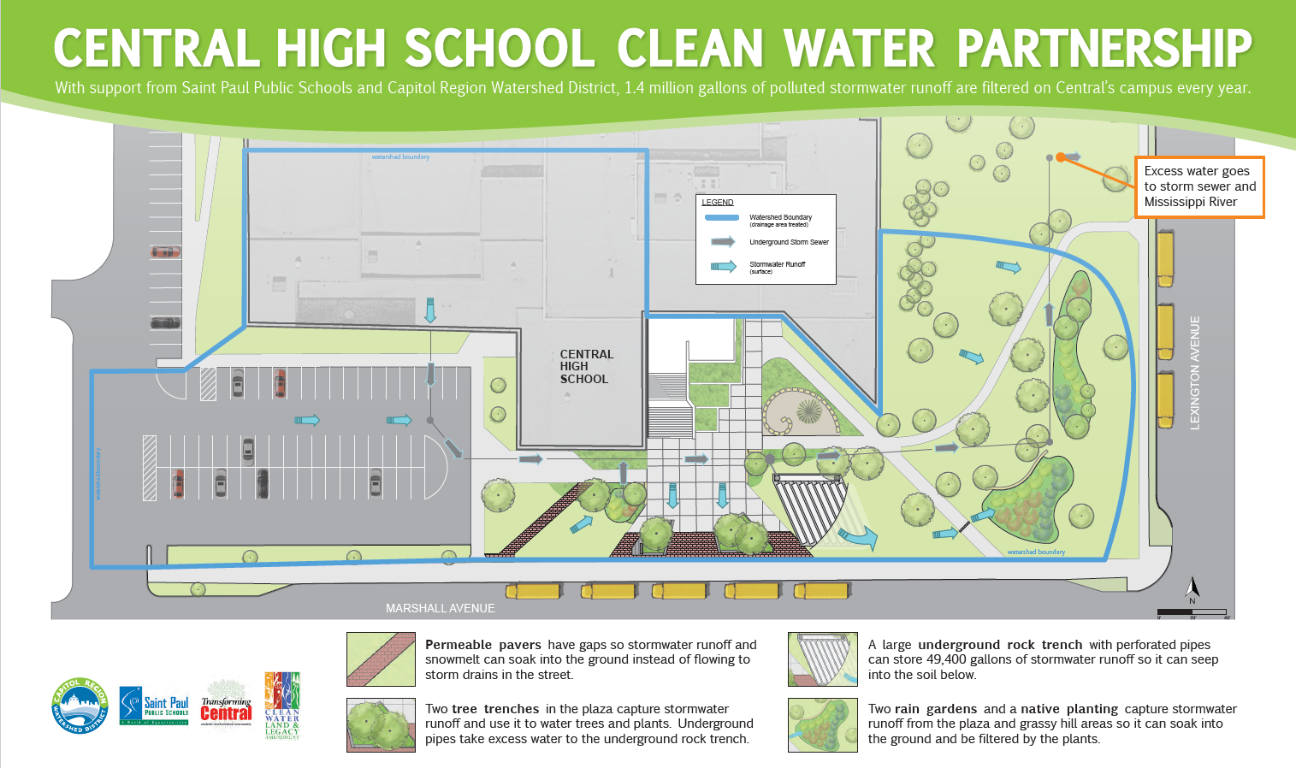
Educational Signage
Central High School

Slide 30
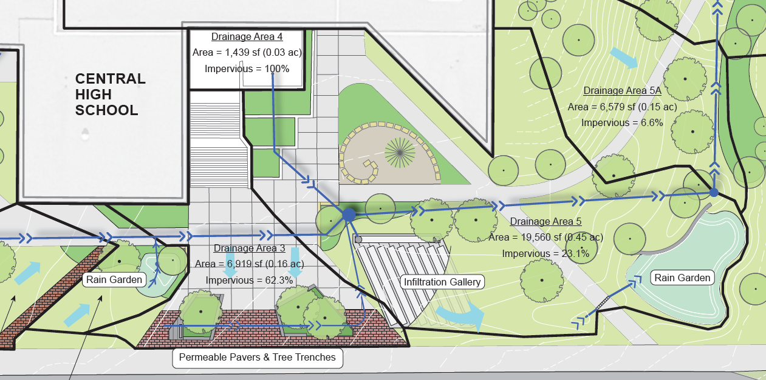
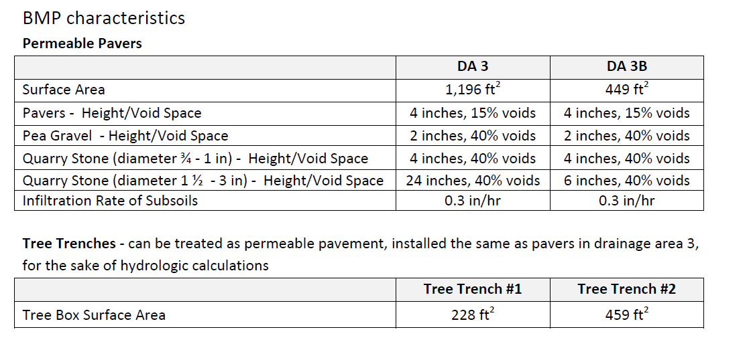
Curriculum Integration
Central High School

Slide 31
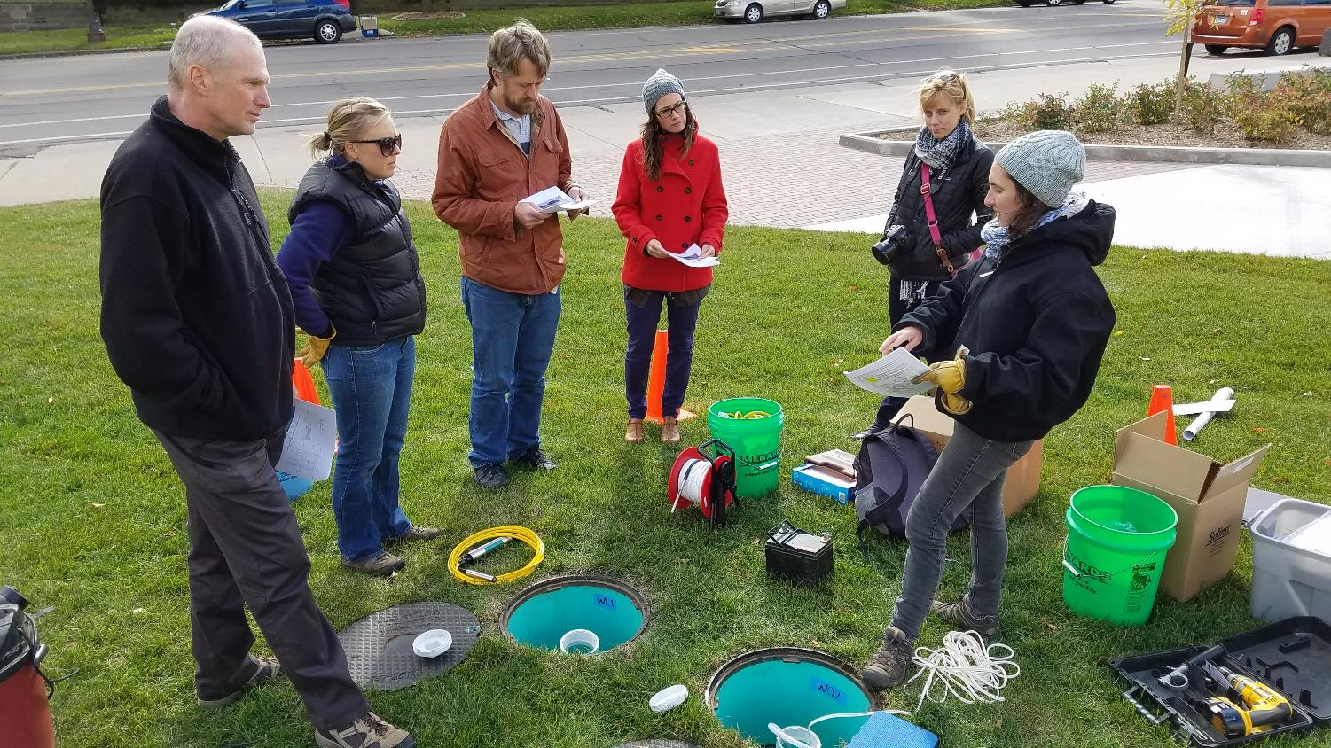
Curriculum Integration
Central High School

Slide 32
Project Funding
CRWD
2013 - $10,000 for feasibility/investigation
BWSR CWF
2015 - $175,000 award to CRWD
2014 - $50,000 for additional design
2016 - $150,000 for installation and CWF Grant match
2016 - $42,350 for education/monitoring
Central High School

Slide 33
Funding and Agreement Structure
BWSR
CRWD
TC Committee
St. Paul Public Schools
Contractor
Central High School

Slide 34
CWF Agreements
BWSR CRWD: standard CWF agreement.
CRWD St. Paul Public Schools: CRWD grant agreement modified with CWF requirements. Required BWSR review/approval.
Central High School

Slide 35
CRWD Staff Role
Grant administration/reporting (eLink)
Technical support and planning
Assisted with construction monitoring
Grant eligibility determination (stormwater vs. non-stormwater)
Central High School

Slide 36
Grant Admin Timeline
April, 2015 CRWD-BWSR Grant Agreement
June, 2015 CRWD-SPPS Grant Agreement
June, 2015-Oct, 2016 Project Implementation
Spring 2017 Project Verification and Closeout
Feb, 2015 CWF Workplan Submitted
Central High School

Slide 37
Questions? Nate Zwonitzer Capitol Region Watershed District 651-644-8888 nate@capitolregionwd.org

