Slide 1


Re-use of Regional Waste in Sustainably Designed Soils for Stormwater Treatment
Mei Cai, Dave Saftner, Marsha Patelke, Kurt Johnson
Date: 05/26/2021
Innovative Research. Minnesota Value. Global Relevance.

Slide 2
What regional waste?
Potential waste or by-products include:
● salvage peat;
● wood waste and byproducts;
● mineral tailings from iron mining;
● dredge sediment from Duluth-Superior Harbor and Mississippi River; and
● compost.

Slide 3
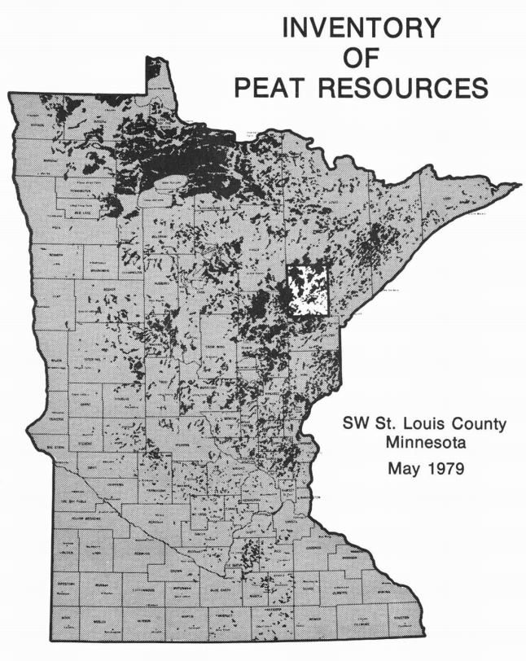
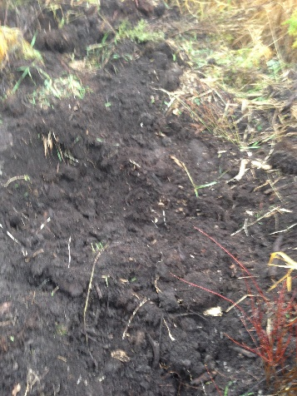
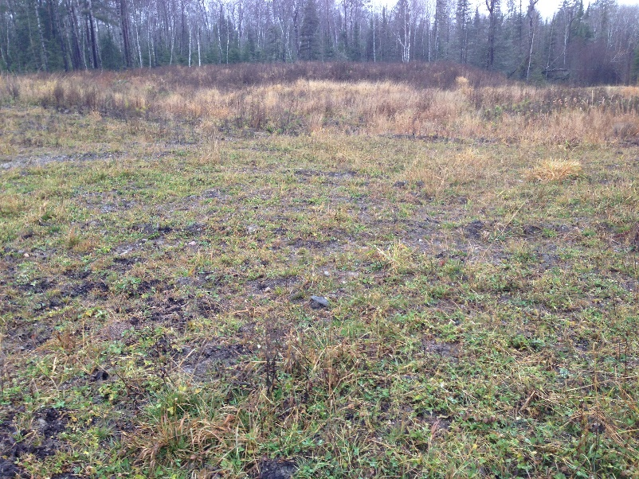
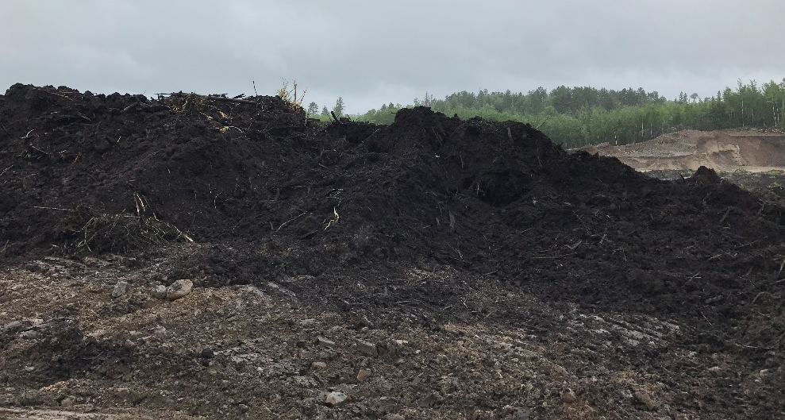
Peatland cover about 7.2 million acres of land which is about 14% of the State's total acreage.

Slide 4
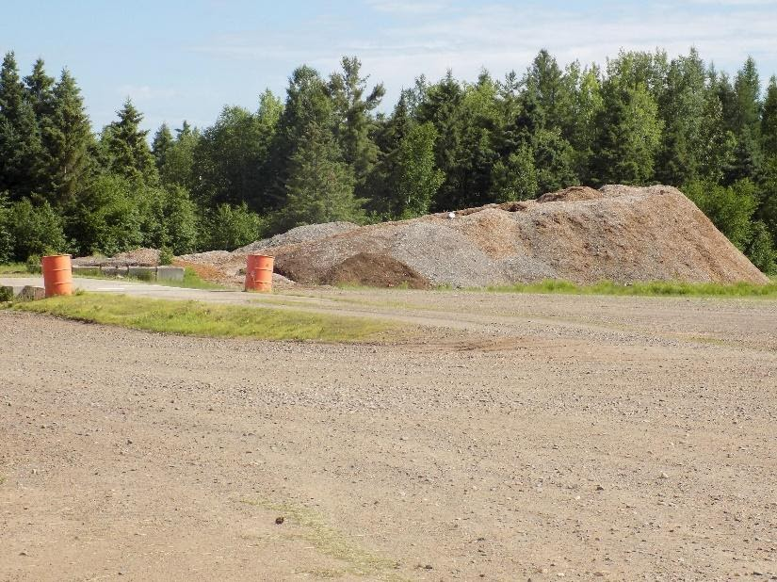
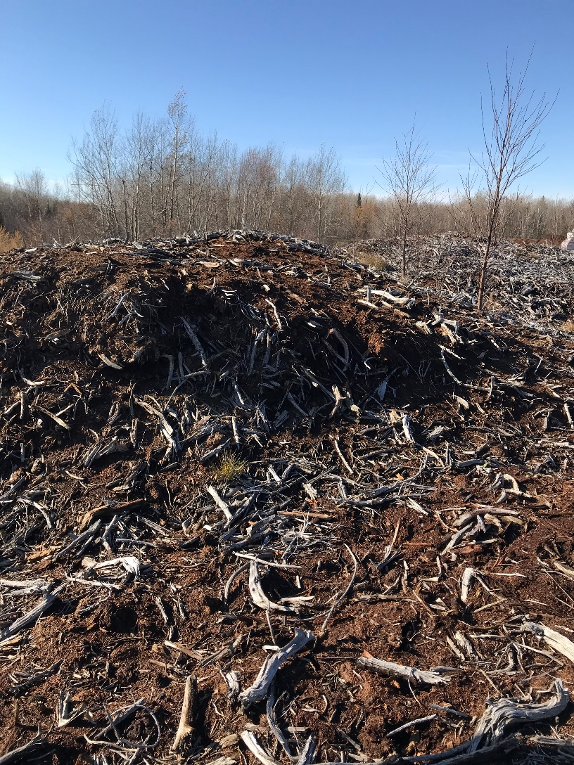
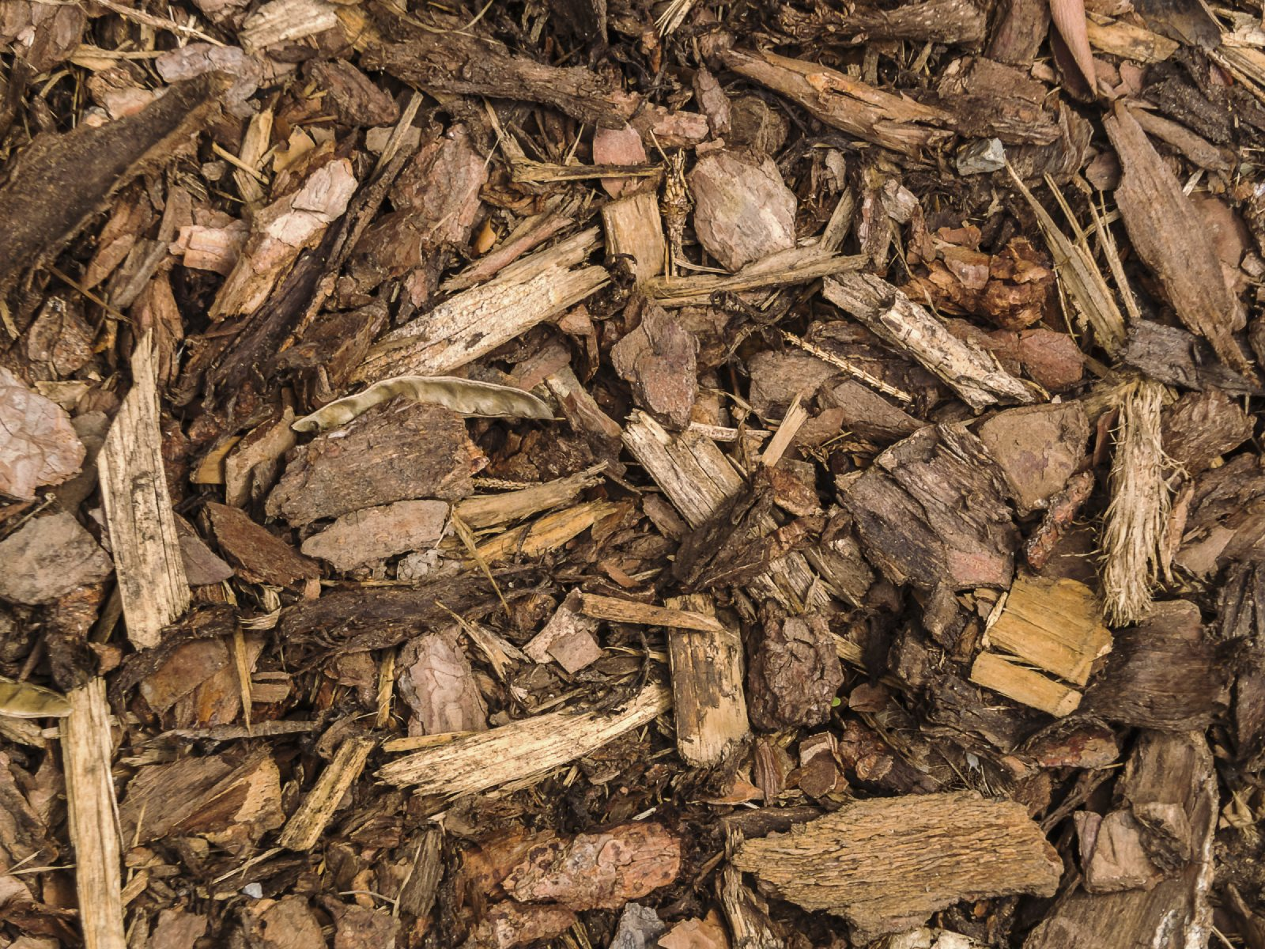
Peat Screenings at Floodwood
Peat Screenings at Cromwell
Tree Barks
Notes:
Wood Product

Slide 5
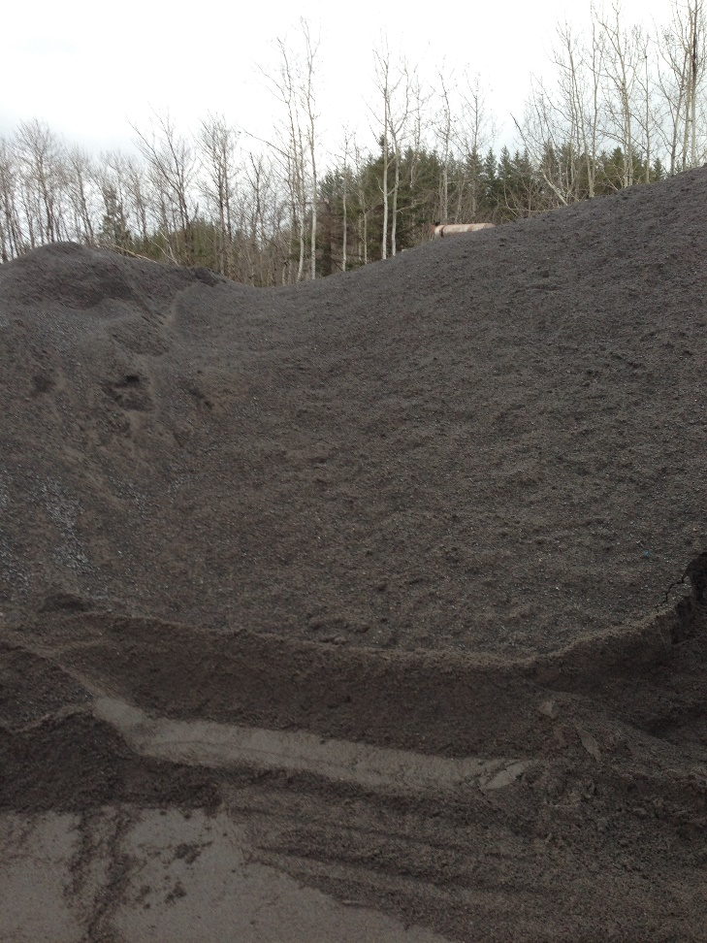
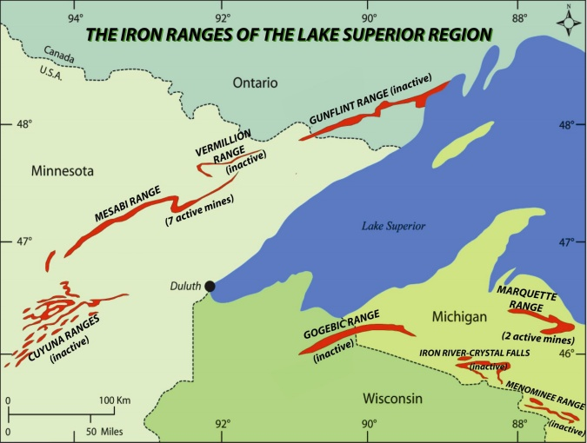
Tens of millions of tons of byproduct (non-ore) taconite rock are generated annually
Taconite Blast Rock
Coarse Crushed Taconite Rock
Coarse Taconite Tailings (taconite fine aggregate)

Slide 6
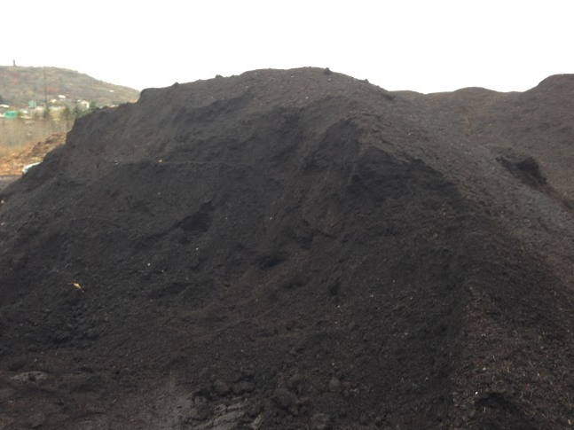
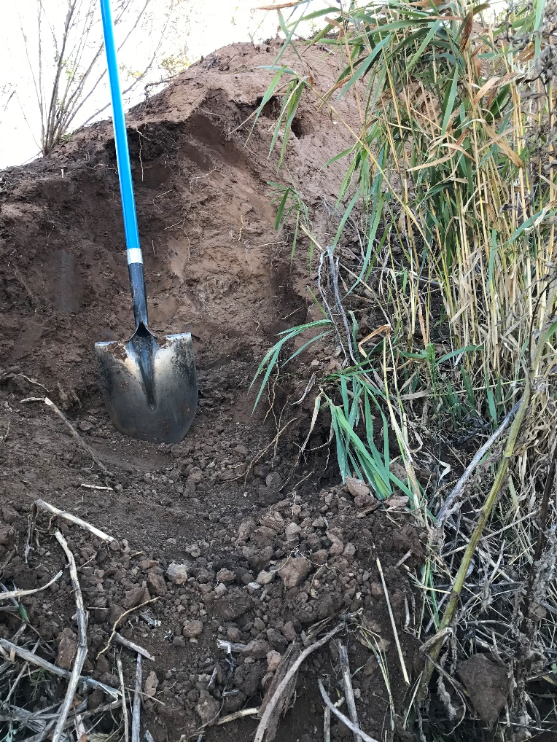
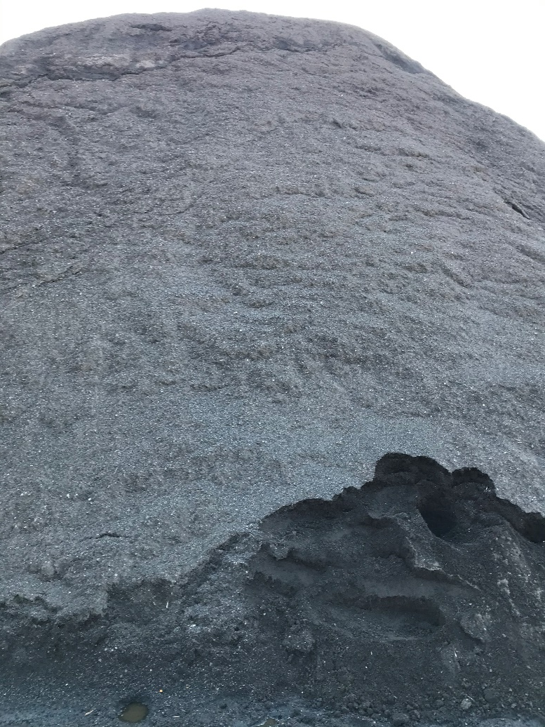
Compost
Duluth Harbor Dredge Sediment
Street Sweeping

Slide 7
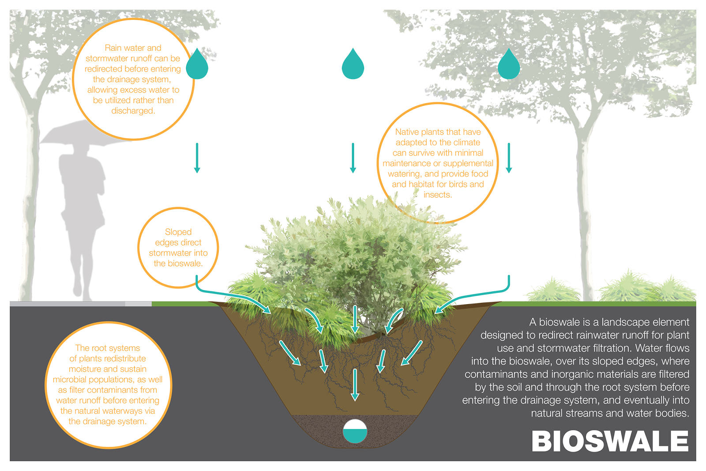
How to use the waste/by-product?
Bonus: Habitat
Filtration
Adsorption, microbial degradation &
plant uptake

Slide 8
Characterization
Civil Engineering
  Water retention capacity
    National Pollutant Discharge Elimination System (NPDES) State Disposal System (SDS) General Permit issued by Minnesota Pollution Control Agency (MPCA) in 2013 requires that the first inch of stormwater runoff from new impervious should be held on site through infiltration, harvesting or reuse.
Environmental Engineering
  Compositions
    Hazardous components, RCRA metals
    Emerging pollutants, PFAs
  Chemical contents in leachate
    Water standard
Plant growth

Slide 9
What we did/are doing
Collected data information from the manufacturers to screen waste materials
Characterize waste materials by lab tests in civil engineering, environmental and biological aspects
Develop possible soil mixture recipes
Apply selected material(s) into field tests

Slide 11
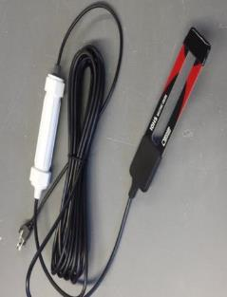
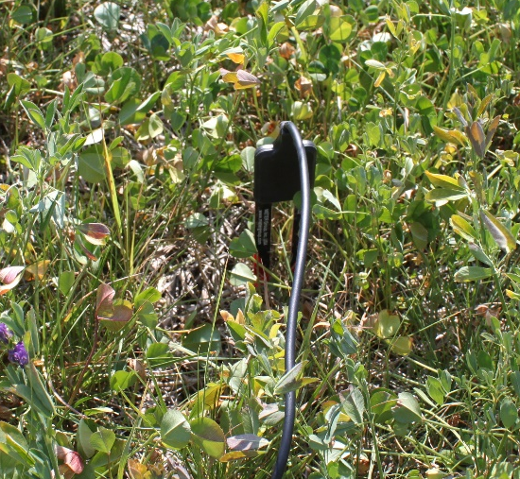
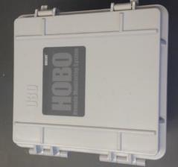
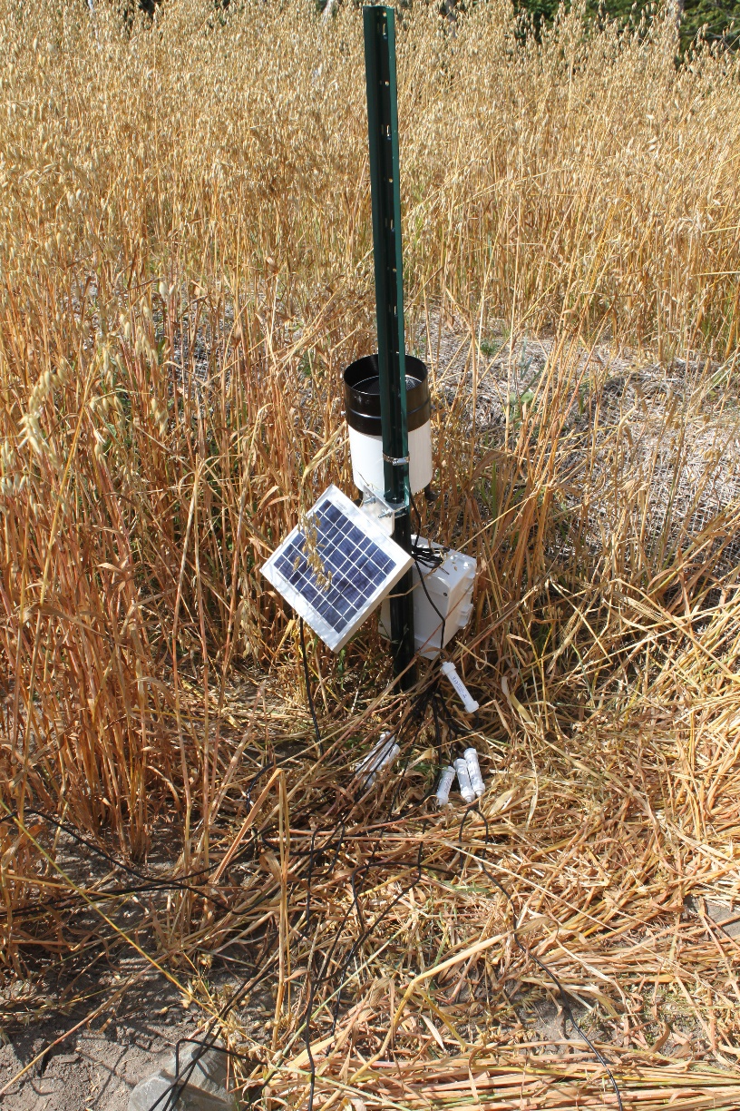
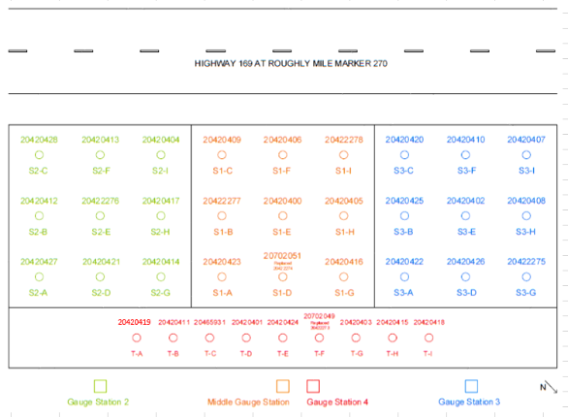
In-situ Moisture Measurement

Slide 12
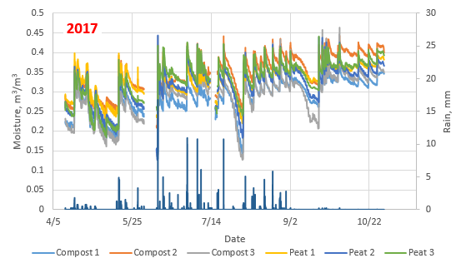
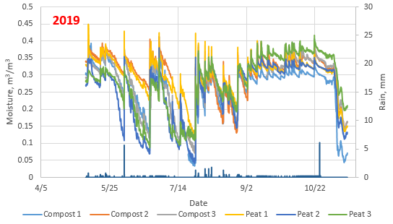
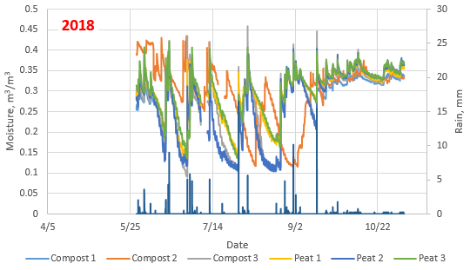
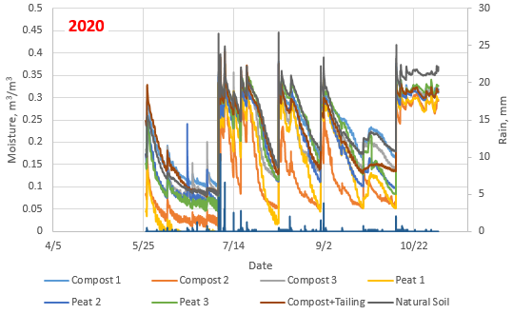
NRRI Site

Slide 13
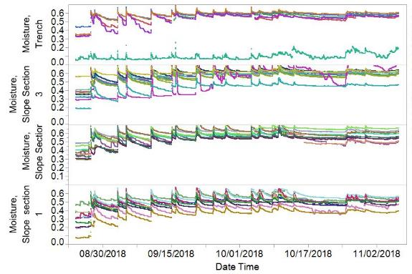
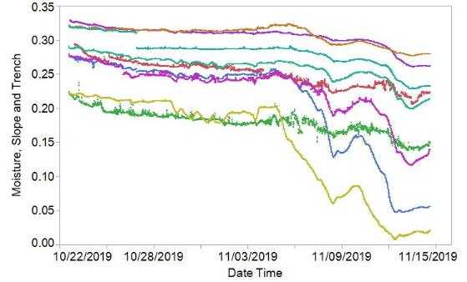
Eagle’s Nest Site

Slide 14
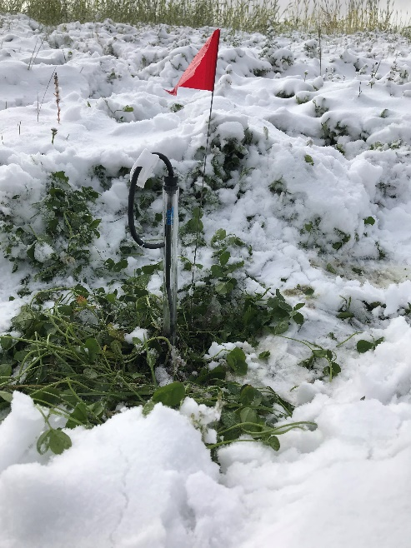
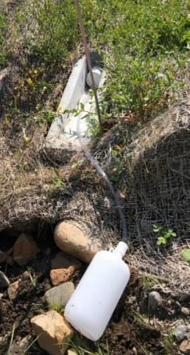
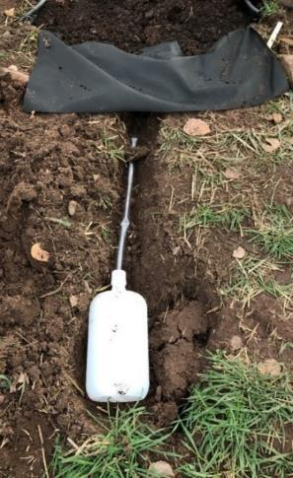
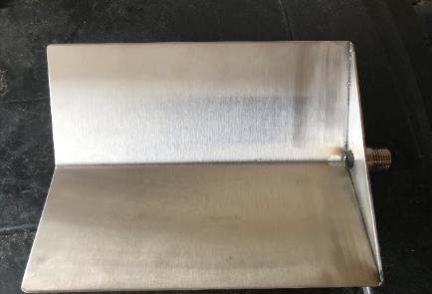
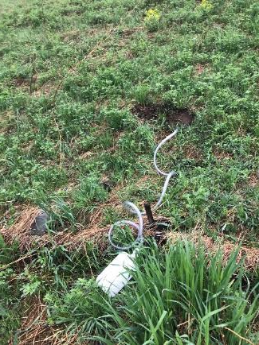
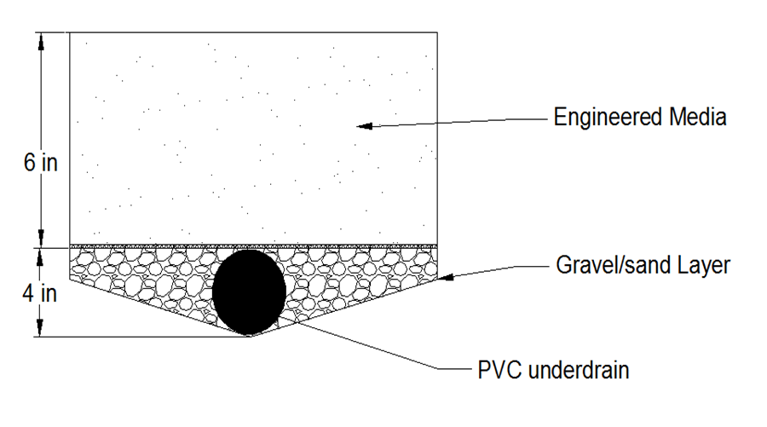
Water Sample Collection
2020
2019
Eagle’s Nest Trench
NRRI Site
Eagle’s Nest Slope

Slide 15
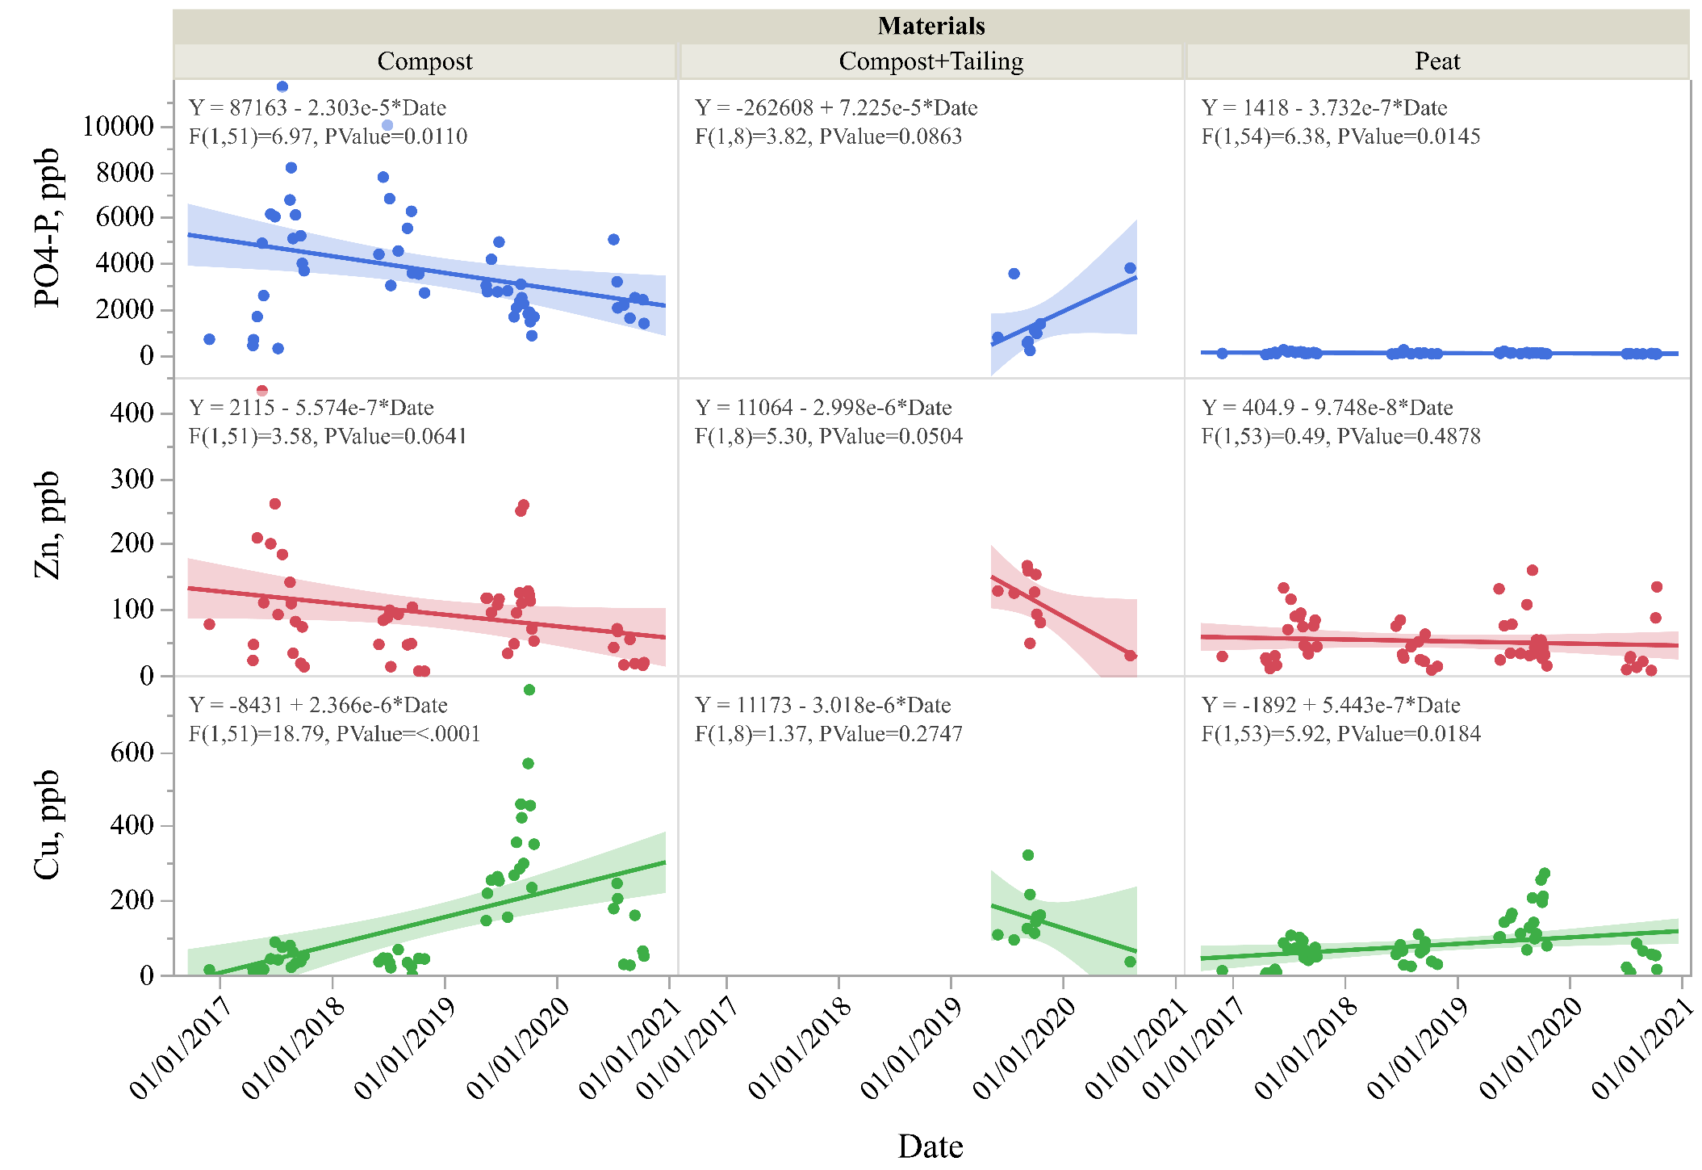
Chemical Retention/Leaching Along Time

Slide 16
Water Quality Comparison between NRRI and Eagle’s Nest
Site | Compositions | Median Value, ppb
 |  | pH | Cu | Zn | PO4-P
NRRI | 50% compost +50% natural soil | 7.6 | 61.0 | 83.3 | 3015.8
 | 50% peat +50% natural soil | 7.4 | 68.1 | 41.4 | 54.1
 | 50% compost + 50% tailing | 7.8 | 133.7 | 125.6 | 969.6
Eagle's Nest | 10% compost + 10% peat | 7.7 | 14.7 | 6.9 | 5.9

Slide 17
Findings
Peat has a high potential to replace commercial compost in stormwater filtration media.
Taconite tailings showed potential to remove phosphorus.
Water retention capacity does not show significant trend for the first four years application.
Phosphorus release from compost declined significantly, at the rate of 750 ppb/year for a soil mixture with 50% compost content.
The mixture of 10% compost+10% peat is recommended in all civil engineering, environmental and biology aspects.

Slide 18
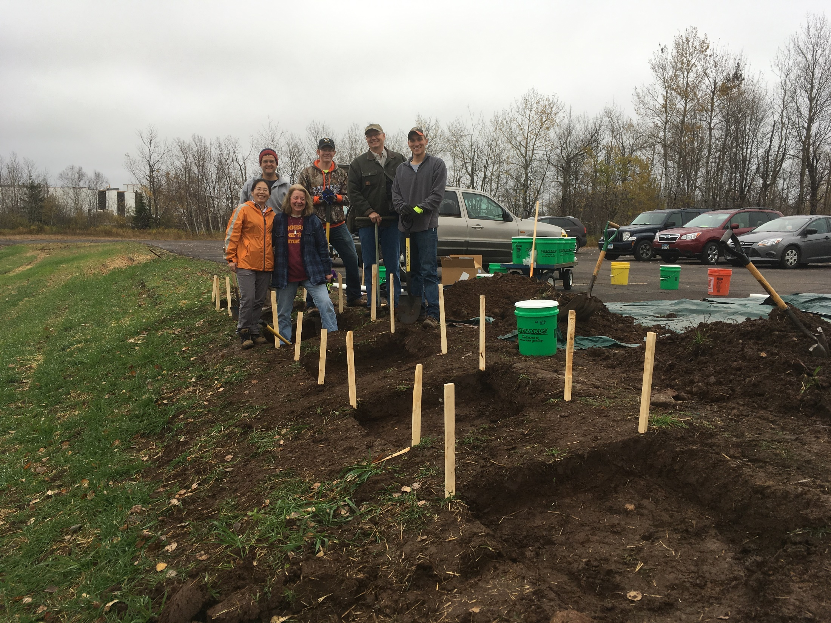

Slide 19
Acknowledgement
Projects funded by MnDOT
Thanks to Dwayne Stenlund as project liaison

Slide 20

Thank You

