Slide 1
Stormwater Infiltration on Contaminated Sites
Rebecca Higgins
Mike Trojan
Minnesota Pollution Control Agency
ASCE MN October Section Meeting
October 19, 2017

Slide 2
Presentation Outline
Infiltration overview
Regulatory framework
Guidance
Scenarios, examples, case study
Q&A

Slide 3
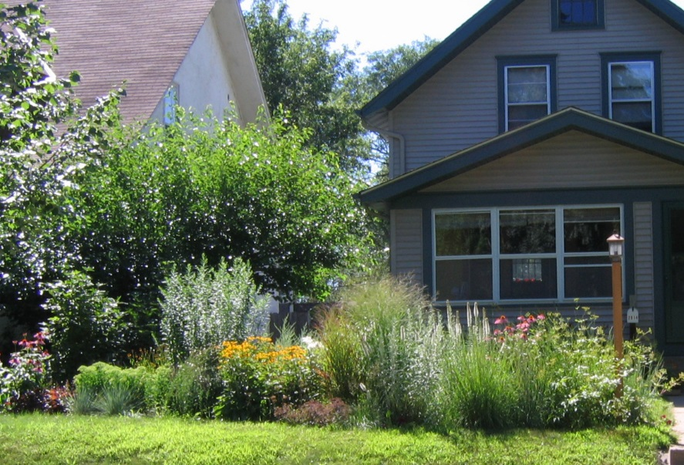
Stormwater infiltration is desired when conditions are appropriate – water quality
About 90% of TP and TSS is removed for an infiltration practice that meets a 1.1 inch (MIDS) performance goal (B soils)
Generally, impacts to groundwater are insignificant. Exceptions:
Chloride
Soils with excessive infiltration rates and poor attenuation properties
Locations that pose higher pollution risk (hot spots and contaminated sites)

Slide 4
Stormwater infiltration is desired when conditions are appropriate – volume control
About 90% reduction in annual runoff volume for an infiltration practice that meets the MIDS 1.1 inch performance goal
NOTE: less important for controlling peak flow

Slide 5
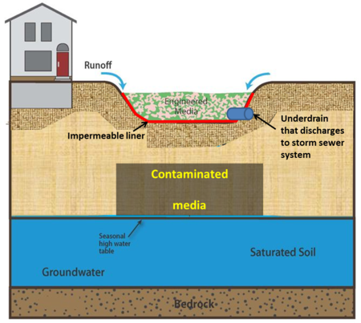
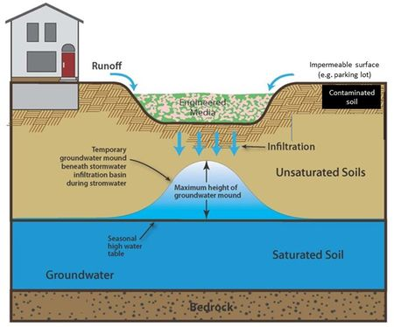
There are many situations where infiltration is not appropriate
Shallow bedrock
High water table
Karst
Inadequate separation distance
Contaminated soils or groundwater – infiltrated stormwater can mobilize contaminants

Slide 6
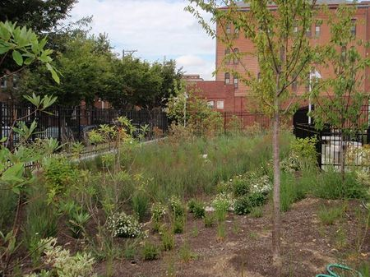
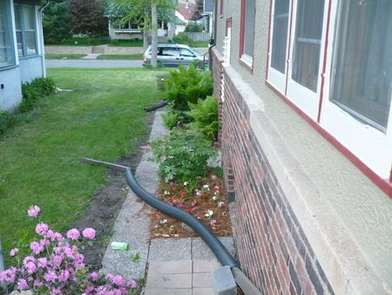
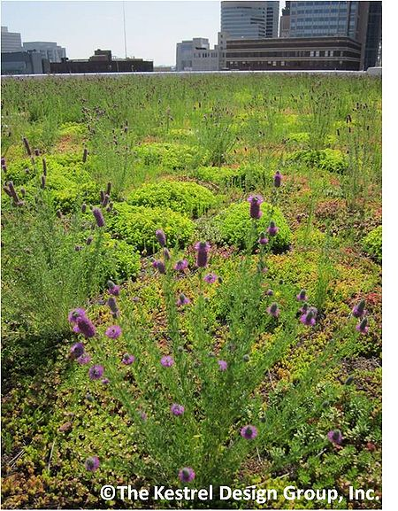
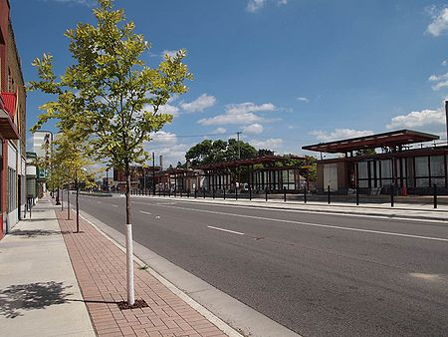
Regulatory Framework encourages infiltration
Current Construction Stormwater General permit
… the Permittee(s) must design the project so that the water quality volume of one (1) inch of runoff from the new impervious surfaces created by the project is retained on site (i.e. infiltration or other volume reduction practices)
Municipal General permit
The permittee shall develop and implement a Post-Construction Stormwater Management program that requires the use of any combination of BMPs, with highest preference given to Green Infrastructure techniques and practices
Source: CDM Smith
Source: Capitol Region Watershed District

Slide 7
Regulatory Framework has restrictions
Current Construction Stormwater General permit
Infiltration is prohibited when the infiltration system will be constructed in … Areas where high levels of contaminants in soil or groundwater will be mobilized by the infiltrating stormwater.
Draft proposed language for next permit issuance
Infiltration is prohibited in areas where infiltrated stormwater could enter contaminated groundwater with contaminant levels over Health Risk Limits (HRLs), Health based Values (HBVs), or Maximum Contaminant Levels (MCLs), unless an appropriate environmental assessment is performed to demonstrate that infiltration will not have a negative impact on groundwater.
Infiltration is prohibited in areas where infiltrated stormwater could come into contact with contaminated soils with levels above Soil Leaching Values (SLVs), unless an appropriate environmental assessment is performed to demonstrate that infiltration will not have a negative impact on groundwater.

Slide 8
Potential Contamination Liability
MERLA (115B)
Persons Not Protected from Liability
Water Pollution Control Act and Petroleum Tank Release Cleanup Act (115, 115C)
Responses to Releases and Duty to Notify and Avoid Water Pollution
MN Rule (7060)
Prohibition Against Discharge into Saturated or Unsaturated Zones

Slide 9
Regulatory Framework –
Contaminated Sites Review
Remediation Programs review sites individually in context
Do not have legal authority to approve stormwater designs
Work with consultants and stormwater staff to be aware of infiltration risks
May comment on potential risks posed by infiltration
A development’s stormwater management system can affect the soil leaching pathway.
The location and design of the stormwater management system should take into account the nature and distribution of contamination at or nearby the site.

Slide 10
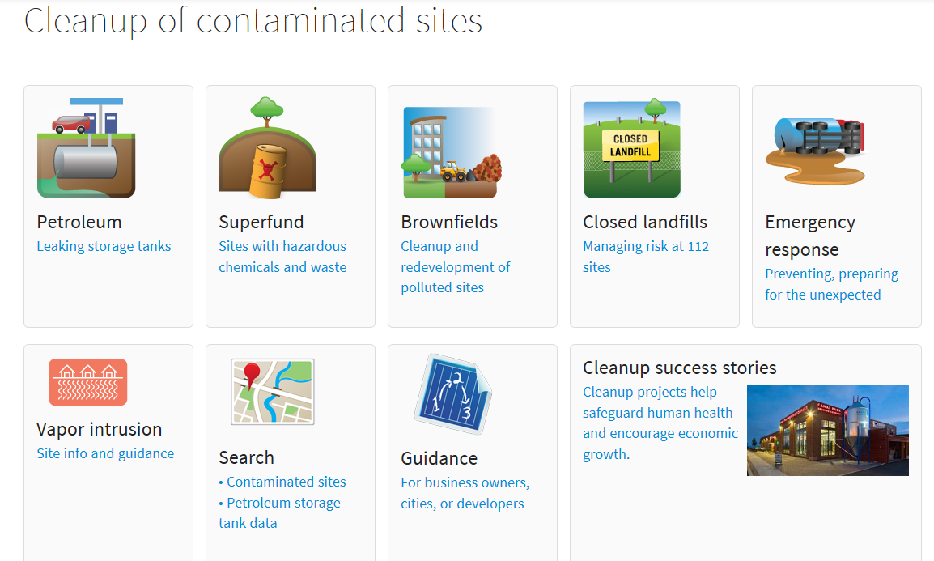
Regulatory Framework –
Contaminated Site Review
Brownfields Redevelopment Sites
RAP/CCP guidance requires stormwater design information:
System Type
Location relative to contamination
If contamination is a hindrance, options include the 4M’s:
Move
Model
Modify
Monitor*

Slide 11
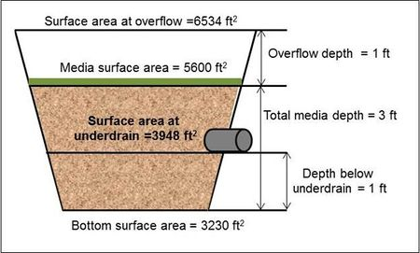
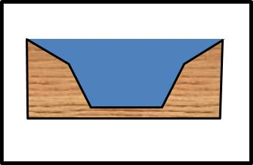
What practices does the guidance apply to?
Current Construction permit
For those projects where infiltration is prohibited … consider other methods of volume reduction and the water quality volume … must be treated by a wet sedimentation basin, filtration system, regional ponding or equivalent methods
Next permit will likely have increased protections
Line to prevent infiltration
Line if contaminated groundwater is encountered
Find an alternative practice (e.g. regional pond)
Could implement a practice that still infiltrates a considerable amount of water
Groundwater
Could implement a practice that intersects contaminated groundwater

Slide 12
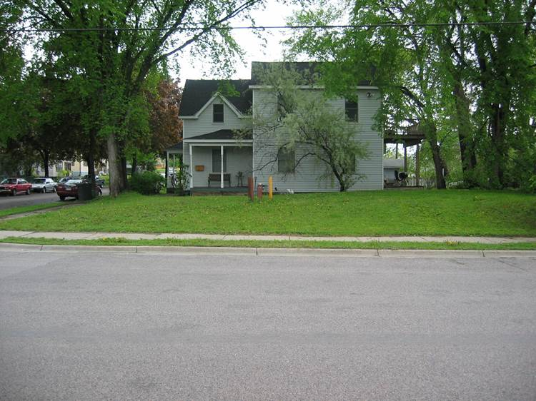
Guidance – 3 scenarios
We don’t know if a site has contaminated soil or groundwater
We know the site has contaminated soil or groundwater or there is a high potential for a site to have contamination
There is off-site contamination that may be impacted
Proposed infiltration practice

Slide 13
Scenario 1 - We don’t know if a site has contaminated soil or groundwater
Current guidance is in the Minnesota Stormwater Manual: Screening assessment for contamination at potential stormwater infiltration sites
We recommend a screening level assessment of the site
The screening utilizes simple methods to assess the likely presence of contamination – doesn’t burden the developer with sampling and analysis
The method is conservative in that infiltration is not recommended if there is potential contamination at the site
The method utilizes a checklist contained in an Excel spreadsheet

Slide 14
Checklist items
Is or was the site contaminated and not remediated?
Are there on-site “indicators” that contamination may exist?
Are there off-site “indicators” that contamination may exist?
If “indicators” exist, can they be isolated or eliminated to allow for infiltration?

Slide 15
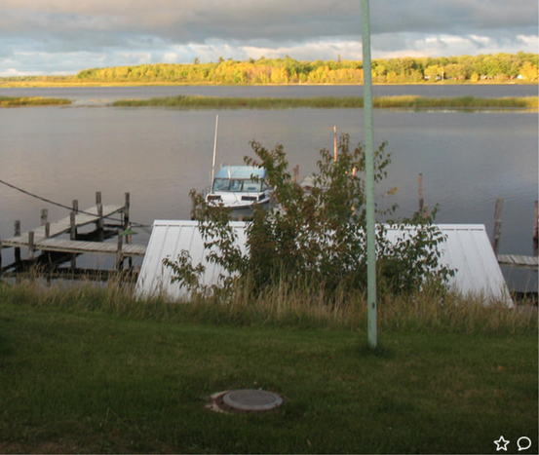
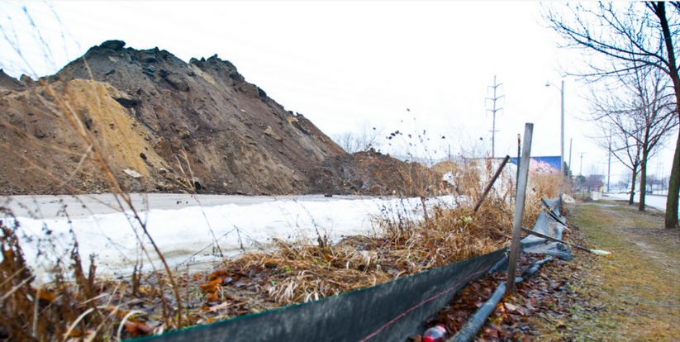
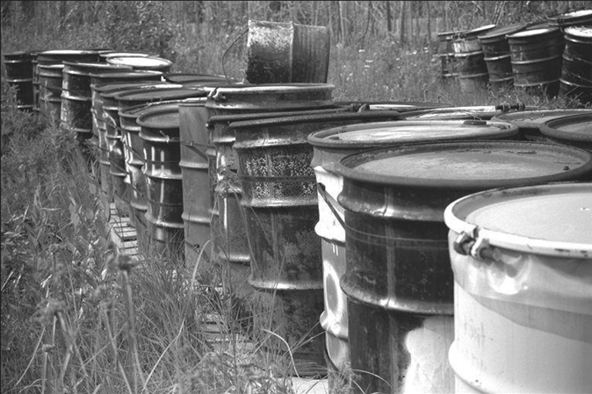
Site “indicators” – presence of any of these
Underground tanks or vents
Monitoring wells
Covered soil piles
Stained soils or dead vegetation
Unusual odors
Mismanaged drums
Excavations that have not been backfilled
Presence of debris
Site is a confirmed hotspot

Slide 16
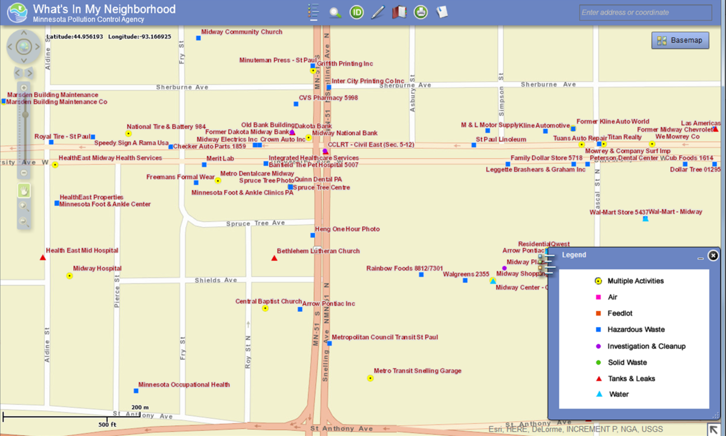
Sources of information
Review of property history
Interviews
Examination of state and federal records
Owner information
What’s In My Neighborhood
PRP Maps Online
University of Minnesota records, maps, photos
Property tax records

Slide 17
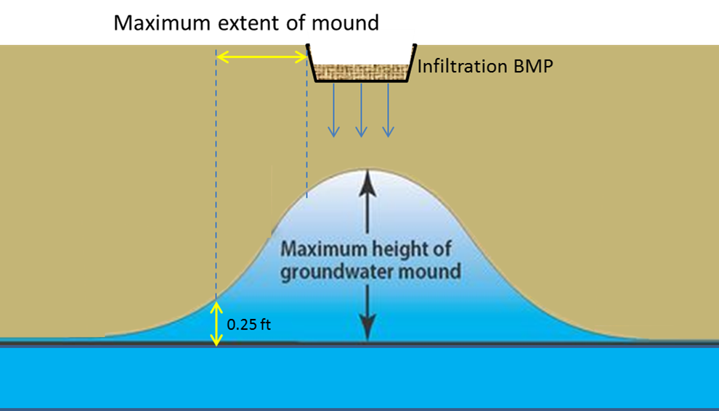
If any of indicators are present, can they be eliminated or can adequate separation be achieved between the feature and the infiltration practice?
If Yes – infiltrate
If No
recommend not infiltrating
If you choose to pursue infiltration, understand the risks and conduct a Phase 1 Environmental Site Assessment
Link to Stormwater Manual

Slide 18
Scenario 2: We know the site has contaminated soil or groundwater or there is a high potential for a site to have contamination
Could be based on sampling
Could be based on failure to pass the screening assessment
In either case, a site investigation, including sampling, is necessary

Slide 19
Guidance has not yet been developed for Scenario 2 but will include the following
Definitions of HRL, HBV, MCL, and SLV
Guidance on site assessments, including sampling
Guidance on determining if contaminant levels are acceptable (risk analysis)
Designing infiltration practices at sites with contamination
Examples
HRL = Health Risk Limit (groundwater concentration above risk limit)
HBV = Health Based Value (groundwater concentration above risk limit)
MCL = Maximum Contaminant Level (groundwater concentration above risk limit)
SLV = Soil Leaching Value (soil concentrations that, when leached, pose a groundwater risk)

Slide 20
Remember: If contamination is a hindrance, options include the 4M’s: - Move - Model - Modify - Monitor*
Some examples and a case study
Keep in mind we have not yet developed this guidance, but these might be examples

Slide 21
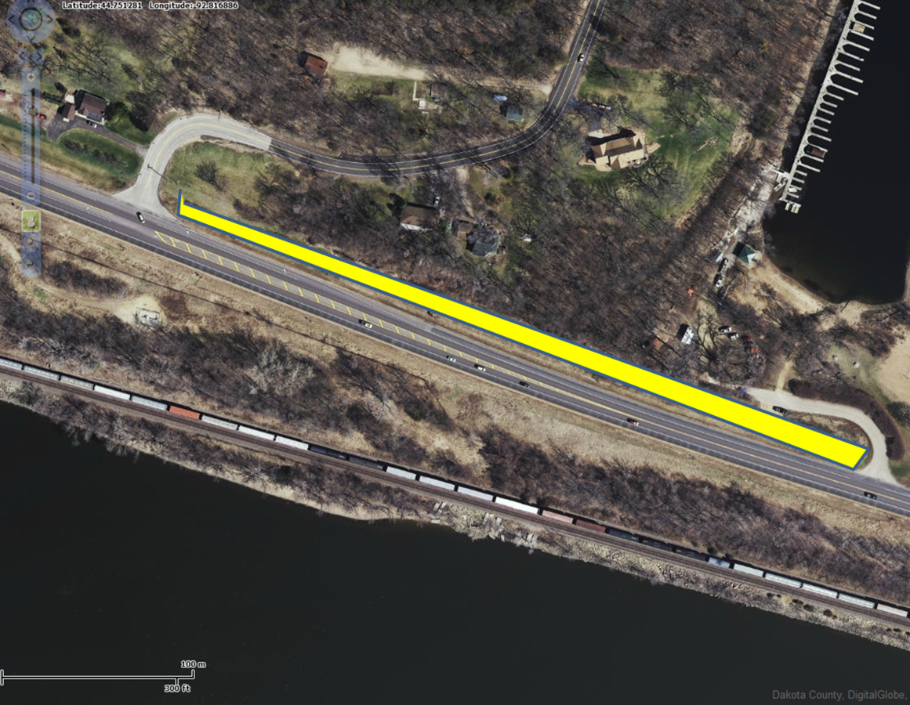
An example of groundwater contamination

Slide 22
Soil leaching value example (Cu in soil)
Concentration (mg/kg) | DTW (ft) | SLV (mg/kg)
6500 | 3 | 2810
7951 | 3 | 2810
2684 | 3.5 | 3160
597 | 3.5 | 3160
58 | 4 | 3510
29 | 5 | 4210
104 | 5 | 4210

Slide 23
Scenario 3: Off-site contamination may be impacted
Usually groundwater down-gradient of or very near the site
Could also be contaminated soil near the water table
Will need to sample to determine groundwater flow and location and concentration of contaminants in soil and groundwater
Will likely need some sort of analysis (mounding analysis, modeling, etc.)
Infiltration practice
Contaminant
X
Mound
< 0.25 feet

Slide 24
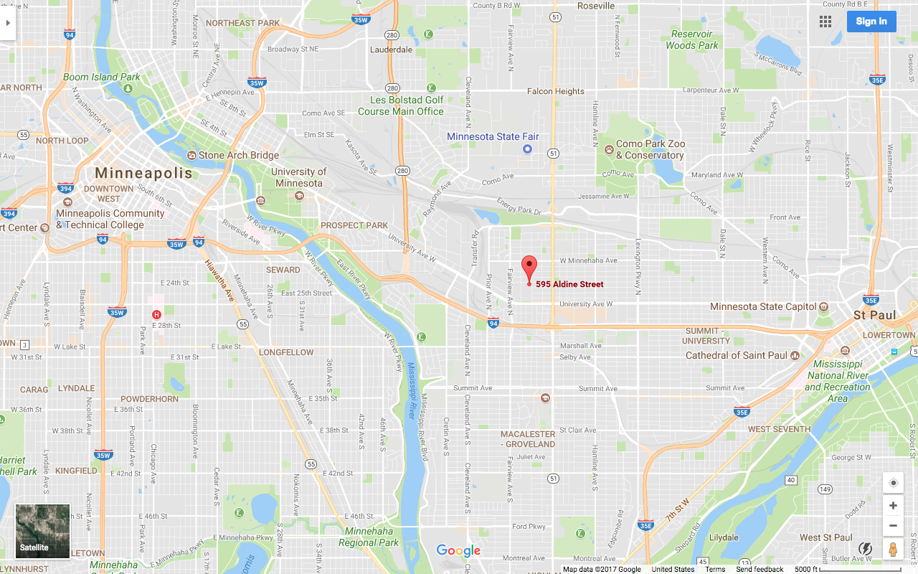
Case Study: Modeled Infiltration w/ Impacts Capitol Region Watershed District HQ

Slide 25
Case Study: Modeled Infiltration w/ Impacts Capitol Region Watershed District HQ
Site Redevelopment
Petroleum and Non-Petroleum Impacts in soil and groundwater
Headquarters for the CRWD
Maximizing BMPs onsite for demonstration purposes
Modeling Infiltration
Located in known area of groundwater impacts
Model demonstrates low-risk to receptors from infiltrating stormwater
Model demonstrates potential for “Beneficial Infiltration” affect on impacted groundwater
Innovative Report, Collaboration with MPCA Project Teams
Continuous communications
Demonstrates 4th “M” option
Installed monitoring network

Slide 26
Guidance
We expect to have guidance completed at the time the next Construction permit is issued.
The guidance will cover the scenarios discussed in this presentation, including examples
The guidance will clarify permit language, which has been ambiguous
The guidance should provide clarification which in turn should make the permitting process simpler
Will be housed in the MN Stormwater Manual, which can be updated as needed
Brownfields Guidance:
https://www.pca.state.mn.us/waste/cleanup-guidance

