Slide 1
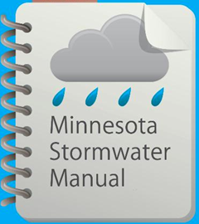
Bioretention from the bottom up
May 30, 2017

Slide 2
Questions and other stuff
Please use the chat box if you have questions.
We will try and answer during the webinar
All Q&A will be posted in the (page called Stormwater Manual webinars)
Webinar is recorded and will be posted in the manual
This PPoint will be posted in the manual

Slide 3
Professional development hours
1.5 PDHs offered
Access to certificate will be posted on the Stormwater manual webinars page
This PowerPoint presentation and other information will be available on this page
Notes:
Or will this be a link in the manual for a certificate? Explain that we keep a record of attendees-that’s the only way you can get PDH’s. We have to show proof.

Slide 5
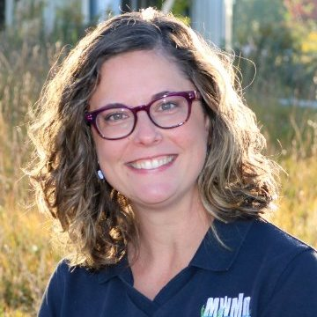
Presenters
Mike Isensee-Administrator, Middle St. Croix Watershed Management Organization
Fred Rozumalski, Registered Landscape Architect- Barr Engineering
Marcy Bean, Professional Landscape Architect-Mississippi Watershed Management Organization
Contact information
Mike.Trojan@state.mn.us
MN Stormwater Manual – (easier to find with a Google search) http://stormwater.pca.state.mn.us/index.php/Main_Page

Slide 6
First – a note on Terminology
Infiltration (basin, trench, underground) – near end of treatment train, regional control, up to 50 acres, large storm, ponding depth to 4 ft.
Bioinfiltration – throughout watershed, local control, 5 acres or less, smaller storms, ponding depth less than 18 inches
Biofiltration – same as bioinfiltration except has an underdrain

Slide 7
For information on terminology, see Bioretention terminology in the MN Stormwater Manual
Bioinfiltration basin
Biofiltration with elevated underdrain
Biofiltration with underdrain at bottom
Bioretention basin
Do I have an infiltration basin or a bioretention basin?
Infiltration basin
Biofiltration with internal water storage
Biofiltration with liner

Slide 8
Objectives for today’s webinar
Focus on information that frequently accounts for failure of bioretention systems but is often overlooked – bioretention media and vegetation
Identify information on these topics that needs to be addressed in the MN Stormwater Manual

