Slide 1
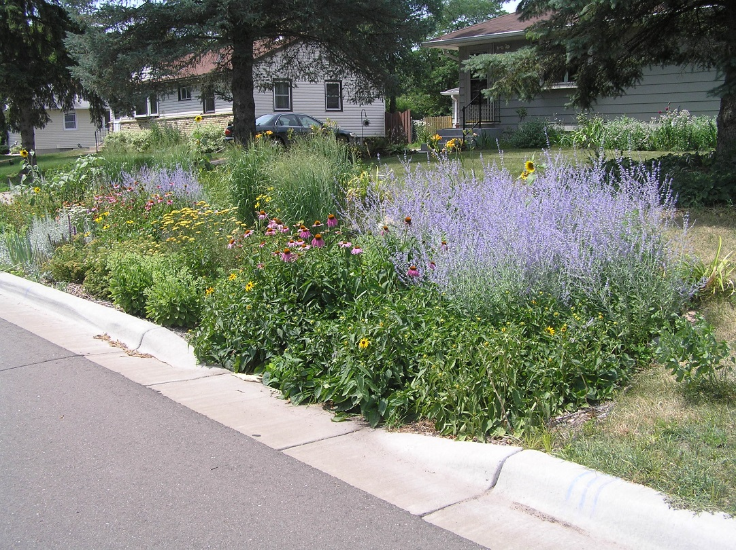
Asset Management and Stormwater? Please Explain!
MPCA Workshop: February 6, 2017
Michael Thompson, P.E.
Public Works Director
City of Maplewood

Slide 2
More Focus on Asset Management
MN 2050 Initiative http://mn2050.org/survey
Office of the State Auditor: Infrastructure Stress Transparency Tool http://www.osa.state.mn.us/default.aspx?page=20160211.001
Storm Pond Inventory Requirements
Call for More Government Transparency
Why Where Certain Budget Decision Made?
Much easier to make the case or explain if leveraging actual data from a holistic asset management approach

Slide 3
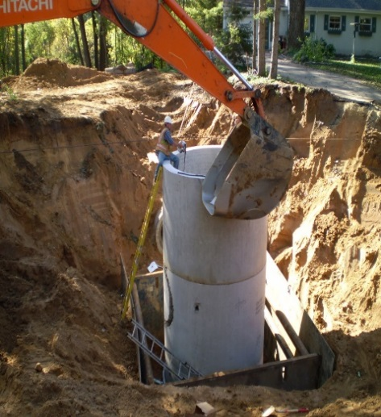
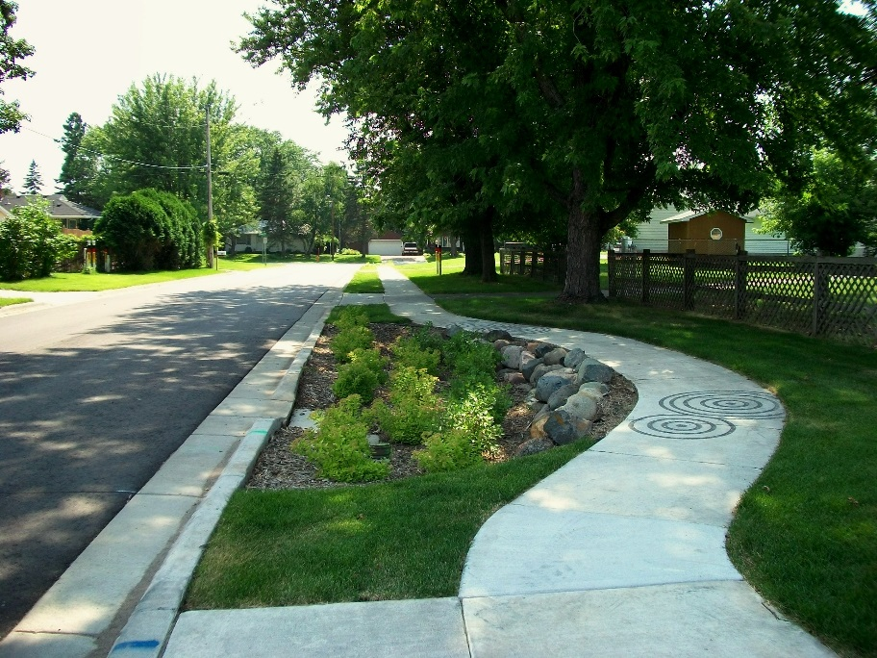
What Are Stormwater Assets?
Basins (Ponds, infiltration basins, raingardens, wetlands)
Outlets (outfall attribute at city limits / wetland for MS4 outfalls)
Treatment Devices (Grit chambers, stormceptors, draintile, etc…)
Culverts
Lift Stations
Inlets
Pipes
Manholes (attribute for sumps)

Slide 4
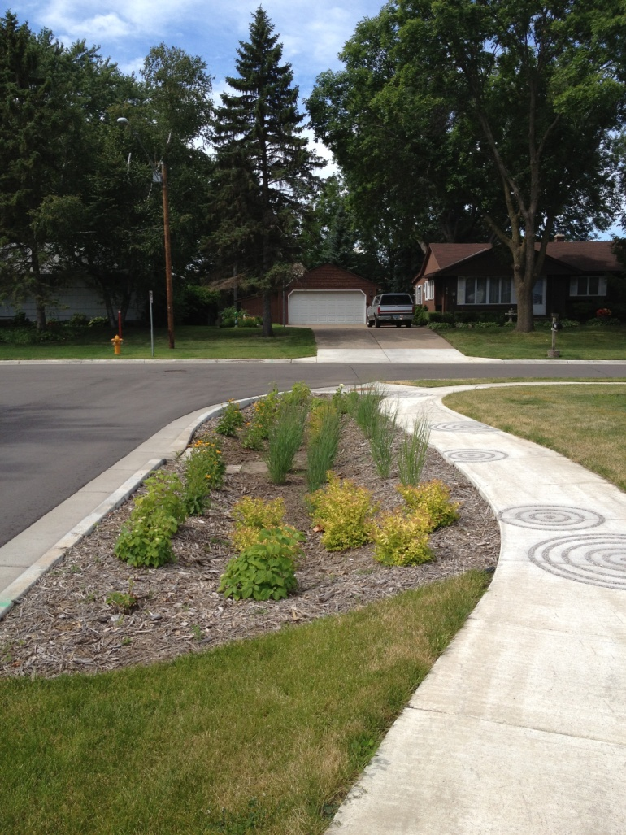
Why Track Your Stormwater Assets?
Preventative Maintenance (PM)
Inspections
Track Maintenance Activities
Proactive vs. Reactive Decisions
Repairs
Replacement
Life Cycle Expectations
Budgeting
MS4 Reporting

Slide 5
Who Currently Tracks Assets?

Slide 6
529 Agencies Responded to MN2050 Survey: Top Systems to Track Assets*
492 - No Asset Management
100 – Cartegraph (*e.g…. 1 agency could represent 3 of the 100 if used for streets, lights, and storm sewer)
96 - Icon
81 - MnDOT SIMS
34 - Simple Signs
29 - CityWorks
28 - Other

Slide 7
City of Maplewood’s Perspective on Asset Management System Selection
Met with key department leaders to determine needs
Vetted numerous programs
Met with sales reps/vendors
Met with fellow agencies to see in action
Created internal city stakeholder group to help vet
Created buy-in and ensured system would meet needs
Currently in the implementation process
Data from paper, other programs, Xcel, must migrate to new system including all stormwater assets

Slide 8
Cartegraph Implementation

Slide 9
How Does It Work?
All assets are mapped and assigned a condition and value
When creating new assets or updating existing assets (location or attributes) all changes get auto-updated to GIS map
Program tracks asset issues and tasks
Integrated into daily operations
Inspection forms (ponds, manholes, pipes) on i-Pads for example
An issue can be reported internally or externally from citizens
Example: Citizens snaps photo of flooding (issue) on smart phone app
Correct person is alerted and prioritizes, task assigned (clear debris) and resources then entered (2 crew members and 1 dump truck)

Slide 10
Example: Citizen reports paint dumped into catch basin
Request input into system at asset location (MH254) as and issue termed “illicit discharge”
Then assigned as a task for the proper city staff person to investigate and document
Documentation forms can be created for MS4 reporting and used in the field by staff
At end of year all illicit discharge reports could be queried into a single report for MS4 reporting purposes
Automated response to citizen when work is completed

Slide 11
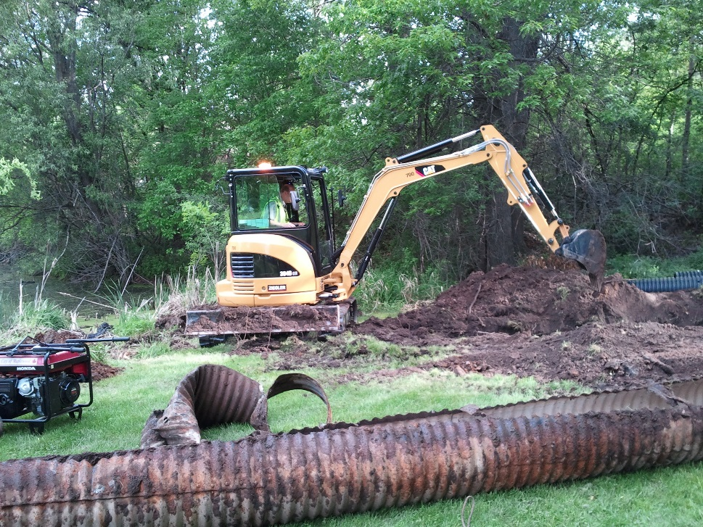
Example: A section of storm pipe is found to be collapsed after a PM inspection
Issue entered into system at asset location (Pipe345) as a “pipe break”
This could then be assigned as a task of “replacement” with resources used (labor, equipment, material)
Pipe gets repaired and City can now rate the pipe in new condition (e.g… went from 2/10 to 10/10) and how much it cost for that action

Slide 12
Why All of This Asset Management Stuff?
Reports and data at the touch of a button
How many manholes are rated poor?
Visual map showing all assets that meet criteria to set work priorities for crews
Triggers preventative inspections and maintenance
Holistically stores all assets across many functions so they “can speak to one another”
Shows the future resources needed to meet conditions you want
Helps inform budgeting and setting fees/rates
FEMA Reporting (special labor rates, etc.)

Slide 13
Final Thoughts
Asset management approach dependent upon your needs
Maplewood went to holistic asset management for pavement, storm, lighting, sewer, buildings, parks etc... To better reflect asset condition, values, and future needs
Very helpful to have all assets and information in a user friendly system that does not rely on specific individuals (retirements?)
Ability to sort, create reports, drill down on data, heat maps, etc.
Informed decision making (data driven)
City Council supportive with this approach in order to make smart capital investment decisions and provide transparency

Slide 14
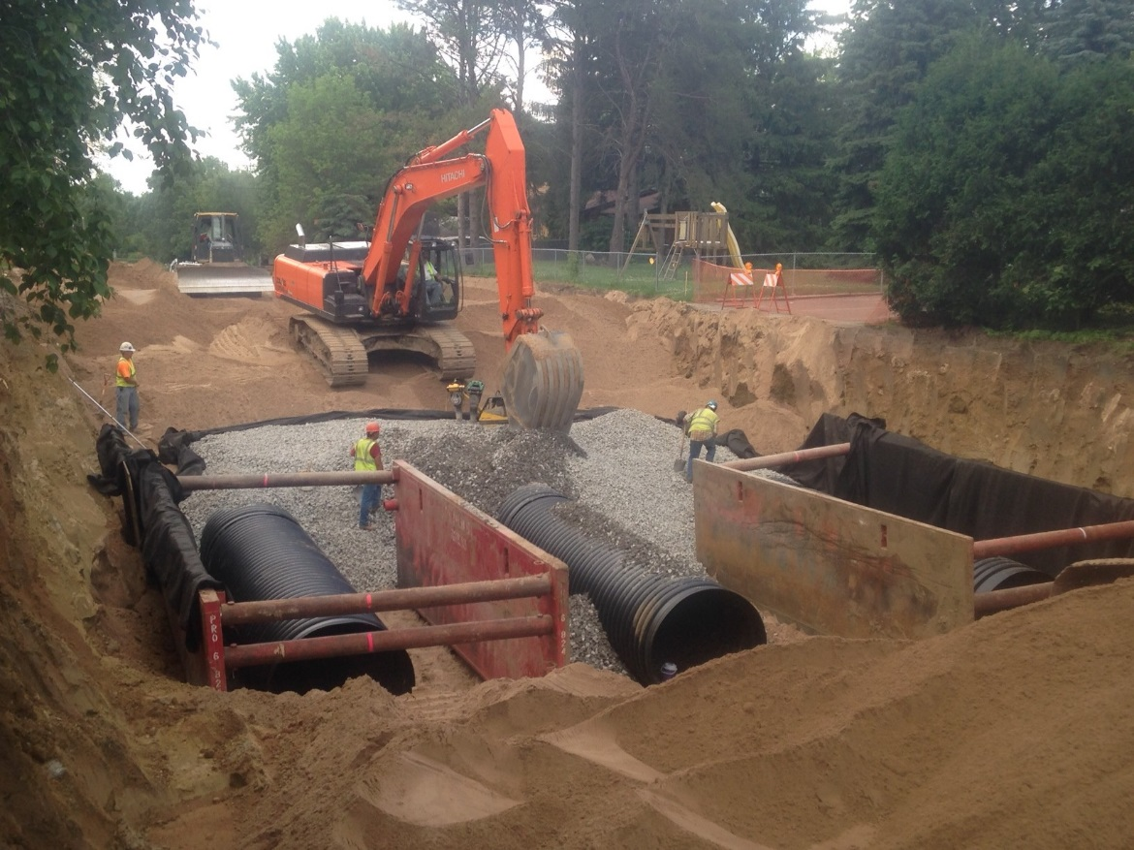
Thank You! Questions?
MPCA Workshop: February 6, 2017
Michael Thompson, P.E.
Public Works Director
City of Maplewood

