Slide 1
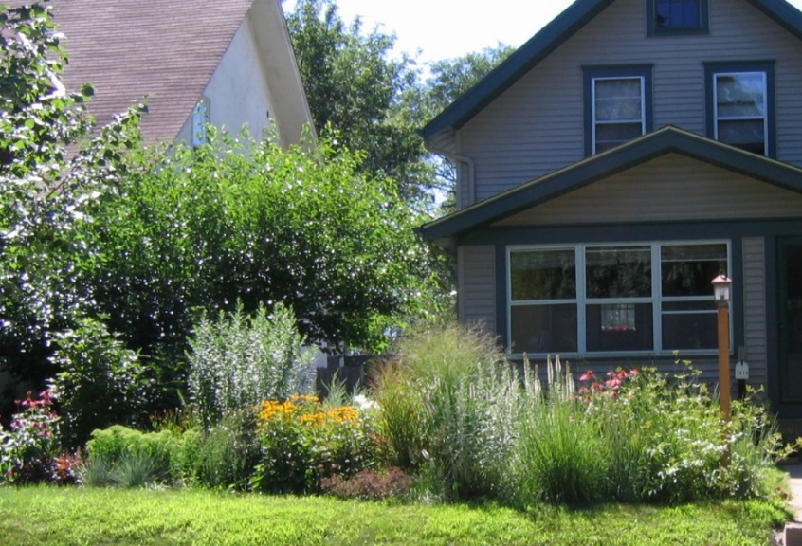
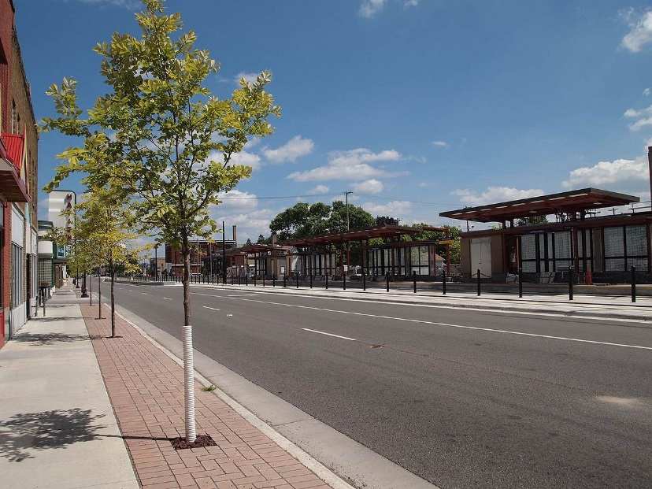
Minnesota’s Stormwater Manual – Connecting Stormwater Management to the Landscape
Mike Trojan
Minnesota Pollution Control Agency
Northern Green Expo
January 3, 2018

Slide 2
Outline
A little bit on stormwater
Overview of the Minnesota Stormwater Manual
History of the Manual
Green Infrastructure and sustainable stormwater management
How the manual is evolving to incorporate sustainable stormwater management

Slide 3
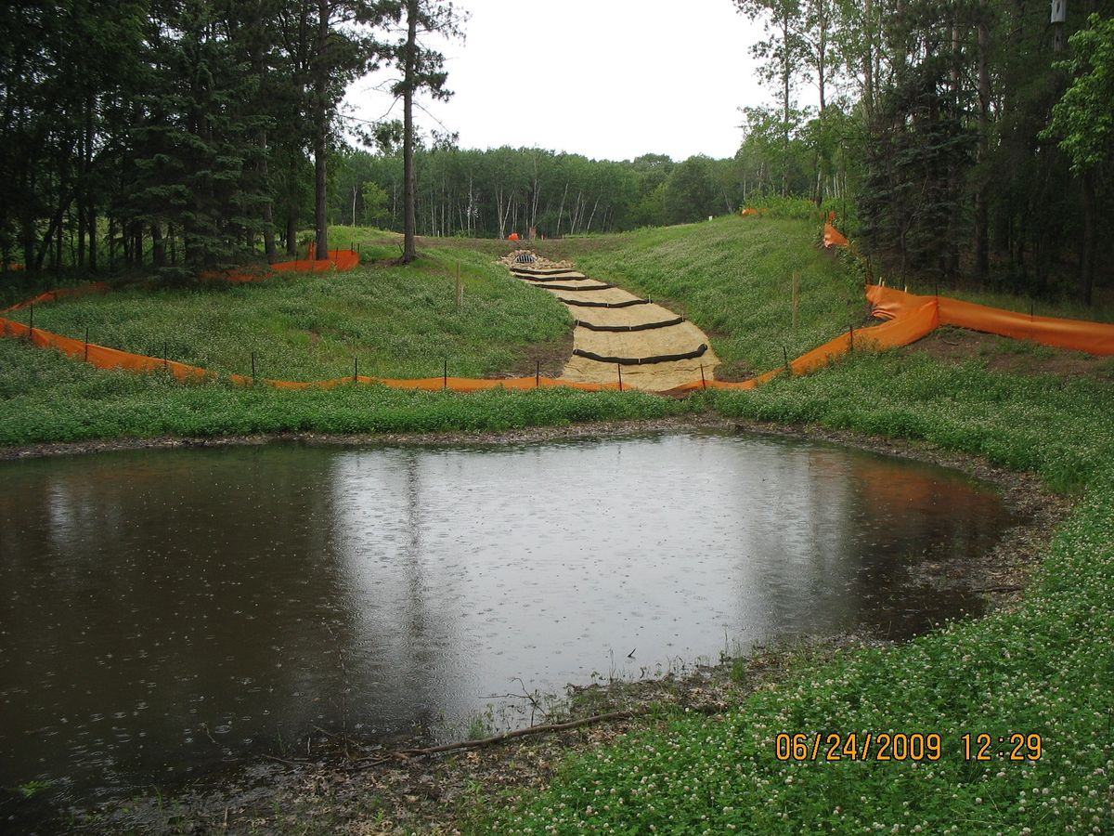
1. A little bit on stormwater runoff

Slide 4
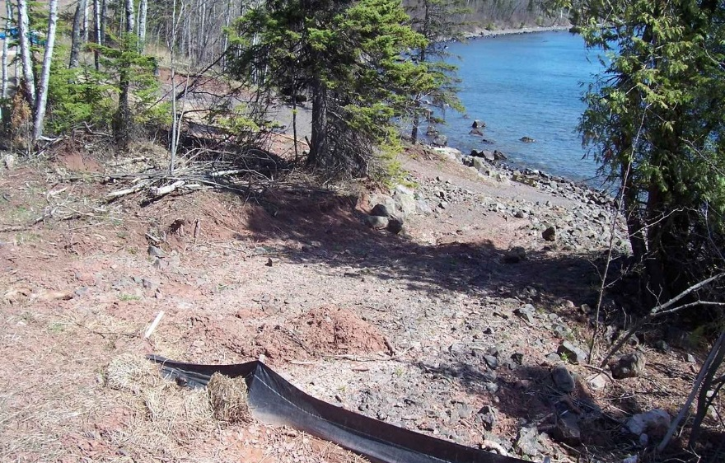
Stormwater Runoff 101
Stormwater runoff is the portion of stormwater that runs off to surface water (lake, river, wetland)
This presentation focuses on urban stormwater runoff, but many of the principles can be applied to agriculture or other settings

Slide 5
The problem with stormwater runoff
Pollutants in stormwater include sediment, phosphorus, nitrogen, bacteria, organics, metals, and others
The numbers for urban look small, but on a load per area basis they are large
Source: EPA (2005)

Slide 6
Phosphorus concentrations greater than 40 to 60 ppb typically are problematic for lakes. Typical phosphorus concentrations in runoff are
Less than this concentration
About this concentration
5 times this concentration
10 times this concentration

Slide 7
Source: Lin (2004)

Slide 8
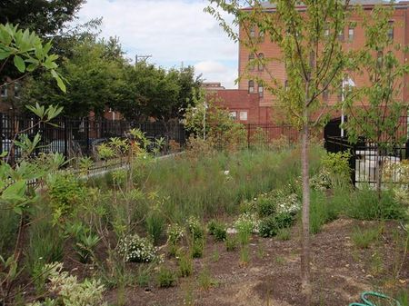
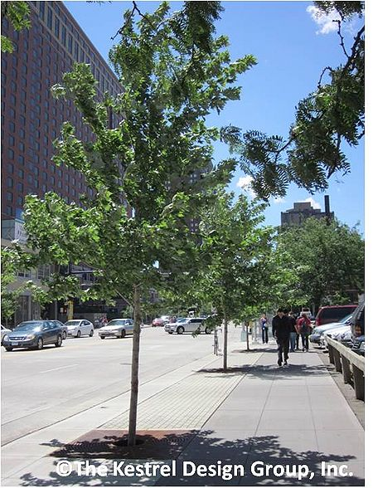
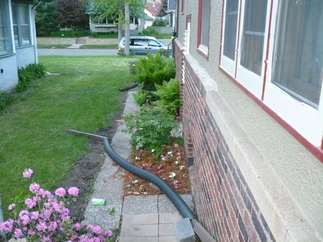
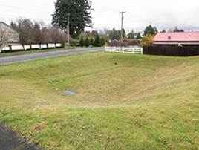
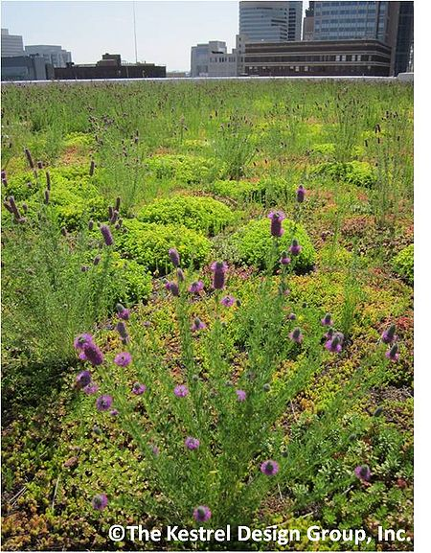
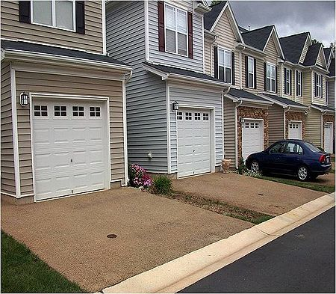
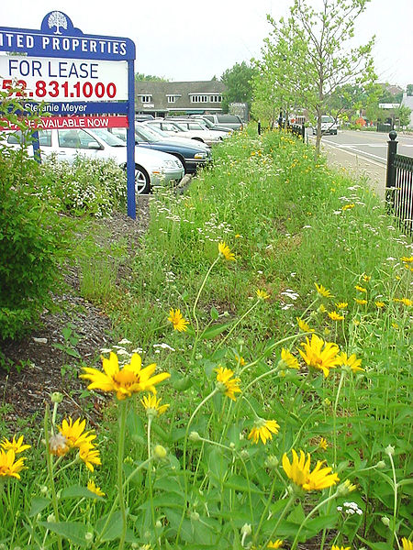
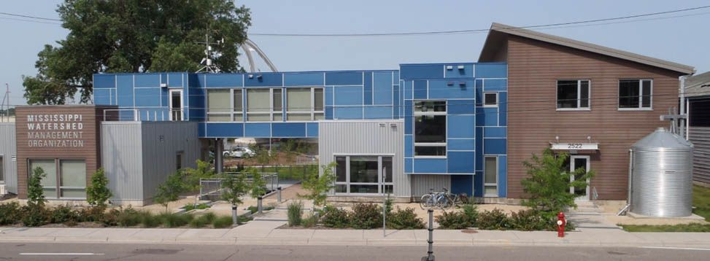
So we build stormwater best management practices (BMPs) to reduce pollution from stormwater runoff
Bioretention
Disconnection
Infiltration basin
Vegetated swale
Tree trench
Green roof
Permeable pavement
Harvest and reuse

Slide 9
2. Overview of the Minnesota Stormwater Manual

Slide 10
What is the Manual?
A resource that provides guidance and tools to help better manage stormwater

Slide 11
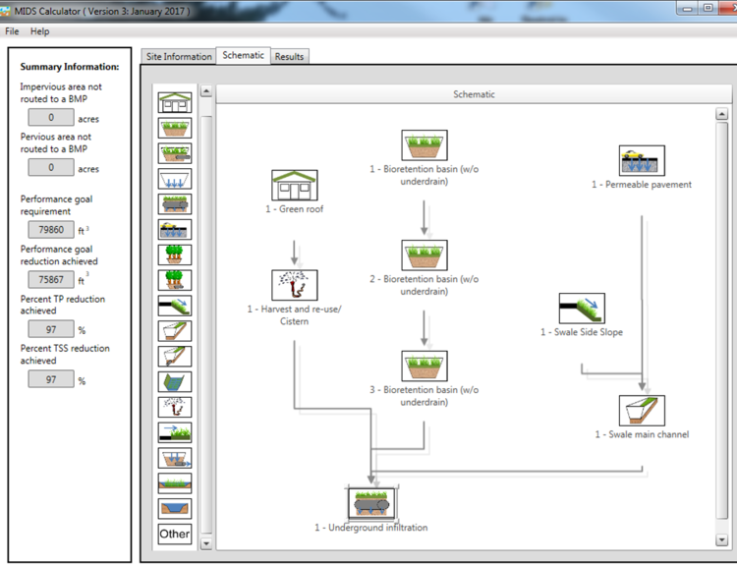
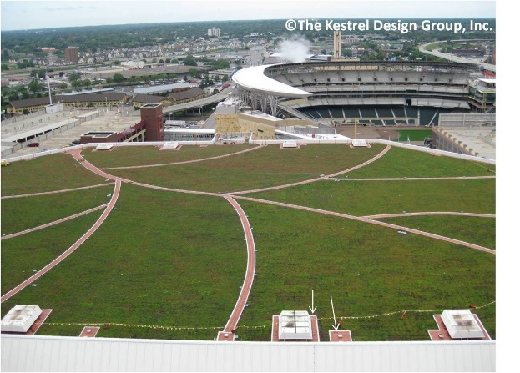
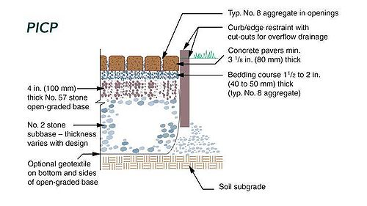
What is in the Manual?
Guidance on BMP selection
Guidance on BMP implementation
Calculation of pollutant loading
Access to tools
Links and case studies

Slide 12
Who uses the manual?
What’s missing?
About
11 million hits to date

Slide 13
3. History of the manual

Slide 14
1st edition in 2005 by Stormwater Steering Committee
“a guidance document that could be used as a single source to guide stormwater managers through the maze of regulations, Best Management Practices (BMPs) designs, models/techniques and terminology that constitute good stormwater management”
Minor updates in 2008
Converted to wiki format in 2011
Funding since 2011 to update the content
Dedicated staff person for Manual upkeep

Slide 15
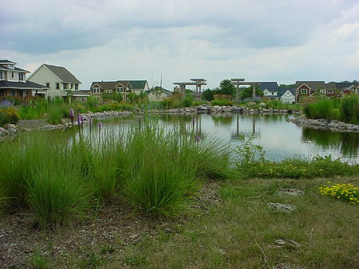
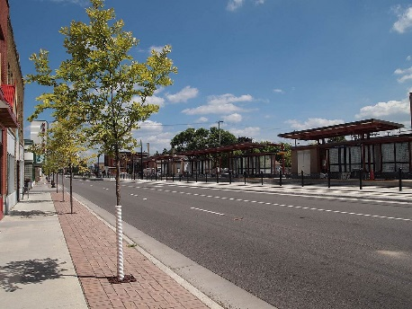
A stormwater timeline
Image courtesy of the Capitol Region Watershed District
1980
1990
2000
2010
2020
Green Infrastructure/Sustainable stormwater management
Pipes and ponds
Low Impact Development
Better Site Design

Slide 16
4. Green Infrastructure and sustainable stormwater management

Slide 17
What is sustainable stormwater management?
Managing stormwater in a manner that limits impacts to natural functions of landscapes, hydrologic systems, and habitats (Porter, 2007; Managing Growth in America’s Communities)
Reuse/replace treated water
Flood control
Habitat/biodiversity
Climate mitigation/adaptation
Pollutant reduction
Ecosystem services (e.g. pollination)
Restore hydrology/recharge groundwater
Social, economic and other environmental benefits

Slide 18
Green Infrastructure is the approach used to achieve sustainable stormwater management
Use of stormwater infiltration practices
Harvesting and using stormwater runoff
Disconnecting hard surfaces
Using vegetation
Landscaping
Education
Stormwater Park; Mississippi Watershed Management Organization

Slide 19
Which of these stormwater practices is generally not considered to be a green infrastructure practice?
Sand filter
Green roof
Constructed wetland
Permeable pavement

Slide 20
Green Infrastructure stormwater - Best Management Practices (BMPs)
Bioretention
Disconnection
Infiltration basin
Vegetated swale
Tree trench
Green roof
Permeable pavement
Harvest and reuse

Slide 21
5. How the manual is evolving to incorporate sustainable stormwater management

Slide 22
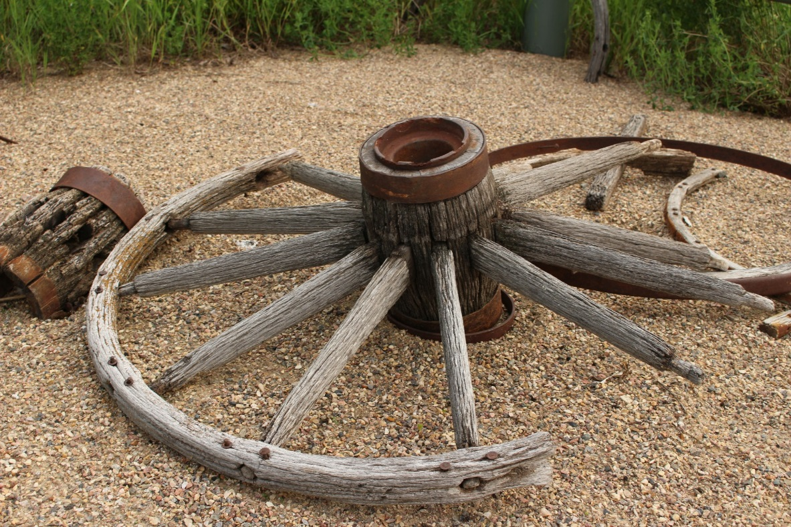
Ways for the Manual to connect to sustainability
Information on the role of stormwater management in green infrastructure and sustainability
Technical guidance and specifications
Tools
Case studies
Links
Communication and outreach

Slide 23
Information on the role of stormwater management in green infrastructure and sustainability
https://stormwater.pca.state.mn.us/index.php?title=Green_Infrastructure_for_stormwater_management

Slide 24
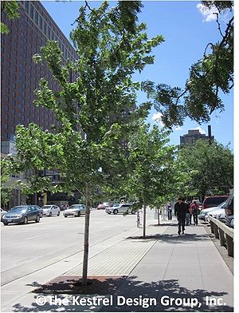
What is the recommended soil volume for a tree?
Just make sure it has enough water and nutrients
500 to 1000 cubic feet
1500 to 2500 cubic feet
1 to 3 cubic feet per square foot of canopy

Slide 25
Technical guidance and specifications

Slide 26
Tools

Slide 27
Case studies

Slide 28
Links

Slide 29
Outreach and communication

Slide 30
Touring the MN Stormwater Manual

Slide 32
Questions? Mike Trojan mike.trojan@state.mn.us Link to Manual – easiest to get there by doing a search on Minnesota Stormwater Manual https://stormwater.pca.state.mn.us/index.php?title=Main_Page

