Slide 1
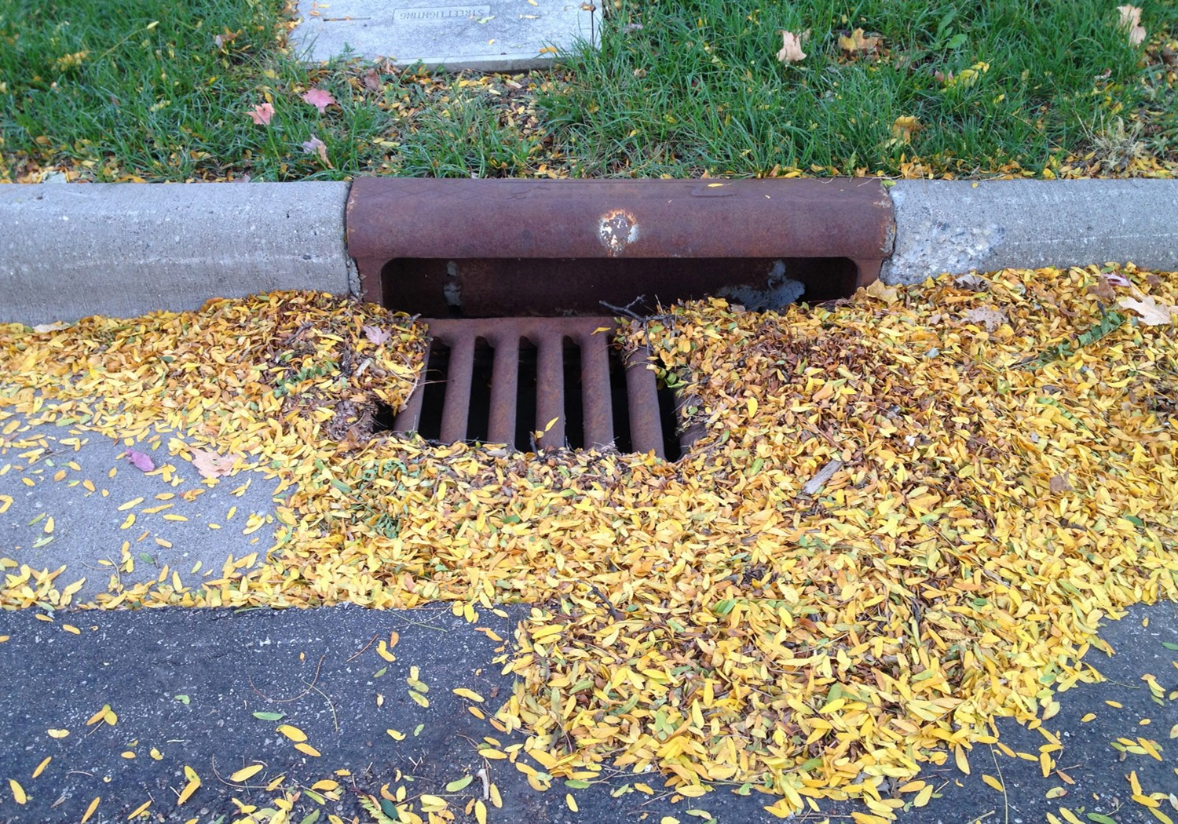
Street Sweeping
Phosphorus Credit Calculator
Image Credit: City of St. Cloud
Tool Overview
The calculator is easy to use! Download the tool, read the User Guide, and follow these steps:
Step 1: Go to the Read Me tab and familiarize yourself with the inputs and outputs of the calculator. There are three options for data entry:
1. Dry mass 2. Wet mass 3. Curb miles swept
Step 2: Go to the Calculator tab to enter your data:
Name your project or watershed
Choose your input data type (1, 2, or 3 above)
Enter additional data where available/required (season, organic matter, and/or moisture)
Step 3: On the Tracking tab, record your inputs and outputs for your records
Step 4: The Calculator automatically tabulates the Total Phosphorus in pounds removed by your street sweeping efforts
Municipalities in Minnesota can use the Street Sweeping Phosphorus Credit Calculator to determine credits for phosphorus removal! Nearly 70% of Minnesota cities surveyed are already conducting some street sweeping activities. Why not optimize your efforts, claim reductions for your MS4, and quantify water quality benefits? The Calculator requires minimal data inputs to calculate load reductions.
Download the Tool
Go to Street Sweeping Phosphorus Credit Calculator: User Guide - Minnesota Stormwater Manual to download the Credit Calculator
The Minnesota Stormwater Manual Wiki includes a wealth of helpful resources including a User Guide and supporting research and documentation.
Did you know?
University of Minnesota data show that tree litterfall can contribute 37% - 64% of the total phosphorus in stormwater runoff. Cleaning up leaf litter year-round can reduce phosphorus and other contaminants reaching waterways!
Image Credit: Dr. Sarah Hobbie

