Slide 1
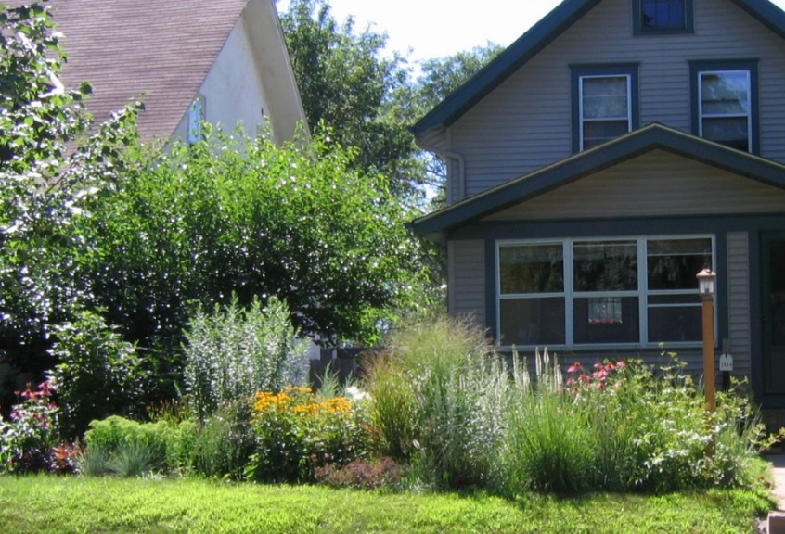
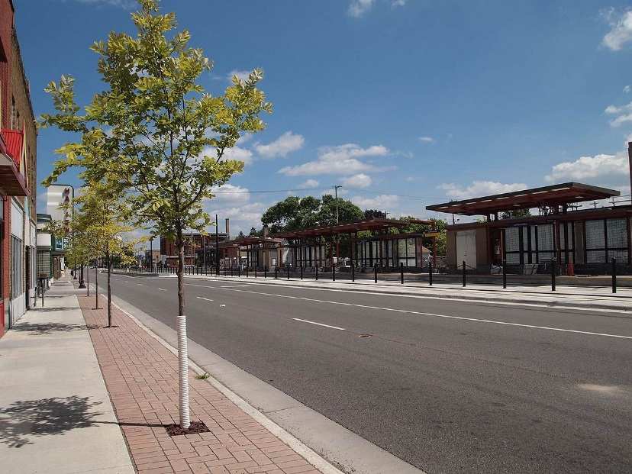
Minnesota’s Stormwater Manual – Connecting Stormwater Management to the Landscape
Mike Trojan
Minnesota Pollution Control Agency
Northern Green Expo
January 3, 2018

Slide 2
Topics covered
A little bit on stormwater
Stormwater management timeline
Green Infrastructure and sustainable stormwater management
Overview of the Minnesota Stormwater Manual
How the manual is evolving to incorporate sustainable stormwater management
Quizzes

Slide 3
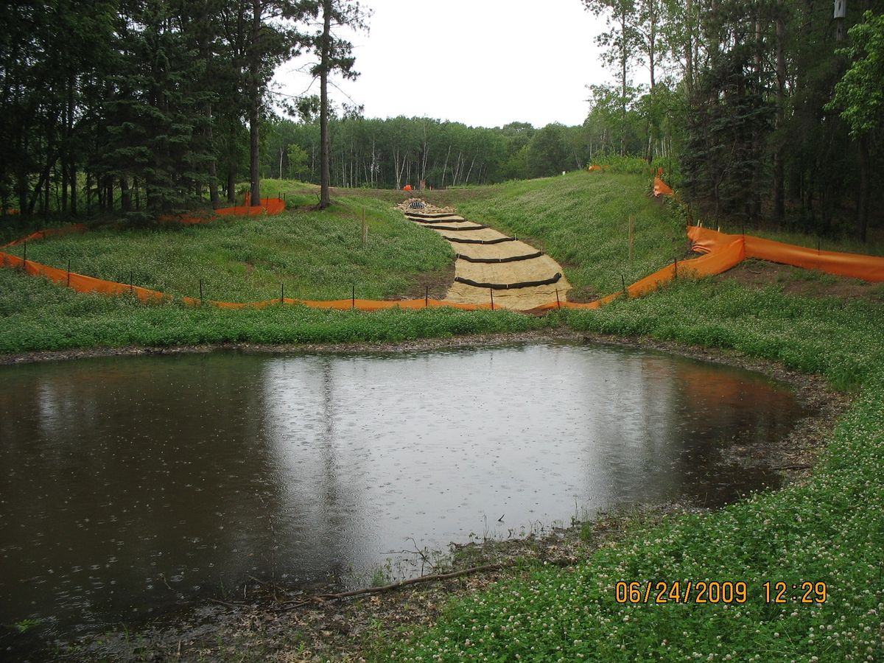
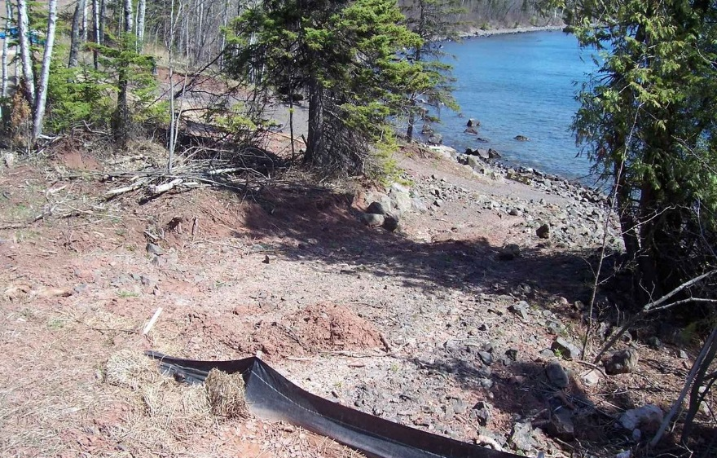
A little bit on stormwater
Stormwater runoff is the portion of stormwater that runs off to surface water (lake, river, wetland)
This presentation focuses on urban stormwater runoff, but many of the principles can be applied to agriculture or other settings

Slide 4
The problem with stormwater runoff
Pollutants in stormwater include sediment, phosphorus, nitrogen, bacteria, organics, metals, and others
The numbers for urban look small, but on a load per area basis they are large
Source: EPA (2005)

Slide 5
Phosphorus concentrations greater than 40 to 60 ppb typically are problematic for lakes. Typical phosphorus concentrations in urban stormwater runoff are
Less than this concentration
About this concentration
5 times this concentration
10 times this concentration
Quiz 1

Slide 6
Source: Lin (2004)

Slide 7
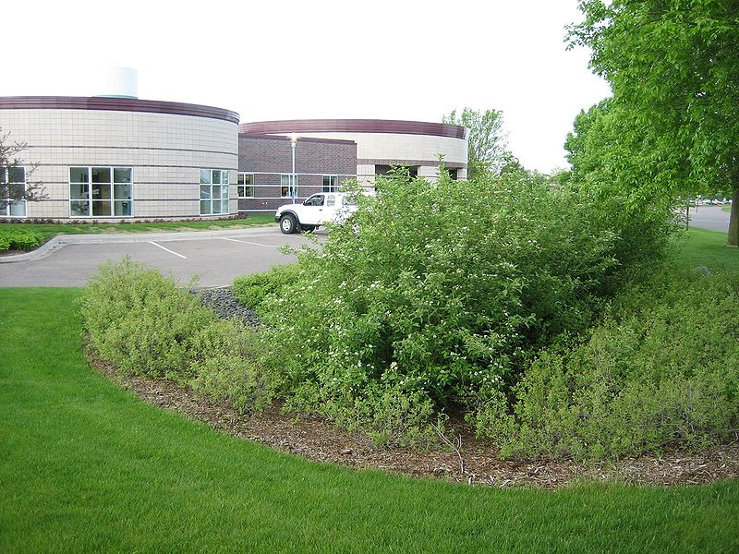
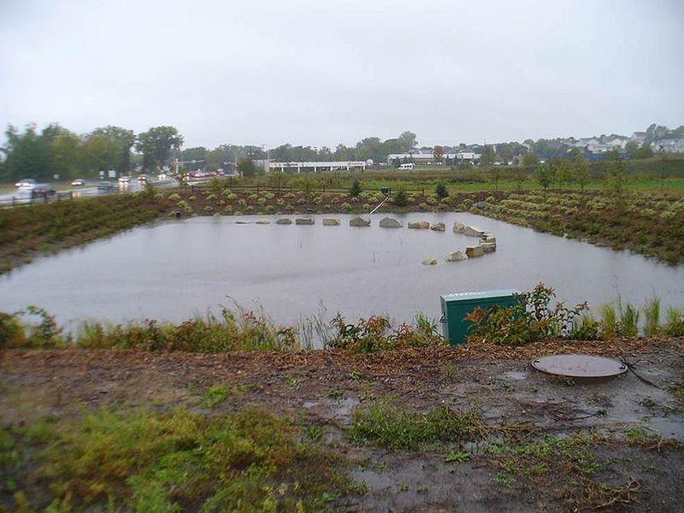
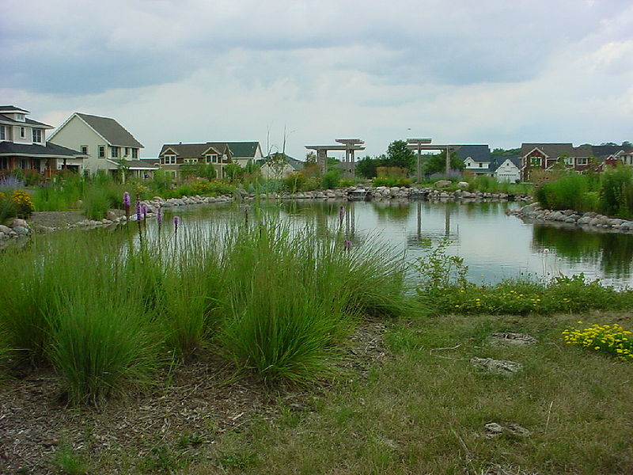
So we build stormwater best management practices (BMPs) to reduce pollution from stormwater runoff
Photo courtesy of Barr Engineering

Slide 8
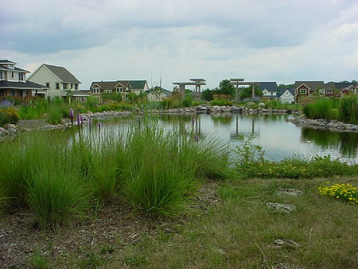
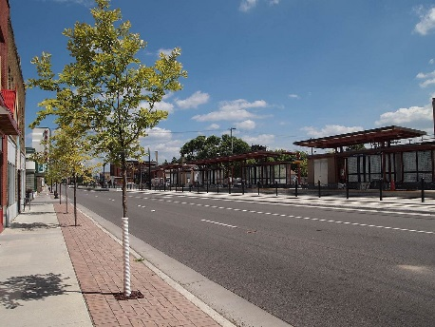
A stormwater timeline
Image courtesy of the Capitol Region Watershed District
1980
1990
2000
2010
2020
Green Infrastructure/Sustainable stormwater management
Pipes and ponds
Low Impact Development
Better Site Design

Slide 9
What is sustainable stormwater management?
Managing stormwater in a manner that limits impacts to natural functions of landscapes, hydrologic systems, and habitats (Porter, 2007; Managing Growth in America’s Communities)
Reuse/replace treated water
Flood control
Habitat/biodiversity
Climate mitigation/adaptation
Pollutant reduction
Ecosystem services (e.g. pollination)
Restore hydrology/recharge groundwater
Social, economic and other environmental benefits

Slide 10
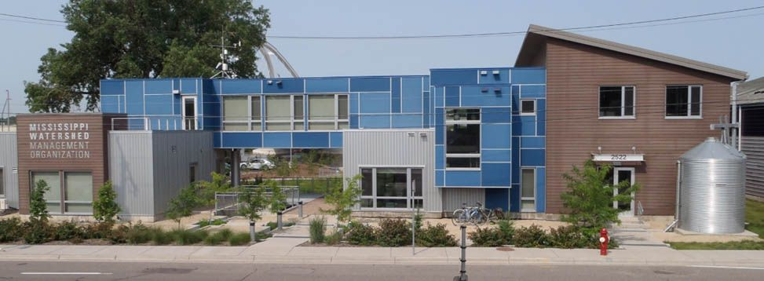
Green Infrastructure is the approach used to achieve sustainable stormwater management
Use of stormwater infiltration practices
Harvesting and using stormwater runoff
Disconnecting hard surfaces
Using vegetation
Landscaping
Education
Stormwater Park; Mississippi Watershed Management Organization

Slide 11
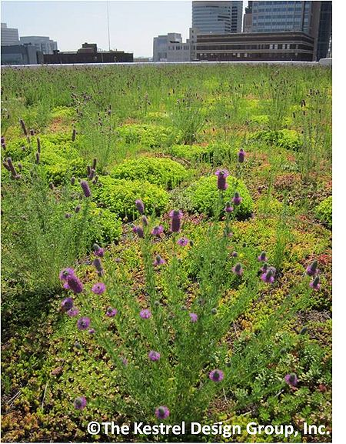
Which of these stormwater practices is generally not considered to be a green infrastructure practice?
Sand filter
Green roof
Constructed wetland
Permeable pavement
Quiz 2

Slide 12
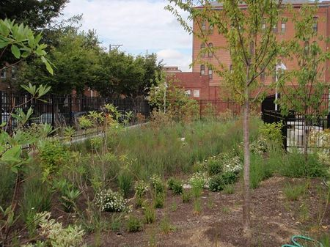
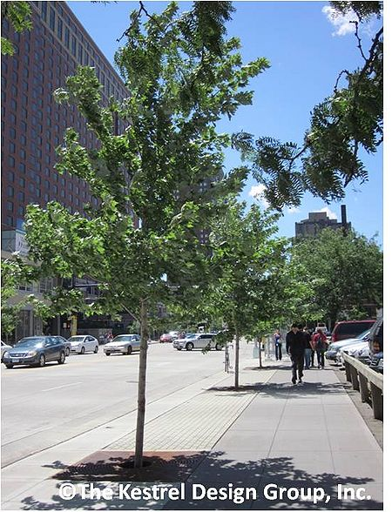
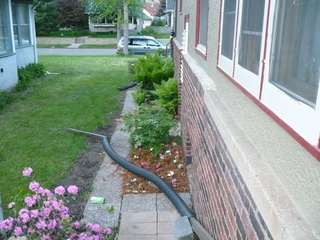
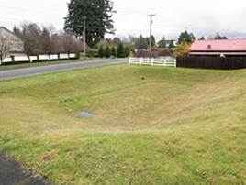
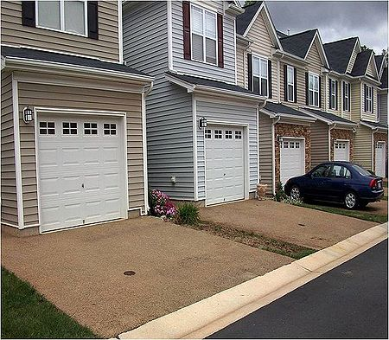
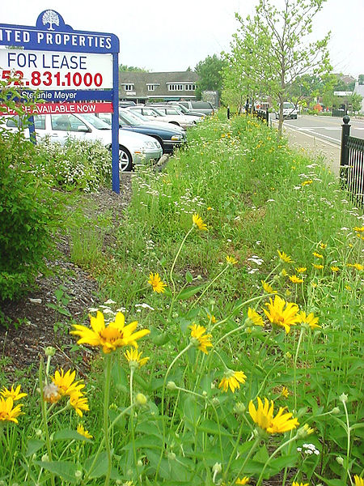
Green Infrastructure stormwater - Best Management Practices (BMPs)
Bioretention
Disconnection
Infiltration basin
Vegetated swale
Tree trench
Green roof
Permeable pavement
Harvest and reuse

Slide 13
What is the Minnesota Stormwater Manual?
A resource that provides guidance and tools to help better manage stormwater

Slide 14
Who uses the manual?
What’s missing?
About
11 million hits to date

Slide 15
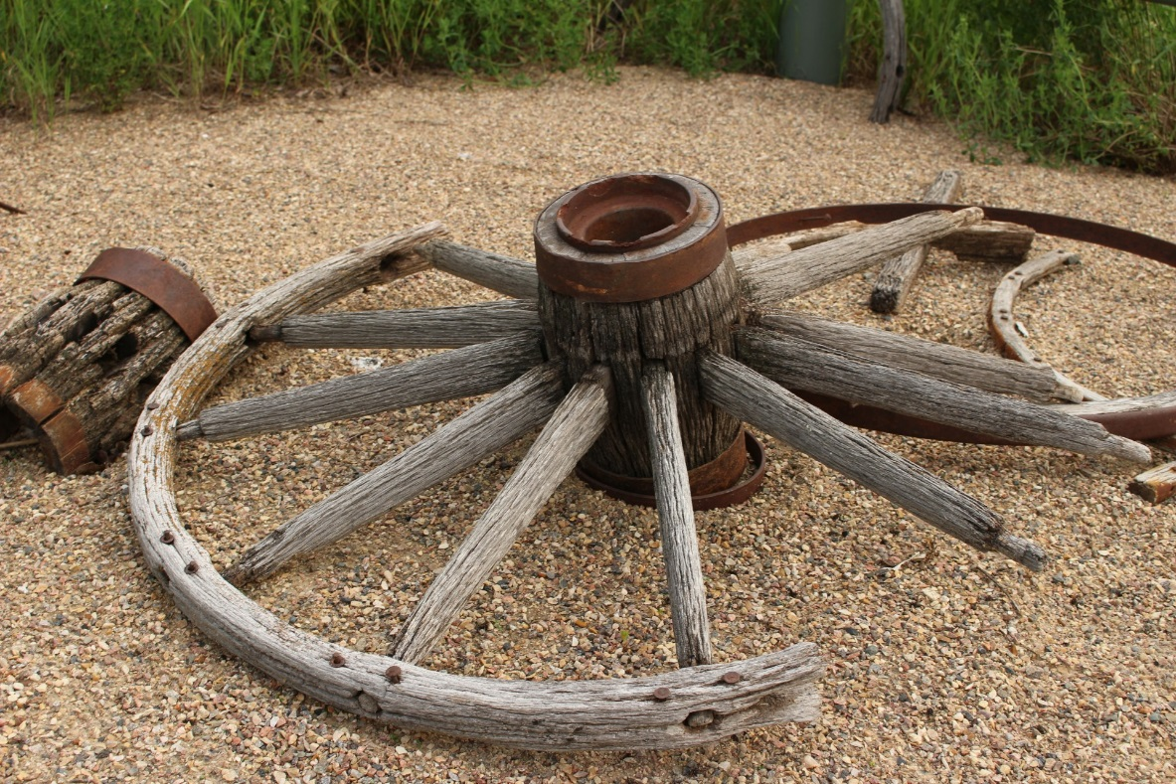
What the manual is not
Not a Green Infrastructure (GI) manual
Not the definitive source of information on GI
A cookbook that you can use at every site

Slide 16
What the manual is
Still a definitive source for how to build stormwater practices properly
A source of information on a variety of topics for stormwater practitioners
A warehouse of links, references, videos, tools, case studies
Image courtesy of Zurich U.S.

Slide 17
Let’s take a look inside the manual

Slide 18
How do I navigate the manual?
Search box
Page contents
Toolbar
Table of contents organized around broad topics
Links

Slide 19
Think of the manual as 1500+ webpages that are linked

Slide 29
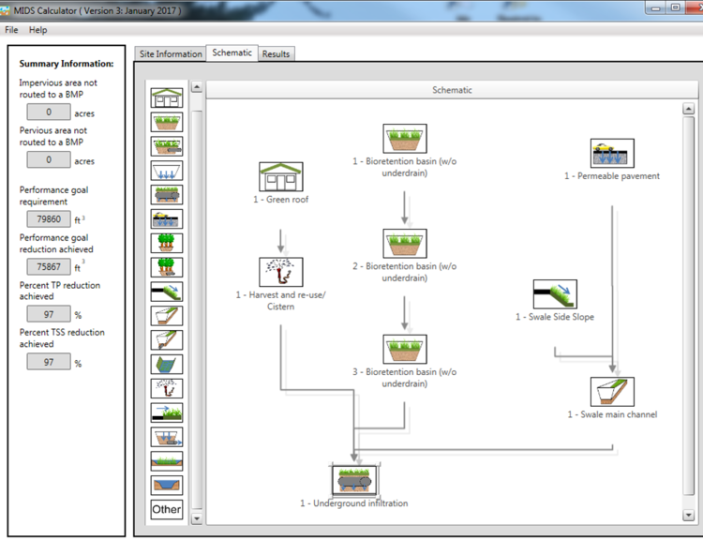
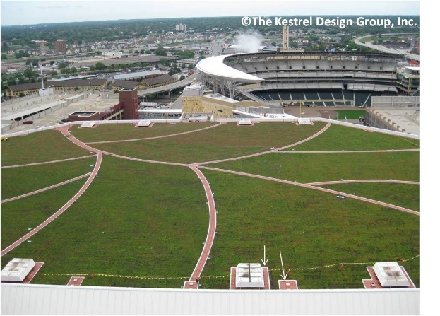
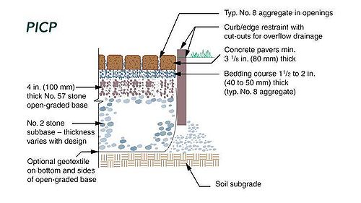
What is in the Manual?
Guidance on BMP selection
Guidance on BMP implementation
Calculation of pollutant loading
Access to tools
Links and case studies
Guidance complying with regulatory requirements

Slide 31
A look at the manual

Slide 38
True or False: Bioretention (rain gardens) is an excellent BMP for climate resiliency
False: Moore and Hunt (2013), in evaluating the effect of several BMP types on climate resiliency, state "Despite accounting for sequestration by vegetation in these systems, only stormwater wetlands and grassed swales were predicted to store more carbon than what was released through construction and maintenance".

Slide 42
Which of these bioretention (rain garden) design considerations improve habitat?
Utilize native, perennial vegetation
Incorporate trees and shrubs if possible
Maximize length to area ratio of BMP
Evaluate compatibility with nearby habitats
Promote soil/media development, including formation of a leaf/plant litter

Slide 45
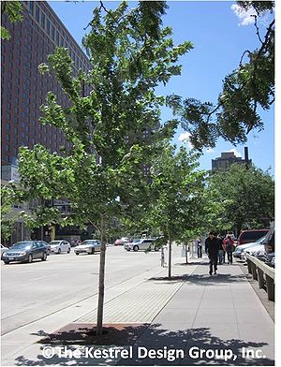
What is the recommended soil volume for a tree?
Just make sure it has enough water and nutrients
500 to 1000 cubic feet
1500 to 2500 cubic feet
1 to 3 cubic feet per square foot of canopy

Slide 47
Things to add
Permeable pavement
Harvest reuse
Golf courses
MS4 permit encourages GI
Organizations (Master Water Stewards, Blue Thumb, Metro Blooms, Watershed organizations)
Legacy funding (funding page in manual)
Show examples

Slide 48
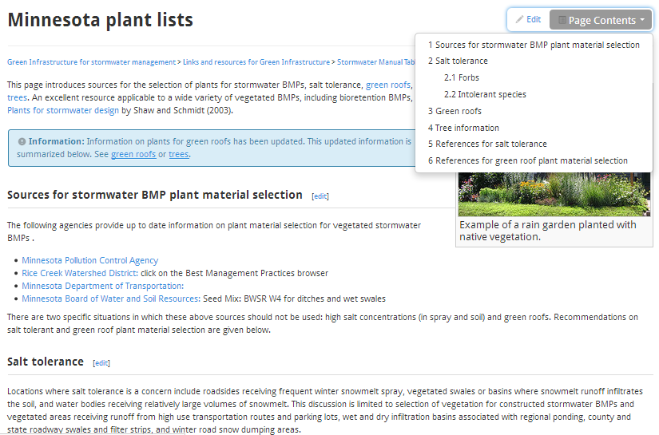
Plants …

Slide 49
… for green roofs

Slide 50
… for tree trenches/boxes

Slide 51
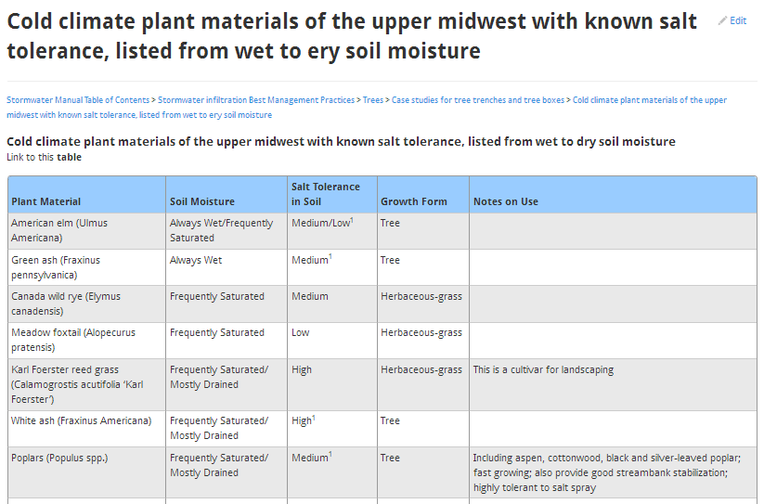
… for salt tolerance
Source: Wikipedia

Slide 52
Improved turf and alleviation of compaction

Slide 53
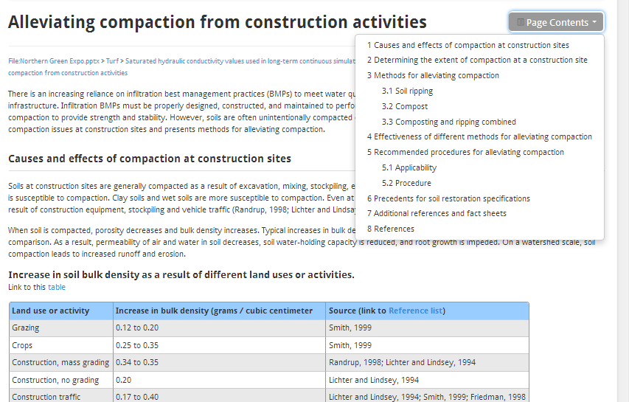

Slide 54
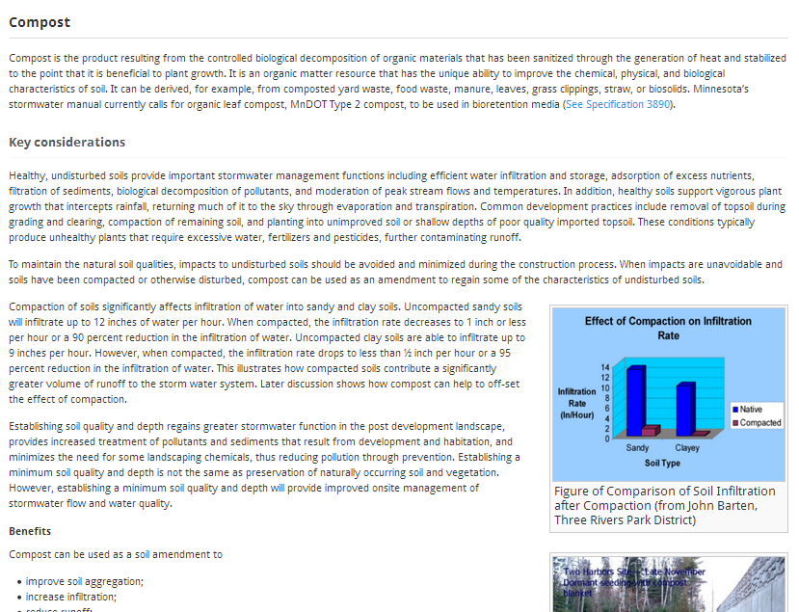

Slide 55
Which of these is not a compost specification?
pH between 5.5 and 8.5
Moisture content between 30 and 60% (mass basis)
Organic matter content between 30 and 65% (dry wt basis)
Particles must pass through 1 inch screen or less

Slide 56
Material specifications – filter media
Composition specs for several mixes
Performance specs
Design and construction information
Designing for phosphorus control

Slide 57
A rain garden w/ an underdrain having a media mix with high organic matter content is
Inadequate drainage
pH is too low for plant growth
Excessive drainage
Leaching of phosphorus
Manual recommends Mixes C or D, testing the media for P, or adding iron to the practice

Slide 58
Questions? Mike Trojan mike.trojan@state.mn.us Link to Manual – easiest to get there by doing a search on Minnesota Stormwater Manual https://stormwater.pca.state.mn.us/index.php?title=Main_Page

