Slide 1
Start recording

Slide 2
Updates to the Minnesota Stormwater Manual
Minnesota Pollution Control Agency
March 29, 2023

Slide 3
Couple housekeeping items
PLEASE MUTE
Q&A after each section of this presentation
Put questions in chat
CEU info provided at the end of the presentation
Being recorded

Slide 4
Outline
Update on Stormwater Manual coordinator
Reorganizing the Manual
How do I find stuff
Making information more accessible
Some quick updates
Discussion/Q&A after each section

Slide 5
1. Update on the Minnesota Stormwater Manual Coordinator

Slide 6
2. Reorganizing the Stormwater Manual
Too much information becoming overlapping, conflicting, disorganized
Consolidate information
Delete extraneous and outdated information
Organize the remaining information
Hard to find what I want

Slide 7
We went through every page in the manual
Deleted 528 pages
Categorized the remaining pages
Updated links on every page
A work in progress, but we’re getting there

Slide 8
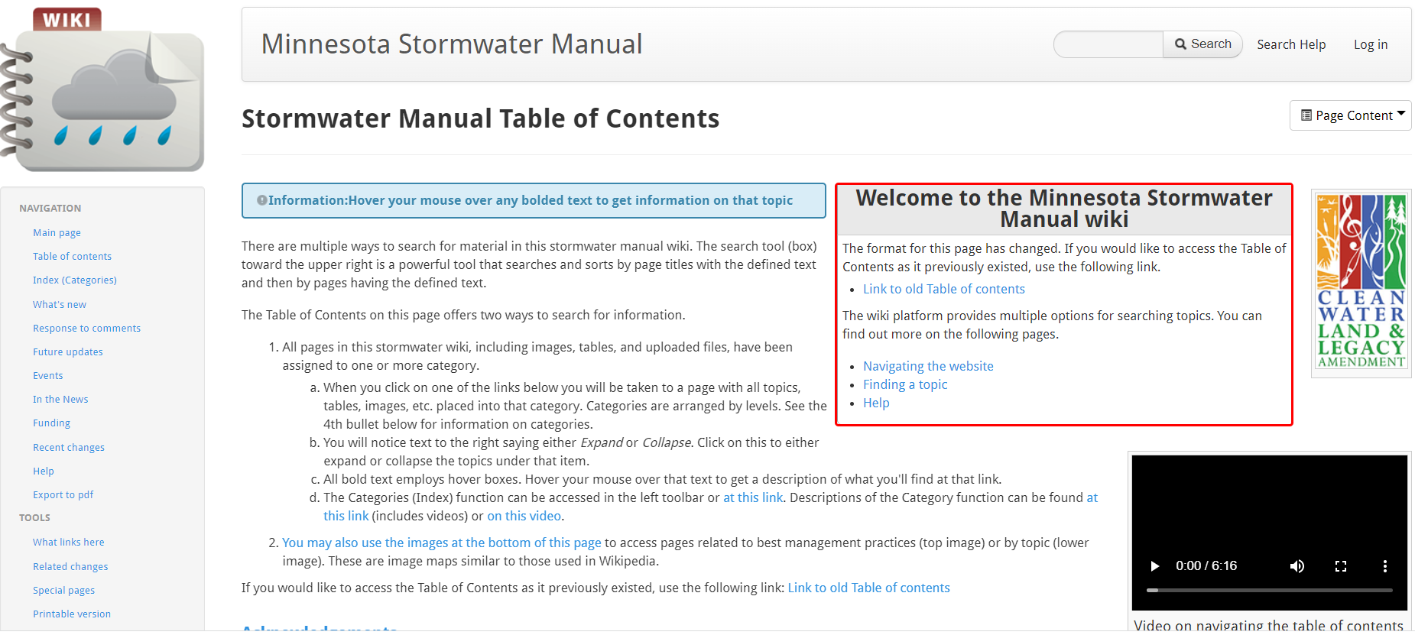
Using the Categories function in Mediawiki

Slide 9
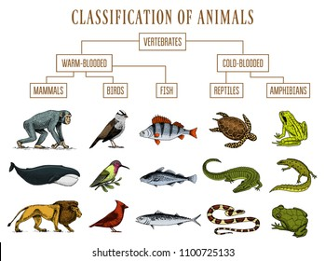
What is a Category
A “bucket” into which related items are placed

Slide 10
Subcategories
Level 1
Level 2
Level 3
Structural practices
Filters
Nonstructural practices
Screening and straining
Settling
Pretreatment practices
Best management practices
Separators
Construction practices
Specifications
Design
Guidance and information
Construction
Models and modeling
Operation and maintenance
Case studies and examples
Assessment

Slide 11
Level 1 categories
Acknowledgements
Best management practices
Case studies and examples
General information, reference, tables, images
Management
Models and modeling
Pollutants
Regulatory
Technical information

Slide 12
Category page
Content page(s)
Subcategory page(s)
Media page(s)

Slide 13
What is a content page?
Text
Tables

Slide 14
What is a media page?
Basically it is an attached file, though images appear on the page

Slide 15
A few category rules
A page can be in multiple categories
Preference to put a page in multiple relevant categories
A category level (e.g. Level 2) can contain subcategories at the same or a lower level, but not at a higher level

Slide 16
Questions/comments

Slide 17
3. How do I find stuff
Categories
Table of Contents
Search tool
Page search

Slide 18
Questions/comments

Slide 19
4. Making information more accessible
Many manual pages are long and contain considerable detail that is not of interest to practitioners
We must have the technical information to support guidance somewhere in the manual, but we should also make an effort to get this information in a more condensed, usable format

Slide 20
How to accomplish this?
Page summaries
Video summaries
Fact sheets
Outreach
Email
Newsletters
Webinars
Workshops/training

Slide 21
Questions/comments

Slide 22
5. Some quick updates
Pavement sweeping at construction sites
Volume-based crediting for street sweeping
MIDS Calculator – adjusting dissolved and particulate P ratios
Manufactured treatment devices annual volume calculator
Green infrastructure climate resiliency
Bioretention media - managing sediment
IESFs do’s, don’ts, and assessment
GSI certification and training information
Peat in engineered media

Slide 23
Questions/comments

