Slide 1
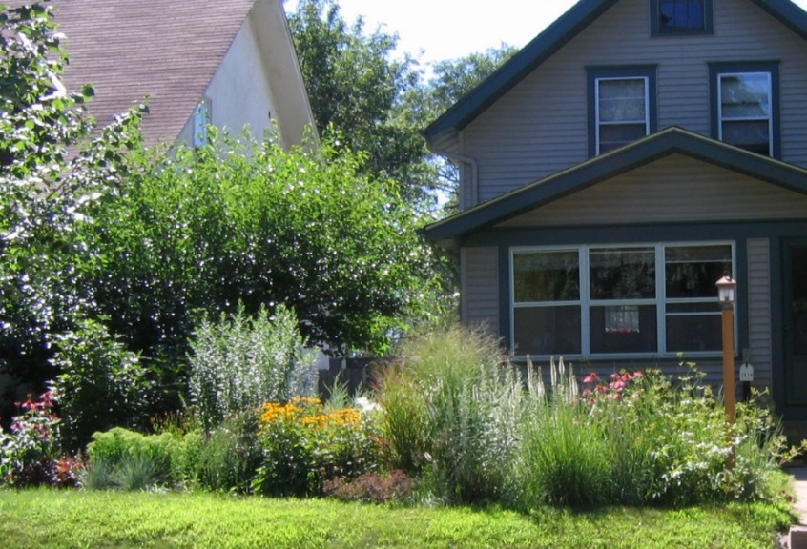
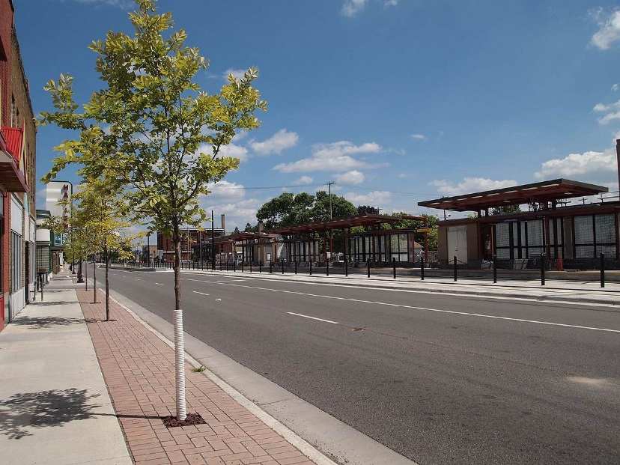
Minnesota’s Stormwater Manual – Connecting Stormwater Management to the Landscape
Mike Trojan
Minnesota Pollution Control Agency
Northern Green Expo
January 3, 2018

Slide 2
Topics covered
A little bit on stormwater
Stormwater management timeline
Green Infrastructure and sustainable stormwater management
The Minnesota Stormwater Manual
Wrap-up
Quizzes

Slide 3
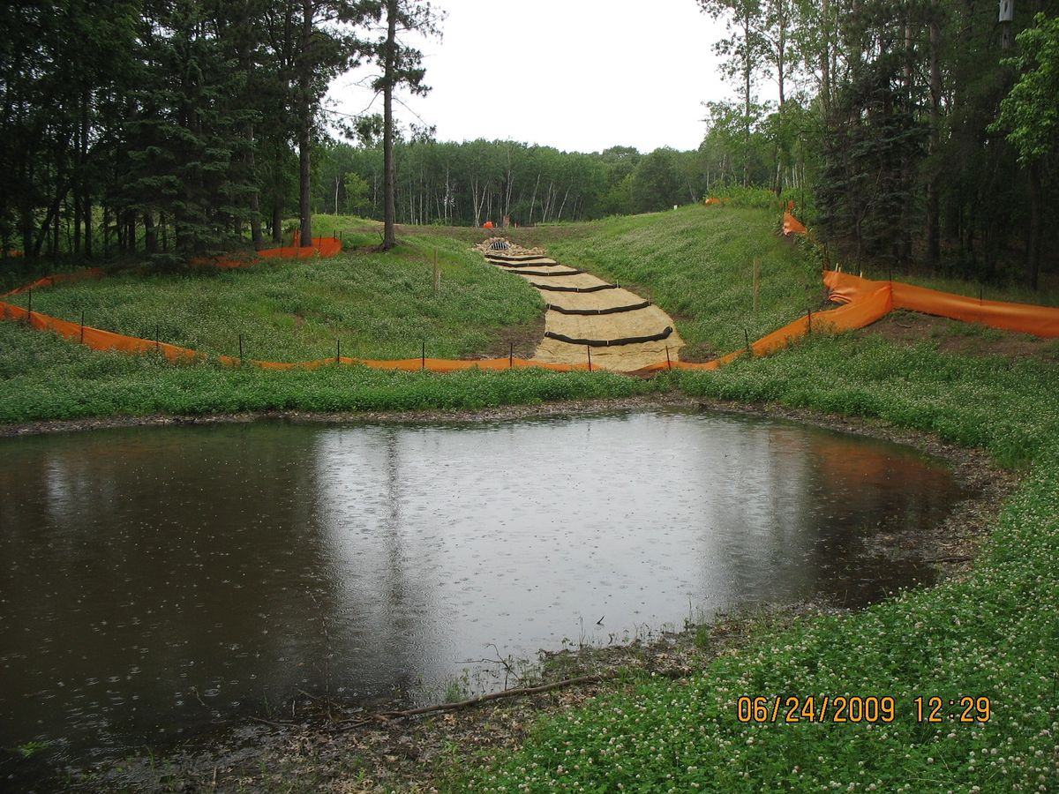
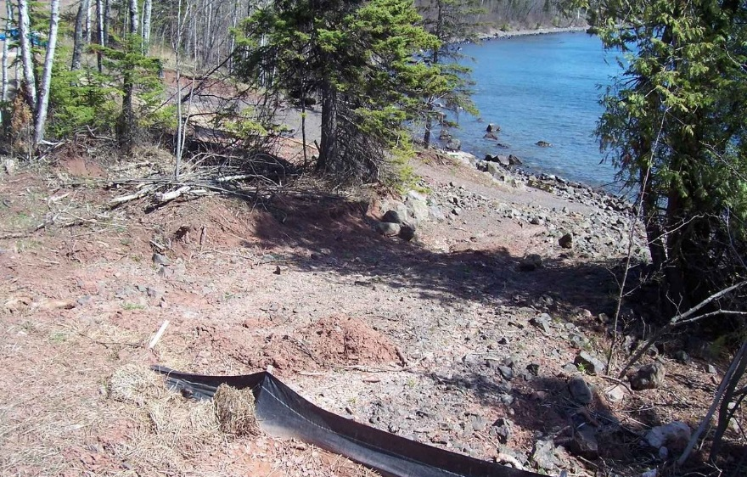
A little bit on stormwater
Stormwater runoff is the portion of rain or snowmelt that runs off to surface water (lake, river, wetland)
This presentation focuses on urban stormwater runoff, but many of the principles can be applied to agriculture or other settings

Slide 4
The problem with stormwater runoff
Pollutants in stormwater include sediment, phosphorus, nitrogen, bacteria, organics, metals, and others
The numbers for urban look small, but on a load per area basis they are large
Source: EPA (2005)

Slide 5
Phosphorus concentrations greater than about 40 to 60 ppb typically are problematic for lakes. Typical phosphorus concentrations in urban stormwater runoff are
Less than this concentration
About this concentration
5 times this concentration
10 times this concentration
Quiz 1

Slide 6
Source: Lin (2004)

Slide 7
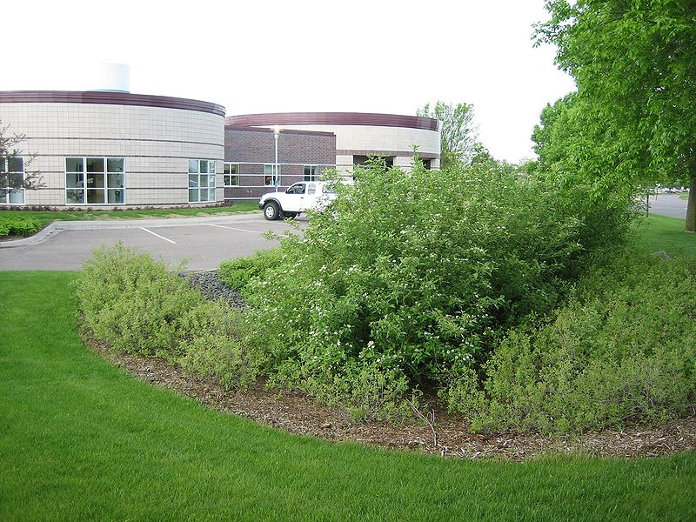
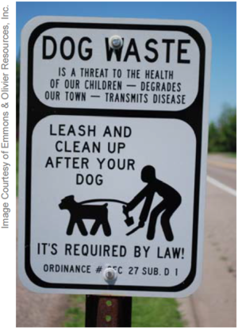
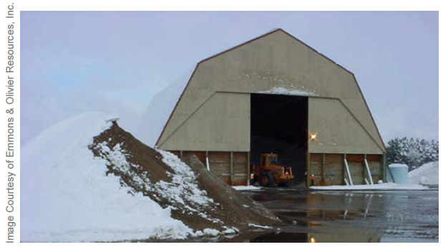
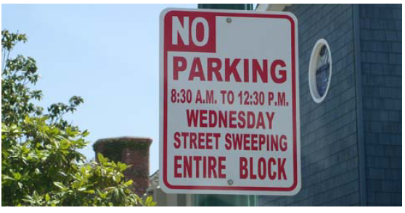
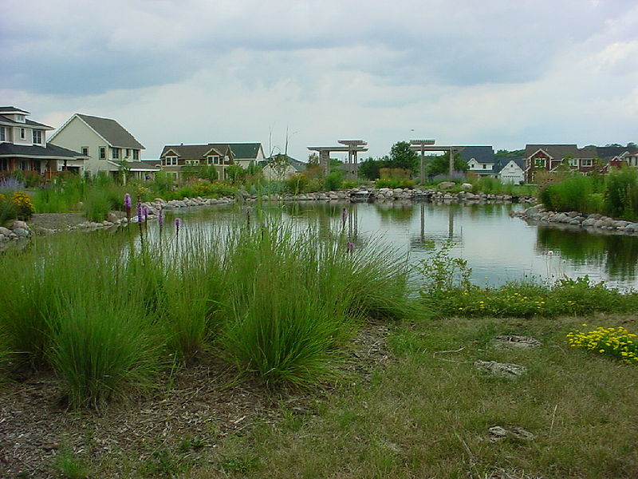
So we implement stormwater best management practices (BMPs) to reduce pollution from runoff

Slide 8
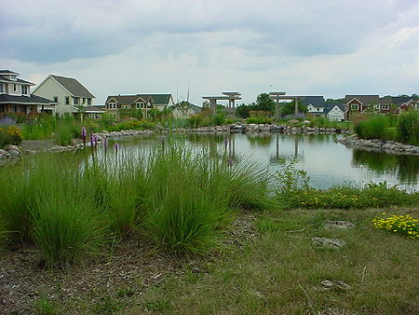
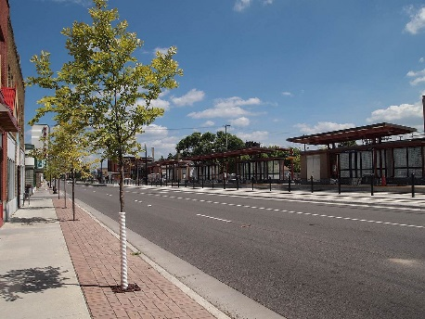
A stormwater timeline
Image courtesy of the Capitol Region Watershed District
1980
1990
2000
2010
2020
Green Infrastructure/Sustainable stormwater management
Pipes and ponds
Low Impact Development
Better Site Design
https://www.youtube.com/watch?v=rrY1ohMLXiM&feature=youtu.be&utm_medium=email&utm_source=govdelivery

Slide 9
Sustainable stormwater management connects stormwater to the landscape
Managing stormwater in a manner that limits or enhances impacts to natural functions of landscapes, hydrologic systems, and habitats (Porter, 2007; Managing Growth in America’s Communities)
Reuse/replace treated water
Flood control
Habitat/biodiversity
Climate mitigation/adaptation
Pollutant reduction
Ecosystem services (e.g. pollination)
Restore hydrology/recharge groundwater
Social, economic and other environmental benefits

Slide 10
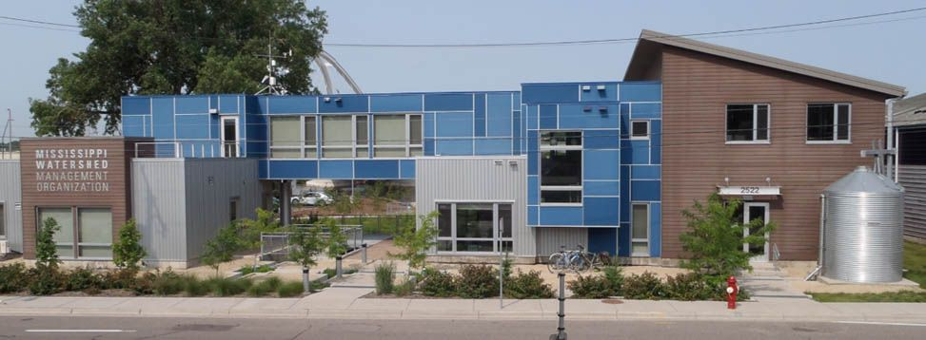
Green Infrastructure is the approach used to achieve sustainable stormwater management
Use of stormwater infiltration practices
Harvesting and using stormwater runoff
Disconnecting hard surfaces
Using vegetation
Landscaping
Education
Stormwater Park; Mississippi Watershed Management Organization

Slide 11
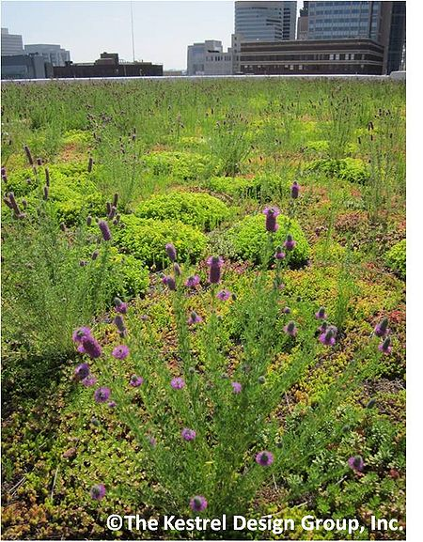
Which of these stormwater practices is generally not considered to be a green infrastructure practice?
Sand filter
Green roof
Constructed wetland
Permeable pavement
Quiz 2

Slide 12
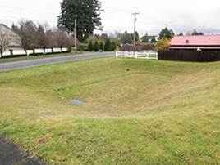
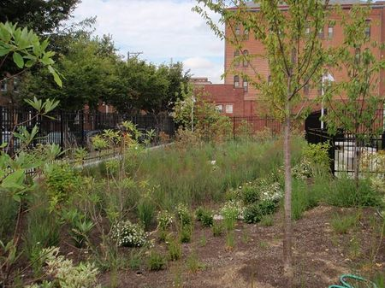
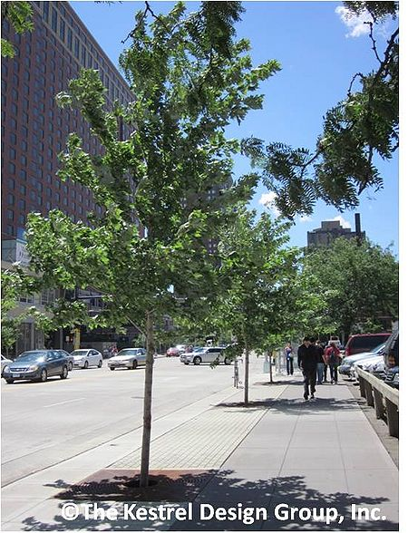
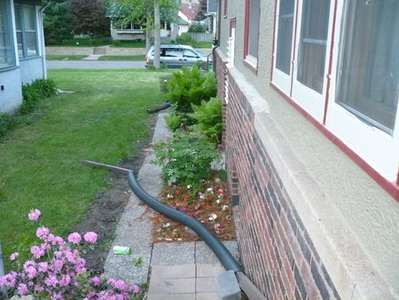
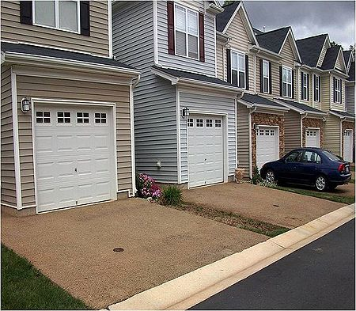
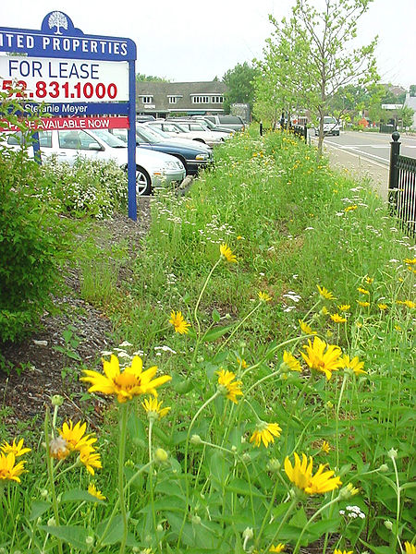
Green Infrastructure stormwater - Best Management Practices (BMPs)
Bioretention
Disconnection
Infiltration basin
Vegetated swale
Tree trench
Green roof
Permeable pavement
Harvest and reuse

Slide 13
What is the Minnesota Stormwater Manual?
A resource that provides guidance and tools to help better manage stormwater

Slide 14
Who uses the manual?
What’s missing?
About
11 million hits to date

Slide 15
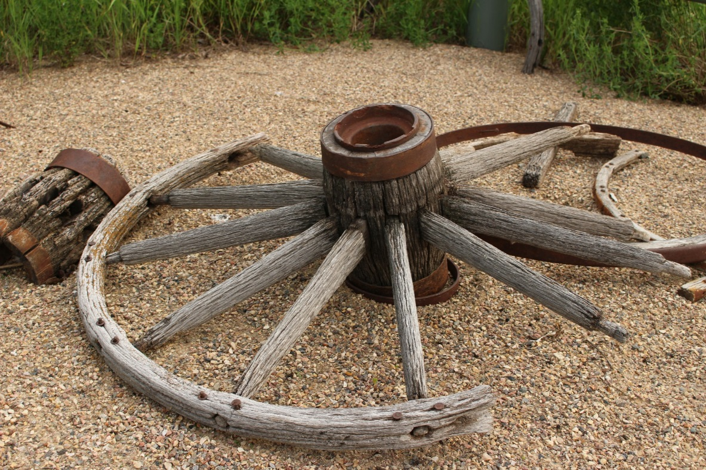
What the manual is not
Not a Green Infrastructure (GI) or landscape manual
Not the definitive source of information on GI or landscape design
A cookbook that applies the same way at every site

Slide 16
What the manual is
A definitive source for how to build and maintain stormwater practices
A source of information on a variety of topics for stormwater practitioners
A warehouse of links, references, videos, tools, case studies
Image courtesy of Zurich U.S.

Slide 17
Let’s take a look inside the manual

Slide 18
How do I navigate the manual?
Search box
Page contents
Toolbar
Table of contents organized around broad topics
Links

Slide 19
Think of the manual as 1500+ linked webpages
(similar to Wikipedia)

Slide 22
Building, maintaining, and assessing stormwater practices

Slide 23
True or false: tree trenches/boxes, bioswales, and rain gardens are all examples of bioretention practices
True
False
Quiz 3

Slide 24
Example: Design for bioretention

Slide 25
Example: Construction specs for permeable pavement

Slide 26
Example: Harvest and reuse O&M

Slide 27
Example: maintenance checklist for green roofs

Slide 28
Example: O&M guidelines for trees

Slide 29
Example: Maintenance agreement for rain garden

Slide 30
Example: Assessing tree trench/box performance

Slide 31
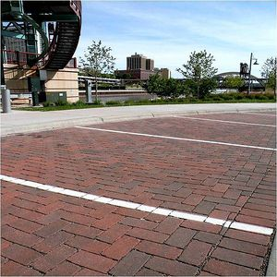
The recommended ratio of area contributing runoff to permeable pavement area is
1:1
2:1
7:1
It doesn’t matter
Area contributing runoff
Permeable pavement
A typical vacuum cleaning schedule may include the end of winter (April) and after autumn leaf-fall (November)
Quiz 4

Slide 32
A source of information on a variety of topics

Slide 33
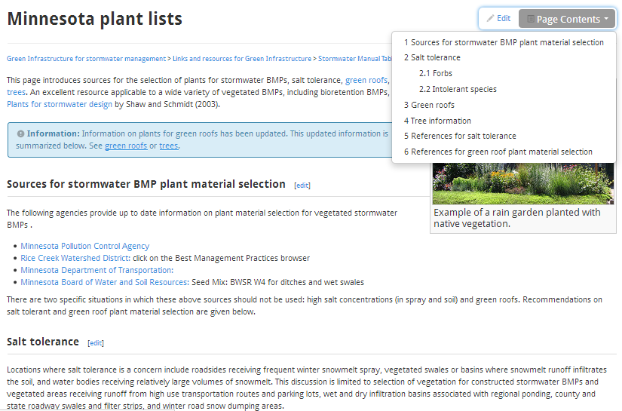
Plants …

Slide 34
… for green roofs

Slide 35
… for tree trenches/boxes

Slide 36
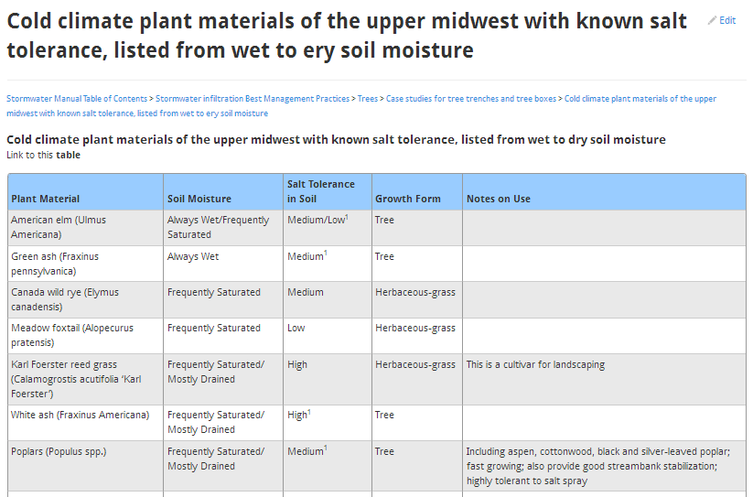
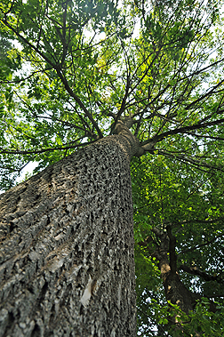
… for salt tolerance
Source: Virginia Tech University

Slide 37
Improved turf and alleviation of compaction

Slide 38
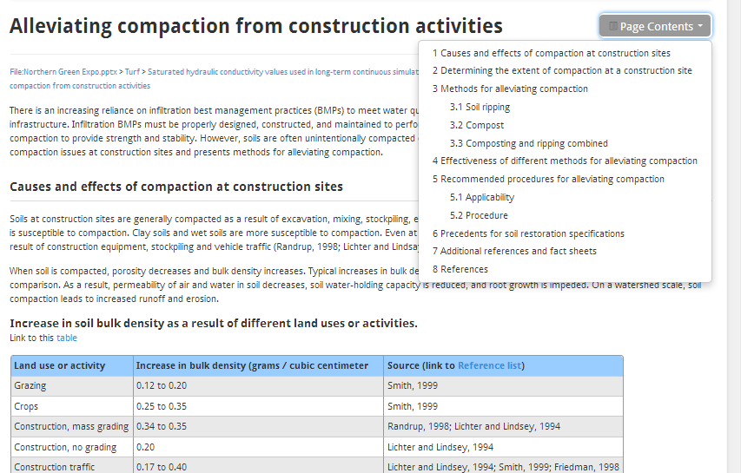

Slide 39
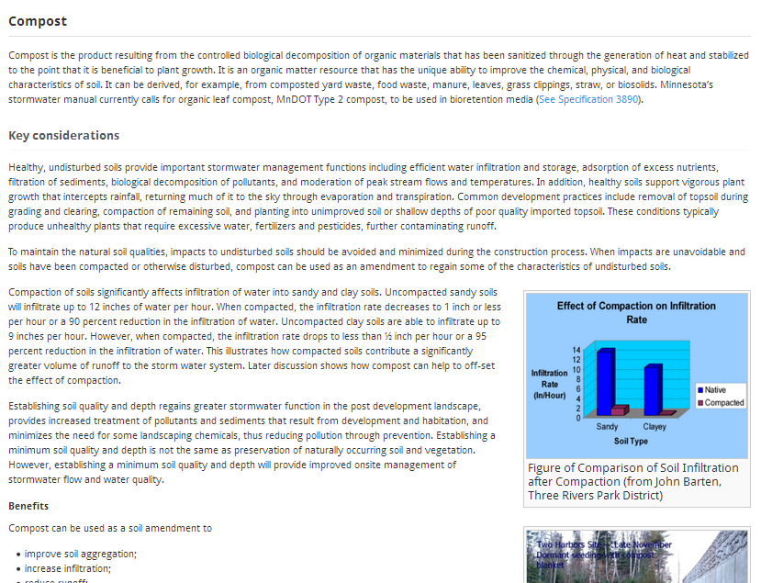
Compost

Slide 40
Which of these is not a compost specification?
pH between 5.5 and 8.5
Moisture content between 30 and 60% (mass basis)
Organic matter content between 30 and 65% (dry wt basis)
Particles must pass through 1 inch screen or less
Quiz 5

Slide 41
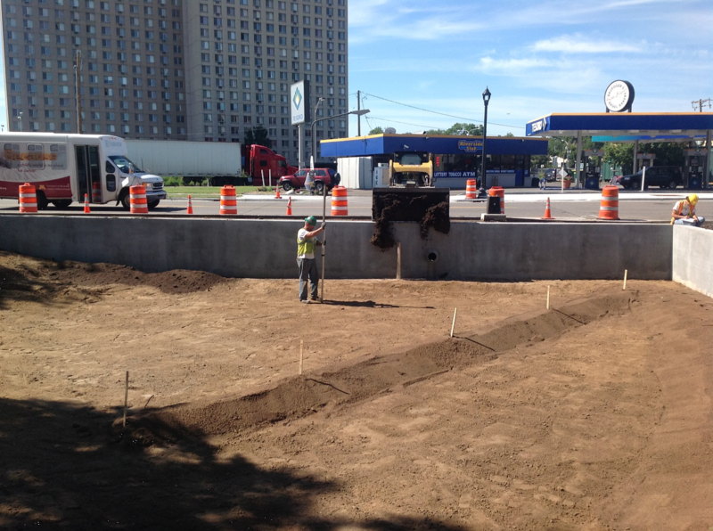
Material specifications – filter media
Composition specs for several mixes
Performance specs
Design and construction information
Designing for phosphorus control

Slide 42
A rain garden w/ an underdrain having a media mix with high organic matter content will leach phosphorus
Manual recommends Mixes C or D, testing the media for P, or adding iron to the practice

Slide 43
Pollinator-friendly practices

Slide 44
… and more
Cold climate impact on runoff management
Managing stormwater sediments
Road salt, smart salting, and winter maintenance
Stormwater management for lake protection and restoration
Mosquito control and stormwater management
Liners for stormwater management
Green Infrastructure for stormwater management
Stormwater and landscape guidance for solar farms and solar projects
Stormwater pollutants
Stormwater infiltration
Etc.

Slide 45
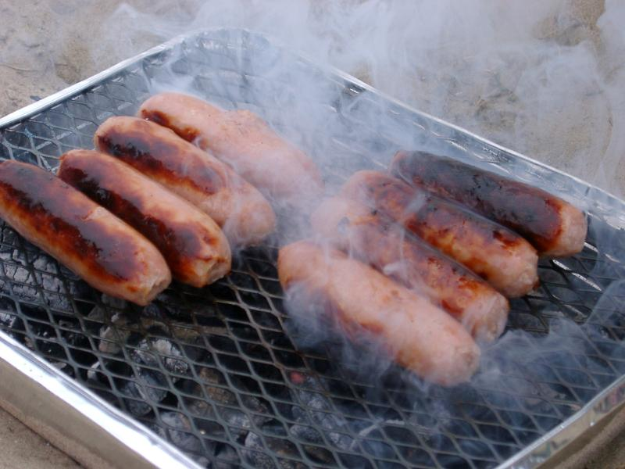
A warehouse of links, references, case studies, maps, etc.
Nearly every page has multiple links to external material
Most pages have reference lists
There is a map page
Training videos
Links to webinars and videos
Outreach materials (newsletters, blogs, etc.)
Etc.

Slide 46
Case studies – harvest use/reuse

Slide 47
Case studies – infiltration

Slide 48
Case studies – Green roofs

Slide 49
Case studies – tree trench/tree box

Slide 50
The future
Will continue to work with our partners to update and enhance the manual
Slowly building information for the general public
Building a Green Infrastructure section

Slide 56
True or False: Bioretention (rain garden) is an excellent BMP for climate resiliency
False: Moore and Hunt (2013), in evaluating the effect of several BMP types on climate resiliency, state "Despite accounting for sequestration by vegetation in these systems, only stormwater wetlands and grassed swales were predicted to store more carbon than what was released through construction and maintenance".
Quiz 6

Slide 57
Which of these bioretention (rain garden) design considerations improve habitat?
Utilize native, perennial vegetation
Incorporate trees and shrubs if possible
Maximize length to area ratio of BMP
Evaluate compatibility with nearby habitats
Promote soil/media development, including formation of a leaf/plant litter
Quiz 7

Slide 58
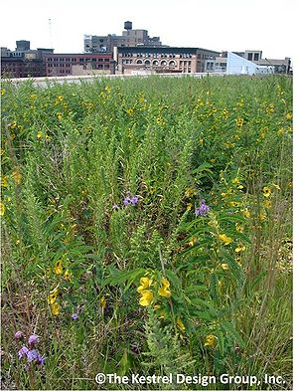
Summary
The Minnesota Stormwater Manual is kind of a One Stop shop for how to manage stormwater and integrate stormwater management into the landscape

Slide 59
Questions? Mike Trojan mike.trojan@state.mn.us Link to Manual – easiest to get there by doing a search on Minnesota Stormwater Manual https://stormwater.pca.state.mn.us/index.php?title=Main_Page

Slide 61
Funding information

Slide 62
Links to GI organizations
Master Water Stewards
developed by the Freshwater Society
volunteer education and outreach program
participates in training and install green infrastructure practices
Metro Blooms
nonprofit
partners with property owners and organizations
promotes environmentally sound gardening and landscaping
Blue Thumb
public/private partnership
promotes ecologically functional landscapes

