Slide 1
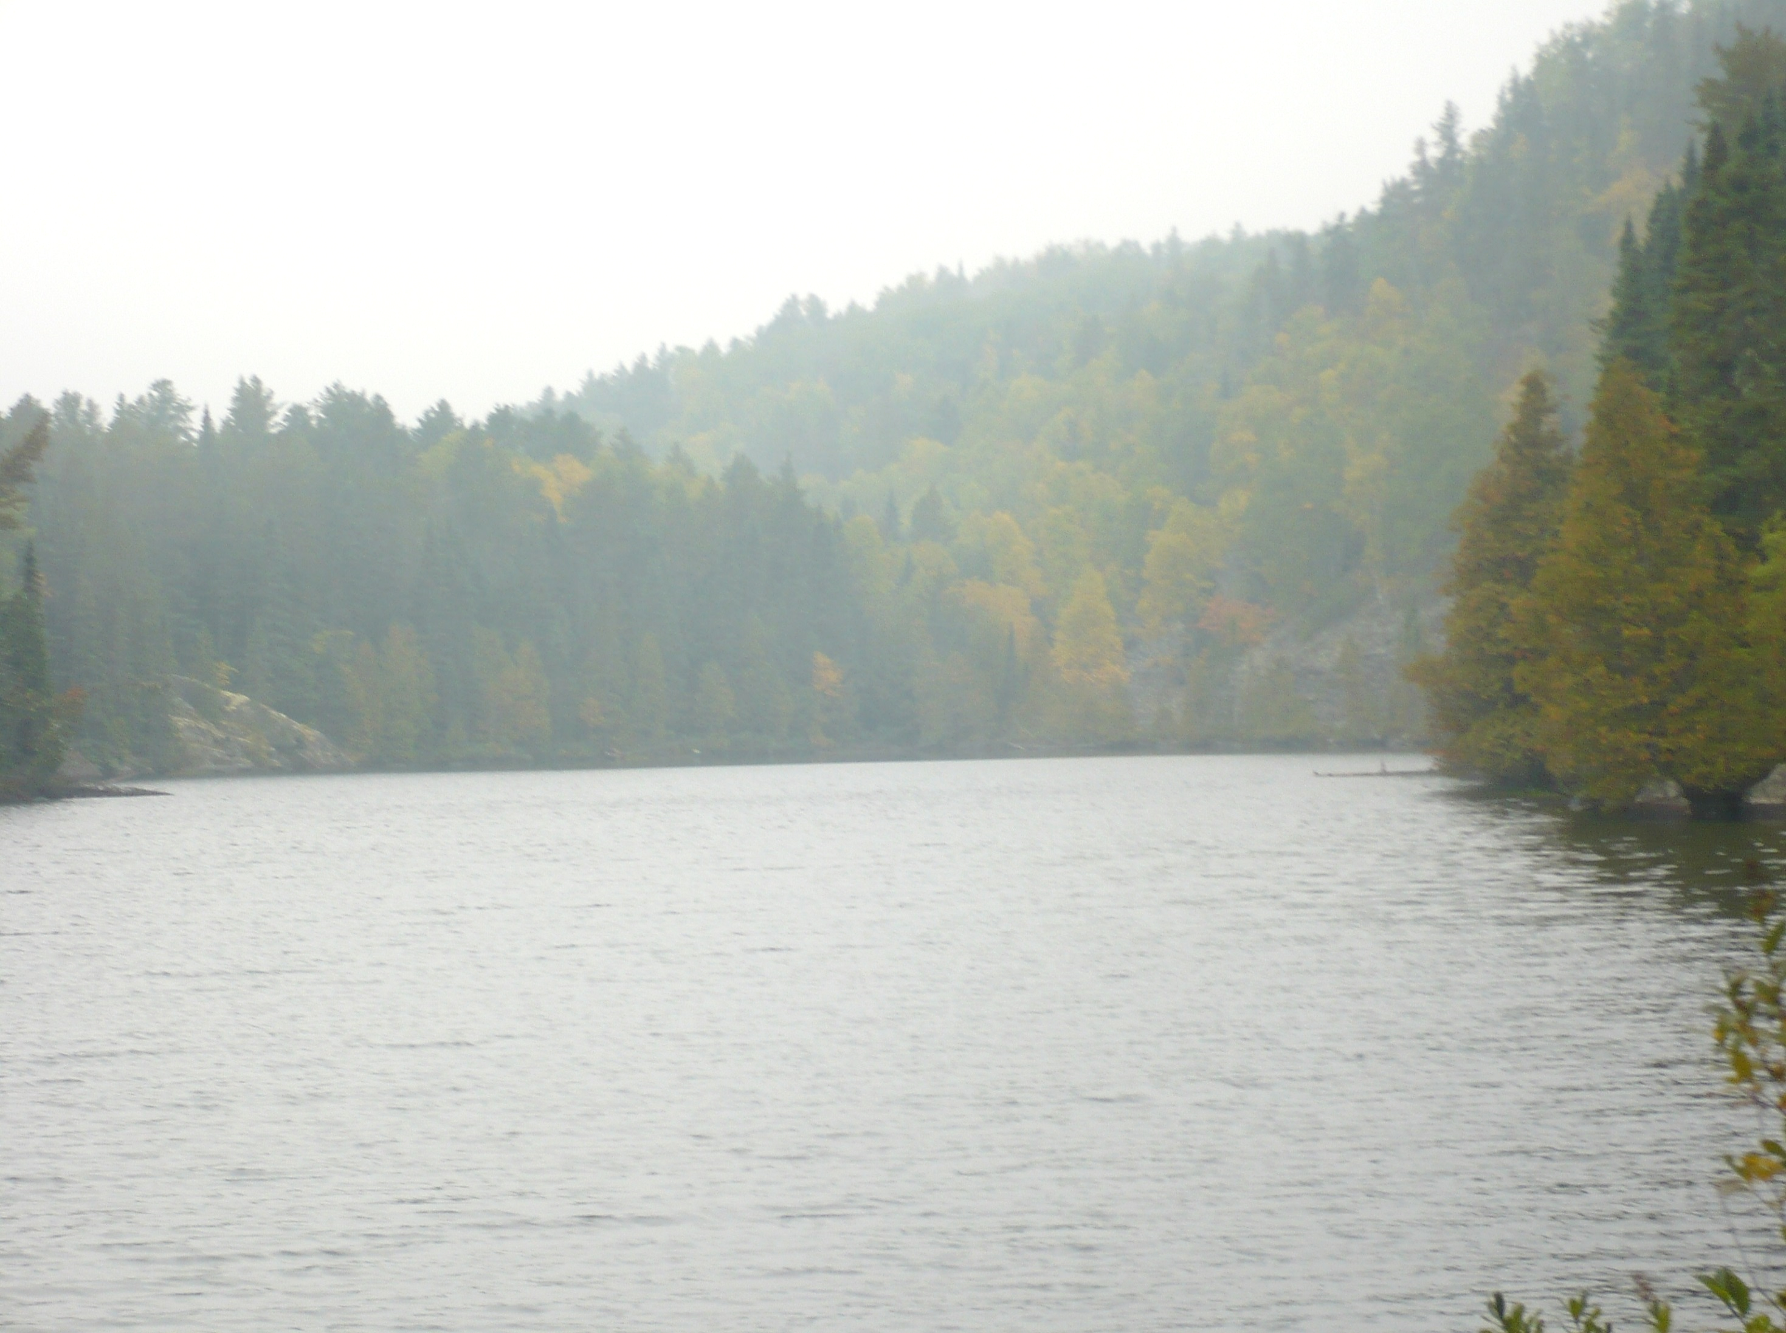
Stormwater infiltration and chloride in groundwater
Mike Trojan
MPCA Stormwater
February 7, 2019

Slide 2
September 10, 2015: Effects of stormwater infiltration on groundwater

Slide 3
Chloride
Mobile and will move through BMPs
Concentrations in stormwater runoff are highly variable and exceed SMCL during winter and early spring runoff events
Findings
No retention: Concentrations in effluent and rate of exceedance of standard are function of runoff concentration
Observed concentrations in shallow groundwater in urban areas are similar to concentrations in runoff
Risk to groundwater:
High based on mobility
Some preliminary data suggests a seasonal lag in peak concentration in groundwater
Concentrations in groundwater not likely to reach 250, but there may be impacts to lakes and streams
From 9/10/15 presentation

Slide 4
Quality impacts - conclusions
Health risks may exist for certain combinations of land use, treatment practice, pollutant, and receptor
Current guidance and regulations (permits) should provide adequate protection for human health
More research is needed on pathogen occurrence in stormwater runoff and fate in infiltration systems, particularly non-vegetated systems
Chloride cannot be treated with stormwater BMPs
Prevention is the only effective management tool
Need to better understand dynamics of chloride in urban systems

Slide 5
MN Groundwater Association white paper: Impacts of stormwater infiltration on chloride in groundwater
The group is still working on the white paper

Slide 6
Outline
Chloride in urban stormwater runoff
Chloride levels in receiving waters
Stormwater infiltration - overview
Fate of chloride in infiltration practices
Estimating chloride loads from infiltration practices
Potential recommendations

Slide 7
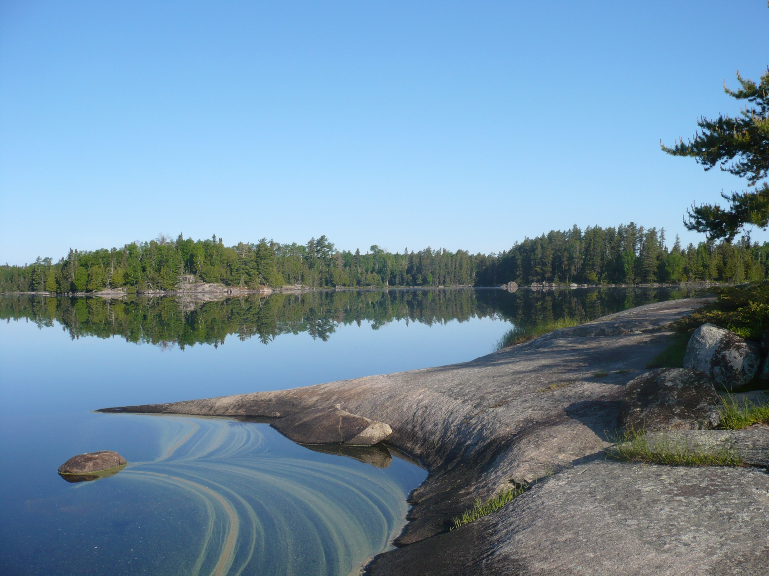
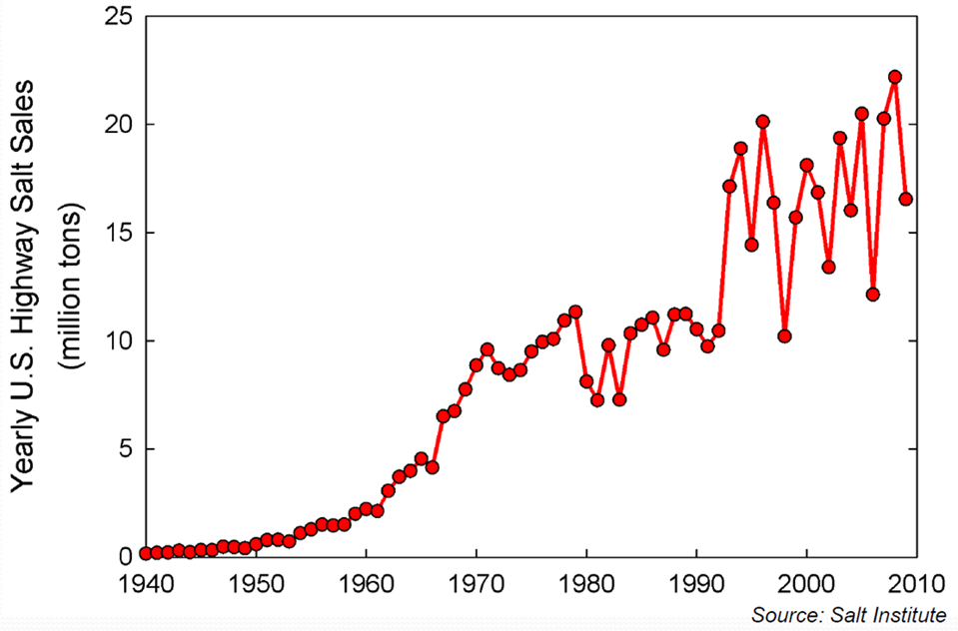
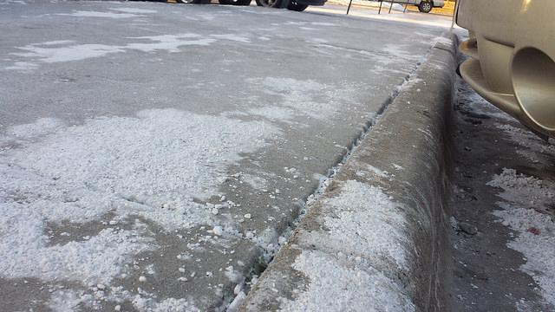
Salt application has increased

Slide 8
Chloride in stormwater runoff
In a MN location with high deicer application rates, 97% of the Cl load was associated with 16% of the total annual runoff volume (Herb, 2018)
Granato and Smith, 1999
Winston et al. (2016)

Slide 9
Summary of water quality status
Statewide
26 lakes were impaired as of 2018
24 streams impaired as of 2018
120 lakes classified as at risk (> 1 sample in past 10 years with Cl > 207 mg/L)
Twin Cities Metro
23 lakes impaired
17 streams impaired
38 lakes classified as at risk
340 assessed waterbodies (11% impaired; 11% insufficient data)
30% of shallow wells exceed the SMCL
Source: Draft Statewide Chloride Management Plan

Slide 10
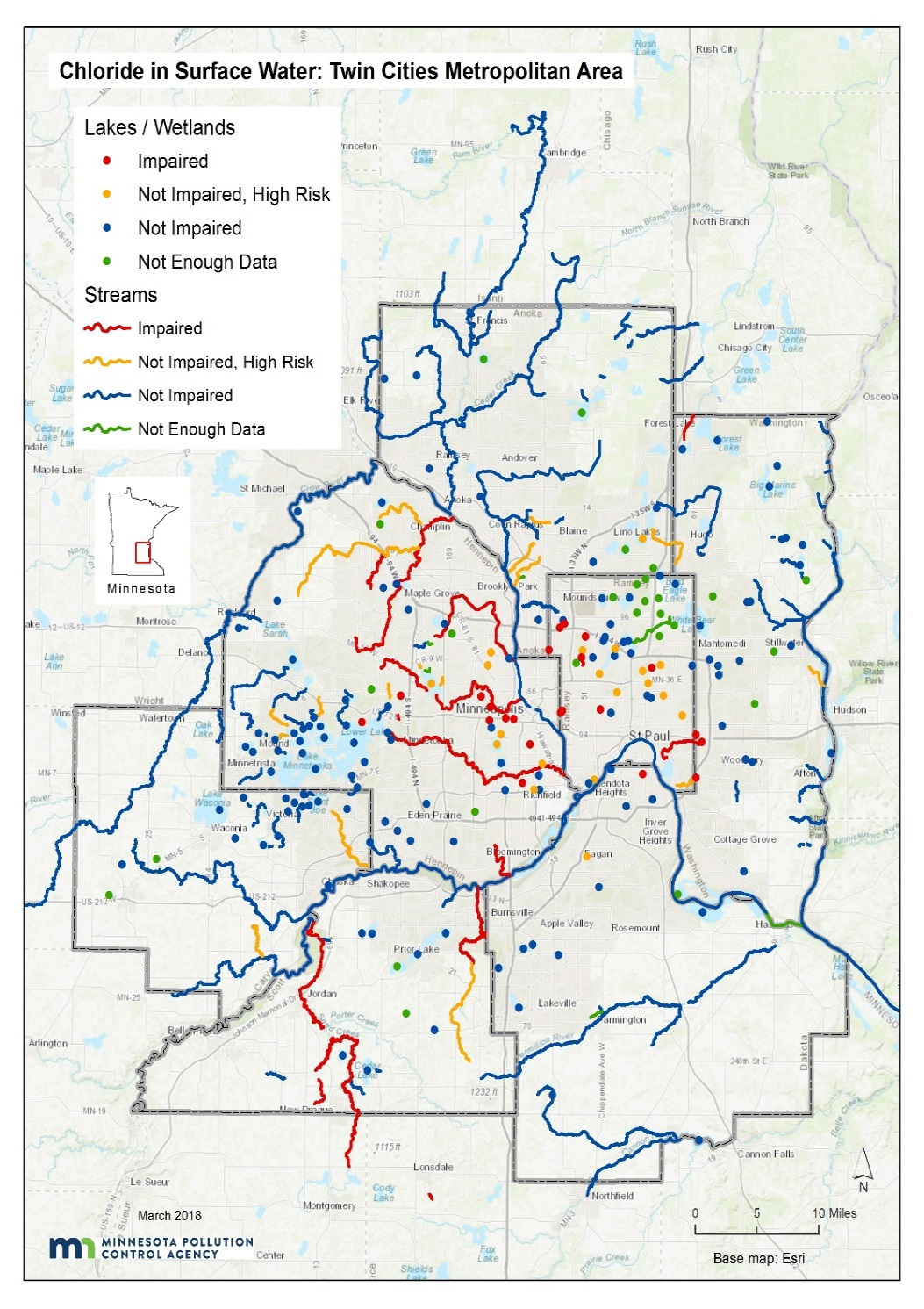
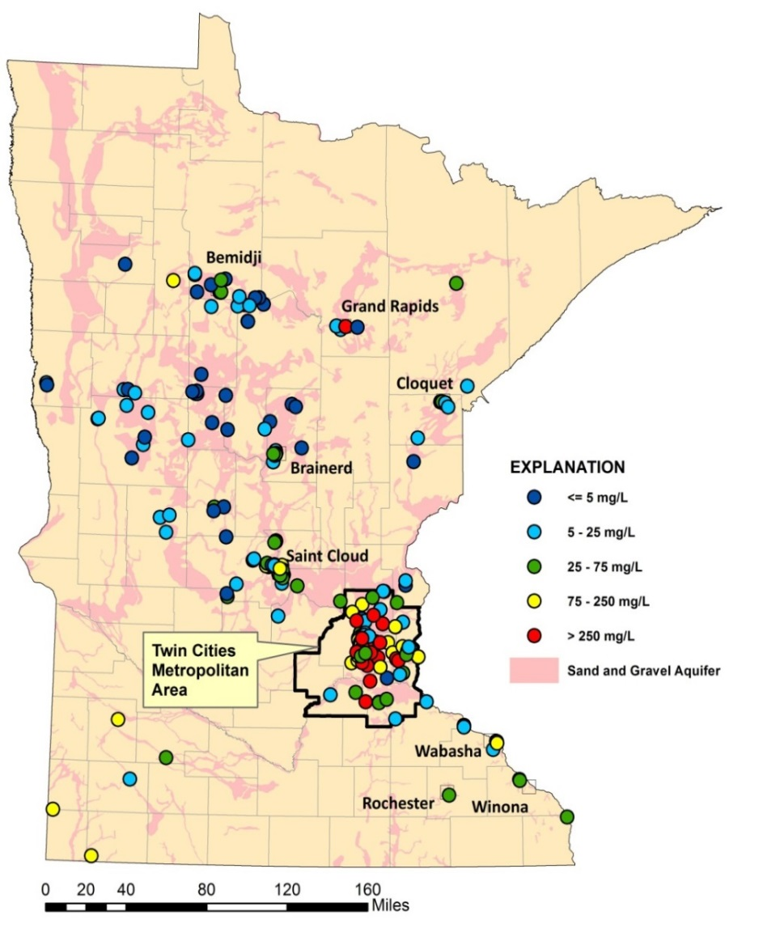
Surface water
(MPCA, 2018)
Groundwater
(MPCA, 2013)
Shallow sand & gravel aquifers

Slide 11
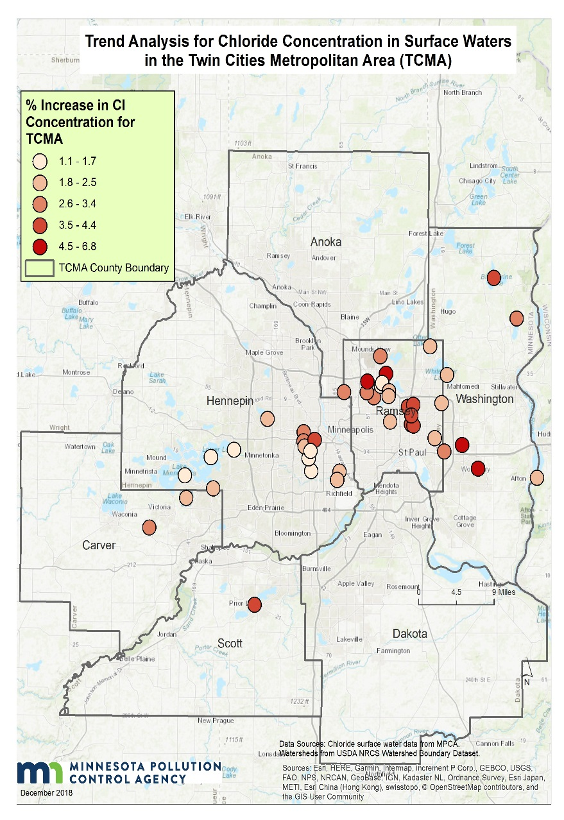
Lake trends
(Source: Draft Chloride Management Plan)
Upward trends in 46 of 69 lakes in TCMA
Outside TCMA, upward trends in 14 of 45 lakes
Rate of increase is greatest in lakes in TCMA urban core
Lakes - % increase per year

Slide 12
Groundwater trends
(Source: MPCA 2013)
Upward trends in 11 of 36 wells in shallow sand/gravel aquifers
Average rate of increase was 3.4 mg/L/yr, but rates were much higher is some wells

Slide 13
Stormwater infiltration

Slide 14
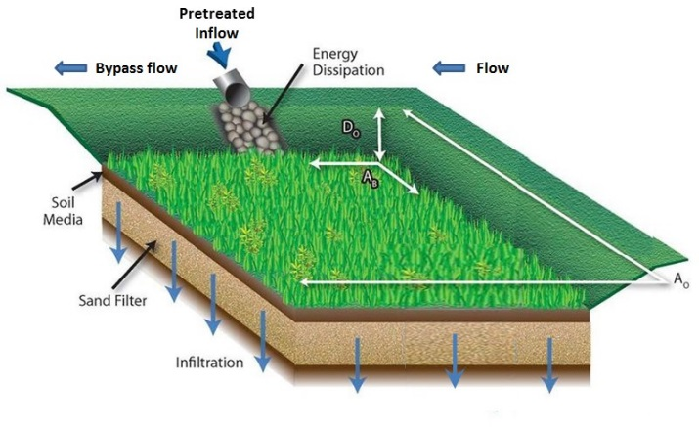
Stormwater infiltration- intentional infiltration of stormwater runoff

Slide 15
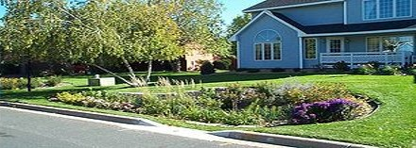
Stormwater infiltration is a preferred method for managing stormwater runoff
Benefit surface waters
Mimic natural hydrology
Use space efficiently
Provides ecosystem services
Effectively treat pollutants – except chloride

Slide 16
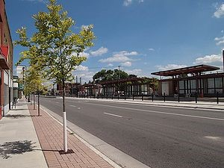
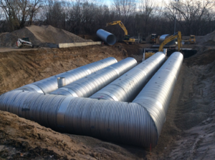
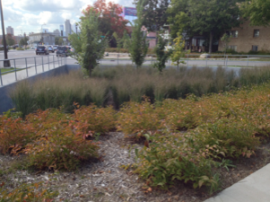
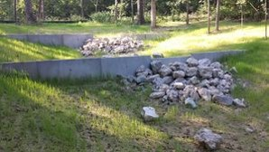
Infiltration BMPs
Bioinfiltration (rain gardens)
Tree trenches/boxes
Infiltration basins/trenches
Pemeable pavement
Some swales

Slide 17
Infiltration practices focus recharge
Example: 1 acre of impervious runoff directed to an infiltration basin
Infiltration
basin
Typical design infiltrates 35-75 feet of water annually

Slide 18
Fate of infiltrated water
Stormwater runoff
Lake or stream
Shallow groundwater
Confining unit
Deep groundwater

Slide 19
Villanova study, Machusick, 2009
Rain garden
MW2
35 feet
MW3
Lysimeters
20 feet
Groundwater flow

Slide 20
Deicers applied
Runoff
Lysimeters (0, 4, 8 ft)
MW2
MW3

Slide 21
Estimating chloride loads from infiltration practices
Cl_{gw} = I_{perv} + I_{imperv} + L_{pi} + L_{ww} + L_{sw} + SW + I_{ponds} + I_{filt} + I_{infil}
SW
I_{perv}
I_{imperv}
I_{infil}
I_{filt}
I_{ponds}
L_{pi}
L_{ww}
L_{sw}
Groundwater

Slide 22
These next slides are DRAFT

Slide 23
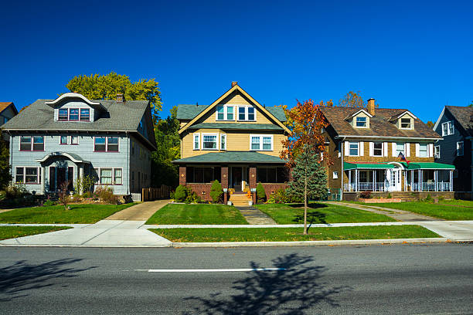

Slide 24
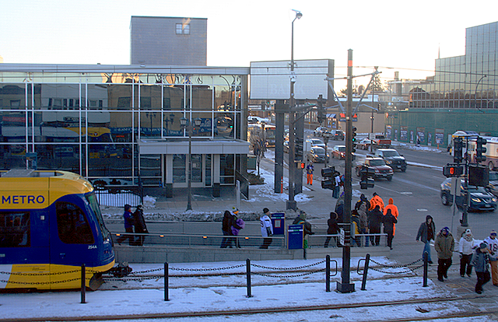
(934 lbs/ac/yr)

Slide 25
Cl in shallow glacial aquifers, northern U.S. (Mullaney et al., 2009)

Slide 26
Cl in shallow groundwater – Minnesota (MPCA)

Slide 27
Factors affecting Cl in shallow glacial aquifers, northern U.S. (Mullaney et al., 2009)
Significant regressions (p < 0.05)
Major road density
Not significant
Highway connector density
Major highway density
Highway density
Local road density
% residential, commercial, industrial, or transportation land use
Population density
Season
p = 0.94
MPCA, 2002

Slide 28
Chloride concentrations are a function of baseflow
Miller Creek, Duluth
Bassett Creek, Minneapolis
Source: Bassett Creek WMC

Slide 29
What are the consequences of high chloride concentrations in groundwater?
Urban streams with significant baseflow are potentially at risk
Shallow sand and gravel aquifers are at risk in core urban areas – is this a concern?
There are few groundwater receptors
Is salty taste more important than impacts to aquatic ecosystems?
What about deeper drinking water aquifers?

Slide 30
Much of the core Metro Area aquifer system has low-moderate vulnerability
We currently have insufficient data to assess trends in deeper aquifers

Slide 31
What are the consequences of high chloride concentrations?
Lakes
Disrupts nutrient cycling
Prevents oxygen from reaching lake bottom
Disrupts community structure
Implications for phosphorus export
Streams
Benthic IBI declined at 190 mg/L
All BIBI indicate impairment at 500 mg/L
Greatest fish effects are on early life stages
Drinking water

Slide 32
Stormwater infiltration recommendations
Infiltrate in areas not vulnerable to chloride contamination
In vulnerable areas, if infiltration is employed, distribute infiltration practices instead of focusing on a single location
Properly site infiltration practices with respect to receiving waters
Utilize permeable pavement when appropriate

Slide 33
Management strategies
Decrease use of chloride deicers
Use alternatives (maybe)
Use liquids (anti-icing)
Establish chloride free zones near receiving waters
Improve snow/ice removal technology
Lower winter speed limits
Infiltrate in the right locations, especially with permeable pavements

Slide 34
Needs
Analyze trend data for Metro streams – Met Council starting this
Improve understanding of fate and transport in groundwater
Map vulnerable areas
Enhance monitoring in these areas
Monitor deeper aquifers in vulnerable areas
Improve understanding of impacts in lakes
Study chloride dynamics in impacted lakes
Study ecological effects
Study phosphorus dynamics
Identify high value waters that are at risk
More research on chloride alternatives

Slide 35
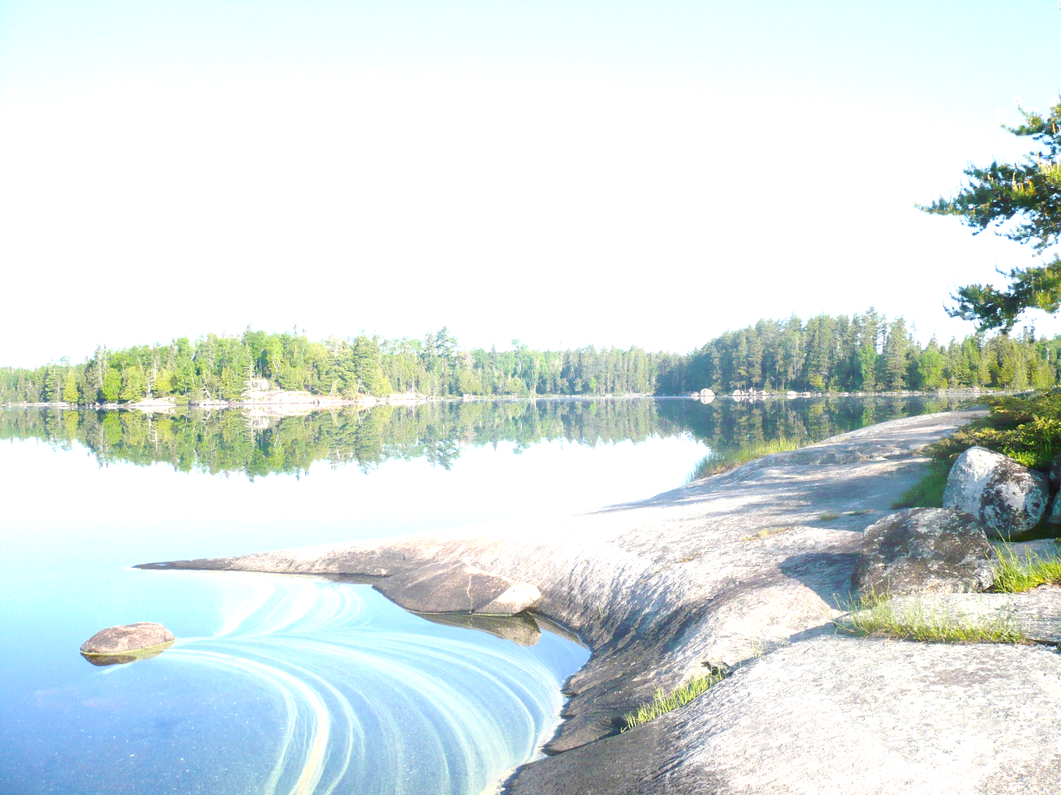
Chloride is attenuated
Delayed peaks in groundwater
Lower max concentrations
Elevated concentrations persist in groundwater

Slide 36
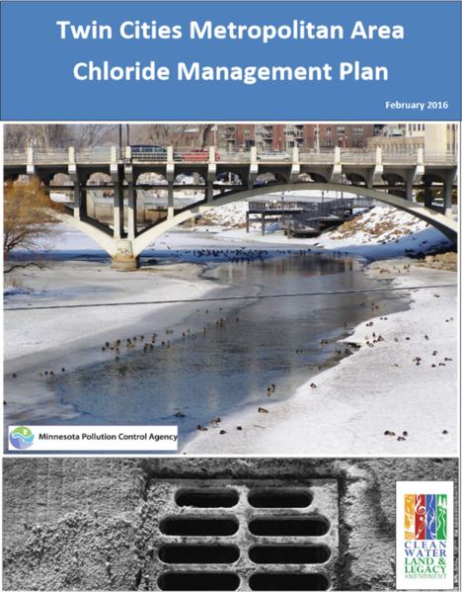
Ultimately, source reduction is the only way to effectively manage chloride
Questions?

