Slide 1
Presented by
Ed Matthiesen
Biochar and Iron Sand Media

Slide 2
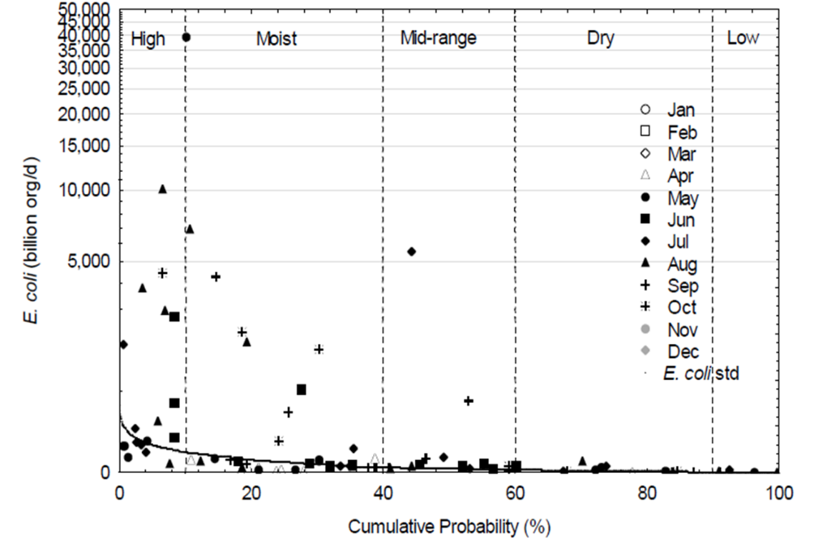
E. COLI TMDL LOAD REDUCTION
Shingle Creek TMDL Load Reduction Curve

Slide 3
IN SUMMARY
Need big reductions in nutrients, sediment, and bacteria
No handy point sources – diffuse non-point sources
Fully developed, highly impervious
Few opportunities for significant new structural BMPs

Slide 4
BIOCHAR BACKGROUND
Research by Dr. Sanjay Mohanty, UCLA
Column study showed biochar could remove up to 99% E. coli from stormwater, compared to 62% with just sand
SK Mohanty, AB Boehm. 2014. Escherichia coli removal in biochar-augmented biofilter: Effect of infiltration rate, initial bacterial concentration, biochar particle size, and presence of compost.
Environmental Science & Technology. 48 (19), 11535-11542.

Slide 5
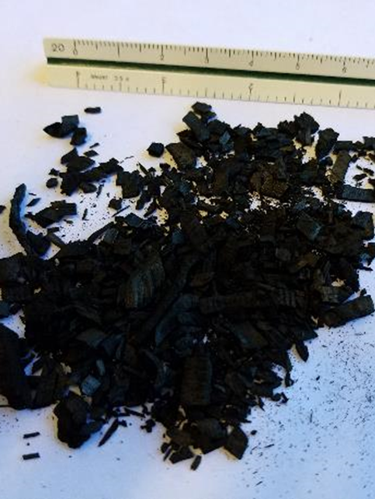
IRON/SAND BIOCHAR MEDIA
Iron/sand 5% by weight purchased premixed from Plaisted Companies.
Biochar produced by Char Energy, LLC. Made from hard wood at 500°C. Optimally installed at 30% by volume.

Slide 6
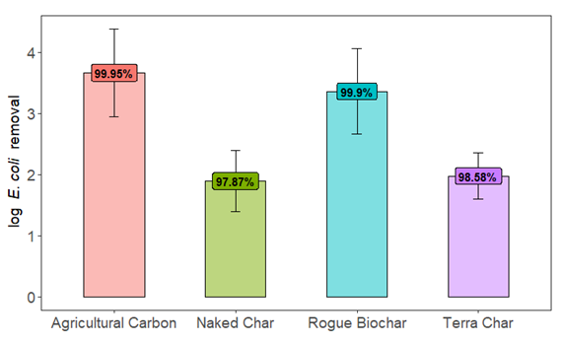
Coon Creek Watershed Biochar
“Agricultural Carbon” by National Carbon Technologies
Source Material: Wood burned >550C
Surface area: 339 m²/g
Composition:
84% Fixed Carbon
12% Volatile matter
4% Ash
99.95% E. coli removal in lab trial
Valenca et al. in prep
Notes:
Countless varieties of biochar depending on source material, pyrolysis temperature, post-processing… no standard exists… hard time choosing, so we sent 4 commercially available biochars to UCLA for testing to find out which worked best for e coli capture specifically.
158 cy biochar which equates to over 1650 sq miles surface area… the northern half of the 7 county metro
UCLA results: removal capacity positively correlated with surface area and carbon content, negatively correlated with ash content and % volatile organic matter

Slide 7
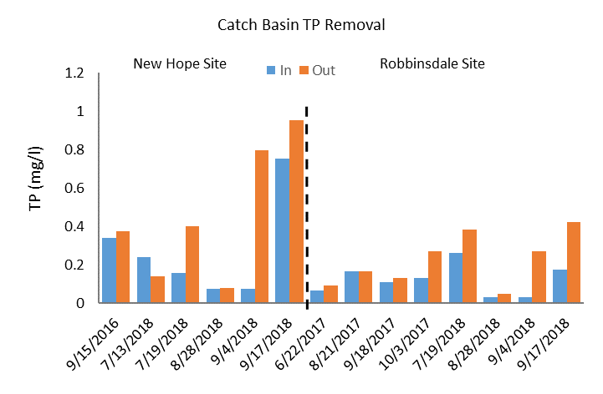
CATCH BASIN INSERTS TP REMOVALS

Slide 8
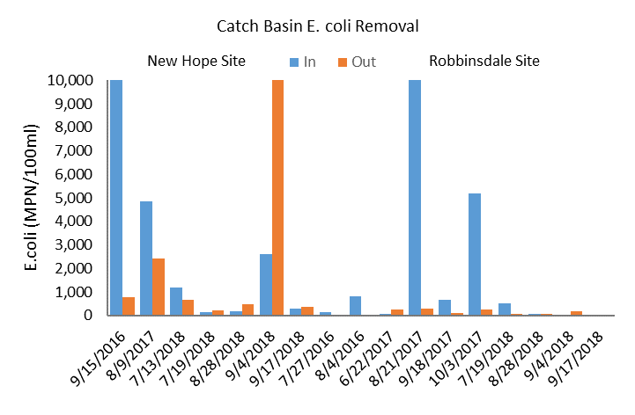
CATCH BASIN INSERTS E. COLI REMOVALS

Slide 9
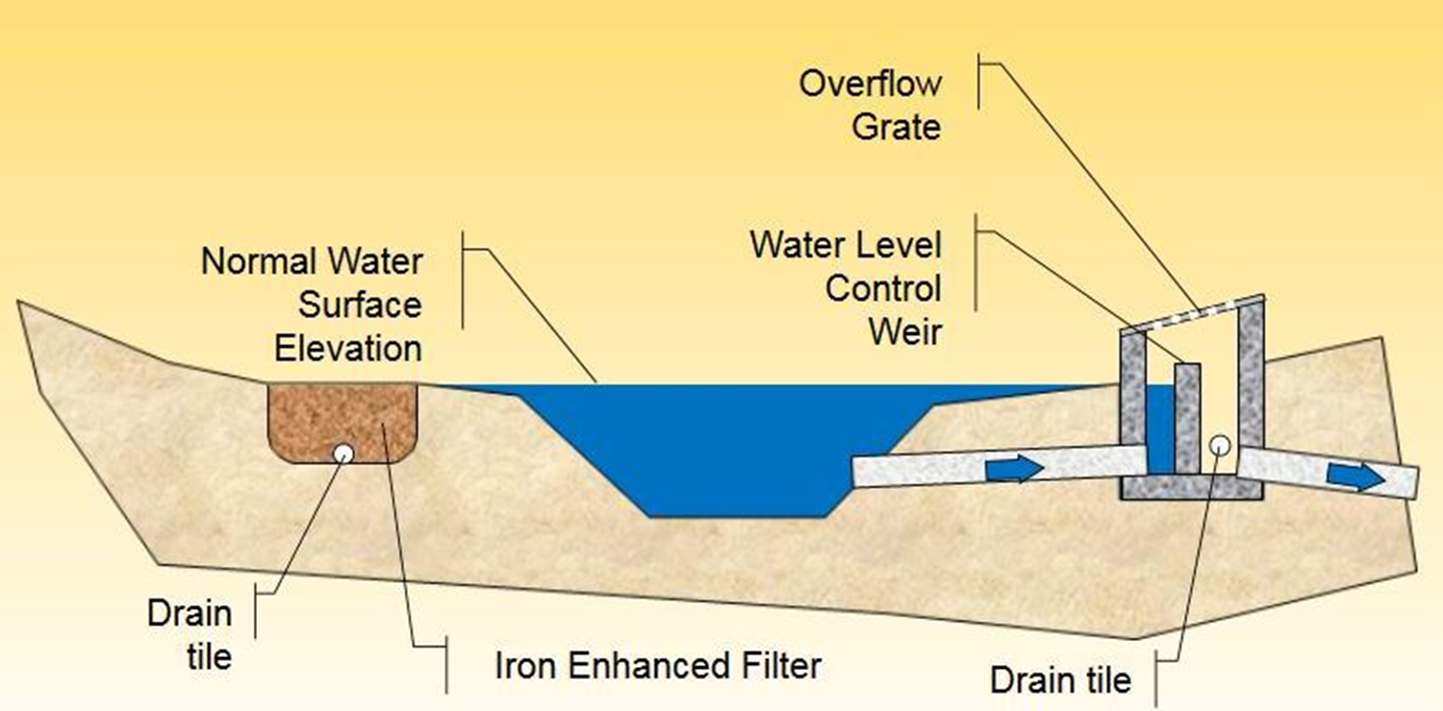
Minnesota Filter
Now with biochar!
Graphic: Andy Erickson, SAFL

Slide 10
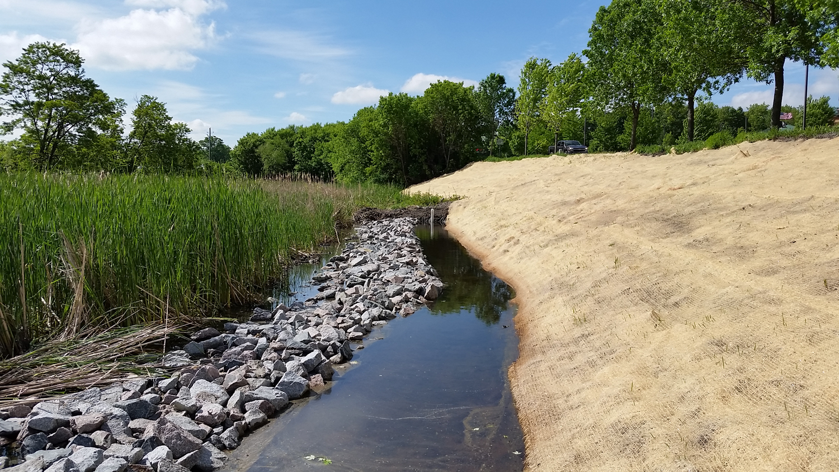
CHAMPLIN POND IN OPERATION

Slide 11
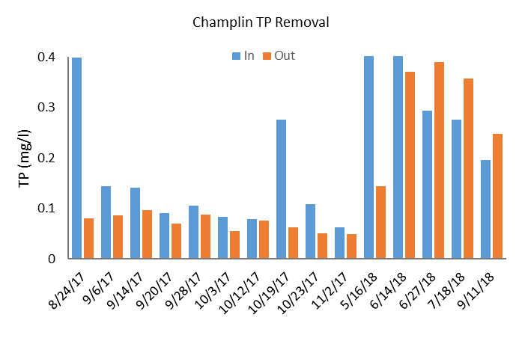
CHAMPLIN TP REMOVAL

Slide 12
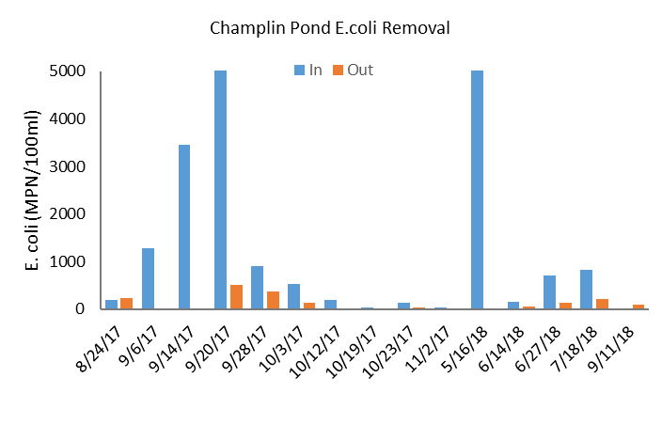
CHAMPLIN E. COLI REMOVAL

Slide 13
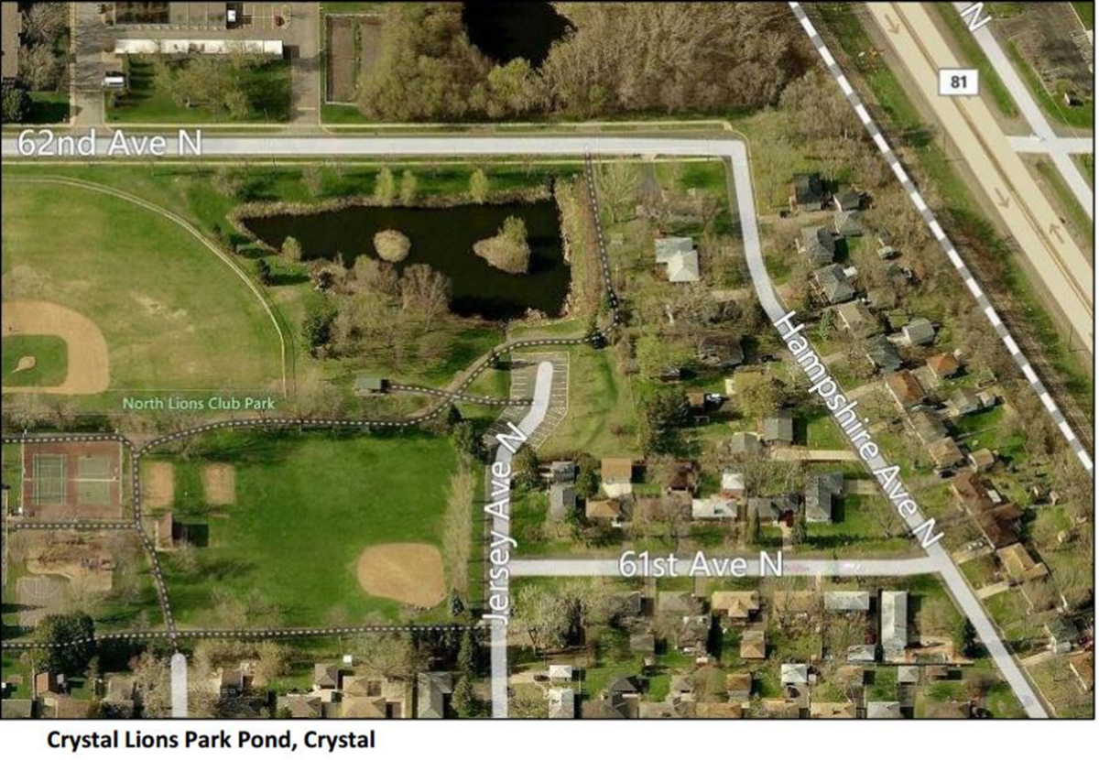
POND 2: CRYSTAL NORTH LIONS PARK IRON/SAND ONLY

Slide 14
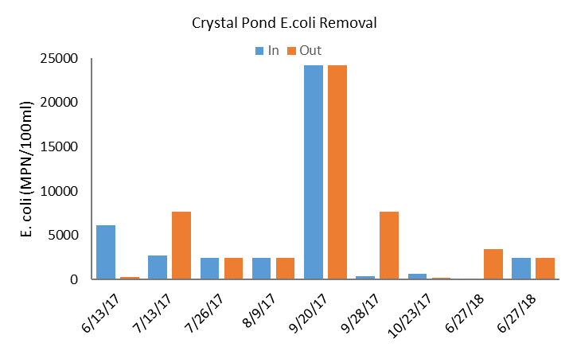
CRYSTAL E. COLI REMOVAL (NO BIOCHAR, IRON/SAND ONLY)

Slide 15
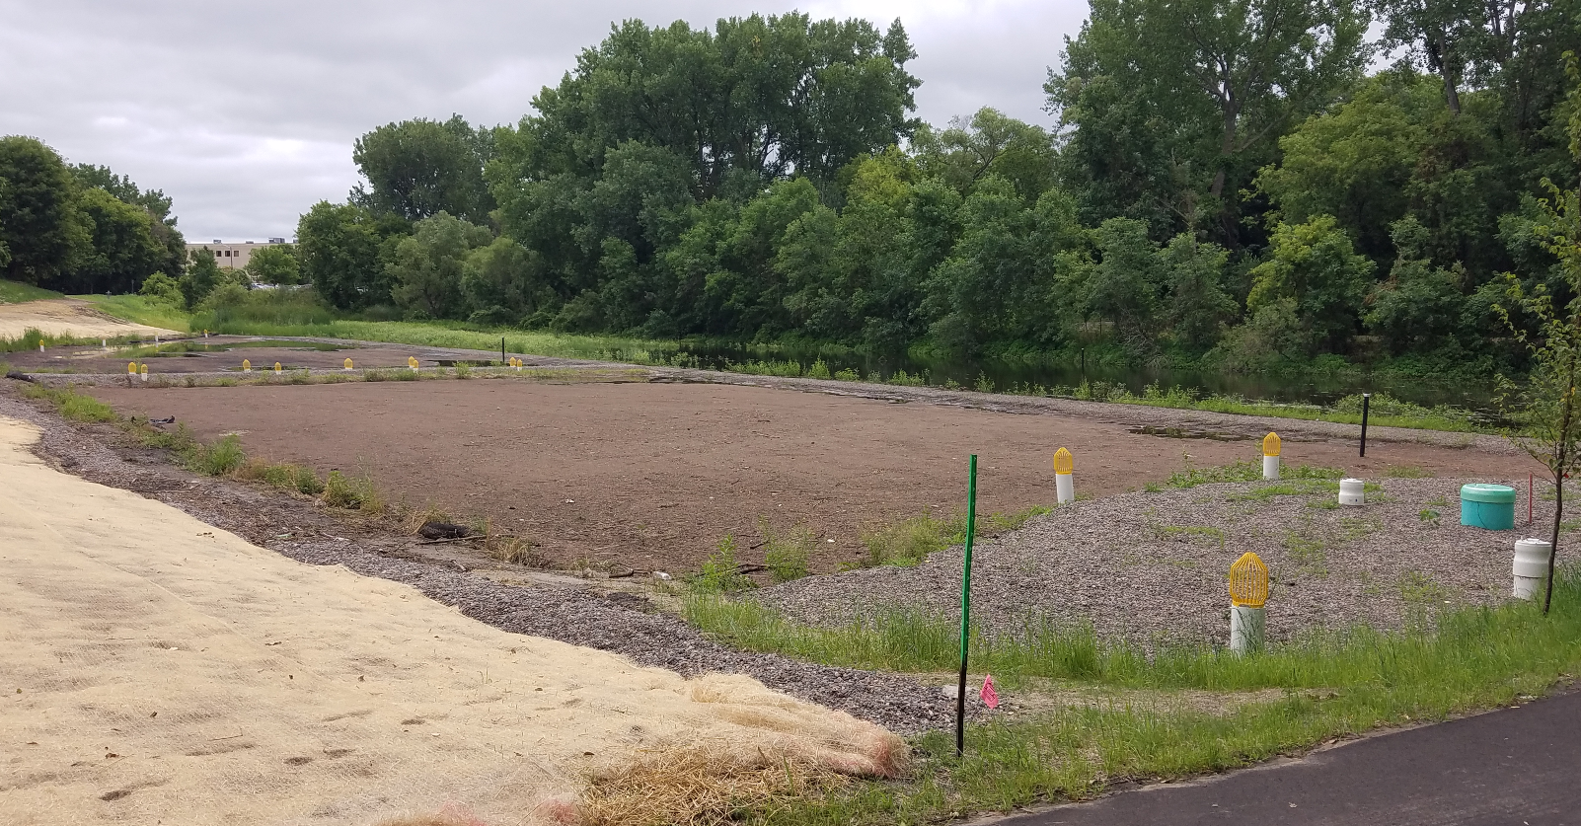
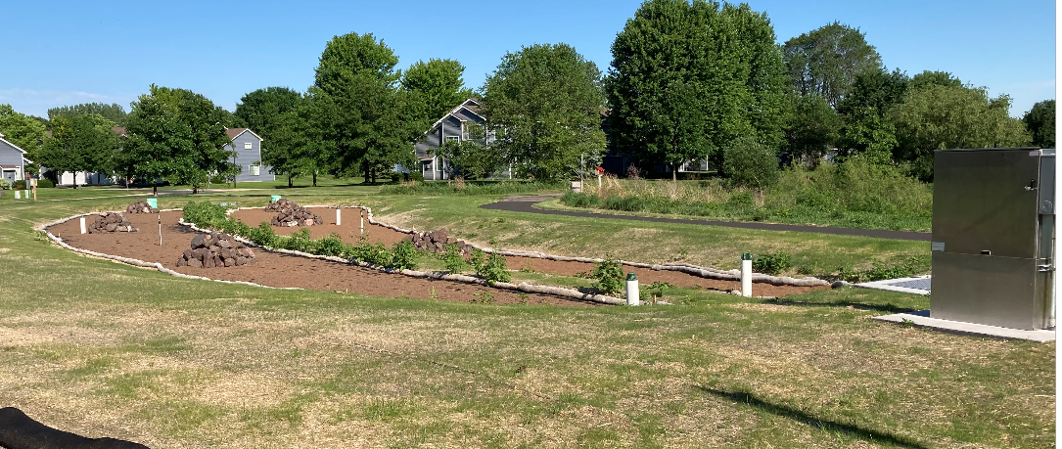
Biochar- & Iron-Enhanced Sand Filters
Woodcrest Creek
Treats 1 sq. mi. area
2 cfs gravity system
75% TP/82% E.Coli removals (preliminary)
Football field, in scale
Pleasure Creek
120-200 gpm pumped system
Treats 200-300 af/yr
26-43 lbs TP/yr

Slide 16
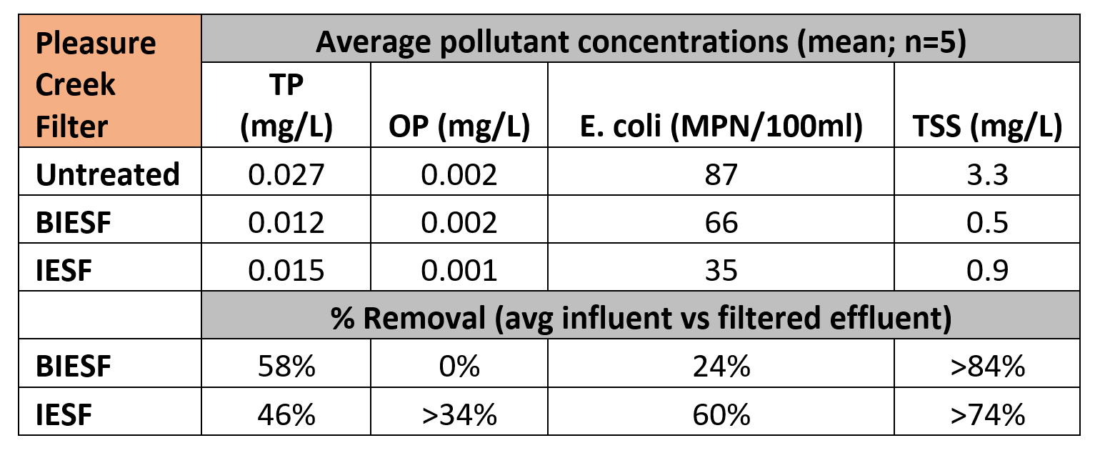
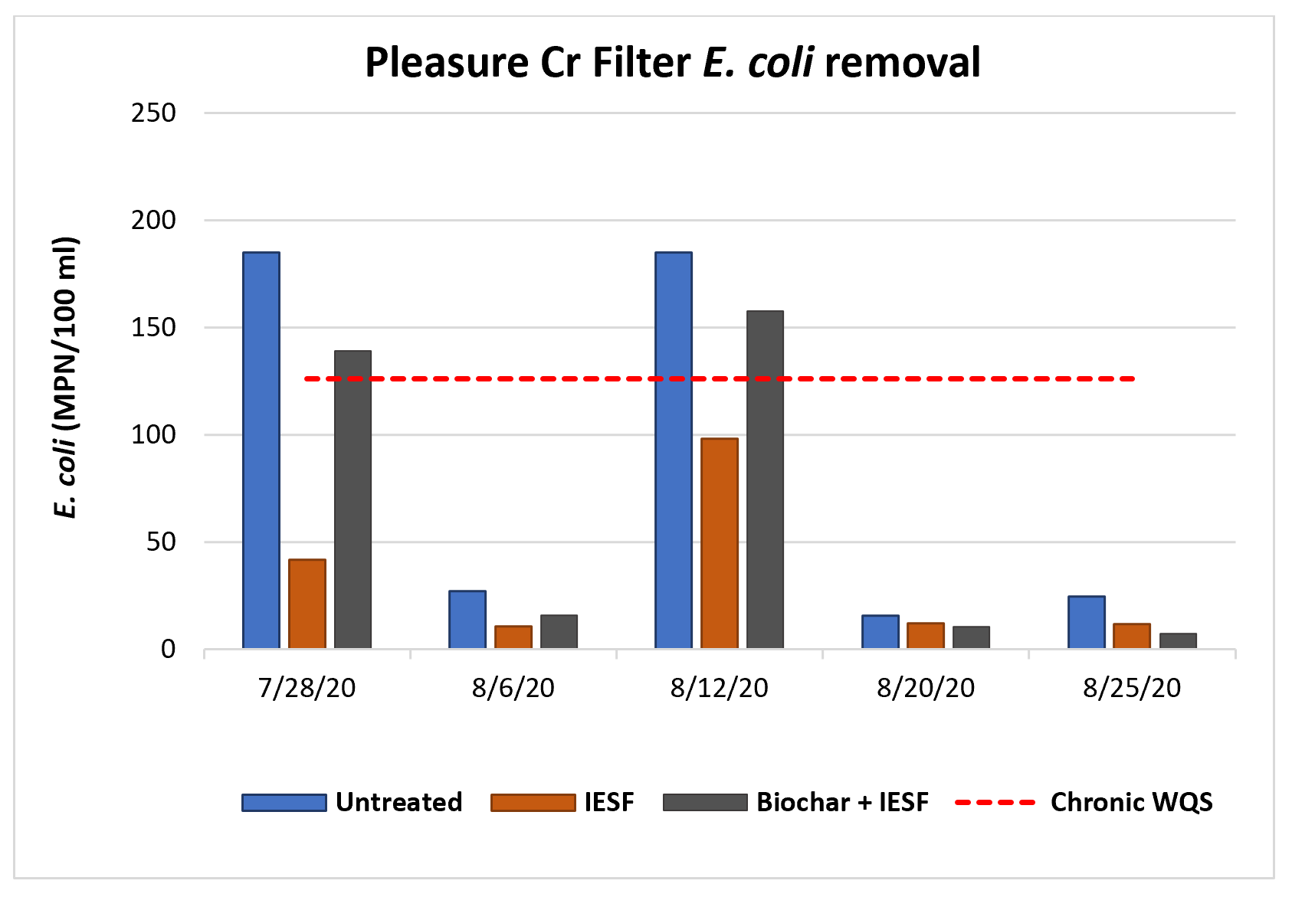

Slide 17
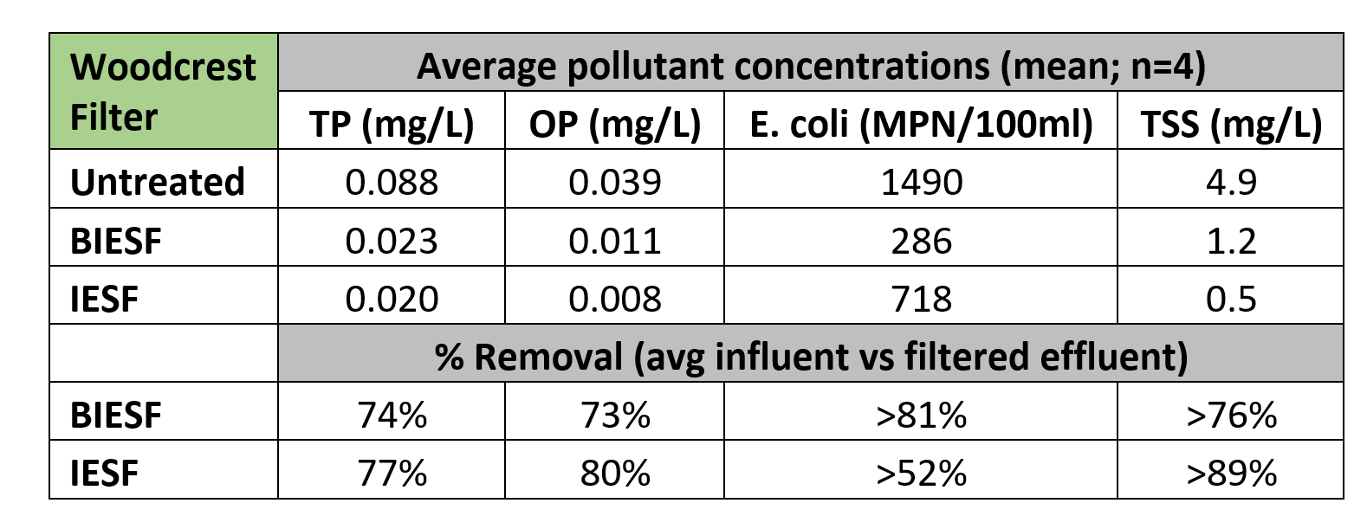
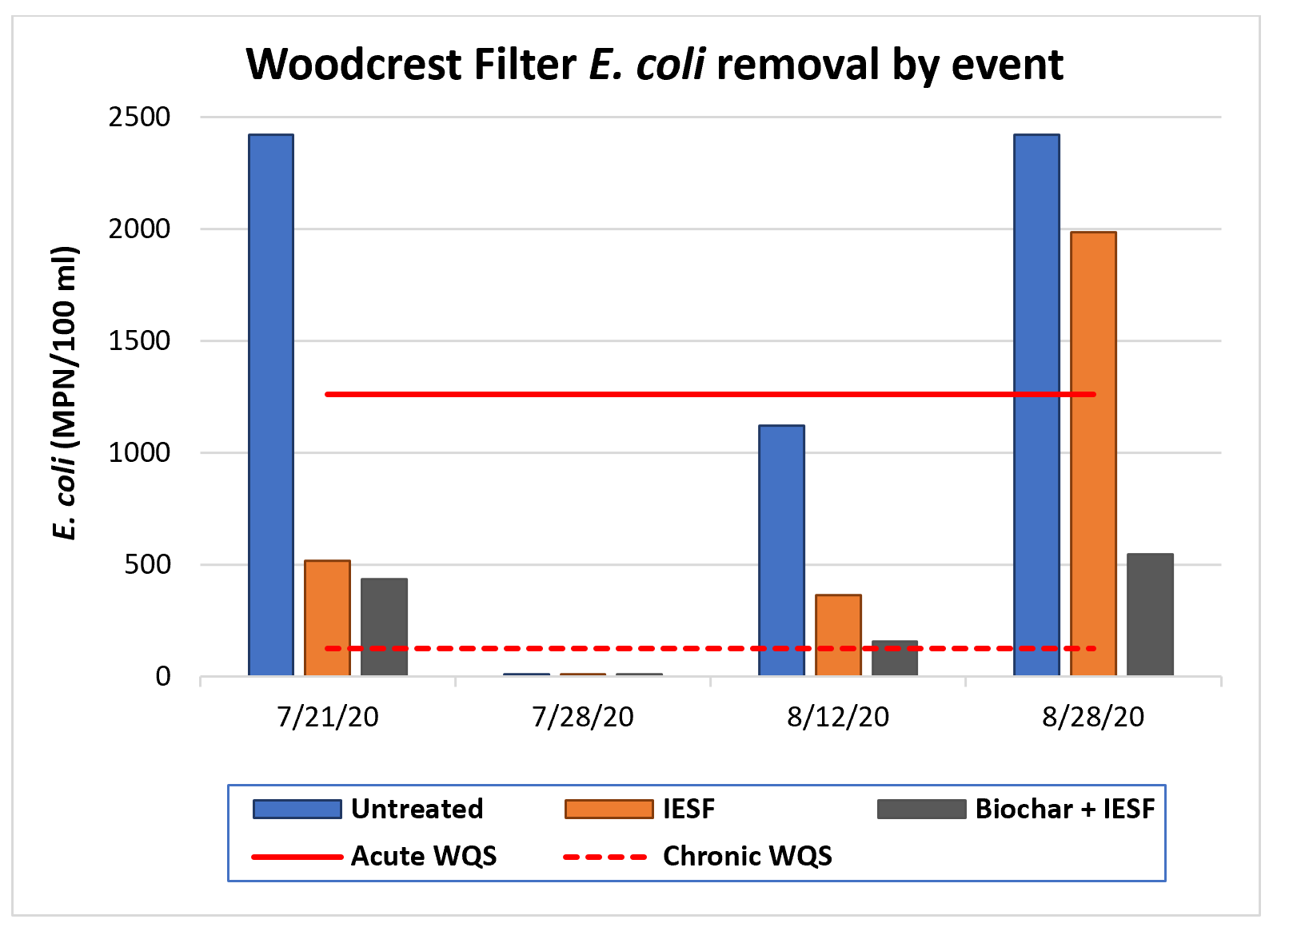

Slide 18
CONTACT INFORMATION
Ed Matthiesen, P.E.
ed.matthiesen@stantec.com
763-252-6851

