Slide 1
Understanding Chloride trends in Minnesota’s water?
Water Resources Conference
Mike Trojan
MPCA Stormwater
October 15, 2019

Slide 3
Primary anthropogenic sources are road salt, fertilizers, and WWTPs
(Includes water softening)
Total = 968,300 tons annually
Cl contributions, Minnesota (From Overbo et al., 2019)

Slide 4
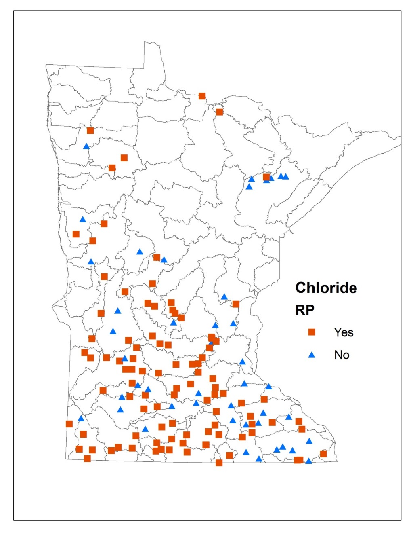
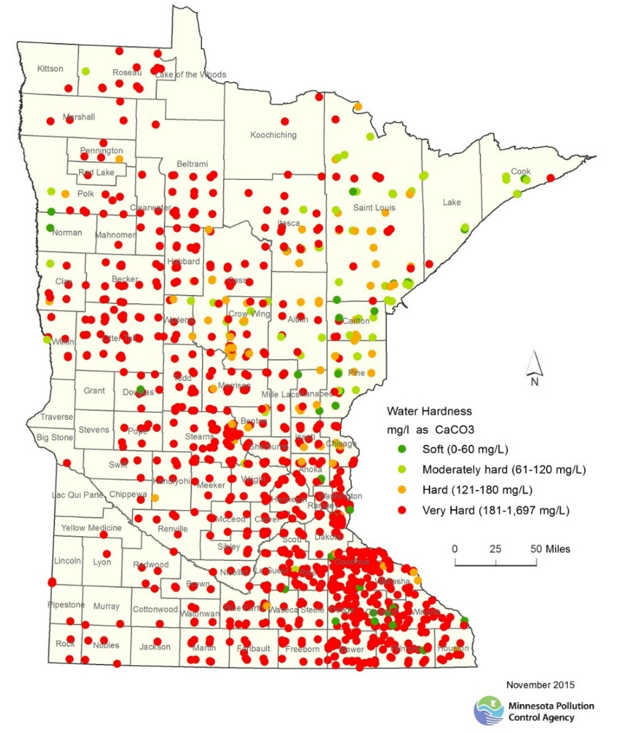
Water Softening
Water softeners used in many households
Chloride treatment at WWTP is cost prohibitive
Chloride passes through Septic Systems
Potential to exceed standard

Slide 5
Chloride in urban stormwater runoff
In a MN location with high deicer application rates, 97% of the Cl load was associated with 16% of the total annual runoff volume (Herb, 2018)
Granato and Smith, 1999
Standard = 230

Slide 6
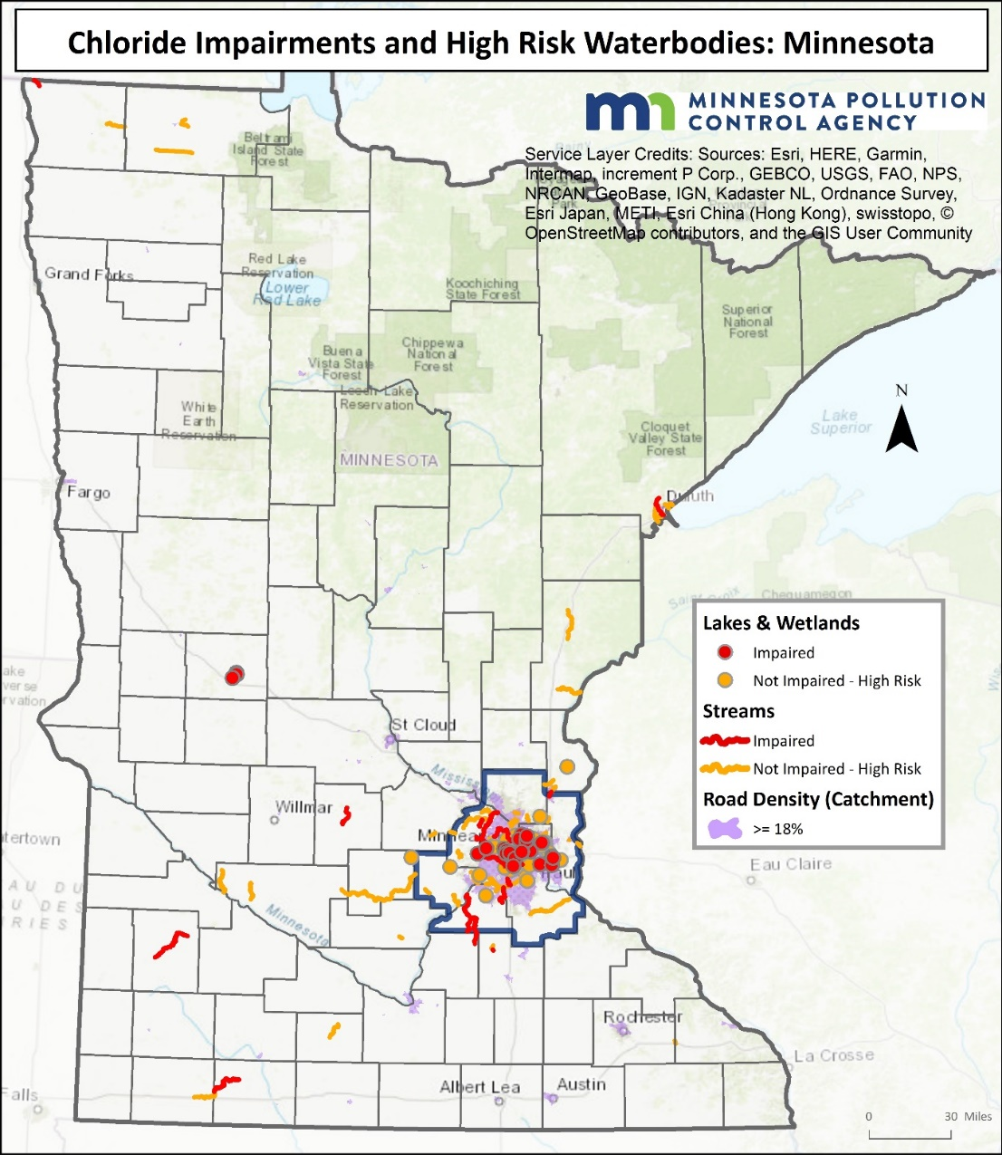
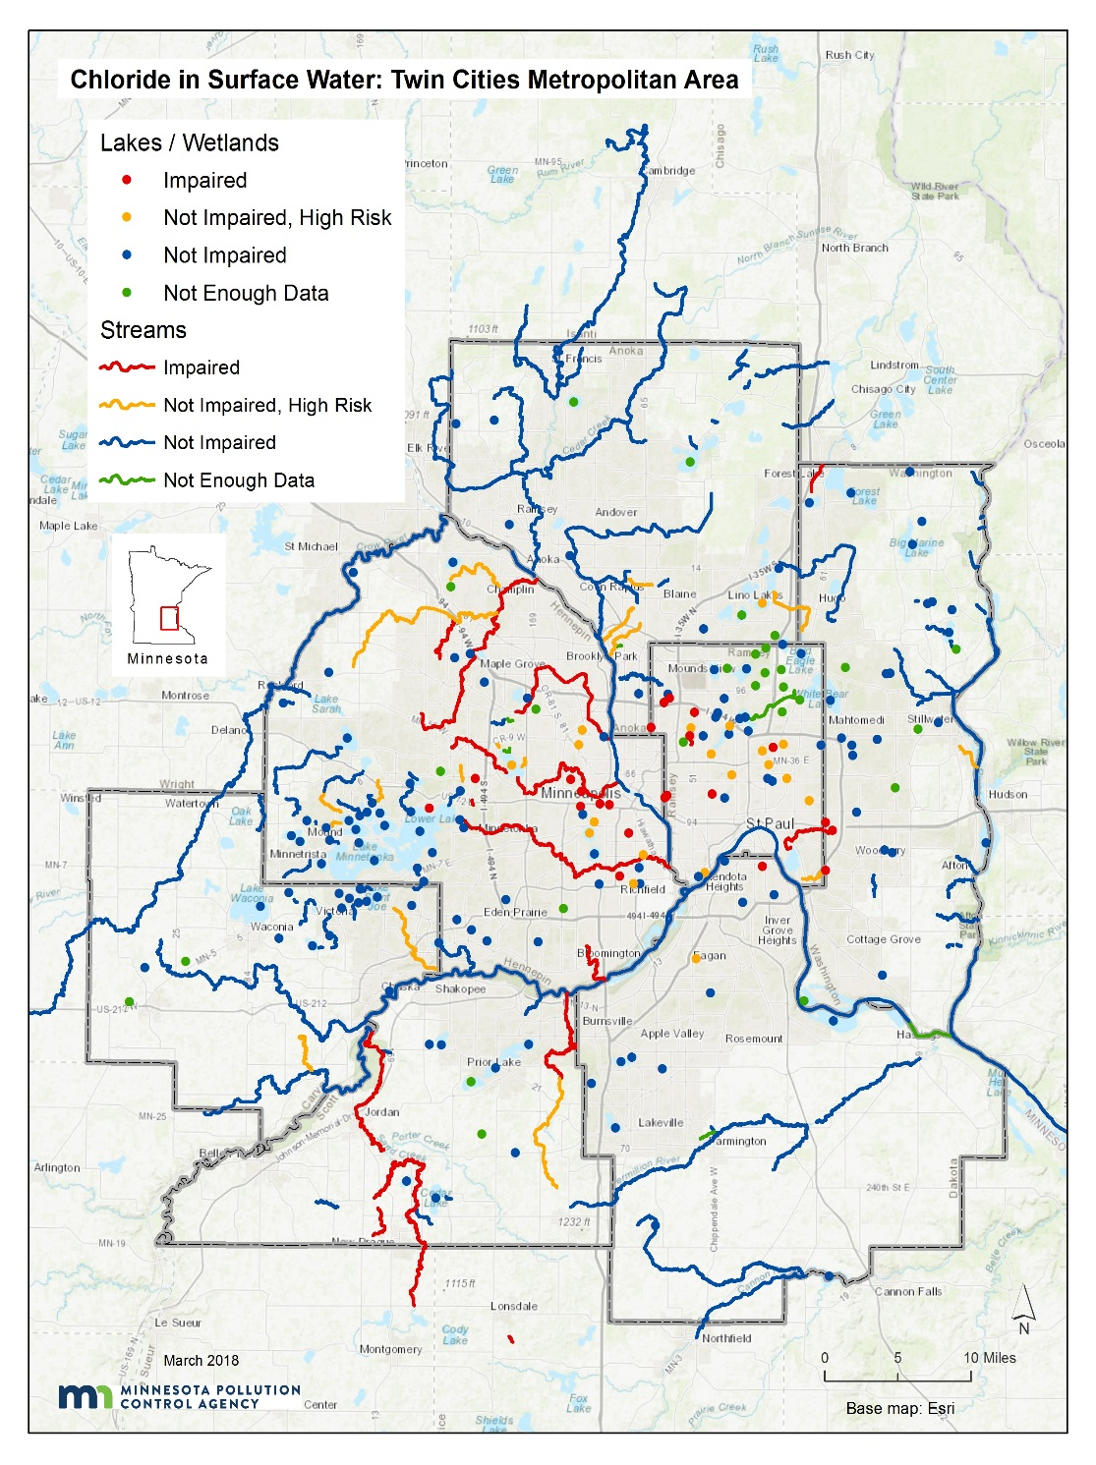
Chloride in surface water

Slide 7
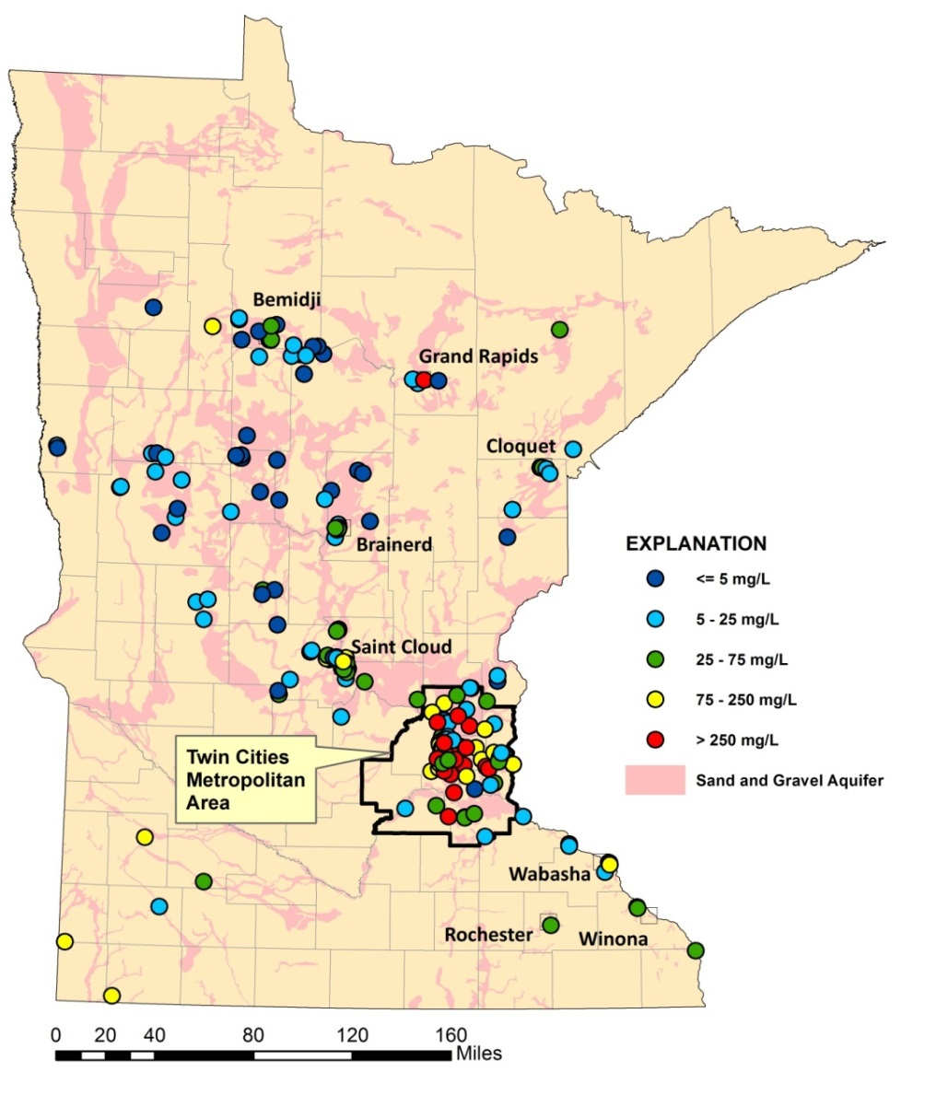
Chloride in groundwater (MPCA, 2013)
Shallow sand & gravel aquifers
Bedrock aquifers

Slide 8
Summary of water quality status
Statewide
26 lakes were impaired as of 2018
24 streams impaired as of 2018
Twin Cities Metro
23 lakes impaired
17 streams impaired
30% of shallow wells exceed the SMCL
Source: Draft Statewide Chloride Management Plan

Slide 9
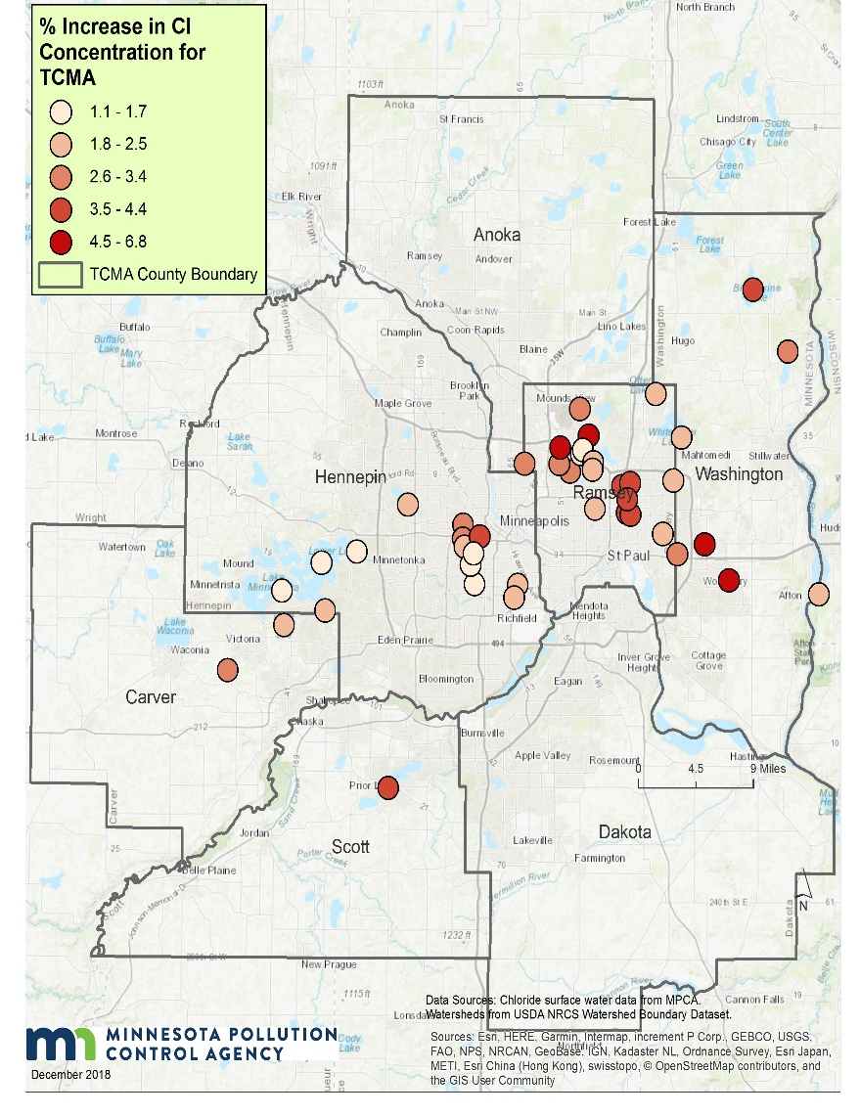
Lake trends
(Source: Draft Chloride Management Plan)
Upward trends in 46 of 69 lakes in TCMA
Outside TCMA, upward trends in 14 of 45 lakes
Rate of increase is greatest in lakes in TCMA urban core
Lakes - % increase per year

Slide 10
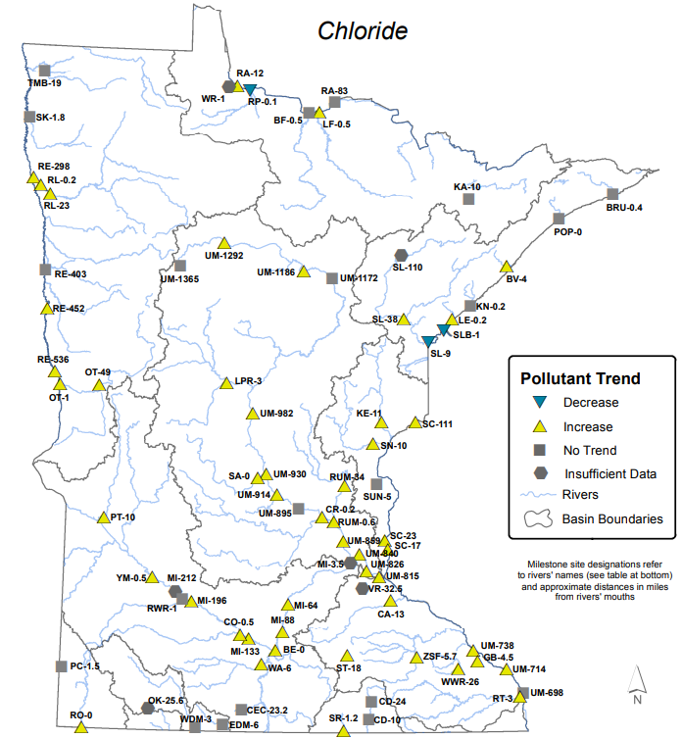
Flow-Adjusted Cl Trends
(MN Milestone sites, 2014)
(Met Council, 2018)

Slide 11
Groundwater trends
(Source: MPCA 2013)
Upward trends in 11 of 36 wells in shallow sand/gravel aquifers
Average rate of increase was 3.4 mg/L/yr, but rates were much higher is some wells

Slide 12
What makes a lake vulnerable to chloride contamination?
Impervious surface and road density within 500 meters of a lake
Deep relative to lake area
Poor mixing
Season (in urban areas)

Slide 13
Consequences of elevated Cl in lakes?
Disrupts community structure (Hintz et al., 2017)
Chemostratification (Novotny and Stefan, 2012)

Slide 14
What makes a stream vulnerable to Cl contamination?
Miller Creek, Duluth
Proximity to inputs
More “winter” events in urban areas
Baseflow
Bassett Creek, Minneapolis
(Source: Bassett Creek WMC)

Slide 15
What are the consequences of high chloride concentrations in streams?
Streambank vegetation impacted above 1500 ppm (Tiwari and Rachlin, 2018)
The most sensitive insects are impacted at about 240 mg/L (Blasius and Merritt, 2002)
Benthic IBI declines started at 190 mg/L (Maryland DNR, 2014)

Slide 16
What makes groundwater vulnerable to Cl contamination?
Land use
Road density
Geologic setting
Stormwater infiltration?
SW
I_{perv}
I_{imperv}
I_{infil}
I_{filt}
I_{ponds}
L_{pi}
L_{ww}
L_{sw}
Groundwater

Slide 17
Knowns and unknowns
Many surface waters are impaired by chloride; most are not
Chloride concentrations in receiving waters are increasing
Groundwater impacts are uncertain, especially deeper aquifers
What will concentrations be at current input levels?
What are “acceptable” input levels?

