Slide 1
Enhancing Multiple Benefits of Green Stormwater Infrastructure
Carlee Kjeldahl
Mike Trojan
Board of Water and Soil Resources Academy
October 26, 2022

Slide 2
Learning Objectives
Understand the multiple benefits of green stormwater infrastructure (GSI) practices
Understand potential design, construction, and O&M considerations in achieving multiple benefits of GSI
Work on one or more example scenarios where GSI is utilized to achieve multiple benefits

Slide 3
Agenda
Definition and overview of green stormwater infrastructure (GSI) practices
Discussion/Questions
Design, construction, and O&M considerations
Exercise 1
Integrating GSI practices
Exercise 2
Tools and resources
Discussion and conclusion

Slide 4
1. Definition and overview of Green Stormwater Infrastructure (GSI)

Slide 5
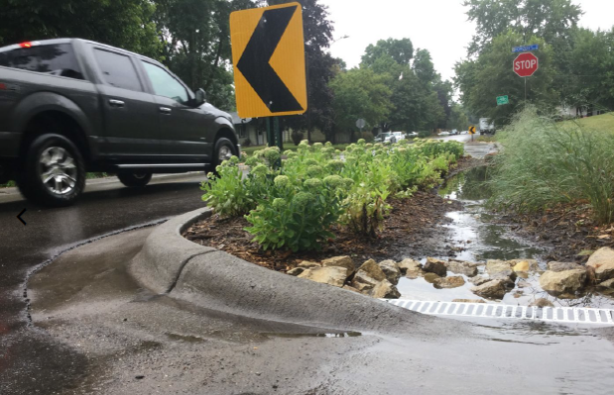
What is Green Stormwater Infrastructure?
Stormwater practices that use natural systems (or engineered systems that mimic or use natural processes) to capture, clean, and infiltrate stormwater; shade and cool surfaces and buildings; reduce flooding, create wildlife habitat; and provide other services that improve environmental quality and communities’ quality of life
Focus in this presentation is on urban stormwater
A couple slides on agriculture

Slide 6
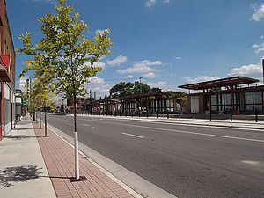
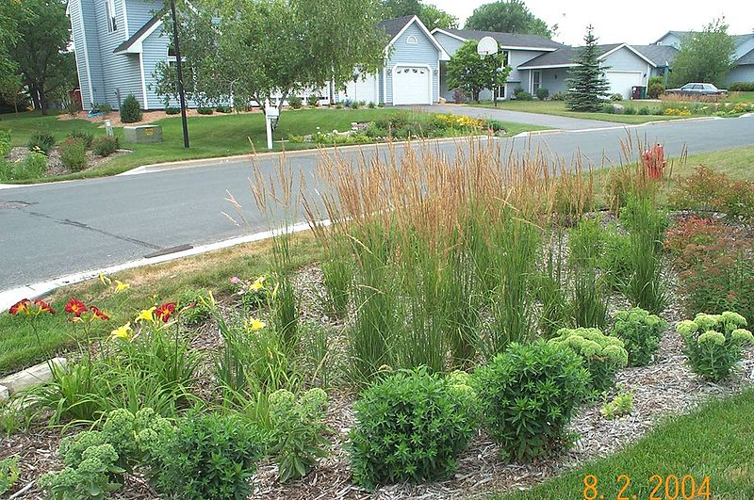
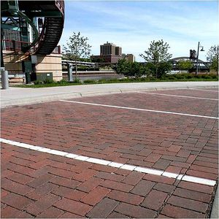
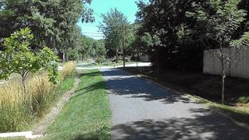
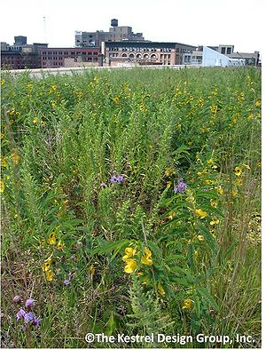
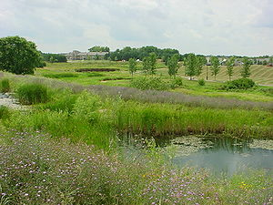
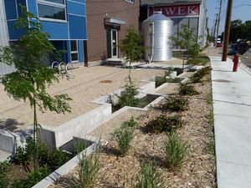
Example practices
Bioretention/Tree trenches
Green roofs
Swales/filter strips
Infiltration/permeable pavement
Constructed wetlands
Harvest/use systems

Slide 7
Potential benefits
Water quality
Water quantity/hydrology
Climate resilience
Habitat improvement
Air quality
Energy savings
Community livability
Health benefits
Economic savings
Macroscale benefits
DRAFT

Slide 8
2. Discussion/Questions
What do you think of when you think of multiple benefits?
Are they seen or unseen benefits or both?
Name potential benefits you see in the images

Slide 9
3. Design, construction, and O&M considerations

Slide 10
Notes
Sometimes a design, construction, or O&M feature provides one benefit but a cost for something else
It is important to identify the benefit(s) you want before implementing design, construction, or O&M features
BMPs can often be used in tandem to provide benefits and overcome costs (discussed later)

Slide 11
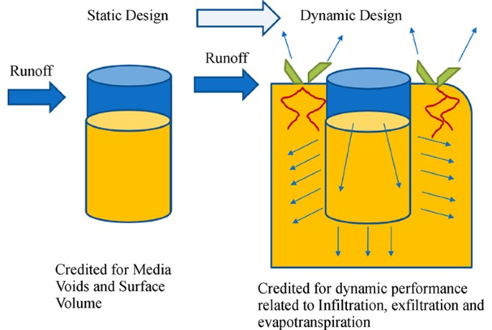
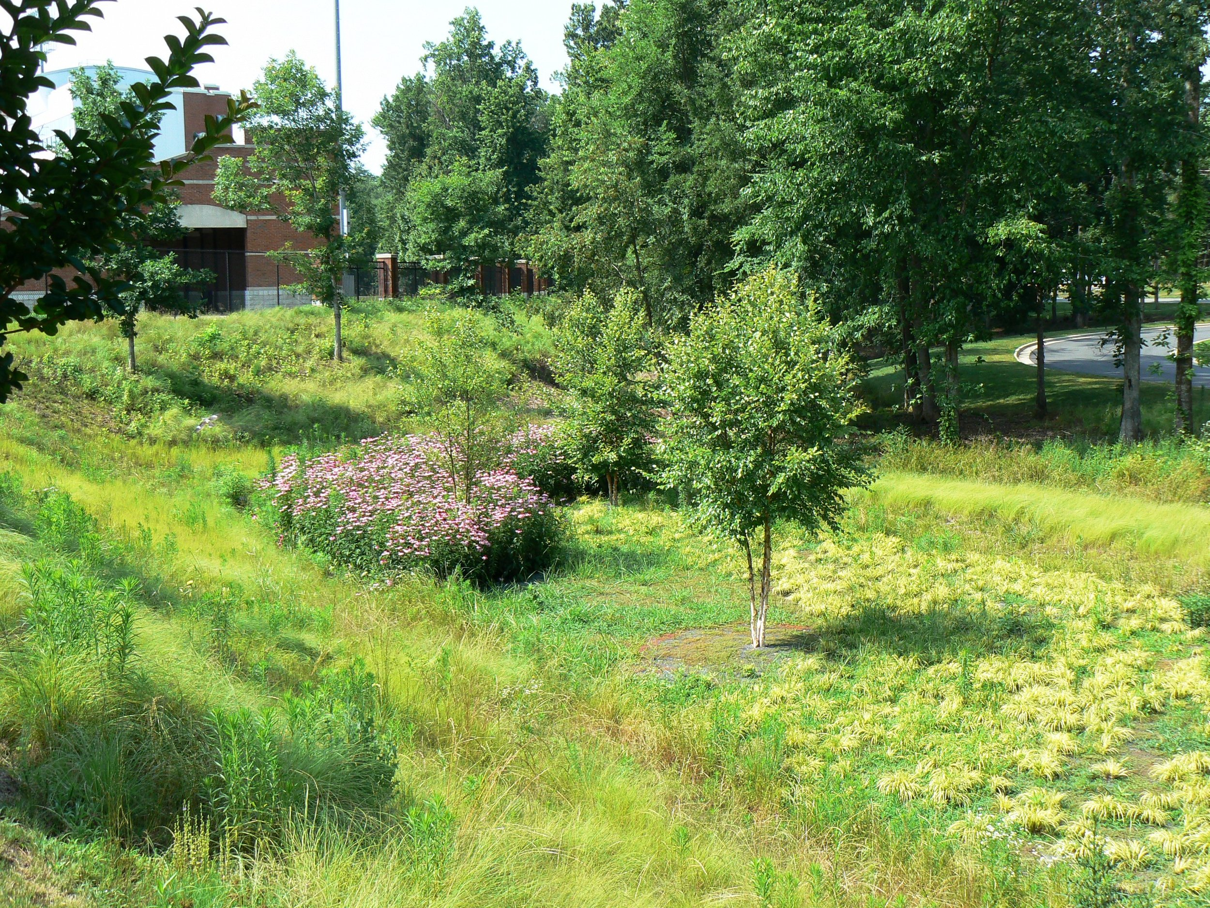
Bioretention/tree trench/infiltration trench
Water quality and water quantity
Maximize infiltration and capture
Design media to maximize pollutant retention
Design media and system to maximize water capture and storage
Use trees

Slide 12
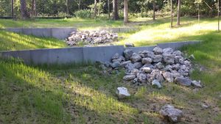
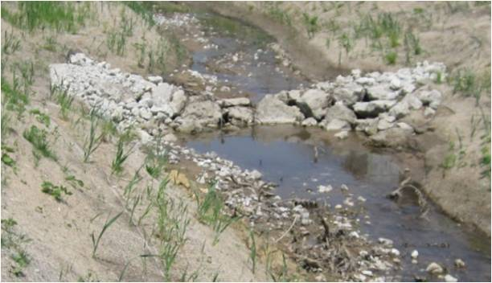
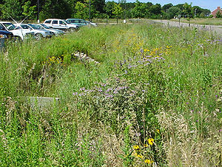
Swales and filter strips
Water quality and water quantity
Promote infiltration on permeable soils
Promote rate control on less permeable soils
Vegetation considerations
Physical considerations for side slopes and main channels
Media considerations

Slide 13
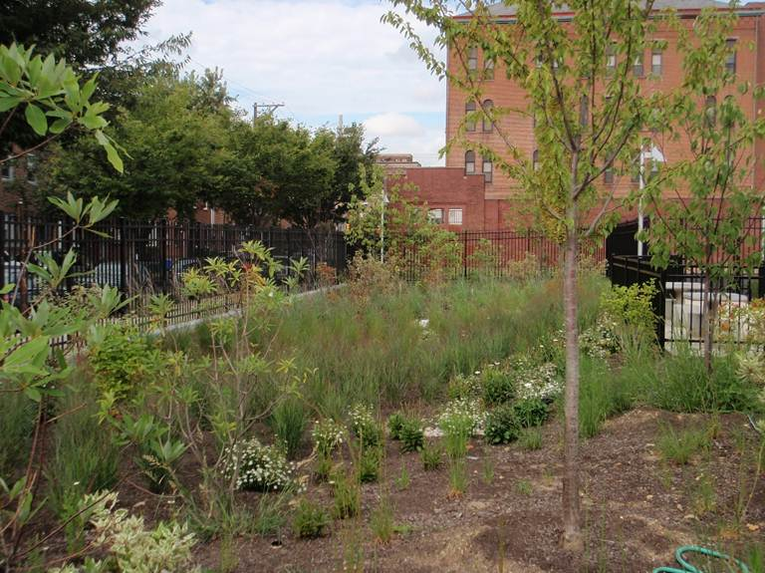
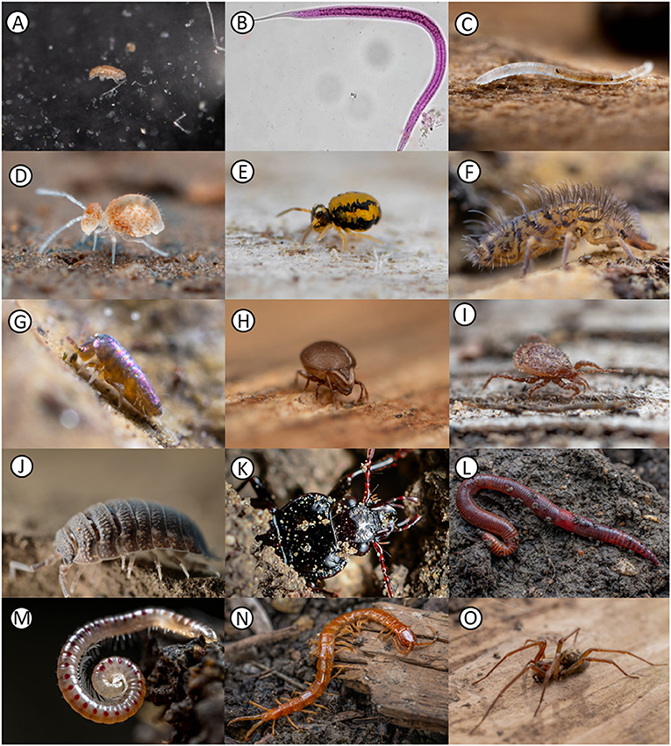
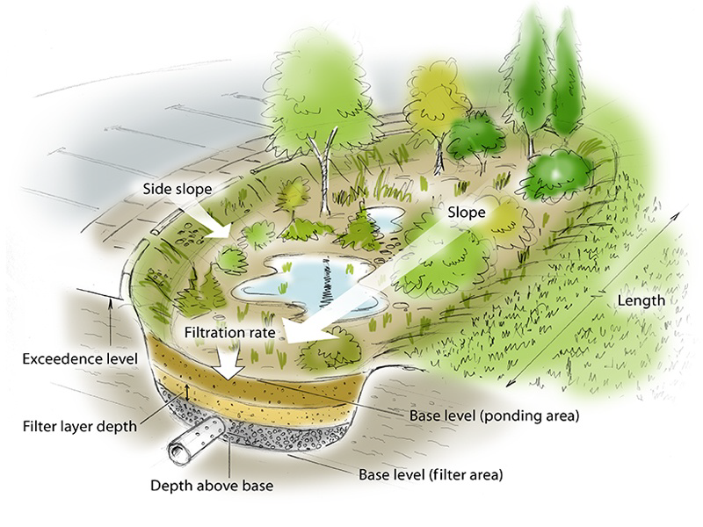
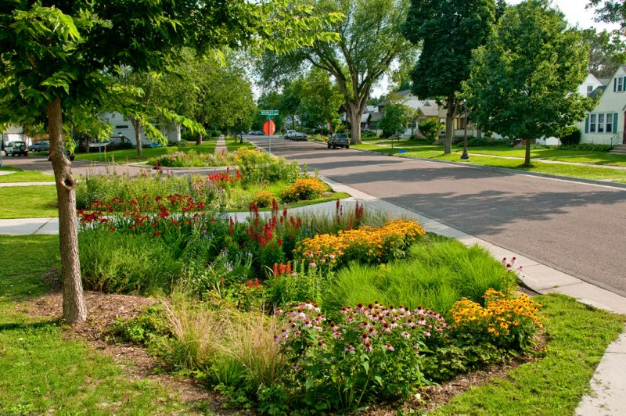
Bioretention, tree trench, infiltration trench, bioswale, filter strip
Habitat
Use native, perennial vegetation
Use trees and shrubs
Use multiple plant taxa
Consider size and shape
Evaluate adjacent plant communities
Soil promotes invertebrates
Utilize side slopes for habitat

Slide 14
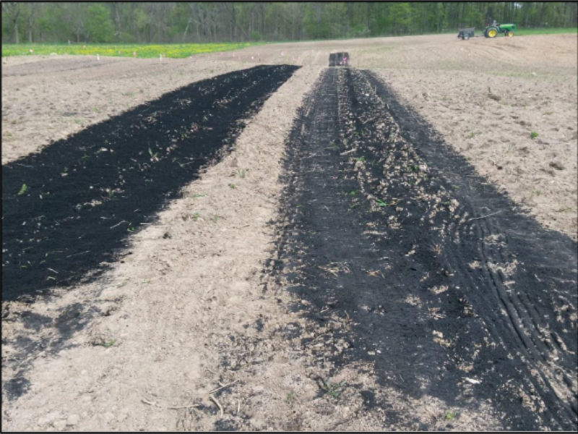
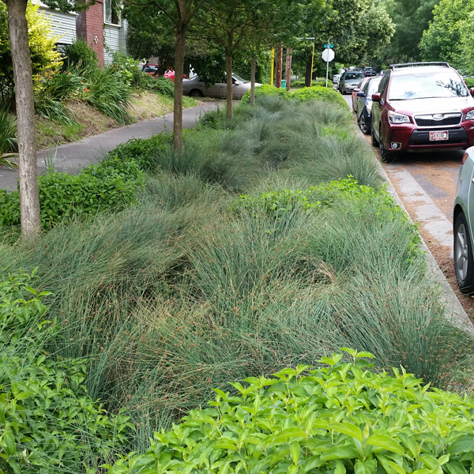
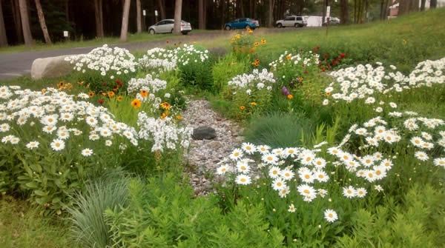
Bioretention, tree trench, infiltration trench, bioswale, filter strip
Climate and energy
Tolerant/adaptable plant species
Plants that reflect and/or have high evapotranspiration rates
Maximize plant and soil carbon sequestration
Maximize infiltration and water storage

Slide 15
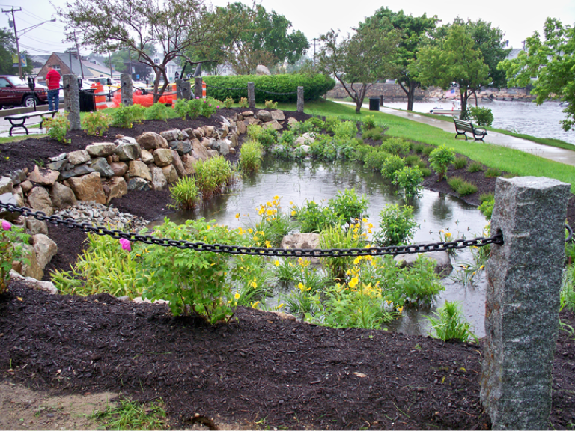
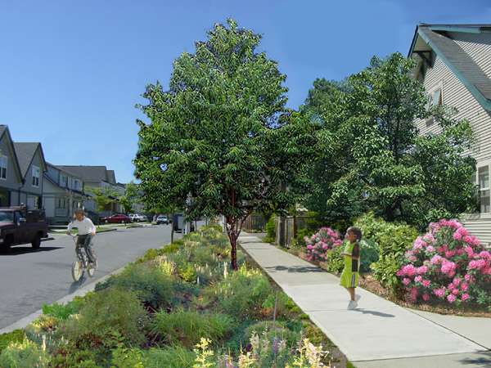
Bioretention/tree trench/infiltration trench
Social benefits
Enhance aesthetics
Select trees that provide air quality benefits
Ensure adequate maintenance of vegetation and soil but minimize carbon footprint of O&M

Slide 16
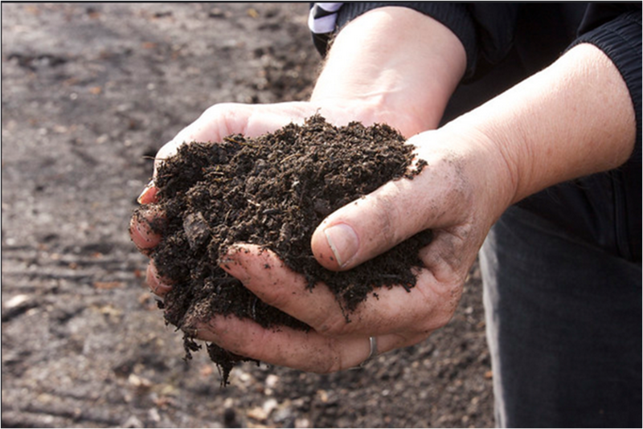
Green roofs
Water quality and quantity
Use amendments that retain phosphorus
Increase media depth
Increase sorptive properties of media
Blue-green roofs
Reuse water on site

Slide 17
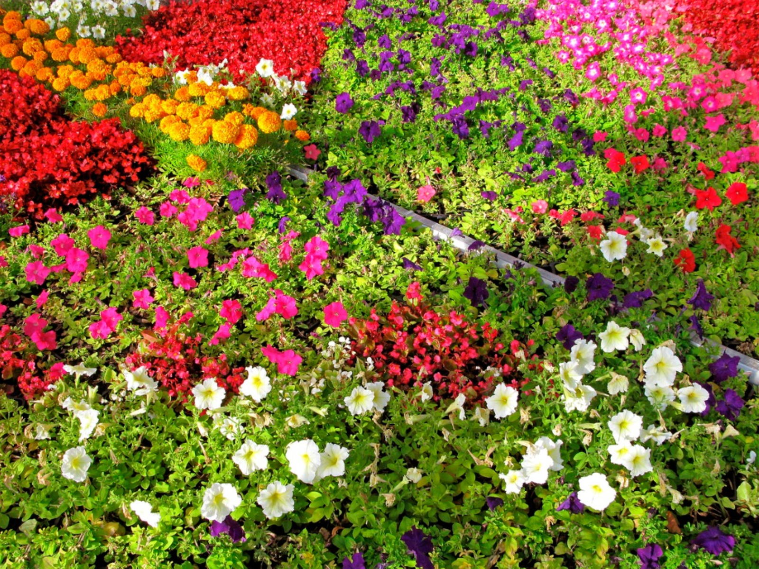
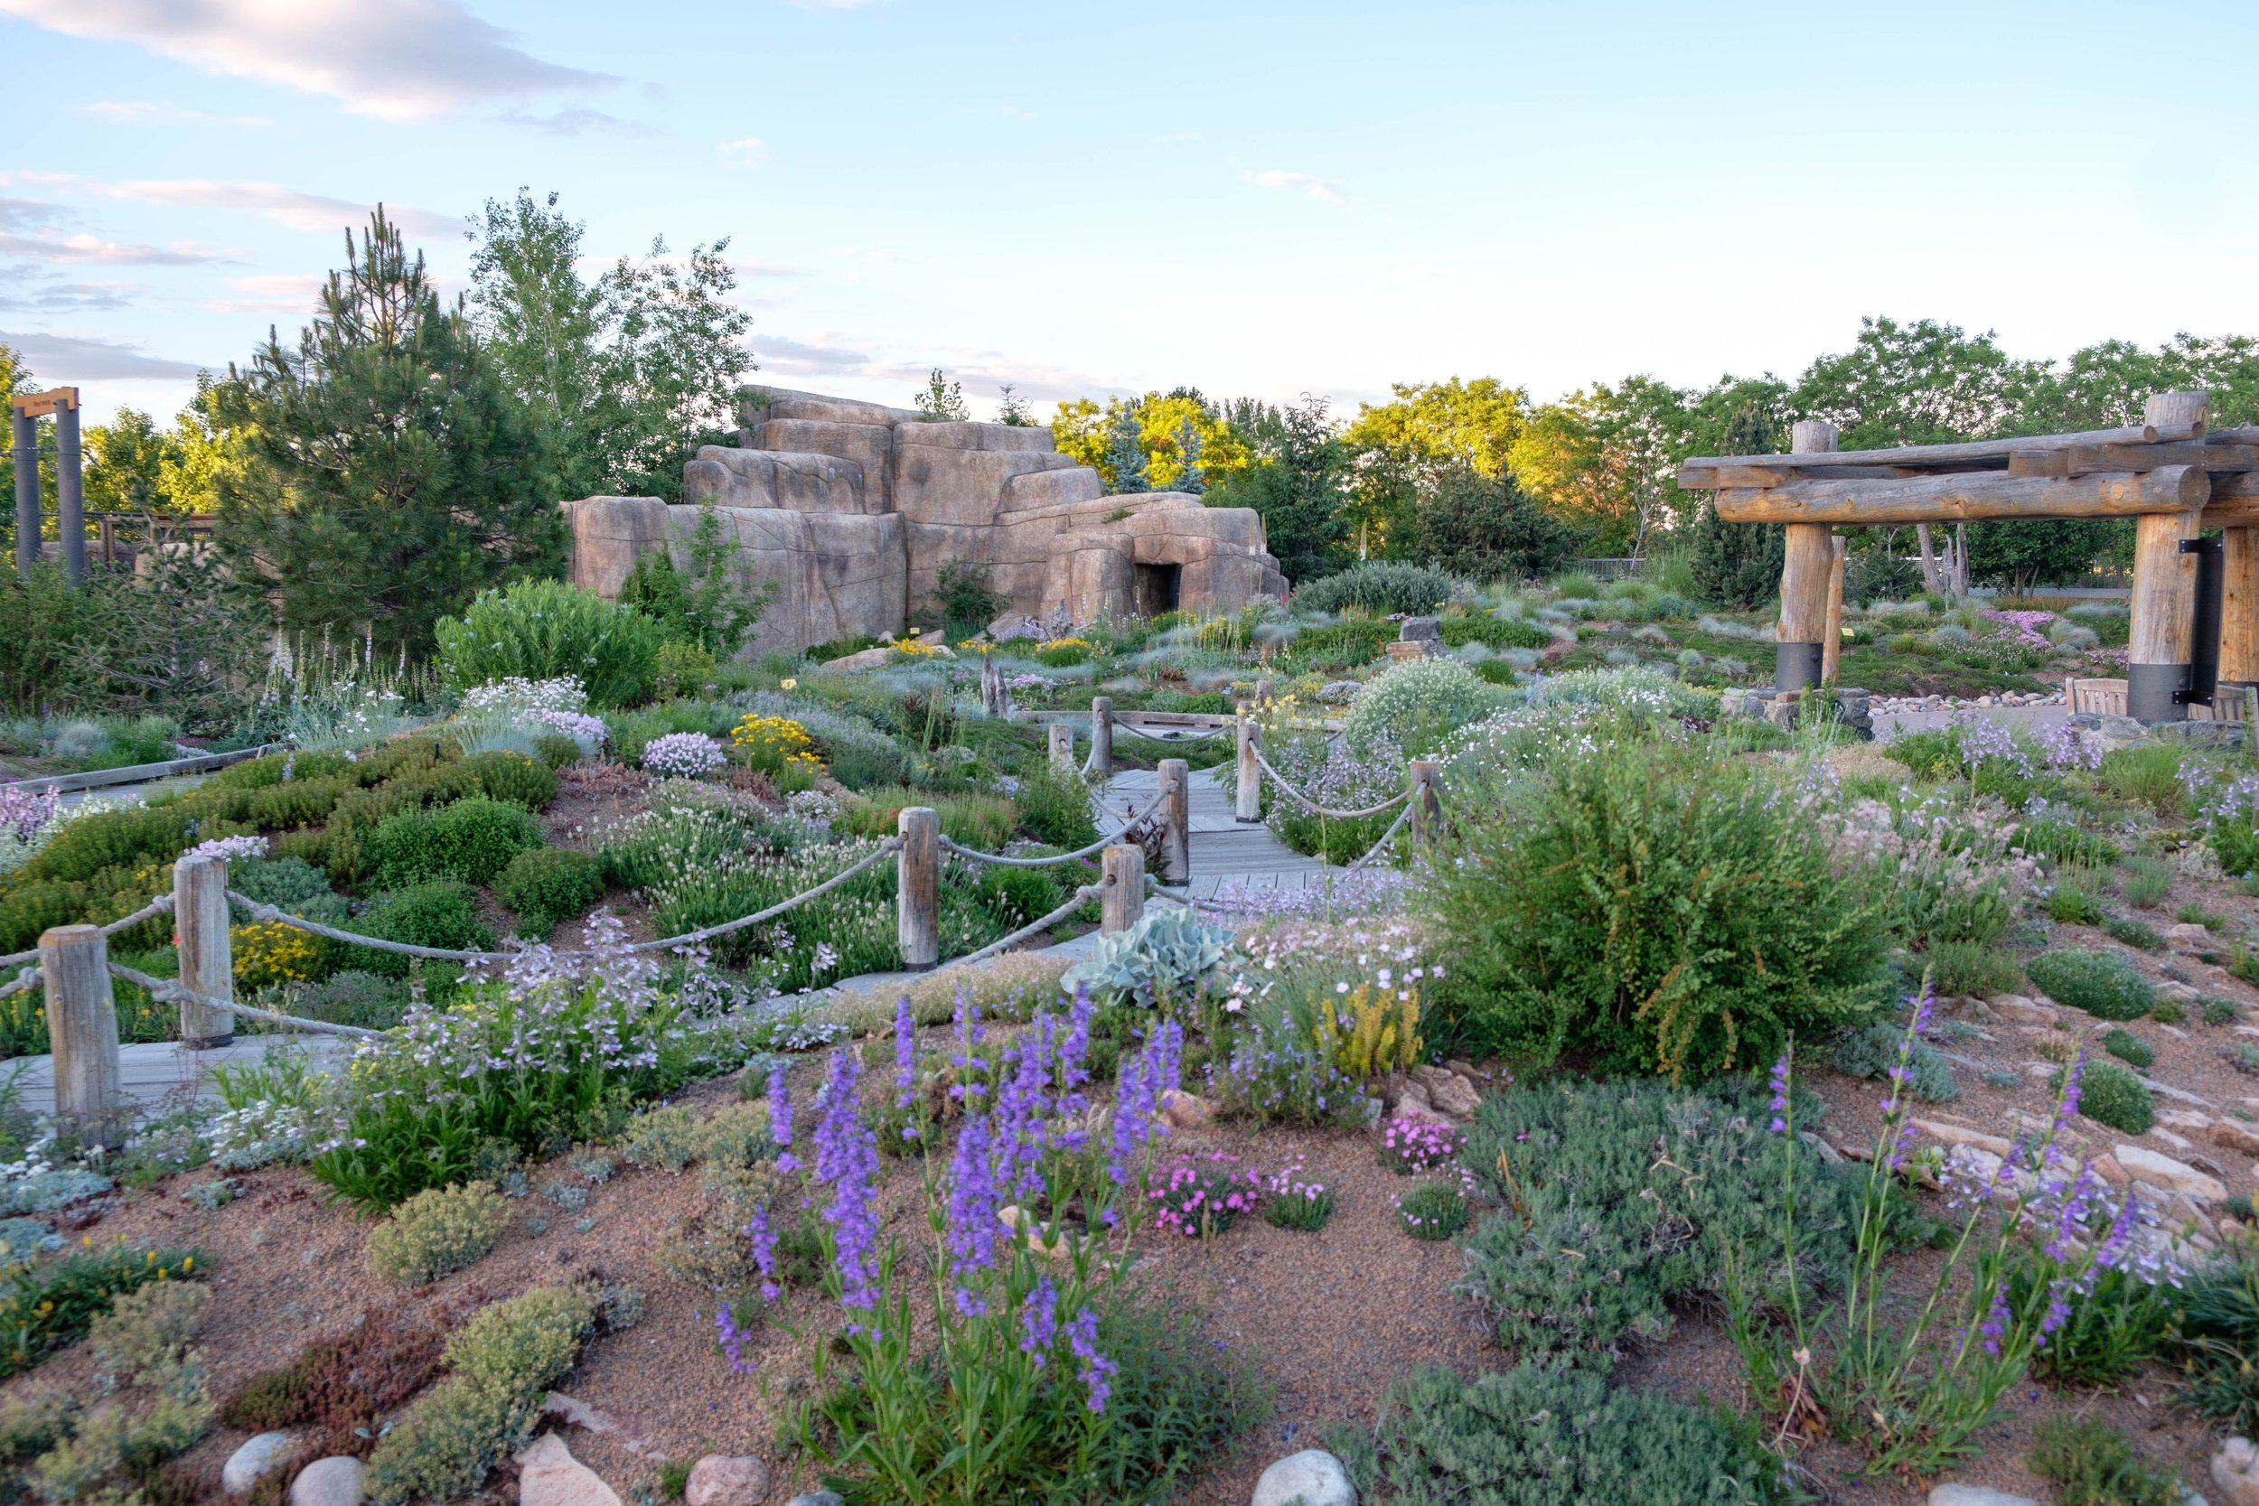
Green roofs
Habitat
Incorporate annuals into the design
Increase plant diversity, including shrubs, grasses, and sedums

Slide 18
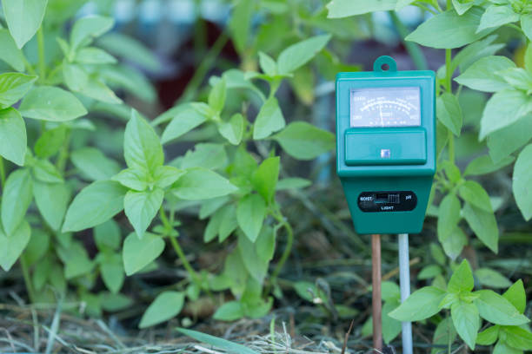
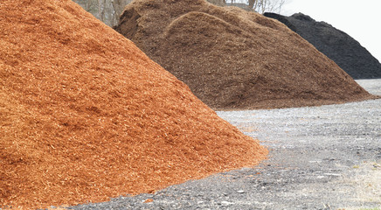
Green roofs
Climate and energy
Plant diversity adapted to microclimates and ecoregion
Incorporate grasses
Select vegetation with high root density
Use light-colored mulch
Use moisture sensors if irrigating

Slide 19
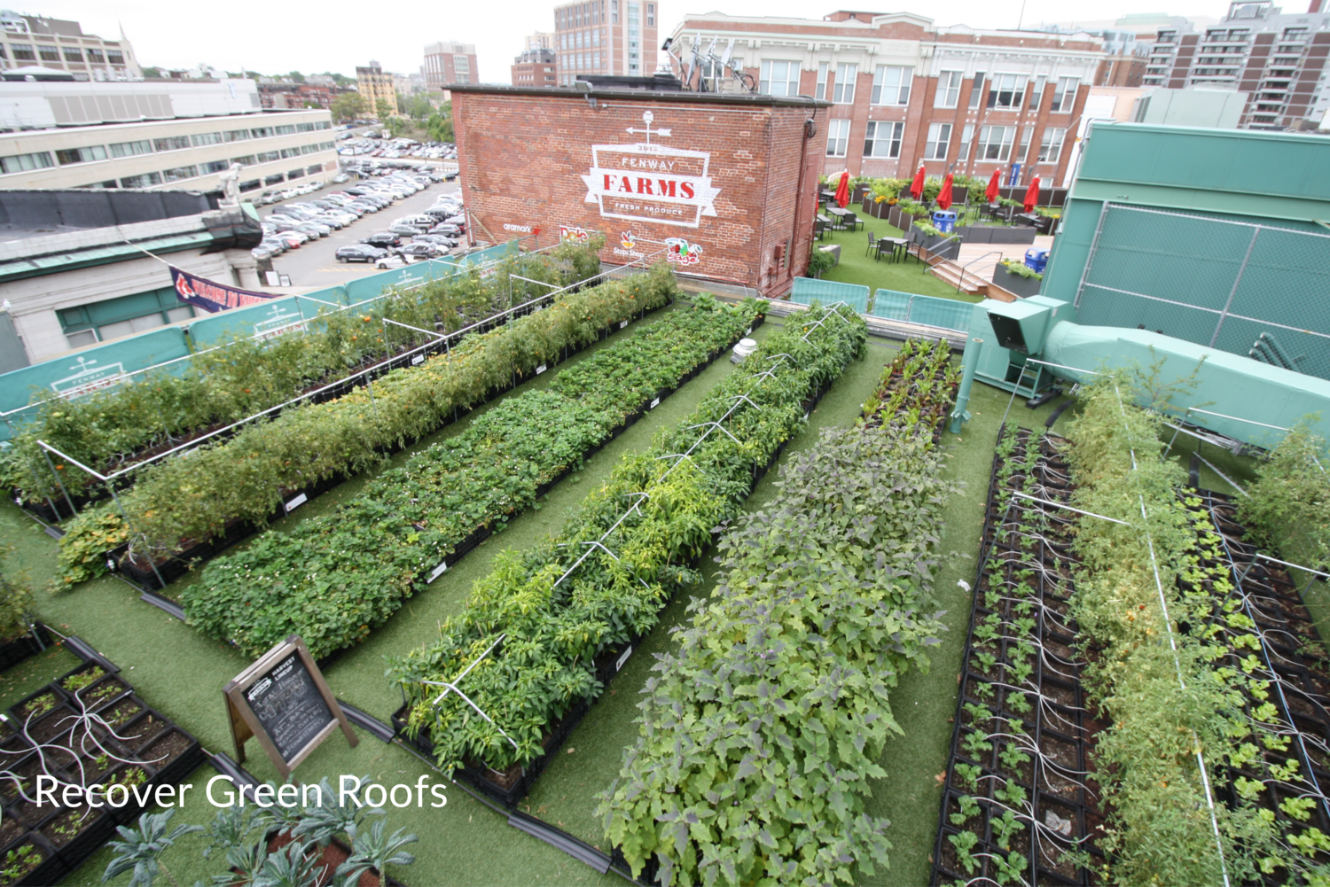
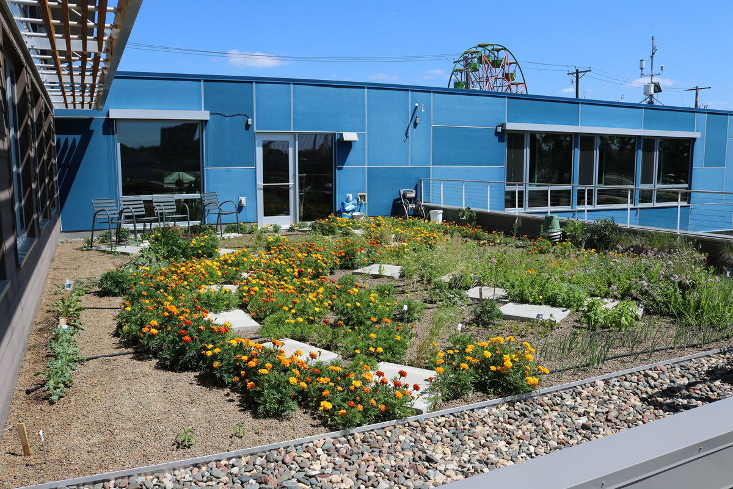
Green roofs
Social benefits
Food production
Consider form and function

Slide 20
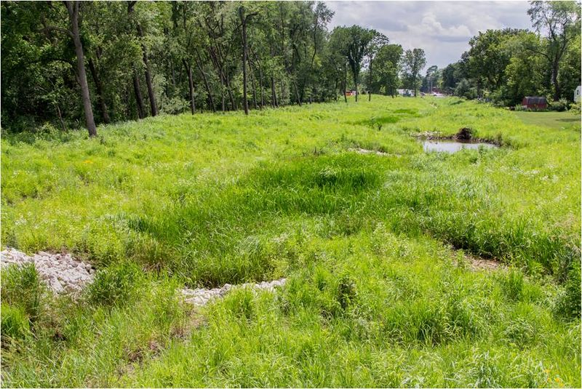
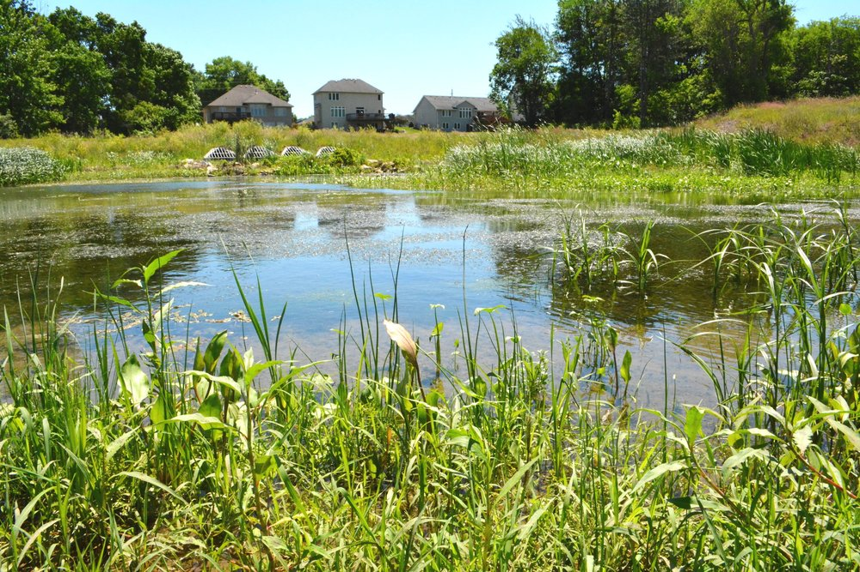
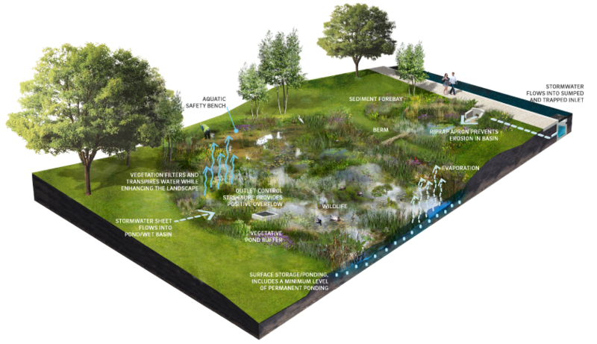
Ponds and wetlands
Water quality and water quantity
Multiple connected wetlands
Create zones
Promote diverse vegetation
Increase length:width ratio

Slide 21
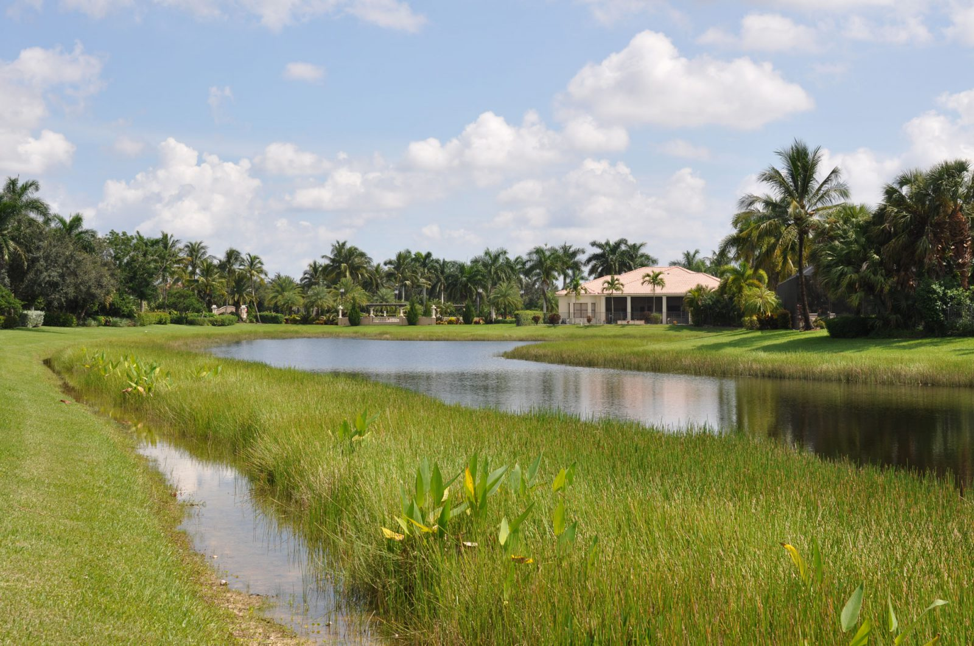
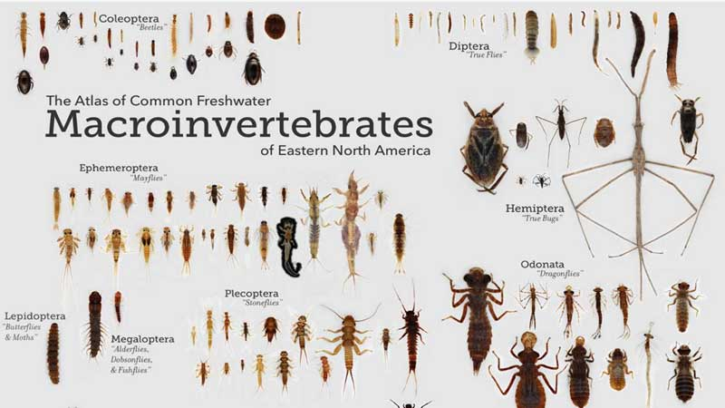
Ponds and wetlands
Habitat
Include a littoral shelf
Plant vs. allow natural colonization
Promote a diversity of organisms

Slide 22
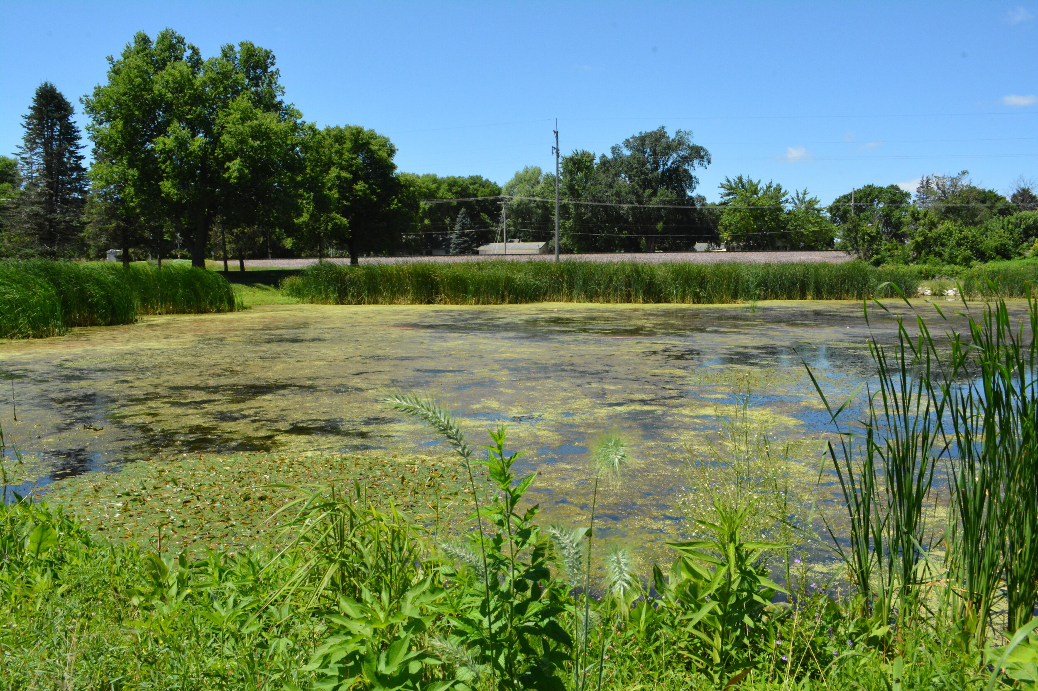
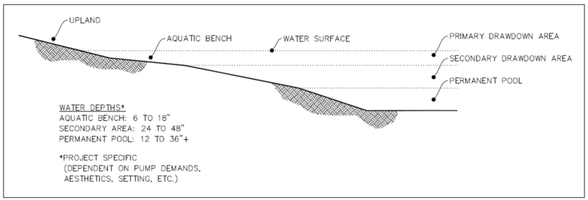
Ponds and wetlands
Climate and energy
Promote dense vegetation
Avoid permanent inundation
Utilize subsurface water flows

Slide 23
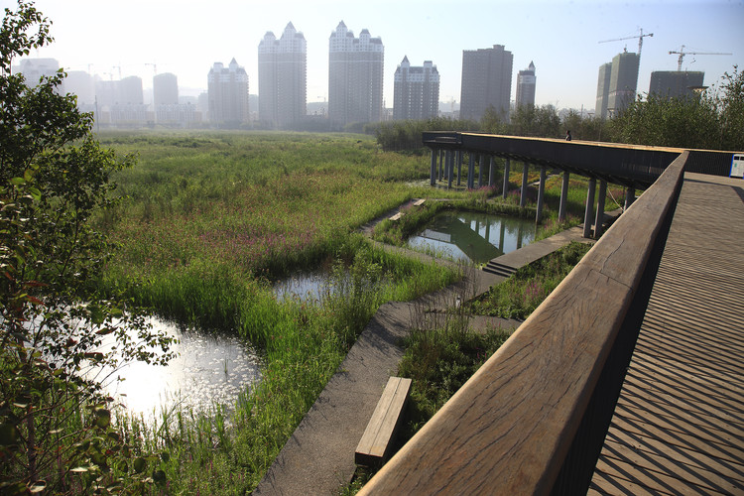
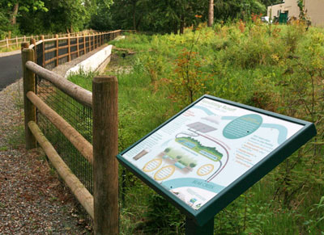
Ponds and wetlands
Social benefits
Incorporate design features to enhance recreational use
Incorporate open space
Incorporate informational signage

Slide 24
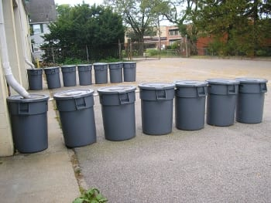
Harvest and use
Water quality and water quantity
Consider pollutant sources in determining level of pretreatment/need for first flush diverter
Maximize storage capacities and prevent short-circuiting
Use appropriate residence times
Distributed harvest systems and tandem systems
Blue-green roofs

Slide 25
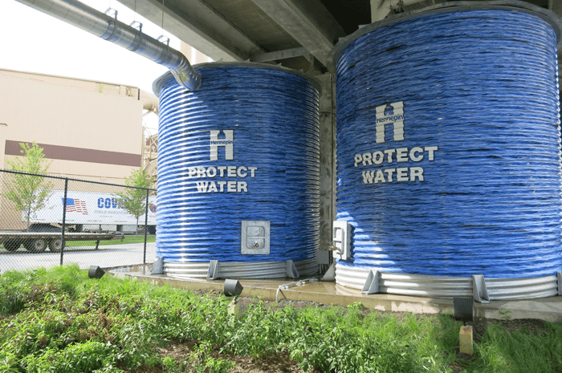
Harvest and use
Habitat
Enhance wildlife benefits
Ensure practices do not put wildlife at risk
Properly manage runoff from surfaces likely to have elevated temperatures in runoff

Slide 26
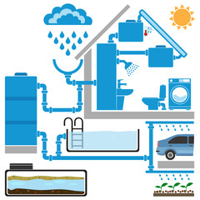
Harvest and use
Climate and energy
Maximize storage (see water quantity)
Incorporate vegetation into site design to enhance carbon sequestration
Enhance harvesting for home gardens and crops
Use energy efficient sources

Slide 27
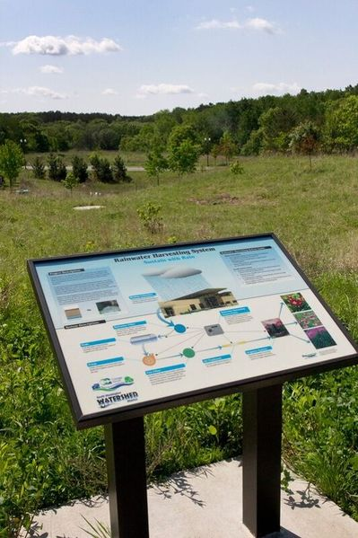
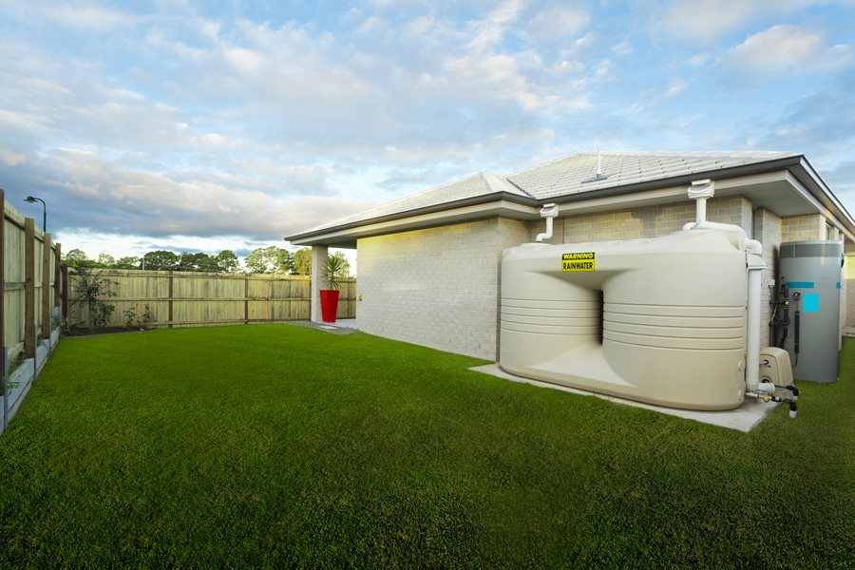
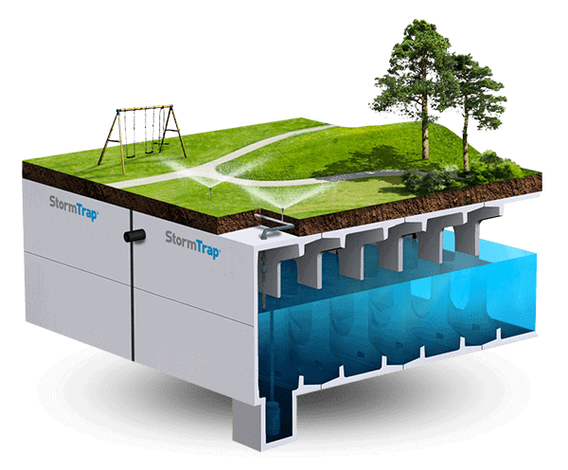
Harvest and use
Social benefits
Include recreational infrastructure and interpretive signs
Design for improved aesthetics
Minimize mosquito habitats
Use to replace treated water

Slide 28
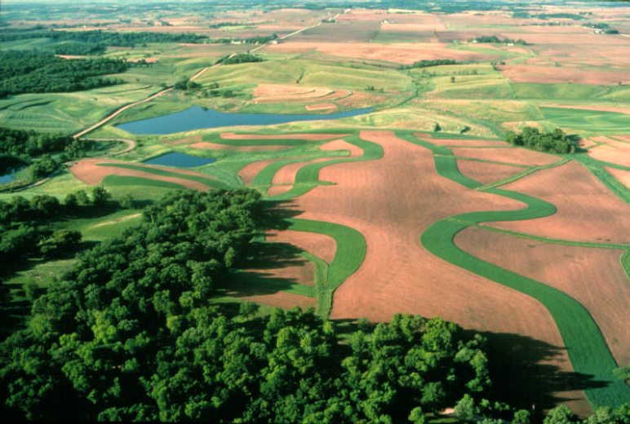
Agricultural settings
Research on stormwater runoff has lagged behind urban settings
Focus on soil erosion
Recently framed under the umbrella of sustainable agriculture
Restoring native landscapes and wetlands
Management of riparian and field edges
Chemical use
Cover crops and crop rotation
Reduced tillage
Modifying grazing patterns

Slide 29
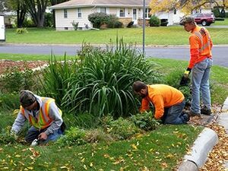
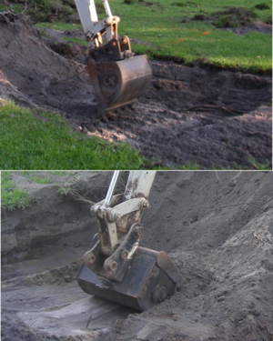
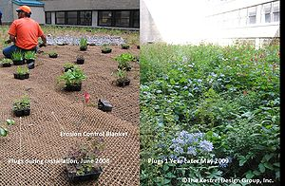
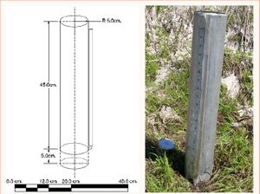
All practices require proper maintenance
Considerations
Design
Construction
Post-construction
First year
Once or more per year
Every 1-5 years
Non-routine

Slide 30
Exercise
Pick one or two GSI practices
Design it to meet your desired needs/benefits. Make sure you fully understand and describe the situation/context where the practice(s) is/are being applied
What are some limitations or negative consequences of your design?
Score your practice(s). How do the design elements you incorporate change your score?
Look at the list of sustainable agricultural practices in a previous slide
Which benefits do these practices deliver and what is the magnitude of those benefits (low, medium, high)?
What are some additional practices not included in the slide?

Slide 31
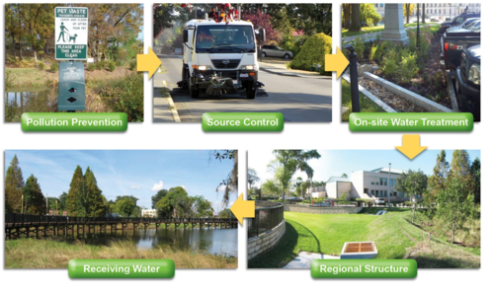
Integrating GSI practices
Maximize benefits by combining multiple GSI practices (treatment train)
Consider goals of the practices
Most important goals for stormwater are typically water quality and hydrology
Are other GI goals desired (e.g. LEED certified buildings)
Consider site features
Physical characteristics (e.g. soils, drainage, hydrology)
Existing conditions and opportunities
Role of grey infrastructure
Economic and social analysis

Slide 32
Scale
Site
Neighborhood
Watershed or larger

Slide 33
SITE: Xcel Energy Marshall Operations Center
Infiltration basins, vegetated swales, pretreatment
Wetland and upland features, native vegetation
Stormwater treatment, habitat, walking path, patio area, interpretive information, bike and pedestrian connections, Brownfield reclamation

Slide 34
NEIGHBORHOOD: Maplewood Living Streets
Rainwater gardens, tree systems, regional filtration basin
Native perennial vegetation, drought tolerant trees
Stormwater treatment, habitat, safer traffic, bike and pedestrian connections, shade, carbon sequestration, economic savings

Slide 35
CITY: Lancaster PA
Driven by combined sewer overflows
Combine grey and green infrastructure
GSI – Infiltrate, capture and reuse, evapotranspire
Environmental, social, economic benefits

Slide 36
Process
Evaluate impervious cover
Identify opportunities
Conduct multiple benefit analysis
Match practices to opportunities and suitability

Slide 37
Strategies
Increase tree canopy cover from 28 to 40% (green streets, alleys, sidewalks)
Incorporate tree trenches and permeable pavement into parking areas
Roofs: 30 acres of green roof and downspout disconnection
Renovate, redesign, and reconstruct existing green spaces to incorporate GSI
Reduce imperviousness on public property
Residential and commercial property
New impervious surface must manage first inch of runoff
Establish GI grant fund
Tie stormwater utility fee to site imperviousness
Demo projects, partnerships, education and outreach, comprehensive plans, modeling and other technical tools, ordinances and incentives

Slide 38
Agricultural settings

Slide 39
Exercise
Pick one of the following. At a high level, design a system utilizing GSI. Describe goals you’re your system, high level strategies, site considerations, and individual practices you will use. Describe why you selected those practices, the benefits they provide, design features, and how the practices are used in tandem. Describe any drawbacks or constraints. Assume no budget constraints unless you want to include that as a variable.
A residential neighborhood
A mixed urban land use setting
An urban watershed
A large farm with multiple farming practices (e.g. crop, livestock)
An agricultural watershed

Slide 40
Considerations in applying GSI practices
How can imperviousness be decreased?
How can impervious surfaces be disconnected?
How can water be routed?
How are pollutants treated in a series of treatment practices?
What practices?
How are these practices aligned?
How are these practices sized?
How can multiple benefits be “stacked”?

Slide 41
Exercise
Pick one of the following. At a high level, design a system utilizing GSI. Describe goals you’re your system, high level strategies, site considerations, and individual practices you will use. Describe why you selected those practices, the benefits they provide, design features, and how the practices are used in tandem. Describe any drawbacks or constraints. Assume no budget constraints unless you want to include that as a variable.
A residential neighborhood
A mixed urban land use setting
An urban watershed
A large farm with multiple farming practices (e.g. crop, livestock)
An agricultural watershed

Slide 42
Some recomendations
How can imperviousness be decreased? Permeable pavement, narrower streets, green roofs, tree-based systems
How can impervious surfaces be disconnected? Downspout disconnection to yards and rain barrels, filter strips and swales, harvest systems
How can water be routed? Vegetated conveyances, multiple detention
How are pollutants treated in a series of treatment practices?
What practices? Pretreatment for solids; strips and swales for solids and conveyance; basins for solids; infiltration and harvesting for dissolved pollutants
How are these practices aligned? Depends on site conditions and goals
How are these practices sized? Identify and minimize contributing areas and use multiple practices vs. regional practices
How can multiple benefits be “stacked”? Vegetation corridors, trees, complimentary distributed practices, local vs. regional practice placement

Slide 43
Tools and resources
Minnesota Stormwater Manual
Multiple benefits of green stormwater infrastructure
Green Stormwater Infrastructure (GSI) and sustainable stormwater management
Operation and maintenance of green stormwater infrastructure best management practices
Planning green stormwater infrastructure projects and practices
Green stormwater infrastructure case studies
Models and calculators
Case studies
Design guides
Professionals

Slide 44
Constraints to GSI
Cost
Social acceptance
Existing regulations
Operation and maintenance

Slide 45
Conclusion – discussion, questions?

