Slide 1
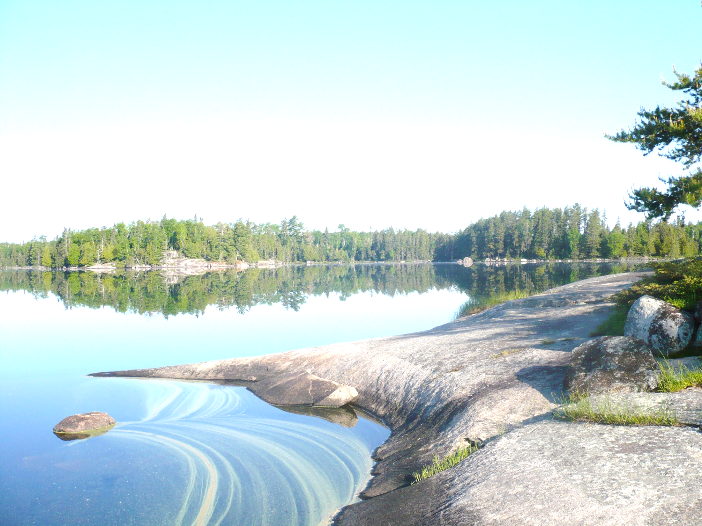
Impacts of Stormwater Infiltration on Chloride in Groundwater
Mike Trojan
MPCA Stormwater
February 7, 2019

Slide 2
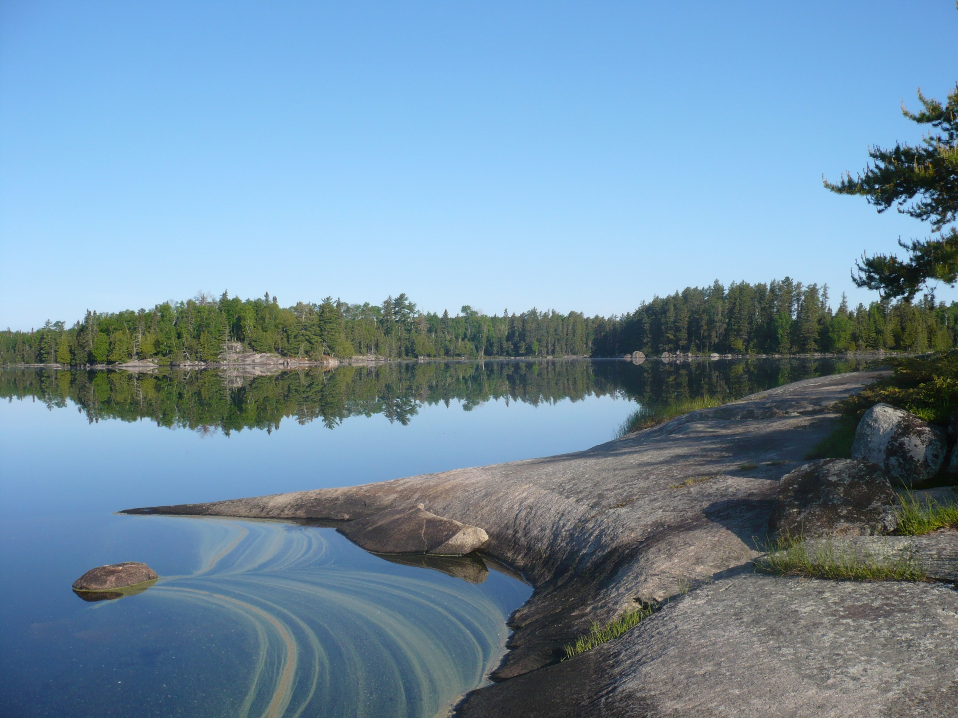
MN Groundwater Association white paper: Impacts of stormwater infiltration on chloride in groundwater
The group is still working on the white paper

Slide 3
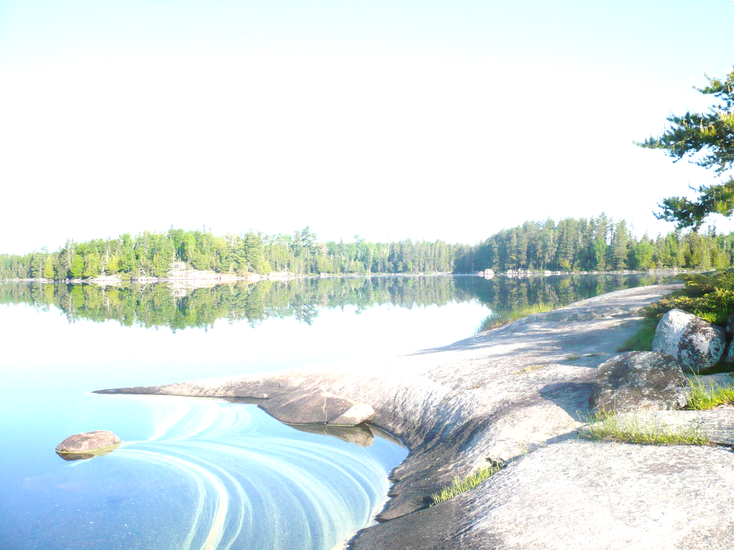
Outline
Salt application
Chloride concentrations in groundwater
Stormwater infiltration 101
Chloride in runoff
Fate of chloride in infiltration practices
Estimating chloride loads from infiltration practices
Summary
Potential recommendations

Slide 4
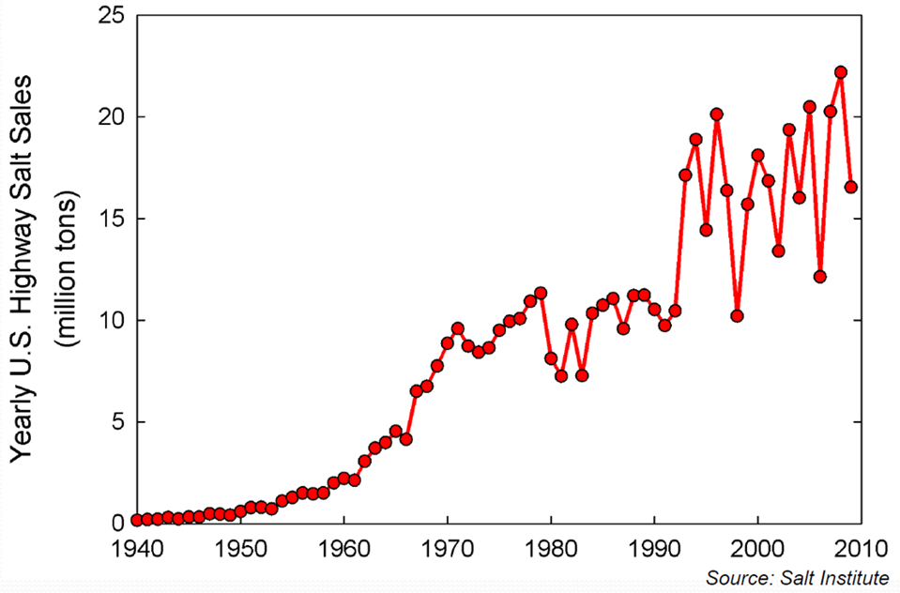
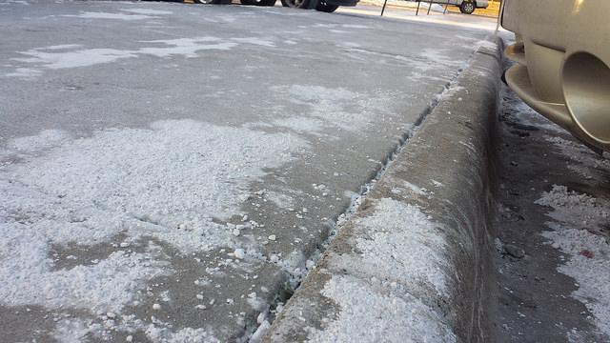
Salt application has increased

Slide 5
Elevated chloride concentrations in shallow groundwater
Source: MPCA Ambient Monitoring Program

Slide 6
Upward chloride trends in shallow urban groundwater
Source: MPCA Ambient Monitoring Program

Slide 7
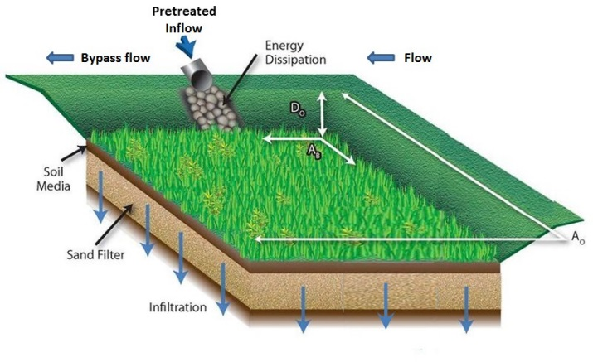
Stormwater infiltration- intentional infiltration of stormwater runoff

Slide 8
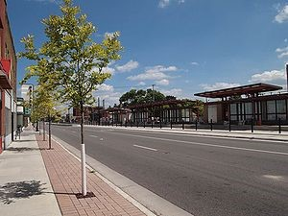
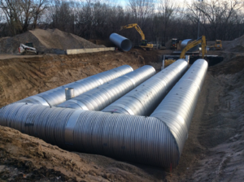
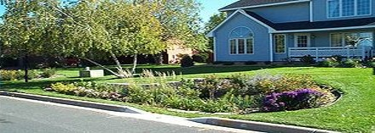
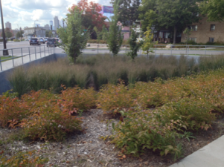
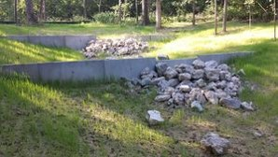
Infiltration BMPs
Bioinfiltration (rain gardens)
Tree trenches/boxes
Infiltration basins/trenches
Pemeable pavement
Some swales

Slide 9
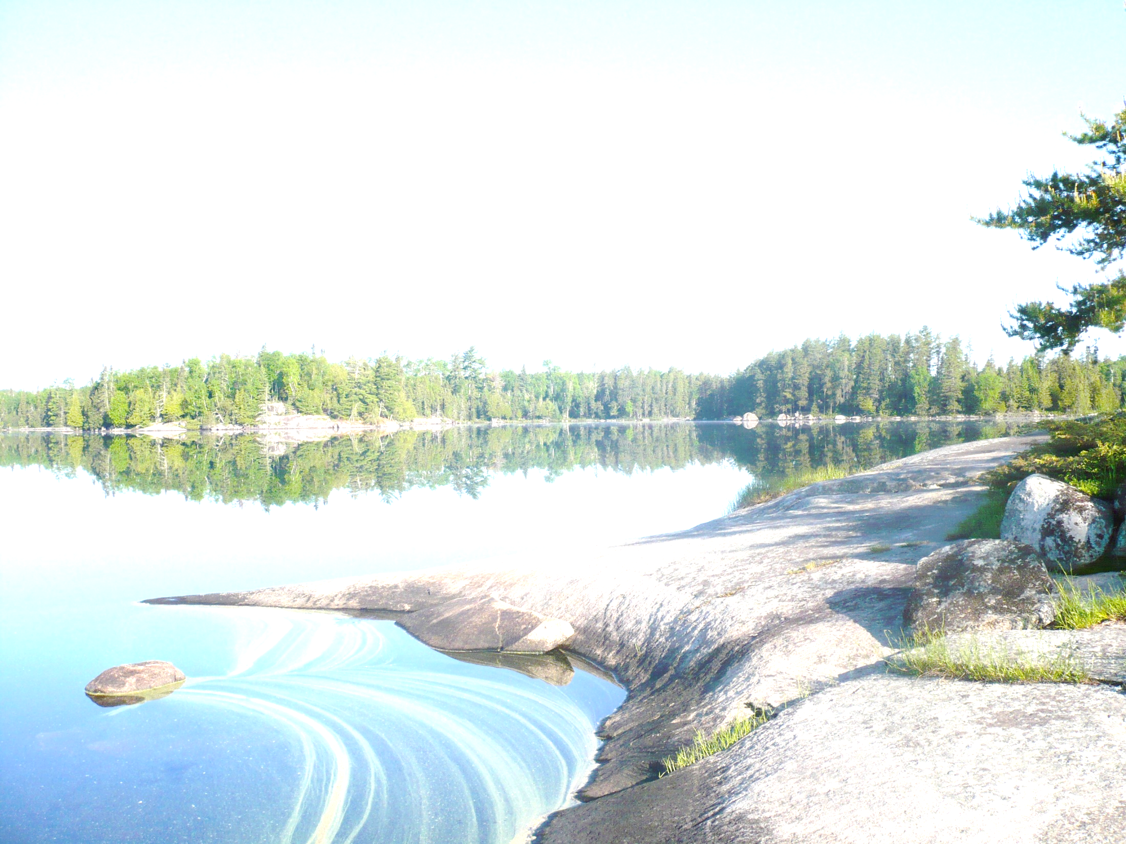
Infiltration is a preferred method for managing stormwater runoff
Benefit surface waters
Mimic natural hydrology
Use space efficiently
Provides ecosystem services
Effectively treat pollutants – except chloride

Slide 10
Infiltration practices focus recharge
Example: 1 acre of impervious runoff directed to an infiltration basin
Infiltration
basin
Typical design infiltrates 35-75 feet of water annually

Slide 11
Chloride in stormwater runoff

Slide 12
Fate of Cl⁻ in infiltration practices (from Machusick, 2009)
Rain garden
MW2
35 feet
MW3
Lysimeters
20 feet
Groundwater flow

Slide 13
Deicers applied
Runoff
Lysimeters (0, 4, 8 ft)
MW2
MW3

Slide 14
Chloride is attenuated
Delayed peaks in groundwater
Lower max concentrations
Elevated concentrations persist in groundwater

Slide 15
Estimating chloride loads from infiltration practices
Cl_{gw} = I_{perv} + I_{imperv} + L_{pi} + L_{ww} + L_{sw} + SW + I_{ponds} + I_{filt} + I_{infil}
SW
I_{perv}
I_{imperv}
I_{infil}
I_{filt}
I_{ponds}
L_{pi}
L_{ww}
L_{sw}
Groundwater

Slide 16
These next slides are DRAFT

Slide 18
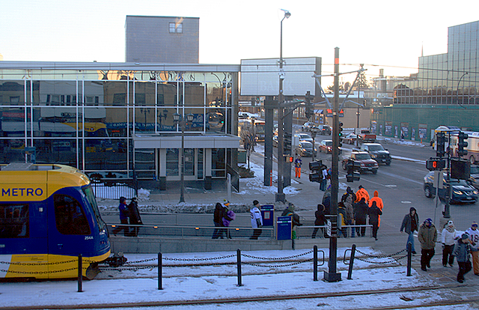
(934 lbs/ac/yr)

Slide 19
Summary
Runoff
Very high concentrations and bulk of mass for a handful of events
Low concentrations and loading for rest of the year
Cl⁻ is attenuated in infiltration practices
Groundwater
Infiltration reduces winter peaks
Cl⁻ enriched groundwater from spring through fall

Slide 20
Potential recommendations
Infiltrate
in areas with low-moderate road salt inputs
where surface streams are vulnerable
Potential concerns in areas that contribute significantly to aquifer recharge
Infiltration practices
Do not use to store salt-laden snow
Permeable pavement should be encouraged

Slide 21
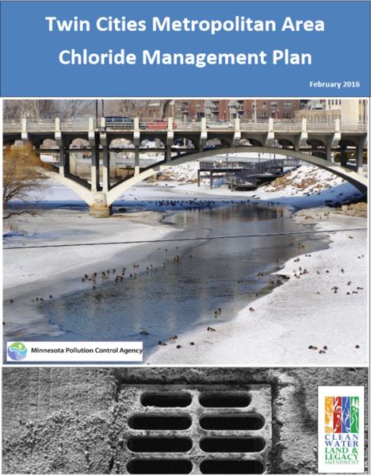
Ultimately, source reduction is the only way to effectively manage chloride
Questions?

