Slide 1
Intro MIDS Calculator Use
What is the calculator?
When can/should it be used?
Basics
  Opening the calculator
  Creating/saving files
  Creating a site
  Implementing best management practices at a site
  Checking results
  Meeting goals
  Getting help
How does the calculator work?

Slide 2
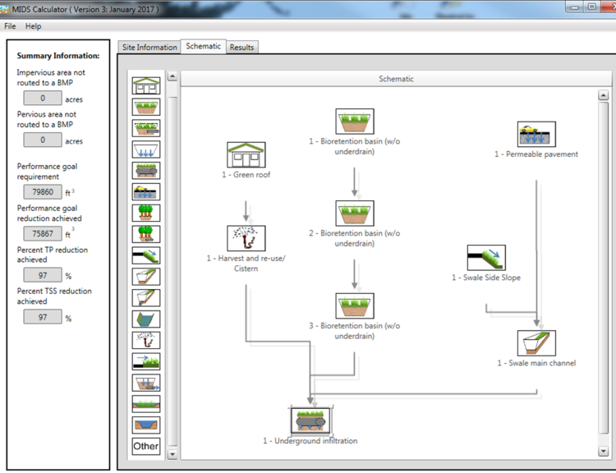
MIDS calculator
An Excel spreadsheet that
  quantifies reductions in stormwater runoff volume for a given BMP or group of BMPs
  quantifies reductions in phosphorus (P) and TSS in stormwater runoff for a given BMP or group of BMPs
  can be used to select and size best BMP(s) for a particular situation
Has a Graphical User Interface (GUI)

Slide 3
Performance goal – a regulatory or water quality objective
Targets for volume and/or pollutant reductions
  CSW permit has a goal of 1 inch retention of impervious surfaces for new development: captures about 90% of annual precipitation
  MIDS goal is 1.1 inches: mimics native vegetation and soils
  TMDLs might have goals for TSS or P reduction to meet surface water quality standards
Called a retention requirement in the MIDS calculator

Slide 4

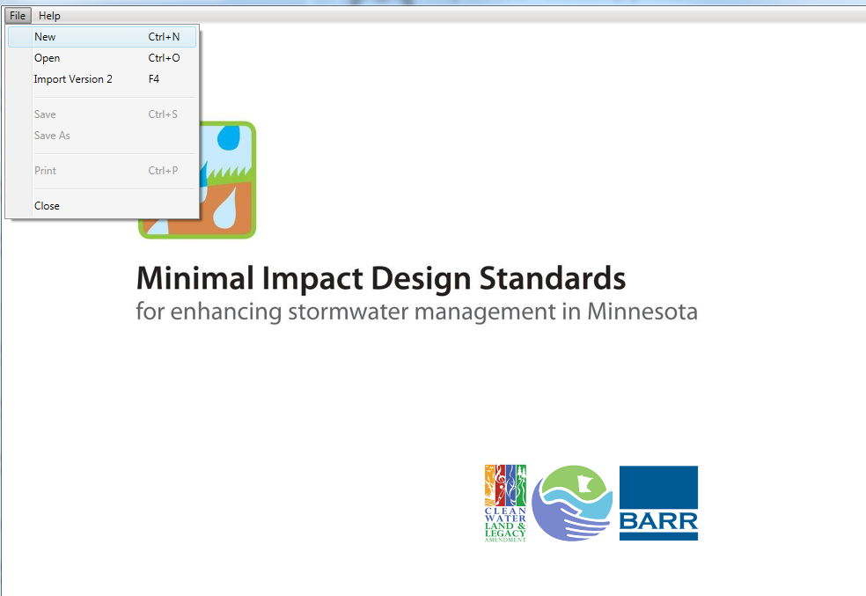
To open the MIDS calculator, double click on the MIDS icon on your desktop
Click on file and create a new file or open an existing MIDS calculator file

Slide 5
Kickoff example
Create a new file
Site information tab: no to CSW permit, zip=55155, 3 acres impervious, 2 acres turf on B soil
Schematic tab
    Bioretention no underdrain, 1 acre impervious , 3000 ft² areas, 1.35 feet depth, B soil, 48 hour drawdown
    Bioretention with underdrain, 2 acre turf B soil, 1 acre impervious, underdrain not raised, not lined, 3000 ft² for each area, overflow depth=1.5 feet, 2 foot media depth, 0.11 FC-WPt, 0.25 MP-FC, no tree, Mix A, no to P test, no amendment, B soil (0.45 in/hr), 48 hr drawdown, route to bioretention with no underdrain
    Infiltration basin, 1 acre impervious, 4000 ft² areas, 1.8 foot overflow depth, B soils, 48 hour drawdown
Results tab: Is the performance goal met? If not, how can it be met?

Slide 6
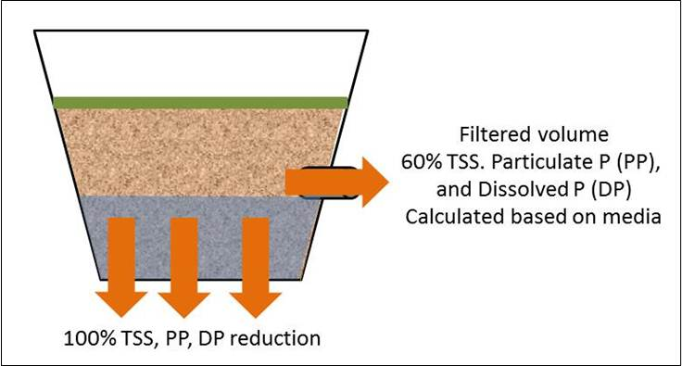
How does it work?
Calculate the amount of stormwater runoff, P, and TSS entering the BMP
Different BMPs have removal efficiencies based on research and monitoring
Calculator does a mass balance on volume, P, and TSS coming in, being removed, and returning as runoff

Slide 7


Overflow volume
0% TSS, Particulate P (PP),
and Dissolved P (DP)
reduction
Infiltration BMPs
100% TSS, PP, DP reduction
Filtered volume
60% TSS. Particulate P (PP),
and Dissolved P (DP)
Calculated based on media
Filtration BMPs w/ some infiltration
100% TSS, PP, DP reduction
Settled solids
90% TSS and associated pollutants,
No removal of dissolved pollutants
Sedimentation BMPs
No infiltration
Settled solids

Slide 8





Green Roof
Bioretention Basin
Infiltration Basin
The BMPs
Permeable Pavement
Swale Side Slope
Swale Main Channel
Wet Swale
Swale With Underdrain

Slide 9







Harvest and Reuse
Impervious Disconnect
Tree trench with underdrain
Stormwater Pond
Stormwater Pond w/ Filter Bench
Wetland
Sand Filter
Underground Infiltration
Other
Other
Bioretention Basin with underdrain
Tree trench

Slide 10
Problem 1
10 acre site
  5 acres impervious
  5 acres pervious turf (B soils)
B soils (0.3 in/hr)
Zip = 55155
Goals
  Infiltrate first 1.1 inches off impervious surfaces
  Capture 80 percent of Total P

Slide 11
Features, warnings, restrictions, help
Zip code – rainfall data
Question about CSW permit – affects BMPs available
Default values for retention requirement, P and TSS concentrations
Must have impervious acres
Summary information toolbar
Warnings involve a change of a default condition (e.g. changing the P concentration)
Restrictions prevent you from entering data (examples - drawdown requirement, green roof and permeable pavement areas, bioretention depth
Help button or links within each BMP – go to Stormwater Manual

Slide 12
Restrictions
48 hour drawdown requirement
Green roof: count as impervious surface, at least ½ of impermeable surface must be green roof, can only route another roof to a green roof
Bioretention: 1.5 foot depth max
Permeable pavement: Count permeable pavement as impervious, max 5:1 impervious:pervious ratio
Swale side slope: can only route to a swale; cannot route to a swale side slope
Disconnection: cannot be used to meet the CSW permit, cannot route another BMP to disconnection; cannot route more impervious or pervious than is in watershed tab for this BMP
Wet swale, sand filter, constructed pond, constructed wetland: no volume reduction

Slide 13
Problem 2 and/or 3
Same as previous problem except C soil
Site is downtown Minneapolis, 9 acres impervious and 1 acres pervious, B soil (0.45 in/hr)
Contact: Mike Trojan, mike.trojan@state.mn.us; 651-757-2790

