Slide 1
Overview and updates to the Minnesota Stormwater Manual
Mike Trojan
Minnesota Pollution Control Agency
MECA Annual Conference
January 23, 2020

Slide 2
Presentation outline
Brief overview of the Manual
A tour of the Manual and some features you may not be aware of
Recent and on-going updates
Needed updates
Critique
Questions and suggestions

Slide 3
1. Brief overview of the manual
Original Manual 2005
Updated in 2008
Wiki format in 2013
Clean Water Funds to provide updates

Slide 4
How is the manual used?
Guidance for Stormwater practitioners
Access to tools and resources
Supports permits and permittees

Slide 5
Some stats (as of January 7)
856 content web pages
5,654 total pages
3,698 uploaded files, including about 950 images
46,807 edits
25,107,370 views

Slide 6
2. Tour of the Manual and some features you may not be aware of

Slide 10
Design
Construction
O & M
Credits
Section on soil amendments

Slide 12
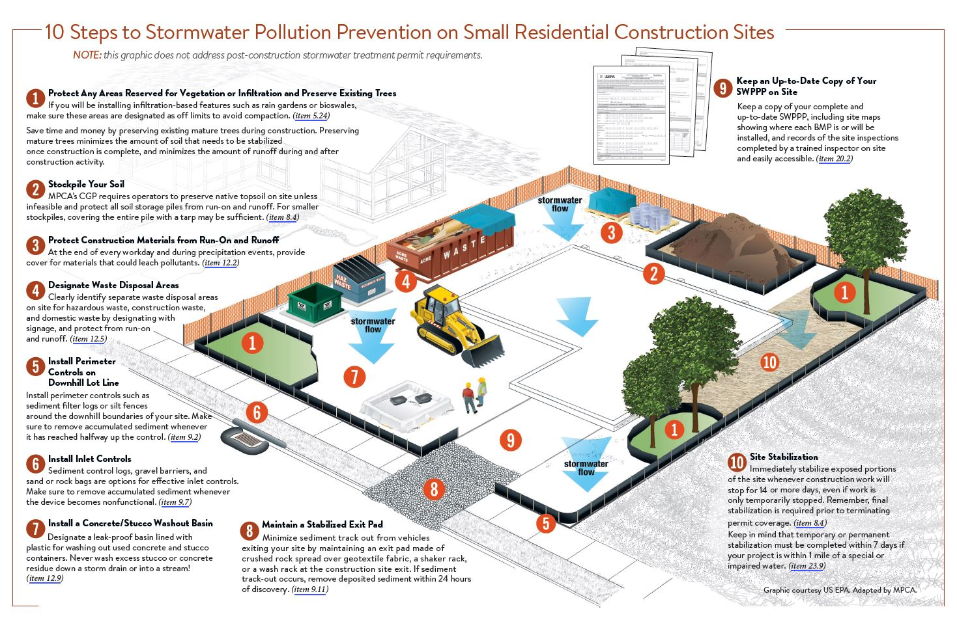

Slide 13
3. Recent and on-going updates
TMDL guidance
Pretreatment
Phosphorus and TSS
Curve numbers
MIDS Calculator updates
MPCA Simple Estimator updates
Street Sweeping
Education/MS4 Toolkit

Slide 14
TMDL Guidance
Meeting chloride TMDL MS4 permit requirements
Meeting bacteria TMDL MS4 permit requirements
Meeting dissolved oxygen or oxygen demand TMDL MS4 permit requirements
Meeting temperature TMDL MS4 permit requirements
Guidance for categorical TMDLs
List of Approved TMDLs with MS4 WLAs
Forms, guidance, and resources for completing the TMDL annual report form
Baseline year
Summary of TMDL requirements in stormwater permits
Interpreting wasteload allocations based on flow/load duration curves

Slide 15
TMDL Guidance
Guidance for using models to meet TMDL requirements, including case studies
P8
WINSLAMM
MIDS Calculator
MPCA Simple Estimator
Guidance for using monitoring to meet TMDL requirements, including case studies

Slide 16
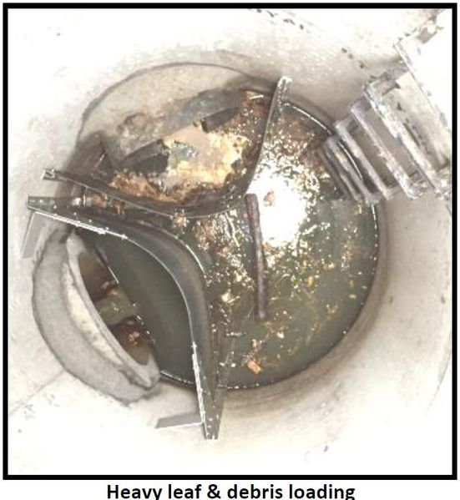
Pretreatment
Hydrodynamic separation devices
Screening and straining devices, including forebays
Above ground and below grade storage and settling devices
Filtration devices and practices
Other pretreatment water quality devices and practices
Pretreatment selection tool
Pretreatment sizing
Case studies
Ramsey Conservation District

Slide 17
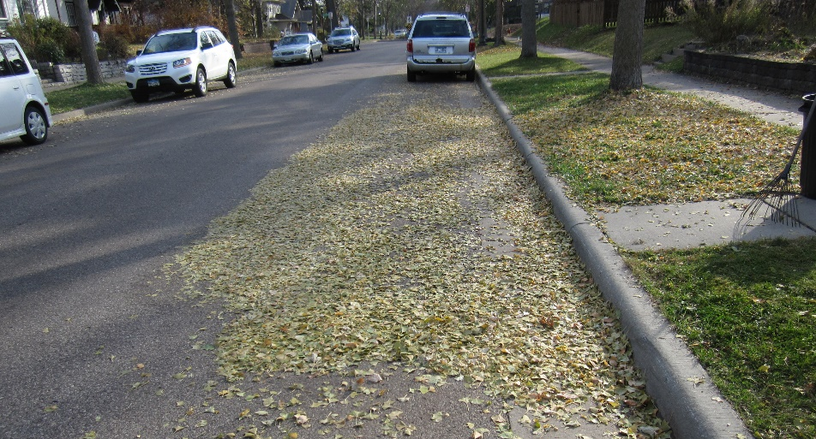
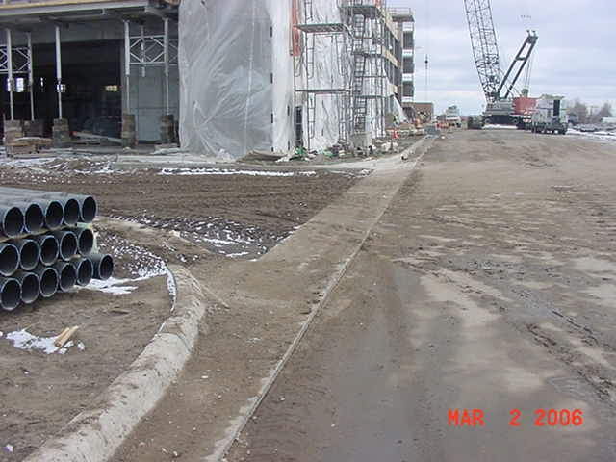
Phosphorus and TSS
Event mean concentrations of total and dissolved phosphorus in stormwater runoff
Event mean concentrations of total suspended solids in stormwater runoff
These will be used in the updates to the MIDS Calculator and MPCA Simple Estimator

Slide 18
Curve numbers, event mean concentrations
Stormwater runoff coefficients/curve numbers for different land uses (link)
Stormwater pollutant concentrations and event mean concentrations (link)
Stormwater event mean concentrations and pollutant loading/export rates for different land uses (link)
Supporting updates to the MIDS Calculator and Simple Estimator

Slide 19
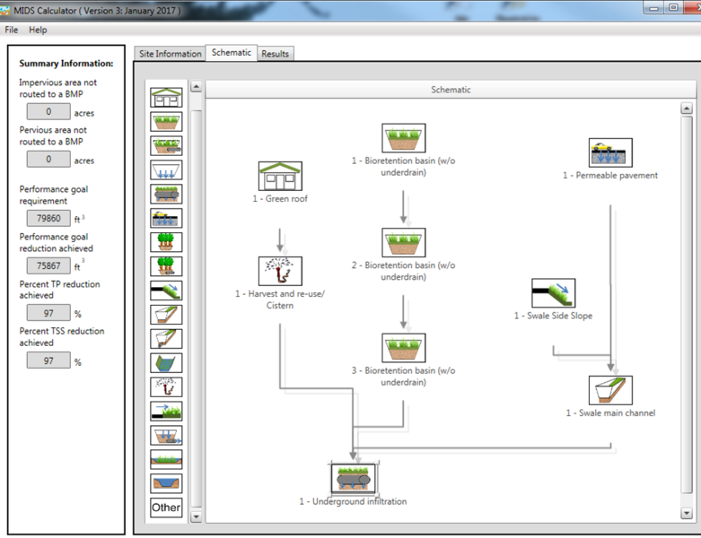
MIDS Calculator updates
Version 4.0 - minor changes
Water quality calculator
Based off MIDS Calculator
Drop-down box for event mean concentrations by land use
Allow for adjusting particulate and dissolved phosphorus ratios
Guidance on how to use other bmps (e.g. underground filters, street sweeping)
Late April-May timeframe
Webinar, workshops, training after release

Slide 20
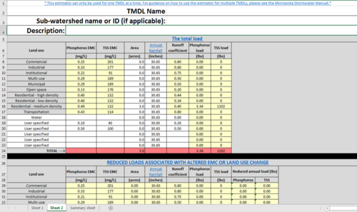
MPCA Simple Estimator
Up to 10 sub-watersheds
Can adjust loads to account for land use changes, street sweeping, or other non-structural practices
Updated event mean concentrations, runoff coefficients
April-May
Outreach

Slide 21
Street sweeping
Developing a credit methodology
Hierarchy: direct measurement > measurement of weight or volume > empirical = modeling
U of M researchers collecting data for establishing the relationships between pollutant and measurement
Spring 2020
Hope to update street sweeping guidance later in 2020

Slide 22
Education/MS4 toolkit

Slide 23
4. Needed updates
Iron enhanced treatment(s)
Vegetation
Constructed ponds and wetlands
Permeable pavement
Sand filters

Slide 24
Other needs
Definitions
Searching the Manual
Organization of the Manual
O & M
Research link to Manual
Outreach
New technologies and designs
Stormwater reuse

Slide 25
5. Critique – what’s worked?
Updating on the fly
An improved resource
Outreach

Slide 26
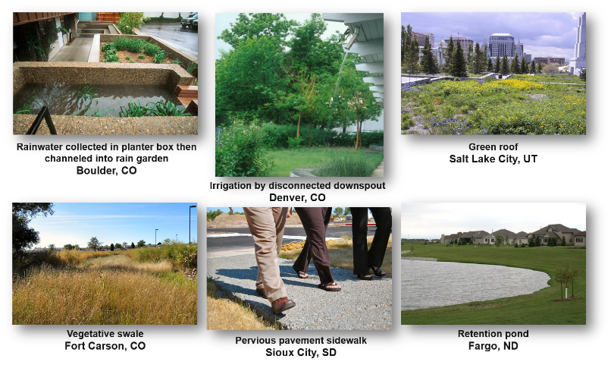
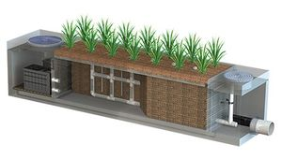
5. Critique – what could be better?
Overall organization
Green Infrastructure/sustainability
New technologies and design
More resources needed/participation
Image courtesy of Bio Clean
Source: EPA

Slide 27
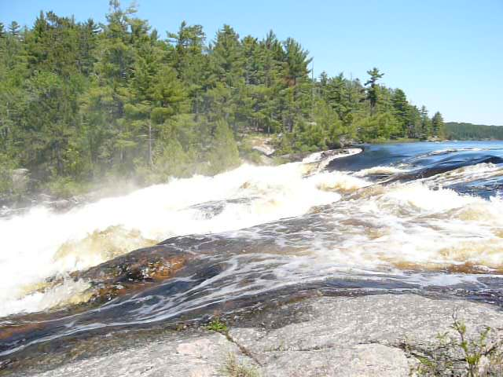
Questions/suggestions
Link to Manual – Google Minnesota Stormwater Manual
Mike Trojan
Mike.Trojan@state.mn.us
651-757-2790

