Slide 1
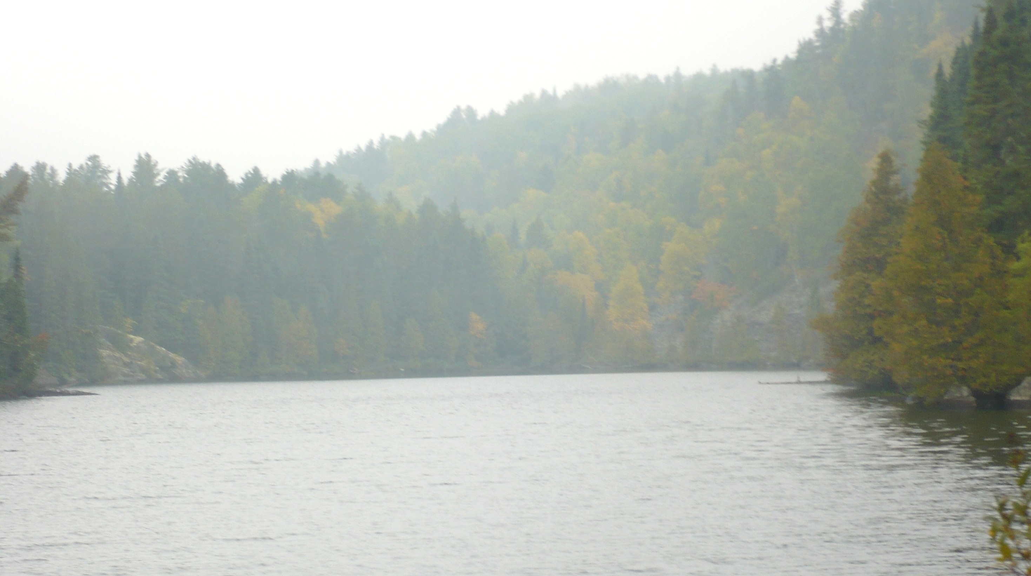
Do we have a chloride problem in our water?
Mike Trojan
MPCA Stormwater
March 8, 2019

Slide 2
YES
Thank you and are there any questions?

Slide 3
Disclaimer
I’m not specifically working on chloride. There is on-going research. To the extent time allowed I reviewed literature and talked with people working on the issue to gain perspective on different aspects of this issue. But be aware that I’m not engaged in research around chloride. Hopefully I’ll qualify my statements appropriately and suggest areas where we need more information.

Slide 4
Outline
A little bit about chloride
Big picture: Chloride concentrations and trends in Minnesota waters
Taking a closer look in urban areas
Wrap-up

Slide 5
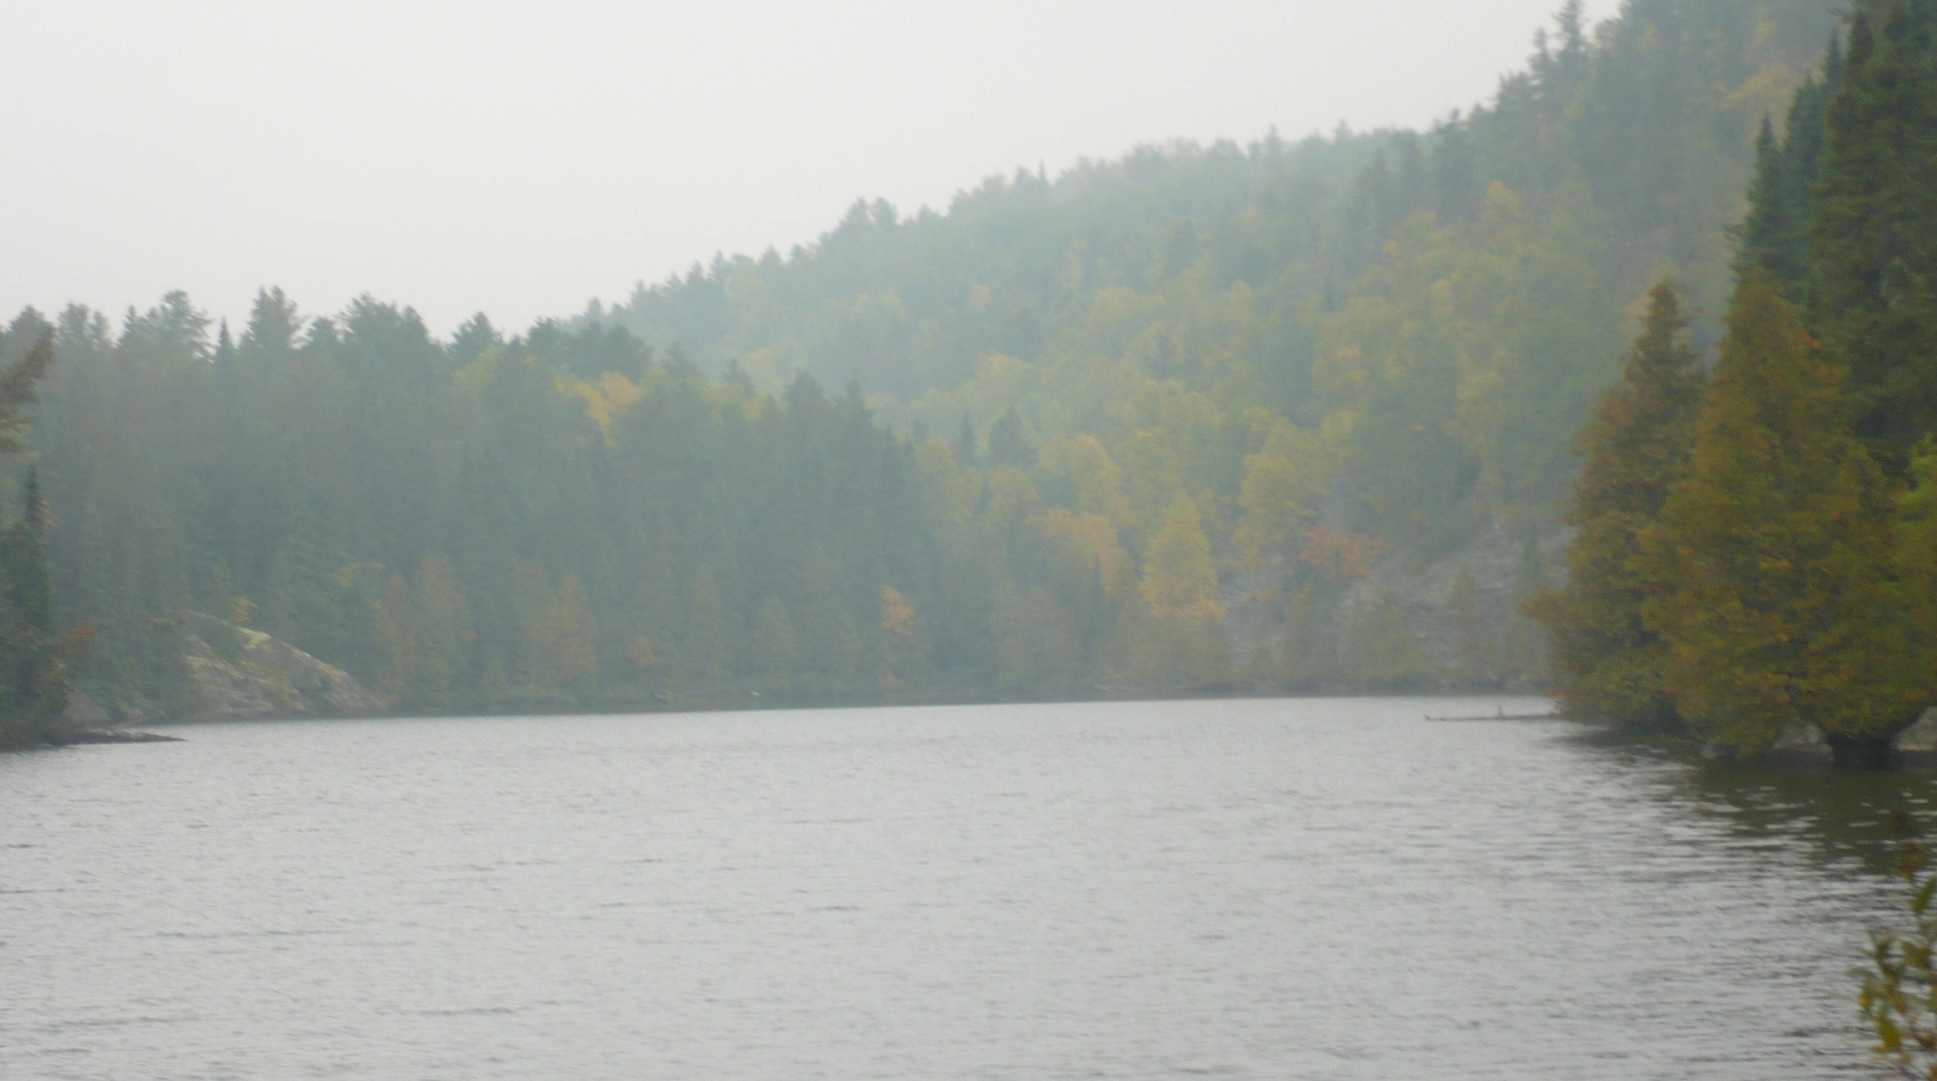

Slide 6
A little bit about chloride
Does not easily precipitate
Is not biodegradable
Is not readily involved in biological processes
Does not adsorb significantly to mineral/soil surfaces
It is therefore assumed to readily move with water

Slide 7
Primary anthropogenic sources are road salt, fertilizers, and WWTPs
Total = 968,300 tons annually
Cl contributions, Minnesota (From Overbo et al., 2019)

Slide 8
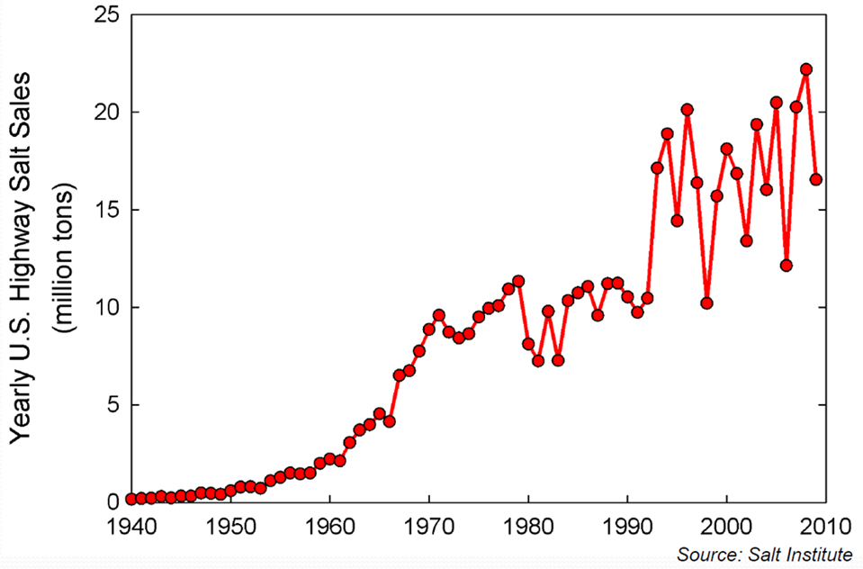

Slide 9
Chloride in stormwater runoff
In a MN location with high deicer application rates, 97% of the Cl load was associated with 16% of the total annual runoff volume (Herb, 2018)
Granato and Smith, 1999
Winston et al. (2016)

Slide 10
At what concentration is chloride a concern?
Aquatic life (EPA, 1985)
Chronic toxicity = 230 mg/L (4 day average, not to be exceeded more than 1 in 3 years
Acute toxicity = 860 mg/L (1-hour average not to be exceeded more than 1 in 3 years)
Human consumption – drinking water, secondary maximum contaminant level = 250 mg/L based on salty taste

Slide 11
Other environmental concerns of chloride
Toxicity in plants (350 mg/L for sensitive species to over 2000 mg/L for tolerant species)
Foliar damage to plants – species dependent; many species show effects above about 200 mg/L
Increased metal mobility – some evidence for Cl complexes with Zn and Cd ; other metals due to ion exchange with the cation
Corrodes steel
Reduced denitrification rates in soil

Slide 12
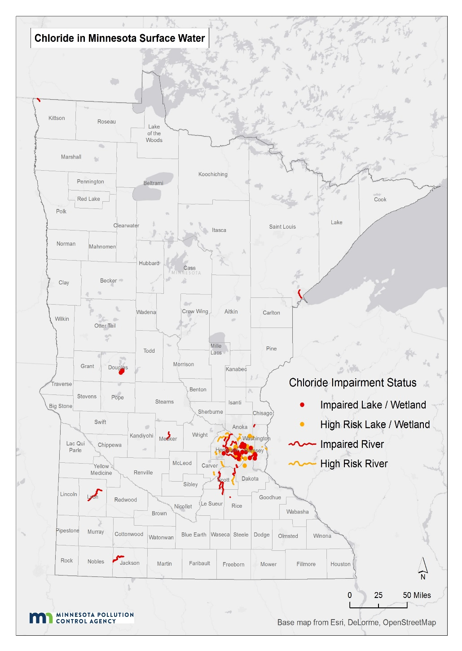
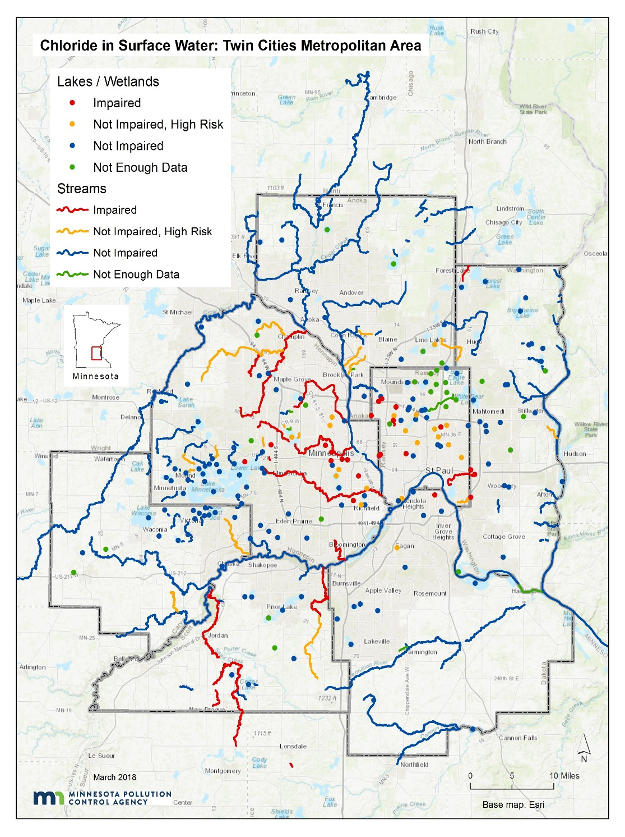
Chloride in surface water (MPCA, 2018)

Slide 13
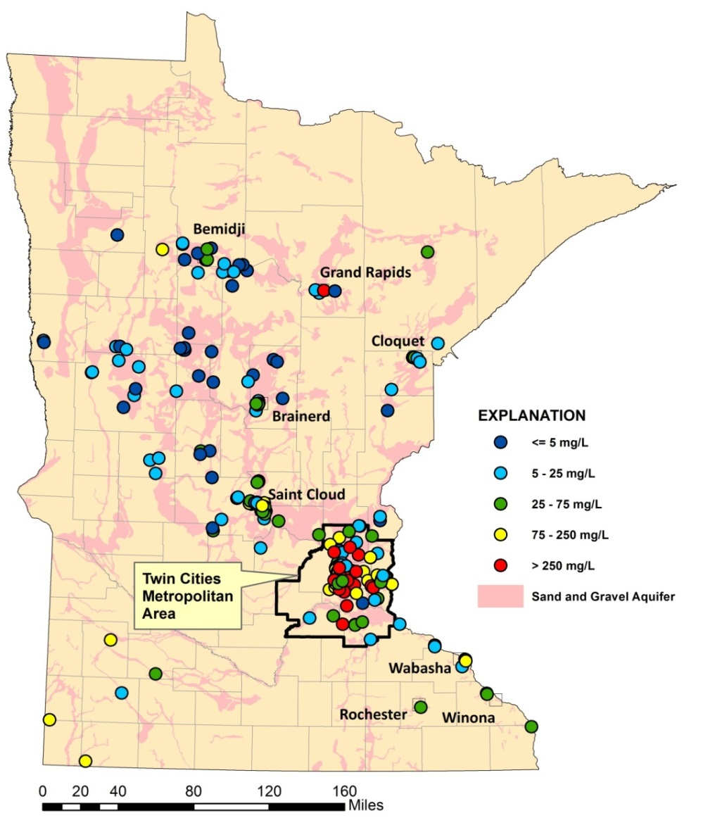
Cl in groundwater (MPCA, 2013)
Shallow sand & gravel aquifers
Bedrock aquifers

Slide 14
Summary of water quality status
Statewide
26 lakes were impaired as of 2018
24 streams impaired as of 2018
120 lakes classified as at risk (> 1 sample in past 10 years with Cl > 207 mg/L)
Twin Cities Metro
23 lakes impaired
17 streams impaired
38 lakes classified as at risk
340 assessed waterbodies (11% impaired; 11% insufficient data)
30% of shallow wells exceed the SMCL
Source: Draft Statewide Chloride Management Plan

Slide 15
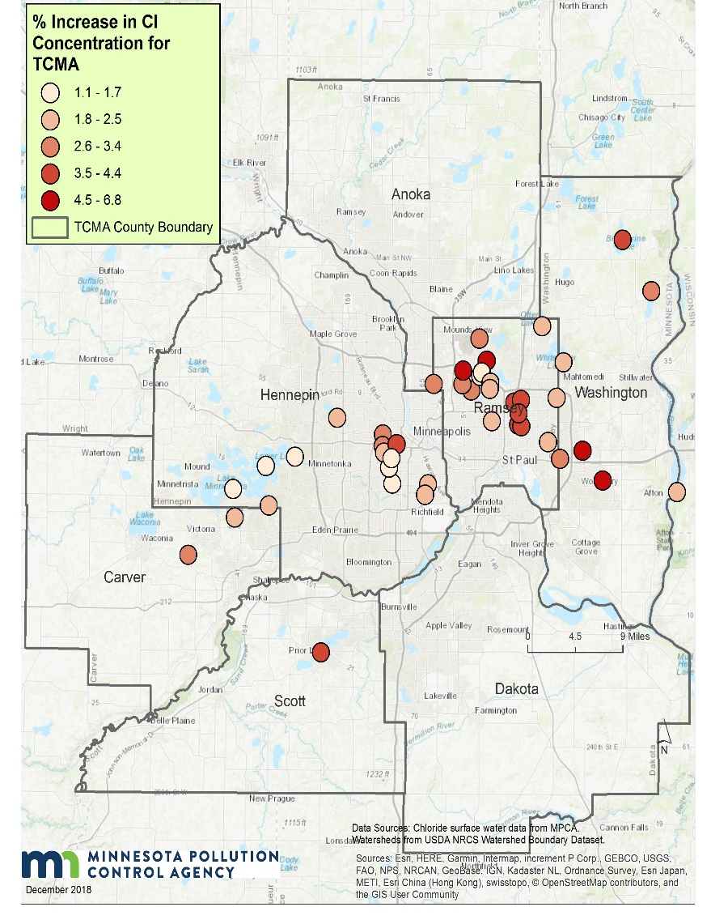
Lake trends
(Source: Draft Chloride Management Plan)
Upward trends in 46 of 69 lakes in TCMA
Outside TCMA, upward trends in 14 of 45 lakes
Rate of increase is greatest in lakes in TCMA urban core
Lakes - % increase per year

Slide 16
Flow-Adjusted Cl Trends, 1985–2015
(Met Council, 2018)
Upward trends at all but one location
Concentrations well below aquatic life standard

Slide 17
Groundwater trends
(Source: MPCA 2013)
Upward trends in 11 of 36 wells in shallow sand/gravel aquifers
Average rate of increase was 3.4 mg/L/yr, but rates were much higher is some wells

Slide 18
General conclusions
Concentrations in shallow groundwater in core urban areas are elevated compared to all other land uses
Outside urban areas, chloride is, in general, not a concern yet, although there are local exceptions
In suburban and exurban areas, results are mixed
Trends in all waters in urban areas are upward

Slide 19
Taking a closer look - lakes
What factors make a lake vulnerable to chloride contamination?
What are the consequences of high chloride concentrations in lakes?

Slide 20
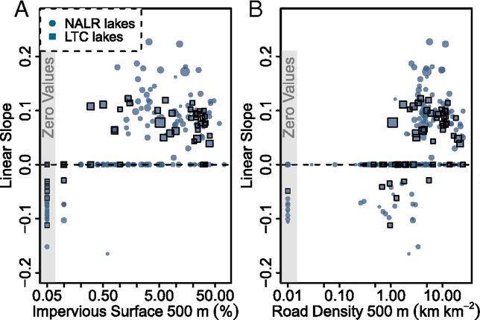
Road density and imperviousness (Dugan et al., 2017)
Impervious surface and road density within 500 meters of a lake were predictors of increasing Cl concentrations in the lake (n=284)
Upward concentration trends observed at impervious values > 1%

Slide 21
Chloride concentrations highest in late winter (Novotny et al., 2007; 13 Metro lakes)
Mid-March

Slide 22
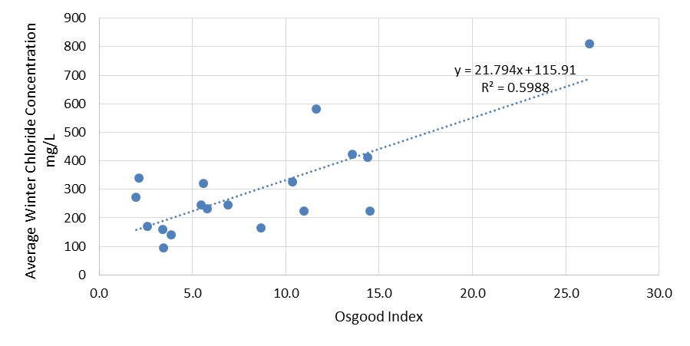
Cl increases as ratio of depth to area increases (Draft chloride management plan)
(mean depth/(surface area)^{0.5}

Slide 23
Bottom concentrations increase relative to top concentrations
1:1 line

Slide 24
Bottom concentrations increase relative to top concentrations

Slide 25
What are the consequences of high chloride concentrations in lakes?
Community structure (Hintz et al., 2017)
Negative impact of salinity on zooplankton
Positive response by phytoplankton
Mixed results for benthic communities
Periphyton and snail grazers unaffected
Biomass of filamentous algae decreased due to competition with phytoplankton
Direct negative impacts to filamentous algae, amphipods, and some snails and clams
Chemostratification (Novotny and Stefan, 2012)
Disrupts nutrient cycling
Prevents oxygen from reaching lake bottom

Slide 26
Taking a closer look – rivers and streams
What factors make a river or stream vulnerable to chloride contamination?
What are the consequences of high chloride concentrations in rivers and streams?

Slide 27
Mississippi River
Flow weighted concentrations have increased about 0.3 mg/L/yr
1996-2005
2006-2015
Concentrations are greatest in winter
Source: Met Council 2018

Slide 28
Minnesota River
Flow weighted concentrations have increased about 0.08 mg/L/yr at Jordan; no trend at Ft. Snelling
1996-2005
2006-2015
Concentrations are greatest in autumn and winter
Source: Met Council 2018

Slide 29
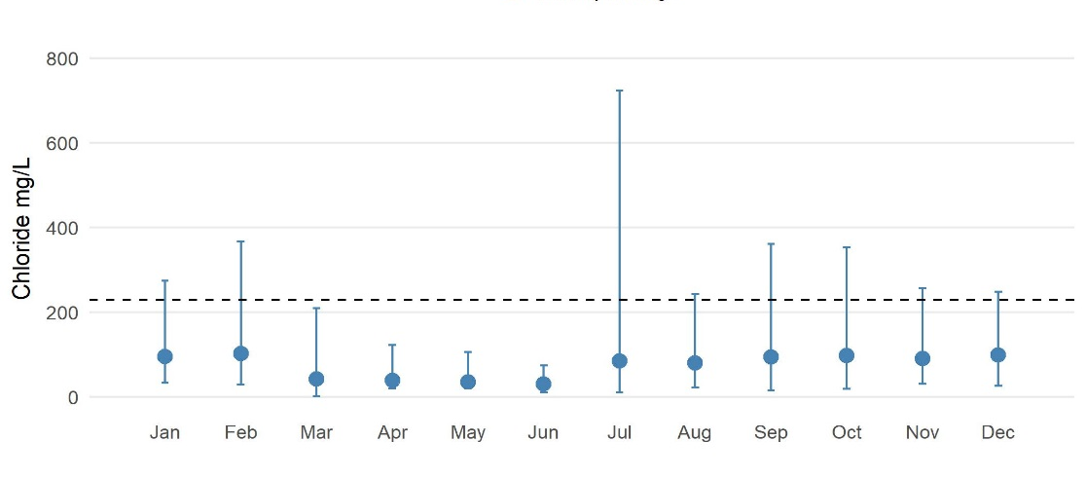
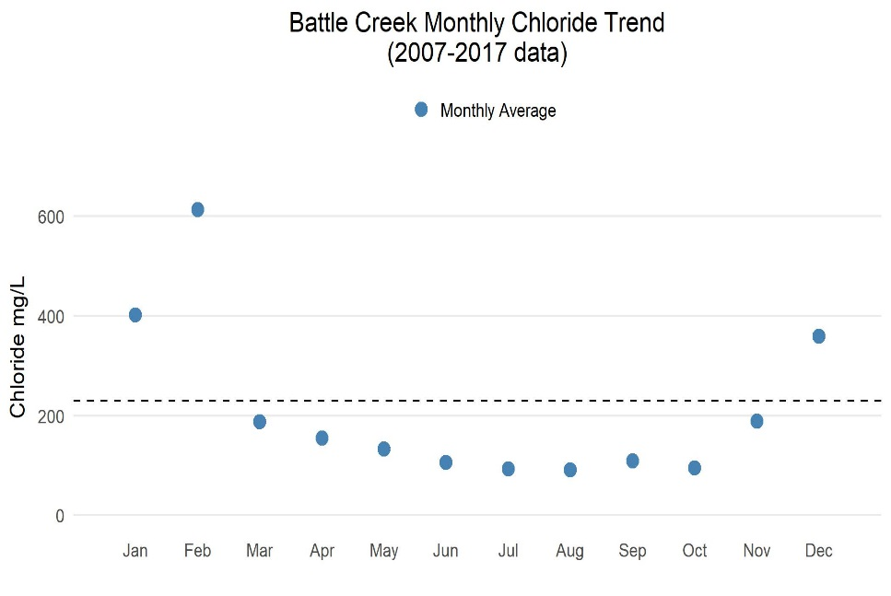
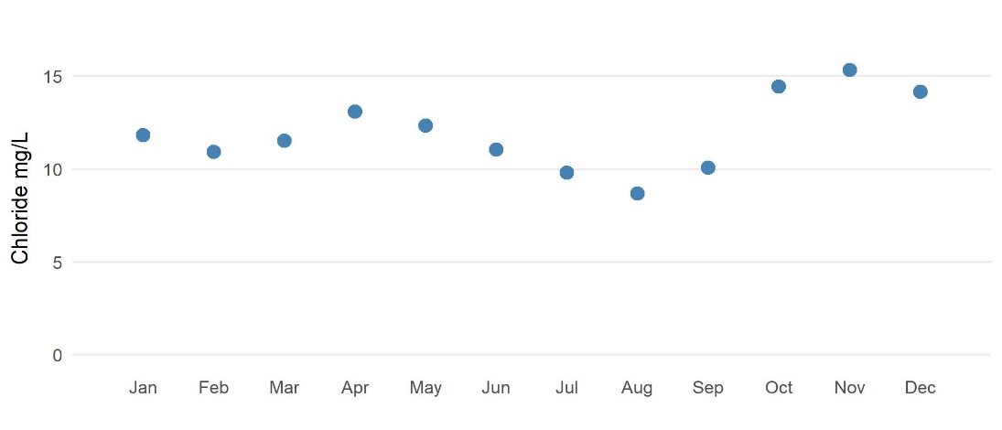
Chloride concentrations are a function of setting
(From draft Metro Cl Management Plan)
Sand Creek – mixed urban/ag
Battle Creek – highly urban
Buffalo River - ag

Slide 30
Source: Nine Mile Creek TMDL Report

Slide 31
Chloride concentrations are a function of baseflow
Miller Creek, Duluth
Bassett Creek, Minneapolis
Source: Bassett Creek WMC

Slide 32
What are the consequences of high chloride concentrations in streams?
Tiwari and Rachlin (2018)
Began seeing minor negative impacts above 150 mg/L
Streambank vegetation changed, but not nutrient cycling
Blasius and Merritt (2002) – most sensitive insects impacted at about 240 mg/L but many unaffected at acute standard
Maryland DNR (2014)
Benthic IBI declined at 190 mg/L
All BIBI indicate impairment at 500 mg/L
Greatest fish effects are on early life stages
Despite considerable information in the literature, difficult to make general statements about ecological effects

Slide 33
Taking a closer look – groundwater
What factors make groundwater vulnerable to chloride contamination?
What are the consequences of high chloride concentrations in groundwater?

Slide 34
Cl in shallow glacial aquifers, northern U.S. (Mullaney et al., 2009)

Slide 35
Cl in shallow groundwater – Minnesota (MPCA)

Slide 36
Factors affecting Cl in shallow glacial aquifers, northern U.S. (Mullaney et al., 2009)
Significant regressions (p < 0.05)
Major road density
Potential evapotranspiration
Not significant
Highway connector density
Major highway density
Highway density
Local road density
% residential, commercial, industrial, or transportation land use
Population density
Season
p = 0.94
MPCA, 2002

Slide 37
Intuitively, the most vulnerable areas should be locations with permeable soils and shallow groundwater, but ….
Cl_{gw} = I_{perv} + I_{imperv} + L_{pi} + L_{ww} + L_{sw} + SW + I_{ponds} + I_{filt} + I_{infil}
SW
I_{perv}
I_{imperv}
I_{infil}
I_{filt}
I_{ponds}
L_{pi}
L_{ww}
L_{sw}
Groundwater

Slide 38
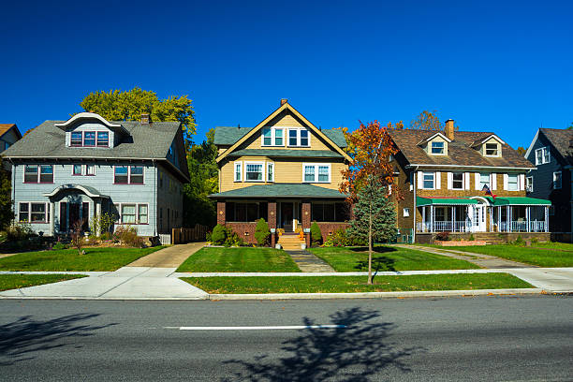

Slide 39
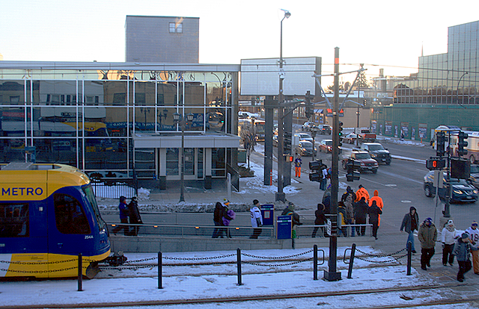

Slide 40
What are the consequences of high chloride concentrations in groundwater?
Urban streams with significant baseflow are potentially at risk
Shallow sand and gravel aquifers are at risk in core urban areas – is this a concern?
State and federal anti-degradation language has often been interpreted to not include practices such as agriculture and road salt application
There are few groundwater receptors
Is salty taste more important than impacts to aquatic ecosystems?
What about deeper drinking water aquifers?

Slide 41
Much of the core Metro Area aquifer system has low-moderate vulnerability
We currently have insufficient data to assess trends in deeper aquifers

Slide 42
Chloride trends in Chicago’s aquifer system (Kelly, 2008)

Slide 43
Sidebar: didn’t look at impacts to wetlands, but many wetland species, including amphibians, are more sensitive to chloride than species found in lakes and rivers

Slide 44
So, do we have a chloride problem?
These are personal conclusions
I’m concerned about chloride in urban lakes
While chloride is a concern in urban streams, these streams have fundamental hydrologic issues that probably need to be addressed first
I’m concerned about deeper aquifers in the Metro but mostly because we don’t know how they might be impacted
Wetlands likely would be a significant concern, but is there such a thing as a functional wetland in an urban area
Urban core is area of greatest concern

Slide 45
Management strategies
Decrease use of chloride deicers
Use alternatives
Use liquids
Establish chloride free zones near receiving waters
Improve snow/ice removal technology
Permeable pavement
Lower winter speed limits
Infiltrate in the right locations

Slide 46
A little bit on stormwater infiltration
Rain garden
MW2
35 feet
MW3
Lysimeters
20 feet
Groundwater flow
From Machusick, 2009

Slide 47
Deicers applied
Runoff
Lysimeters (0, 4, 8 ft)
MW2
MW3

Slide 48
Needs
Met Council is analyzing trend data for Metro streams
Fate and transport in groundwater is poorly understood, particularly in the TC Metro. Modeling may be useful (Metro Model?)
Better understanding of impacts in lakes
Mapping vulnerable waters and identifying high value waters that are at risk
More research on chloride alternatives

Slide 49
Final thoughts
Continue to focus on reductions in chloride-based deicing
Let the science play out on impacts to receiving waters
Unless or until we find an alternative to chloride-based deicers, we’ll have to accept some losses, but with practical solutions, we can minimize our losses

Slide 50
Questions?
Mike Trojan (mike.trojan@state.mn.us)
Brooke Asleson (brooke.asleson@state.mn.us)
John Gulliver (U of M)
Bill Herb (U of M)
Hilary Dugan (UW-Madison)
Lots of work being done on permeable pavement
Jennifer Drake, University of Toronto
Michael Dietz, University of Connecticut

