Slide 1

Clean Water Fund
Competitive Program
Stormwater Funding Strategies
February 6, 2017

Slide 2
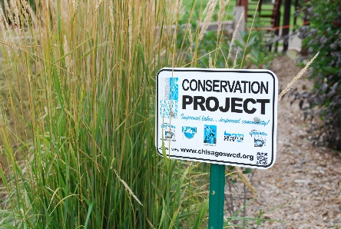
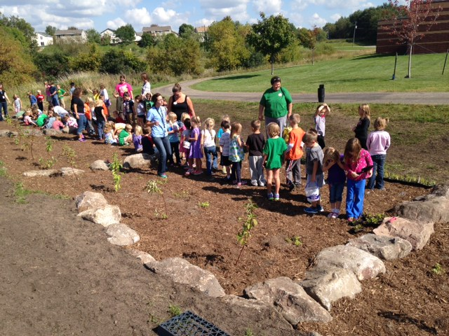
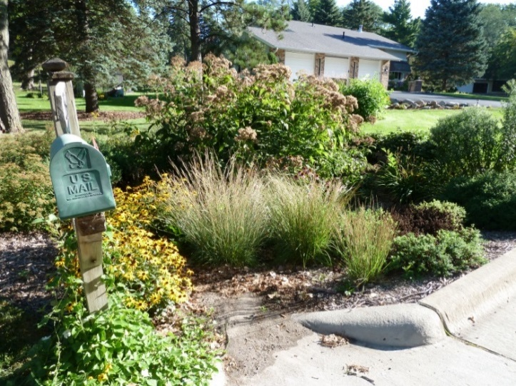
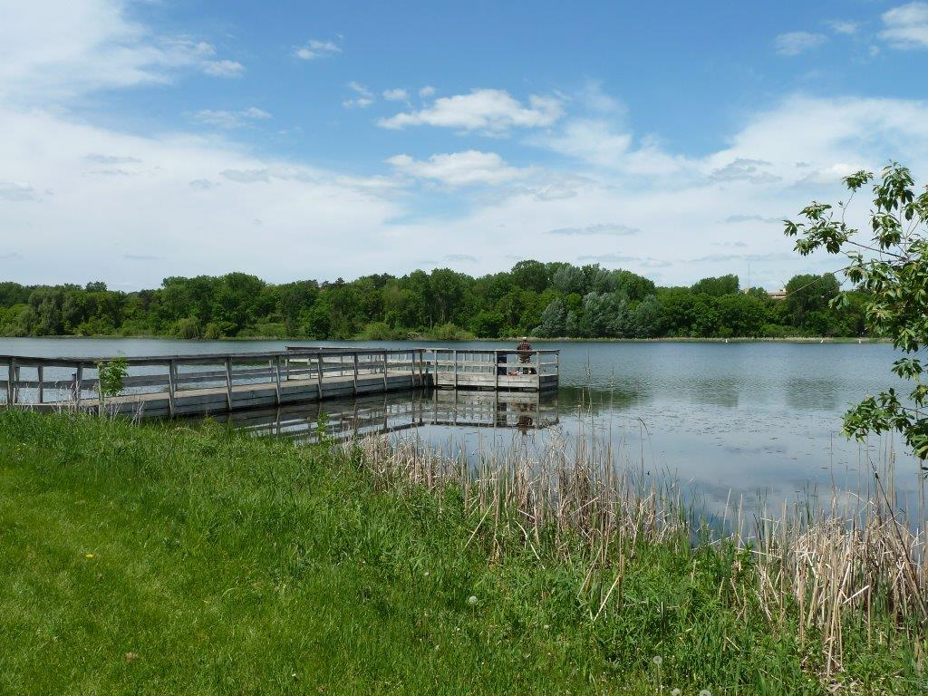

Achieving Clean Water Fund Goals & Priorities

Slide 3
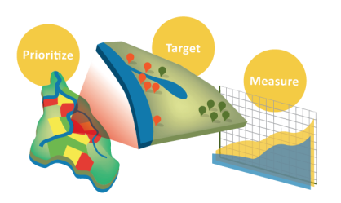
Implementation of on-the-ground non-point restoration and protection activities
Prioritizing local resources
Targeting for effectiveness
Measuring the impact on water quality

Slide 4
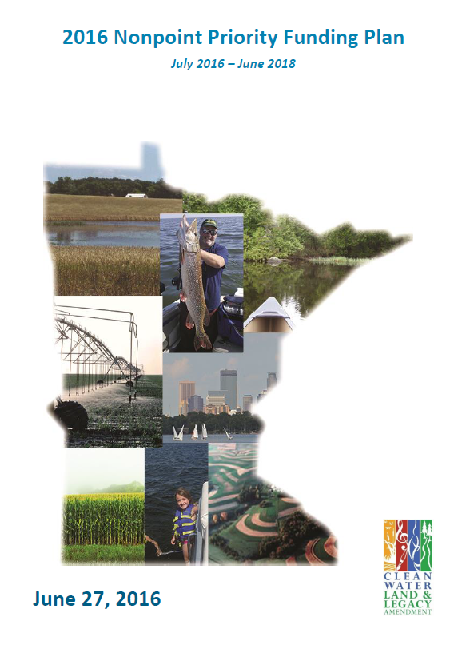
NonPoint Priority Funding Plan

Slide 5
Clean Water Fund
Primary Agency Programs
Projects and Practices
Accelerated Implementation Grants

Slide 6
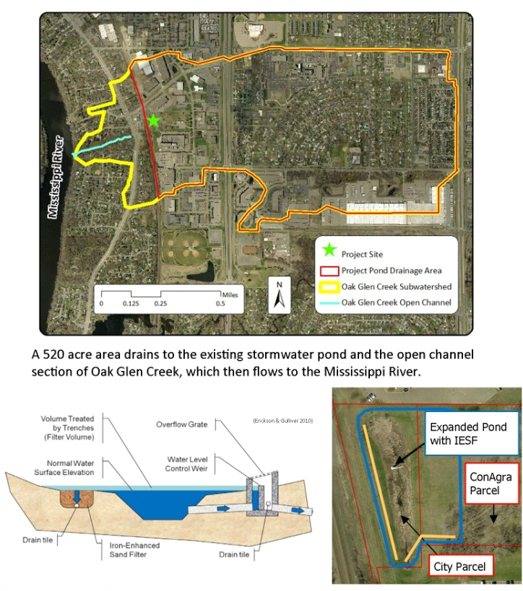
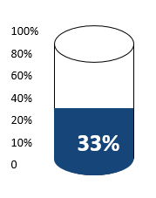
Primary Programs: Projects and Practices
Oak Glen Creek Stormwater Pond Expansion and Iron Enhanced Sand Filter Retrofit
Grant: $517,780
Notes:
This grant makes an investment in on-the-ground projects and practices that will protect or restore water quality in lakes, rivers or streams, or will protect groundwater or drinking water.

Slide 7

Primary Programs: Accelerated Implementation
Prioritization, Targeting, and Measuring Water Quality Improvement Application
Grant: $235,250
Grant funds supported development, testing, and deployment of an operational PTM App in two pilot areas within the Red River Basin.
Notes:
Before on-the-ground clean water projects get implemented, there is the need for pre-project identification, planning and design. This grant invests in building capacity for local governments to accelerate on-the-ground projects that improve or protect water quality and perform above and beyond existing state standards for protecting and restoring water quality.

Slide 8
Ranking Utilizes an Interagency Approach
BWSR
DNR
MDA
MPCA
MDH

Slide 9
Urban Stormwater
Notes:
Stormwater projects are competitive and being funded, to the tune of approx 46% on average over the past 6 grant cycles.

Slide 10
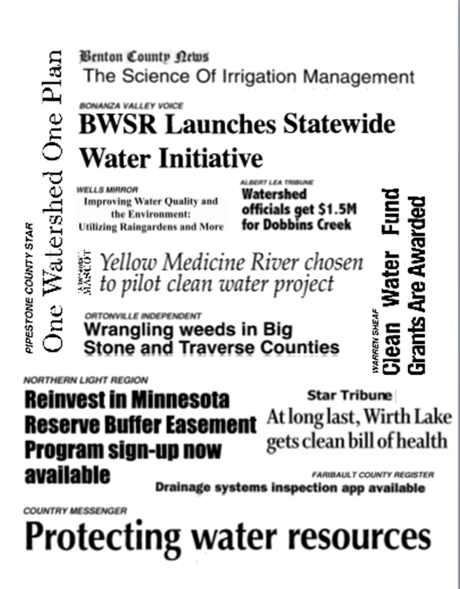
Questions?

