Slide 1
Guidance for Street Sweeping
May 13, 2020
Hillary Yonce, Tetra Tech

Slide 2
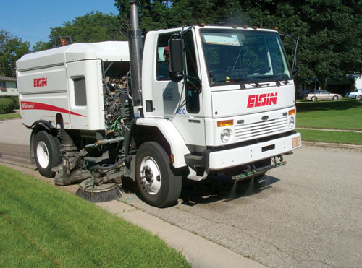
Guidance Document Table of Contents
Overview
Equipment
Benefits
Effectiveness
Managing Waste
Cost Considerations
Training
Case Studies
Program Development
References

Slide 3
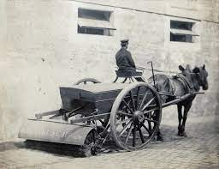
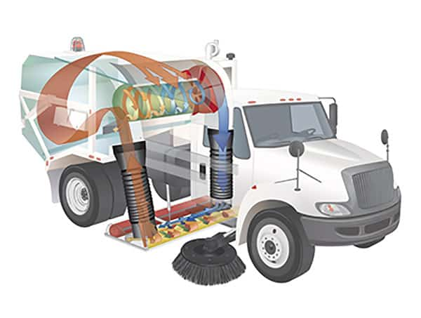
Overview and Equipment
Removal of sediment, litter, accumulated substances
Not: raked leaves, large debris, bulky items
Large Mechanized Sweeper Types
Mechanical Broom
Vacuum
Regenerative Air
High-Efficiency / New Technology

Slide 4
Benefits
Improved Aesthetics
Improved Roadway Safety
Reduced roadway hazards from trash and sediment for drivers, cyclists, pedestrians
Improved Environmental Quality
Improved stormwater runoff quality
Debris removed from roadways and curblines
Reduced debris wash-off into BMPs, ditches, waterways
Other Benefits
"Free" waste material for re-use
Improved pavement and marking visibility
Improved air quality
Cost-effective crediting opportunity
Potential for decreased inlet clogging, and decreased maintenance for stormwater pipe system, ditches, sumps, ponds, and BMPs.

Slide 5
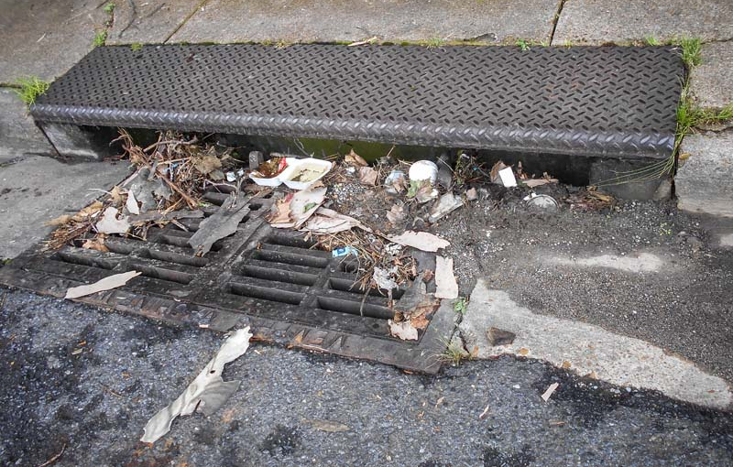
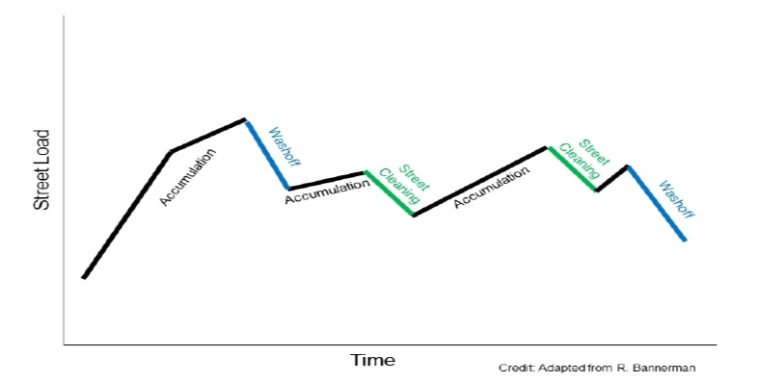
Effectiveness
Variables:
Timing
Sweeper Type
Curb/Gutter
Seasonality
Land Use
Tree Cover
Frequency
Precipitation
Public Engagement
Timing, Timing, Timing!

Slide 6
Managing Waste
Sweeping Waste
Recycle
Compost
Landfill
Reuse
YES:
Winter Road Application
Landfill Daily Cover
Construction/Development Material
NO:
Playgrounds, residential yards, areas with continuous human contact, near drinking water wells, wellhead protection areas, near karst features, or into wetlands or streams.
Aluminum Cans, Glass Bottles
Leaves
Plastic Bags

Slide 7
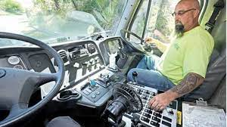
Cost Considerations
$/lb TP removed

Slide 8
Training
Program
Efficiency
Safety
Success
Programmatic Training
Standard Operating Procedures
Guidance Document
Credit Calculator User Manual
Operator Training
Operation, Safety, Troubleshooting, Maintenance
Reasons for sweeping

Slide 9
Case Studies
Primary Objectives
Impetus for Program
Issues Encountered
Type and Number of Sweepers
Routes and Frequency
Hot Spots Identification
Waste Management
Etc.

Slide 10
Program Considerations
Street Sweeping for Water Quality
SOPs
Public Interface
Timing and Frequency
Routes
Equipment
Waste Management
Staffing
Performance Measures
Adaptive
Management

