Slide 1
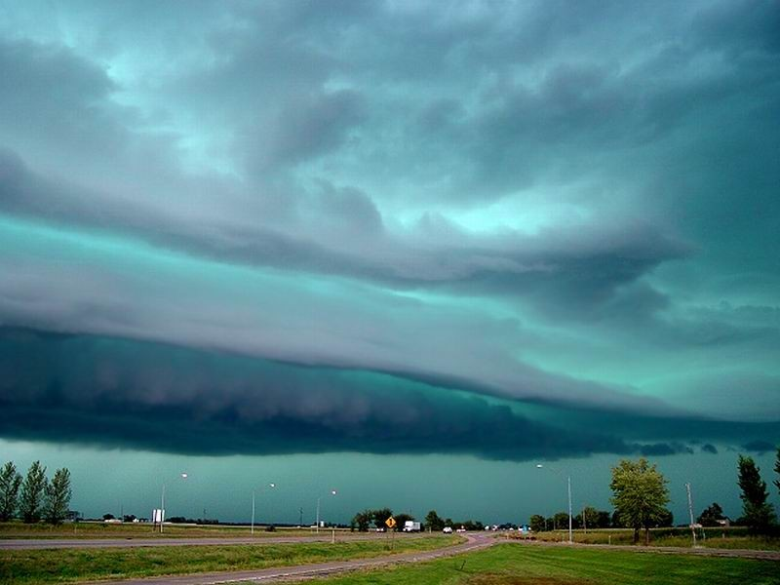


NPDES Construction Stormwater General Permit for Minnesota
University of Minnesota Erosion and
Sediment Control Certification 2013 -2014
Todd Smith P.E.
MPCA Senior Engineer
Stormwater Policy & Technical
Assistance
Notes:
1
As you may or may not know, the NPDES general stormwater permit for construction activity expires on august 1st of this year

Slide 2
NPDES is a national program
Delegation agreement between each state and U.S. EPA
Most states have been given the authority to administer this federal program
EPA audits each state’s program
NPDES for construction started in 1994
New CSW permit issued in August 2013!

Slide 3
Permit writing - a public process
Public informational meeting (Dec.17, 2012)
45-day Public Notice comment period published in the State Register (February 4 – March 20, 2013)
Public Informational Meeting during comment period (March 8, 2013)
MPCA Citizens Board Meeting (Informational Item March 26th Board meeting)
MPCA Citizens Board Meeting - June

Slide 4
Permit writing - new rules at the national level
New EPA Construction and Development Point Source Category Rule – December, 2009
EPA then writes their permit based on the Rule including these changes:
Soil stabilization timelines
Erosion and sediment control design parameters
Preservation of natural buffers or alternative controls
Dewatering requirements
Additional waste control requirements

Slide 5
2 main goals of the CSW Permit:
Prevent or minimize negative impacts from construction activity both:
  During active construction using erosion and sediment control practices
  After construction is complete by providing a permanent stormwater treatment system

Slide 6
Part I: Permit Coverage and Limitations
Who needs a construction permit?
    Any construction activity that disturbs more than 1 acre of total land area.
    Exemptions for routine maintenance
    Provisions for emergency construction
    If a project is part of a larger “common plan of development or sale” that disturbs more than 1 acre total.

Slide 7
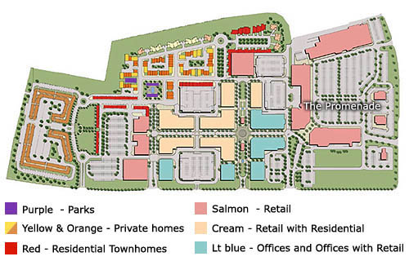
Common Plan of Development
.8 acre gas station
Notes:
Emphasize that these are the major changes not ALL the changes. They need to read the permit carefully!!

Slide 8
Part II: Submitting the Application
  Owner or operator or representatives of, complete one application to MPCA prior to project start date
  Both owner and operator are permittees
  Owner is responsible for all permit terms and conditions
  Operator is not responsible for Part I and Part III.A (SWPPP development)
  Send in appropriate fee ($400.00) with application

Slide 9
  What is the engineers role & responsibility?

Slide 10
Part II: Using the Online Application
  Permit coverage (for most projects):
  You must use the online application
  You do not need to submit the stormwater pollution prevention plan (SWPPP)
  Permit coverage becomes effective 7 days after completing the application
  Permit letter and coverage certificate are no longer mailed to permittees. You will receive an e-mail conformation

Slide 11
Online Application Exception
  You may not use the online application if the project will disturb over 50 acres and is within one mile of a special water or an impaired water.
  Paper application is available online.
  You must contact the MPCA to receive an unique submittal number.
  The submittal number must be included on the application or it will be returned
  Include a copy of the SWPPP with the application and a check or make other arrangements to make the SWPPP available electronically.
  Permit coverage becomes effective 30 days after the post marked date on the application or upon receiving an approval letter from the MPCA unless the SWPPP is found to be deficient
  Permit letter and coverage certificate are no longer mailed to permittees.

Slide 12


Apply online and receive permit coverage in
7 days.
Payment can now be made by credit card or checking
account (Visa and Mastercard only)
Project must not qualify for mandatory plan review
Project must not be on tribal land
Can be done by a third party

Slide 13
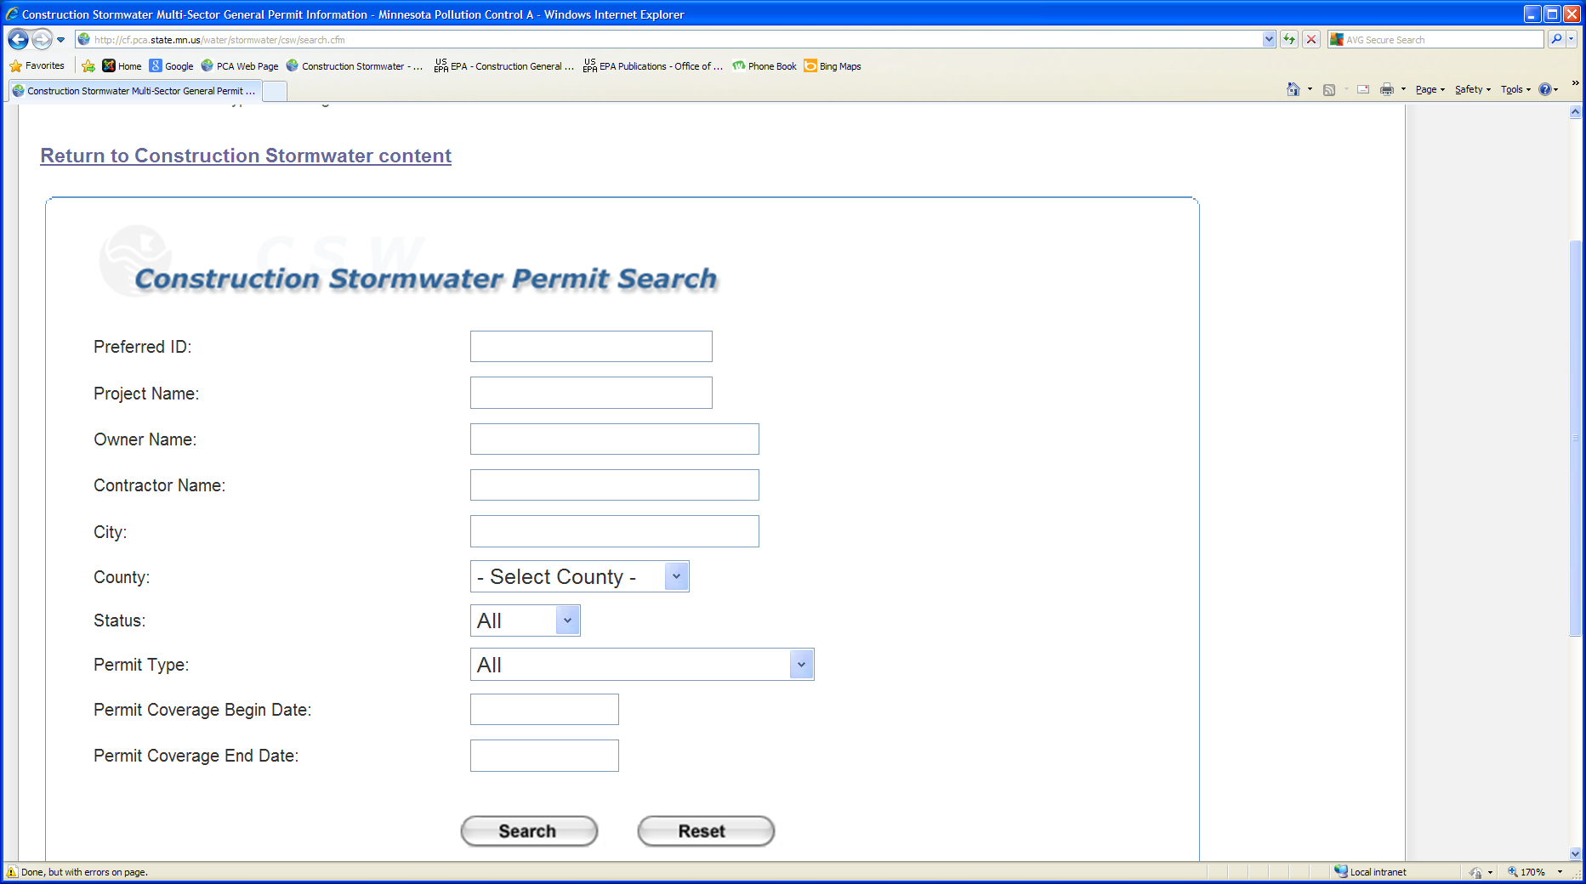
Look up permits online, both active and terminated permits. Search by:

Slide 14
Look up site specific information:
Most information provided on the application
Coverage letter for both owner and operator
Coverage card
Permit status (open or terminated)

Slide 15
Part II: Submitting the Application
  Change of Coverage : Use the Permit modification Form
  Available on CSW web page
  Use anytime there is a change of owner or operator on a permitted project.
  Use when a portion of a project has a change of ownership
  Example: original residential developer sells empty lots to various homebuilders

Slide 17
Part III: Stormwater Discharge Design Requirements
A. The owner is responsible for creating the
Stormwater Pollution Prevention Plan (SWPPP)
  Include a description of the nature of the project and the potential for discharge of sediment and other pollutants from the site using narrative descriptions, plan sheets, standard detail sheets
  Must identify a knowledgeable person who will oversee the implementation of the SWPPP including installing, inspecting and maintaining the SWPPP - chain of responsibility
  Documentation of training including names of personnel that are required to have training as per Part III.F.
  Design calculations for the permanent stormwater treatment system and the erosion prevention and sediment control BMP’s as required in Part III and Part IV.

Slide 18
Part III: stormwater Discharge Design Requirements
Stormwater Pollution Prevention Plan
    location and types of all temporary and permanent erosion prevention and sediment control BMP’s

Slide 19
Part III: stormwater Discharge Design Requirements
Stormwater Pollution Prevention Plan
    location and types of all temporary and permanent erosion prevention and sediment control BMP’s
    Estimated preliminary quantity tabulation

Slide 20
Part III: stormwater Discharge Design Requirements
Stormwater Pollution Prevention Plan
    location and types of all temporary and permanent erosion prevention and sediment control BMP’s
    Estimated preliminary quantity tabulation
    impervious surfaces, pre and post construction

Slide 21
Part III: stormwater Discharge Design Requirements
Stormwater Pollution Prevention Plan
    location and types of all temporary and permanent erosion prevention and sediment control BMP’s
    Estimated preliminary quantity tabulation
    impervious surfaces, pre and post construction
    A site map with existing and proposed grades and areas of steep slopes

Slide 22
Part III: stormwater Discharge Design Requirements
Stormwater Pollution Prevention Plan
    location and types of all temporary and permanent erosion prevention and sediment control BMP’s
    Estimated preliminary quantity tabulation
    impervious surfaces, pre and post construction
    A site map with existing and proposed grades and areas of steep slopes
    areas not to be disturbed including required buffer zones

Slide 23
Part III: stormwater Discharge Design Requirements
Stormwater Pollution Prevention Plan
    location and types of all temporary and permanent erosion prevention and sediment control BMP’s
    Estimated preliminary quantity tabulation
    impervious surfaces, pre and post construction
    A site map with existing and proposed grades and areas of steep slopes
    areas not to be disturbed including required buffer zones
    phased construction areas

Slide 24
Part III: stormwater Discharge Design Requirements
Stormwater Pollution Prevention Plan
    location and types of all temporary and permanent erosion prevention and sediment control BMP’s
    Estimated preliminary quantity tabulation
    impervious surfaces, pre and post construction
    A site map with existing and proposed grades and areas of steep slopes
    areas not to be disturbed including required buffer zones
    phased construction areas
    surface waters, including existing wetlands, within 1 mile of project which will receive stormwater runoff

Slide 25
Part III: stormwater Discharge Design Requirements
Stormwater Pollution Prevention Plan
    BMP design factors:
    i. expected amount, frequency, intesity and duration of precipitation
    ii. expected flow from impervious surfaces, slopes and site drainage features
    iii. if channelized flow, design BMP’s to control both peak flow and volume of flow
    iv. the range of soil particle sizes expected to be present at the site

Slide 26
Part III: stormwater Discharge Design Requirements
Stormwater Pollution Prevention Plan
    Methods used to minimize soil compaction and preserve topsoil

Slide 27
Part III: stormwater Discharge Design Requirements
Stormwater Pollution Prevention Plan
    Methods used to minimize soil compaction and preserve topsoil
    A maintenance plan for any permanent SW management system created by the project

Slide 28
Part III: stormwater Discharge Design Requirements
Stormwater Pollution Prevention Plan
    Methods used to minimize soil compaction and preserve topsoil
    A maintenance plan for any permanent SW management system created by the project
    Stormwater pollution mitigation measures identified in any type of environmental review

Slide 29
Part III: stormwater Discharge Design Requirements
Stormwater Pollution Prevention Plan
    Methods used to minimize soil compaction and preserve topsoil
    A maintenance plan for any permanent SW management system created by the project
    Stormwater pollution mitigation measures identified in any type of environmental review
    Documentation of infeasibility

Slide 30
Part III: stormwater Discharge Design Requirements
Stormwater Pollution Prevention Plan
    Methods used to minimize soil compaction and preserve topsoil
    A maintenance plan for any permanent SW management system created by the project
    Stormwater pollution mitigation measures identified in any type of environmental review
    Documentation of infeasibility
    - Temporary sediment basins, Part III.C
    - Lack of right-of-way, Part III.D

Slide 31
Part III: stormwater Discharge Design Requirements
Definition of infeasible:
“means not technologically possible or not economically practicable and achievable in light of the best industry practices”

Slide 32
Part III: stormwater Discharge Design Requirements
Stormwater Pollution Prevention Plan
    Methods used to protect groundwater if the project is in a Karst area

Slide 33
Part III: stormwater Discharge Design Requirements
Stormwater Pollution Prevention Plan
    Methods used to protect groundwater if the project is in a Karst area
    Impaired waters and TMDL’s - identify impaired waters within one mile and determine if the pollutant is either;
    - phosphorus (or nutrients)
    - turbidity
    - dissolved oxygen
    - aquatic biota (fish, aquatic plant, aquatic macroinverterbrate bioassesment)

Slide 34
Part III: stormwater Discharge Design Requirements
Stormwater Pollution Prevention Plan
    Methods used to protect groundwater if the project is in a Karst area
    Impaired waters and TMDL’s - identify impaired waters within one mile and determine if the pollutant is either;
    - phosphorus (or nutrients)
    - turbidity
    - dissolved oxygen
    - aquatic biota (fish, aquatic plant, aquatic macroinverterbrate bioassesment)
    If the TMDL identifies specific BMPs or implementation activities related to construction, they must be documented in the SWPPP, otherwise, follow Appendix A

Slide 35

Part III.B SWPPP Amendments
A change in design, construction, operation or any site condition.
Inspections by the project owners, USEPA or MPCA that indicate that the SWPPP is not effective or found to be inconsistent with the requirements.
If the MPCA determines that project’s stormwater has the potential to cause non-attainment of a water quality standard
Or,
if a water quality standard changes during the course of
the project.

Slide 36
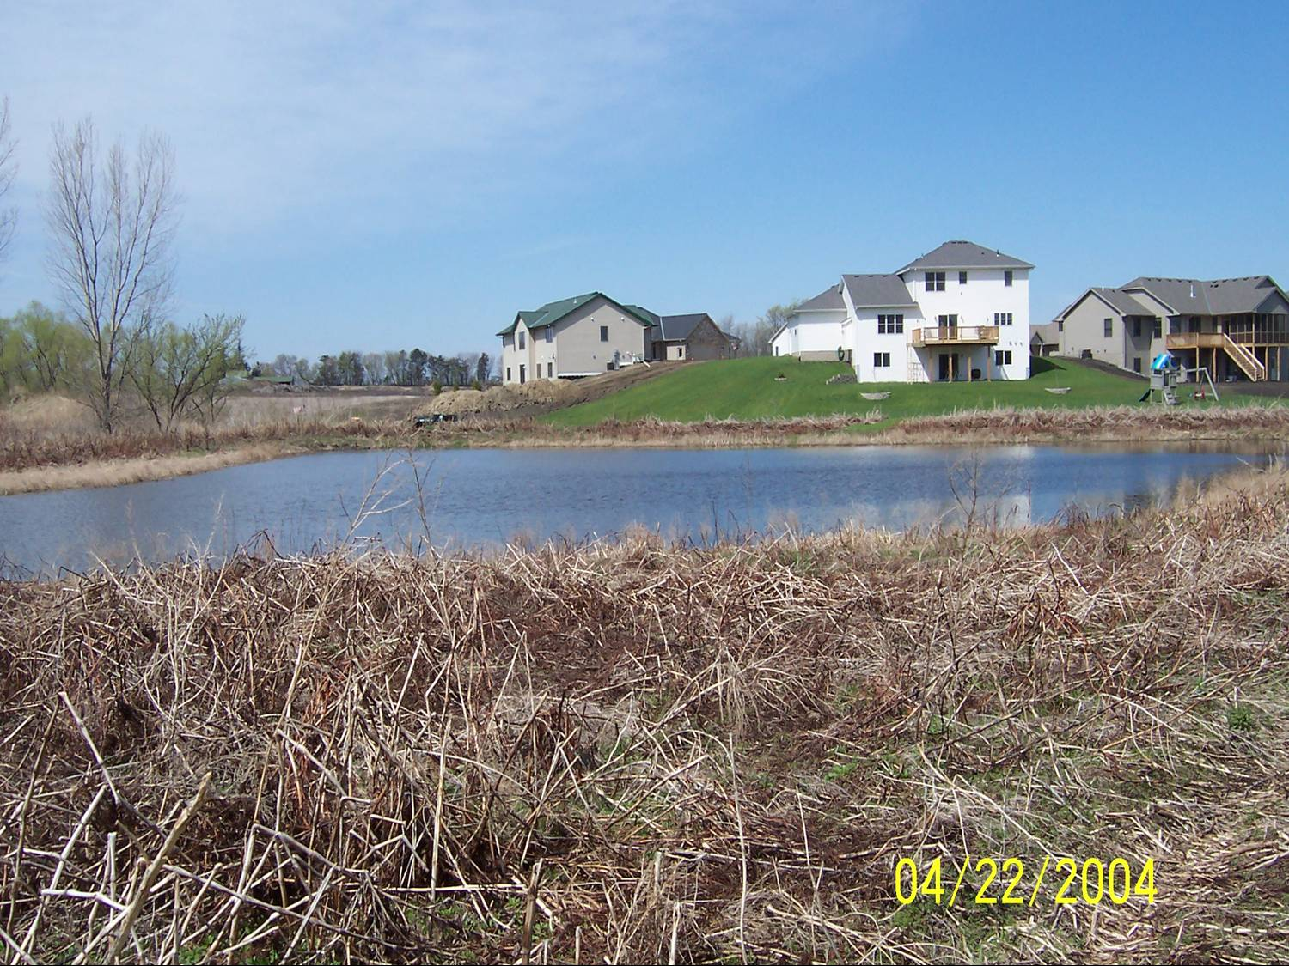
Part III.C Requirements for temporary sediment basins
  Must provide where 10 or more acres of disturbed soil drain to a common location
  Calculate basin size based on runoff from a 2 year, 24 hour storm, for each acre drained to the basin. At a minimum the basin must provide 1800 cubic feet of storage for each acre drained to the basin.
  Without calculation, a basin with 3600 cubic feet of storage per acre drained is required

Slide 37
Part III.C Requirements for temporary sediment basins
  Prevent short-circuiting and discharge of floating debris
  Allow for complete basin drawdown for maintenance activities
  Provide stabilized emergency overflow
  Energy dissipation for basin outlet

Slide 38
Part III.C Requirements for temporary sediment basins
  Basins must be constructed before up-gradient land disturbing activities begin.
  Equivalent controls allowed for site limitations - Must be documented in the SWPPP
  When determining infeasibility, must consider public safety, site soils, slope and available area on site
  The outlet structure must be designed to withdraw water from the surface (not required in frozen conditions)

Slide 39
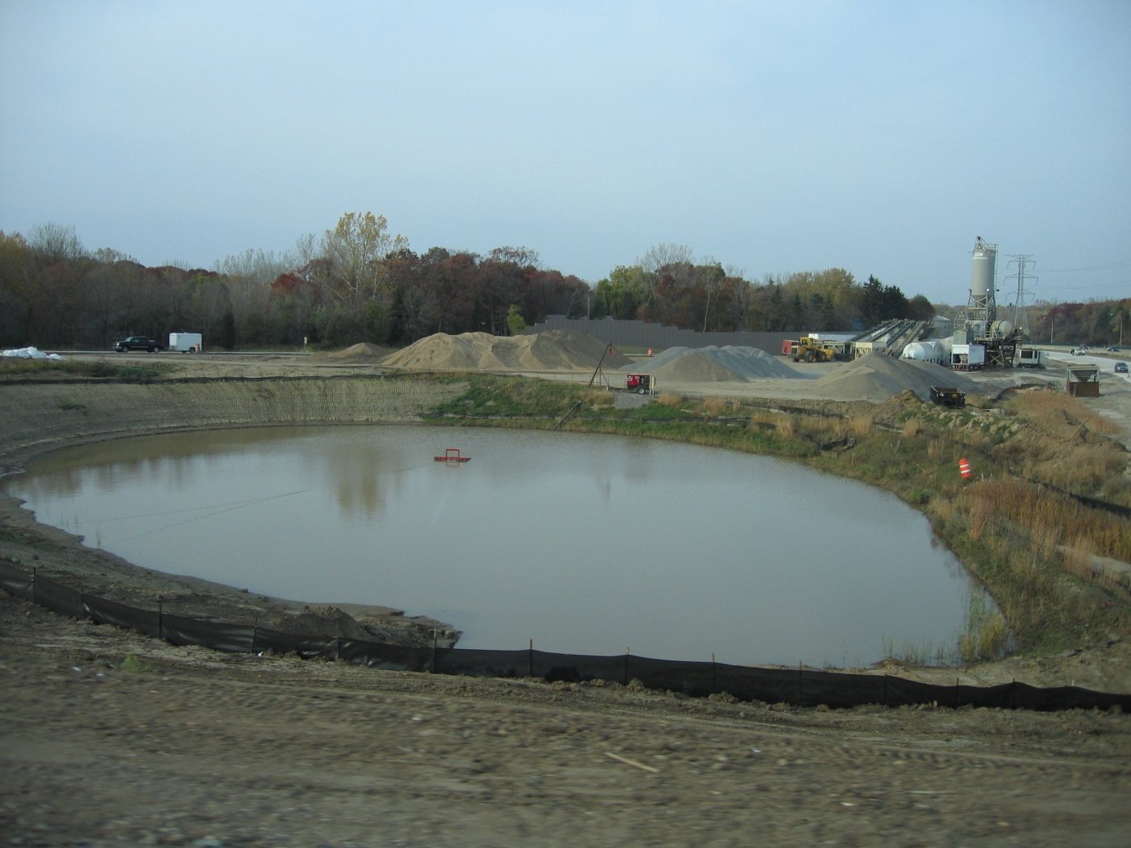
Basin draw down : pump with floating head intake

Slide 40
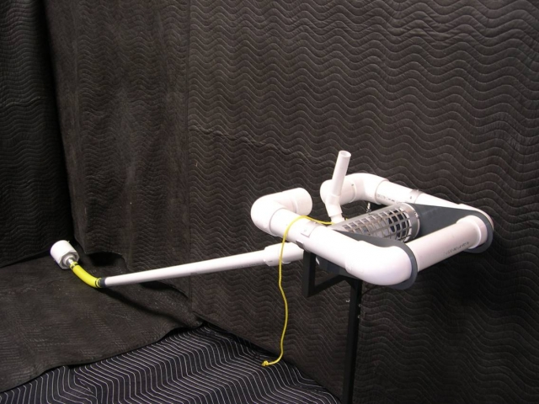
Basin draw down : Faircloth Skimmer R

Slide 41

Part III.D Post construction stormwater treatment system design requirements
  If the project is located in an Jurisdiction subject to an MS4 permit, and that permittee (MS4) has established permanent stormwater treatment system requirements that include volume control, the project’s system may be designed according to those rules in lieu of the MPCA requirements.

Slide 42
Part III.D Post construction stormwater treatment system design requirements
  Where one or more acres of cumulative impervious surface is created by the project, permanent SW management is required.
  Water volume of 1 inch of runoff from the new impervious surface must be retained on site (i.e. infiltration or other volume control practices)
  For those projects where infiltration is prohibited, the water quality volume must be treated by a sedimentation basin, filtration or equivalent methods.

Slide 43
Site Conditions
Existing Impervious Area = 8 Acres
Proposed Impervious Area = 13 Acres
Net Increase in Area = 5 Acres
You have fulfilled your permanent stormwater treatment requirements.
The NPDES Permit requires that volume of runoff = to 1” times 5 acres be captured and retained onsite
Drainage Area 1
Drainage Area 2
Drainage Area3
Existing Impervious = 3 Acres
Proposed Impervious = 2 Acres
Total Impervious = 5 Acres (new & old)
Existing Impervious = 2 Acres
Proposed Impervious = 1 Acres
Total Impervious = 3 Acres (new & old)
Existing Impervious = 3 Acres
Proposed Impervious = 2 Acres
Total Impervious = 5 Acres (new & old)
Begin Construction
Wetland
Impaired Stream
End Construction

Slide 44
Part III.D Post construction stormwater treatment system design requirements
  Where the proximity to bedrock precludes the installation of any of the systems found in Part III.D, other treatment such as grassed swales, filtration, smaller ponds or grit chambers or other prior to discharging
  For linear projects where there is a lack of right-of-way precluding the installation of any of the practices in Part III.D, other treatment such as grassed swales, filtration, smaller ponds or grit chambers or other prior to discharging

Slide 45
Part III.D Post construction stormwater treatment system design requirements
Stormwater infiltration is prohibited in the following situations:
  Areas that receive discharges from vehicle fueling and maintenance
  Areas with less than 3 feet of separation from the seasonally saturated soils or bedrock
  Areas that receive runoff from industrial facilities which are not authorized to infiltrate under an NPDES Industrial Permit
  Areas where of contaminated soils

Slide 46
Part III.D Post construction stormwater treatment system design requirements
Stormwater infiltration is prohibited in the following situations unless allowed by a local unit of government with a current MS4 permit:
  Areas of predominantly Hydrologic Soiil Group D (clay) soils
  Areas with 1,000 feet up-gradient or 100 feet down-gradient of active karst features
  Areas within a Drinking Water Supply Management Area (Minn.R. 4720.5100, subp. 13)
  Areas where soil infiltration rates are more than 8.3 inches per hour unless the soils are amended to slow the rate

Slide 47
Part III.D Post construction stormwater treatment system design Requirements
  Systems allowed:
  1. Infiltration/filtration (must be considered first)
  2. Other volume reduction practices (must be considered first)
  3. Wet sedimentation basins
  4. Regional ponds
  5. Any other system!

Slide 48
Part III.D Post construction stormwater treatment system design Requirements
  Systems allowed:
  1. Infiltration/filtration (must be considered first)
  2. Other volume reduction practices (must be considered first)
  3. Wet sedimentation basins
  4. Regional ponds
  5. Any other system!

Slide 49
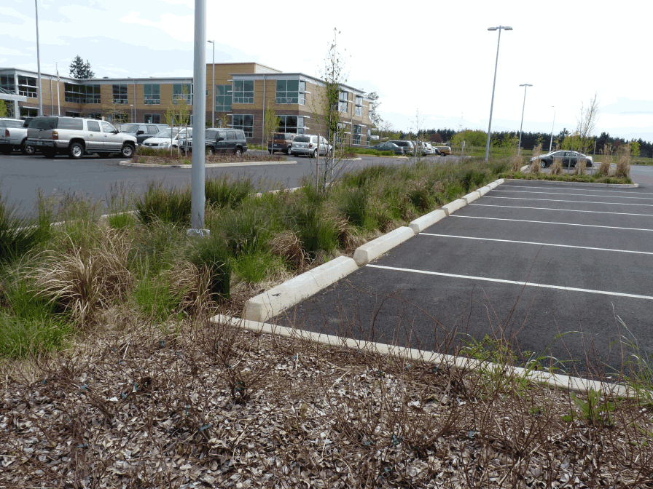
Commercial infiltration trench

Slide 50
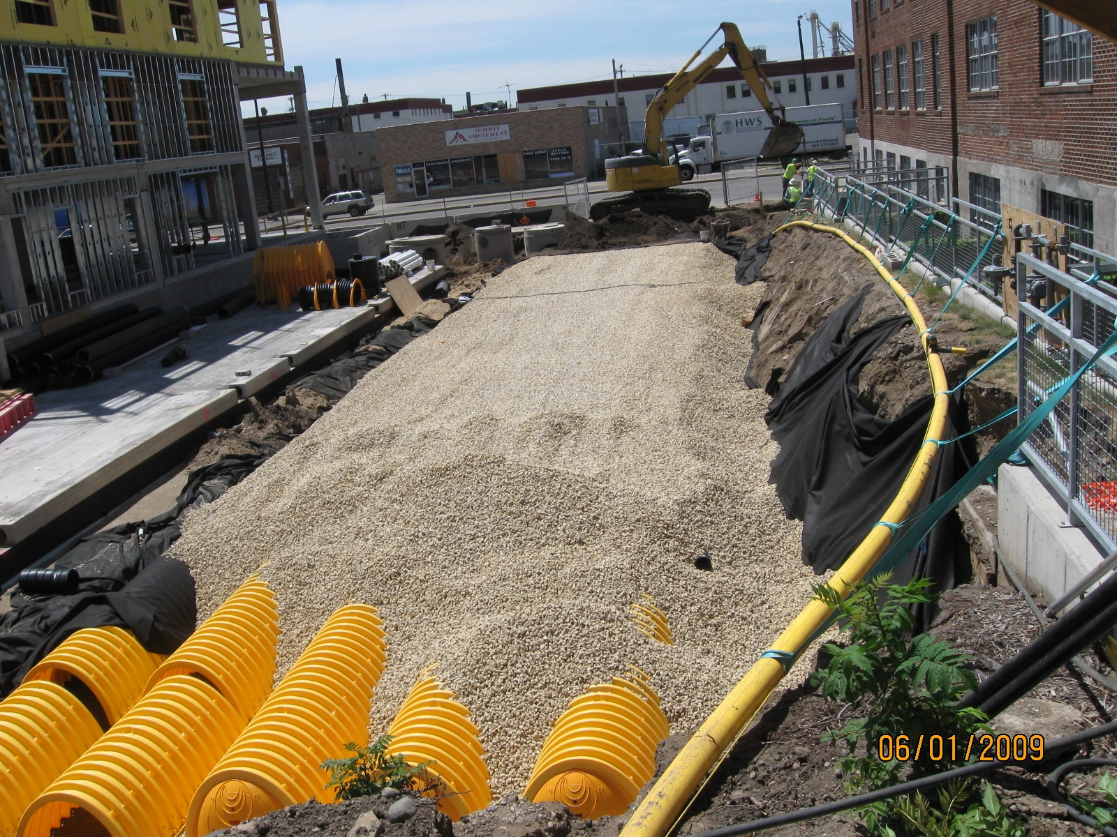
Underground infiltration

Slide 51
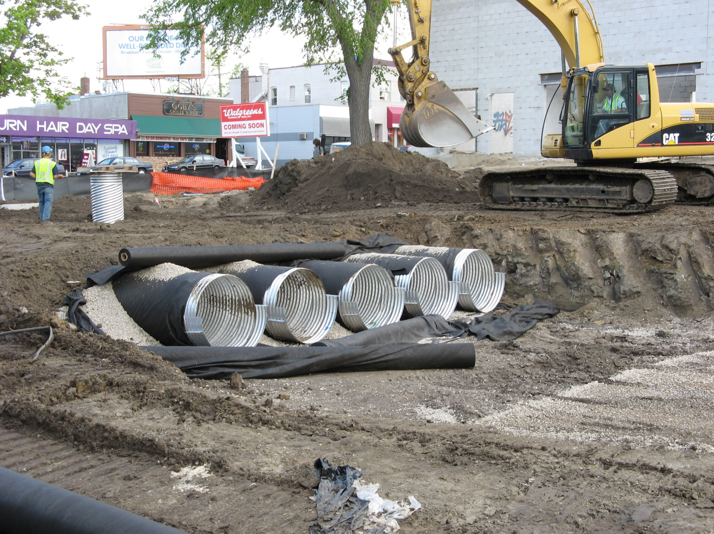
Underground infiltration

Slide 52
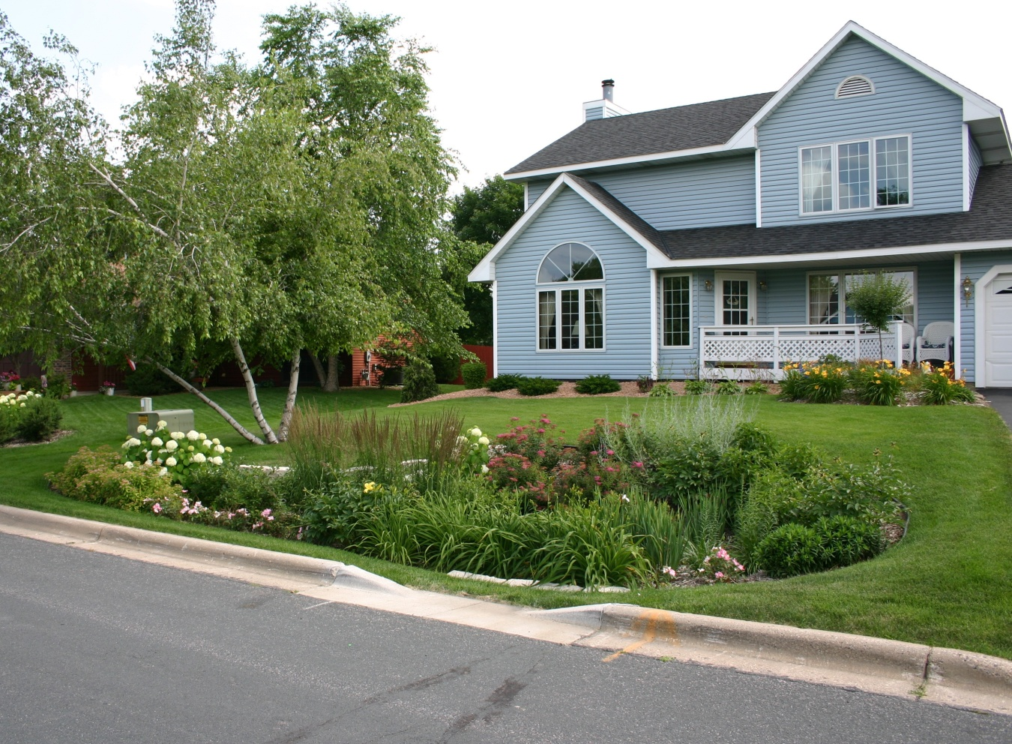
Residential rain garden

Slide 53
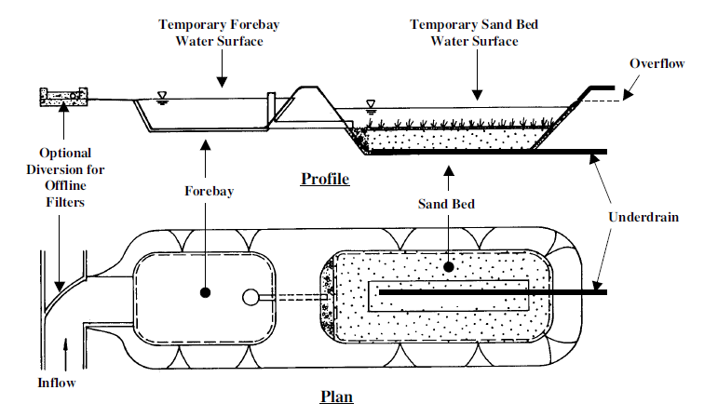
Sand filtration treatment

Slide 54
Design Requirements for infiltration/filtration systems :
  Final excavation should not occur until the drainage area has been fully stabilized.
  Extra care should be taken to avoid runoff entering the infiltration basin and it should be clearly marked.
  A pretreatment device must be used to prevent clogging.
  The system must be capable of capturing 1 inch of runoff from the new impervious surface.
  The water quality volume must discharge within 48 hrs. An emergency spillway must be provided

Slide 55
Design Requirements for infiltration/filtration systems continued:
  A minimum of 3’ of separation must be provided between the bottom of the basin and the ground water level.
  Maintenance access and a maintenance plan must be provided.
  Use of designated infiltration systems from industrial areas, vehicle fueling or maintenance etc. is prohibited.

Slide 56
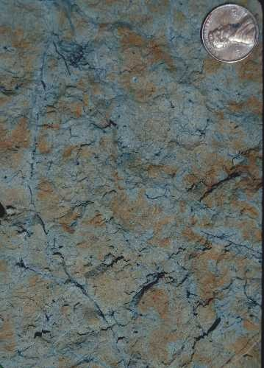
Depth to Ground water and soil mottling:
Color patterns in the soil formed by the oxidation and reduction of iron and/or manganese caused by saturated conditions within the soil.

Slide 57
Other things to consider:
Pond/infiltration basin location (safety)
Plants/landscaping
Shape
Construction techniques
Soil exploration
Pond liners
Check Minnesota stormwater manual for more design information

Slide 58
Part III.C Post construction stormwater treatment system design Requirements
  Systems allowed:
  1. Infiltration/filtration (must be considered first)
  2. Other volume reduction practices (must be considered first)
  3. Wet sedimentation basins
  4. Regional ponds
  5. Any other system!

Slide 59
Part III.C Post construction stormwater treatment system design Requirements
  Other Volume Reduction Practices:
  Dry Swale
  Infiltration basins or trenches with under drains
  Green roof
  Stormwater harvest and re-use
  Turf
  Trees (mainly tree box and trench system)
  Constructed stormwater wetlands
  Other

Slide 60
Part III.C Post construction stormwater treatment system design Requirements
  Systems allowed:
  1. Infiltration/filtration (must be considered first)
  2. Other volume reduction practices (must be considered first)
  3. Wet sedimentation basins
  4. Regional ponds
  5. Any other system!

Slide 61
Design requirements for wet sedimentation basins
  Permanent Volume of 1800 ft³/acre of drained area below the outlet pipe.
  A basins permanent depth must be between 3’ and 10’ deep
  The water quality volume is calculated as 1 in of runoff from the new impervious surface.
  Outlet structure must discharge at 5.66 cfs maximum per acre of pond surface area.
  Outlets must be designed to prevent short circuiting, remove floating debris and must have energy dissipation.
  Must have stabilized emergency spillway.
  Maintenance access must be provided.

Slide 62
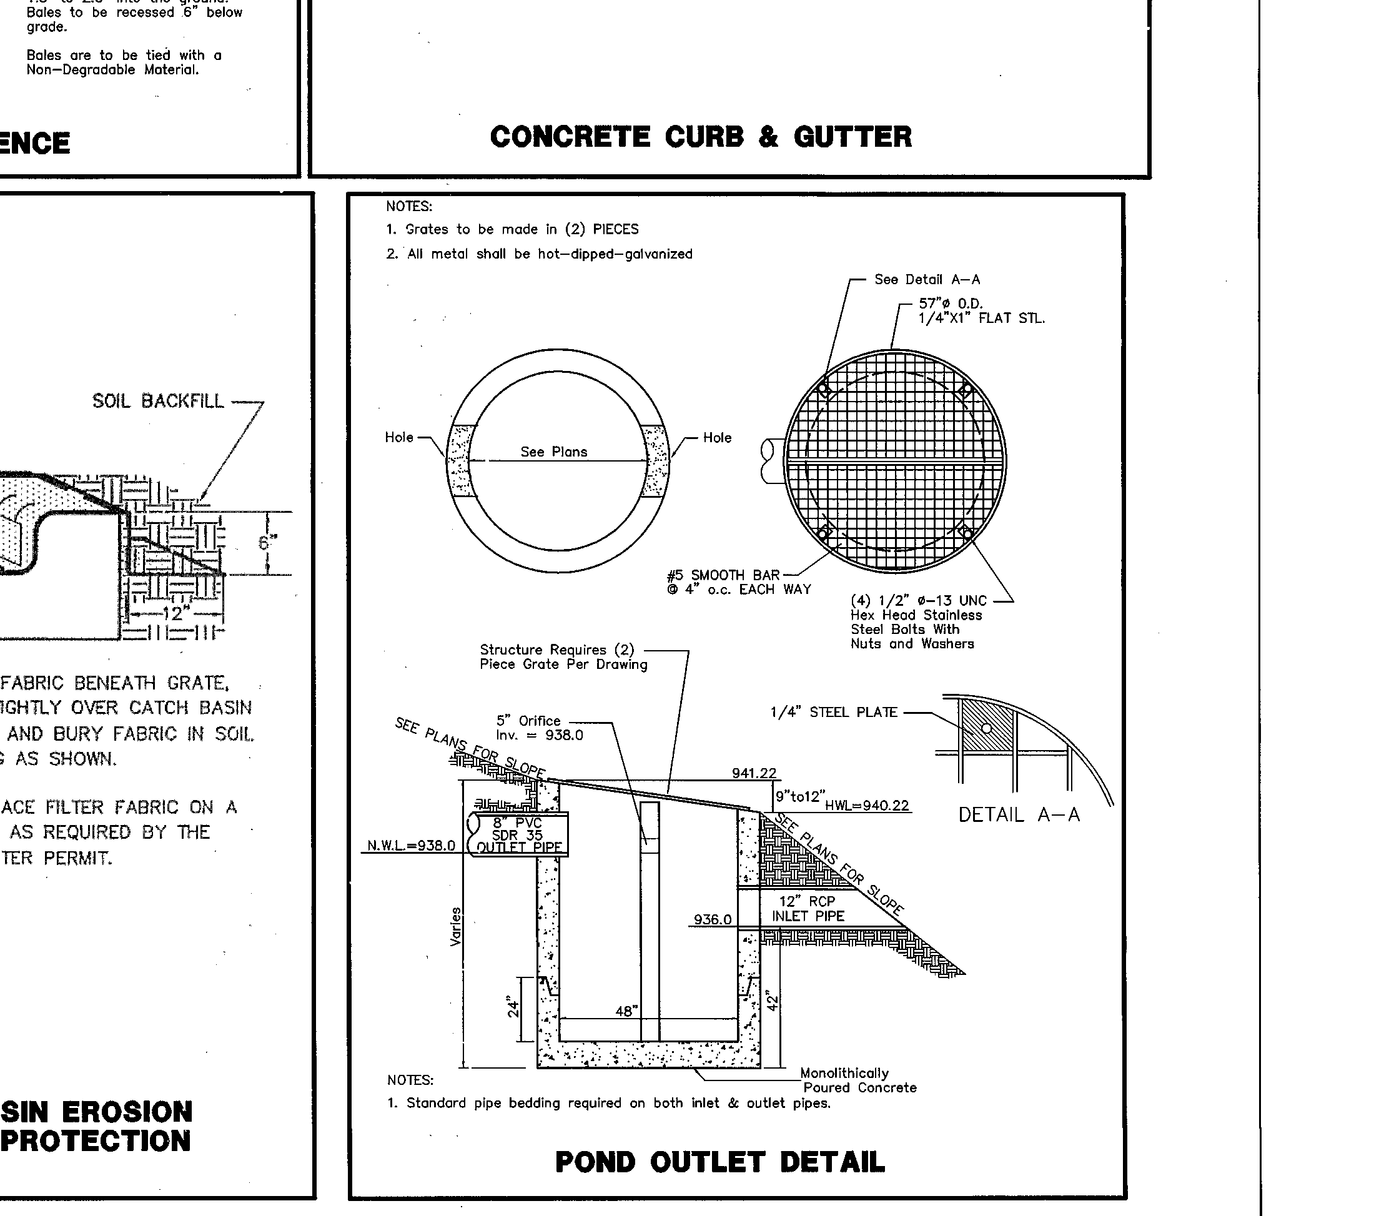
Weir wall with orifice

Slide 63
Part III.D Post construction stormwater treatment system design Requirements
  Systems allowed:
  1. Infiltration/filtration (must be considered first)
  2. Other volume reduction practices (must be considered first)
  3. Wet sedimentation basins
  4. Regional ponds
  5. Any other system!

Slide 64
Design requirements for regional pond systems :
  Regional ponds can be used provided they have proper capacity. Ponds must meet the general requirements of the permit to treat the runoff from all new impervious areas.
  Wetlands used as stormwater ponds cannot be used without mitigation (see appendix A).
  Written permission must be obtained from the applicable government agency.
Notes:
* Must be able treat ½” of runoff from all new impervious surfaces.
Discharge at 5.66 cfs per acre of pond surface area
See Appendix A
The written permission must identify that the regional pond will meet the other permit requirements

Slide 65
Part III.C Post construction stormwater treatment system design Requirements
  Systems allowed:
  1. Infiltration/filtration (must be considered first)
  2. Other volume reduction practices (must be considered first)
  3. Wet sedimentation basins
  4. Regional ponds
  5. Any other system!

Slide 66
Training requirements
Individual(s) preparing the SWPPP for the project.
Individual(s) overseeing implementation of, revising, and amending the SWPPP and individual(s) performing inspections as required in Part IV.E. One of these individual(s) must be available for an on site inspection within 72 hours upon request by the MPCA.
Individual(s) performing or supervising the installation, maintenance and repair of BMPs. At least one individual on a project must be trained in these job duties.

Slide 67
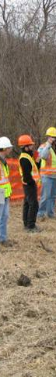
Training requirements
At least one trained individual must be present on the on the project (or available to the project site in 72 hours)
Training content – the content and extent of training must be commensurate with individual’s job responsibility with regard to activities covered under the permit.
Training documentation must be in or with the SWPPP (or available within 72 hours)
An updated refresher-training must be attended every three years

Slide 68
Where do I get Training?
University of Minnesota continuing education.
MECA.
CPESC.
Builders Association of the Twin Cities.
Training from another state may also count.
Training guidance is available on the MPCA website.

Slide 69
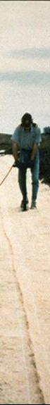
Part IV: Construction Activity Requirements
Erosion Prevention Practices
  Minimize erosion using phasing, buffer strips, horizontal slope grading, etc.
  All exposed soil areas must have temporary erosion protection or permanent cover year round
  Stabilization must be initiated immediately when construction activity has temporarily or permanently ceased and will not resume for more than 14 days
  Stabilization must be completed within 14 days

Slide 70
Part IV: Construction Activity Requirements
Definition of initiated immediately
means taking an action to commence stabilization as soon as practicable, but no later than the end of the work day, following the day when the earth‐disturbing activities have temporarily or permanently ceased, if the Permittee(s) know that construction work on that portion of the site will be temporarily ceased for 14 or more additional calendar days or 7 calendar days where Appendix A.C.1.a applies. The following activities can be taken to initiate stabilization:
1. prepping the soil for vegetative or non‐vegetative stabilization
2. applying mulch or other non‐vegetative product to the exposed soil area
3. seeding or planting the exposed area
4. starting any of the activities in # 1 – 3 on a portion of the area to be stabilized, but not on the entire area and
5. finalizing arrangements to have stabilization product fully installed in compliance with the applicable deadline for completing stabilization

Slide 71
Part IV: Construction Activity Requirements
Stabilization on waters where the MN DNR has promulgated “work in waters restrictions” during fish spawning time:
  Exposed soil areas within 200’ of and drain to the waters edge must be stabilized within 24 hours
  Temporary stockpiles without significant silt, clay or organic components and constructed road beds are exempt
  Example's include clean aggregates, demolition concrete and sand stockpiles

Slide 72
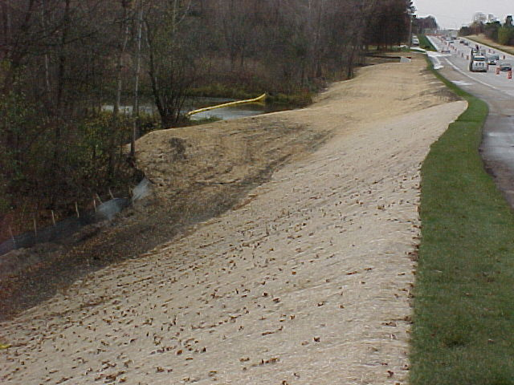

Slide 73
Sediment Discharge from Construction
Unstabilized construction site sediment loads are typically:
  35 - 45 Tons/Acre/Year
  Have been measured as high as 100 tons/acre/year

Slide 74
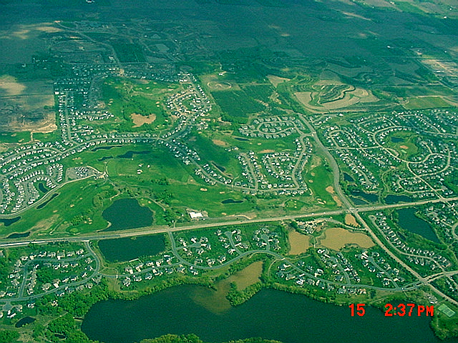

Slide 75
Part IV: Construction Activity Requirements
Conveyance channels
  If using, must be designed to route water around unstabilized areas unless infeasible.
  Must use erosion controls and velocity dissipation such as check dams, sediment traps or riprap within and along conveyance channels
  Must provide a non-erosive flow velocity to minimize erosion of channels and their embankments, outlets, adjacent stream banks, slopes and downstream waters during discharge conditions

Slide 76
Part IV: Construction Activity Requirements
Erosion Prevention Practices
  Normal wetted perimeter of ditches that drain water from, or around a site, must be stabilized within 200 feet of property edges or point of discharge to surface water – within 24 hours of connection to a surface water
  All other ditches must be stabilized within 14 days

Slide 78
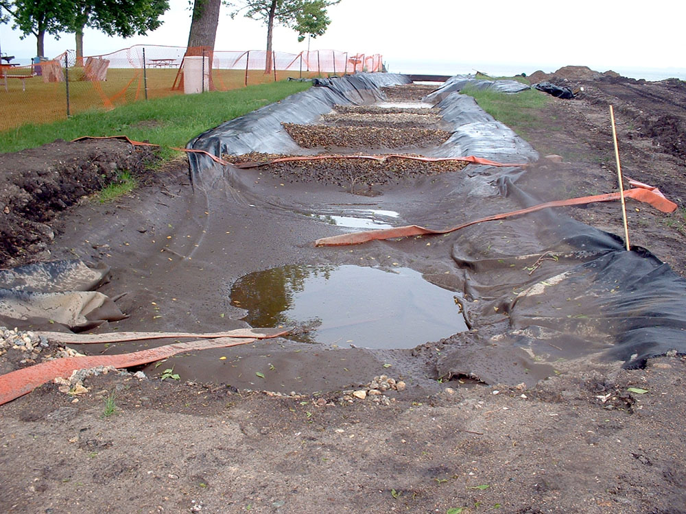
Ditches being used as a sediment containment system do not need to be stabilized
Photo by Dwayne stenlund

Slide 79
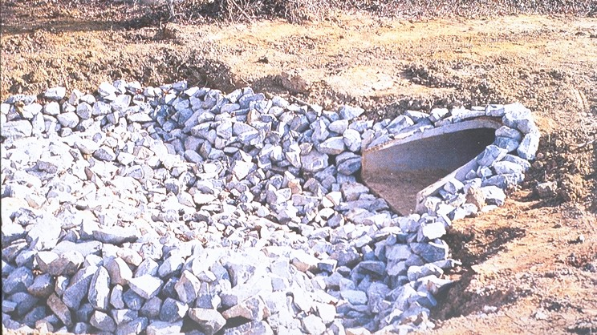
Pipe outlets must have temporary or permanent energy dissipation within 24 hours of connection to a surface water

Slide 80
Unless infeasible due to lack of pervious or vegetated areas, the Permittee(s) must direct discharges from BMPs to vegetated areas of the site (including any natural buffers) in order to increase sediment removal and maximize stormwater infiltration. The Permittee(s) must use velocity dissipation devices if necessary to prevent erosion when directing stormwater to vegetated areas.er

Slide 81
Part IV: Construction Activity Requirements – Sediment Control
  Permittee(s) must use sediment control practices as necessary to minimize sediment from entering surface waters including curb and gutter systems and storm sewer inlets
  Temporary or permanent drainage ditches and sediment basins designed as part of a sediment containment system require sediment control only as appropriate
  Sediment control practices must be installed before upgradient land disturbing activities occur.
  Floating silt curtain is not a sediment control practice to keep sediment out of surface waters except when working on the shore or in the water

Slide 82
Part IV: Construction Activity Requirements – Sediment Control
  Sediment control practices can be removed to accommodate short term construction activity
  Storm drain inlets must be protected
Inlet protection can be removed if the permittee or a jurisdictional authority (e.g., city, county, township, MnDOT Engineer) directs the permittee to do so because of a specific safety concern

Slide 83
Part IV: Construction Activity Requirements – Sediment Control
  Temporary soil stockpiles must have perimeter control – cannot be placed in conveyance system unless a bypass is provided
  Must minimize soil compaction and, unless infeasible, preserve topsoil
  Must install vehicle tracking BMP’s to minimize track out. Examples include rock pads, mud mats, rumble strips, wash racks or equivalent systems

Slide 84
Locate stockpiles away from curb systems or water bodies!

Slide 85
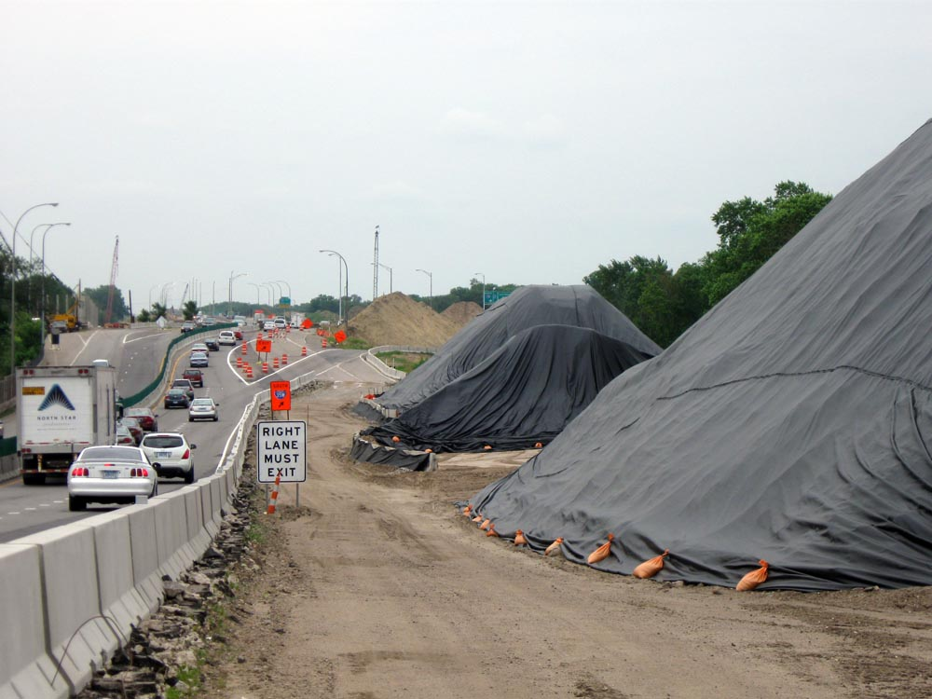

Slide 86
Part IV: Construction Activity Requirements – Sediment Control
  Temporary soil stockpiles must have perimeter control – cannot be placed in conveyance system unless a bypass is provided
  Must minimize soil compaction and, unless infeasible, preserve topsoil
  Must install vehicle tracking BMP’s to minimize track out. Examples include rock pads, mud mats, rumble strips, wash racks or equivalent systems

Slide 87
#1 Complaint from the public:

Slide 88
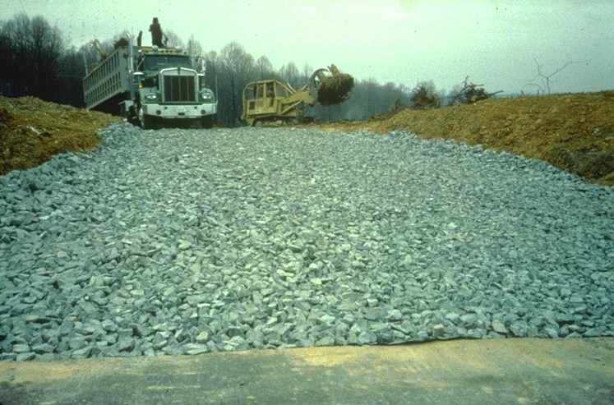
Vehicle Entry Pad

Slide 89
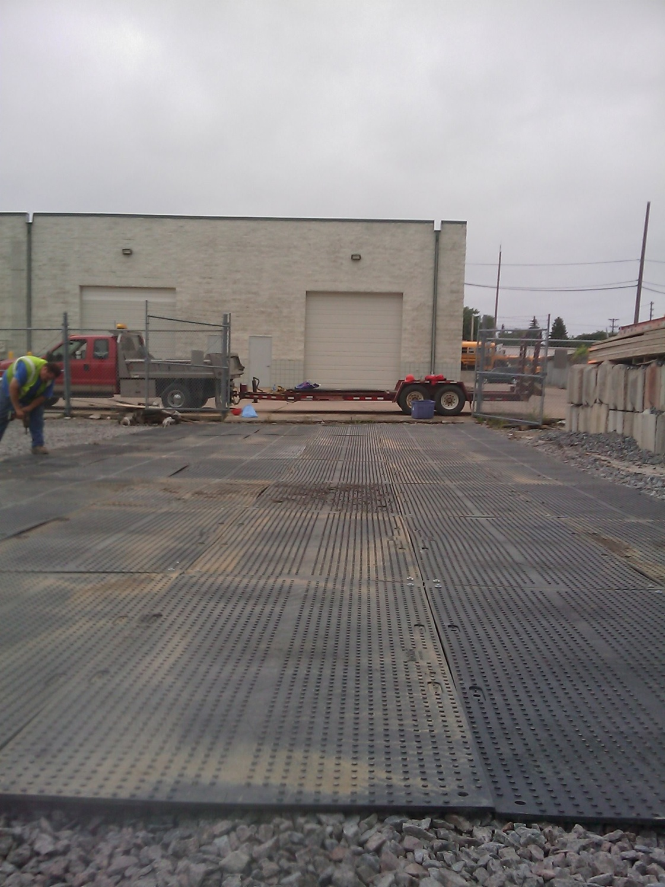
From: Neaton Brothers

Slide 90
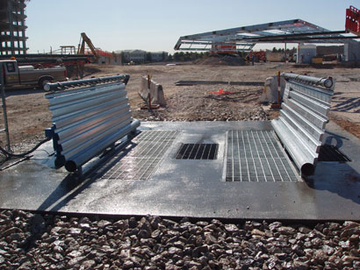
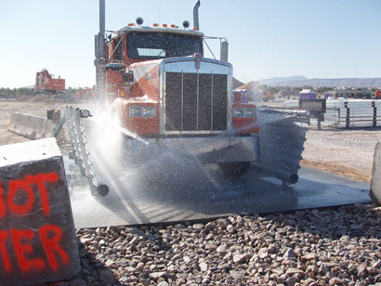
From: Stanton Systems

Slide 91
Part IV: Construction Activity Requirements
Buffers
  Must preserve a 50 foot natural buffer around surface waters
  If a buffer is infeasible, redundant sediment controls are required
  Buffers are not required around road ditches, judicial ditches, county ditches, stormwater conveyance systems, stormdrain inlets or sediment basins.
  Not required to provide vegetation or enhancements to the buffer
  Note: this is an entirely different requirement than the buffer in appendix A.
Additional buffer guidance coming soon.

Slide 92
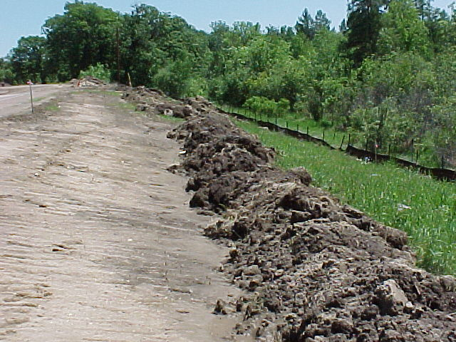

Slide 93
Part IV: Construction Activity Requirements
Chemicals (flocculants)
  Must use conventional erosion and sediment control practices prior to chemical addition
  Must be able to discharge to a sediment control system for filtration or sedimentation
  Must be used in accordance with accepted engineering practices and with dosing specs provided by the manufacturer

Slide 94
Part IV: Construction Activity Requirements
D. Dewatering and Basin Draining
  Dewater sediment-laden water to sedimentation basins if possible, or use other BMPs to prevent erosion and scour when discharging to receiving water or downstream landowners
  Disperse discharge using appropriate energy dissipation measures
  Dewatering can not cause nuisance conditions, erosion of receiving channels or down-slope properties, or inundation of wetlands

Slide 95
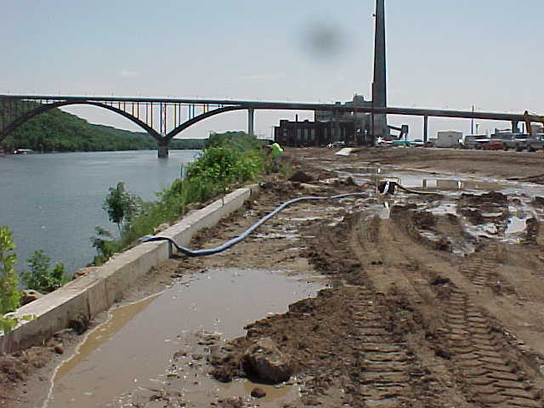
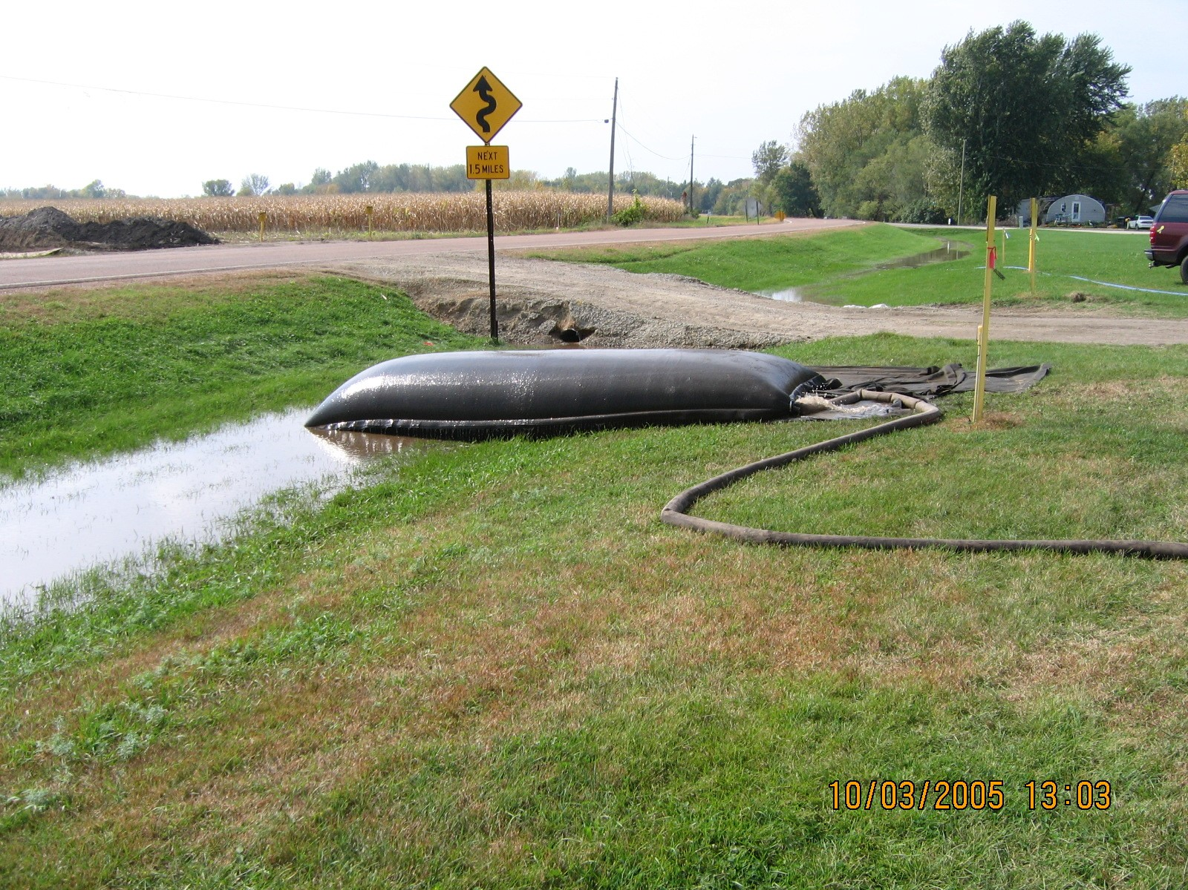
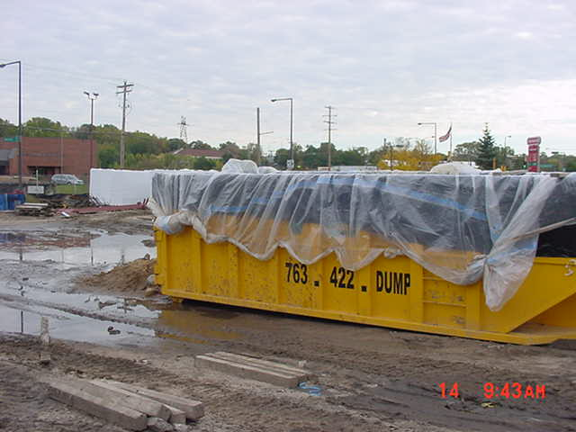
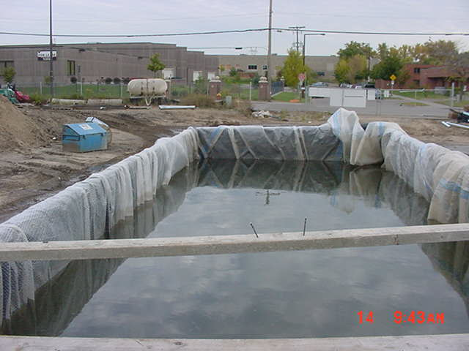

Slide 96
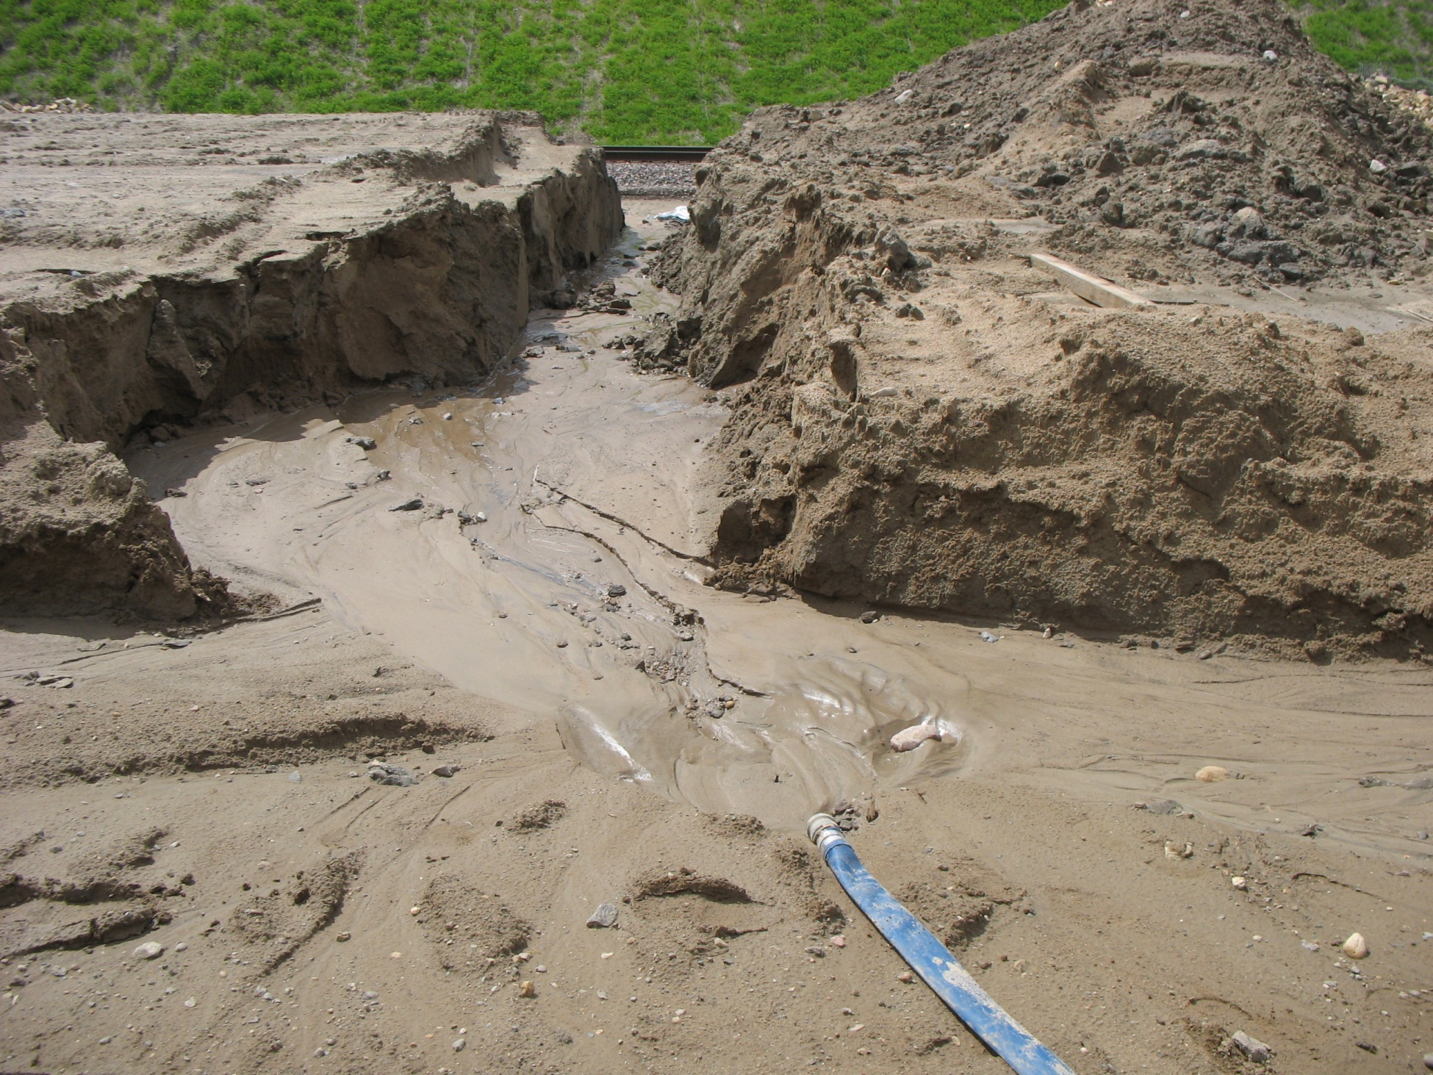

Slide 97
Part IV: Construction Activity Requirements
Inspections and Maintenance
  Inspect site every 7 days during active construction, and within 24 hours after a rainfall event of greater than 0.5 inches in 24 hours
  Inspect stabilized areas once a month
  Inspections not required if site is in frozen condition.
  Inspect in spring as soon as runoff occurs or prior to resuming construction
If construction activity has been suspended and site is in a vegetated condition for 12 months, inspections are no longer required

Slide 98
Part IV: Construction Activity Requirements
Inspections and Maintenance
  Maintain and/or replace sediment control practices as required:
    Perimeter control devices – sediment is ½ the height of device, w/in 24 hours
    Temporary sed. basins – ½ storage volume, w/in 72 hours
    Surface waters – remove and stabilize, w/in 7 days of discovery
    Vehicle sediment removal– w/in 24 hours

Slide 99
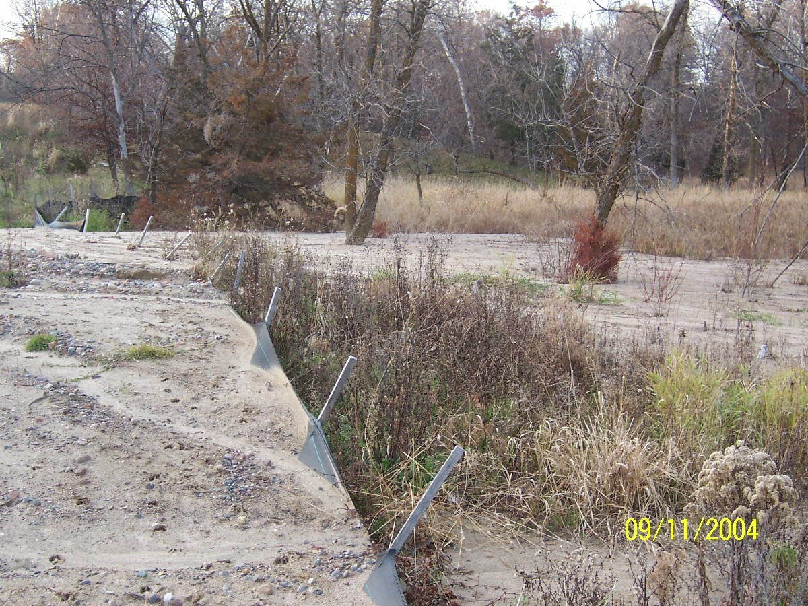
L. Woog, MPCA

Slide 100
Temporary sediment basin

Slide 101

Pollution Prevention Management Measures
Storage, handling, and disposal of construction products, materials, and wastes: The permittee shall minimize exposure to stormwater of the following:
Building products that have the potential to leach pollutants (must be under cover)
Pesticides, herbicides, insecticides, fertilizers, treatment chemicals, and landscape materials must be under cover (e.g., plastic sheeting or temporary roofs)
Hazardous materials, toxic waste, (including oil, diesel fuel, gasoline, hydraulic fluids, paint solvents, petroleum‐based products, wood preservatives, additives, curing compounds, and acids) must be properly stored in sealed containers to prevent spills, leaks or other discharge.

Slide 102
Pollution Prevention Management Measures
More: Storage, handling, and disposal of construction products, materials, and wastes: The permittee shall minimize exposure to stormwater of the following:
Solid waste must be stored, collected and disposed of properly in compliance with Minn. R.ch. 7035.
Portable toilets must be positioned so that they are secure and will not be tipped or knocked over. Sanitary waste must be disposed of properly in accordance with Minn. R. ch. 7041.
Take steps to prevent spills during fueling or transfer of chemicals Including the use of drip pans or absorbents unless infeasible. Must ensure adequate supplies are available in case of a spill. Report spills per Minn. Stat. 115.061

Slide 103
Pollution Prevention Management Measures
More: Storage, handling, and disposal of construction products, materials, and wastes: The permittee shall minimize exposure to stormwater of the following:
Vehicle washing must be done in a defined area and runoff must be contained.
No engine degreasing is allowed on sight

Slide 104
Concrete Washout
All liquid and solid wastes generated by concrete washout operations must be contained in a leak-proof containment facility or impermeable liner.
Liquid and solid wastes must be disposed of properly and in compliance with MPCA regulations.
A sign must be installed adjacent to each washout facility to inform concrete equipment operators to utilize the proper facilities.

Slide 105
What is Allowed:
Plastic structural concrete can be placed on the ground.
Small amounts of hardened material (1/2 yd³) can be buried on site.
Washout onto a prepared compacted road bed.
Notes:
      there MUST be a barrier of some type to hold the material in place.
      Intended for slip form machines where the area will paved over the next day
      Not intended for truck washout
Recover and recycle back into truck
May be discharged into sanitary sewer

Slide 106
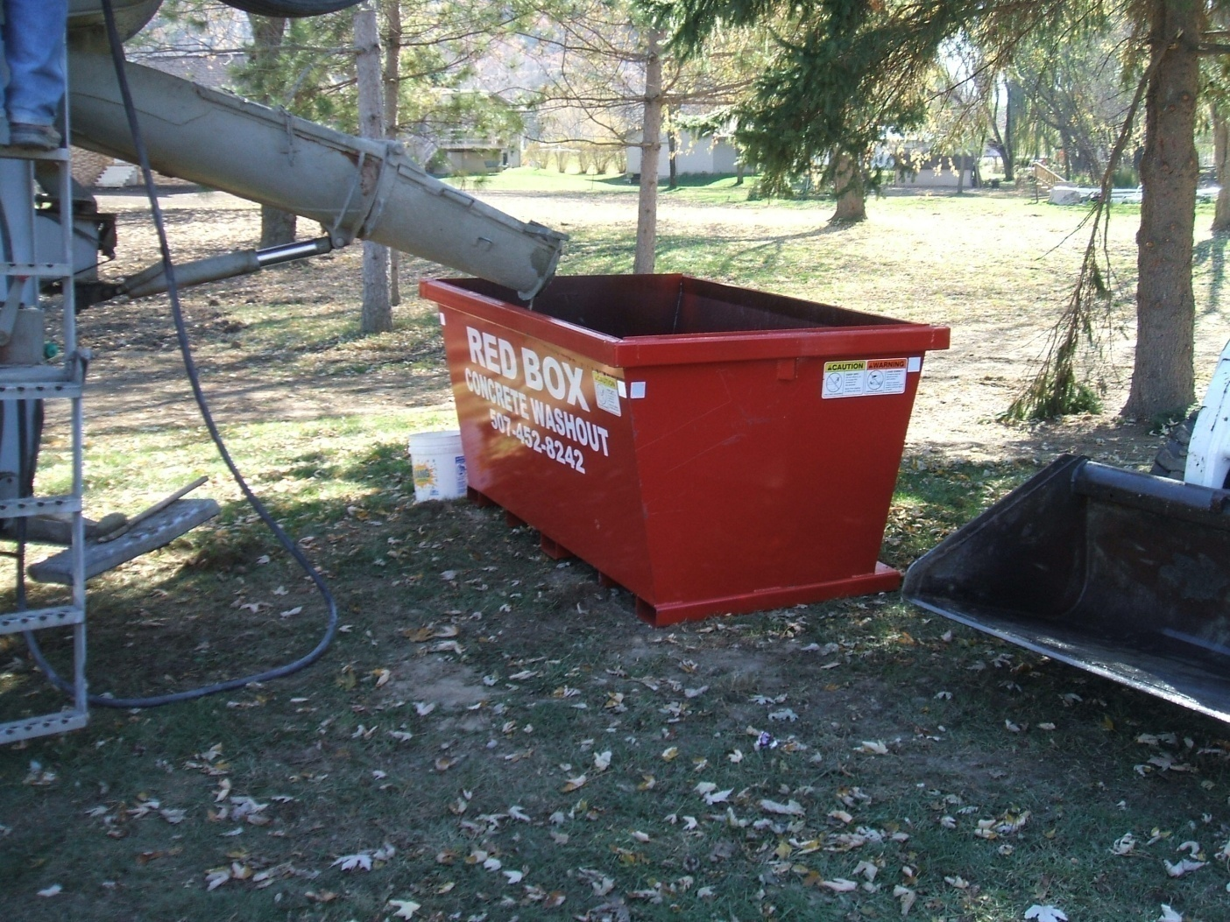
Concrete washout service company:

Slide 107
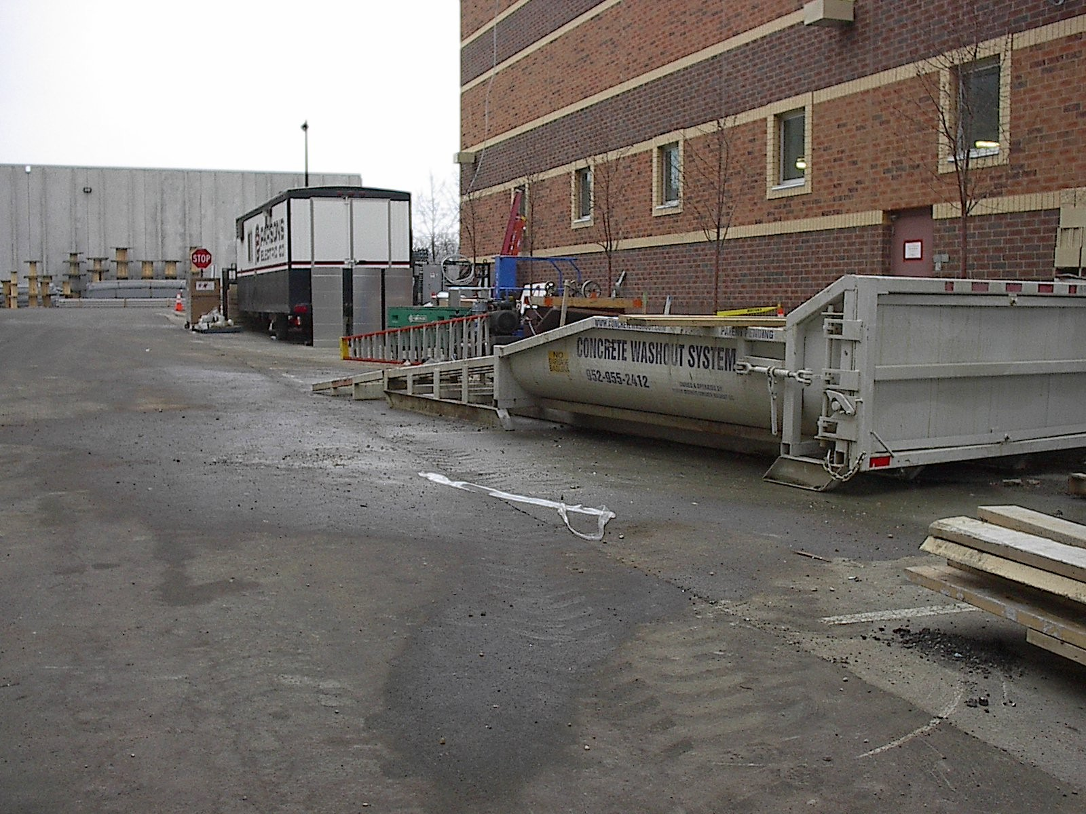
Another from Neaton Brothers:

Slide 108
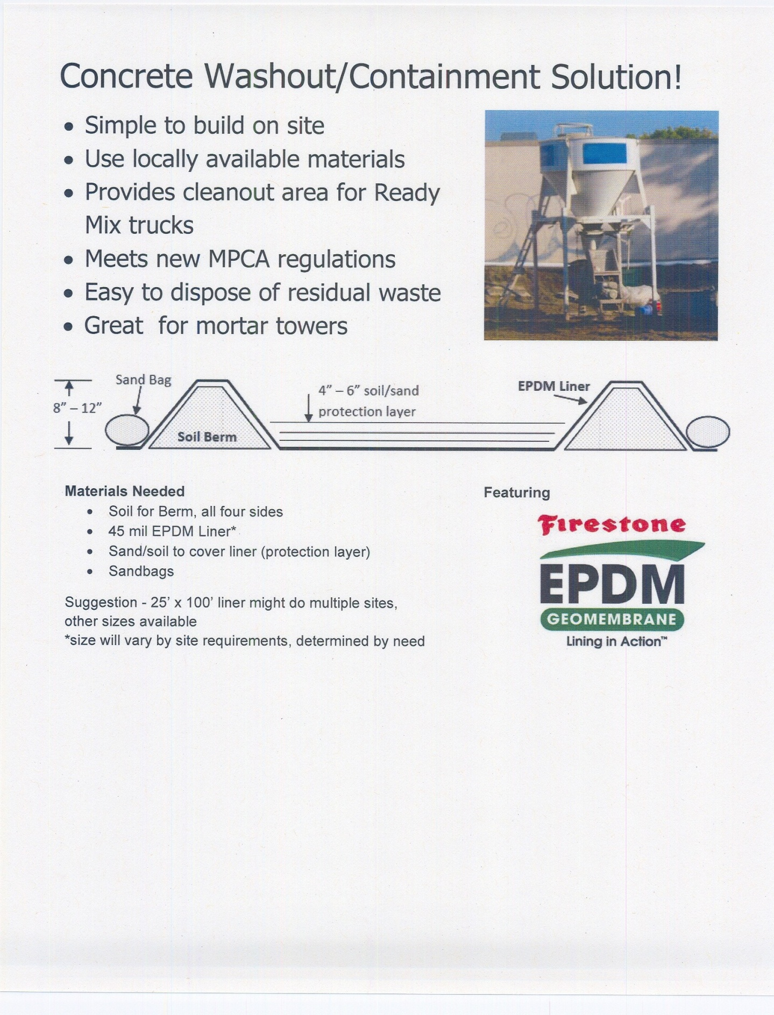
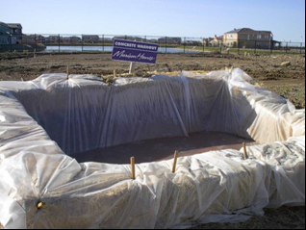
From Brock White:
Build your own:

Slide 109
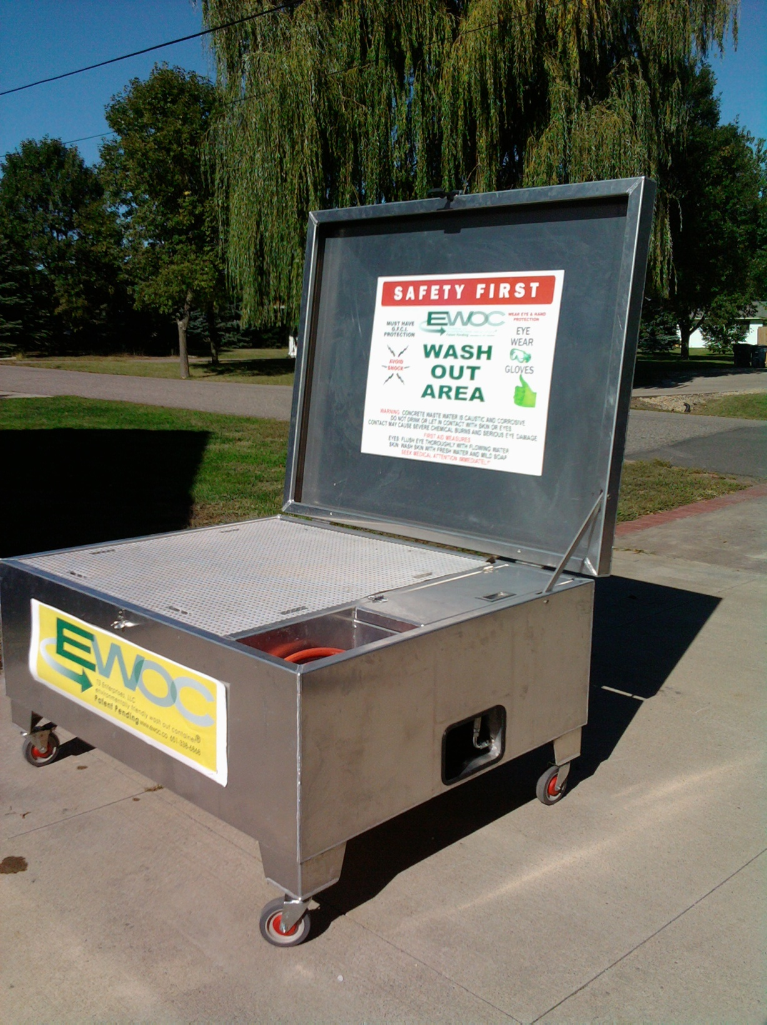

Slide 110
Part IV: Construction Activity Requirements
Final Stabilization
  Uniform perennial vegetative cover over all pervious surface and approximately 70% established
  Permanent stormwater management system must be brought back to design grade
  All temporary erosion prevention and sediment control BMPs should be removed, ditches stabilized
  Final maintenance/cleanout of any permanent stormwater treatment systems
  Residential sites only, final stabilization achieved when temporary erosion prevention controls and down gradient perimeter controls are in place on an individual lot, and residence has been transferred to homeowner
  Permittee must give homeowner fact sheet

Slide 111
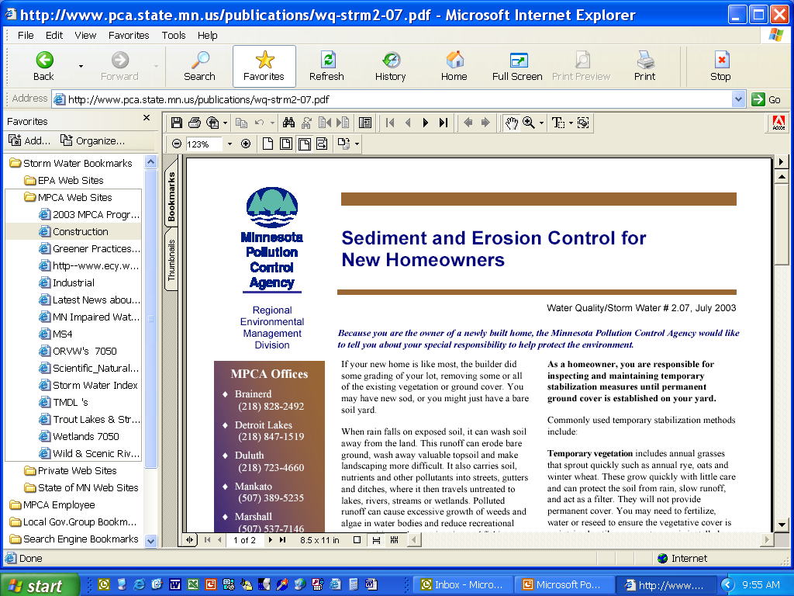
MPCA Homeowner Fact Sheet

Slide 112

Appendix A – “Special Conditions”
A. General Requirements
  Appendix A requirements are in addition to, and take precedence over, BMPs already specified in the permit
  Document Appendix A BMPs in SWPPP
  If Appendix A conditions cannot be met, an individual construction stormwater permit will be required in accordance with Minnesota Rules Chapter 7001

Slide 113
Appendix A – “Special Conditions”
B. Requirements for Discharges to Special or impaired Waters
Additional BMPs and enhanced runoff controls are required for discharges to the following special or impaired waters. The BMPs identified for each water are required for just those areas of the project draining to a discharge point on the project that is within 1 mile of a special or impaired water and flows to that water.

Slide 114
Appendix A – “Special Conditions”
B. Requirements for Discharges to Certain Waters
  Special Waters:
    Wilderness areas…………….. (MN Rules 7050.0180)
    Mississippi River… …………….(MN Rules 7050.0180)
    Scenic/rec. river segments.(MN Rules 7050.0180)
    Lake Superior …………….......(MN Rules 7050.0180)
    Scientific and natural areas.(MN Rules 7050.0180)
    Lake trout lakes………… .......(MN Rules 7050.0470)
    Trout lakes…………………………..(MN Rules 6264.0050)
    Trout streams…………………….…(MN Rules 6264.0050)
  Waters impaired for:
    Phosphorus (other nutrients)
    Turbidity
    Dissolved Oxygen
    Biotic impairment (fish, plant or macroinvertebrate bioassessment)

Slide 115
Appendix A – “Special Conditions”
C. Additional BMPs for Special Waters
  There are exemptions for bedrock and road projects
  1. During construction:
    All exposed soil areas must have cover within 7 days
    Temporary sedimentation basins for 5 or more acres of disturbed soil that drain to a common point

Slide 116
Appendix A – “Special Conditions”
C. Additional BMPs for Special Waters
  2. Post construction:
    The water quality volume retained on site by the permanent stormwater management system shall be 1 inch of runoff from the new impervious surface created by the project
This requirement is the same treatment requirement outlined in Part III.D (for all projects) and includes all of the prohibitions and site limitation factors described in that section in addition to the considerations for discharges to trout streams.

Slide 117
Appendix A – “Special Conditions”
C. Additional BMPs for Special Waters
  3. Buffer zone:
    100 feet or greater from special water (not tributaries) at all times
    Document exceptions in SWPPP
    Other guidance for buffer zones available on MPCA website.

Slide 118
Appendix A – “Special Conditions”
C. Additional BMPs for Special Waters
  4. Temperature controls:
    Permanent stormwater management system designed so discharge from the project to the trout stream will minimize temperature increase resulting from 1 and 2-year 24-hour precipitation events – includes tributaries to trout stream

Slide 119
Is this water special ?

Slide 120
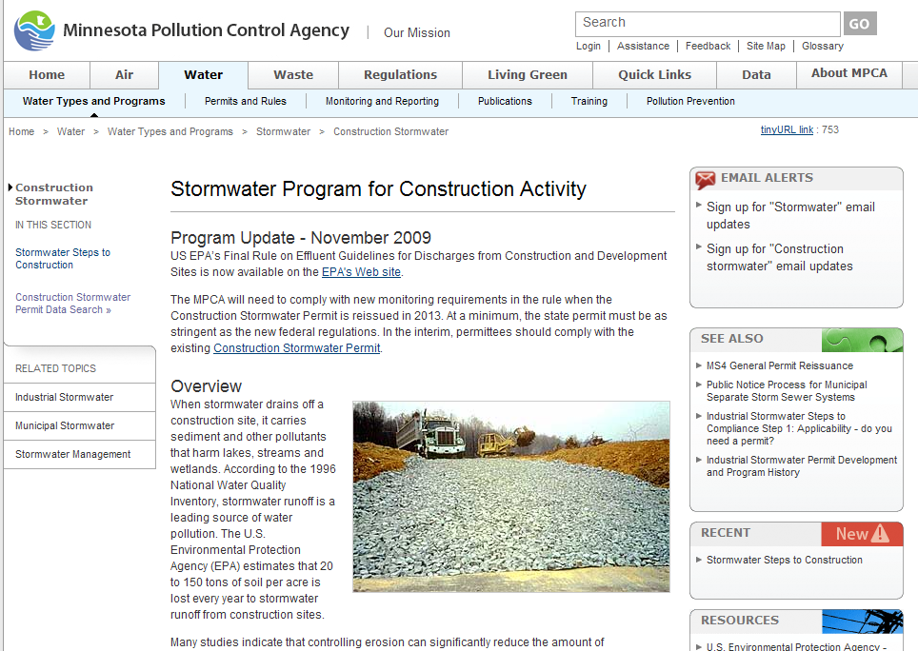
Construction stormwater web site
  http://www.pca.state.mn.us/water/stormwater/stormwater-c.html

Slide 121
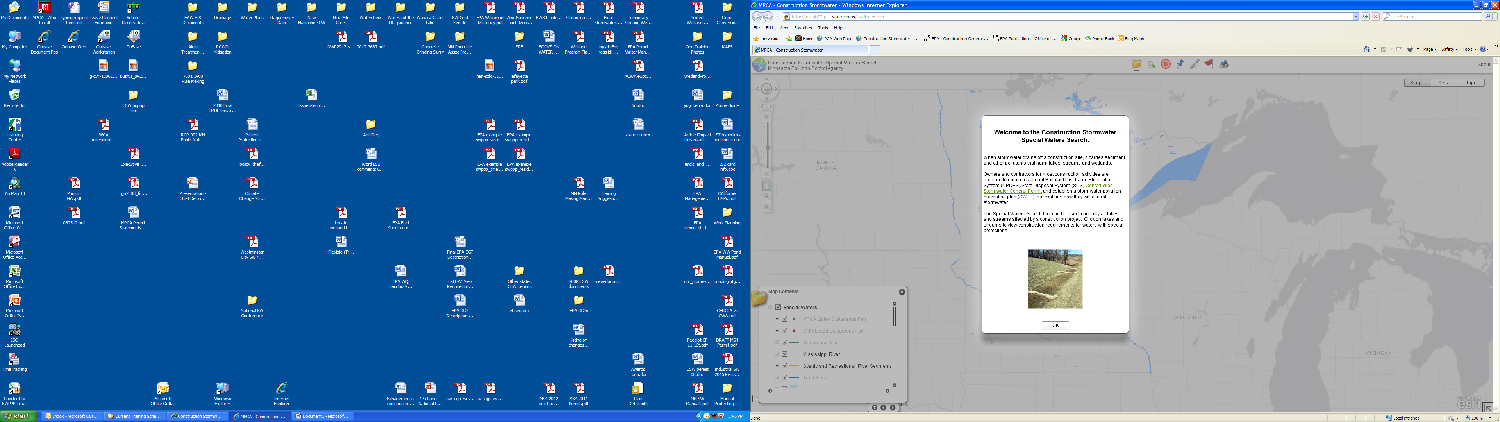
Finding special and impaired waters

Slide 122
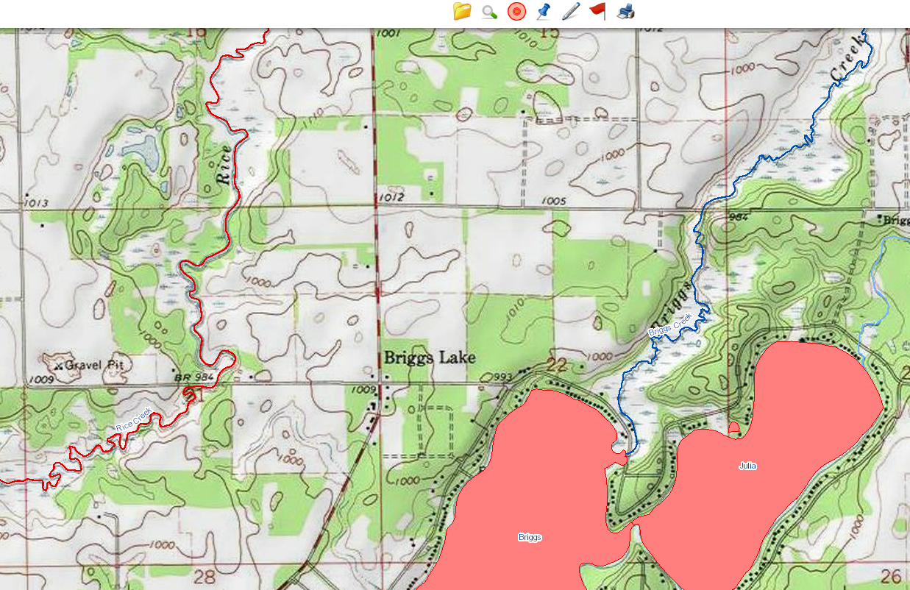
Zoom in…USGS Quad…Color Coded Waters

Slide 123
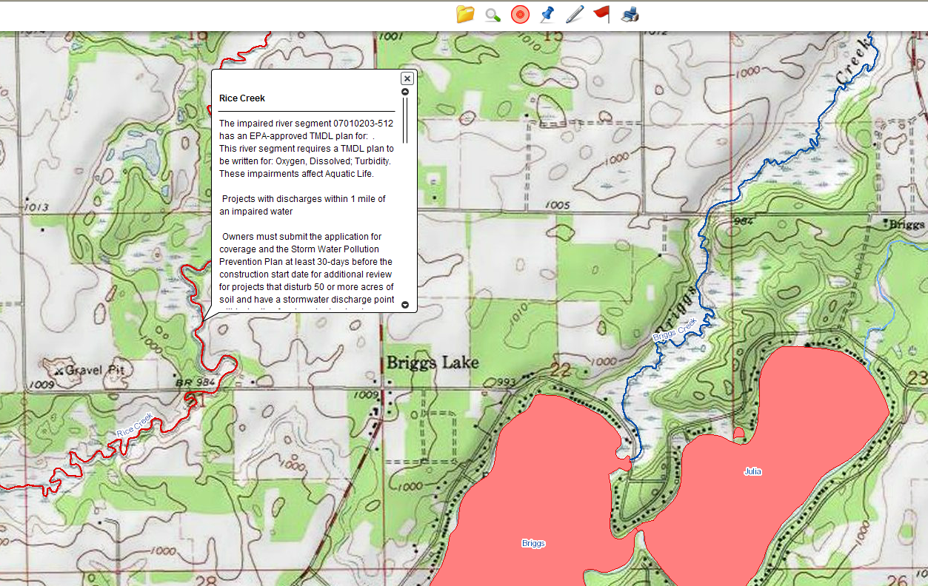
Click to Identify Impaired Streams (red)

Slide 124
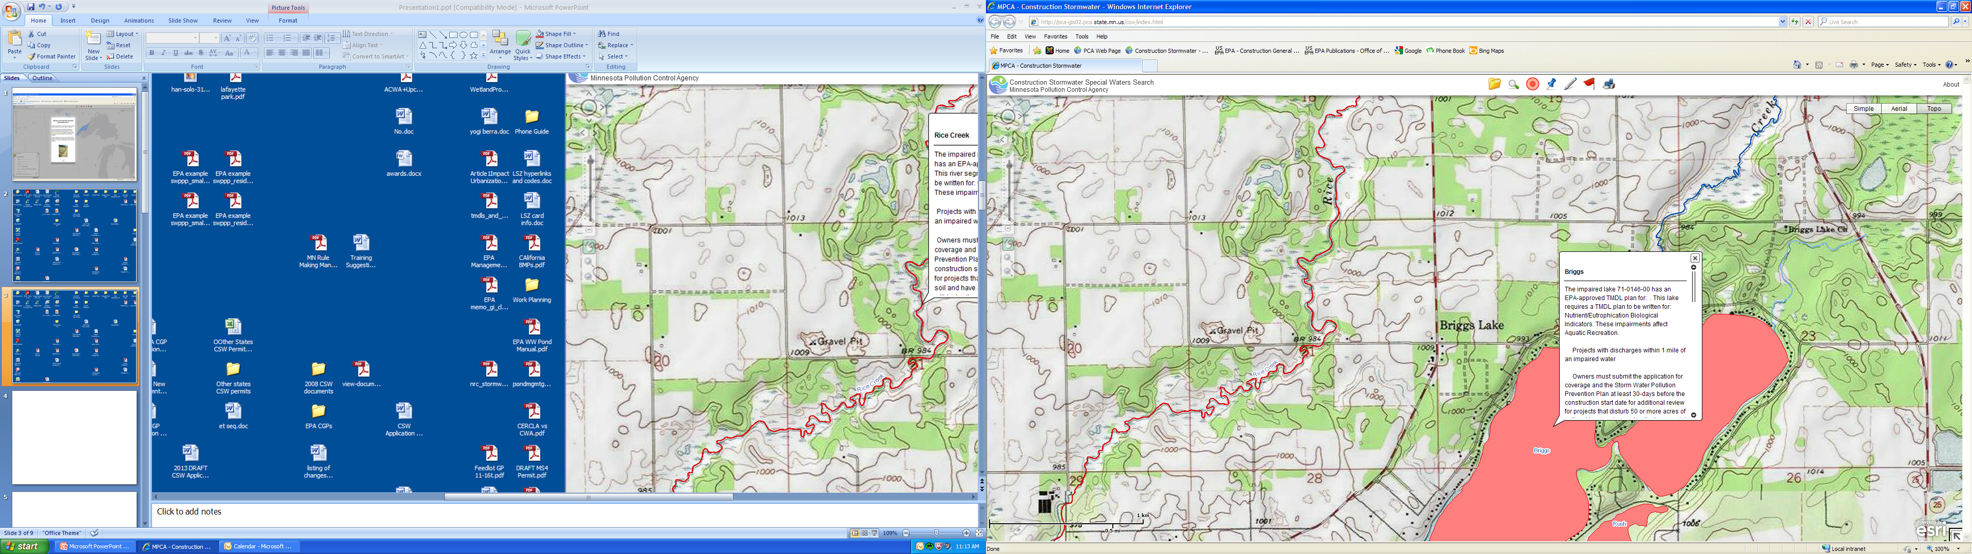
Click to Identify Impaired Lakes (red)

Slide 125
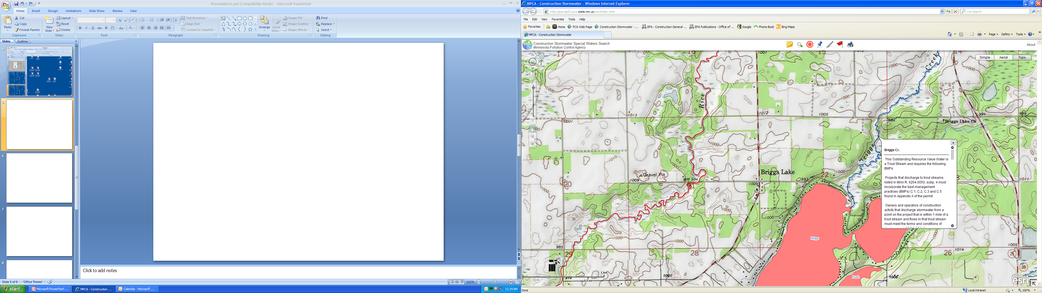
Click to Identify Special Waters (Blue for trout streams)

Slide 126
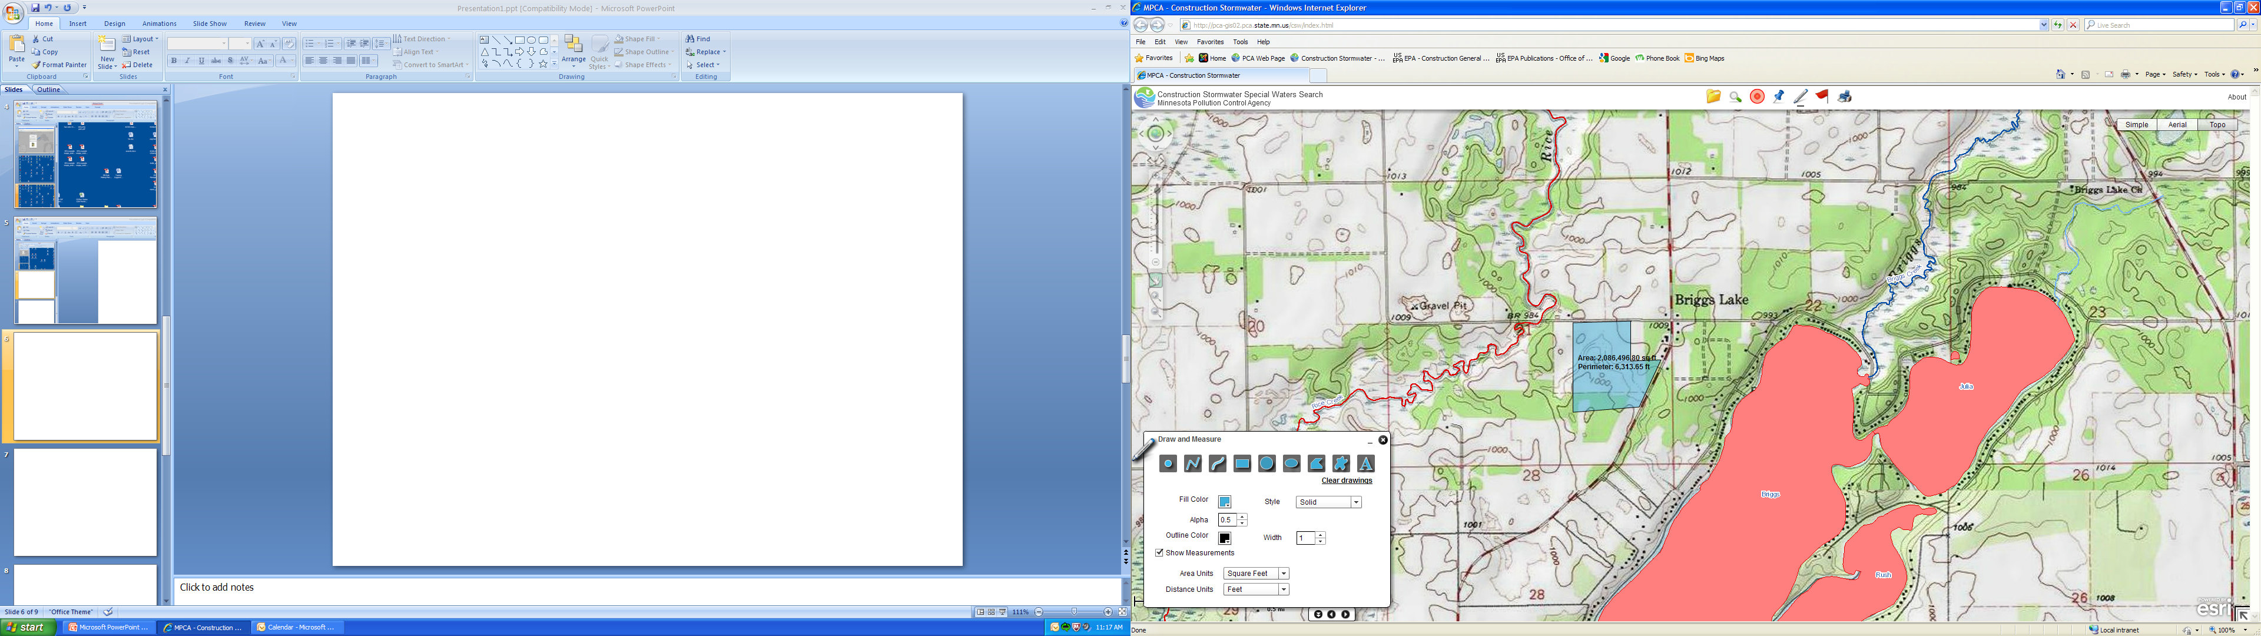
Draw your site…Calculates area

Slide 127
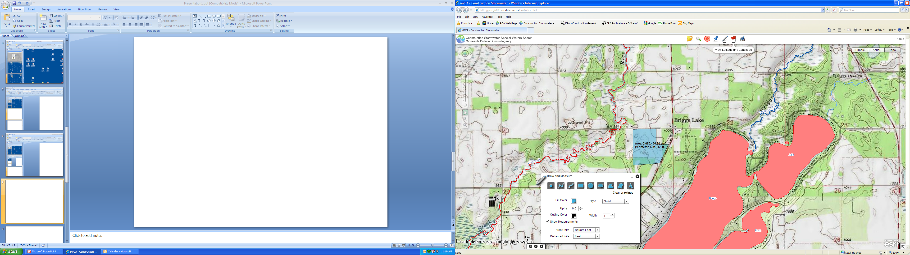
Will show the Latitude and Longitude of Site

Slide 128
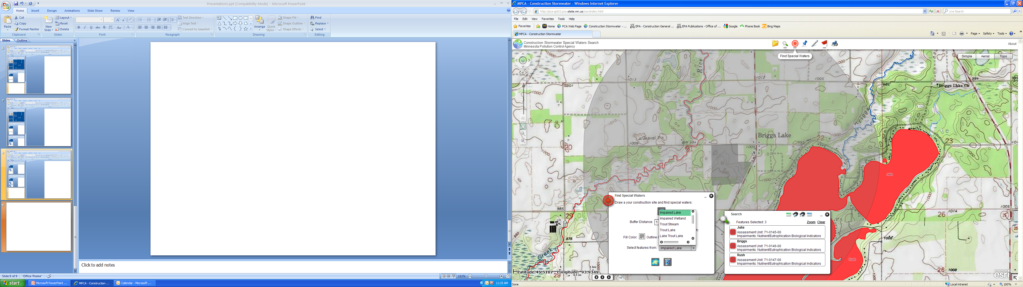
Show a One Mile Circle Around Site to Find Special or Impaired Waters

Slide 129
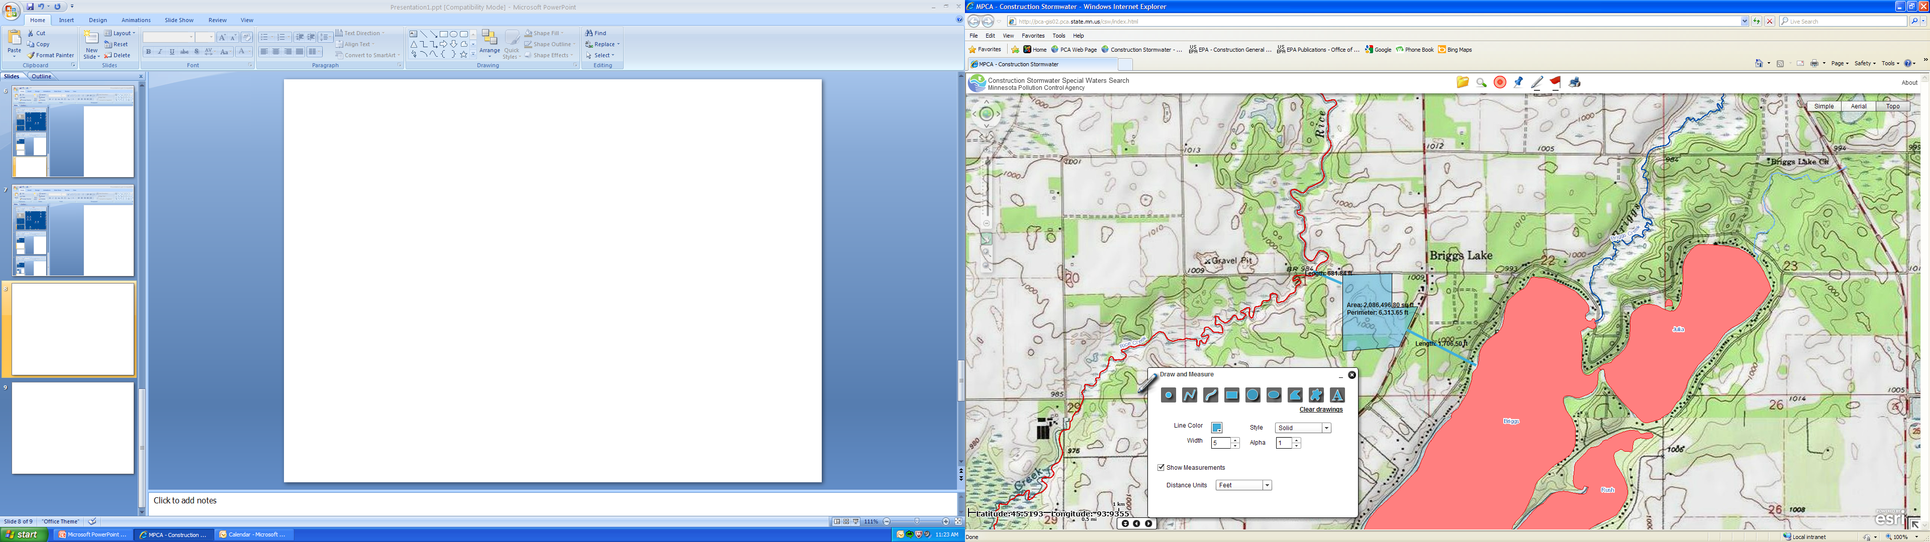
Measure Distance to Waters from Site
Measure Here
Stormwater Pond

Slide 130
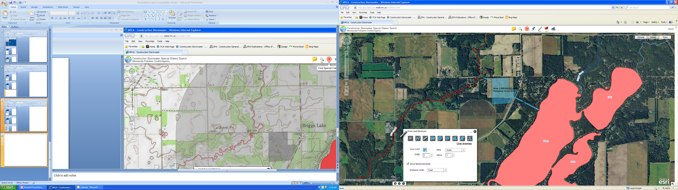
Can Use the Satellite Photo View

Slide 131
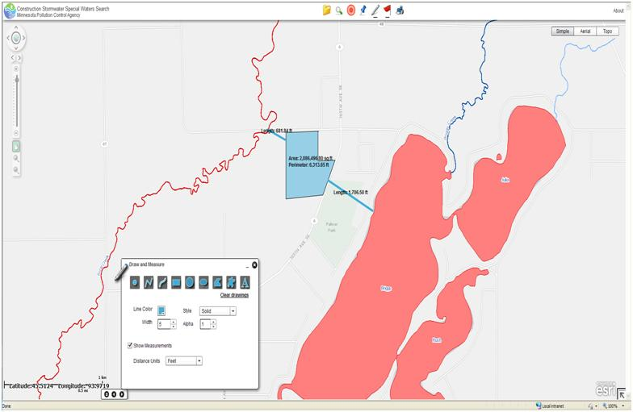
Or Use Just a Simple View

Slide 132
New Stormwater Rule: 7090.2010
QUESTIONS ?
Complete inclusion of all permit language
Anyone performing construction activity can be sited for permit violations even if no permit has been obtained!
Allows for emergency construction
Does more for the MS4 and industrial program
Photo’s courtesy of:
Dwayne Stenlund, MnDOT
MPCA Staff
Neaton Brothers
Faircloth Skimmer R
constructionphotographs.com

