Slide 1
Agenda
What is the calculator and how is it used?
Kickoff example illustrating the basics
How does the calculator work?
Problem 1
Features, warnings, and help
Treatment trains
Problem 2
Working with specific BMPs
Problem 3
Discussion

Slide 2
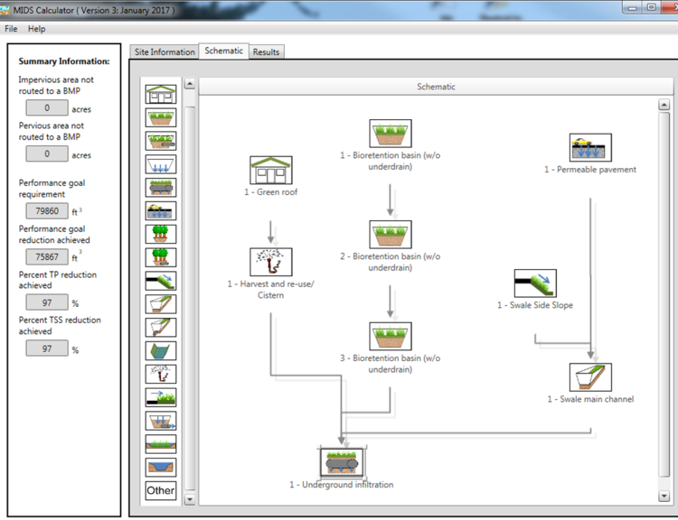
MIDS calculator
An Excel spreadsheet that
  quantifies reductions in stormwater runoff volume
  quantifies reductions in phosphorus (P) and TSS
  can be used to select and size BMP(s)
Has a Graphical User Interface (GUI)

Slide 3
BMP vs. performance goal vs. annual
Quantification of volume, TSS, and P reductions are for BMPs, for a performance goal, and on an average annual basis
A performance goal is a target for volume and/or pollutant reductions
  CSW permit has a goal of 1 inch retention of impervious surfaces for new development: captures about 90% of annual precipitation
  MIDS goal is 1.1 inches: mimics native vegetation and soils
  TMDLs might have goals for TSS or P reduction to meet surface water quality standards
Notes:
The calculator can be used to calculate reductions for individual BMPs, progress toward meeting a performance goal, and/or on an average annual basis. Examples:
For a BMP, we may want to see how a specific BMP is performing
For a performance goal – are we meeting some target, such as MIDS (1.1 inches) or the construction permit
Annual average reduction calculations have a variety of potential uses, such as looking at reductions in TSS or P loading in response to a TMDL

Slide 4
Kickoff example
Open the calculator (double click on icon)
Create a new file
Site information tab: no to CSW permit, zip=55155, 3 acres impervious, 2 acres turf on B soil
Schematic tab
    Bioretention no underdrain, 1 acre impervious , 3000 ft² areas, 1.35 feet depth, B soil, 48 hour drawdown
    Bioretention with underdrain, 2 acre turf B soil, 1 acre impervious, underdrain not raised, not lined, 3000 ft² for each area, overflow depth=1.5 feet, 2 foot media depth, 0.11 FC-WPt, 0.25 MP-FC, no tree, Mix A, no to P test, no amendment, B soil (0.45 in/hr), 48 hr drawdown, route to bioretention with no underdrain
    Infiltration basin, 1 acre impervious, 4000 ft² areas, 1.8 foot overflow depth, B soils, 48 hour drawdown
Results tab: Is the performance goal met? If not, how can it be met?
Notes:
As described above, the performance goal will not be met. Have the attendees look at the site summary and see which BMPs are undersized or oversized. Routing the bioretention to the infiltration will meet the performance goal.

Slide 5
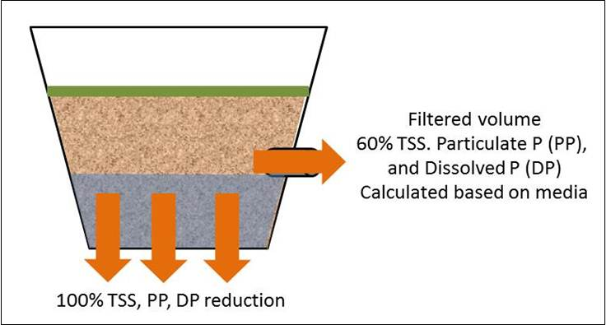
How does the calculator work?
Calculates the amount of stormwater runoff, P, and TSS entering the BMP
Different BMPs have removal efficiencies based on research and monitoring
Calculator does a mass balance on volume, P, and TSS coming in, being removed, and returning as runoff

Slide 6


Overflow volume
0% TSS, Particulate P (PP),
and Dissolved P (DP)
reduction
Infiltration BMPs
3 types of BMPs in the calculator
100% TSS, PP, DP reduction
Filtered volume
60% TSS. Particulate P (PP),
and Dissolved P (DP)
Calculated based on media
Filtration BMPs w/ some infiltration
100% TSS, PP, DP reduction
Settled solids
90% TSS and associated pollutants,
No removal of dissolved pollutants
No volume reduction
Sedimentation BMPs
No infiltration
Settled solids
Notes:
The calculator has three basic types of BMPs. A brief explanation of removal for each is warranted. Since later slides don’t cover ponds and wetlands, should mention the calculator assumes no volume reduction for these and these are properly sized.
Also, this does not include the Other BMP, which can be used in a variety of ways.

Slide 7





Green Roof
Bioretention Basin
Infiltration Basin
The BMPs
Permeable Pavement
Swale Side Slope
Swale Main Channel
Wet Swale
Swale With Underdrain
Notes:
No discussion of these here. Just informing attendees what the BMPs are. They are discussed in greater detail later.

Slide 8







Harvest and Reuse
Impervious Disconnect
Tree trench with underdrain
Stormwater Pond
Stormwater Pond w/ Filter Bench
Wetland
Sand Filter
Underground Infiltration
Other
Other
Bioretention Basin with underdrain
Tree trench

Slide 9
Problem 1
10 acre site
  5 acres impervious
  5 acres pervious turf (B soil)
B soils (0.45 in/hr)
Zip = 55155
Goals
  Infiltrate first 1.1 inches off impervious surfaces
  Capture 80 percent of Total P
Notes:
Should only take 5 minutes or so. Check to make sure the solution makes physical sense. For example, could put in a very large bioinfiltration system, but is this always practical?

Slide 10
Features, warnings, restrictions, help
Zip code – rainfall data
Question about CSW permit – affects BMPs available
Default values for retention requirement, P and TSS concentrations
Must have impervious acres
Summary information toolbar on left
Warnings involve a change of a default condition (e.g. changing the P concentration)
Restrictions prevent you from entering data (examples - drawdown requirement, green roof and permeable pavement areas, bioretention depth
Help button or links within each BMP – go to Stormwater Manual
Notes:
Will illustrate specific warnings and restrictions when the individual BMPs are discussed later

Slide 11
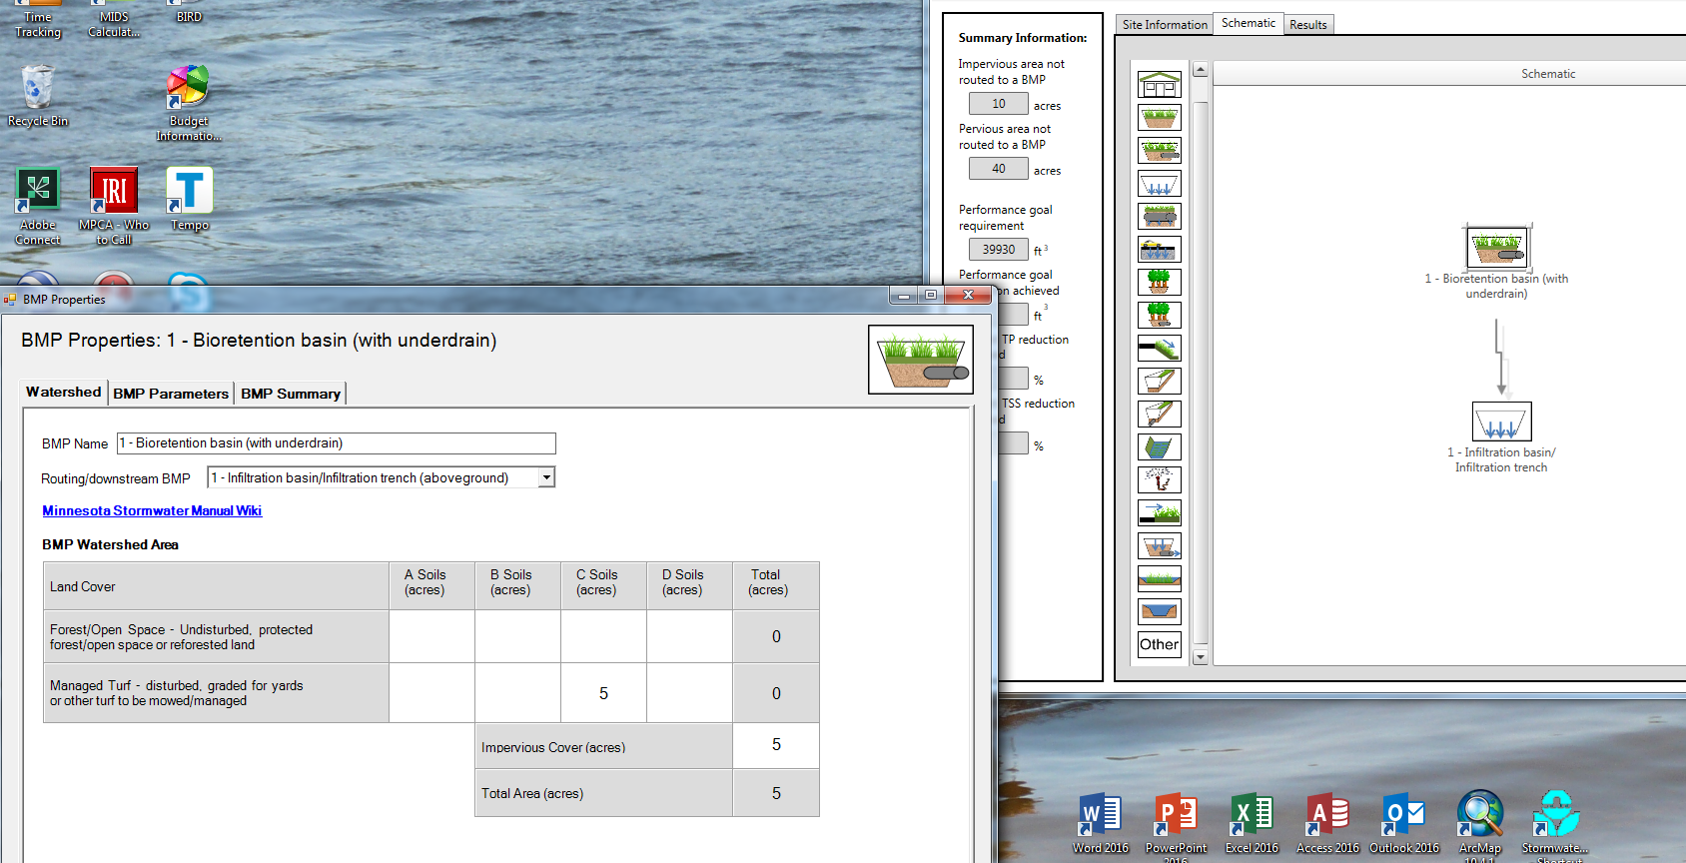
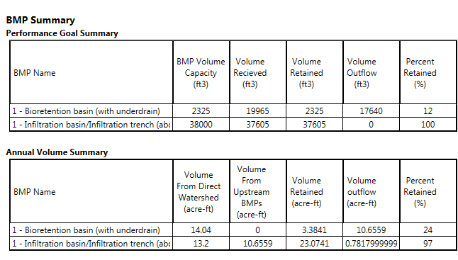
Treatment train
Route one BMP to another
Multiple BMPs used in series
Route excess water from one BMP to the next
Downstream BMP receives water from upstream BMP
Notes:
Looks like a busy slide, but it’s not. The image in the lower left just shows what a treatment train looks like in the calculator. The images on the right show a BMP being routed to another and what this looks like in the BMP summary tab. Show attendees how accounting occurs within each BMP in the summary tab.

Slide 12
Problem 2
Same as previous problem except C soil

Slide 13
Bioretention with underdrain
Elevating the underdrain
Lining
Including a tree
Maximum 1.5 foot water depth
Phosphorus retention
  Media mixes C and D retain P; A and B leach P unless P content is <30 ppm
  Adding an amendment to attenuate phosphorus
Notes:
For this slide and the next several slides on BMPs, go into the calculator and demo to the group how these work within each BMP. Encourage them to mimic on their machines what you are doing on the main screen. Explain what each selection does. For example, raising the underdrain increases infiltration volume; adding a tree does the same.

Slide 14
Permeable pavement considerations
The area of permeable pavement must be included in the impervious acreage for the BMP
The impervious:permeable pavement area ratio cannot exceed 5:1 (e.g. for 1 acre of impervious, must have at least = 8712 of permeable pavement)
Volume credit for water stored beneath drain and infiltration during drawdown time
An effective BMP for retaining runoff

Slide 15
Harvest and reuse/cistern
Storage volume – ponds can store very large volumes, while cisterns typically are limiting to what volume can be retained
User-defined max irrigation rate can be 2 in/week on A soils. On other soils default is lesser of defined rate or PET
Offline systems – drained during winter
Can retain water for non-irrigation uses

Slide 16
Tree trench
Field capacity minus wilting point is available to plants
More ET for larger trees
Will get a warning and lose credit if soil volume per tree is below the recommended value
Phosphorus crediting is same as for bioretention
Note the ET credit

Slide 17
Green roof
Can have a conventional roof drain to a green roof, but the conventional roof area must be equal to or less than the green roof area
Maximum media depth is 4 inches
No phosphorus credit
Disconnection BMP
Can’t be used if you are trying to meet the Construction SW permit
On Watershed tab, must enter permeable acres that will be used as effective pervious area
Difficult to meet retention requirement with this BMP

Slide 18

Swales (with or without underdrain)
Side slope is routed to a swale main channel or with underdrain – treat as a single BMP (e.g. match lengths)
Have all impervious acres go to side slope(s) and none to main channel
Ways to increase infiltration
  Put in check dams
  Put in bioretention base
  Make swale longer

Slide 19
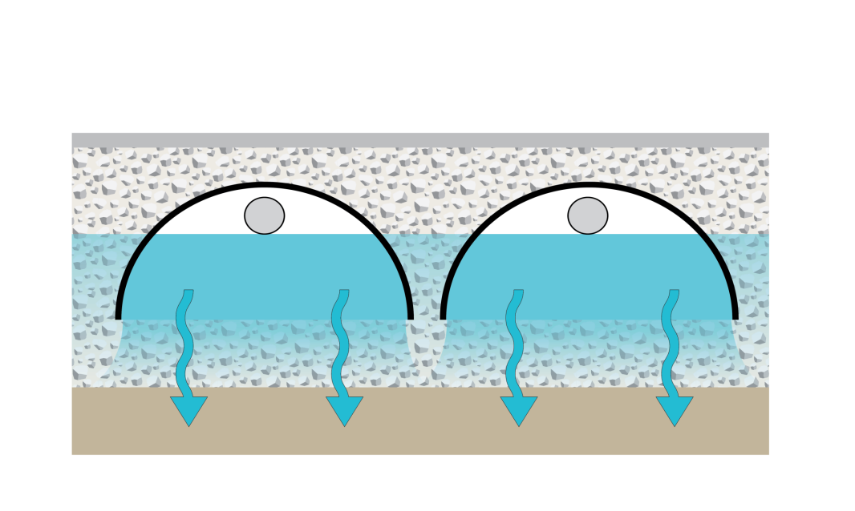
Underground infiltration
Along with infiltration basin/trench, the most effective retention BMP for highly permeable soils (A soils)
Must either know two values or go outside calculator to a spreadsheet to calculate these 2 values (equations were too difficult to incorporate into the calculator)
  Vp = underground pipe/storage volume
  Am = area of engineered media
Width of basin
Pipe/storage device volume (V_{P})
Overflow depth (D_{o})
Depth of media (D_{M})
Engineered media storage volume below pipes (V_{M})

Slide 20
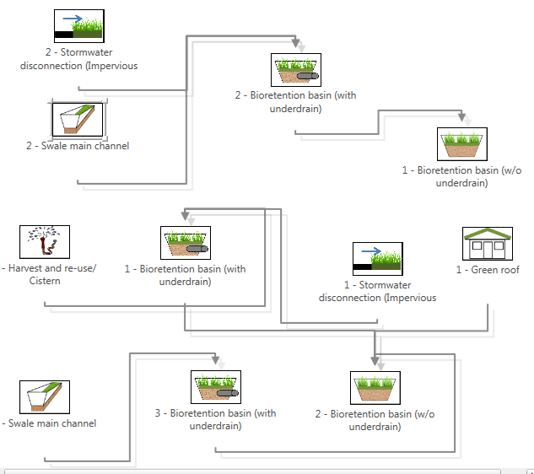
Problem – low permeability soils
50 acre site – 20 percent impervious; 40 acres residential; 5 acres commercial; 5 acres green space
35 acres turf on D soil; 5 acres turf on C soil (0.3 in/hr)
Individual bioretention max size = 10000 ft²
Can the goal be met with a realistic BMP scenario? If not, how can we maximize volume and P retention?
Park
C soils
D soils
D soils
Commercial
One option
D soils
Notes:
Pick this or the next problem. They should map out the site before working in the calculator. If they get done early, do both problems.

Slide 21
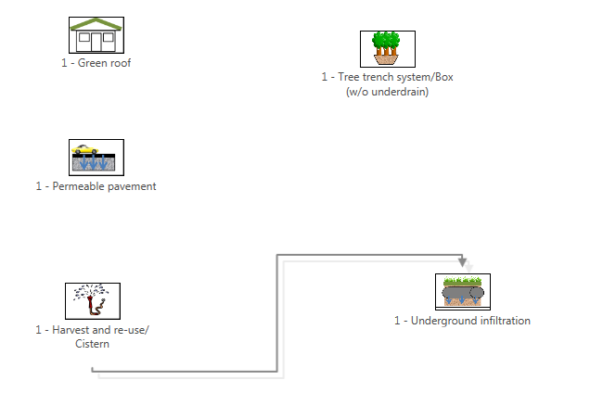
Problem: ultra-urban site
50 acre site – 90 percent impervious; all commercial/business
A soils (0.8 in/hr)
Can the retention goal be met with a realistic BMP scenario? If not, how can we maximize volume and phosphorus retention?
What BMPs work well for this scenario?
One option

