Slide 1
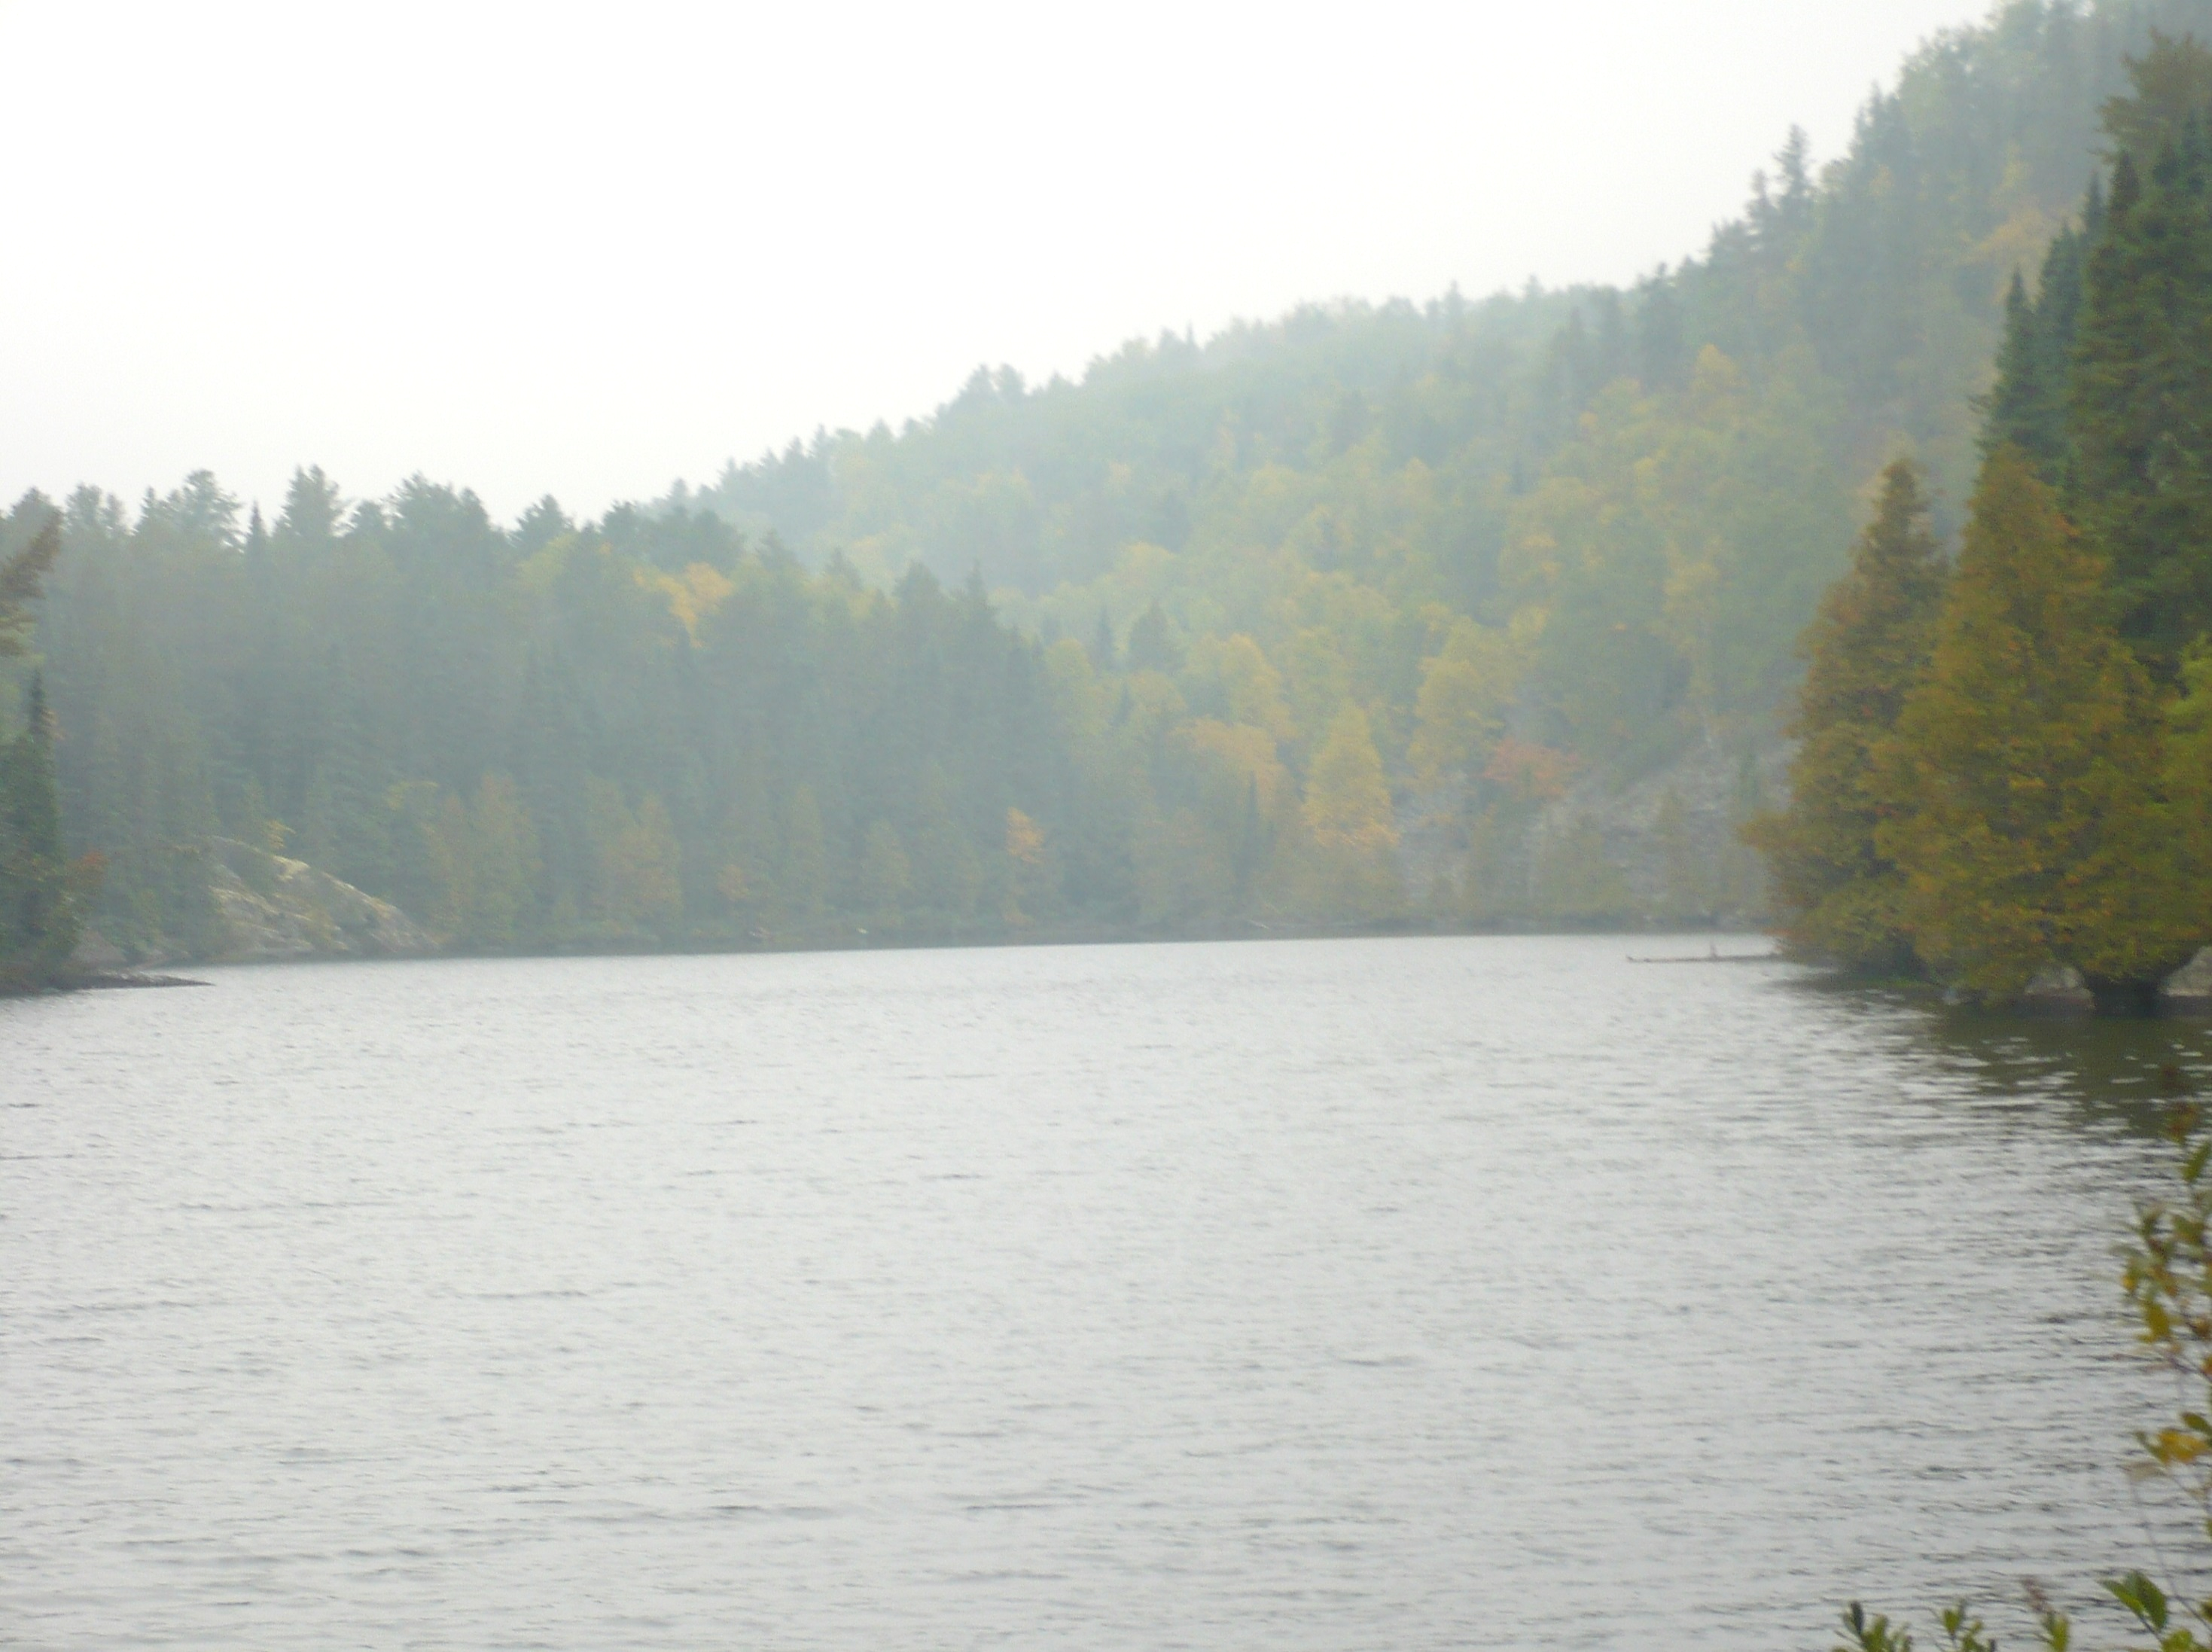
Stormwater infiltration and chloride in groundwater
Mike Trojan
MPCA Stormwater
February 7, 2019

Slide 2
Outline
Stormwater infiltration - overview
Chloride in urban stormwater runoff
Chloride in our waters
Stormwater infiltration
Fate of chloride in infiltration practices
Estimating chloride loads from infiltration practices
Potential recommendations

Slide 3
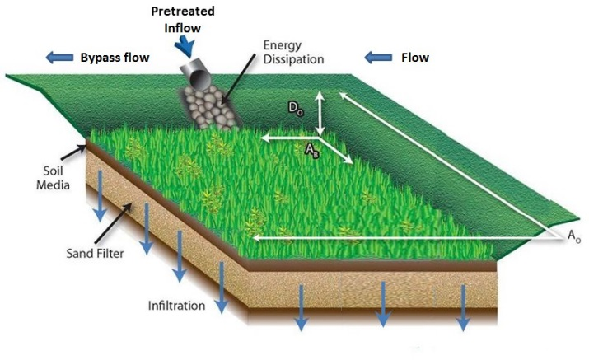
Stormwater infiltration- intentional infiltration of stormwater runoff

Slide 4
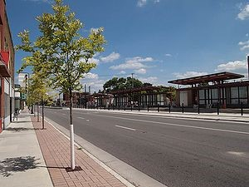
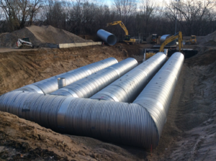
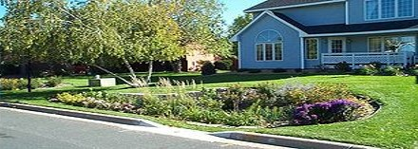
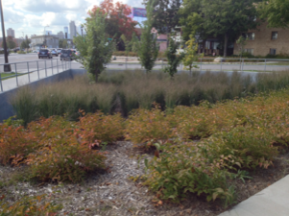
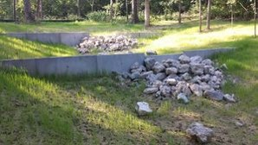
Infiltration BMPs
Bioinfiltration (rain gardens)
Tree trenches/boxes
Infiltration basins/trenches
Pemeable pavement
Some swales

Slide 5
Infiltration is a preferred method for managing stormwater runoff
Benefit surface waters
Mimic natural hydrology
Use space efficiently
Provides ecosystem services
Effectively treat pollutants – except chloride

Slide 6
Infiltration practices focus recharge
Example: 1 acre of impervious runoff directed to an infiltration basin
Infiltration
basin
Typical design infiltrates 35-75 feet of water annually

Slide 7
September 10, 2015: Effects of stormwater infiltration on groundwater

Slide 8
Chloride
Mobile and will move through BMPs
Concentrations in stormwater runoff are highly variable and exceed SMCL during winter and early spring runoff events
Findings
No retention: Concentrations in effluent and rate of exceedance of standard are function of runoff concentration
Observed concentrations in shallow groundwater in urban areas are similar to concentrations in runoff
Risk to groundwater:
High based on mobility
Some preliminary data suggests a seasonal lag in peak concentration in groundwater
Concentrations in groundwater not likely to reach 250, but there may be impacts to lakes and streams
From 9/10/15 presentation

Slide 9
Quality impacts - conclusions
Health risks may exist for certain combinations of land use, treatment practice, pollutant, and receptor
Current guidance and regulations (permits) should provide adequate protection for human health
More research is needed on pathogen occurrence in stormwater runoff and fate in infiltration systems, particularly non-vegetated systems
Chloride cannot be treated with stormwater BMPs
Prevention is the only effective management tool
Need to better understand dynamics of chloride in urban systems

Slide 10
MN Groundwater Association white paper: Impacts of stormwater infiltration on chloride in groundwater
The group is still working on the white paper

Slide 11
Potential fate of infiltrated water

Slide 20
A little bit about chloride
Does not easily precipitate
Is not biodegradable
Is not readily involved in biological processes
Does not adsorb significantly to mineral/soil surfaces
It is therefore assumed to readily move with water

Slide 21
Primary anthropogenic sources are road salt, fertilizers, and WWTPs
Total = 968,300 tons annually
Cl contributions, Minnesota (From Overbo et al., 2019)

Slide 22
Chloride water quality standards
Aquatic life (EPA, 1985)
Chronic toxicity = 230 mg/L (4 day average, not to be exceeded more than 1 in 3 years)
Acute toxicity = 860 mg/L (1-hour average not to be exceeded more than 1 in 3 years)
Human consumption – drinking water, secondary maximum contaminant level = 250 mg/L based on salty taste

Slide 23
Other environmental concerns of chloride
Toxicity in plants (350 mg/L for sensitive species to over 2000 mg/L for tolerant species)
Foliar damage to plants – species dependent; many species show effects above about 200 mg/L
Increased metal mobility – some evidence for Cl complexes with Zn and Cd ; other metals due to ion exchange with the cation
Corrodes steel
Reduced denitrification rates in soil

Slide 24
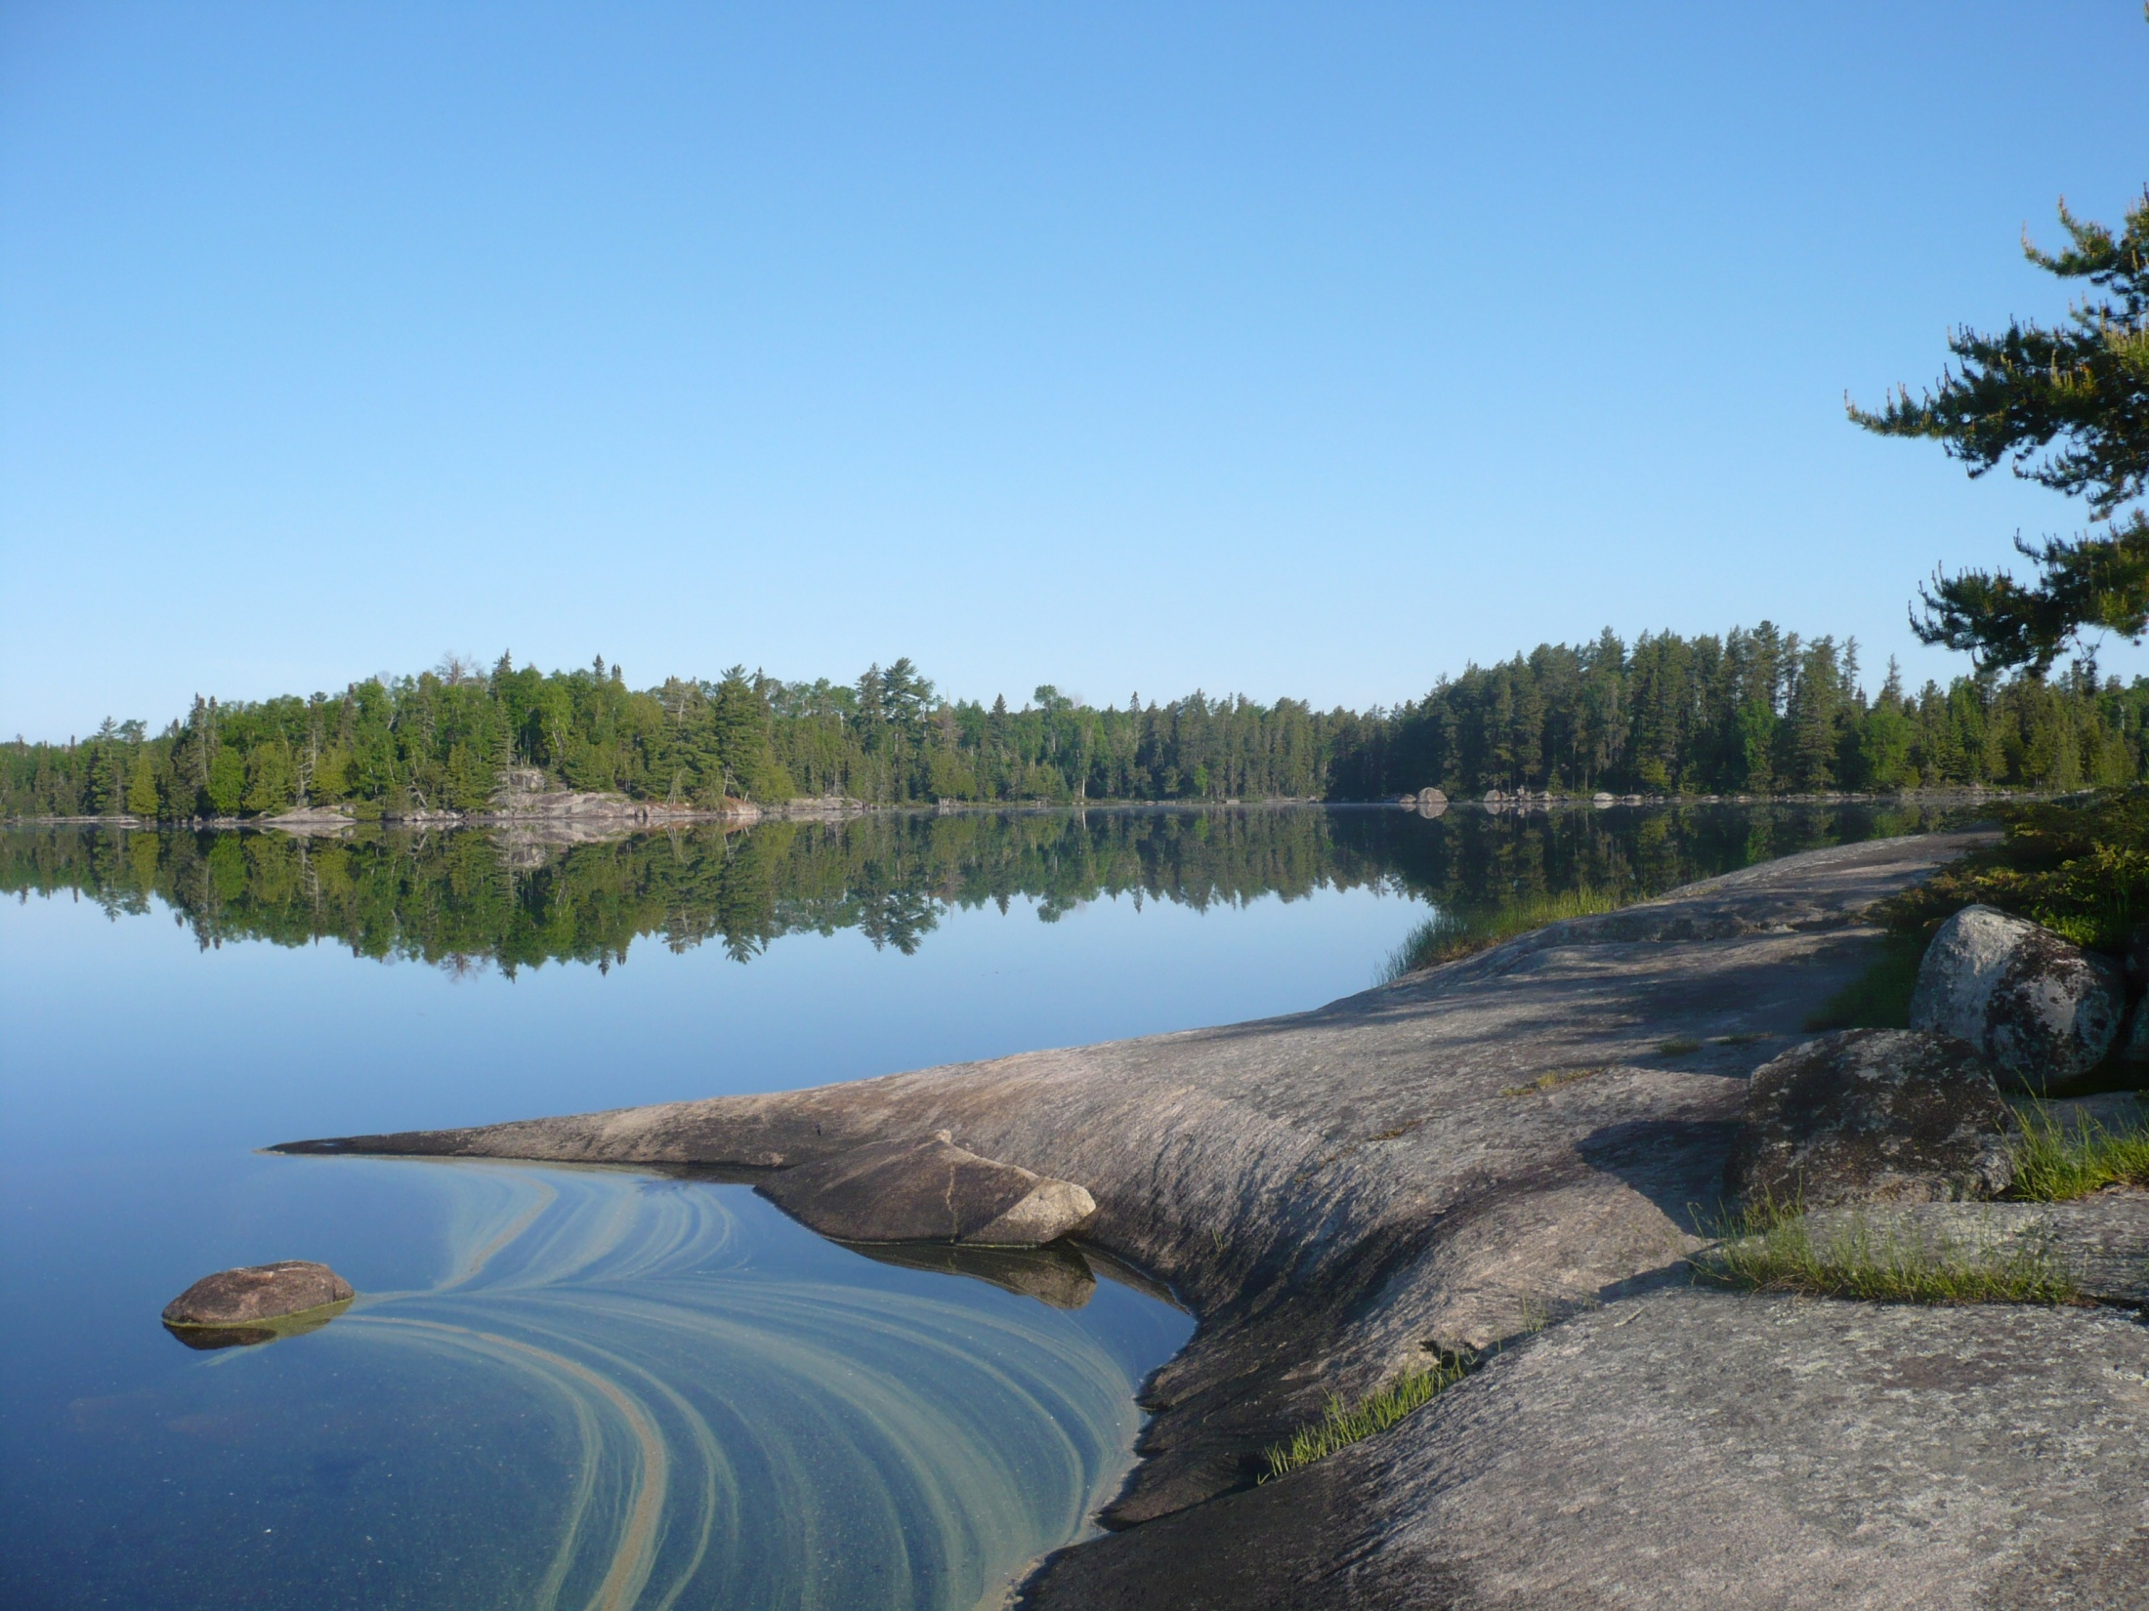
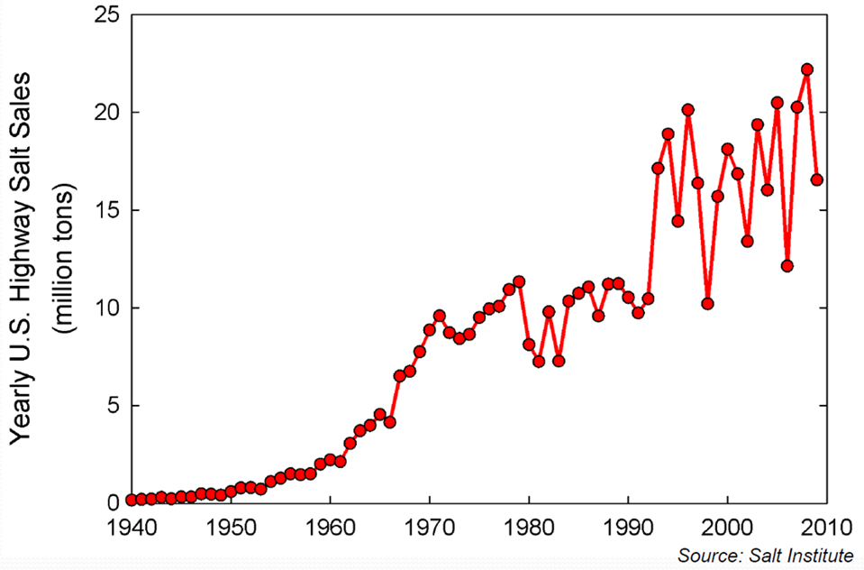
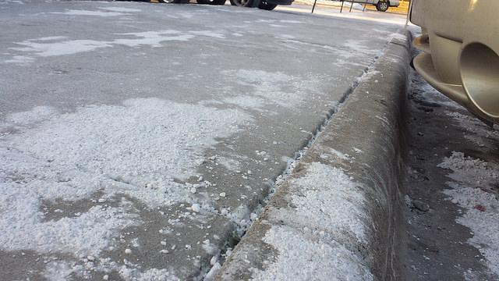
Salt application has increased

Slide 25
Chloride in stormwater runoff
In a MN location with high deicer application rates, 97% of the Cl load was associated with 16% of the total annual runoff volume (Herb, 2018)
Granato and Smith, 1999
Winston et al. (2016)

Slide 26
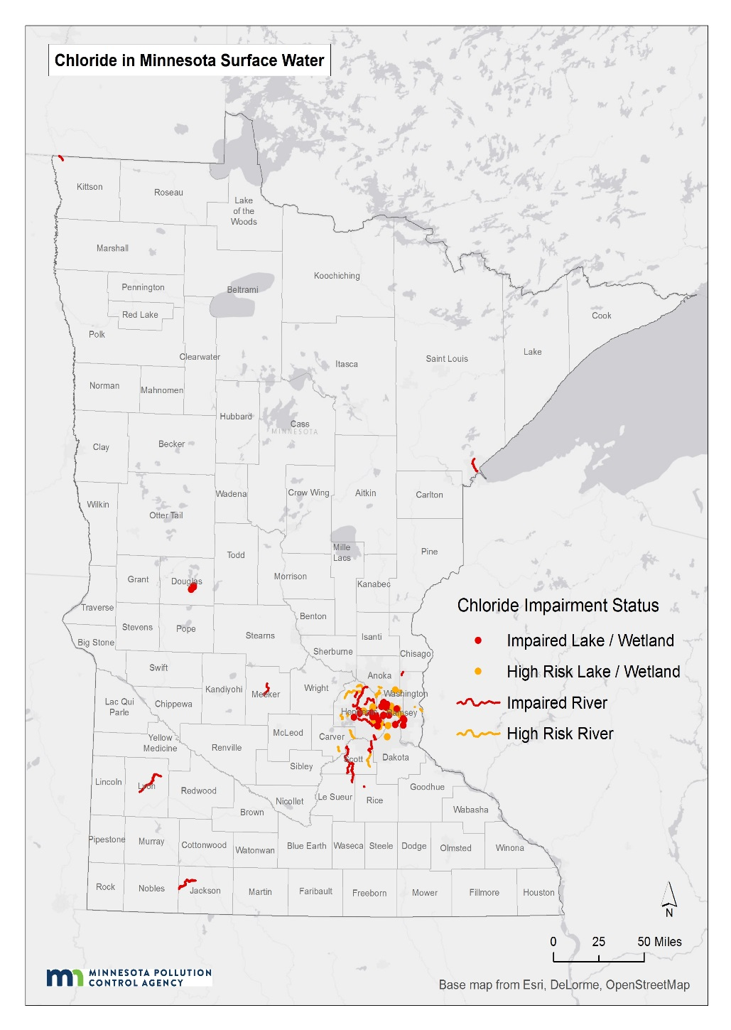
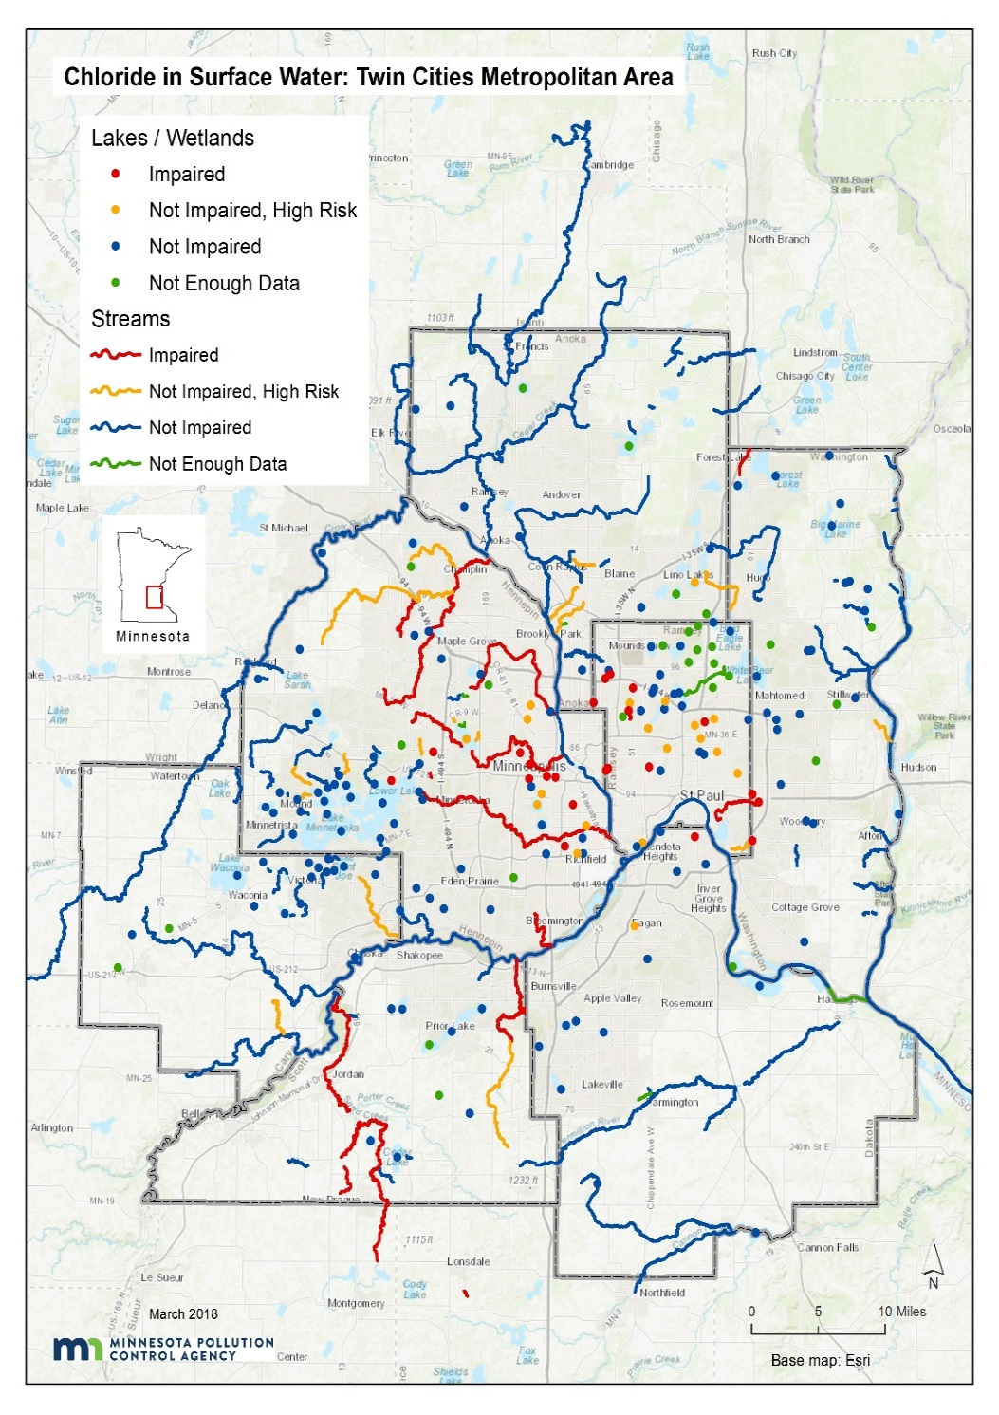
Chloride in surface water (MPCA, 2018)

Slide 27
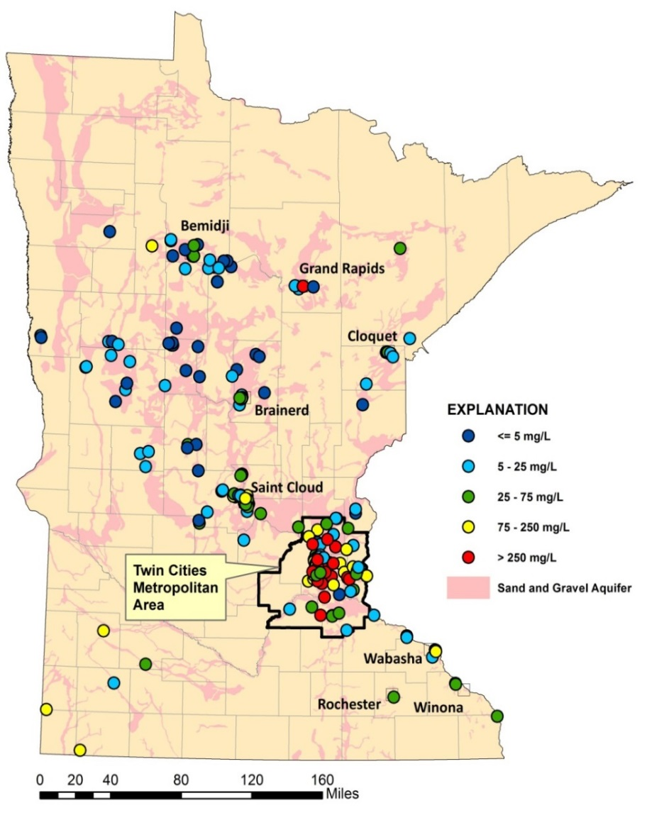
Chloride in groundwater (MPCA, 2013)
Shallow sand & gravel aquifers
Bedrock aquifers

Slide 28
Summary of water quality status
Statewide
26 lakes were impaired as of 2018
24 streams impaired as of 2018
120 lakes classified as at risk (> 1 sample in past 10 years with Cl > 207 mg/L)
Twin Cities Metro
23 lakes impaired
17 streams impaired
38 lakes classified as at risk
340 assessed waterbodies (11% impaired; 11% insufficient data)
30% of shallow wells exceed the SMCL
Source: Draft Statewide Chloride Management Plan

Slide 29
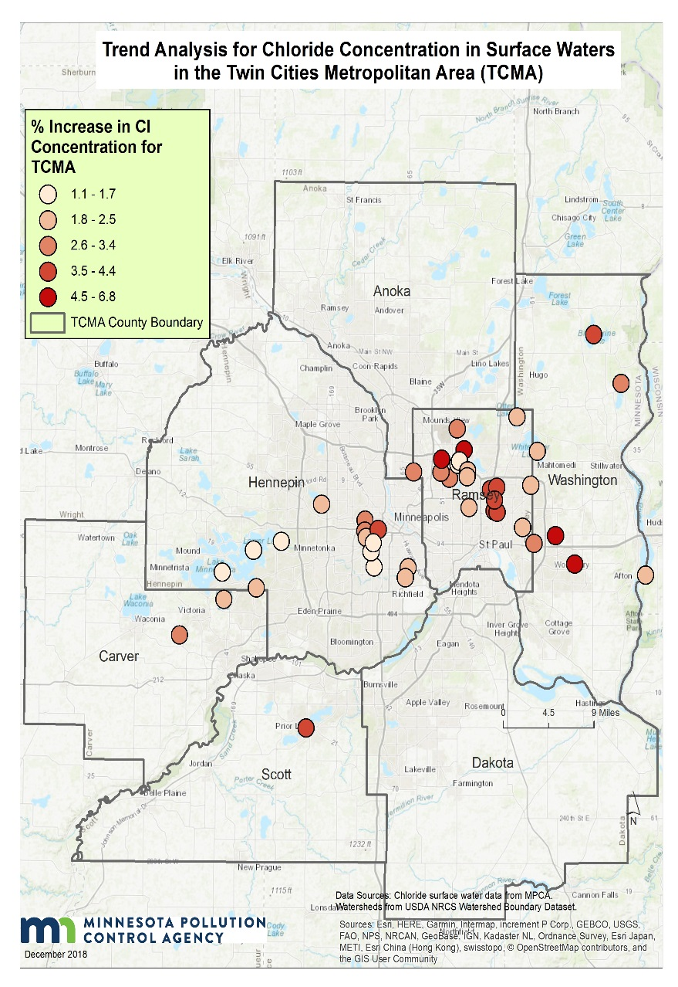
Lake trends
(Source: Draft Chloride Management Plan)
Upward trends in 46 of 69 lakes in TCMA
Outside TCMA, upward trends in 14 of 45 lakes
Rate of increase is greatest in lakes in TCMA urban core
Lakes - % increase per year

Slide 30
Flow-Adjusted Cl Trends, 1985–2015
(Met Council, 2018)
Upward trends at all but one location
Concentrations well below aquatic life standard

Slide 31
Groundwater trends
(Source: MPCA 2013)
Upward trends in 11 of 36 wells in shallow sand/gravel aquifers
Average rate of increase was 3.4 mg/L/yr, but rates were much higher is some wells

Slide 32
Villanova study, Machusick, 2009
Rain garden
MW2
35 feet
MW3
Lysimeters
20 feet
Groundwater flow

Slide 33
Deicers applied
Runoff
Lysimeters (0, 4, 8 ft)
MW2
MW3

Slide 34
Estimating chloride loads from infiltration practices
Cl_{gw} = I_{perv} + I_{imperv} + L_{pi} + L_{ww} + L_{sw} + SW + I_{ponds} + I_{filt} + I_{infil}
SW
I_{perv}
I_{imperv}
I_{infil}
I_{filt}
I_{ponds}
L_{pi}
L_{ww}
L_{sw}
Groundwater

Slide 35
These next slides are DRAFT

Slide 36
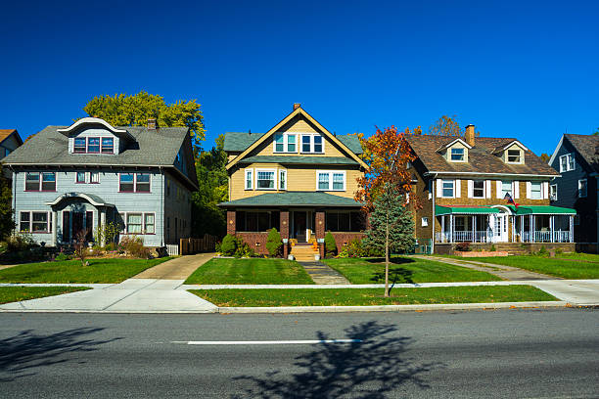

Slide 37
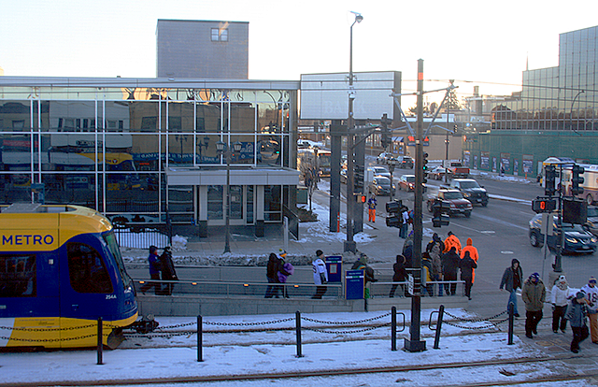
(934 lbs/ac/yr)

Slide 39
Bottom concentrations increase relative to top concentrations
1:1 line

Slide 40
What are the consequences of high chloride concentrations in lakes?
Community structure (Hintz et al., 2017)
Negative impact of salinity on zooplankton
Positive response by phytoplankton
Mixed results for benthic communities
Periphyton and snail grazers unaffected
Biomass of filamentous algae decreased due to competition with phytoplankton
Direct negative impacts to filamentous algae, amphipods, and some snails and clams
Chemostratification (Novotny and Stefan, 2012)
Disrupts nutrient cycling
Prevents oxygen from reaching lake bottom
Implications for phosphorus export

Slide 41
Chloride concentrations are a function of baseflow
Miller Creek, Duluth
Bassett Creek, Minneapolis
Source: Bassett Creek WMC

Slide 42
What are the consequences of high chloride concentrations in streams?
Tiwari and Rachlin (2018)
Began seeing minor negative impacts above 150 mg/L
Streambank vegetation changed, but not nutrient cycling
Blasius and Merritt (2002) – most sensitive insects impacted at about 240 mg/L but many unaffected at acute standard
Maryland DNR (2014)
Benthic IBI declined at 190 mg/L
All BIBI indicate impairment at 500 mg/L
Greatest fish effects are on early life stages
Despite considerable information in the literature, difficult to make general statements about ecological effects

Slide 43
Cl in shallow glacial aquifers, northern U.S. (Mullaney et al., 2009)

Slide 44
Cl in shallow groundwater – Minnesota (MPCA)

Slide 45
Factors affecting Cl in shallow glacial aquifers, northern U.S. (Mullaney et al., 2009)
Significant regressions (p < 0.05)
Major road density
Not significant
Highway connector density
Major highway density
Highway density
Local road density
% residential, commercial, industrial, or transportation land use
Population density
Season
p = 0.94
MPCA, 2002

Slide 46
What are the consequences of high chloride concentrations in groundwater?
Urban streams with significant baseflow are potentially at risk
Shallow sand and gravel aquifers are at risk in core urban areas – is this a concern?
There are few groundwater receptors
Is salty taste more important than impacts to aquatic ecosystems?
What about deeper drinking water aquifers?

Slide 47
Much of the core Metro Area aquifer system has low-moderate vulnerability
We currently have insufficient data to assess trends in deeper aquifers

Slide 48
Management strategies
Decrease use of chloride deicers
Use alternatives (maybe)
Use liquids (anti-icing)
Establish chloride free zones near receiving waters
Improve snow/ice removal technology
Lower winter speed limits
Infiltrate in the right locations, especially with permeable pavements

Slide 49
Stormwater infiltration recommendations
Infiltrate in areas not vulnerable to chloride contamination
In vulnerable areas, if infiltration is employed, distribute infiltration practices instead of focusing on a single location
Properly site infiltration practices with respect to receiving waters
Utilize permeable pavement when appropriate

Slide 50
Needs
Analyze trend data for Metro streams – Met Council starting this
Improve understanding of fate and transport in groundwater
Map vulnerable areas
Enhance monitoring in these areas
Monitor deeper aquifers in vulnerable areas
Improve understanding of impacts in lakes
Study chloride dynamics in impacted lakes
Study ecological effects
Study phosphorus dynamics
Identify high value waters that are at risk
More research on chloride alternatives

Slide 51
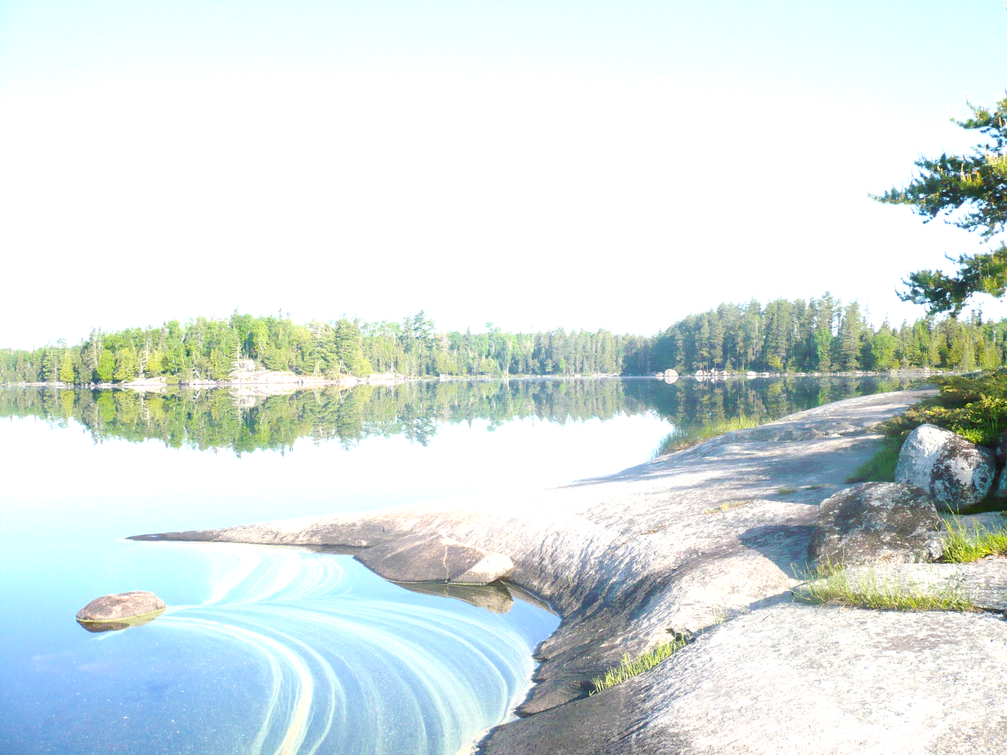
Chloride is attenuated
Delayed peaks in groundwater
Lower max concentrations
Elevated concentrations persist in groundwater

Slide 52
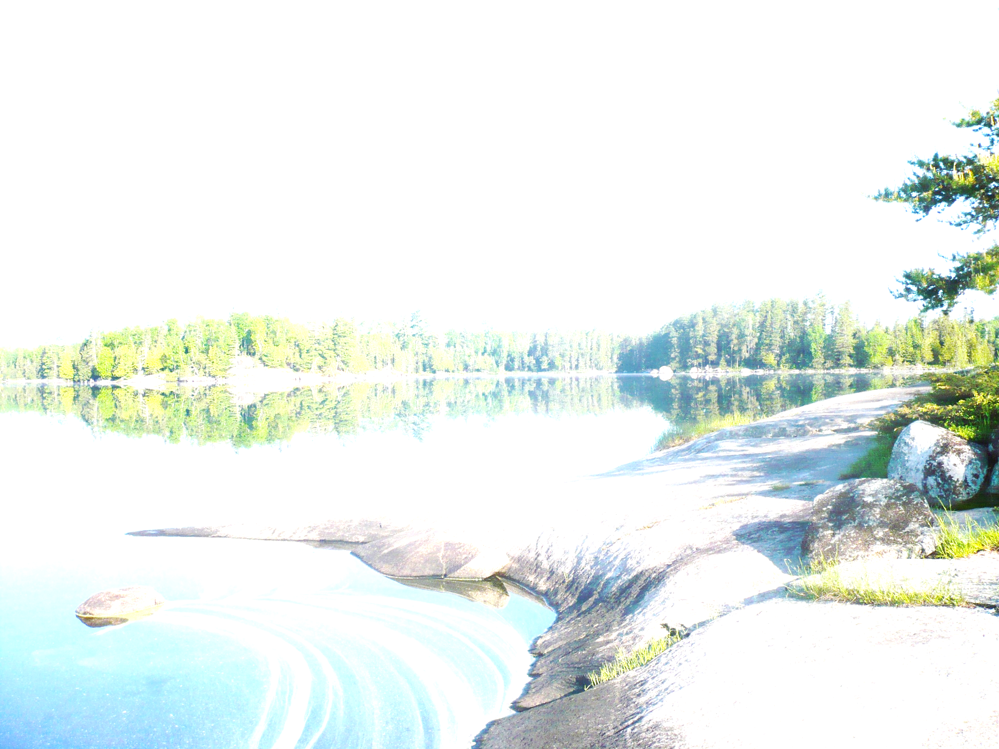
Summary
Runoff
Very high concentrations and bulk of mass for a handful of events
Low concentrations and loading for rest of the year
Cl⁻ is attenuated in infiltration practices
Groundwater
Infiltration reduces winter peaks
Cl⁻ enriched groundwater from spring through fall

Slide 53
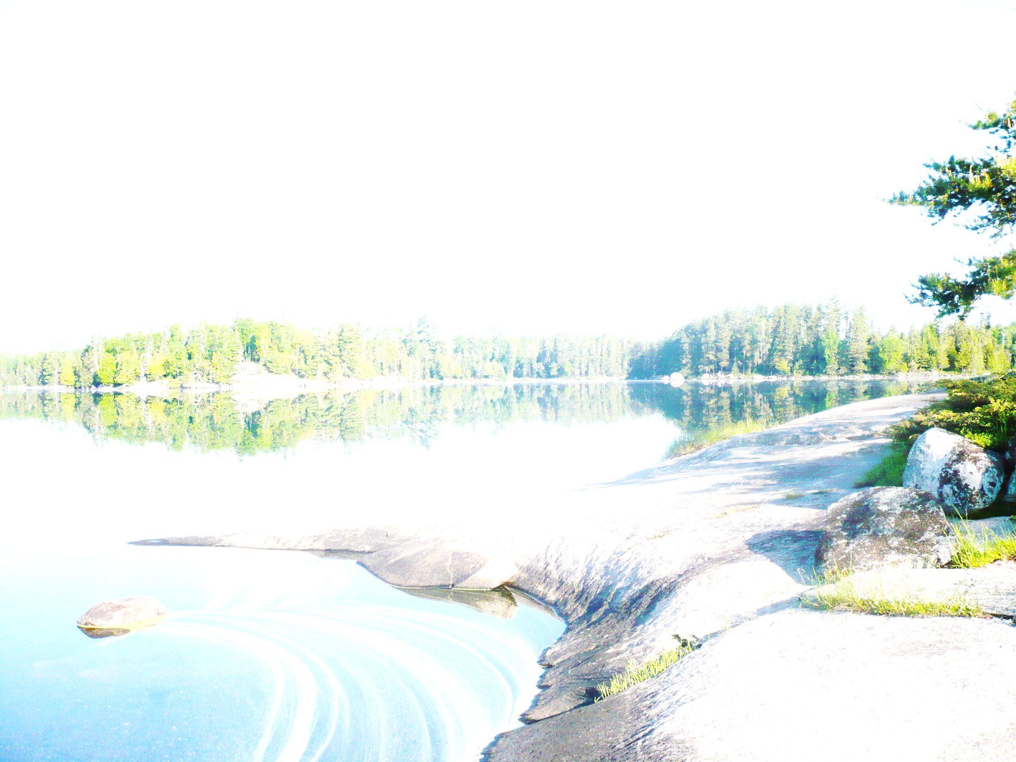
Potential recommendations
Infiltrate
in areas with low-moderate road salt inputs
where surface streams are vulnerable
Potential concerns in areas that contribute significantly to aquifer recharge
Infiltration practices
Do not use to store salt-laden snow
Permeable pavement should be encouraged

Slide 54
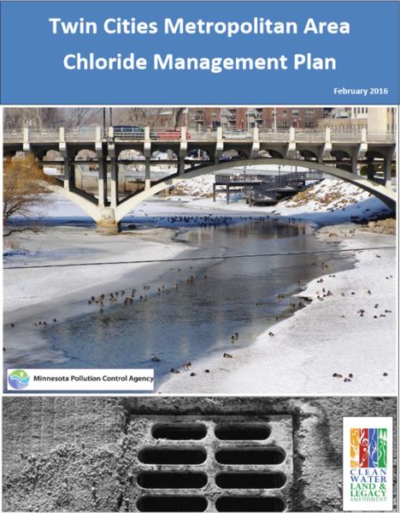
Ultimately, source reduction is the only way to effectively manage chloride
Questions?

