Slide 1
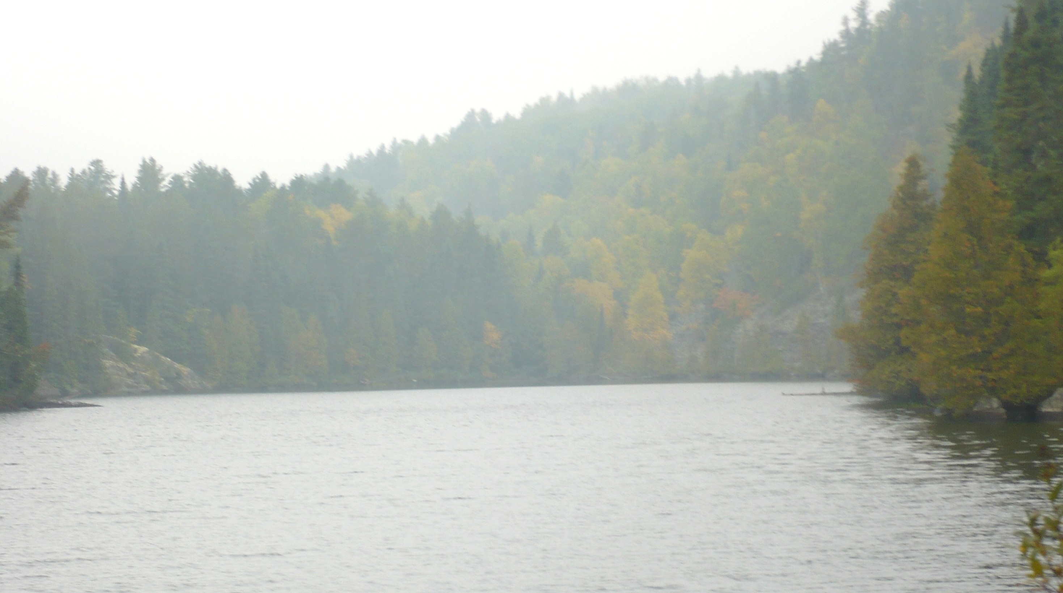
Do we have a chloride problem in our water?
Mike Trojan
MPCA Stormwater
March 8, 2019

Slide 2
YES
Thank you and are there any questions?

Slide 3
Disclaimer
I’m not specifically working on chloride. There is on-going research. To the extent time allowed I reviewed literature and talked with people working on the issue to gain perspective on different aspects of this issue. But be aware that I’m not engaged in research around chloride. Hopefully I’ll qualify my statements appropriately and suggest areas where we need more information.

Slide 4
Outline
A little bit about chloride
Big picture: Chloride concentrations and trends in Minnesota waters
Taking a closer look in urban areas
Management strategies
Knowledge gaps
Wrap-up

Slide 5
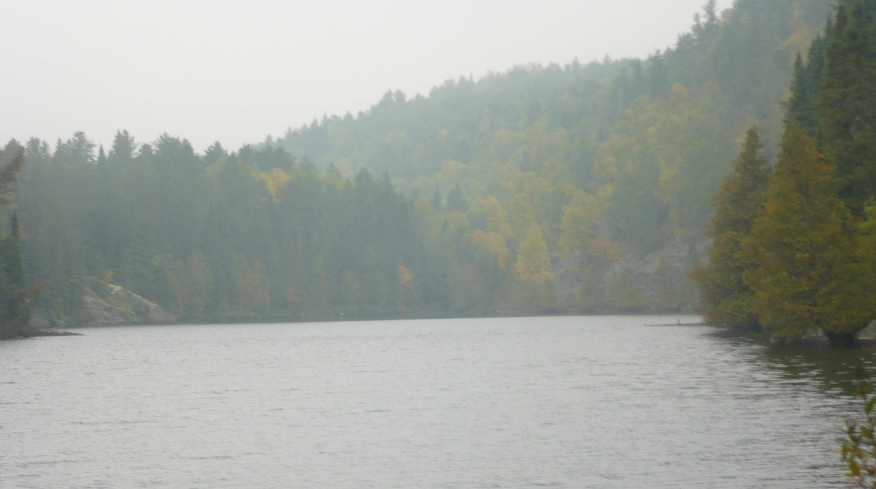

Slide 6
A little bit about chloride
Does not easily precipitate
Is not biodegradable
Is not readily involved in biological processes
Does not adsorb significantly to mineral/soil surfaces
It is therefore assumed to readily move with water

Slide 7
Primary anthropogenic sources are road salt, fertilizers, and WWTPs
Total = 968,300 tons annually
Fraction of annual chloride contributions from major point and nonpoint sources for State of Minnesota (From Overbo et al., 2019)

Slide 8
Chloride in stormwater runoff
Runoff (from Granato and Smith, 1999)

Slide 9
At what concentration is chloride a concern?
Aquatic life (EPA, 1985)
Chronic toxicity = 230 mg/L (4 day average, not to be exceeded more than 1 in 3 years
Acute toxicity = 860 mg/L (1-hour average not to be exceeded more than 1 in 3 years)
Human consumption – drinking water, secondary maximum contaminant level = 250 mg/L based on salty taste

Slide 10
Other environmental concerns of chloride
Toxicity in plants (350 mg/L for sensitive species to over 2000 mg/L for tolerant species)
Foliar damage to plants – species dependent; many species show effects above about 200 mg/L
Increased metal mobility – a complex issue, but some evidence for Cl complexes with Zn and Cd ; other metals appears to be due to ion exchange with the cation
Corrodes steel
Reduced denitrification rates in soil

Slide 11
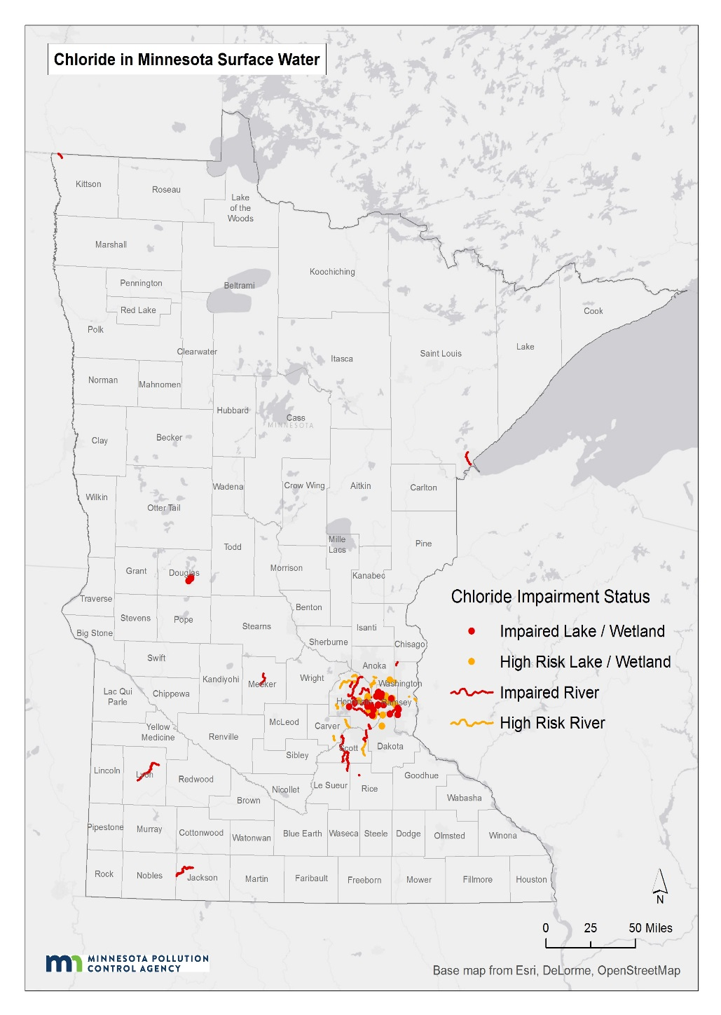
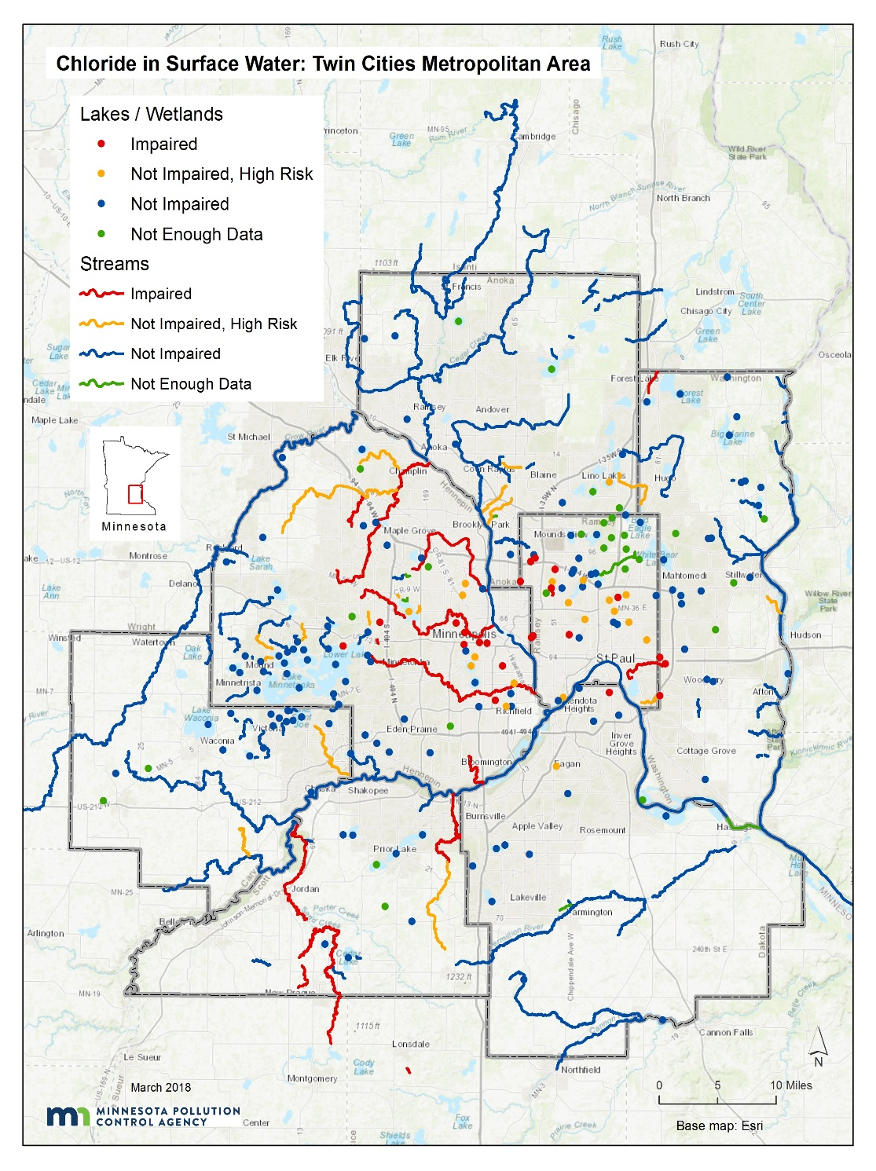
Chloride in surface water (MPCA, 2018)

Slide 12
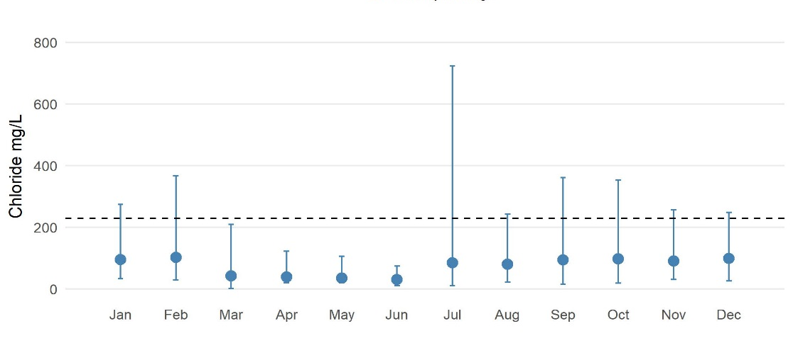
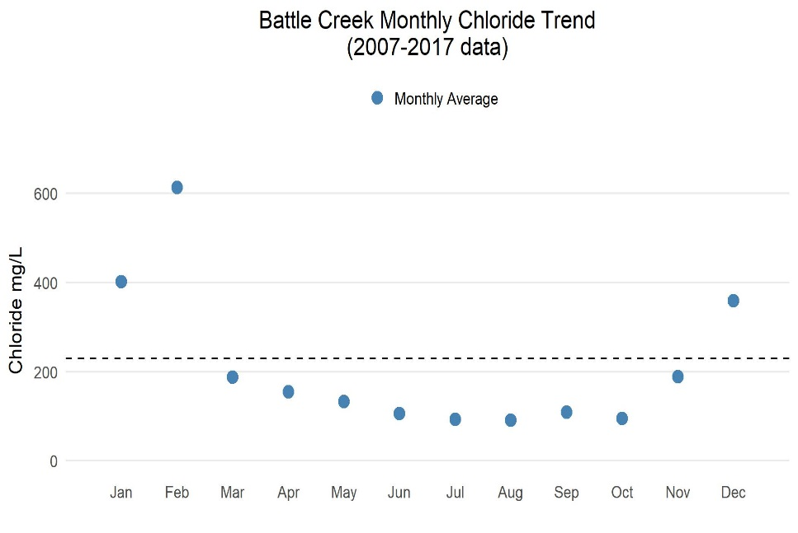
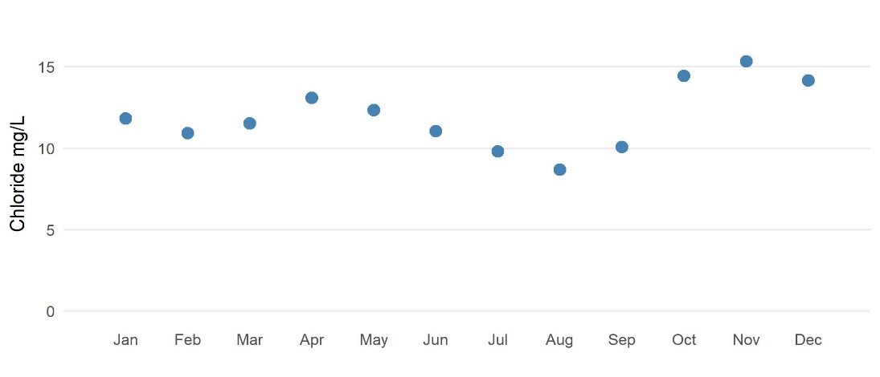
Chloride concentrations are a function of setting
(From draft Metro Cl Management Plan)
Sand Creek – mixed urban/ag
Battle Creek – highly urban
Buffalo River - ag

Slide 13
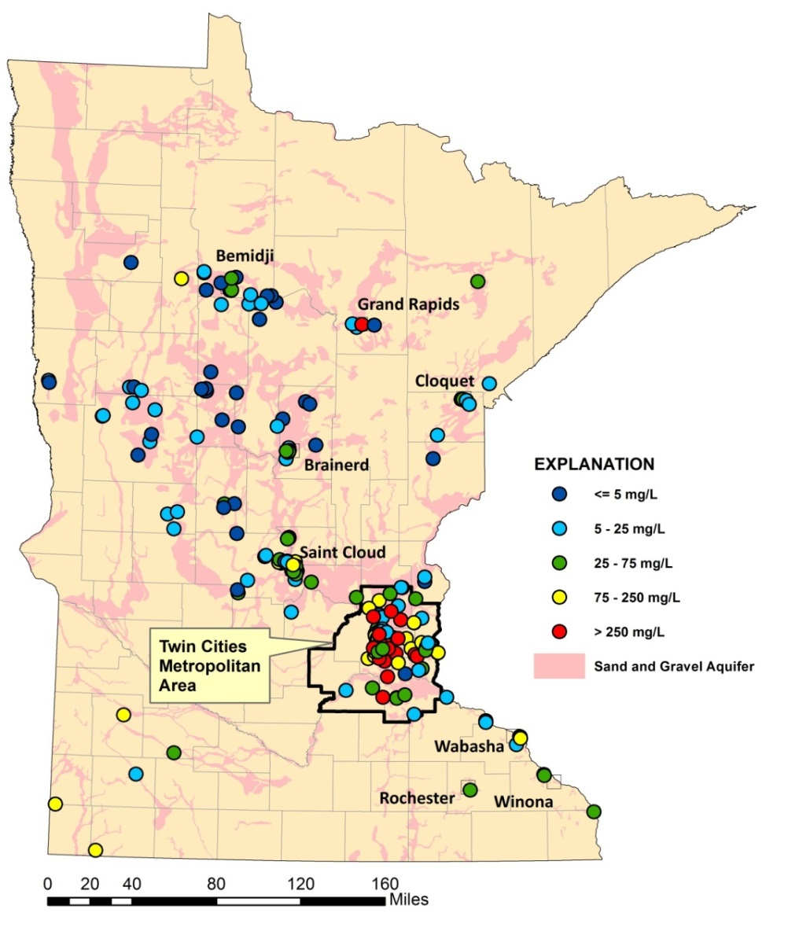
Cl in groundwater (MPCA, 2013)
Shallow sand & gravel aquifers
Bedrock aquifers

Slide 14
Summary of water quality status
Statewide
26 lakes were impaired as of 2018
24 streams impaired as of 2018
120 lakes classified as at risk (> 1 sample in past 10 years with Cl > 207 mg/L)
Twin Cities Metro
23 lakes impaired
17 streams impaired
38 lakes classified as at risk
340 assessed waterbodies (11% impaired; 11% insufficient data)
30% of shallow wells exceed the SMCL
Source: Draft Statewide Chloride Management Plan

Slide 15
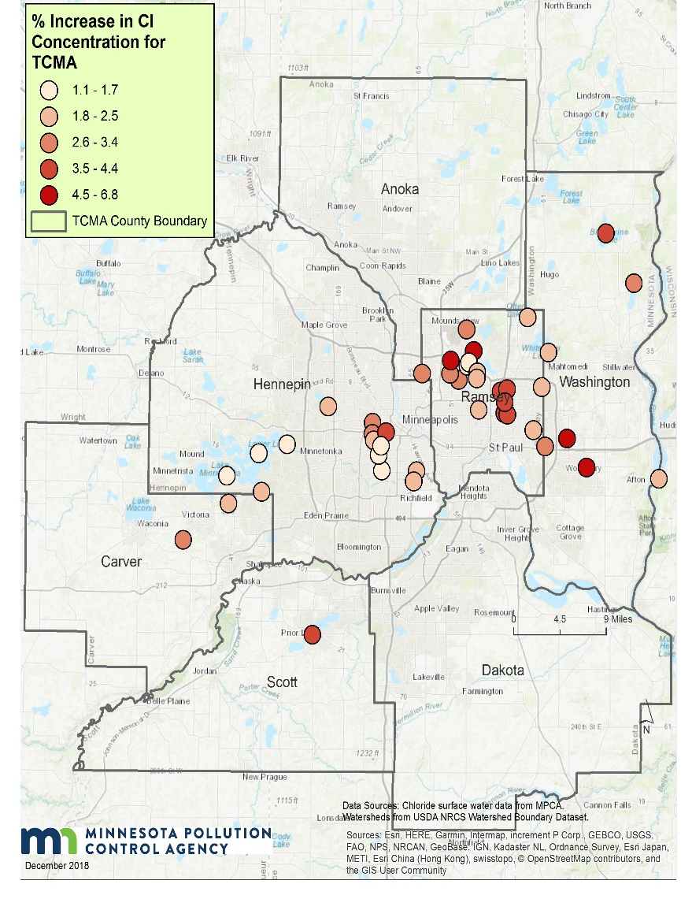
Lake trends
(Source: Draft Chloride Management Plan)
Upward trends in 46 of 69 lakes in TCMA
Outside TCMA, upward trends in 14 of 45 lakes
Rate of increase is greatest in lakes in TCMA urban core
Lakes - % increase per year

Slide 16
Flow-Adjusted Cl Trends, 1985–2015
(Met Council, 2018)
Upward trends at all but one location
Concentrations well below aquatic life standard

Slide 17
Groundwater trends
(Source: MPCA 2013)
Upward trends in 11 of 36 wells in shallow sand/gravel aquifers
Average rate of increase was 3.4 mg/L/yr, but rates were much higher is some wells

Slide 18
General conclusions
Chloride is a concern in surface waters in core urban areas
Concentrations in shallow groundwater in core urban areas are elevated compared to all other land uses
Outside urban areas, chloride is, in general, not a concern yet, although there are local exceptions
In suburban and exurban areas, results are mixed
Trends in all waters in urban areas are upward

Slide 19
Taking a closer look - lakes
What factors make a lake vulnerable to chloride contamination?
What are the consequences of high chloride concentrations in lakes?
Should we be concerned/questions we might want to ask?

Slide 20
Potential factors affecting lake vulnerability
Deicer application rates
Imperviousness
Lake characteristics
Depth
Area
Watershed area

Slide 21
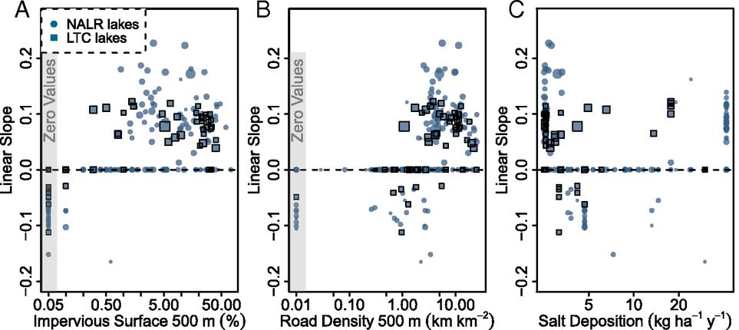
Road density and imperviousness (Dugan et al., 2017)
Impervious surface and road density within 500 meters of a lake were strong predictors of increasing Cl concentrations in the lake (n=284)
Upward concentration trends observed at impervious values > 1%

Slide 23
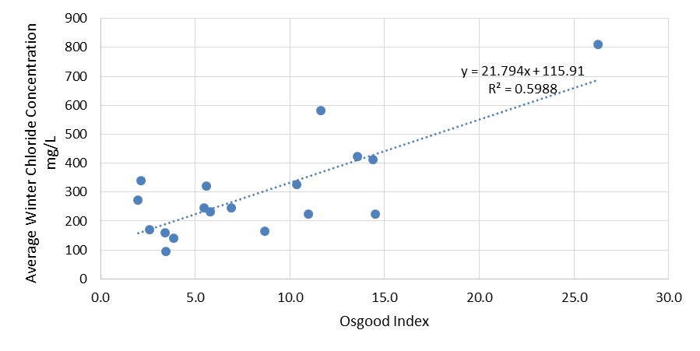

Slide 24
What are the consequences of high chloride concentrations in lakes?
Community structure (Hintz et al., 2017)
Negative impact of salinity on zooplankton
Positive response by phytoplankton
Mixed results for benthic communities
Periphyton and snail grazers unaffected
Biomass of filamentous algae decreased due to competition with phytoplankton
Direct negative impacts to filamentous algae, amphipods, and some snails and clams

Slide 25
Rivers and streams
Importance of baseflow
Highway density/imperviousness
Biotic community?

Slide 26
Groundwater
Connection to deeper aquifer systems
Connection to rivers
Connection to lakes
Residence time
Receptors (7060)

Slide 27
Management strategies
Decrease use of chloride deicers
Use alternatives
Use liquids
Establish chloride free zones near receiving waters
Improve snow/ice removal technology
Permeable pavement
Lower winter speed limits
Infiltrate in the right locations
Accept the loss of some waters

Slide 28
Reseacrh or other information-gathering studies
Identifying factors affecting surface water vulnerability
Mapping vulnerable areas
Modeling groundwater
Identifying and mapping vulnerable groundwater areas based on geology and receptors
Identify high-value streams, rivers, and lakes at risk
Conduct hydrologic studies

Slide 29
Recommendations
Continue to focus on reductions in chloride-based deicing
Let the science play out on impacts to receiving waters
Unless or until we find an alternative to chloride-based deicers, we’ll have to accept some losses, but with practical solutions, we can minimize our losses

