Slide 1
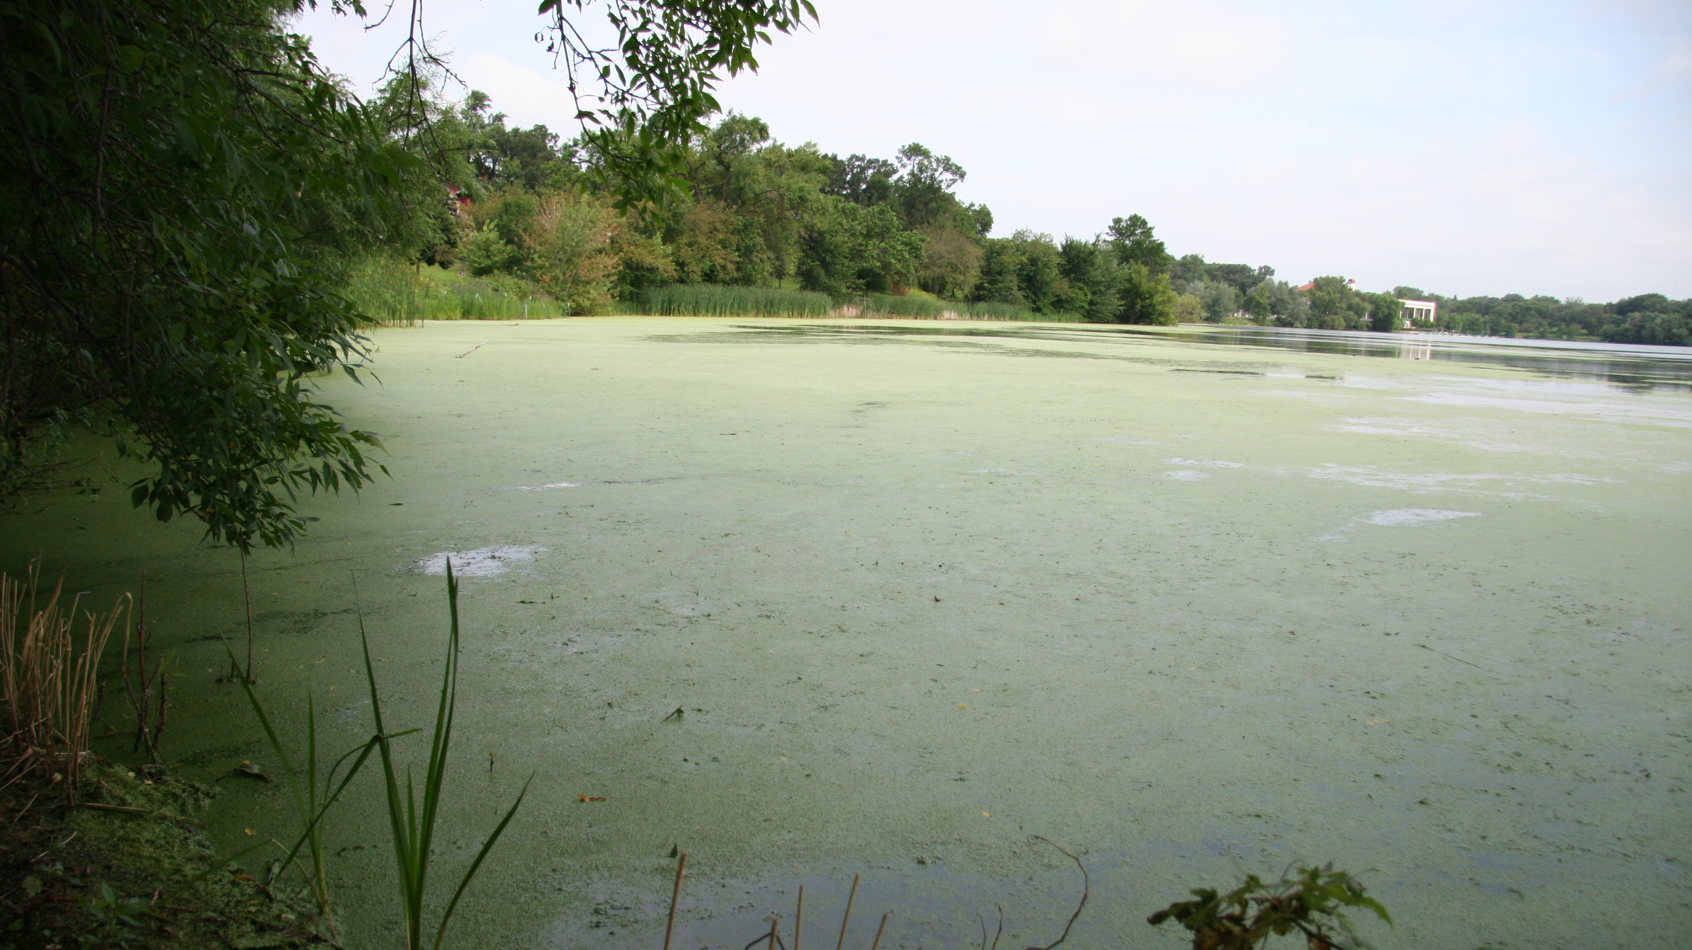
Phosphorus in stormwater – are we making progress?
Mike Trojan, MPCA Stormwater Program
Water Issues presentation, October 8, 2020

Slide 2
Outline
The concern with phosphorus
A closer look at phosphorus in stormwater
Stormwater BMPs (treatment)
Research and progress
Wrap-up

Slide 3
Some terms
TP = total phosphorus
DP = dissolved (filtered) phosphorus
PP = particulate phosphorus
OP = orthophosphate
BMP = best management practice

Slide 4
Qualifier
The information in this presentation is gathered from a number of sources
The presentation does not include rigorous data analysis
The presentation is therefore not a comprehensive analysis of phosphorus in stormwater, but more of an overview and summary of on-going work

Slide 5
Stormwater runoff contributes to phosphorus impairments
TP (mg/L)
mg/L
0.4
High
Concentrations in runoff
0.2
Low
0.0
Source: MPCA

Slide 6
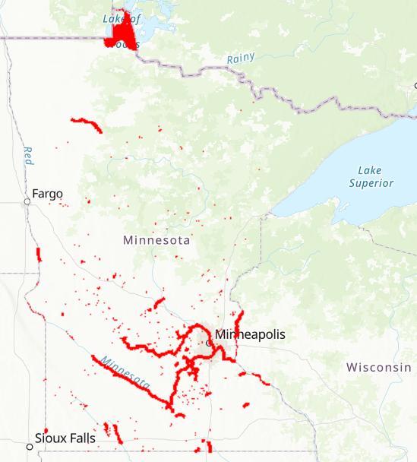
Nutrient impairments (2020 list)
689 lakes
53 river/stream stretches
Source: MPCA

Slide 7
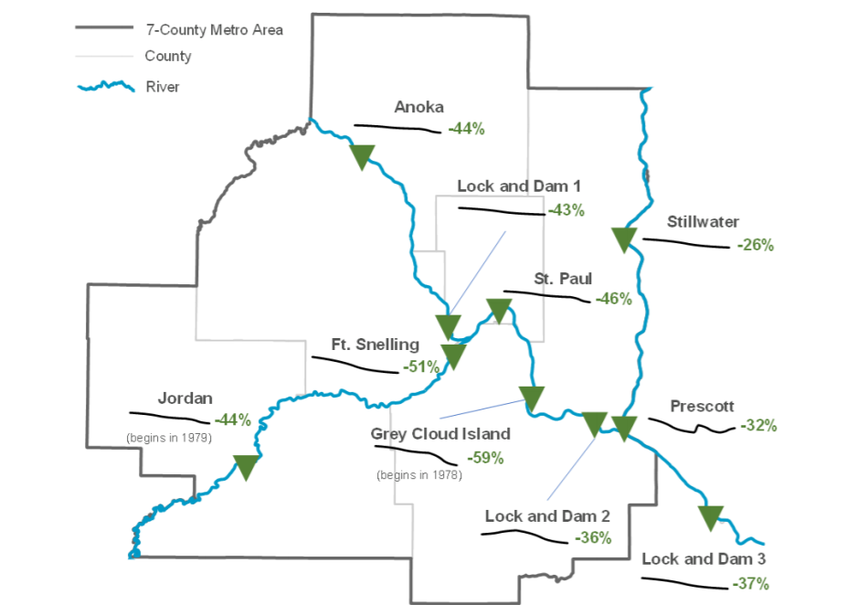
Phosphorus concentrations in Metro rivers are decreasing
(1976-2015)
Source: Metropolitan Council

Slide 8
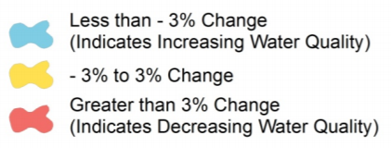
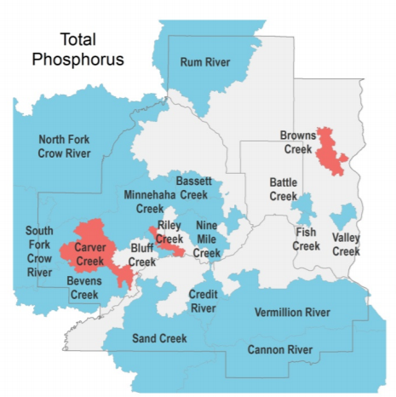
Phosphorus concentrations in most Metro streams are decreasing
(2008-2012)
Source: Metropolitan Council

Slide 9
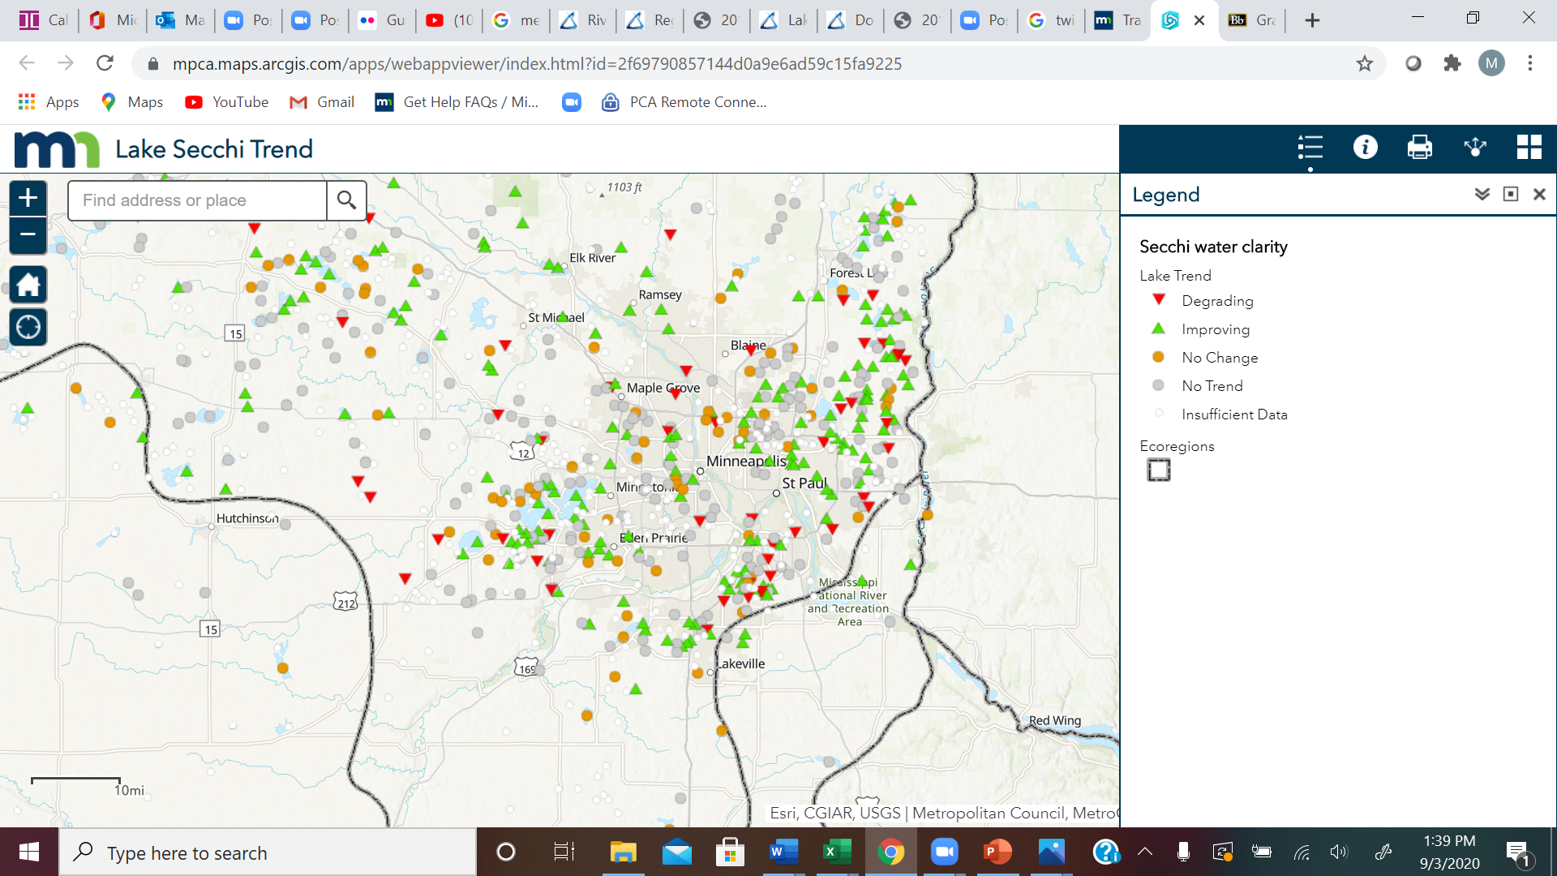
Secchi disk readings in many of the core Metro lakes are decreasing
Source: MPCA

Slide 10
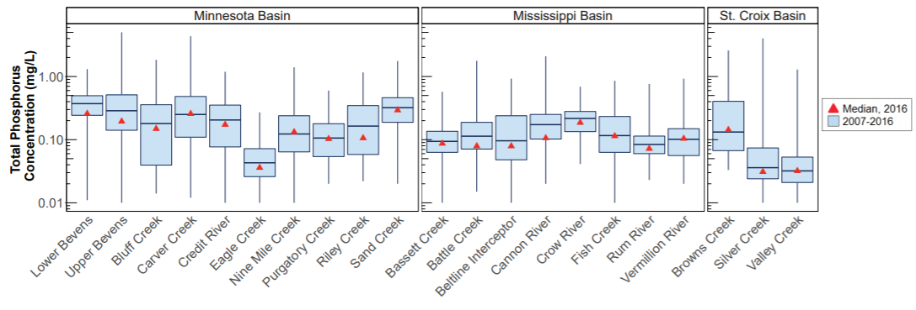
… but phosphorus concentrations in many Metro streams are still above water quality standards
Source: Metropolitan Council

Slide 11
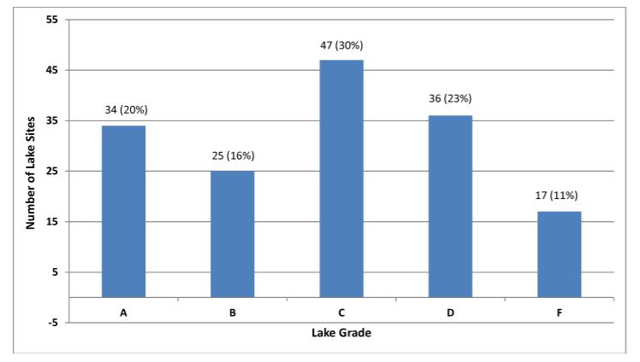
… and the quality of many Metro lakes is poor
Source: Metropolitan Council

Slide 12
… and there has been very little analysis of stormwater runoff
E. Kittsendale
Trout Brook
Villa Park
St. Anthony
Data from Capital Region WD

Slide 13

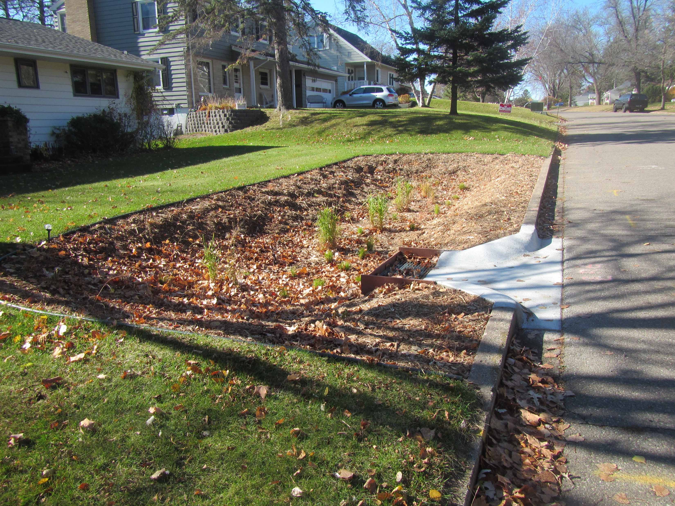
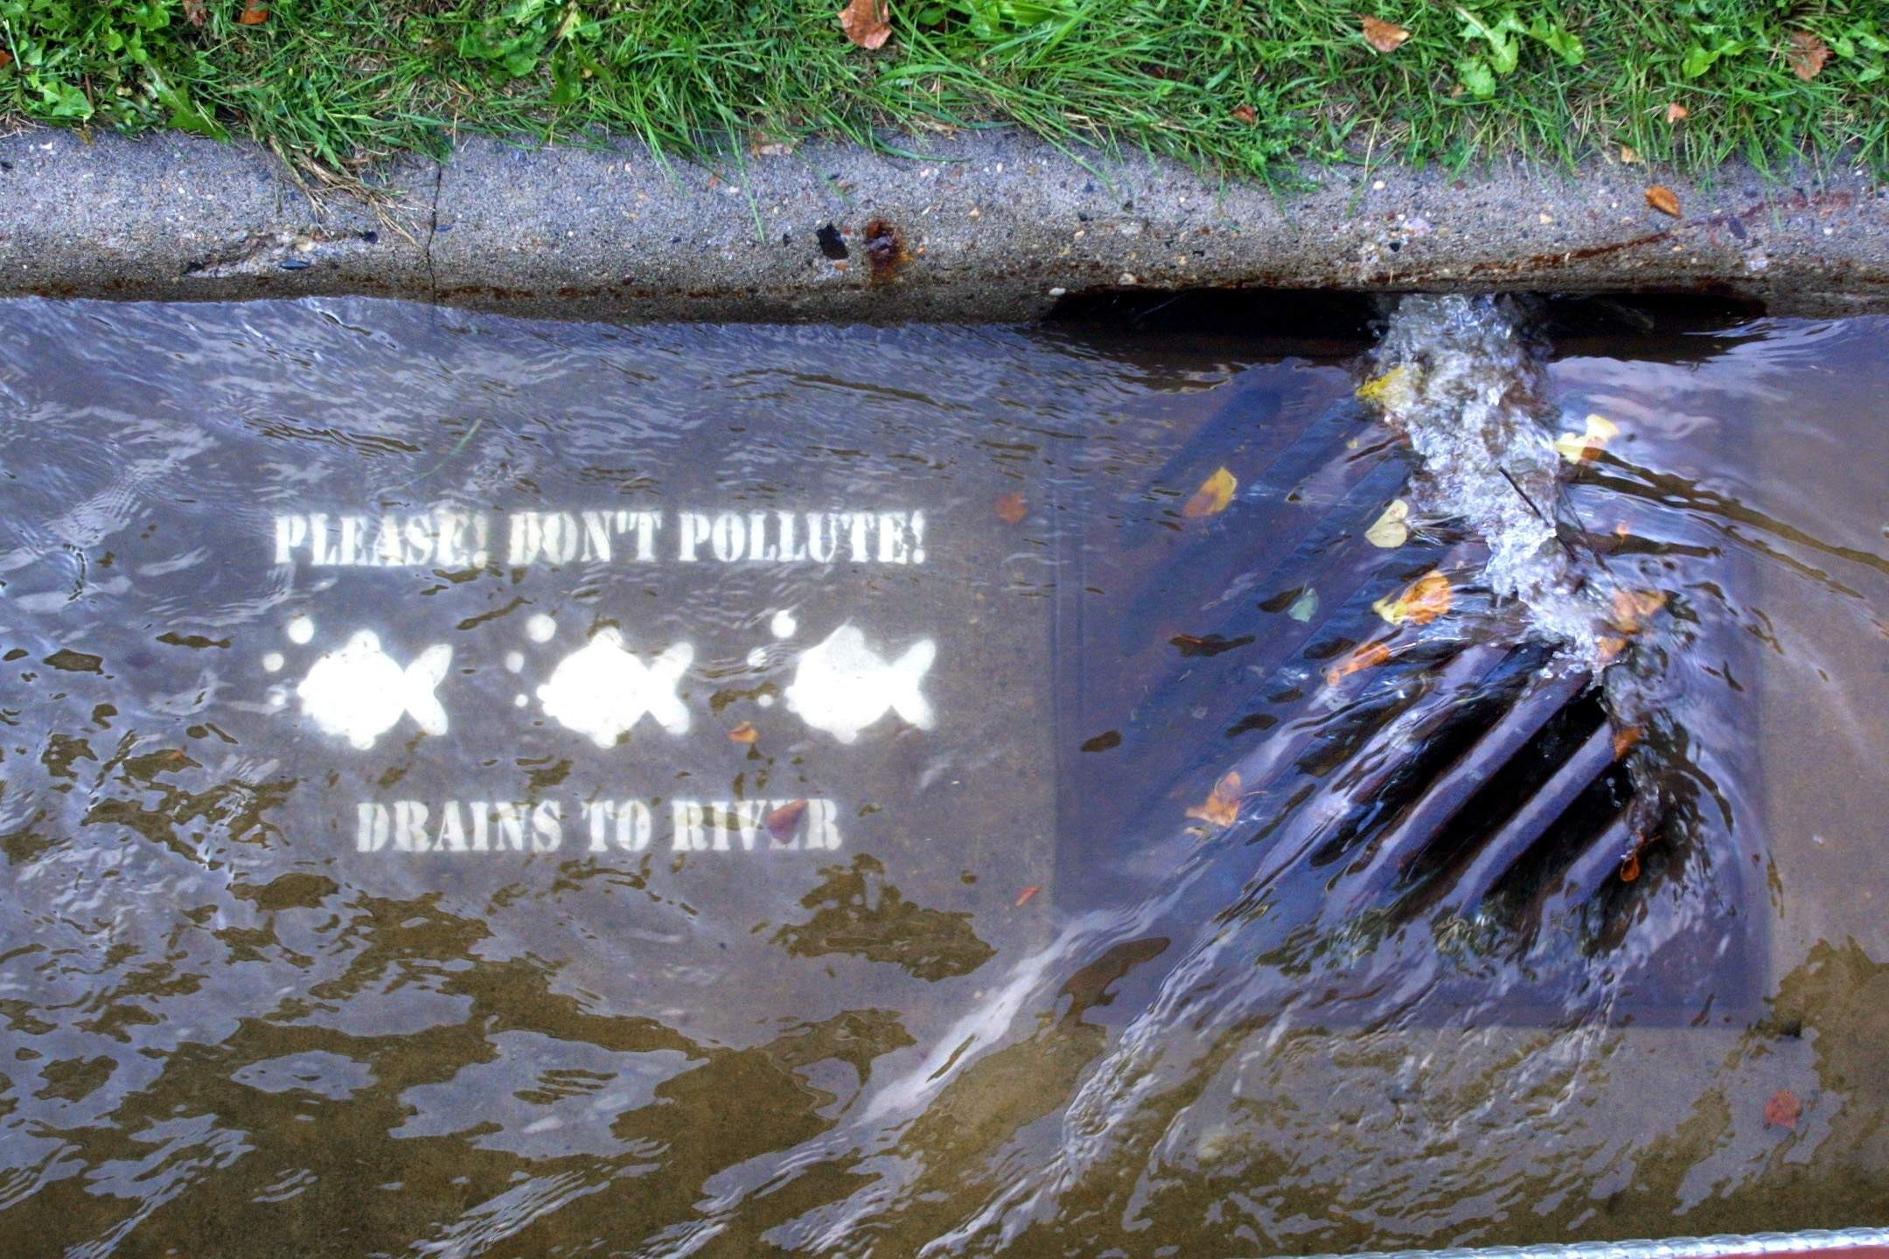
There are indications we’ve made some but not enough progress

Slide 14
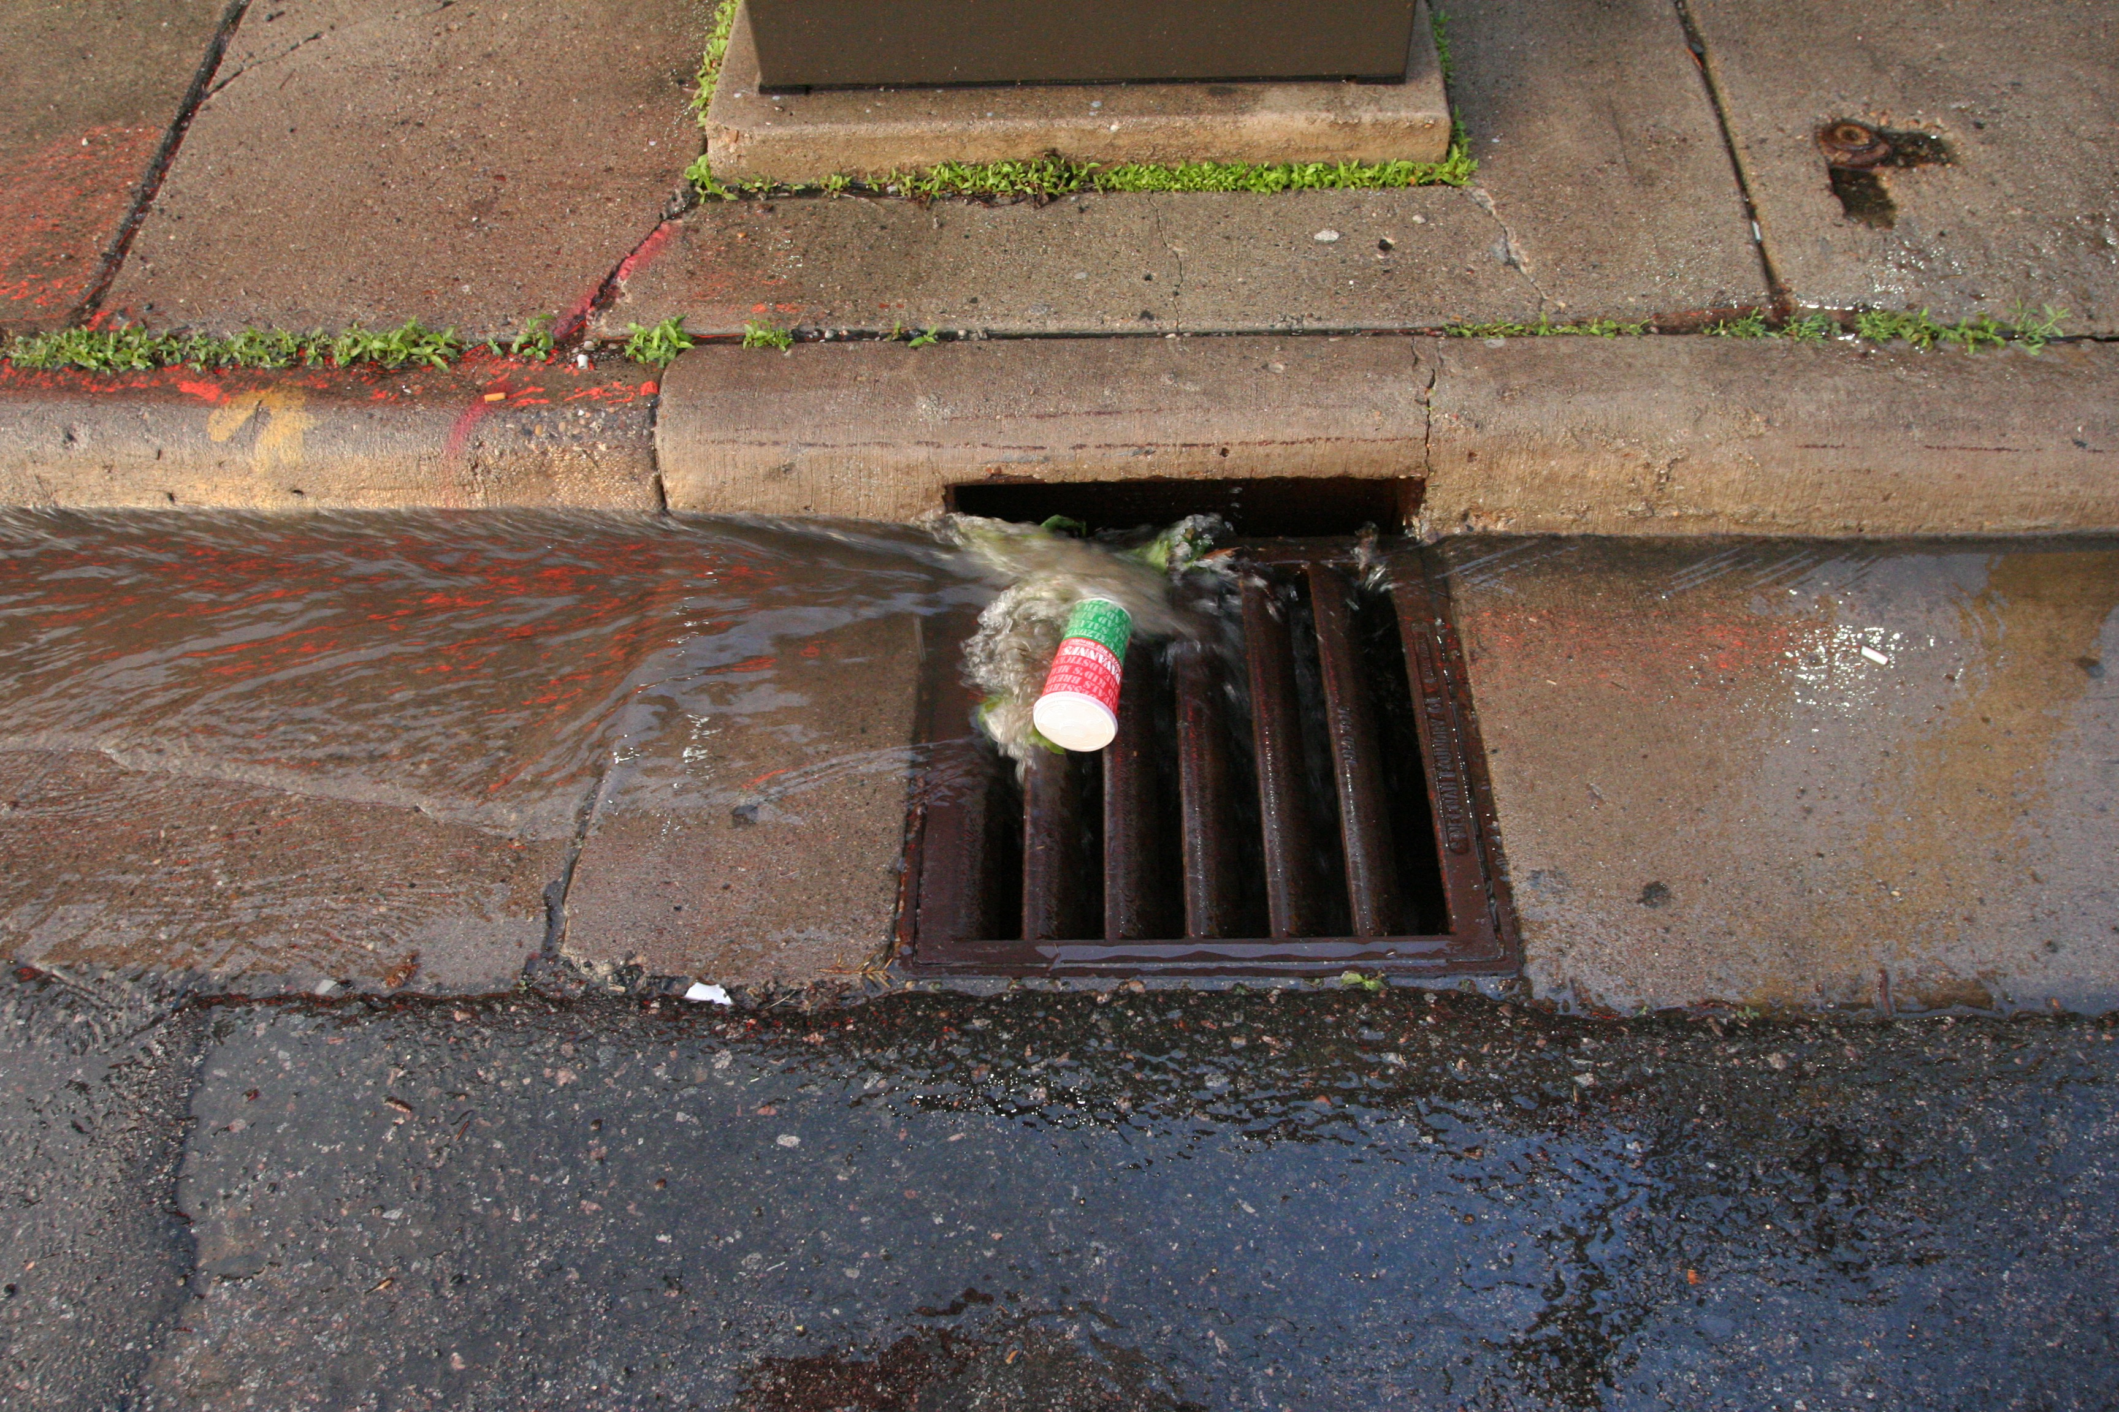
Phosphorus in stormwater

Slide 15
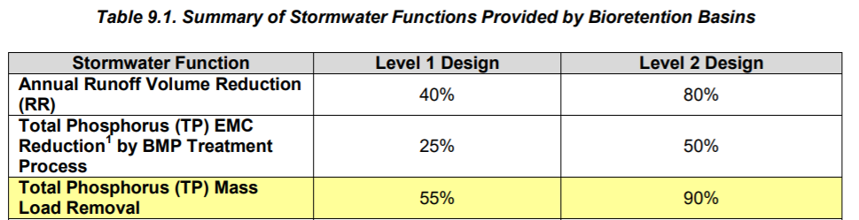
In general, all phosphorus and phosphorus sources have been considered equal
TMDLs are written for total phosphorus
Most regulations are written for total phosphorus
Most pollutant crediting efforts focus on total phosphorus
Estimates of P loading often ignore factors likely to affect loading
Source: Virginia Department of Conservation and Recreation

Slide 16
A closer look at phosphorus in stormwater runoff suggests we should give this more thought

Slide 17
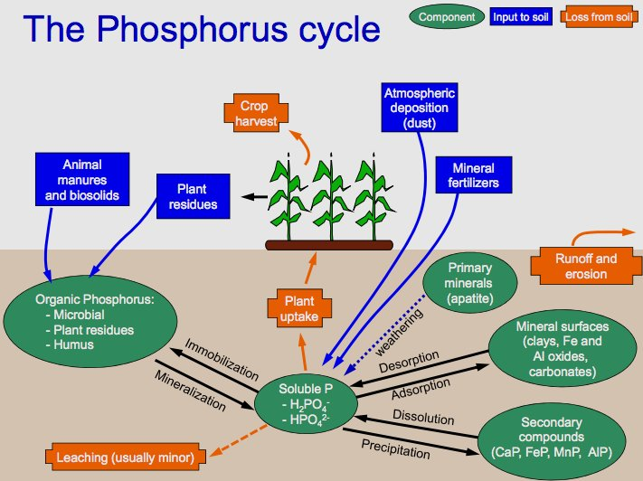
Phosphorus cycling is complex

Slide 18
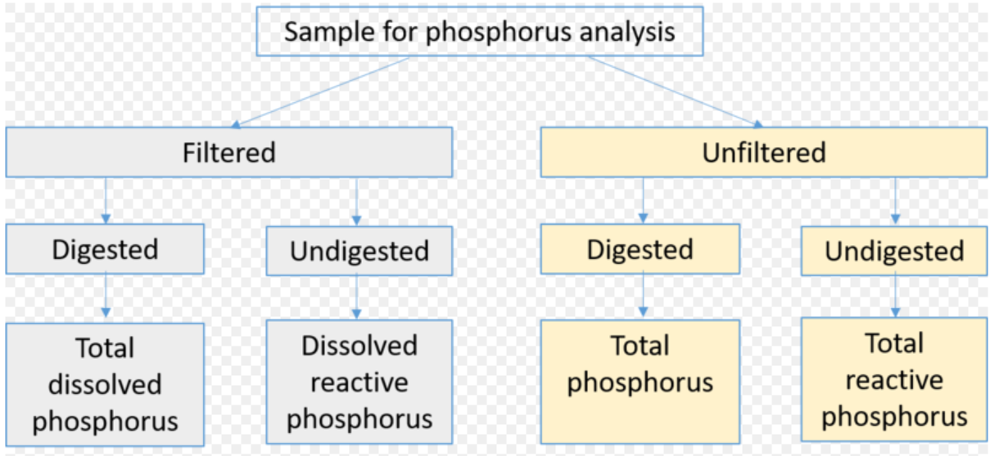
P is generally considered to be in dissolved or particulate form
Dissolved forms are >90% bioavailable; particulate <30% bioavailable
TP = PP + DP

Slide 19
Total phosphorus concentrations and export vary by land use

Slide 20
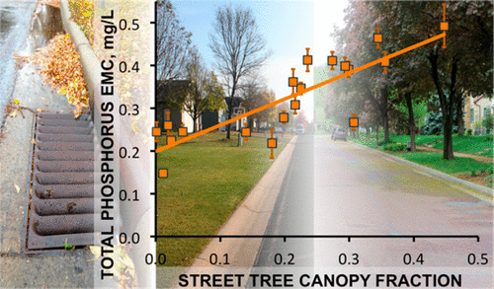
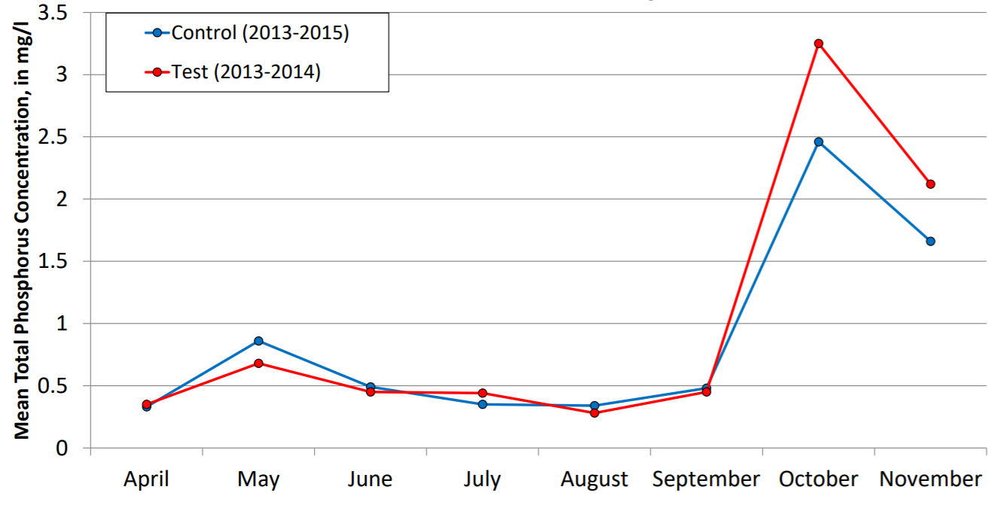
TP concentrations are affected by tree canopy ...
Janke et al., 2017
Selbig, 2020

Slide 21
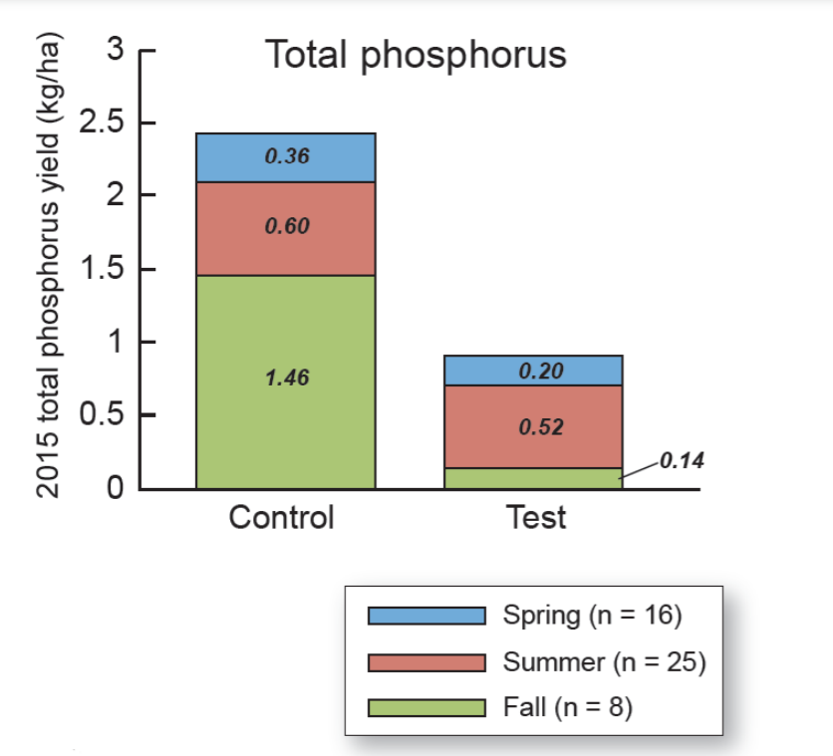
… which affects seasonal loading
Selbig, 2020

Slide 22
Ratios of dissolved to particulate P vary with land use
Ratio
Source: Minnesota Stormwater Manual

Slide 23
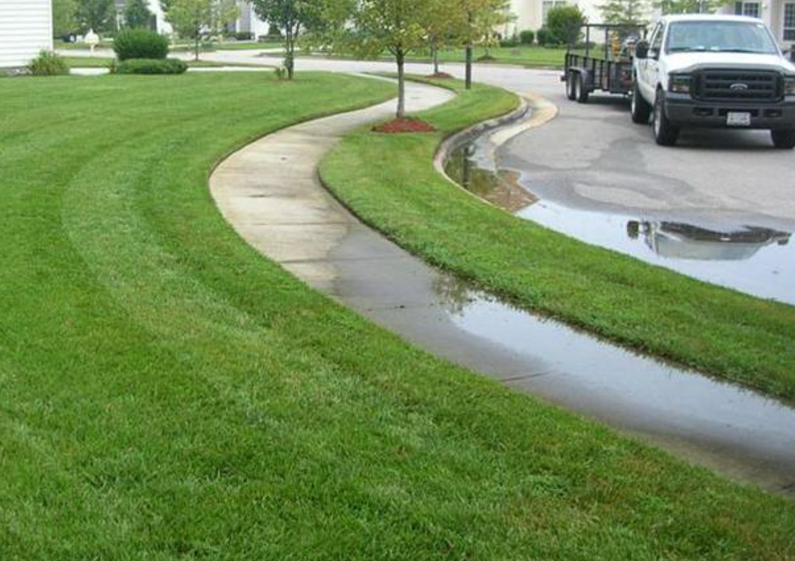

Important sources of dissolved P
Plant residues
Soil organic matter
Lawn irrigation
Animal wastes
Source: Minnesota Stormwater Manual

Slide 24
TP snowmelt concentrations >= stormwater
DP snowmelt concentrations > stormwater
Data from Capital Region WD

Slide 25
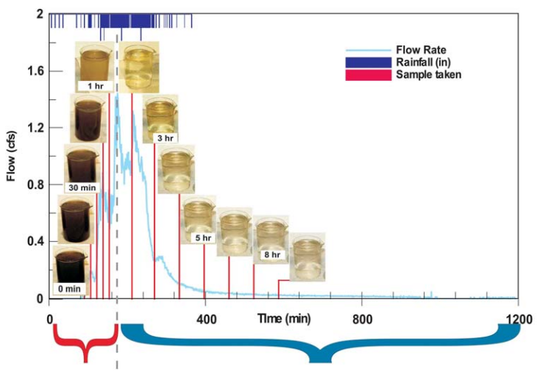
First flush – pollutant concentrations are highest in the early stages of runoff
Stenstrom and Kayhanian, 2005

Slide 26
First flush for phosphorus is more pronounced
in smaller watersheds
as length of time between runoff events increases
with greater directly connected impervious surface
with higher rainfall intensities in the early part of a runoff event
when the majority of phosphorus is associated with sediment
Source: Minnesota Stormwater Manual

Slide 27
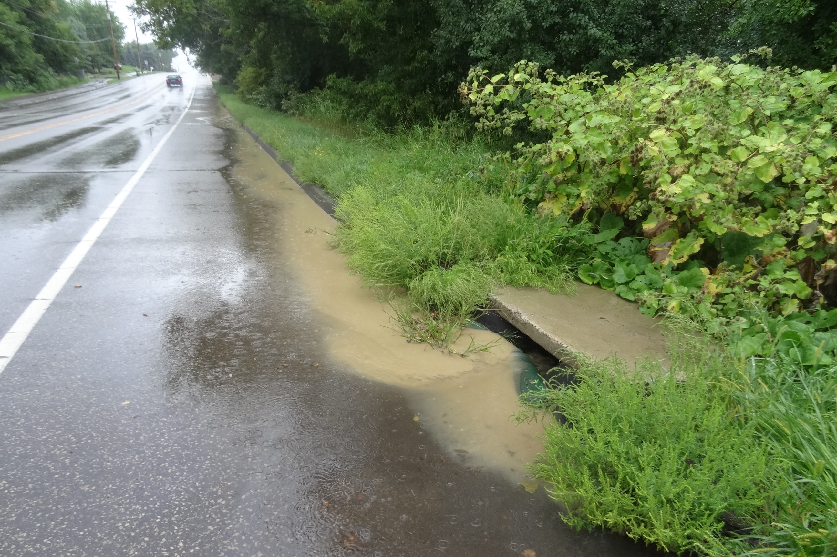
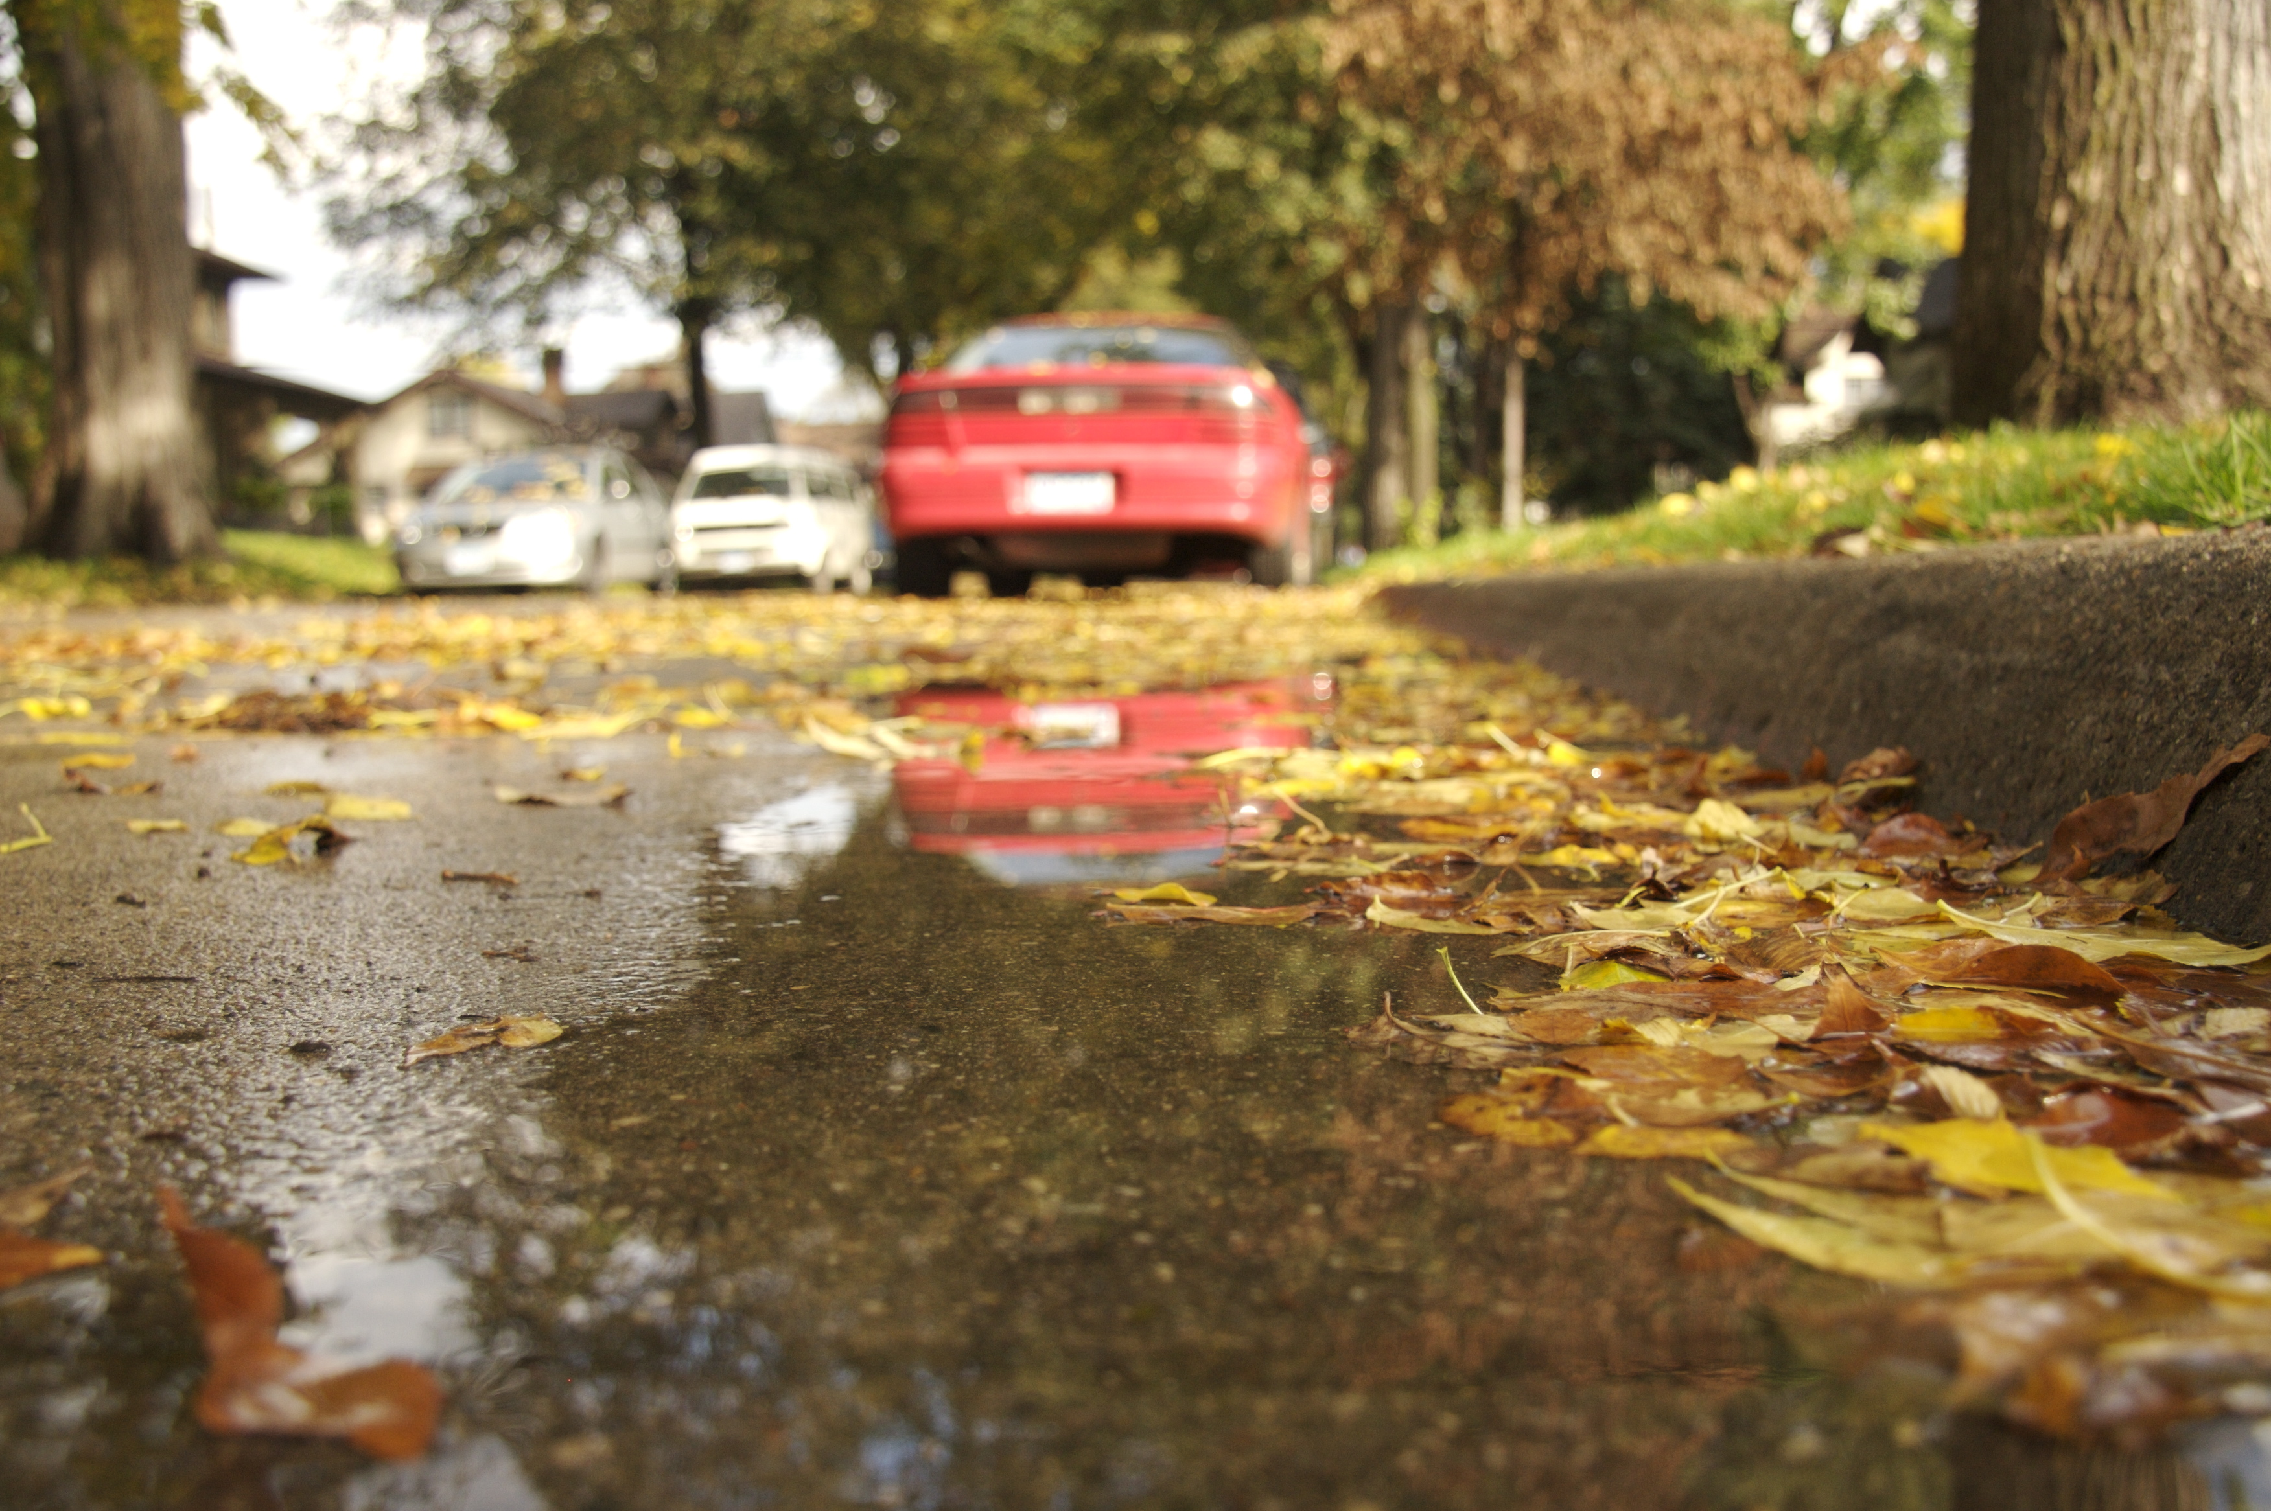
The fraction of total P in particulate form during a runoff event is greatest during first flush

Slide 28

Treatment for phosphorus – best management practices (BMPs)

Slide 29
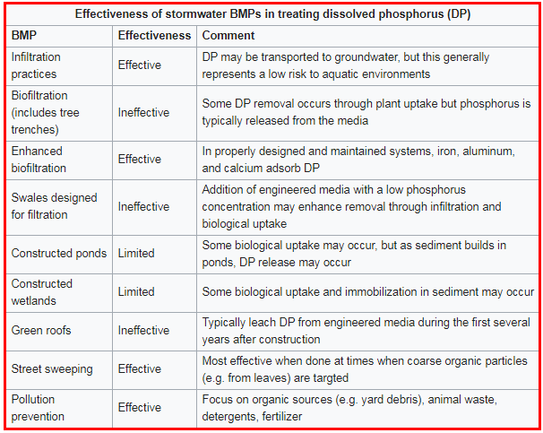
Stormwater practices (BMPs) must be properly targeted
Source: Minnesota Stormwater Manual

Slide 30
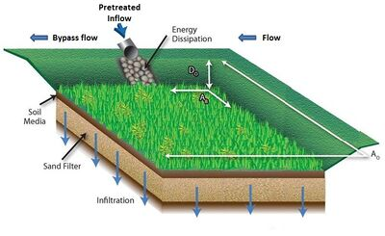
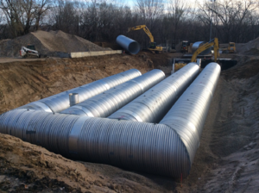
Infiltration - effective
Runoff captured by BMP infiltrates into underlying soil
P is attenuated in unsaturated zone
Concentrations reaching groundwater are near background levels
P in groundwater is not very mobile
Possible exception: BMP located near impaired water

Slide 31
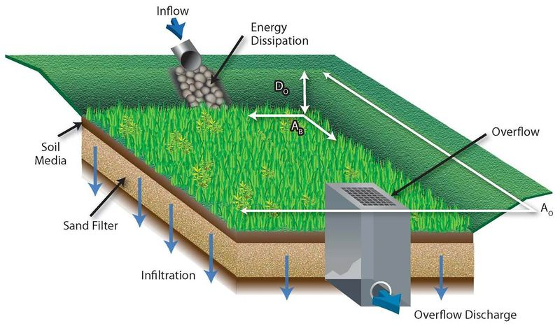
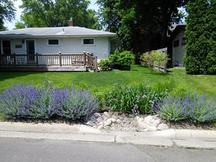
Biofiltration (incl. tree trenches) –ineffective
Media leaches phosphorus (source is compost)
Int’l BMP Database

Slide 32
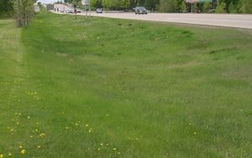
Swales – generally ineffective
Conveyance limits effectiveness
Varies with soil/media

Slide 33
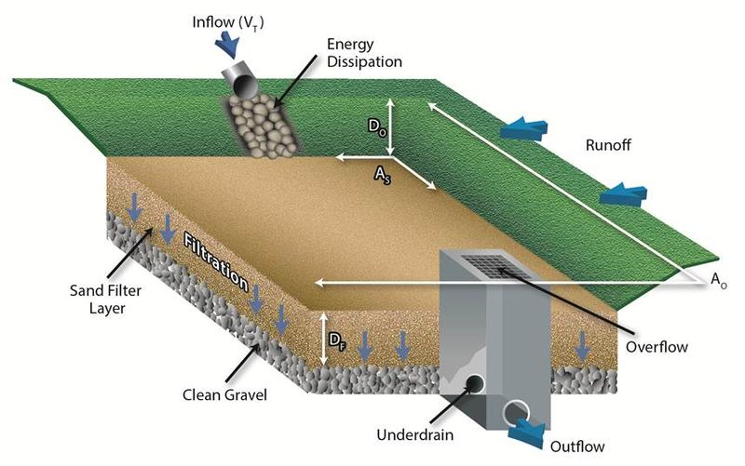
Media (sand) filters – partly effective
Effective for PP
Ineffective for DP

Slide 34
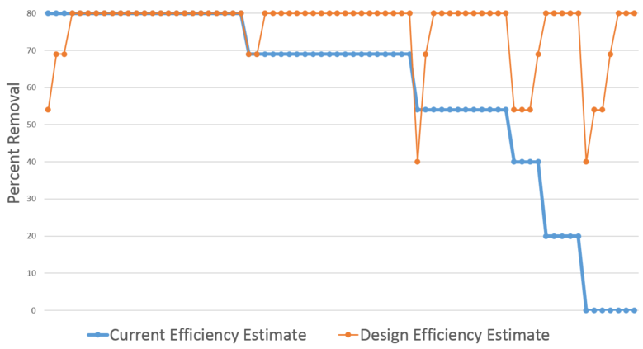
Stormwater ponds/wetlands – partly effective
Effective for PP
Variable effectiveness for DP

Slide 35
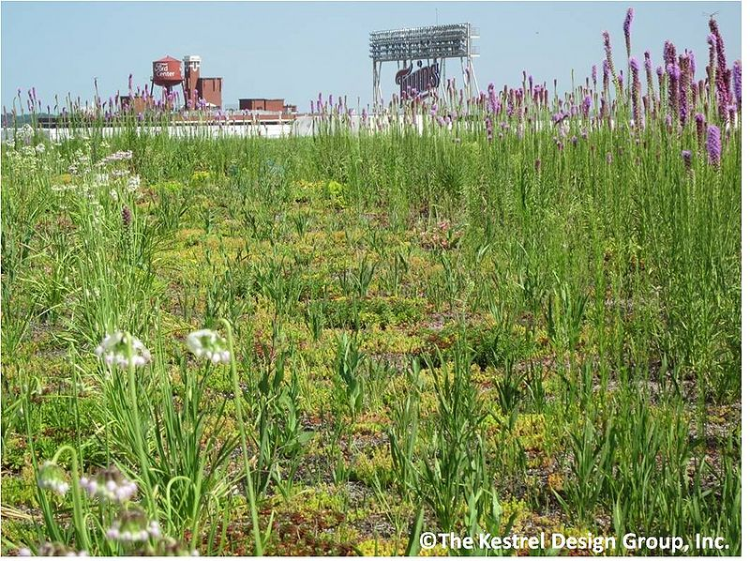
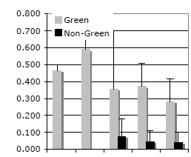
Green roofs - ineffective
Media leaches phosphorus
TP (mg/L)
Berndtsson et al., 2009

Slide 36

Is it hopeless?

Slide 37
Lessons learned and research
Adding amendments to BMPs
Modifying media
Understanding pond design
Source control – street sweeping

Slide 38
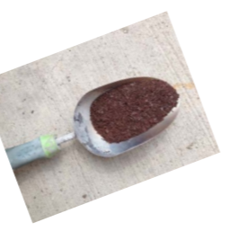
1. Amending BMPs
Iron
Aluminum
Calcium
Example materials
  Water treatment residuals
  Spent lime
  Alum
  Iron filings

Slide 39
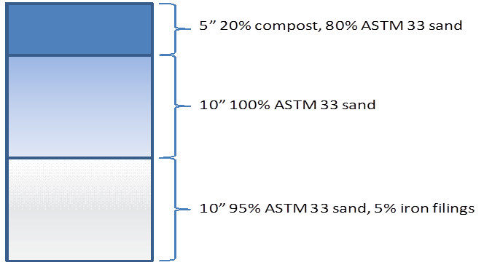
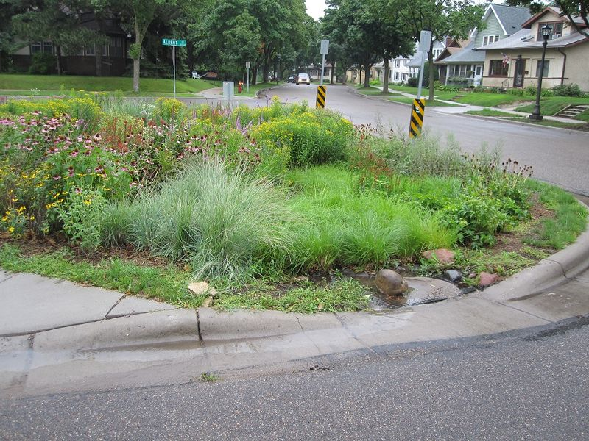
Iron-enhanced biofiltration
Bannerman, 2013

Slide 40
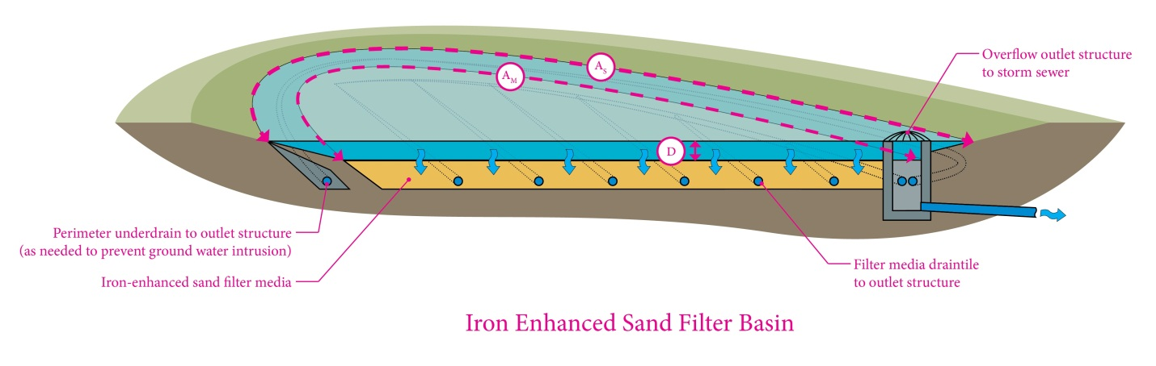
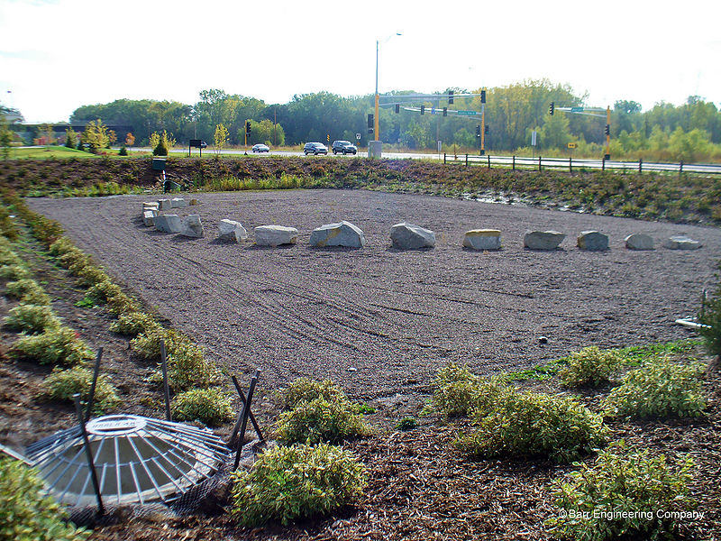
Iron-enhanced sand filter
Ramsey Washington Watershed District

Slide 41
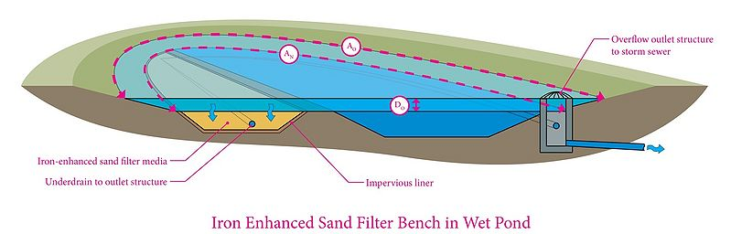
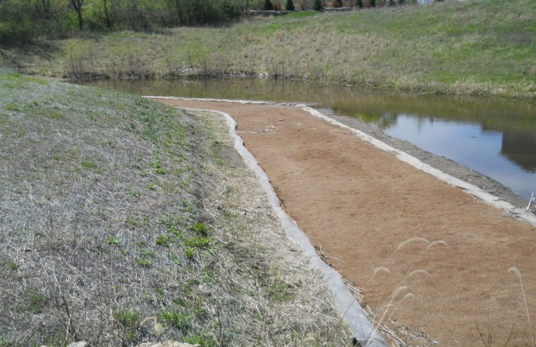
Iron-enhanced pond bench
City of Prior Lake

Slide 42
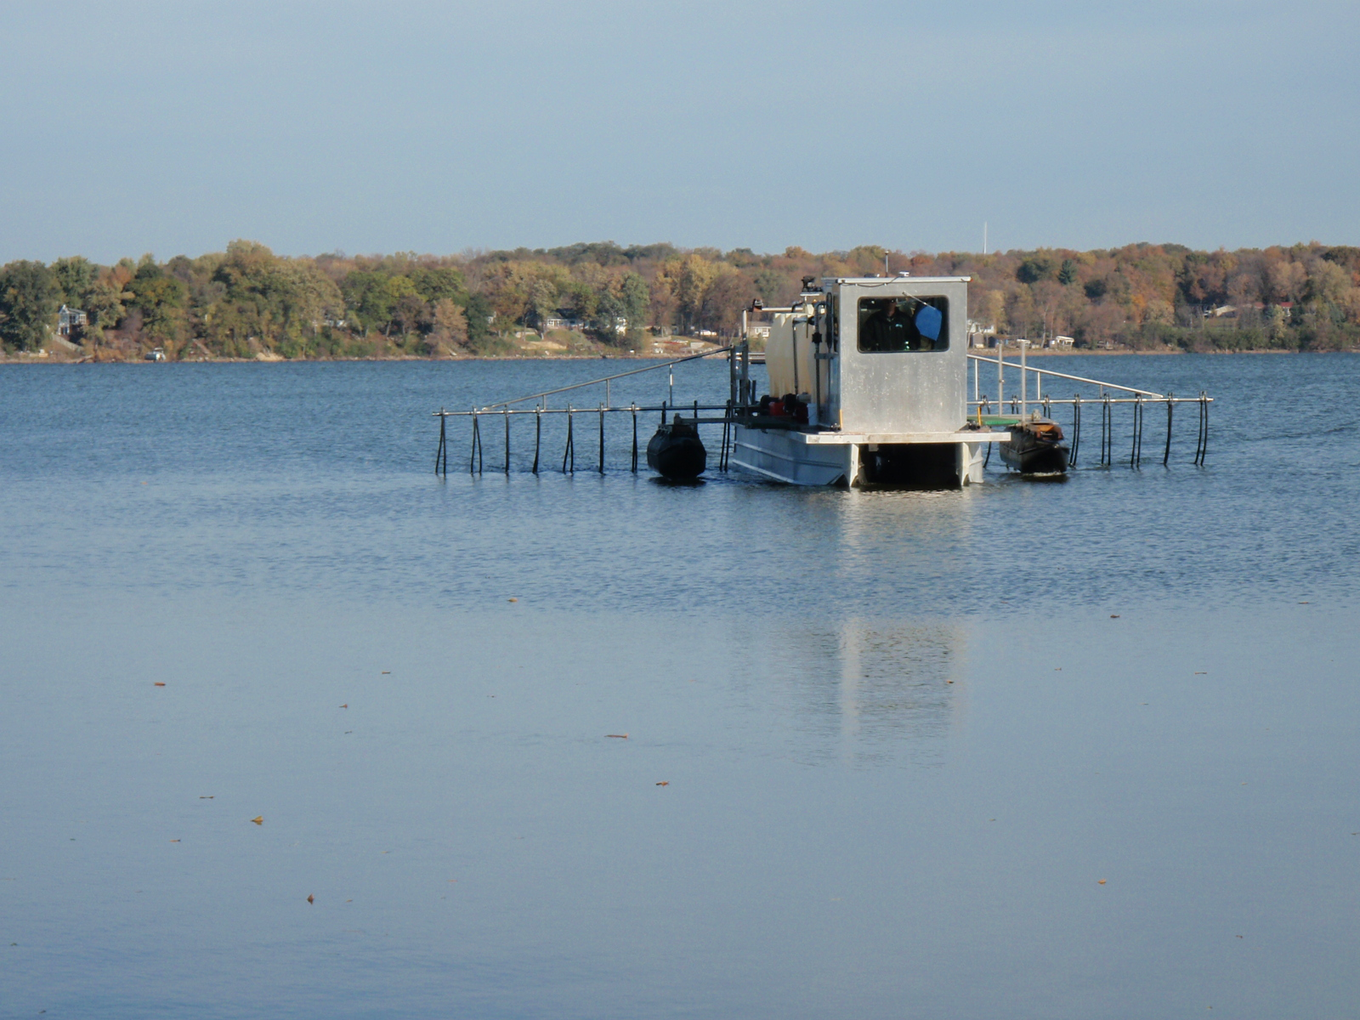
Pond treatments (iron, alum, calcium)
Prior Lake Spring Lake Watershed District

Slide 43
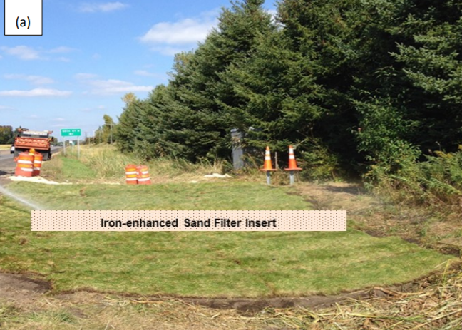
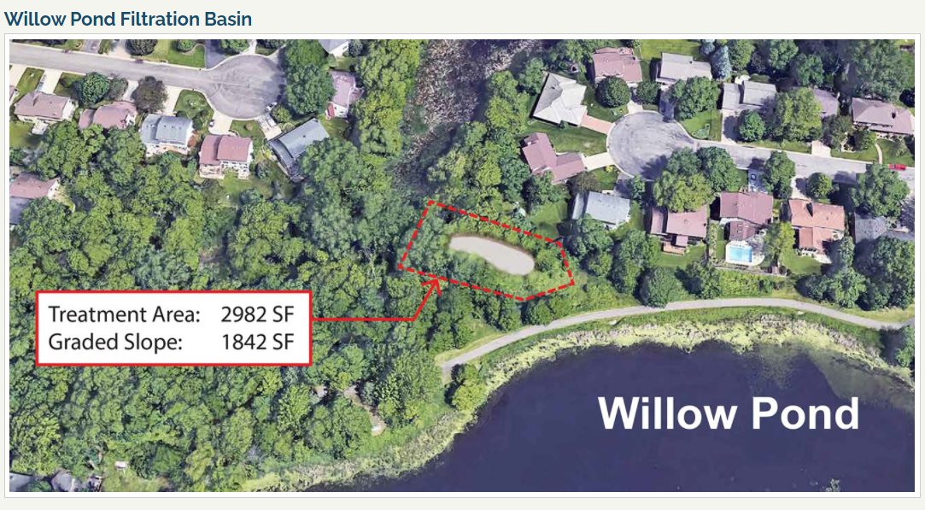
Other
Filtration systems, reactive barriers (e.g. alum, spent lime)
Iron-enhanced ditch check dams
Barr Engineering, City of Roseville
Natarajan et al., 2019

Slide 44
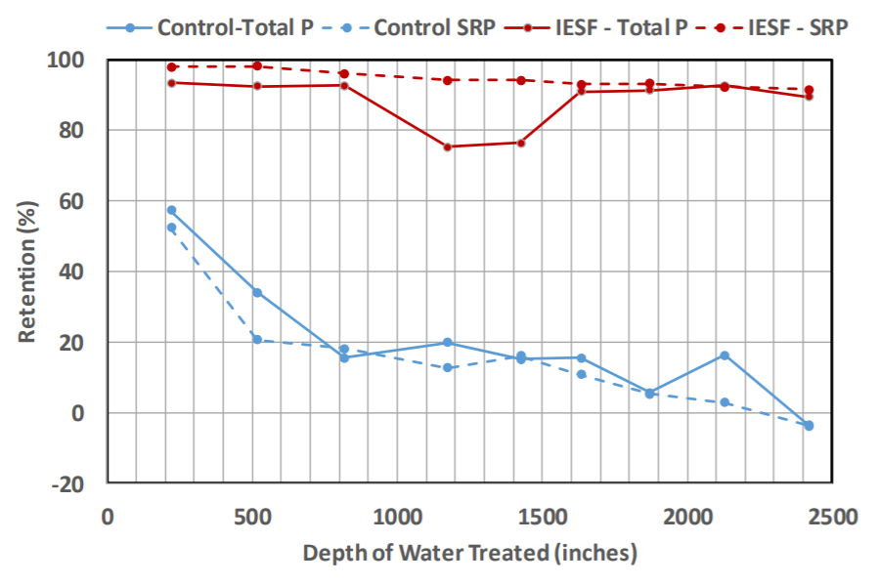
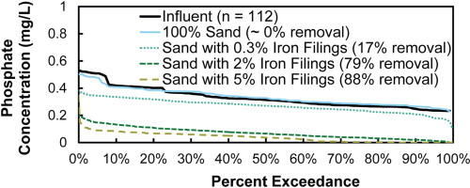
Iron amendments significantly increase DP retention and reduce DP concentration
Weiss and Aljobeh, 2016
Erickson et al., 2012

Slide 45
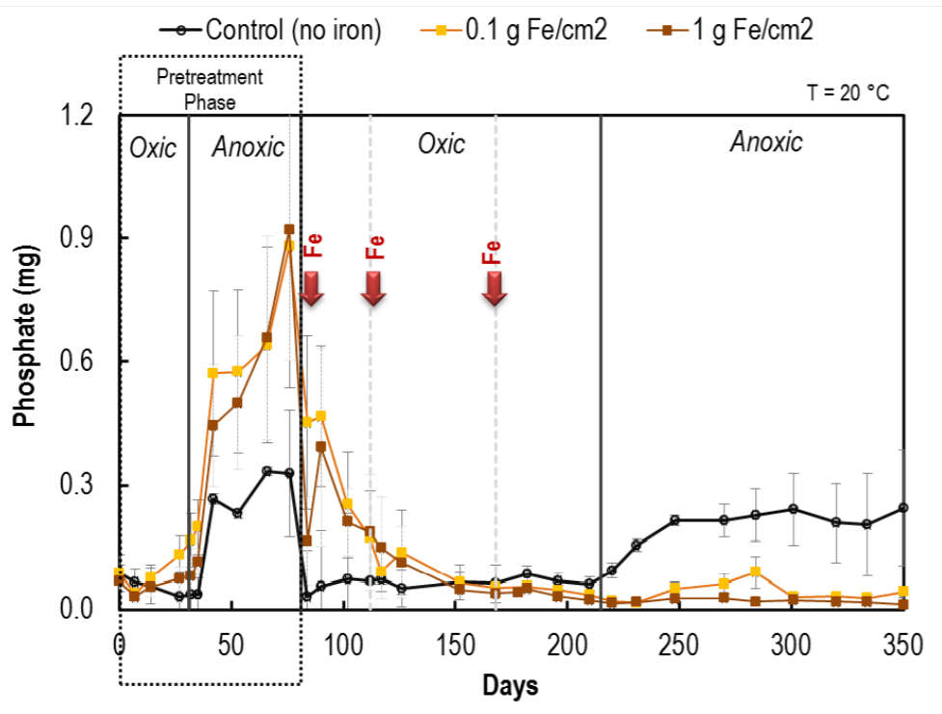
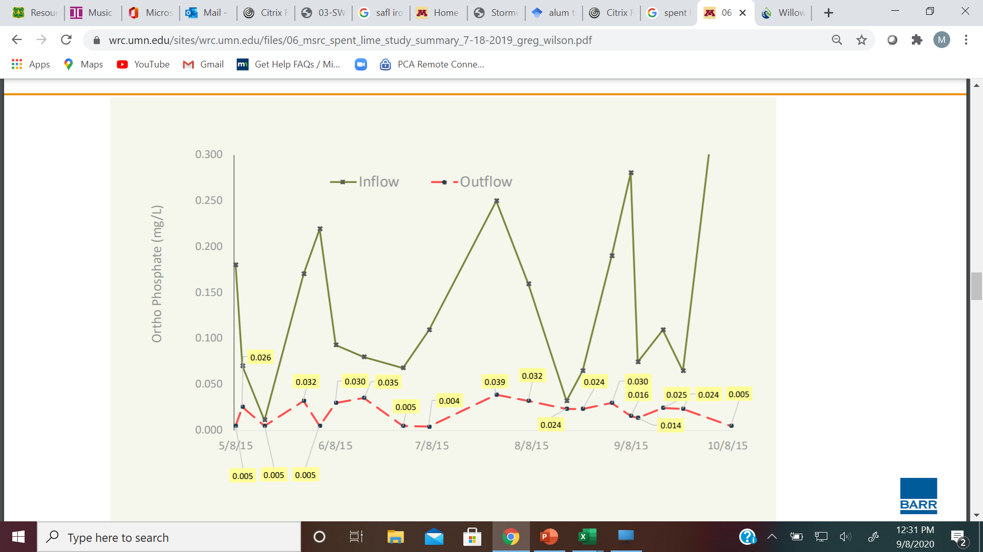
Iron, aluminum, calcium are effective in reducing internal loading in ponds/wetlands
Natarajan at. al., 2017

Slide 46
On going research
Bioretention media
  Which amendments retain P and are suitable for bioretention
  Which amendments do not leach P and are suitable for bioretention
Ponds
  Numerous questions regarding use of iron and spent lime
Sand filters and pond benches
  About 150 documented systems, but need more monitoring of these
  Need guidance on design and maintenance

Slide 47
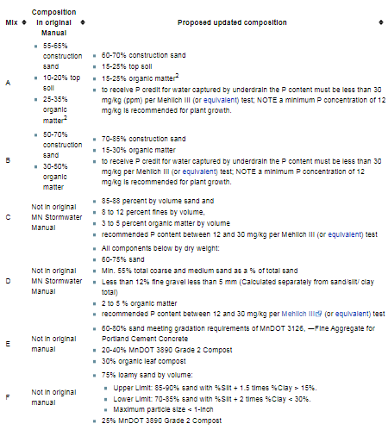
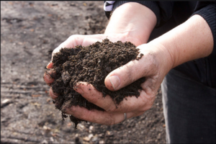
2. Modifying media
√
√
√
√

Slide 48
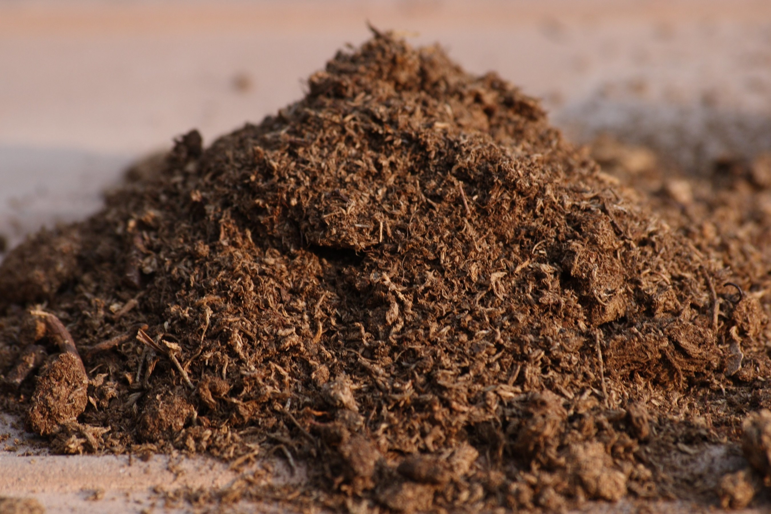
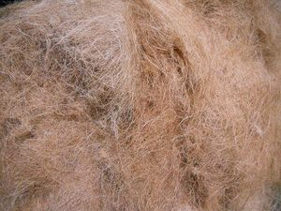
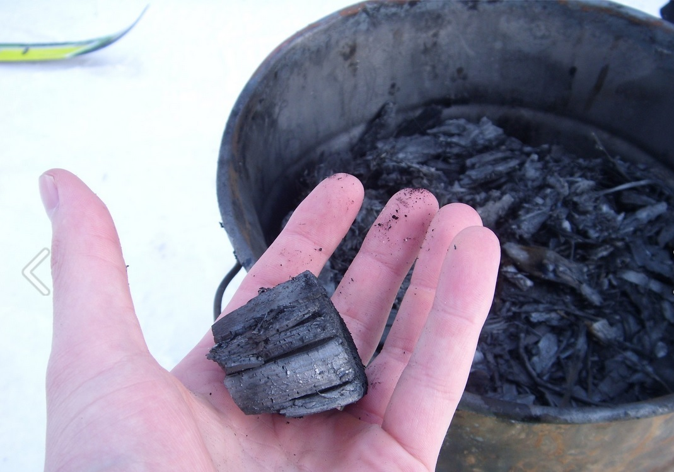

Options
Low compost media
Compost substitutes
  Peat
  Biochar
  Coir
  Wood chips

Slide 49
What we know so far
Compost has high nutrient value but leaches P if >~ 5%
Peat does not leach P, has good nutrient value, is not sustainable
Biochar does not leach P, does not retain P, has variable nutrient value
Coir does not leach P, does not retain P, has limited nutrient value
Wood chips do not leach P, has minor retention of P, has limited nutrient value
No silver bullet yet

Slide 50
Some research questions
What level of compost will not leach?
At that level, what are the effects on plants and media properties?
Are certain biochars an option?
Does age of compost matter?

Slide 51
3. Understanding pond design
Why do some ponds perform well and others poorly with respect to P retention?

Slide 52


Pond design and geometry
Deeper ponds (> 5 feet) are less likely to turn over, especially if influenced by chloride
Narrow, straight ponds are less likely to be well mixed
Heavily shaded ponds are less likely to mix properly
Taguchi et al., 2018

Slide 53
Pond sediments
Ponds that have not been properly maintained will decrease in P retention (>50% filled)
Ponds receiving high inputs of organic material appear more likely to have poor P retention
Gulliver, 2018 Water Issues presentation

Slide 54

Research needs
Continued research on pond design and geometry
A better understanding of geochemical and biological processes in stormwater ponds, particularly across different landscapes
Time-intensive studies vs. annual or seasonal studies

Slide 55
4. Source control and pollution prevention
Lawn maintenance and yard waste collection
Managing wildlife waste
Illicit discharges
Fertilizer management
Road salt management
Street sweeping
Waschbusch et. al (1999) found that lawns and roads contributed about 80 percent of total and dissolved phosphorus loading

Slide 56


Current credits for P removal with street sweeping are low
Chesapeake Bay
Florida

Slide 57
But there is limited guidance on when, where, and how to sweep
Janke et al., 2017
Selbig, 2020

Slide 58
We are working with U of M researchers, our contractor, and stakeholders to develop a sweeping credit and associated guidance
U of M completed the research and developed relationships between P content and sweeping material, including measuring protocol (Wednesday 14th presentation; U of M stormwater research seminar)
Our contractor is developing a simple tool that allows stormwater practitioners to sweep, measure, and plug info into the tool to determine P removal
Guidance on when and where to sweep, including measuring protocols, will be put into the MN Stormwater Manual

Slide 59

DRAFT

Slide 60
Recap
Dissolved phosphorus (DP) is much more bioavailable than particulate phosphorus
Most structural BMPs have not been effective for treating DP
BMPs can be amended to treat DP
Nonstructural practices can be effective for DP

Slide 61
We need to develop phosphorus management strategies and design our systems for phosphorus management

Slide 62
Hypothesis: What would a phosphorus management strategy look like?
Characterize runoff in the management area, including winter runoff and dissolved phosphorus
Implement infiltration practices where appropriate
Better design for filtration systems (media, amendments)
Timely, focused street sweeping in appropriate areas
Where feasible, focus pond design and O&M on P
Keep doing other stuff (pet waste, illicit discharges, fertilizer ban, road salt management. etc.)
Chemical treatment of runoff if necessary

Slide 63
Questions?

