Slide 1
Sump Maintenance Frequency
Clean all sumps/HDS spring & fall
Priority sumps: 3 times annually
Summer cleaning based on inspections, budget & weather
Maintenance timing
Isolator/Maintenance Row Maintenance Frequency

Slide 2
Sump Inspection & Maintenance Documentation
Sump Maintenance By | Avg. Staff Hrs./Sump | Cost Per Each Sump Cleaning
Contract Services (Nelson’s) | 1.10 Hrs. | $140 each
*Average last 3 years. ~375 cleanings per year

Slide 3
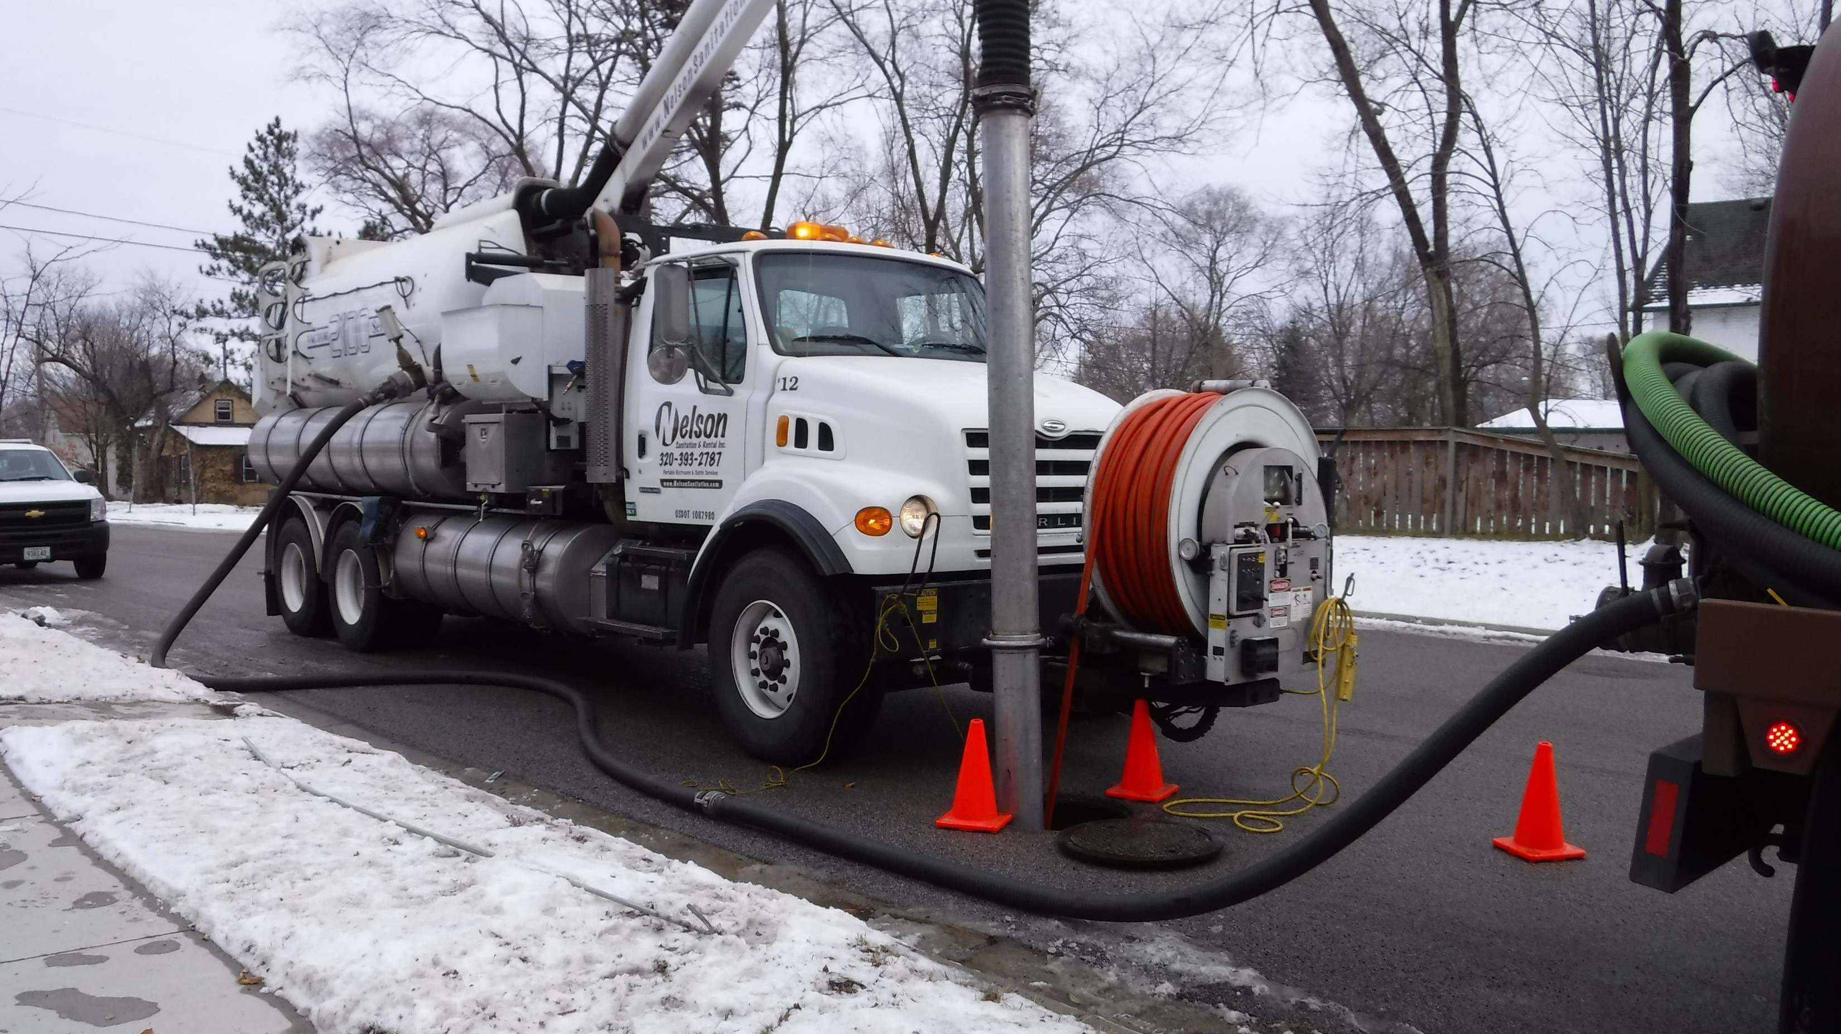

Slide 4
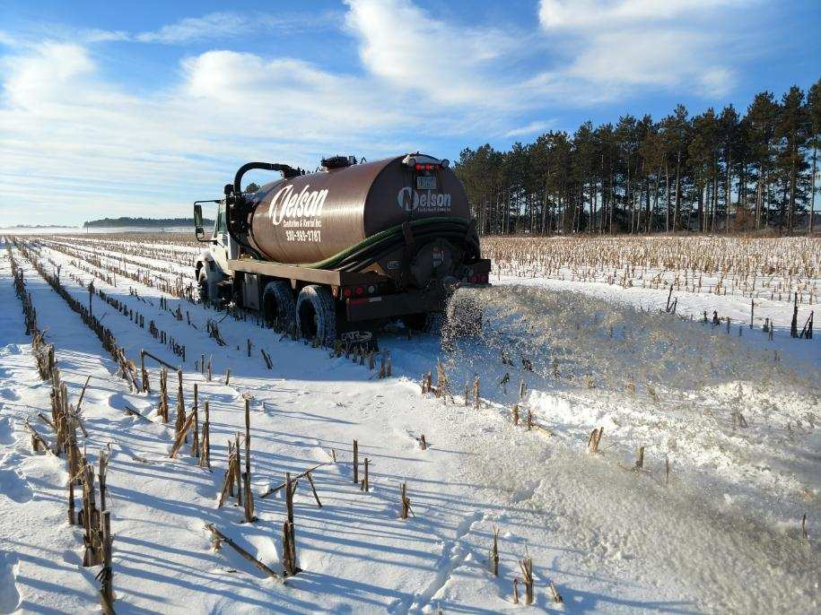
Maintenance Considerations
Water Management & Decant Water Disposal
Sanitary Sewer
Wastewater Facility
Surface filter area
Sump pump out
Other?

Slide 5
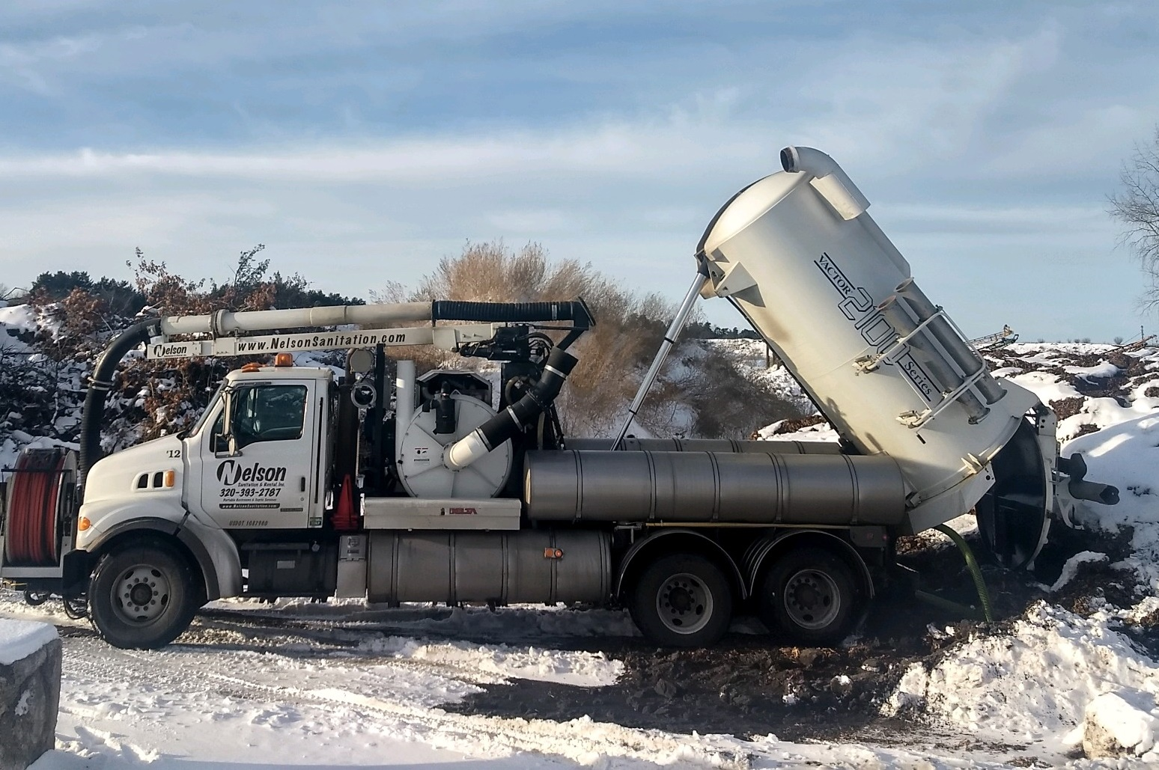
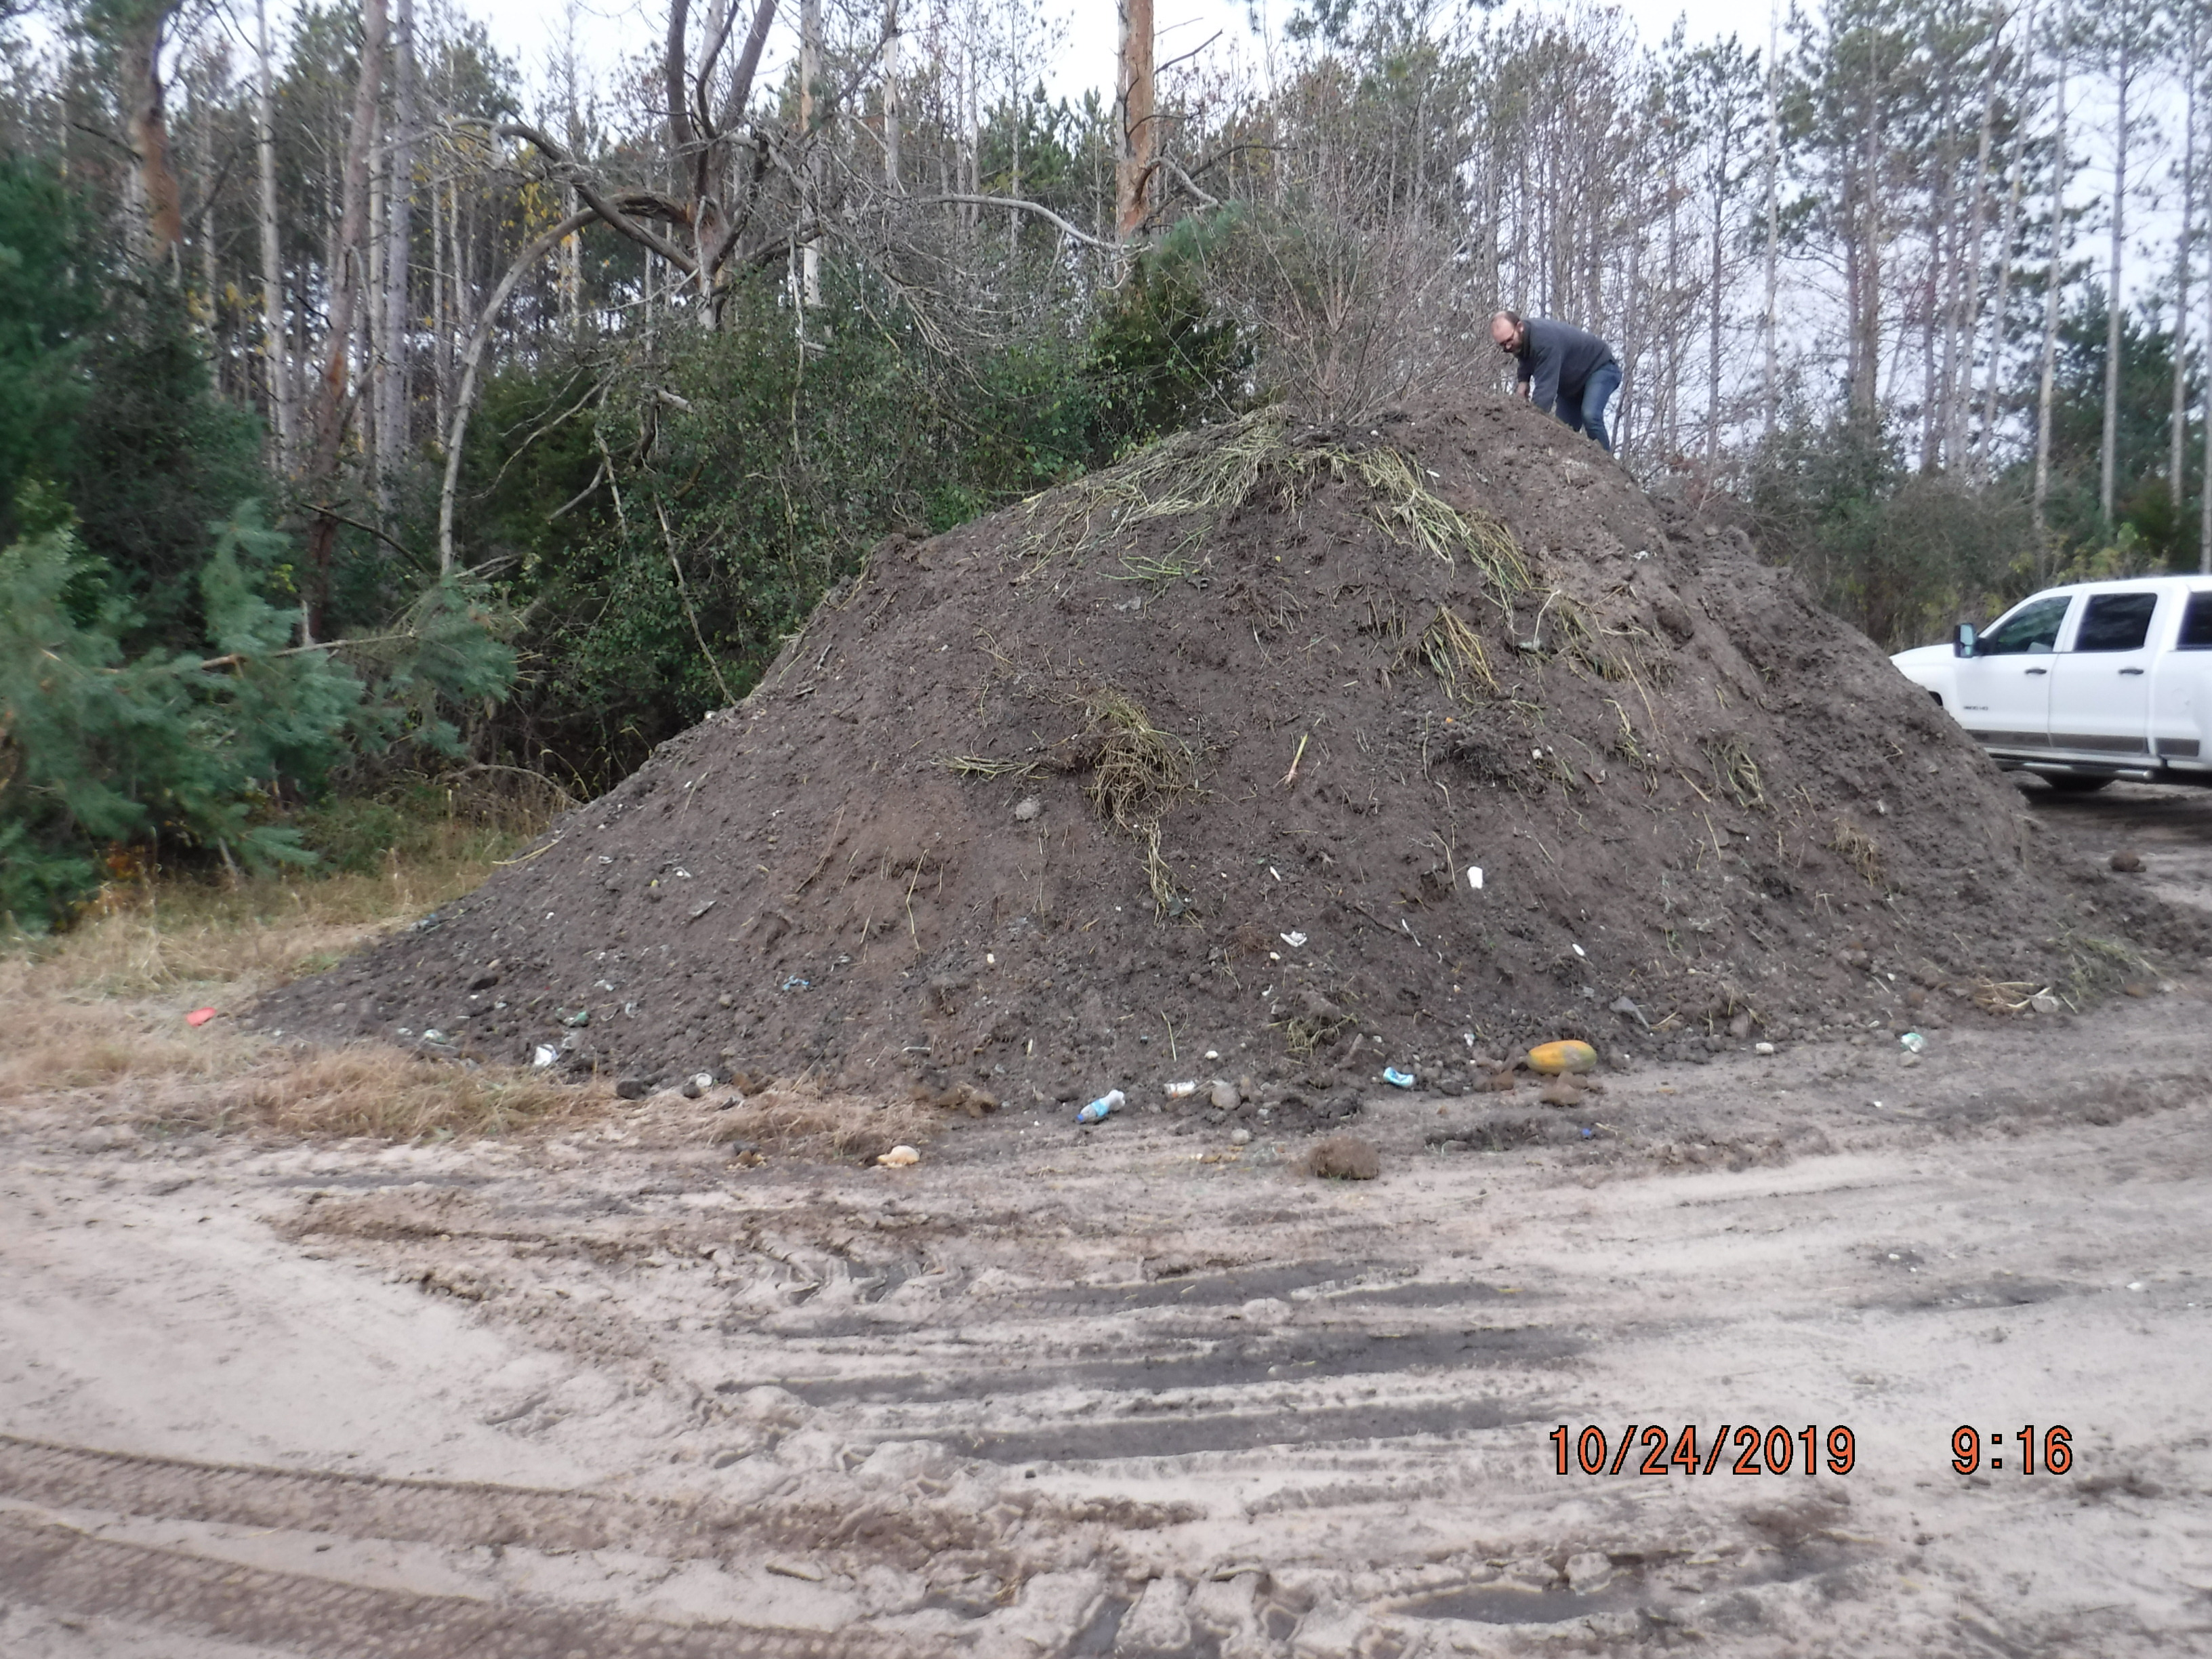
Maintenance Considerations
Solids Disposal - Requirements?
Contained Area
Reuse
Landfill

Slide 6
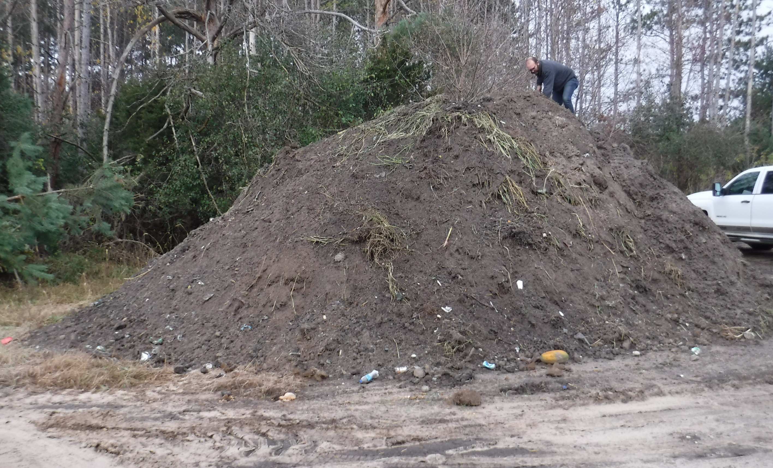
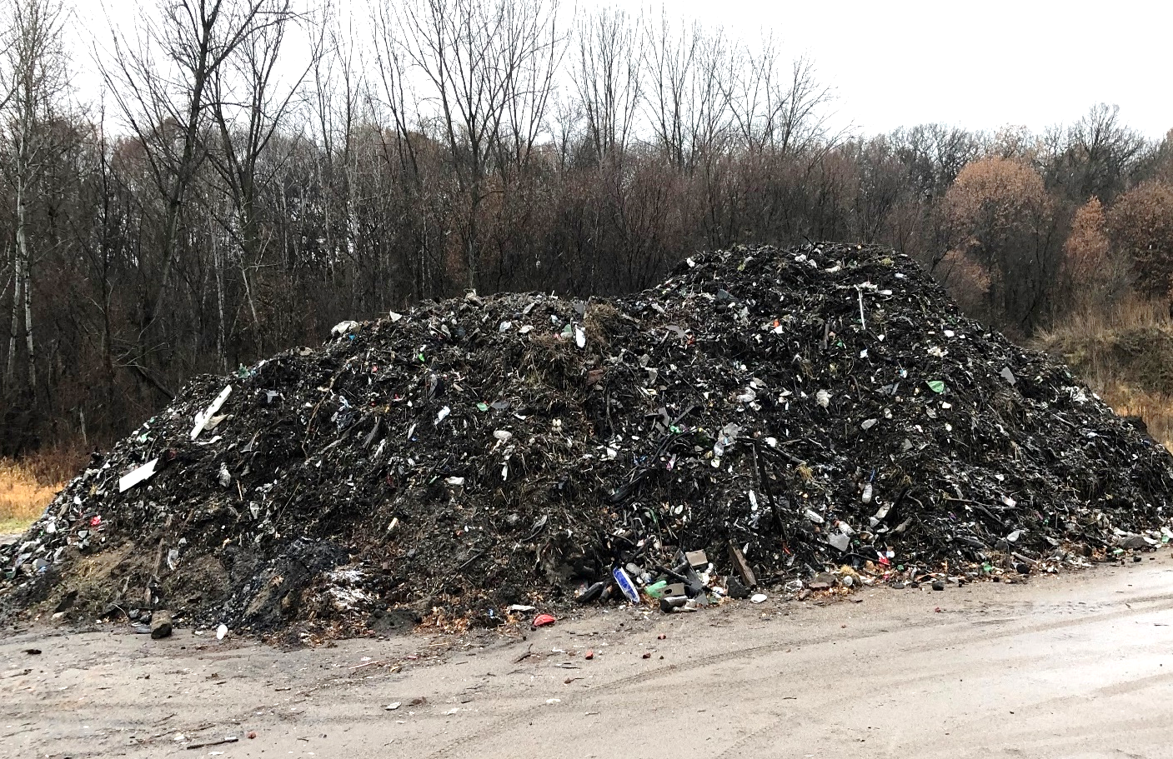
Landfill Disposal Requirements
Toxicity Characteristic Leaching Procedure (TCLP) analysis for 8 RCRA metals: Arsenic, Barium Cadmium, Lead, Mercury, Selenium, Silver.
DRO & Paint Filter Tests

Slide 9
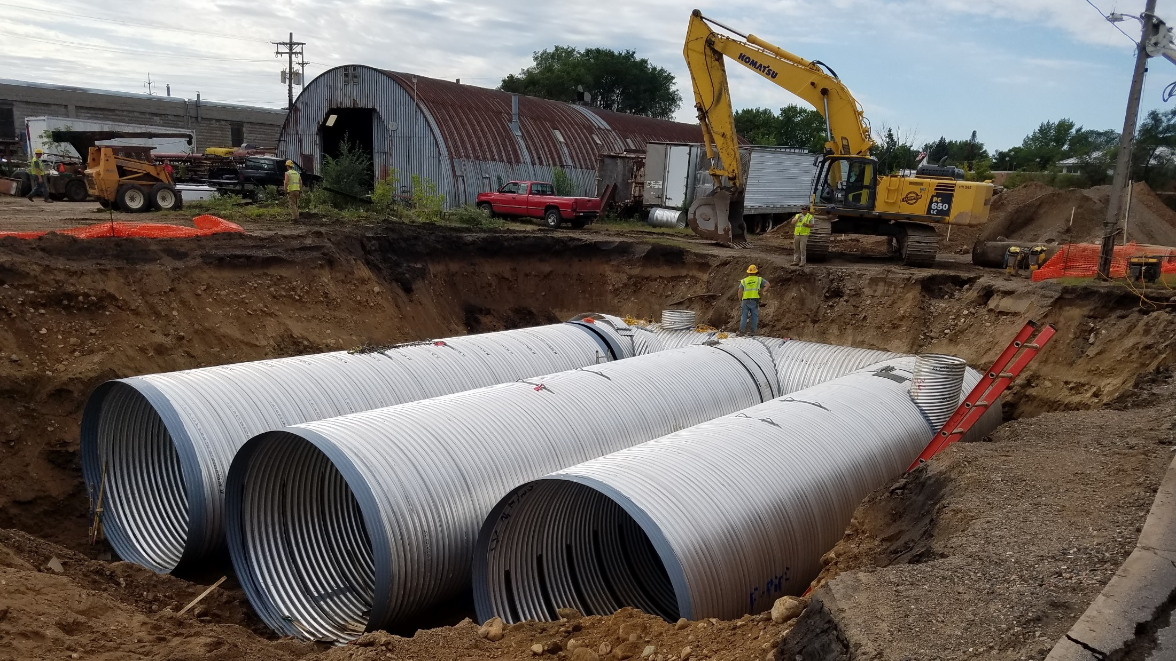

Slide 10
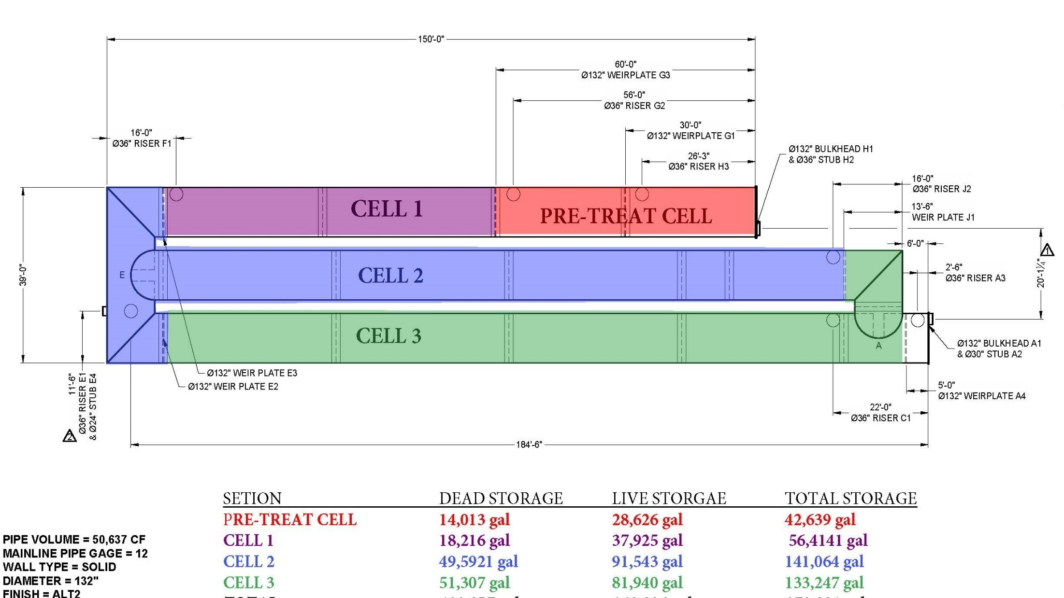

Slide 11
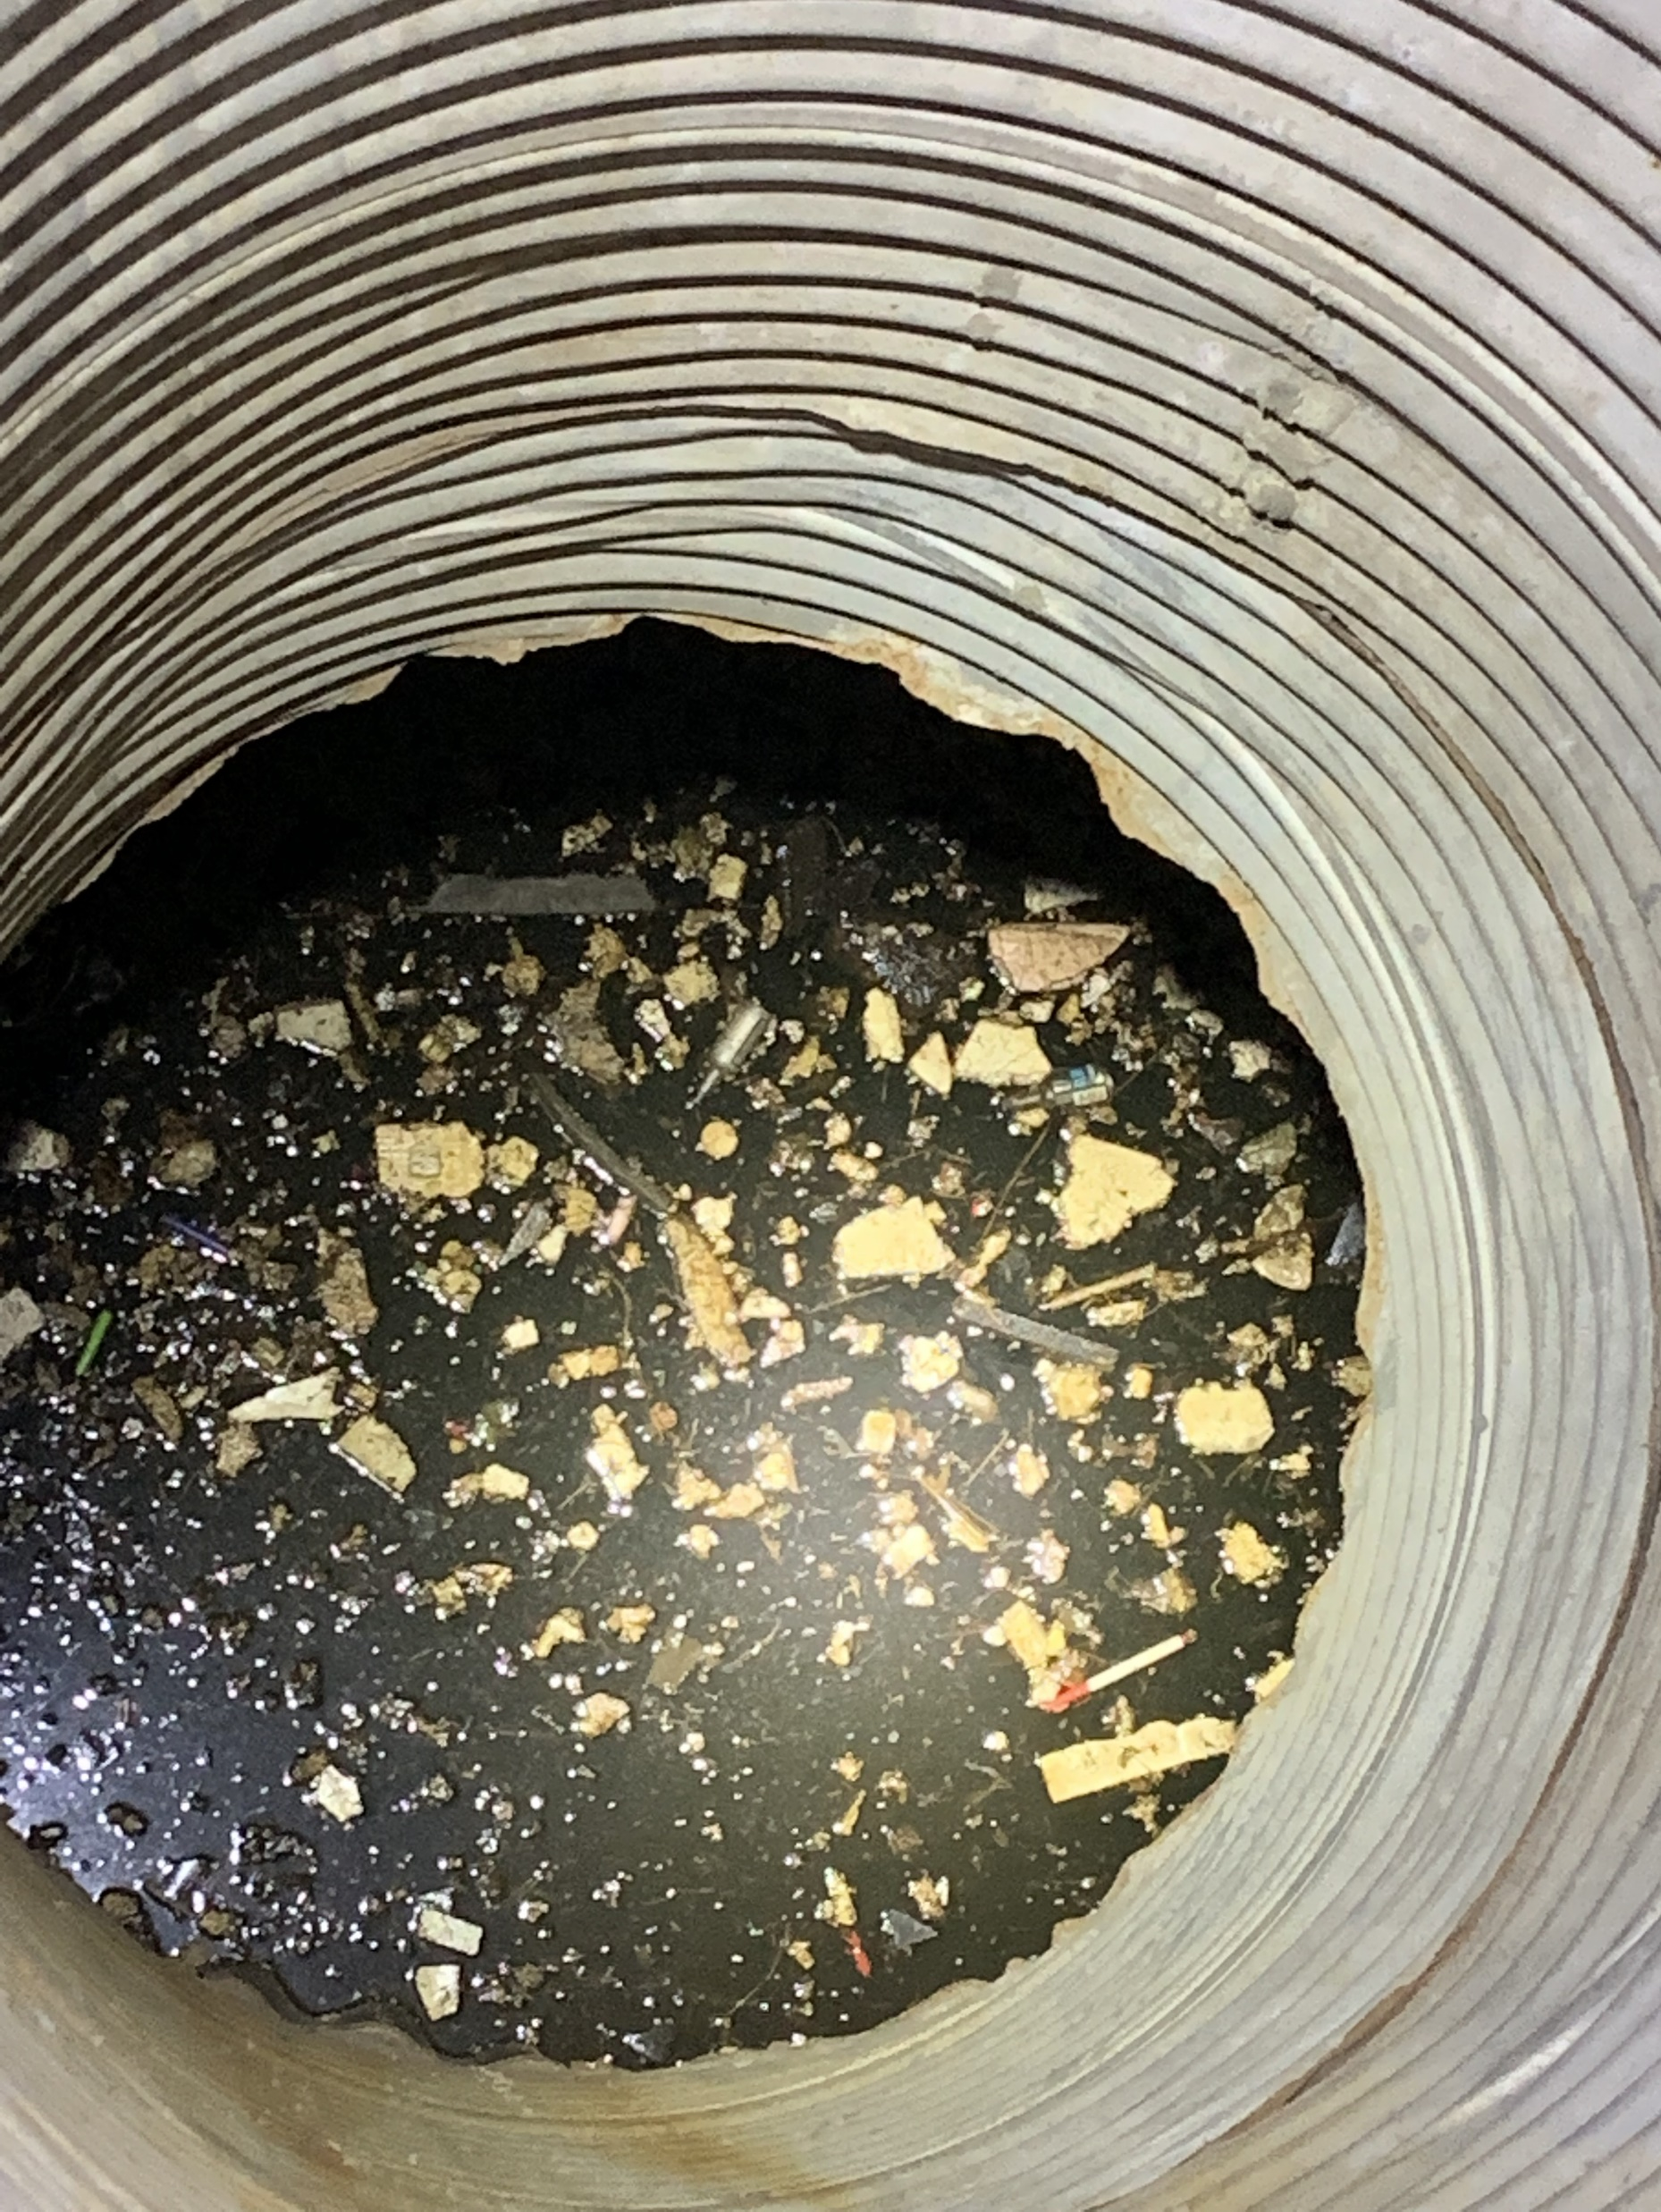
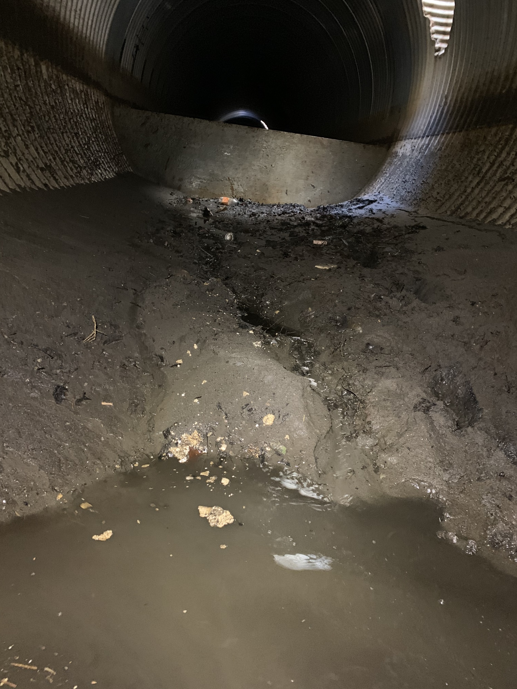

Slide 12
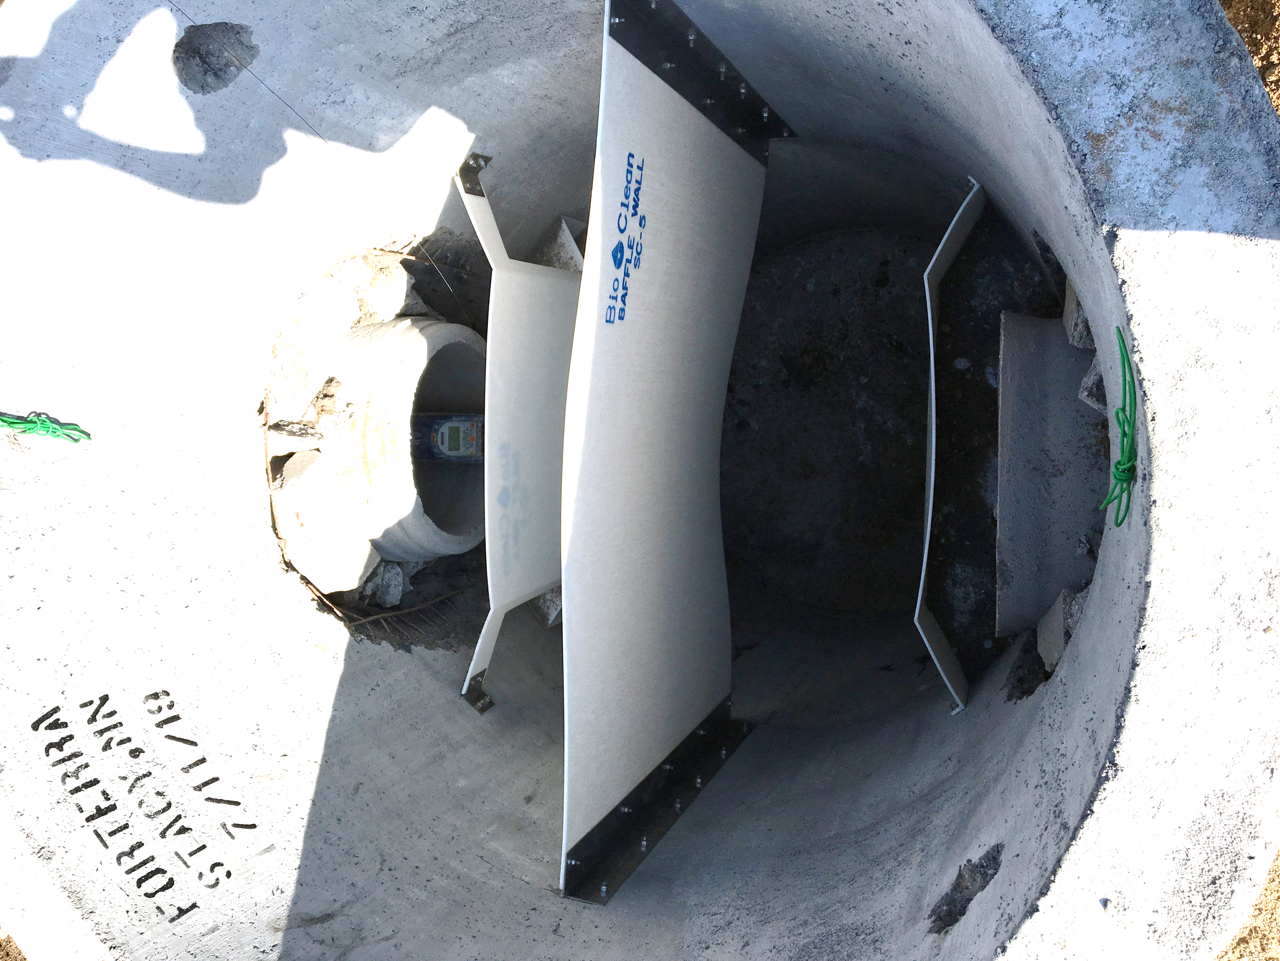
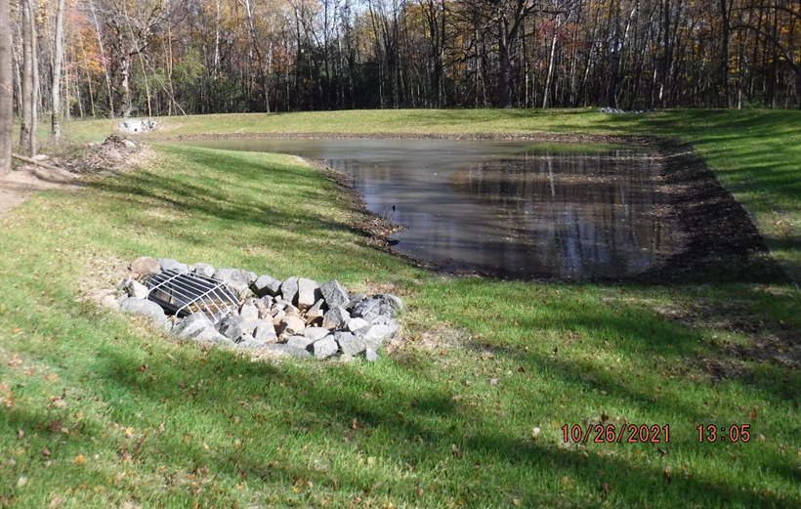
Pond Pre-Treatment
MIDS Design Level 3 Pond (TP = 60%)
Meets all design requirements for Levels 1, 2, 3.
Wet extended detention or multi-cell system
Sediment forebay at all major inflows
Flow path length to pond width ratio 3:1 to 10:1
WQV (flood pool volume) > 1.5 inch of impervious area
It is Highly Recommended that each pond have a sediment forebay or equivalent upstream pre-treatment (non-pond BMPs may serve as pre-treatment)

Slide 13
