Slide 1
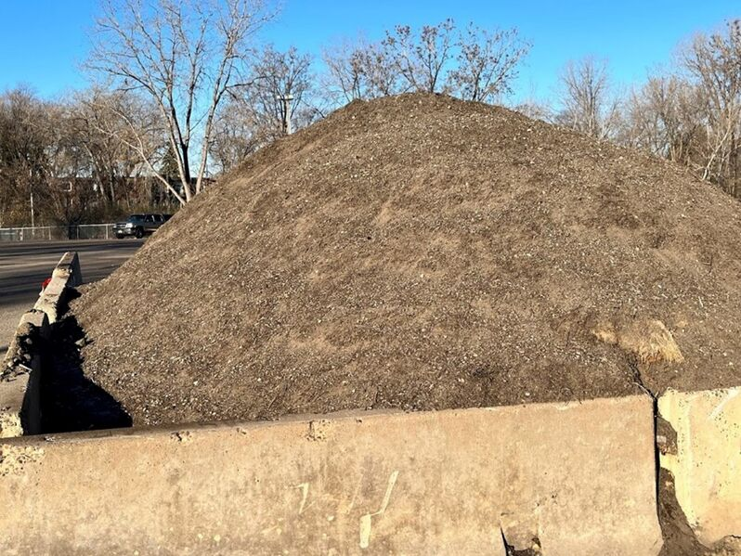
Disposal and reuse of street sweepings
Mike Trojan, MPCA
Clean Sweep Workshop
September 27, 2022
Courtesy: St. Anthony Village

Slide 2
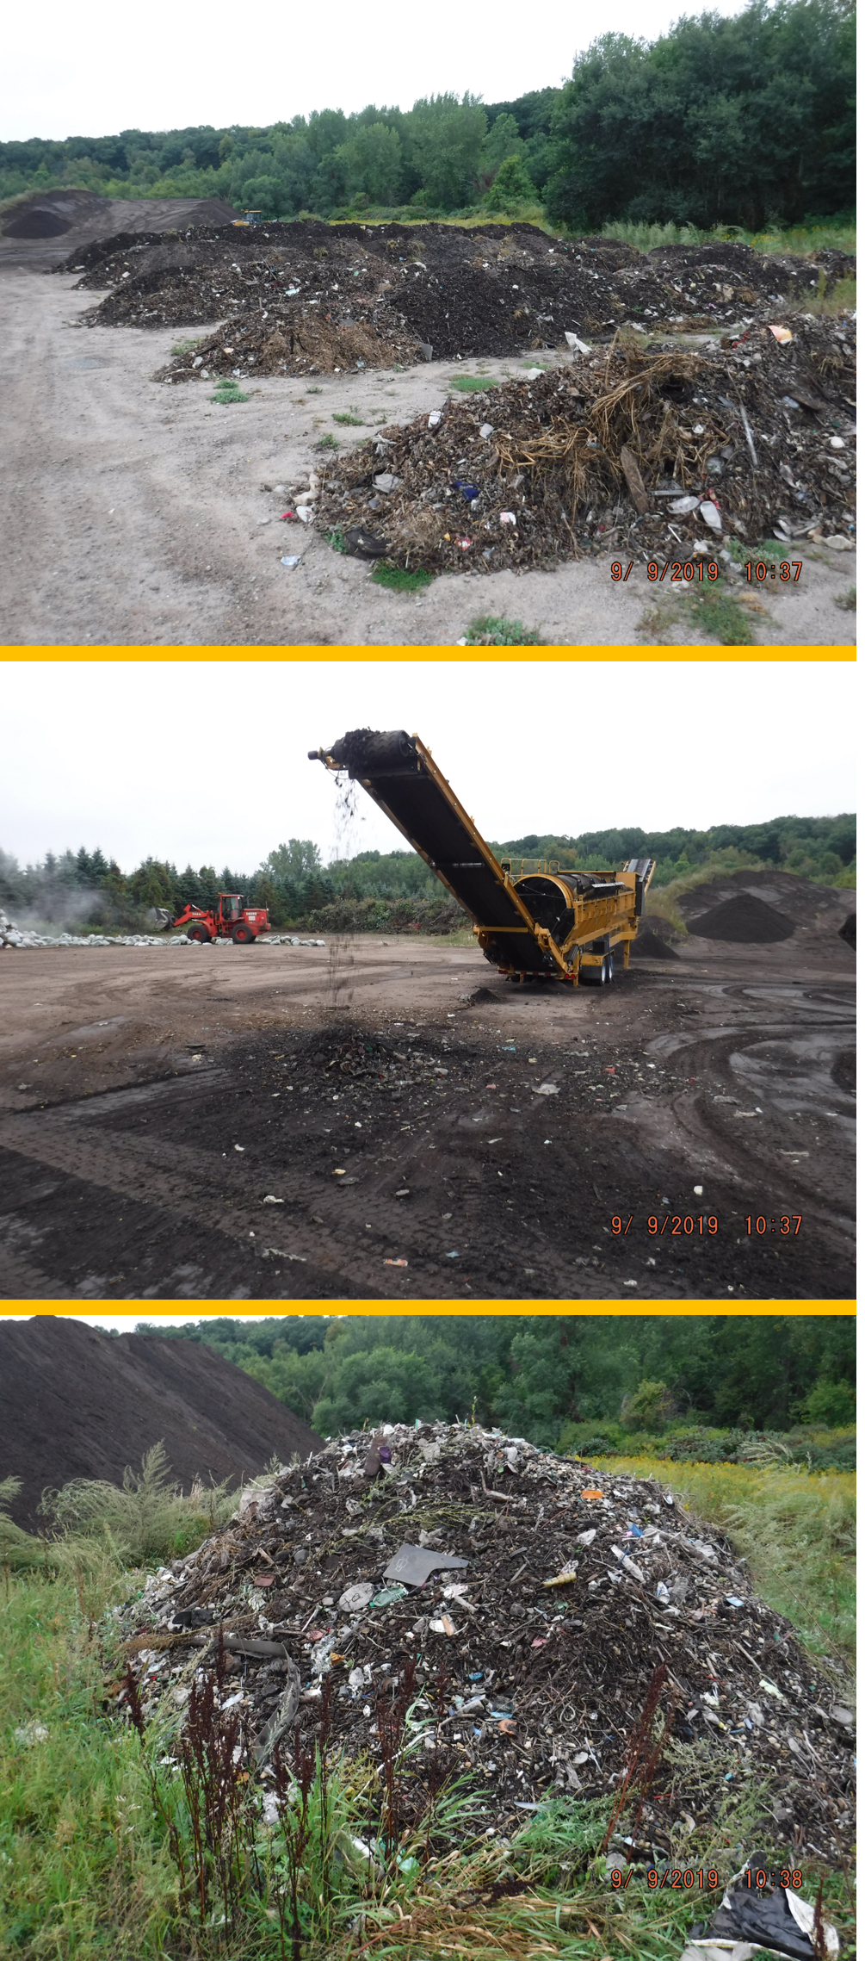
What’s in sweepings before separating and composting?
Trash, organic material, mineral material
Proportions of these varies with land use and season
Chemistry
Metals: Below levels of concern
Light-weight organics (oil): Elevated, often above levels of concern
Heavy organics (PAHs): Elevated, often above levels of concern
Nutrients: Enriched in N and P
Road salt: Below levels of concern
Courtesy: City of St. Cloud

Slide 3
Sweeping characteristics
Generally, higher concentrations of metals and organics as land use intensity increases, but daily traffic is a poor indicator
Generally, higher metal and organic concentrations as particle size decreases
Higher PAH concentrations in cool/cold seasons
While street debris/materials have been well characterized, detailed street sweeping characterization is limited
Courtesy: City of St. Cloud

Slide 4
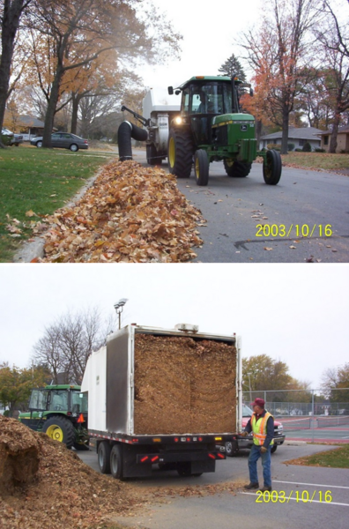
After separating and proper composting
Light-weight organics decrease below levels of concern
Heavier organics remain unchanged
Characteristics of organic fraction are an unknown
Courtesy: City of Mankato

Slide 5
MPCA Guidance
If unscreened and not separated
Classified as an industrial solid waste and disposed in landfill
Can be reused if screened to remove trash and organics
No longer considered a solid waste
Dispose trash in landfill
Cannot be used at playgrounds, residential yards, near drinking water supplies, karst areas
Acceptable uses
Winter road application
Daily cover at landfills
In commercial/industrial/road restoration/construction projects
Other uses not discussed

Slide 6
Storage, screening, testing – very little in literature
Storage
Observe setbacks
Covered or contained
Controlled location near collection areas
Maximum storage times 6-12 months
Screening
¾-1 inch mesh to screen debris (trash, brush, etc.)
Little guidance beyond this
Testing
Not required unless from spill sites, hazardous waste cleanup sites, or other contaminated areas
Protocol may be needed, but we would first like to know what is in the organic fraction

Slide 7
Survey - 100 responses, all but 2 from cities

Slide 8
Challenges of increase sweeping

Slide 9
Management options – strategies to explore
Centralized collection/storage
Can screened/composted material be used?
Commercial use
Residential use
Stormwater applications
Land application
Other
Energy source

Slide 10
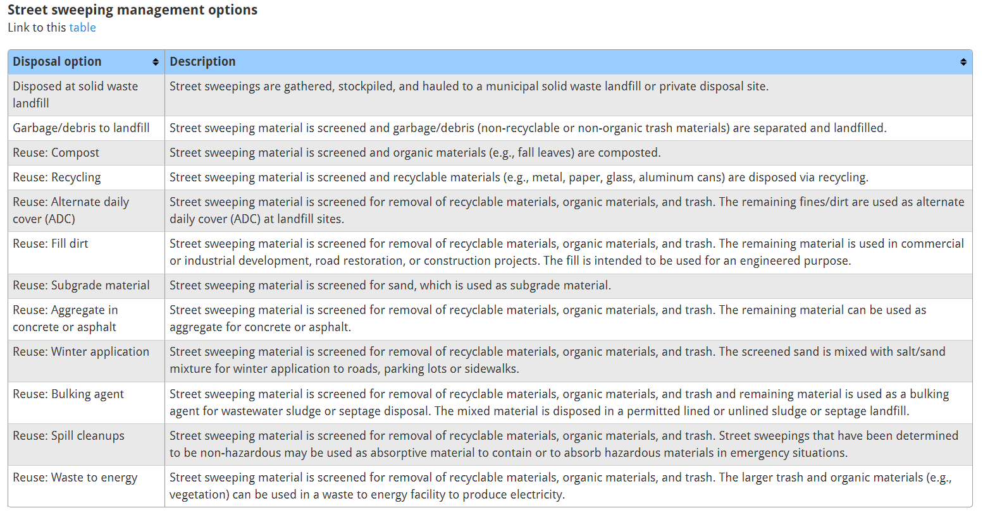
Where to find things in the stormwater manual wiki
Composition, characterization, and management of street sweepings
Street sweeping
Or see list developed for this workshop

Slide 11
Possible needs
Screening protocol
Testing of organic fraction
Testing protocol
Storage options
Reuse options

