Slide 1


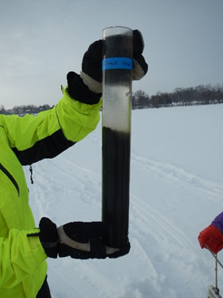
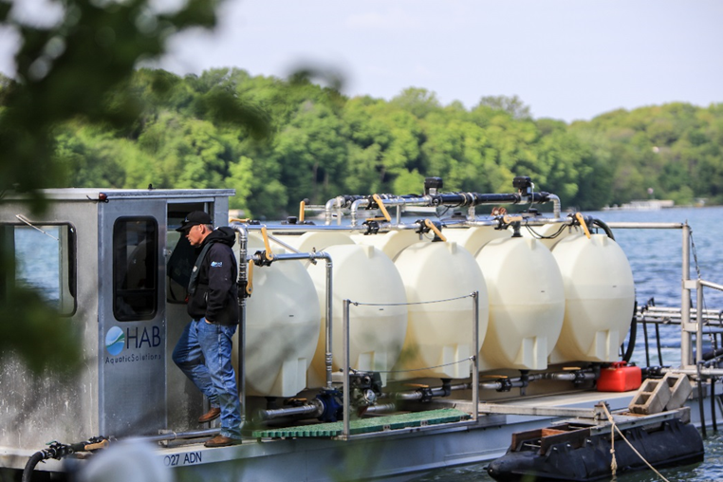
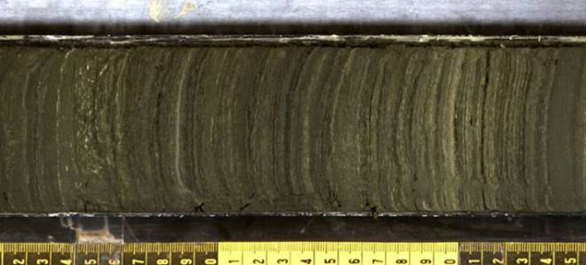




Limitations of Using Stormwater Ponds for Phosphorus Control
Joe Bischoff
Brian Beck
Bill James
January 9, 2017

Slide 2








Slide 3
Presentation Objectives
Overview of Watershed Phosphorus Cycle
  Sources and management
Constructed Ponds and Stormwater Wetlands as Phosphorus Sinks
  General design
  Sediment phosphorus burial and release
  Implications for watershed phosphorus loading
Understanding and Managing Watershed Sediment Phosphorus Pools
  Modeling approaches for identifying sediment P sources
  Management approaches for sediment P sources

Slide 4
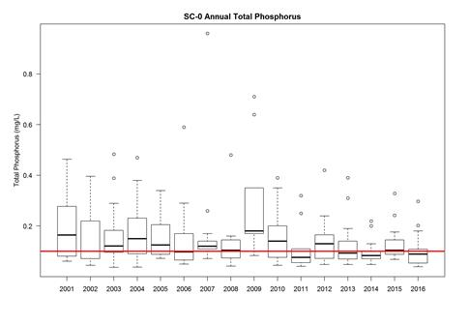
The Problem
Shingle Creek Outlet
Shingle Creek Watershed Management Commission
Since 2005, $12 million invested in water quality projects
Municipal retrofits, $2.7M
MNDOT and County water quality projects, $2M
Total Phosphorus (mg/L)
Year
Notes:
Even with heavy investment in watershed BMPs and source management, often little progress is made in reducing watershed P loading
So, how do we move forward

Slide 5
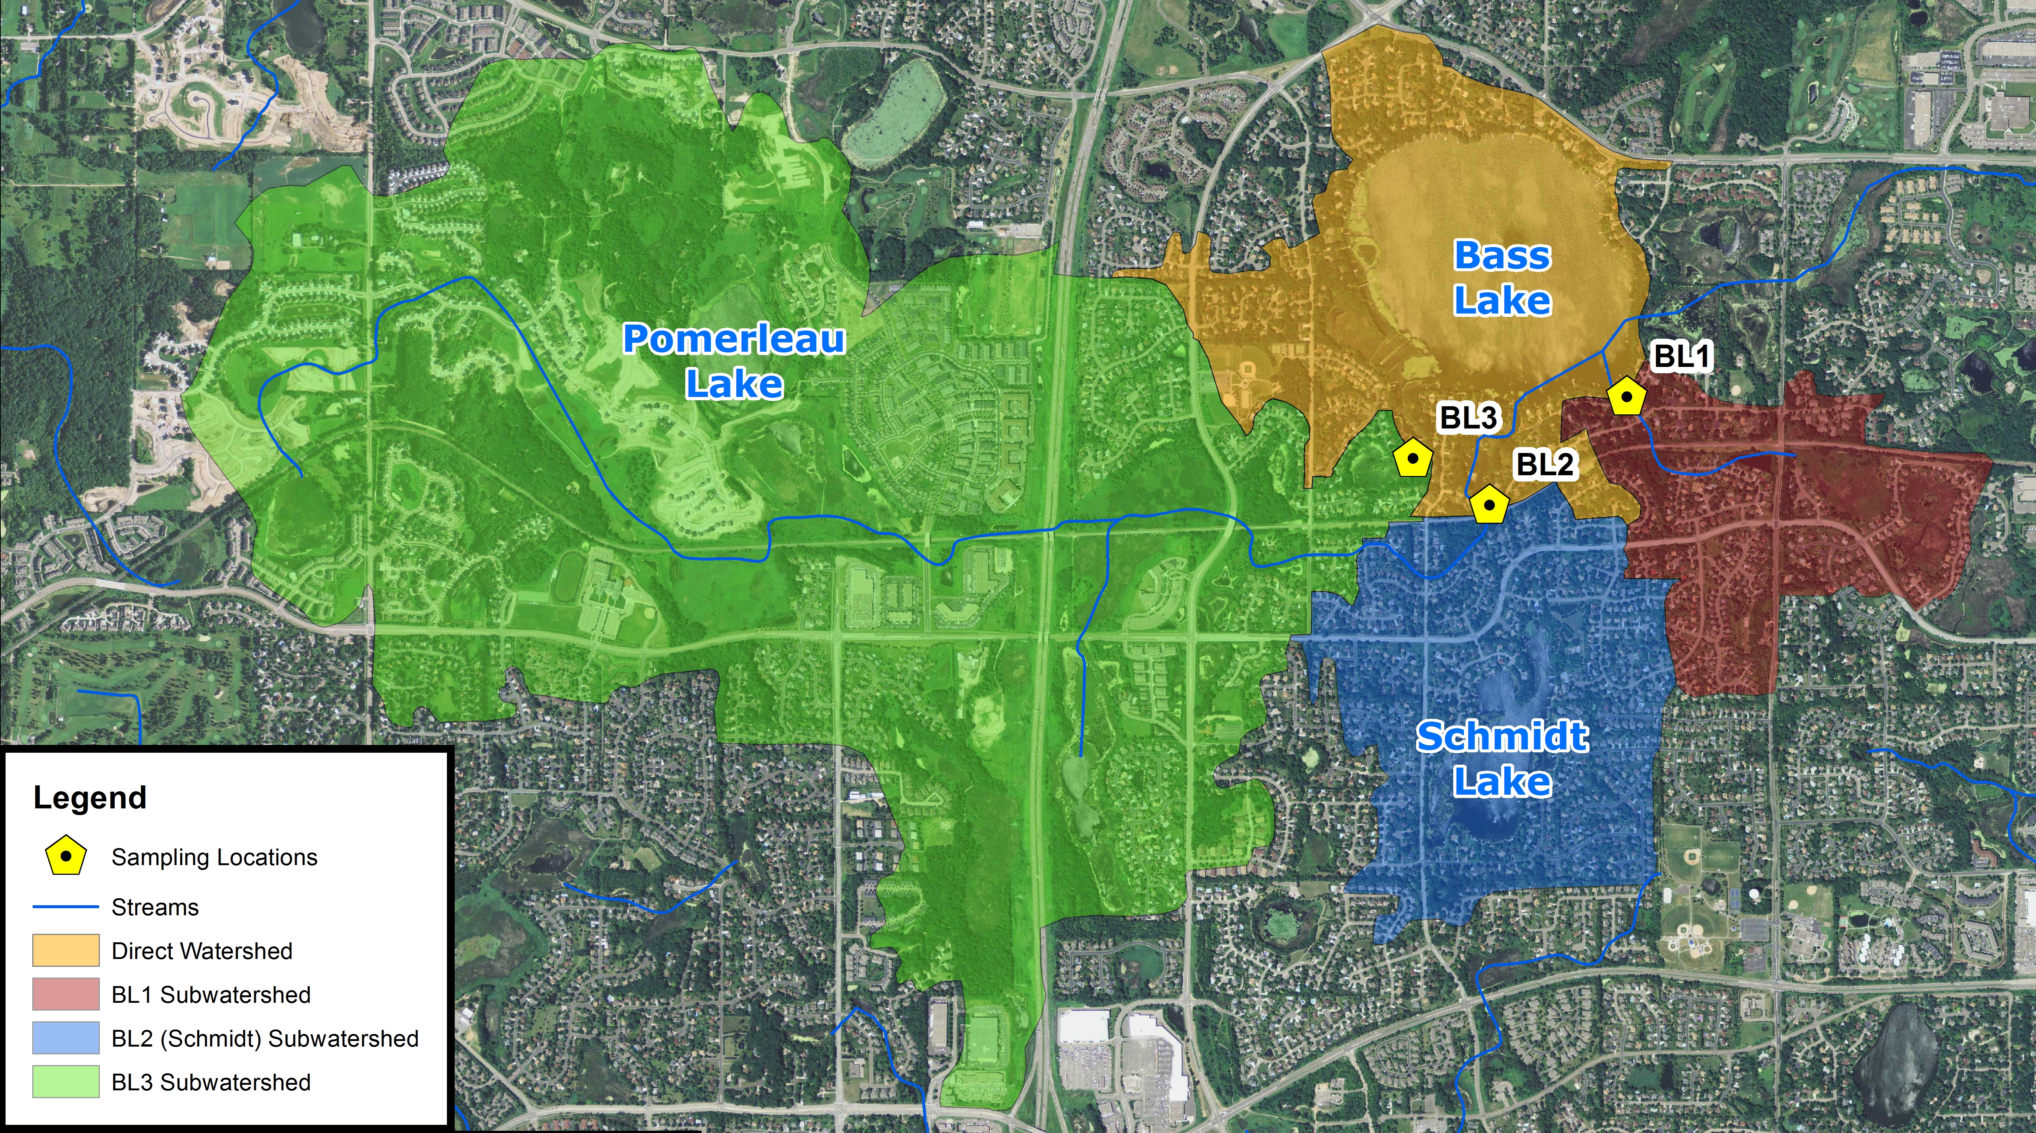
2015 only
TP = 170 µg/L
SRP = 63 µg/L
TSS = 6.5 mg/L
2010-2012
TP= 243 µg/L
SRP = 101 µg/L
TSS = 18 mg/L
2010-2012
TP= 199 µg/L
SRP = 108 µg/L
TSS = 62 mg/L
Bass Lake Watershed Phosphorus Reduction Project (5-year TMDL review monitoring)

Slide 6
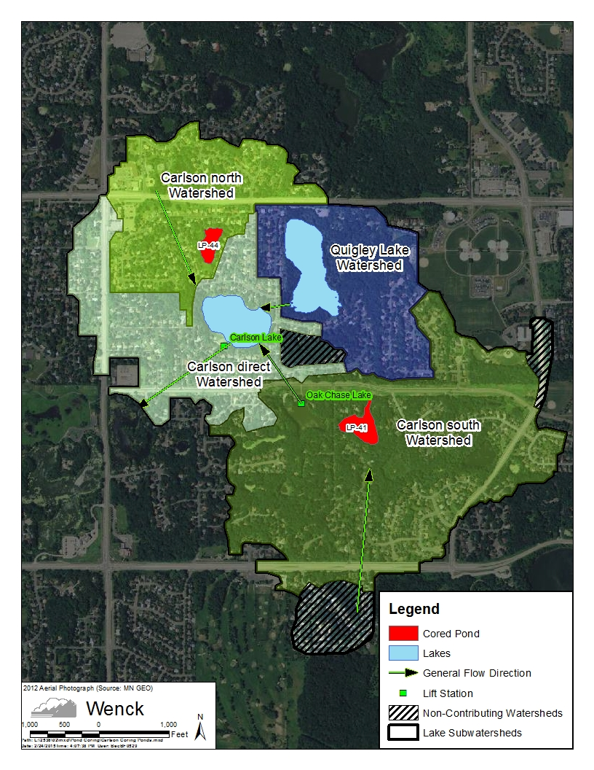
Watershed Phosphorus Management
The Traditional Stormwater Paradigm
Phosphorus Source Management
  Phosphorus fertilizer ban
  Homeowner best practices
    Grass clippings, runoff management
  Street sweeping
Provide phosphorus sinks in the watershed
  Constructed ponds to settle particulate phosphorus
  Wetlands to settle and adsorb phosphorus
  Rain gardens and biofilters
Notes:
Map of watershed with ponds

Slide 7
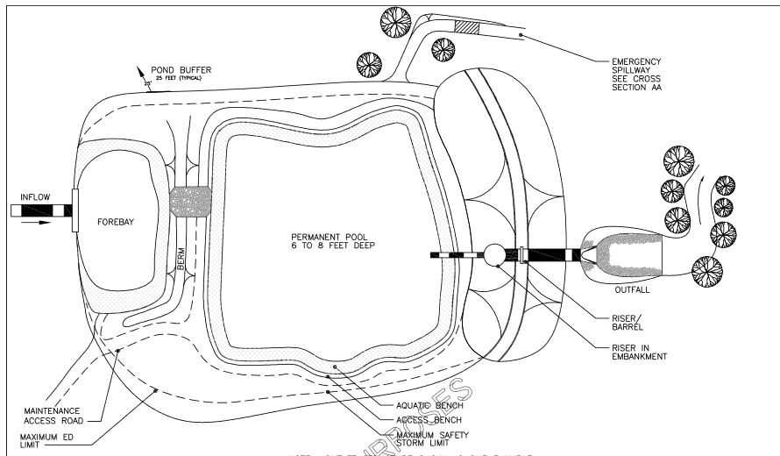
Standard Constructed Pond Design
A 4-foot mean depth and volume equal to the runoff volume from a 2.5-inch, 24-hour rainfall event over the watershed, or 1800 cubic feet per acre of drainage to the basin, or 3600 cubic feet per acre of drainage area for enhanced phosphorus removal.
Source: Minnesota Stormwater Manual
Notes:
Where phosphorus load reductions are a priority, it is Recommended that a maximum depth of 8 feet be used, to limit the likelihood of stratification and the potential for bottom sediment to release phosphorus.

Slide 8
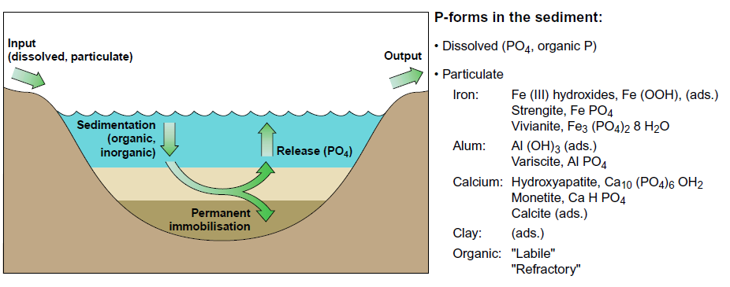
Sediment Phosphorus Cycle
Sondergaard et al. 2001

Slide 9
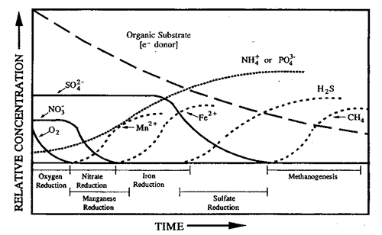
What is Causing Sediment Phosphorus Release?
Sediment Redox Reactions
Anoxic Conditions
Release of Phosphorus
0
-
2
-
-
4
-
6
Sediment depth (cm)
-
8
-
10
-
12
-
14
Burial of phosphorus
-
16
0
1
2
3
Mobile Phosphorus (mg/g)
Redox
-
-
1
Notes:
Historic equilibrium phosphorus concentrations represent a balance between burial and release
Elevated phosphorus in sediment will diffuse into surface waters
This cycle will continue until the sediment phosphorus peak is reduced

Slide 10
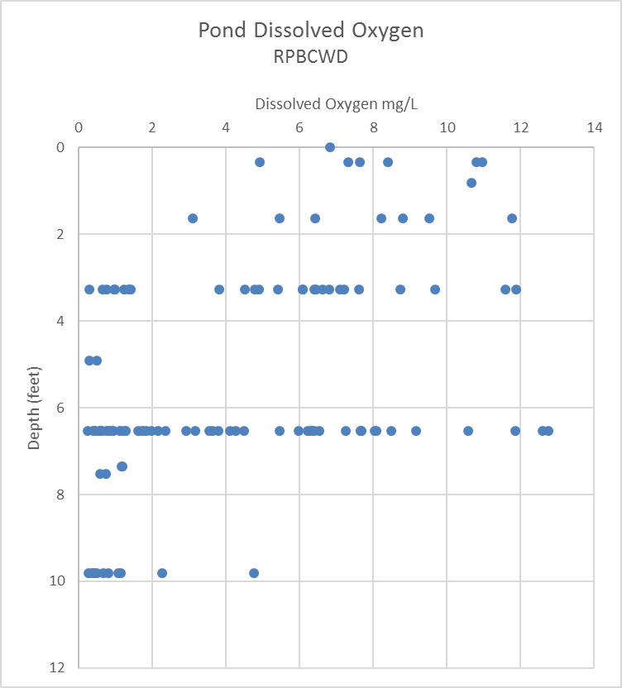
Anoxia in Stormwater Ponds and Wetlands
Pond Monitoring
6 stormwater ponds and wetlands in Chanhassen and Eden Prairie
Monitored May through August
Anoxia observed as shallow as 3 feet in ponds
Source: Riley Purgatory Bluff Creek Watershed District 2013 Pond Monitoring Report

Slide 11
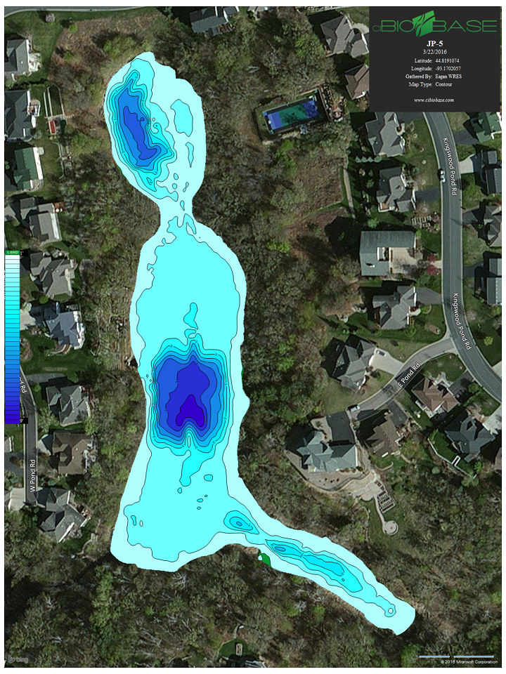
Eagan Pond JP-5
Receives discharge from Fish Lake
Discharges to Blackhawk Lake
Pond is undersized
Max depth of 8 feet
Concerned adding phosphorus to discharge and inadequately treating watershed runoff
7
6
5

Slide 12
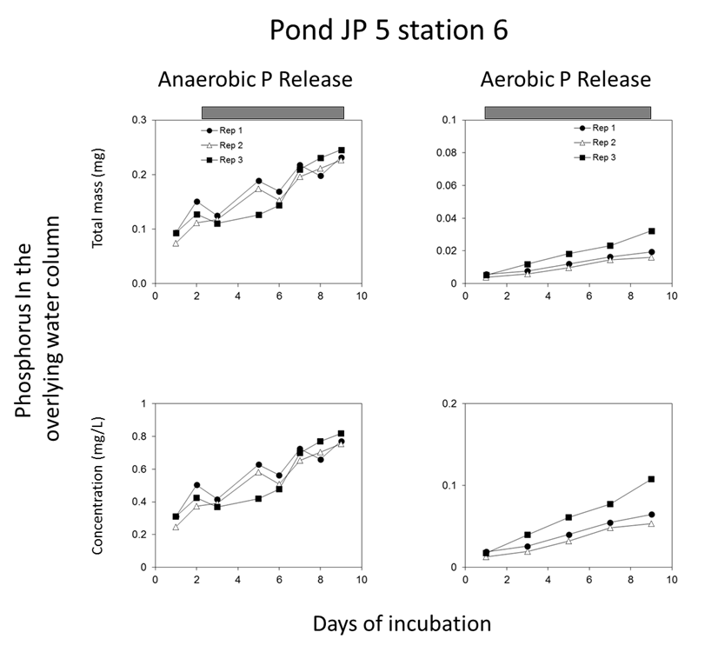
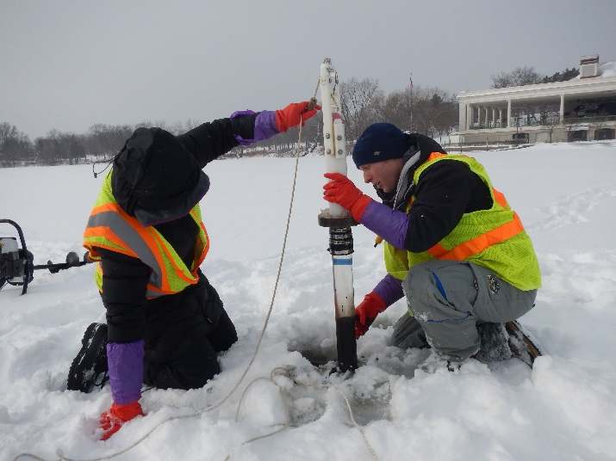
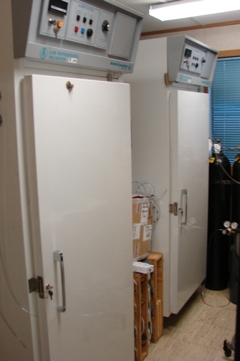
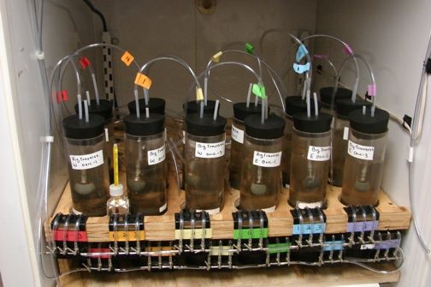
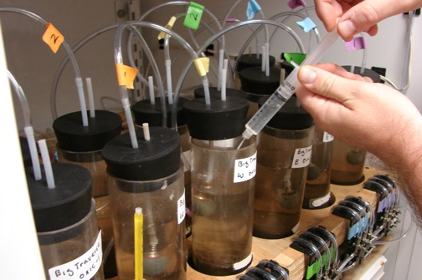
5.2 mg/m²/day
0.6 mg/m²/day

Slide 13
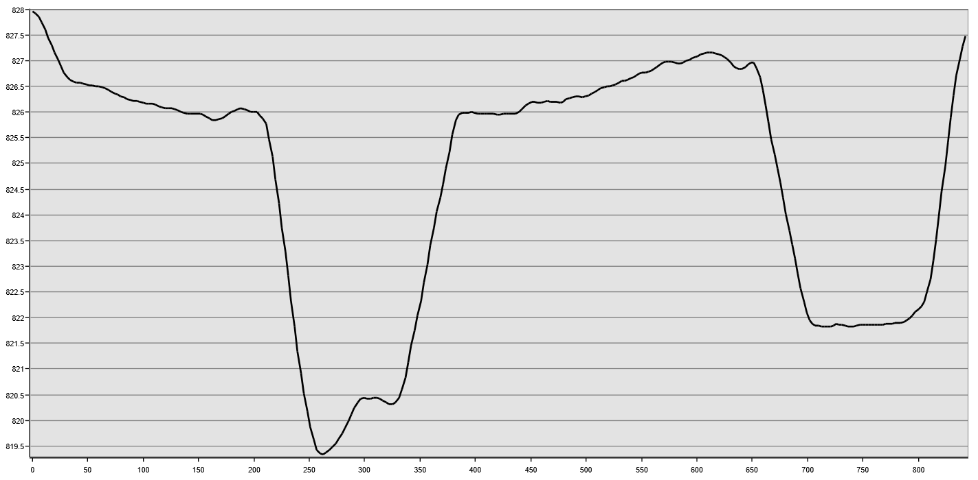
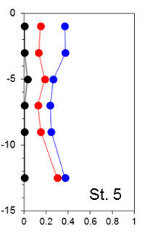
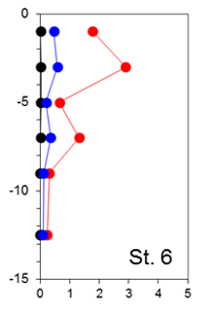
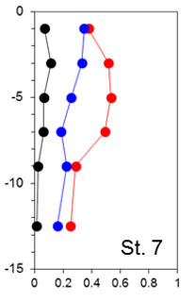
Pond/Stormwater Wetland JP-5
City of Eagan
Mobile P (mg/g)
Mobile P (mg/g)
Mobile P (mg/g)

Slide 14
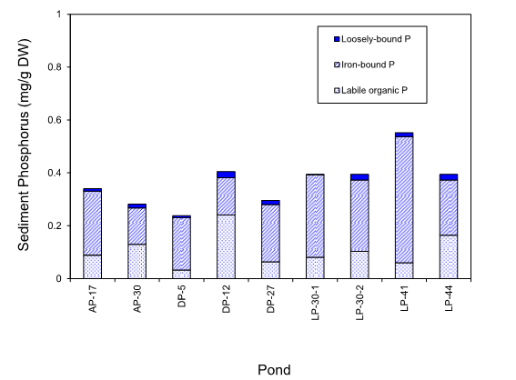
Urban Pond Sediment Chemistry
City of Eagan

Slide 15
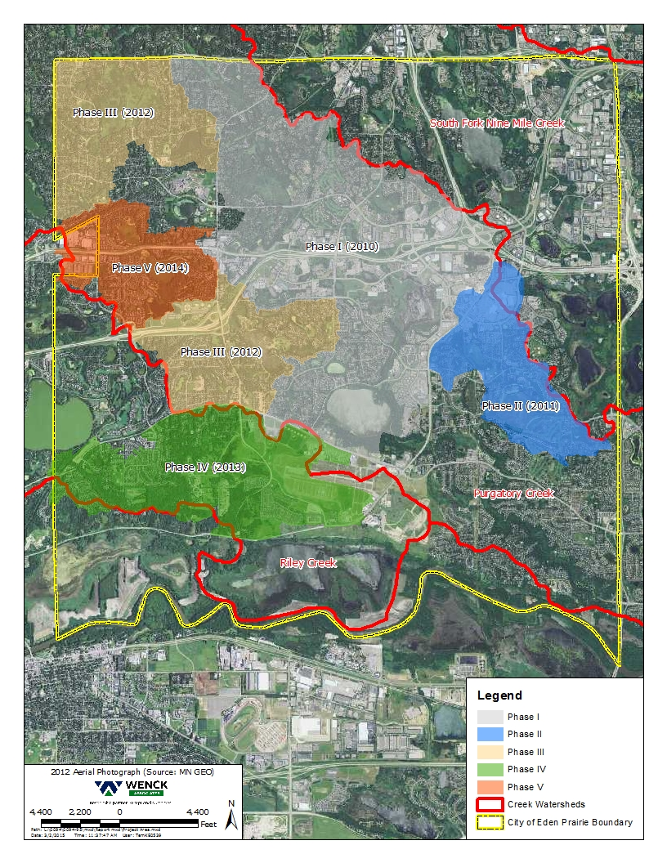
Pond Inspection Program
Eden Prairie, Minnesota
MS4 Permit requires annual inspection of stormwater ponds
  Identify those with maintenance issues
  Identify ponds that are losing dead storage and settling effectiveness
  Identify critical ponds in treatment train
  Over 1,400 stormwater ponds and wetlands
    Mix of private and public ownership
  Systematically working through City
  Almost $1,000,000 in inspection costs

Slide 16
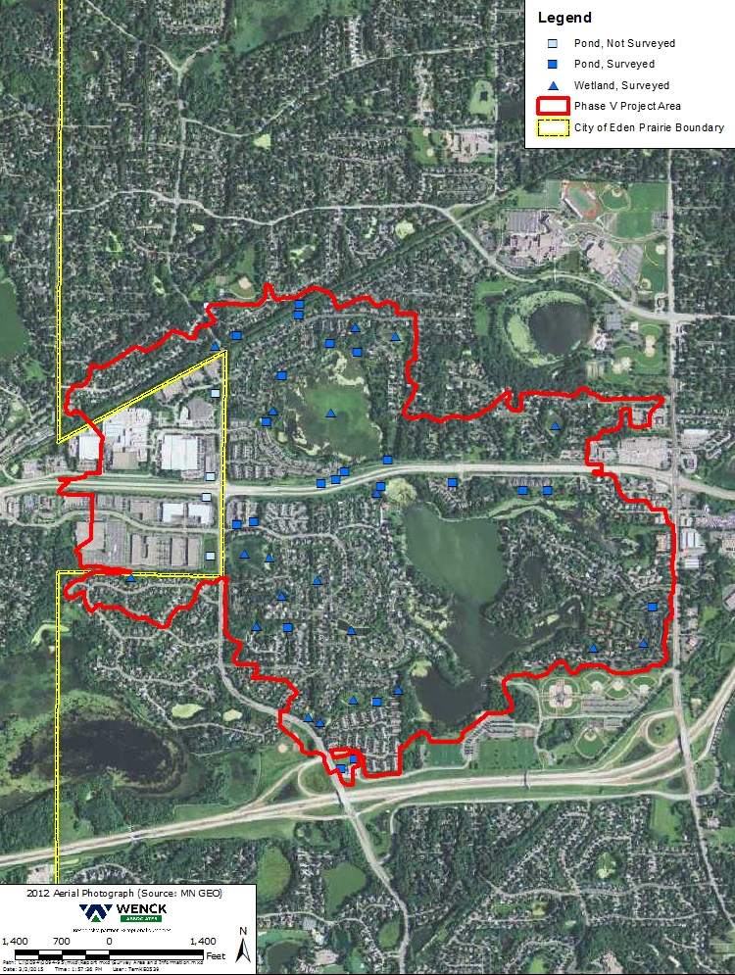
Mitchell Lake Watershed
Parameter | Mitchell Lake
Surface Area (acres) | 120
Average Depth (feet) | 5.0
Maximum Depth (feet) | 20
Volume (acre-feet) | 598
Residence Time (years) | 0.7
Littoral Area (acres) | 120
Littoral Area (%) | 100%
Watershed (acres) | 943
Stormwater Ponds | 45
Mitchell
Lake

Slide 17
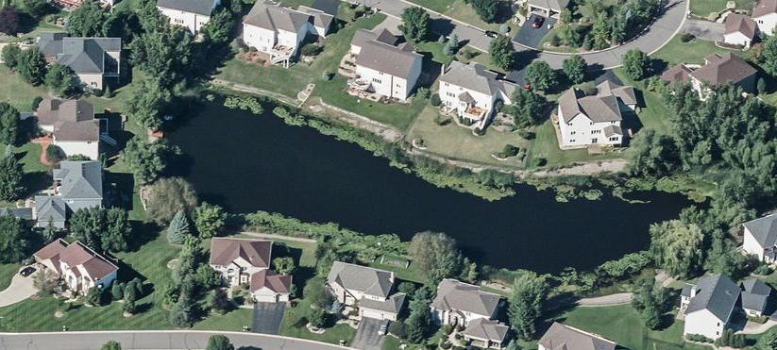
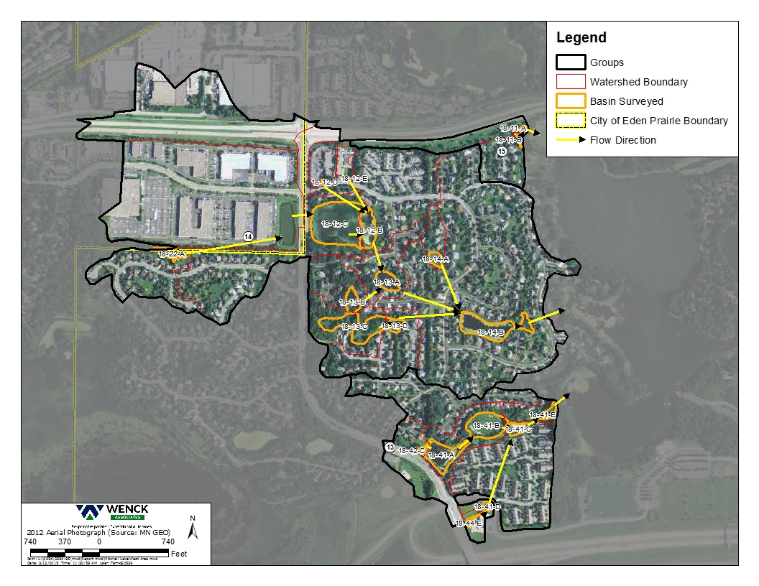
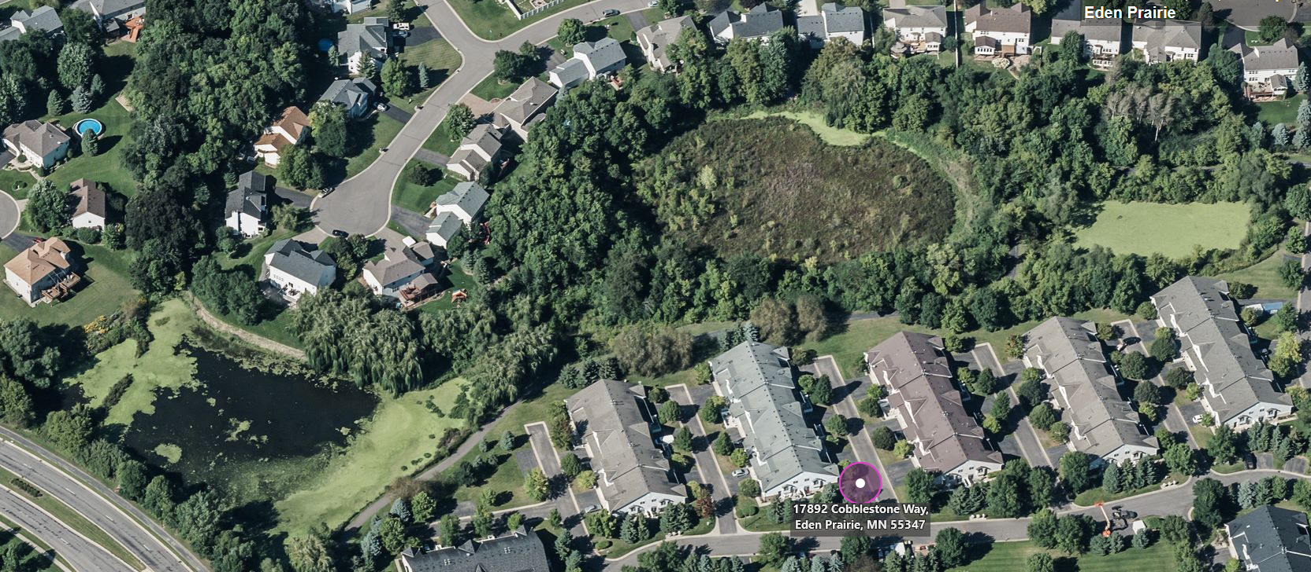
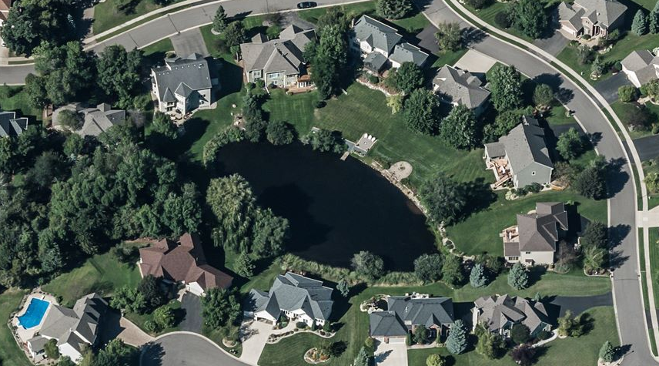
Mitchell Lake Subwatershed
Eden Prairie, Minnesota
18-14-B
Mitchell
Lake
18-41-B
18-13-A

Slide 18
Pond Inspection Results
Basin ID | Pond Type | Surveyed Permanent Pool Volume (AF) | NURP Ratio¹ | P8 TP Removal (%) | P8 TP Concentration (µg/L) | Monitored TP Concentration (µg/L)
18-41-B | Stormwater Wetland | 1.45 | 4.7 | 33 | 105 | 1,912
18-13-A | Stormwater Wetland | 1.24 | 1.0 | 12 | 153 | 335
18-14-B | Stormwater Wetland | 10.16 | 1.5 | 26 | 134 | 254
07-43-A | Constructed Pond | 2.3 | 1.3 | 55 | 136 | 720
¹ The NURP ratio is based on the cumulative area and dead storage to account for basins in sequence. Values over 1 exceed NURP standards and values under 1 do not meet NURP standards.

Slide 20
Assessment Approaches
Modeling Considerations
City of Eagan Ponds | LP-41 | LP-44
Pond Area (acres) | 4.8 | 2.4
Pond P release (lbs/yr) ¹ | 9.7 | 4.9
Pond TP Sedimentation (lbs/yr) ² | 8.6 | 6.5
Sediment Redox P (pounds) | 728 | 33
Sediment Mobile P (pounds) | 1,295 | 227
¹ Assumes release of 5 mg/m²/day and 45 days anoxia
² 2008-2012 average using PondNet
    City of Eagan, MN has over 1,200 Stormwater wetlands and constructed ponds over 34.5 square miles

Slide 21


Management of P Release in Stormwater Ponds
Sediment Excavation and Disposal
Increase dead storage to improve settling
Remove high phosphorus sediments
Sediment Phosphorus Inactivation
Aluminum, iron, lanthanum
Dissolved Oxygen Management
  Eliminate anoxic release of sediment P
Notes:
Implications for watershed phosphorus loading

Slide 22
Sediment Removal and Disposal
Basin ID | Estimated Excavation Costs | Priority | TP Reduction | Cost per pound P removal
 |  |  | (lb/yr) | $
14-43-A | $69,000 | Medium | 0.3 | $7,667
14-34-A | $81,000 | High | 1.4 | $1,929
24-33-A | $110,000 | High | 0.9 | $4,074
24-33-C | $195,000 | Medium | 0.8 | $8,125
Excavation for improved settling efficiency
  Increase dead storage to improve settling to remove additional particulate P
  Excavation and disposal are typically expensive
    Contaminated sediments must be landfilled
  Limited by wetland regulations in stormwater wetlands

Slide 23
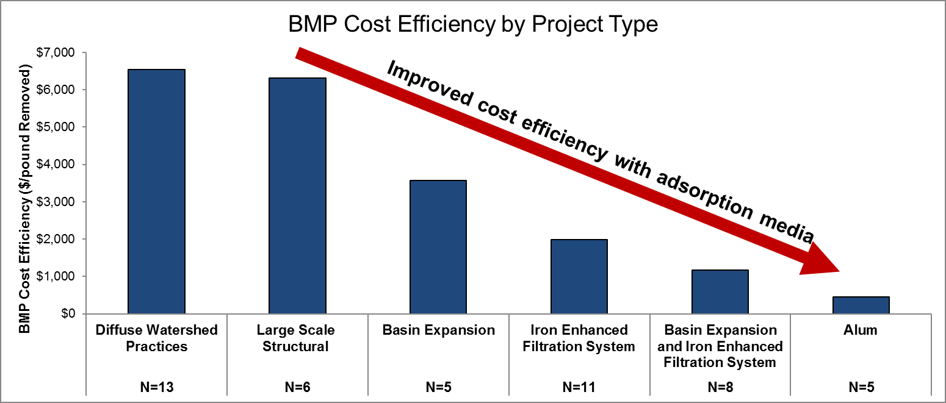
BMP Cost Efficiency

Slide 24

Excavation for Phosphorus Control
Mobile P (mg/g)

Slide 25

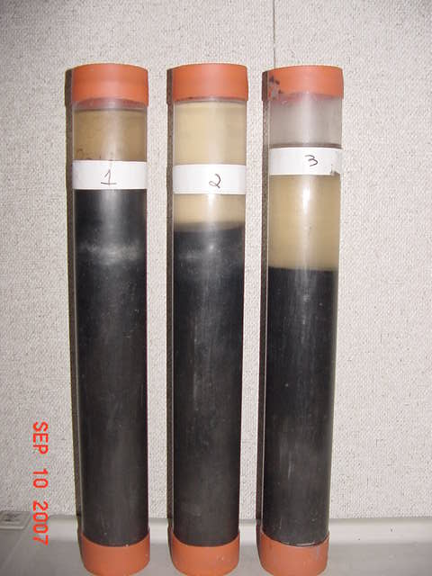

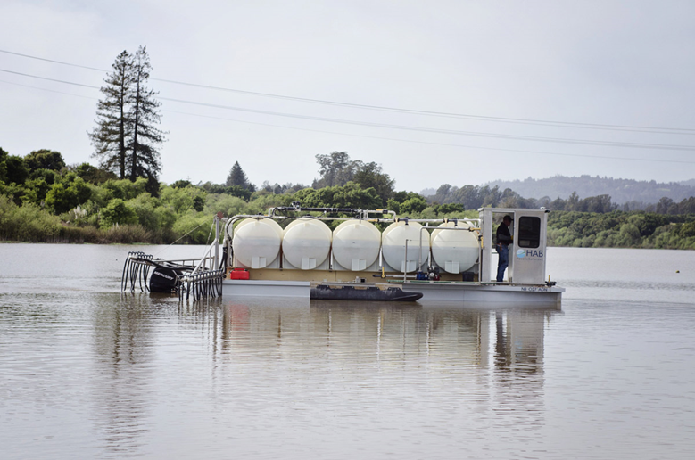

Sediment Phosphorus Inactivation
Aluminum Sulfate (liquid)
  Dissolves in water to form aluminum hydroxide and sulfate
  Aluminum hydroxide is a white solid that settles out of the water column
Permanently binds phosphorus in the sediments
Aluminum phosphate complexation (Al(OH)₃PO₄)
  Very stable in the environment
  Not sensitive to anoxia (low oxygen)
Alum has been used in hundreds of lakes throughout the world to reduce P cycling

Slide 26
Assessment Approaches
Modeling Considerations
City of Eagan Ponds | LP-41 | LP-44
Pond Area (acres) | 4.8 | 2.4
Pond P release (lbs/yr) ¹ | 9.7 | 4.9
Pond TP Sedimentation (lbs/yr) ² | 8.6 | 6.5
Sediment Redox P (pounds) | 728 | 33
Sediment Mobile P (pounds) | 1,295 | 227
Alum Inactivation Cost³ | $137,000 | $39,000
Alum Treatment Frequency⁴ (years) | 6 | 16
Cost ($ per treatment) | $10,000
Cost ($ per 30 year life cycle) | $187,000 | $59,000
¹ Assumes release of 5 mg/m²/day and 45 days anoxia
² 2008-2012 average using PondNet
³Based on inactivating 90% of mobile P in top 5 cm
⁴ Assumes 43% and 23% of settled TP is mobile P respectively and minimum dose of 50 g Al/m ²

Slide 27
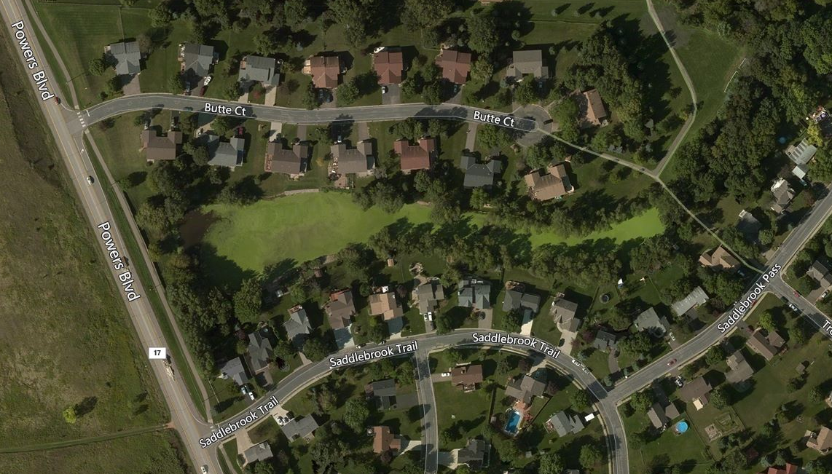
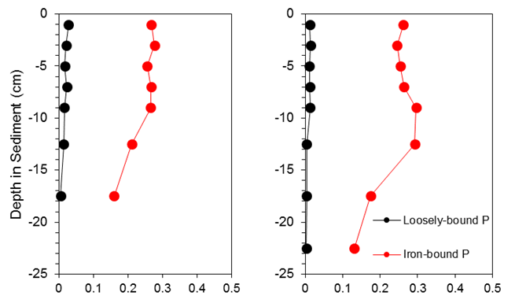
Chanhassen Pond LLP 10.4
Residents complained of foul odors
  Could be result of dead algae (filamentous), decaying plant material, or hydrogen sulfide production
  No water quality data available
  Clear hydrogen sulfide production from anoxic sediments
  Heavy duckweed coverage
Solution
Sediment P inactivation
Aeration to control hydrogen sulfide production

Slide 28
Summary
Stormwater ponds and wetlands are potential sources of phosphorus
  Offsetting watershed phosphorus BMPs
  Transformers of P: settling particulate P, releasing dissolved P
  Release is driven by anoxia and sediment mobile phosphorus
Quantifying watershed wide sediment phosphorus pools and dissolved oxygen dynamics is critical
  Good sediment and DO data is invaluable
  Mobile phosphorus in pond and wetland sediments
  Anoxia as the driver of P release
Standard maintenance techniques are not cost effective or feasible in most cases
Sediment removal is expensive, limited by wetland regulations and does not address P release

Slide 29
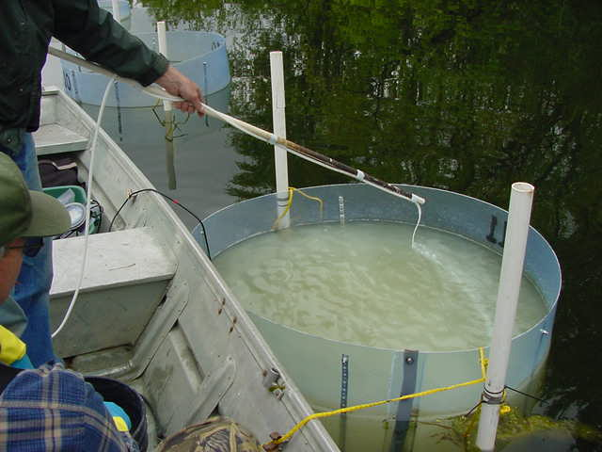
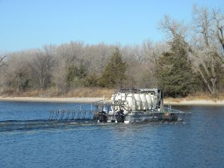
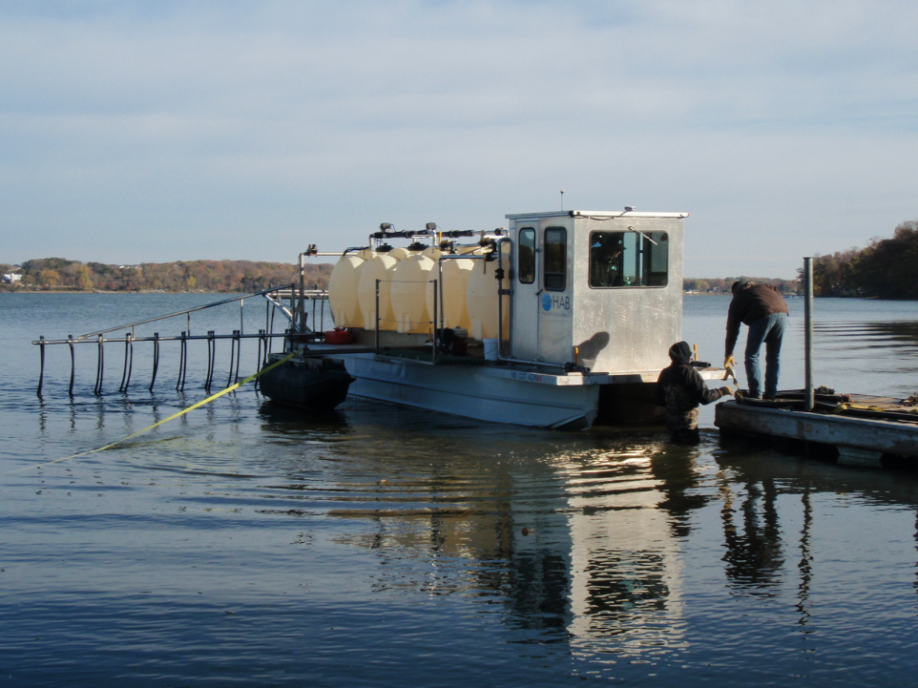
Questions?
Joe Bischoff jbischoff@Wenck.com

