Slide 1
MIDS Calculator Introduction

Slide 2
Outline
Bioretention/BioInfiltration (w/out underdrain)
  Introduction
  Exercise 1
Bioretention/BioInfiltration with Underdrain (underdrain at bottom—biofiltration and underdrain suspended from bottom)
  Introduction
  Exercise 2

Slide 3
Outline
Swales
  Introduction
  Exercise 3
Exercise 4: Individual vs. Clumping of BMPs
Introduce Green Roof and Permeable Pavement
Exercise 5: Several BMPs in series

Slide 4

Opening the MIDS Calculator

Slide 5


Slide 6
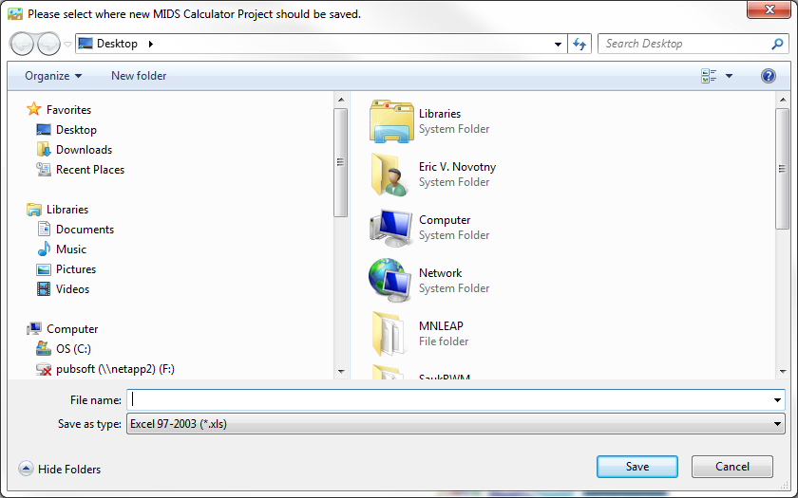
File saves as an excel file
Excel file contains all of the data and equations used in the calculator
Excel file can be used as a stand alone calculator

Slide 7
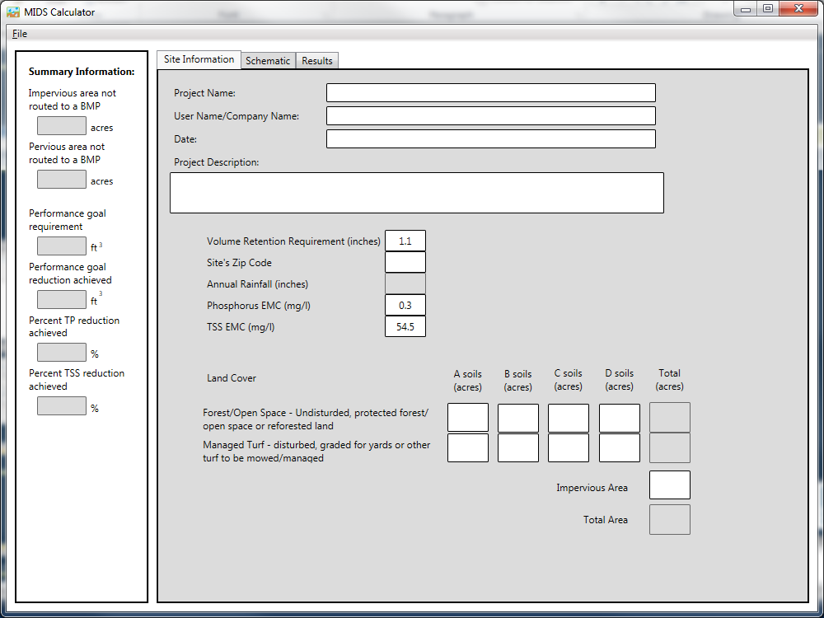

Slide 8

Bioretention Basin Example:
Turf Area
(B soils,
0.8 acres)
Parking Lot
(1.4 acres)
Building
(0.8 acres)
Bioretention
Basin
Total site area = 3 acres

Slide 9
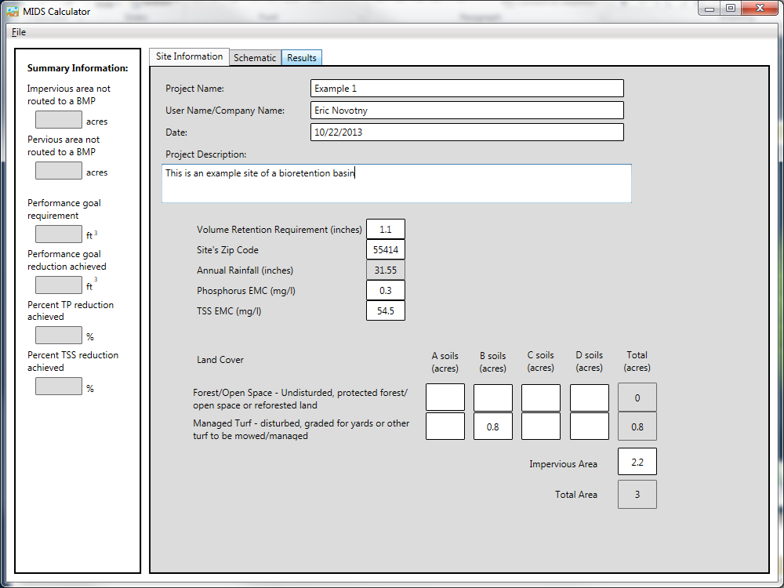

Slide 10
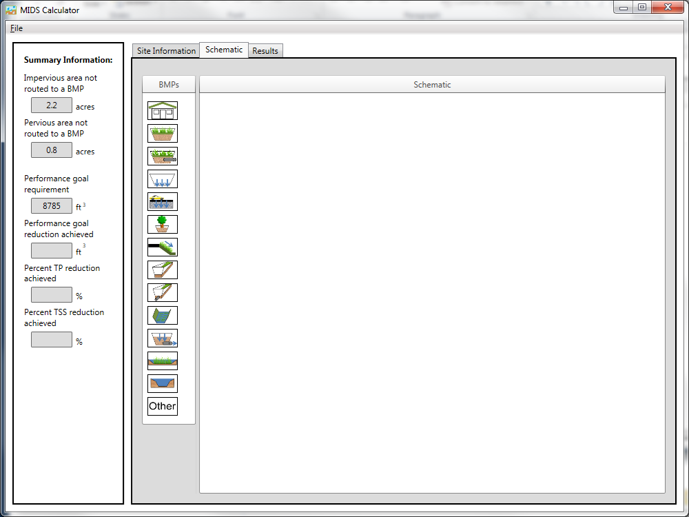
Drag and Drop
Bioretention Icon
Performance goal
(1.1 inches * Impervious Area)

Slide 11
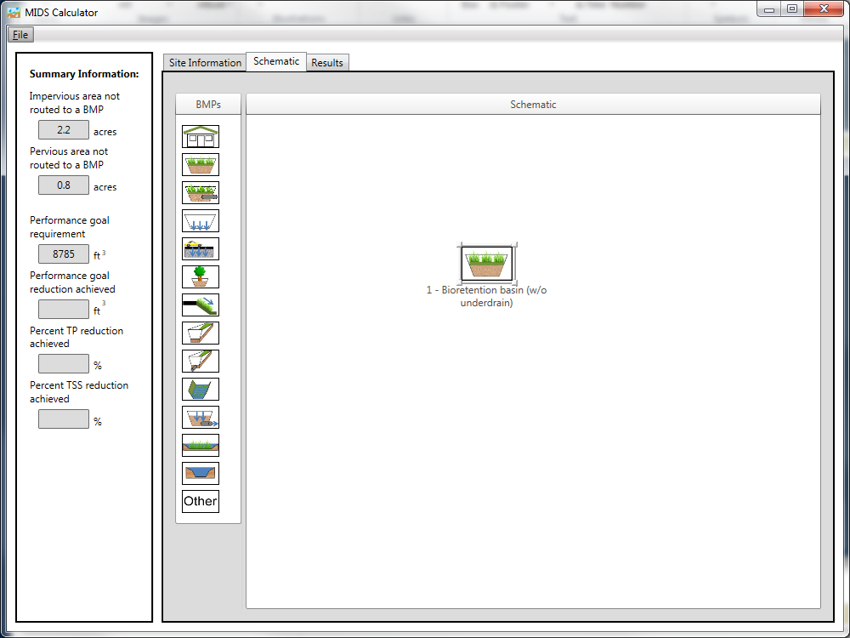
Double Click
Or
Right Click and select
Edit Properties

Slide 12
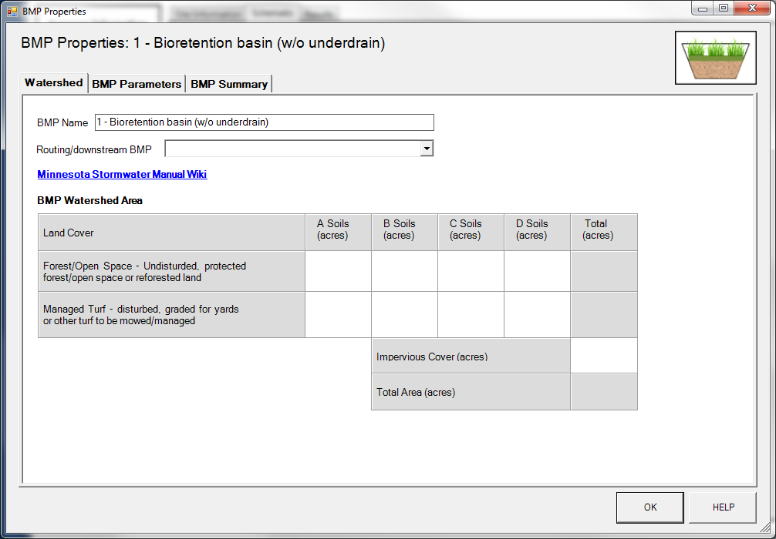

Slide 13


Slide 14
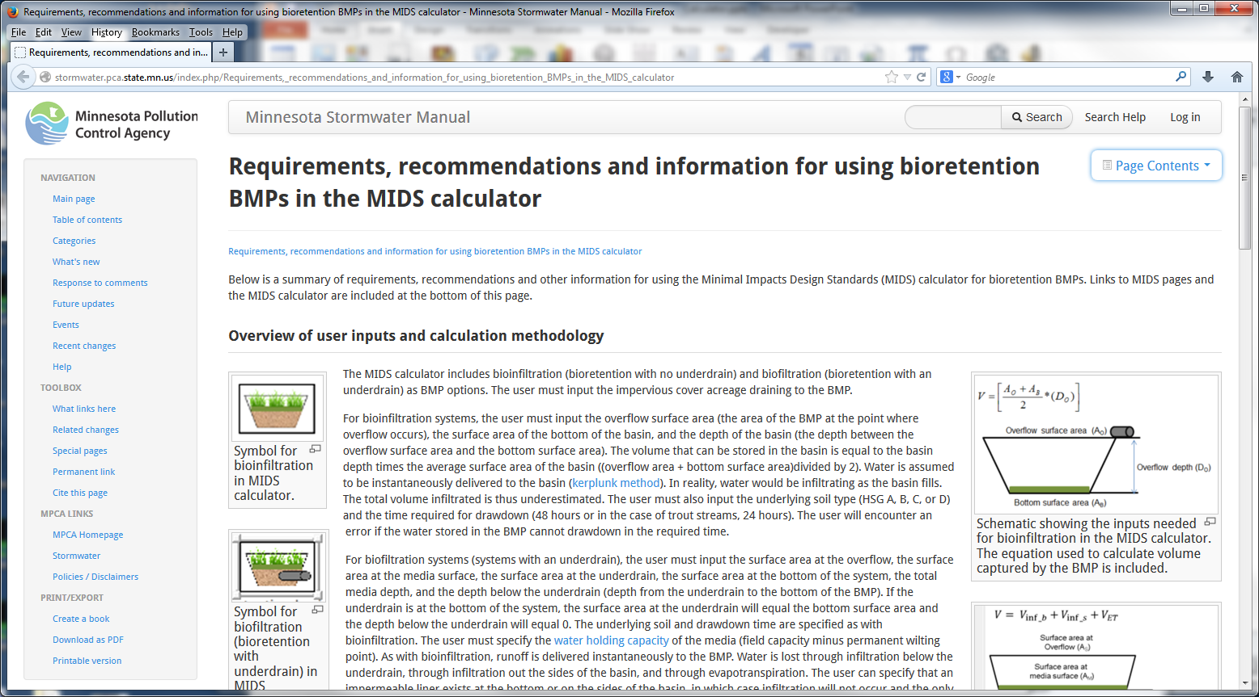

Slide 16
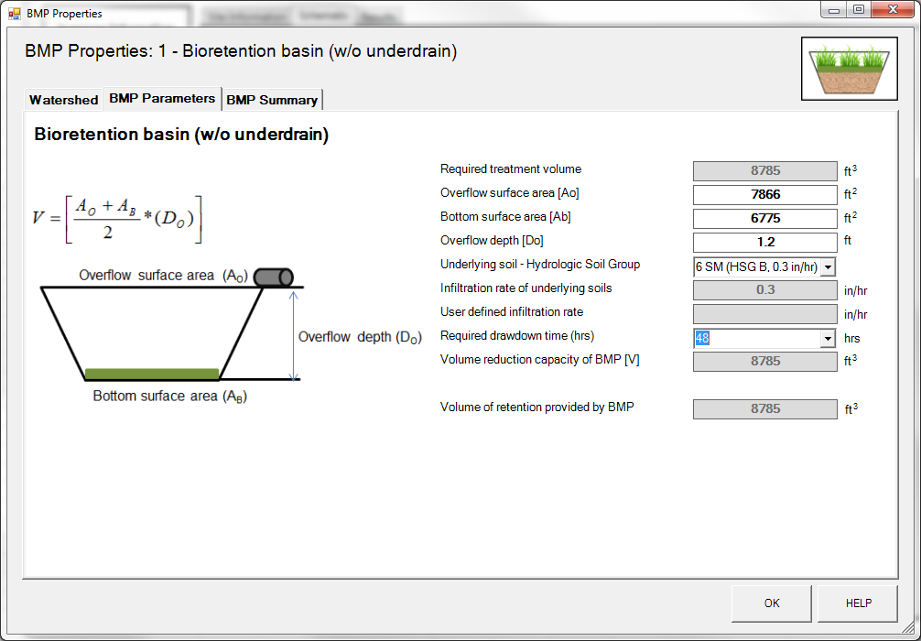

Slide 17
Design Requirements for Bioretention Basins
Overflow depth cannot be > 1.5 feet
Basin must meet drawdown time requirement (48 or 24 hours)
Infiltration rate cannot be > 1.63 inches/hour (this is being examined and might change)
Bottom surface area cannot be greater than overflow surface area

Slide 19
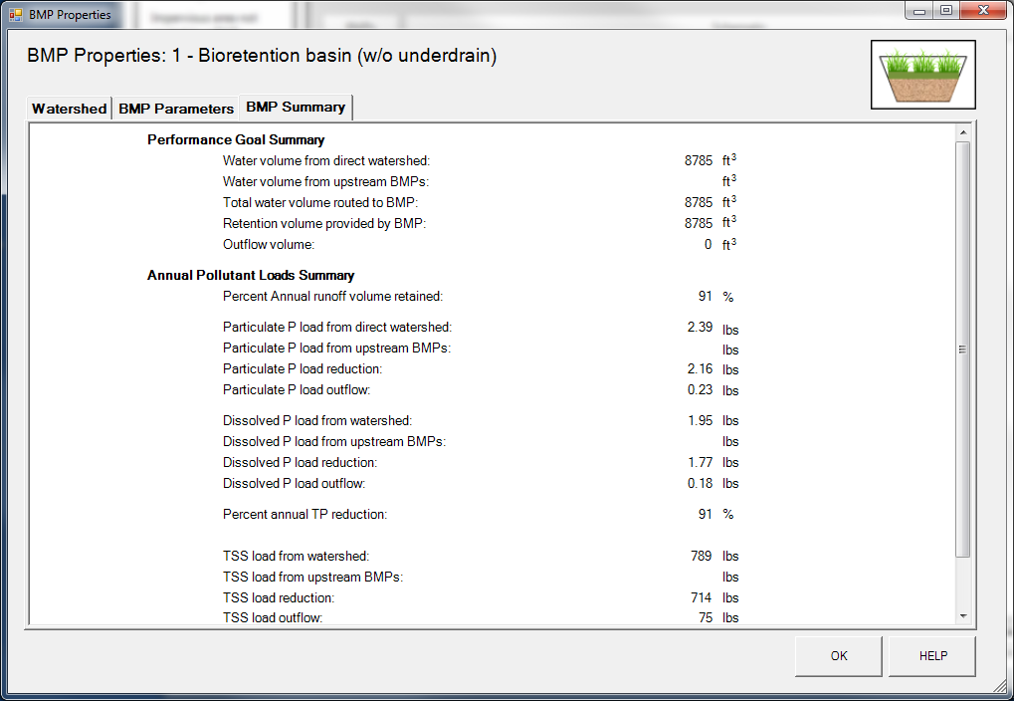

Slide 20
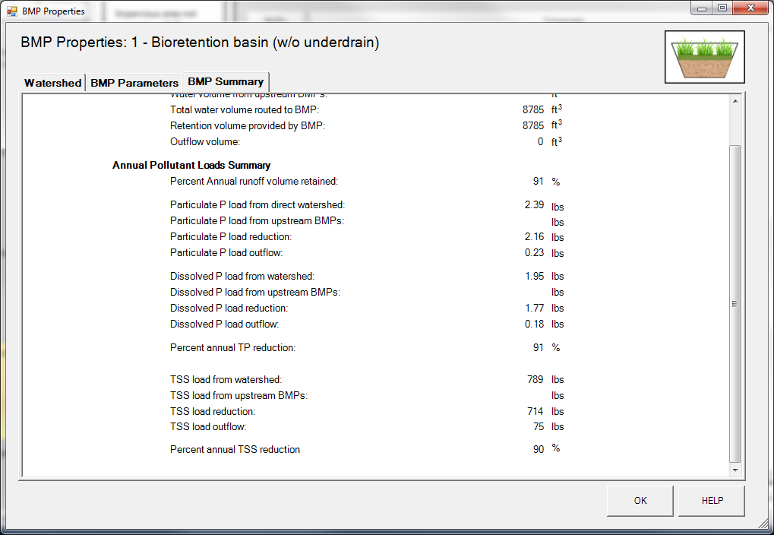

Slide 21
Annual Pollutant Load Reduction Calculations
Calculate Annual Pollutant load to BMP
  Calculate annual TP and TSS pollutant load from direct watershed
  Add any remaining TP/TSS loads from upstream BMPs

Slide 22
Annual Pollutant Load Reduction Calculations
% Annual Volume Overflow?
% Annual Volume Reduction?

Slide 23
Performance Curve for Type B soils (0.3 in/hr)
BMP Volume = 8785 ft³
Impervious Area = 73%
Annual Volume Reduction = 90.5%

Slide 24
Annual Pollutant Load Reduction
9 % Annual Volume
0% TSS, Particulate P (PP), and Dissolved P (DP) Reduction
91% Annual Volume
100% TSS, PP, DP Reduction

Slide 25
Questions?

Slide 26
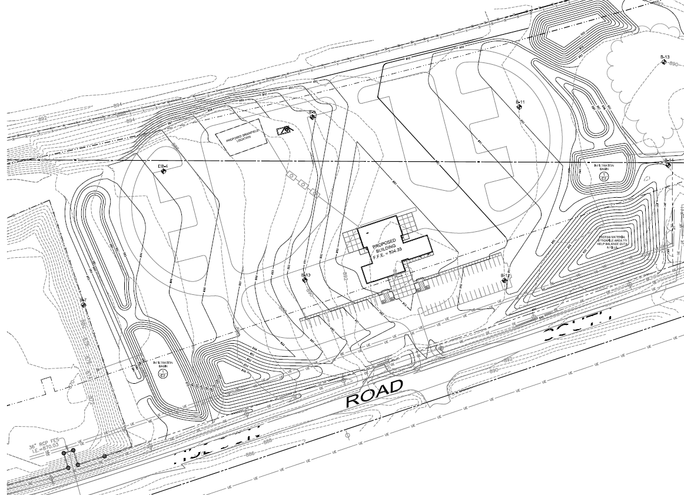
Exercise 1: Simple Bioretention
New Project on Site without Restrictions
Source: Larson Engineering

Slide 27
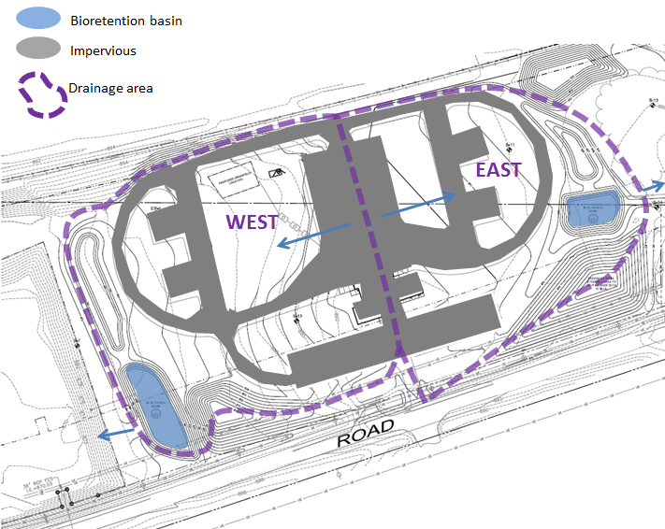
Source: Larson Engineering

Slide 28
Exercise 1: Calculator Inputs
Drainage Area | Land Cover (acres) - assume all 'B' Soils |  |  | Total
 | Turf | Forest/Open Space | Impervious
WEST | 5.95 | 0.00 | 2.53 | 8.48
EAST | 5.35 | 0.00 | 2.60 | 7.95
Total: | 11.3 | 0.00 | 5.13 | 16.43
Drainage Area | BMP Description | BMP Information
 |  | Overflow Surface area (ft²) | Bottom Surface Area (ft²) | Overflow Depth (ft)
WEST | Bioretention basin | 14,000 | 11,000 | 1.2
EAST | Bioretention basin | 7,500 | 5,000 | 1.2
Zip Code: 55001

Slide 29
Exercise 1: Assignment/Questions
Does the site conform to the new site without restrictions performance goal?
What percentage of TP is removed from WEST, EAST, and Total?
How would you make this site conform to the performance goal?
Notes:
You lost me on that 3rd bullet

Slide 30
Lunch

Slide 31
Bioretention Basin with Underdrain Example:
Turf Area
(B soils,
0.8 acres)
Parking Lot
(1.4 acres)
Building
(0.8 acres)
Bioretention
Basin with
underdrain
Total site area = 3 acres

Slide 32
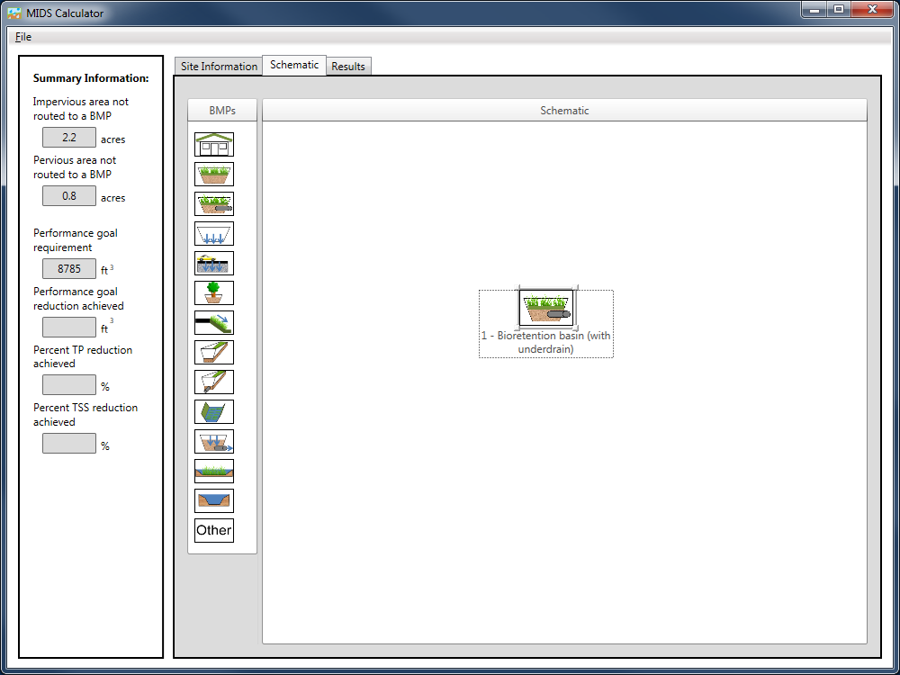

Slide 33
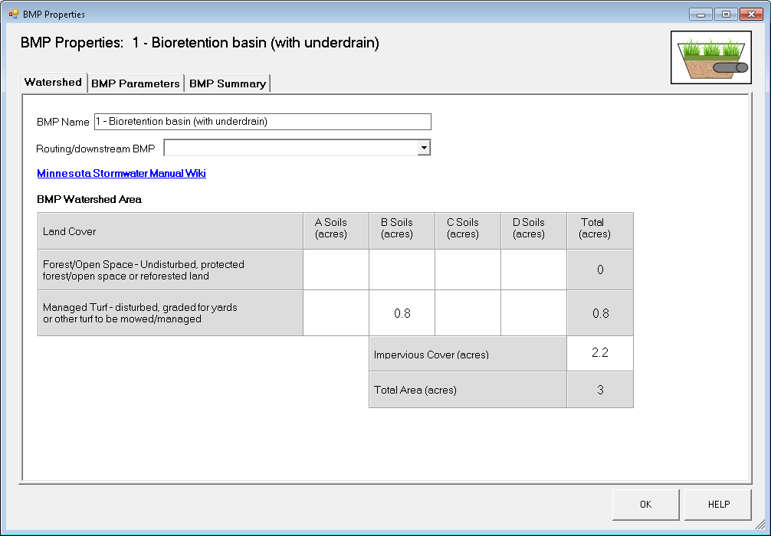
Bioretention Basin with an Underdrain

Slide 34
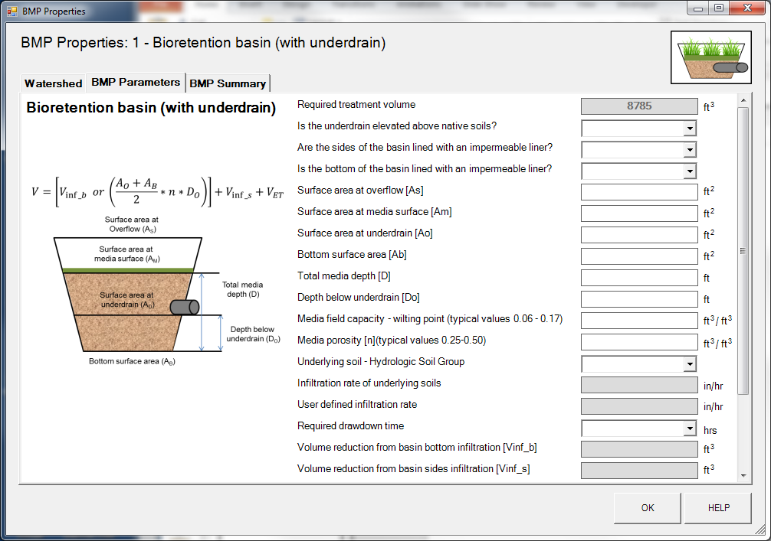

Slide 35
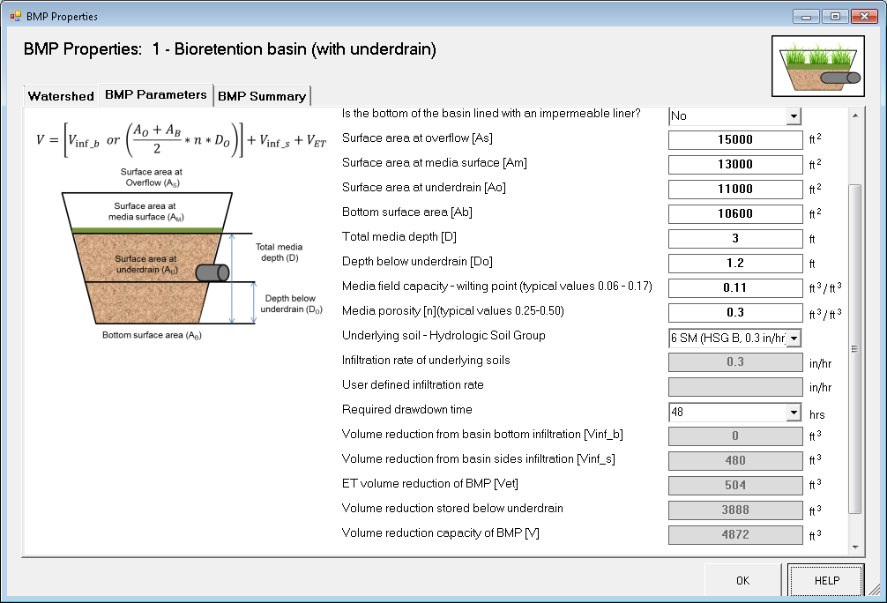

Slide 36


Infiltration through side of BMP
$$V_{In{f_}_{S }}=I_{R}∗\left(\frac{DDT}{2}\right)∗\left(A_{S}−A_{O}\right)/(\frac{12in}{ft})$$
Where
I_{R} = infiltration rate (always 0.06 in/hr)
DDT = drawdown time requirement (48 or 24 hours)
A_{S} = BMP surface area at BMP overflow
A_{O} = surface area at underdrain
A_{S}
A_{O}

Slide 38


Volume losses through Evapotranspiration
minimal value between ET rate and the media water holding capacity
$$V_{ET}=min\left[\left(A_{M}∗0.31\frac{in}{day}∗0.5∗3 days/12 in/ft\right) , \left(\left(D−D_{O}\right)∗A_{m}∗\left(FC−WP\right)\right)\right]$$
Where
A_{M} = BMP surface area at media surface (ft²)
0.31 in/day = max pan ET rate recorded in Minnesota (Climate of Minnesota Part XII – The Hydrologic Cycle and Soil Water, 1979)
0.5 = correction factor for pan ET rate
3 days = typical time period between precipitation events (per MPCA)
D = Total media depth of BMP (ft)
D_{O} = media depth below underdrain (ft)
(FC – WP) = water holding capacity of media (i.e., Field capacity – Wilting point)
Notes:
This slide has bunch of small text….can’t expect folks to be able to see it on a screen

Slide 40
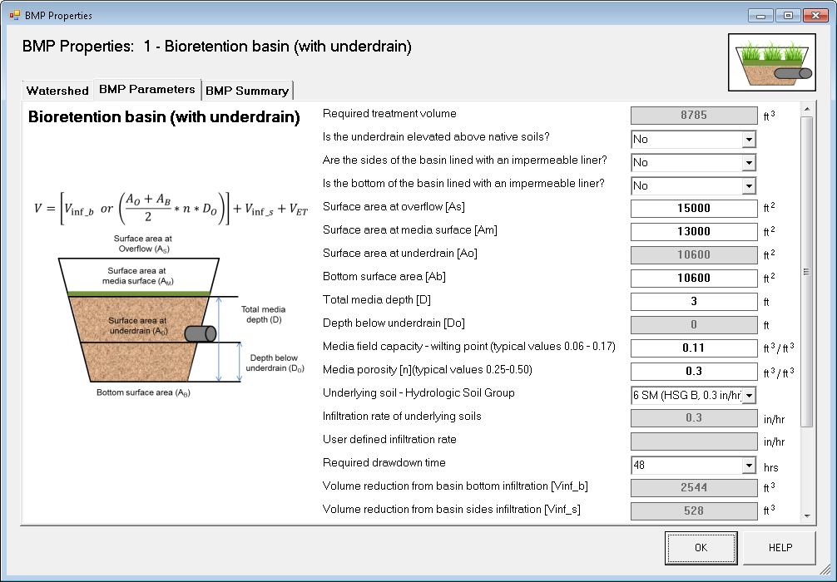

Slide 41
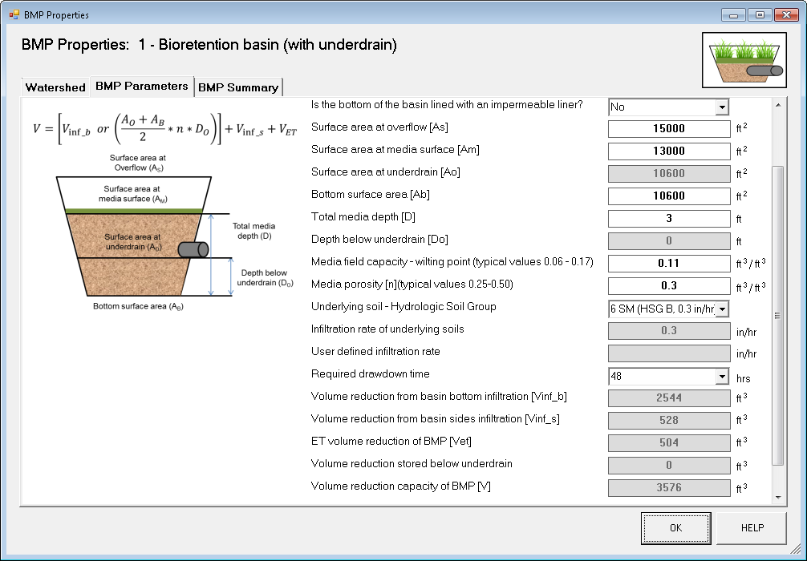

Slide 42

Infiltration through bottom of BMP
$$V_{Inf_B}=I_{R}∗\left(DDT\right)∗A_{B}/(\frac{12in}{ft})$$
Where
I_{R} = infiltration rate
(always 0.06 inches/hour)
DDT = drawdown time requirement (48 or 24 hours)
A_{B} = surface area at bottom

Slide 43
Annual Pollutant Load Reduction
45% PP
0% DP
60% TSS
100% TSS, PP, DP Reduction
(performance curves)

Slide 44
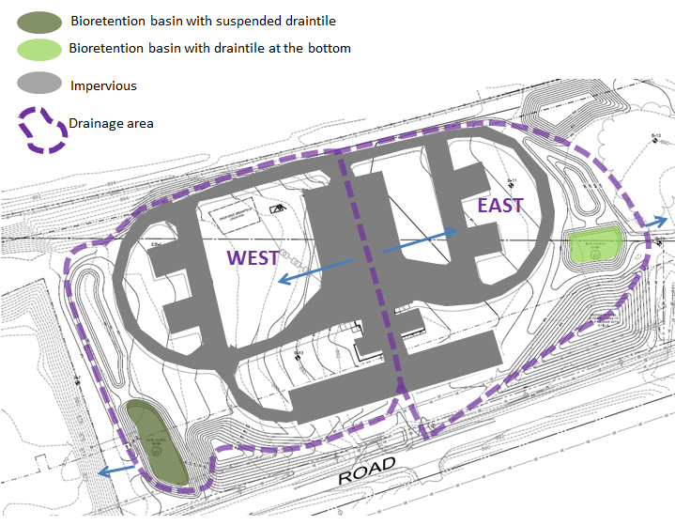
Exercise 2: Bioretention Basins with Underdrains
Bioretention basin with elevated underdrain
Bioretention basin with underdrain at the bottom
Impervious
Drainage area
Zip Code: 55001
Source: Larson Engineering

Slide 45
Exercise 2: Givens
Drainage Area | Land Cover (acres) - assume all ‘D' Soils |  |  | Total
 | Turf | Forest/Open Space | Impervious
WEST | 5.95 | 0.00 | 2.53 | 8.48
EAST | 5.35 | 0.00 | 2.60 | 7.95
Total: | 11.3 | 0.00 | 5.13 | 16.43
Drainage Area | BMP Description | BMP Information
 |  | Surface Area at Overflow (ft²) | Area at Media Surface (ft²) | Surface Area at Underdrain (ft²) | Bottom Surface Area (ft²) | Total Media Depth (ft) | Depth below Underdrain (ft) | field capacity – Wilting point (ft³/ft³) | Media porosity (ft³/ft³) | Underlying Soil | Required drawdown time (hours)
WEST | Bioretention basin with elevated underdrain | 14,000 | 11,000 | 8500 | 7875 | 1.24 | 0.24 | 0.11 | 0.3 | CL | 48
EAST | Bioretention basin with underdrain at the bottom | 7,500 | 5,000 | 2400 | 2400 | 1 | NA | 0.11 | 0.3 | CL | 48

Slide 46
Exercise 2: Assignment/Questions
What is the annual TP reduction at WEST and EAST?

Slide 47
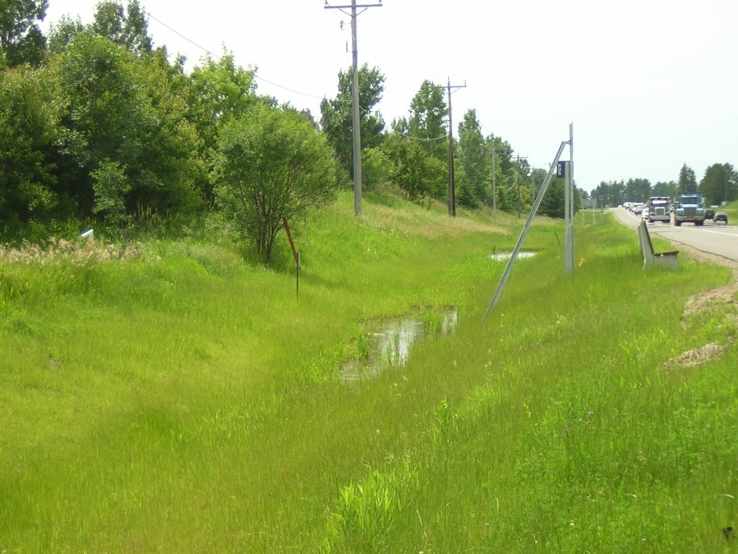
Swale BMP
Swales separated into components
  Side slope
  Dry swale - main channel
  Dry swale with an underdrain - main channel
  Wet swale – main channel
Side Slope Reductions
Bottom/Main Channel Reductions
Photo: Ray Roemmich

Slide 48
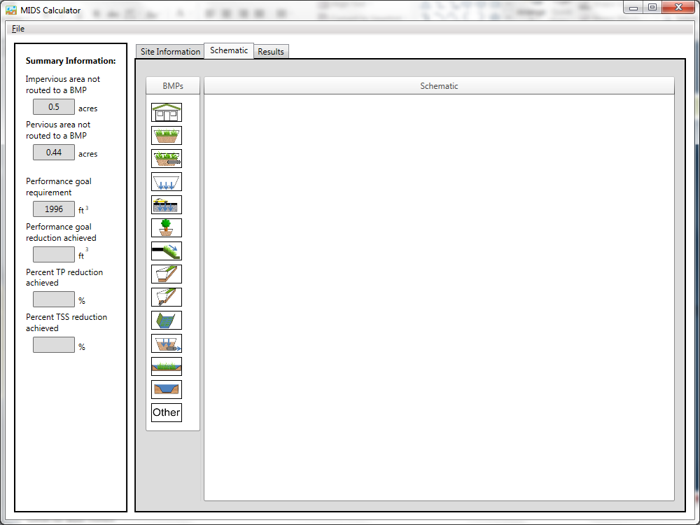
Swale Side Slope
Swale Main Channel
Swale Main Channel with Underdrain
Wet Swale

Slide 49
Why separate components?
BMP overflow
Dry Swale – Main Channel
Watershed Area
Swale Side Slope
Dry Swale w/ underdrain – Main Channel
Wet Swale – Main Channel

Slide 50

Swale BMP
Roadway
(0.5 acre)
27.2 feet
Swale Side slope area: = 0.367 acres
Swale Main Channel Area: = 0.073 acres
Total Area = 0.94 acres
Sheet Flow
Dry
Swale
800 feet

Slide 51
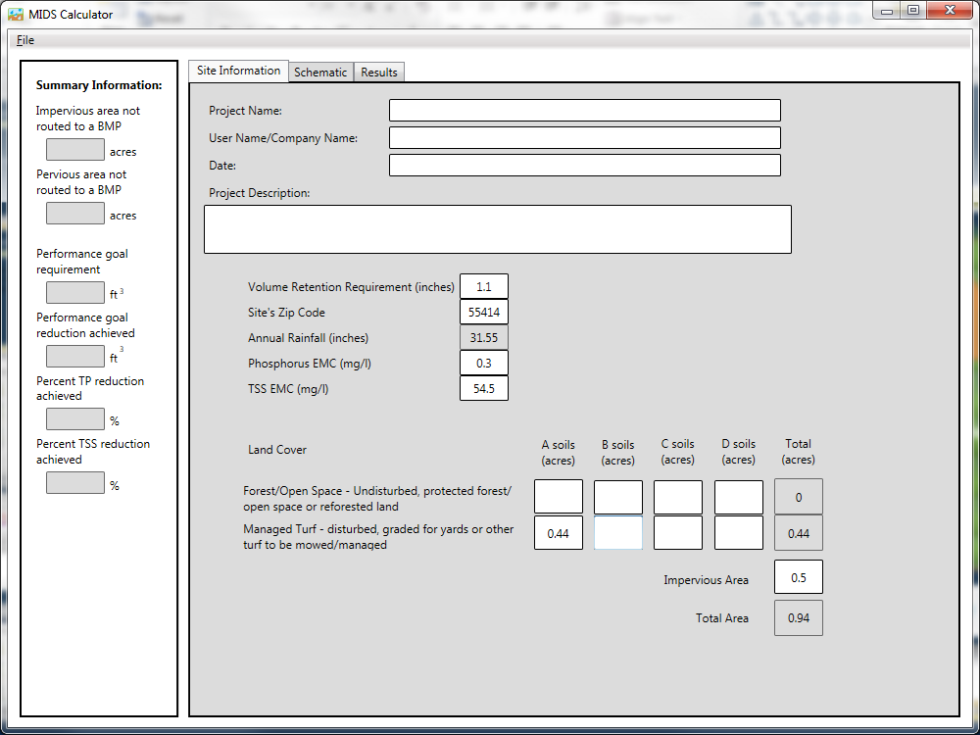

Slide 52
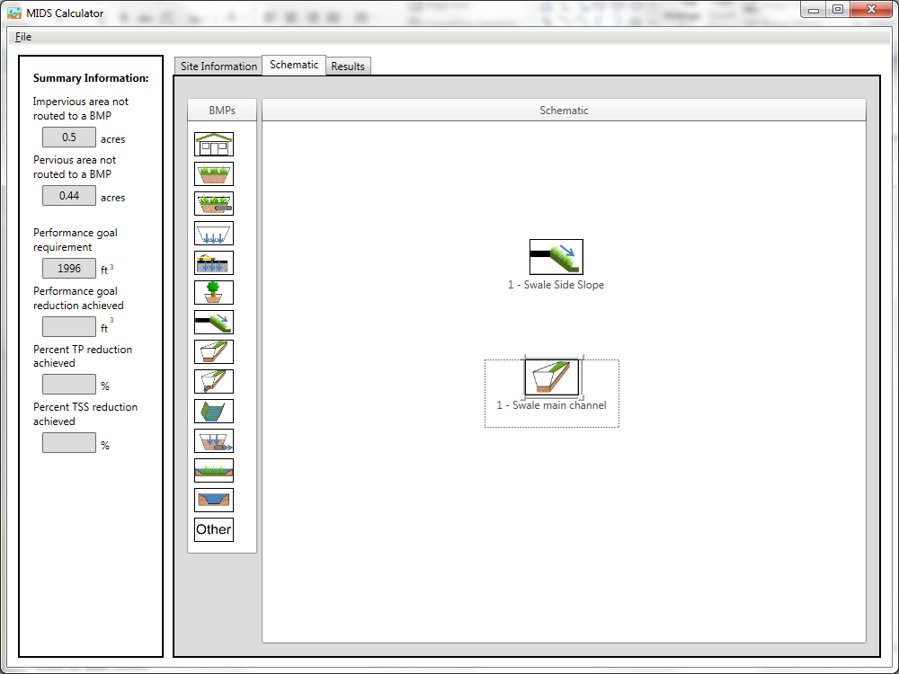

Slide 53
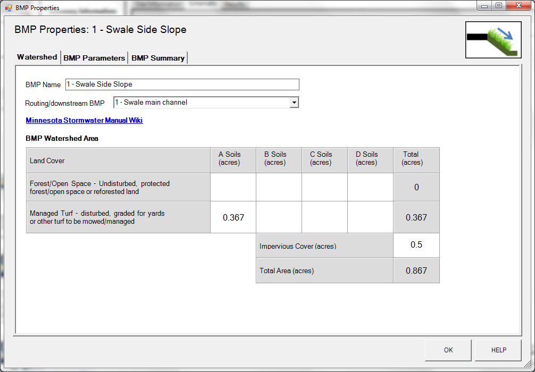

Slide 54
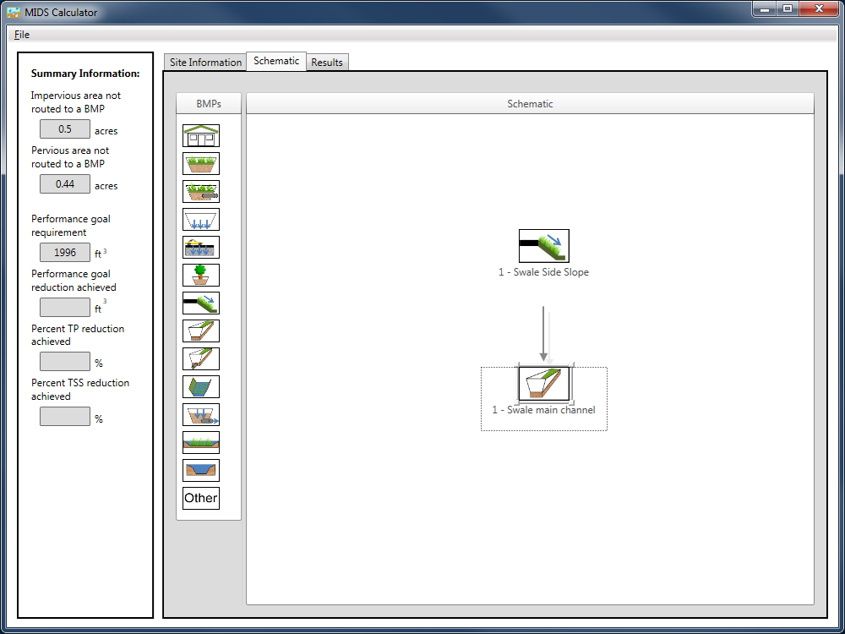

Slide 56
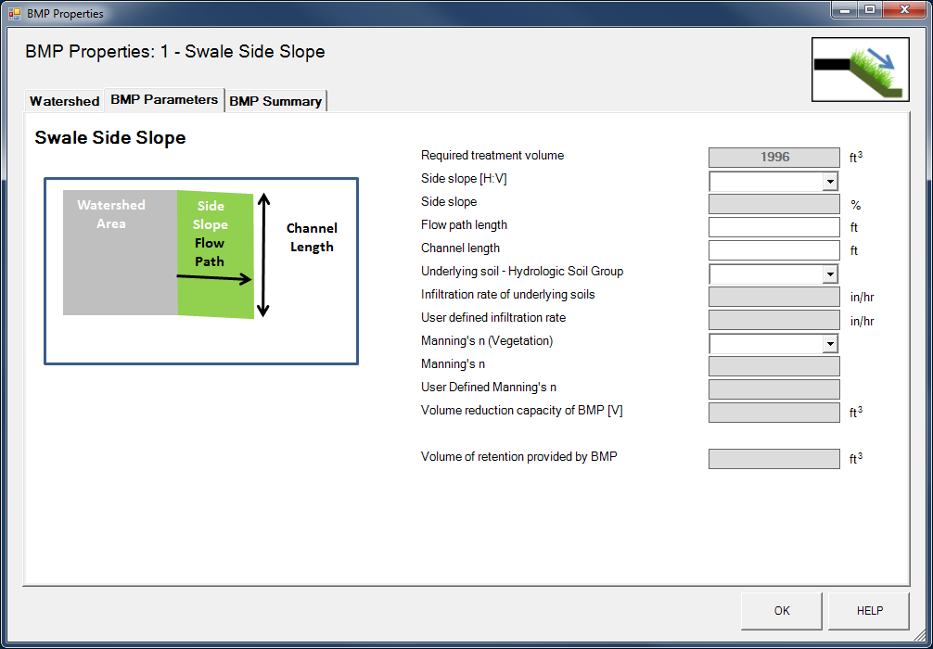

Slide 57
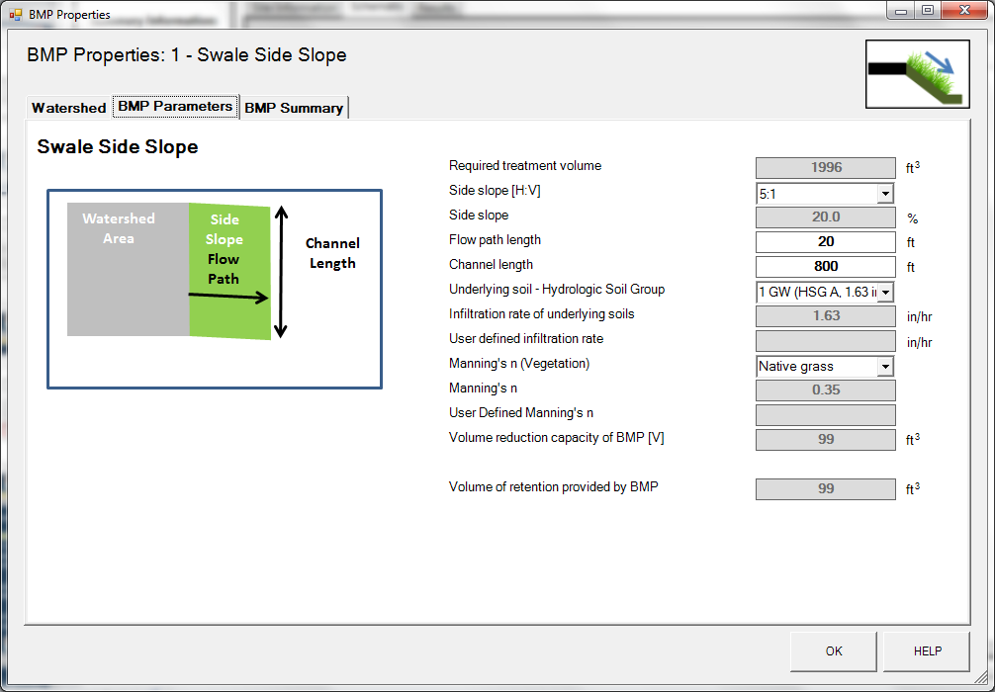

Slide 58
How is swale volume reduction capacity calculated?
55 years of P8 modeling based on multiple configurations of side slope, channel length, flow path length, infiltration rate, and Manning’s n
P8 model results were used to develop relationship between swale parameters and annual volume reductions
Performance curves are used to convert annual reductions to event based reductions

Slide 59
Look up table for type A soils (1.63 in/hr)
Annual Percent Reduction = 24%
Impervious Area = 58%
BMP Volume = 99 ft³

Slide 60
Calculator Requirements for Side Slopes
Can only be routed to swale main channel BMPs (swale main channel, swale main channel with an underdrain, wet swale)
Cannot receive runoff from other BMPs
Flow must be sheet flow over entire channel length (if not, channel length should be adjusted to only cover areas where sheet flow occurs)
Only calculates flow from one side slope

Slide 61
Calculator Requirements Continued
Manning’s n cannot be > 1
Infiltration rate cannot be > 1.63 inches/hour (might change)
Side slopes cannot be steeper than 3H:1V or flatter than 7H:1V

Slide 63
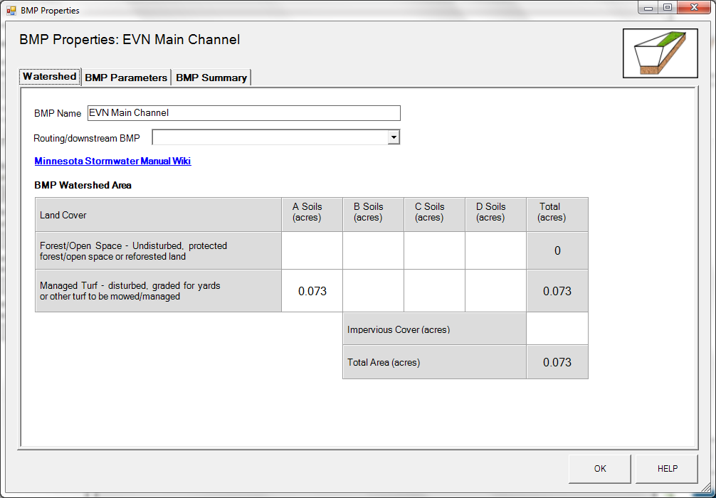

Slide 64
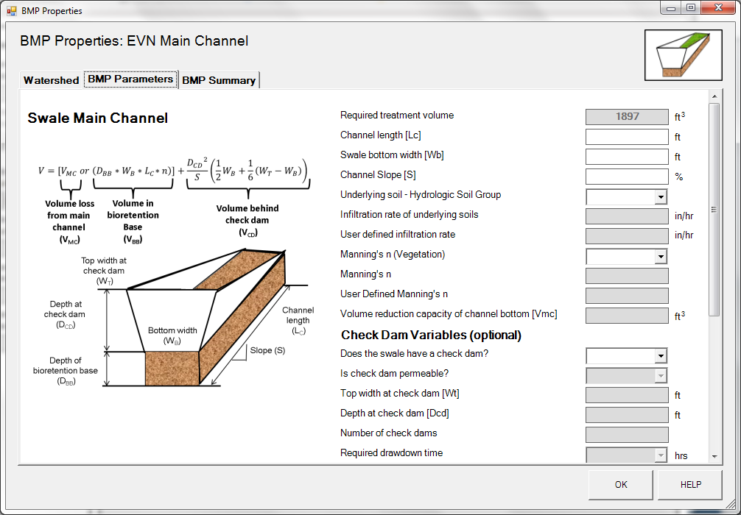

Slide 65
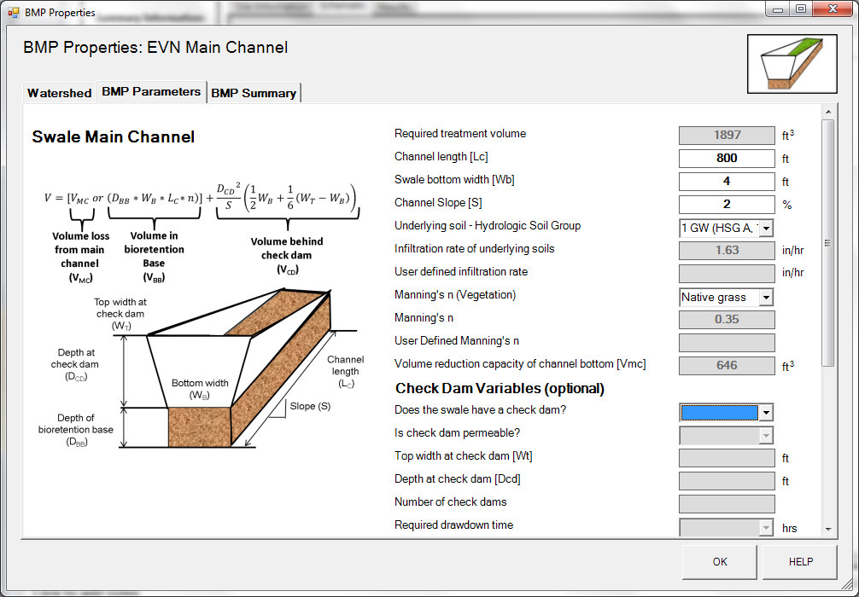
Calculated with same
method used for side slope
calculation

Slide 66
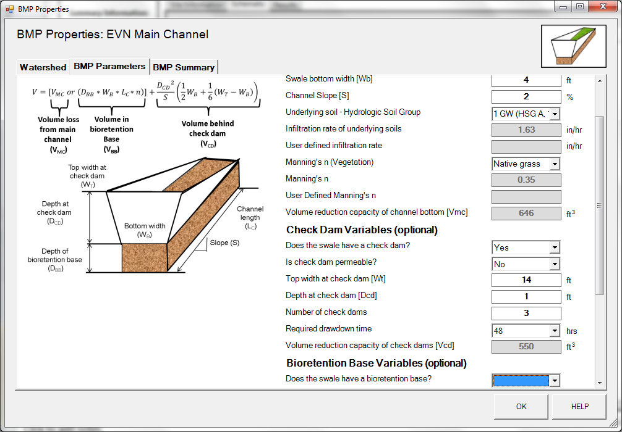
Calculate the volume of
water that can be held behind
the check dam at any one time

Slide 67
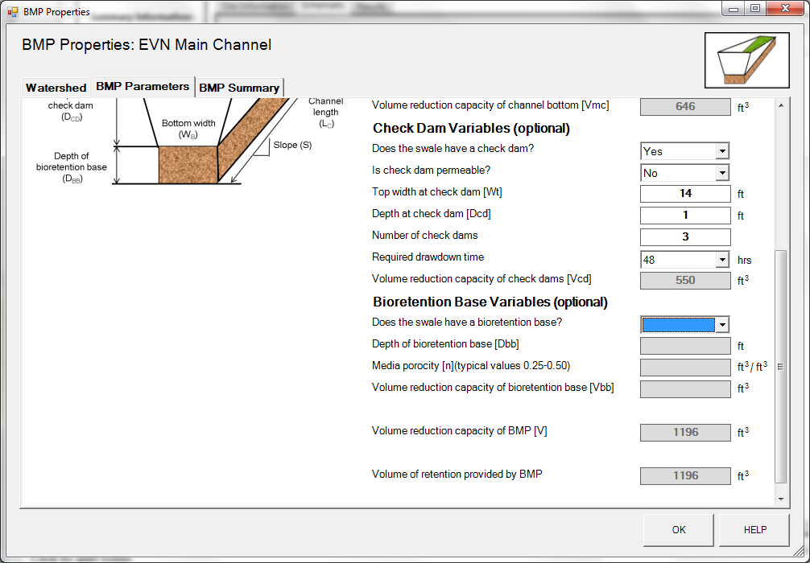
Total volume reduction
capacity equals the sum of
the two reductions

Slide 68
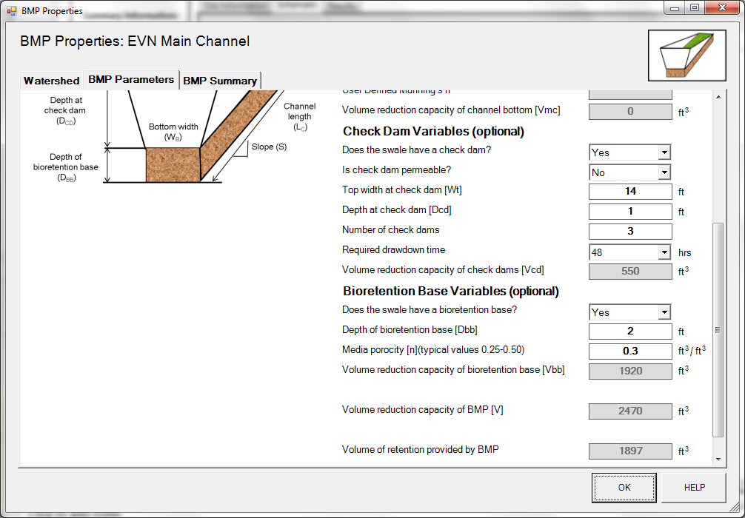
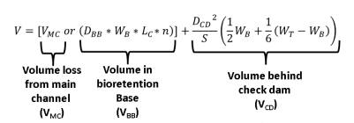
Bioretention base volume loss
replaces channel bottom
calculation

Slide 69
Annual Pollutant Load Reduction
73% PP
0% DP
68% TSS
100% TSS, PP, DP Reduction
(performance curves)

Slide 70
Design Requirements
Swale bottom width cannot be < 2 feet
Channel slope cannot be > 4%
Manning’s n cannot be > 1
Water behind check dam must drain within required drawdown time (48 or 24 hours)
Infiltration rate cannot be > 1.63 inches/hour (might change)

Slide 71
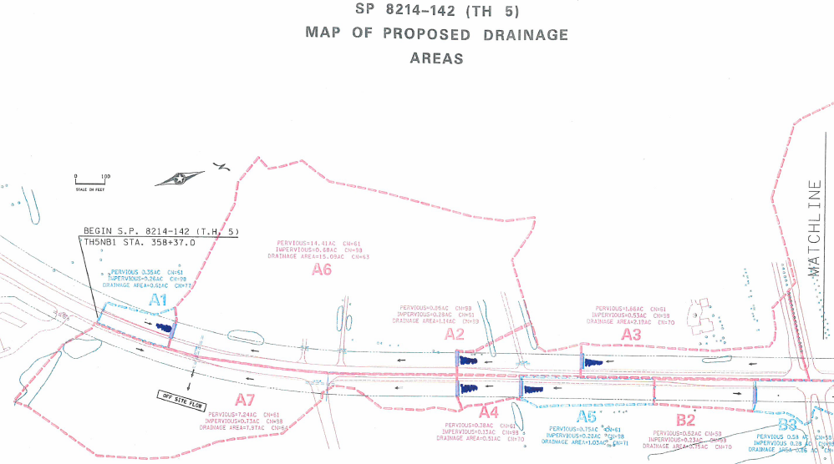
Exercise 3: Simple Swale
Rural Section of Highway 5 in Lake Elmo
Source: Minnesota Department of Transportation

Slide 72
Exercise 3: Simple Swale
Rural Section of Highway 5 in Lake Elmo, MN (55042)
  Drainage Area A5:
    B soils
    Rectangular drainage area: 450’ by 100’
    Road/shoulder: 27’ wide
    Swale side slopes must start no closer than 5 feet from edge of pavement
    Longitudinal slope is 2%
    Side slope is 4:1

Slide 73
100’
27’
20’
8’
20’
25’
Swale side slope
watershed
Swale main channel
watershed
Roadway

Slide 74
Exercise 3A: Assignment/Questions
Use given swale cross-section and no check dam or bioretention base
  Determine the volume of runoff lost through the entire swale by the road with mowed turf
  with native (tall) grass
Extra time?:
  Design side slope and bottom swale and determine the effect of
    Flatter/steeper side slopes
    Wider/narrower base
    Changes in other parameters

Slide 75
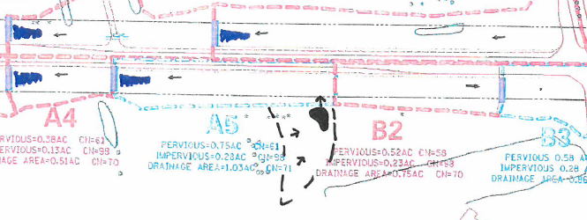
Exercise 3B: Add a stormwater pond
Assume an adjacent stormwater pond discharges into the bottom of the swale

Slide 76
Exercise 3B: Givens
Stormwater Pond drainage area (designed to specific standards):
  0.45 acres of B soils in turf
  0.25 acres of impervious surface

Slide 77
Exercise 3B: Assignment/Questions
Does the example conform to the performance goal?
What percent annual TSS is removed?

Slide 78
Exercise 3C: Assignment/Question
Add check dams and a bioretention base until the example conforms to the performance goal. What did you do?

Slide 79
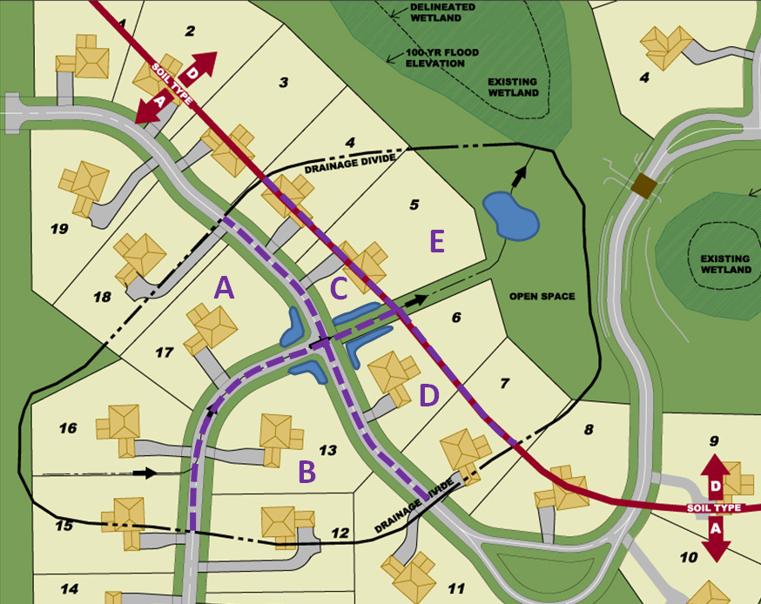
Exercise 4: “Individual” vs. “Clumping”
Site’s zip code: 55042
Source: Original from Folz, Freeman, and Erickson and modified for this exercise by Barr Engineering

Slide 80
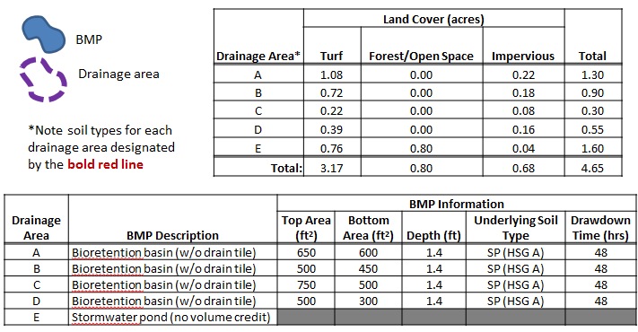
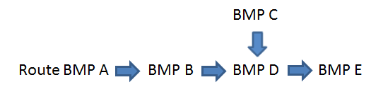
Exercise 4A: “Individual” Givens

Slide 81
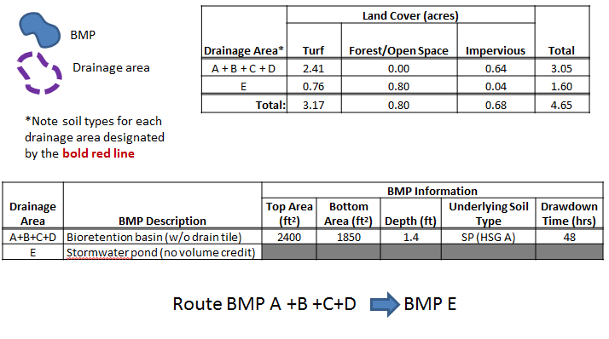
Exercise 4B: “Clumping” Givens

Slide 82
Exercise 4: Assignment/Questions
Determine the results by calculating bioretention basins with individual drainage areas and as one clumped basin.
Are the results different? Why/why not?
Extra Time?:
Experiment with the “Individual” routing to optimize the volume retention.

Slide 83
Permeable Pavement
Permeable Pavement
(0.8 acres)
Parking Lot
(0.8 acres)
Total Area = 2 acres
Turf Area (B soils,0.4 acres)

Slide 84
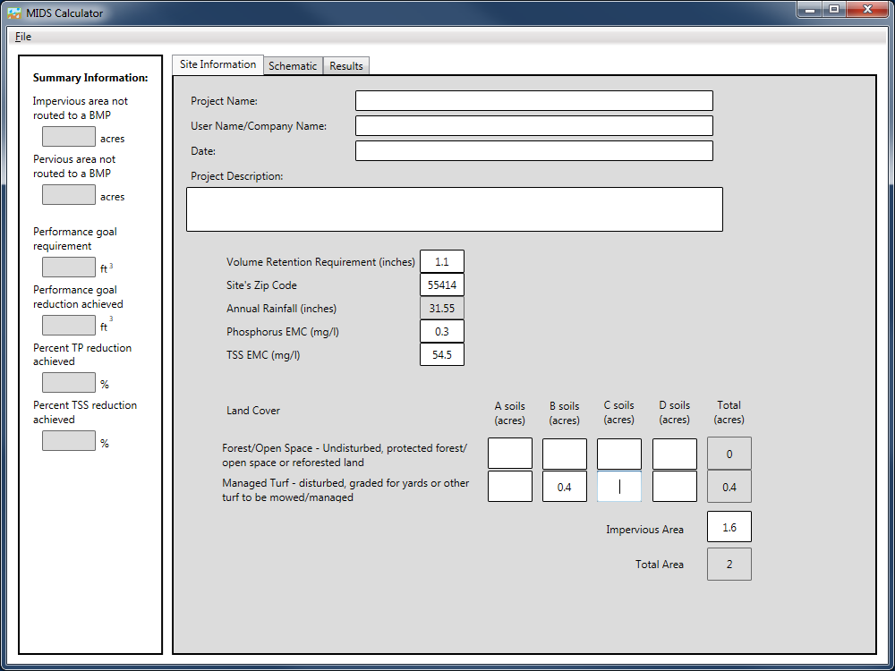
Permeable pavement area
is treated as Impervious area.

Slide 85
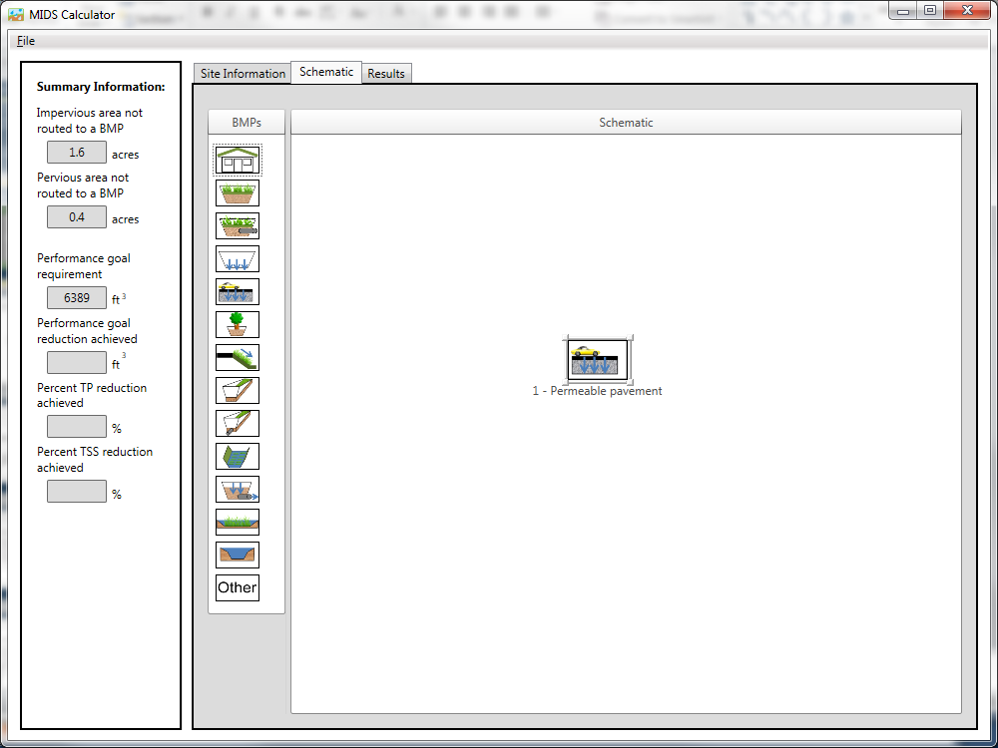

Slide 86
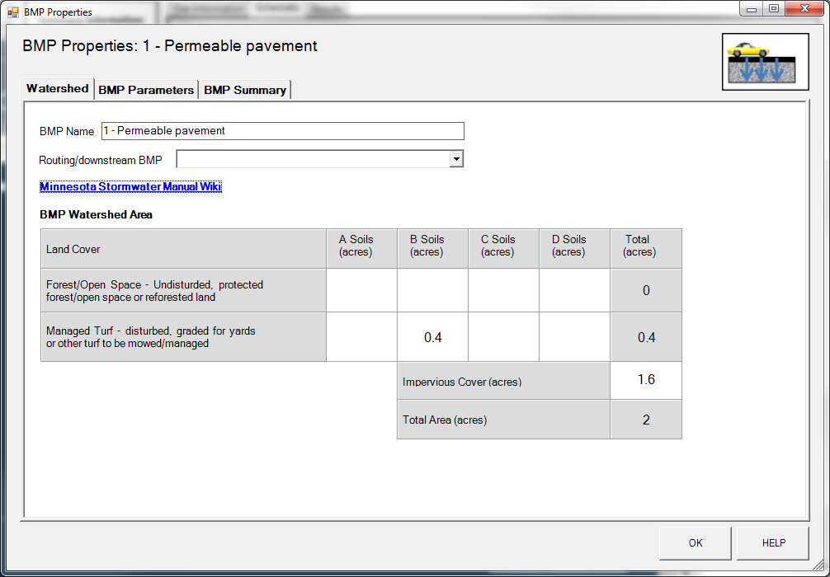

Slide 87
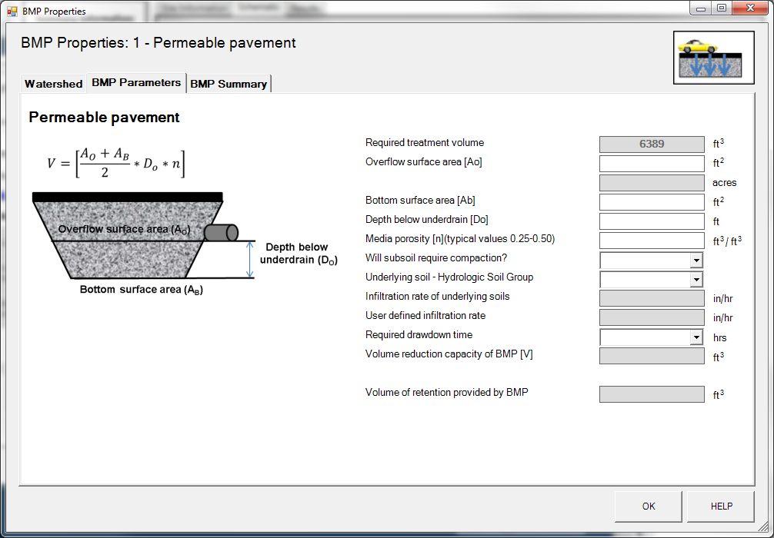

Slide 88
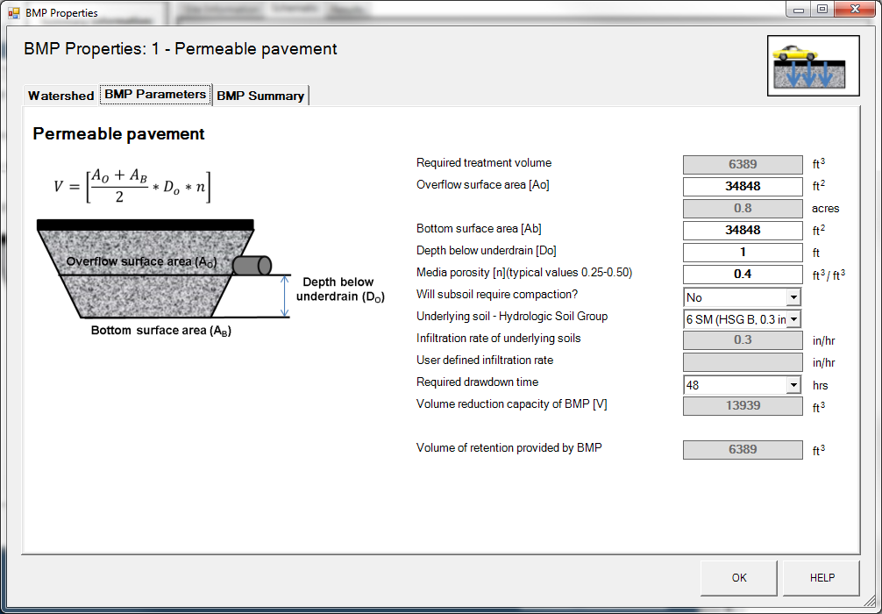
If BMP reduction capacity is greater than required treatment volume, BMP only receives credit equal to required treatment volume

Slide 89

Annual Pollutant Load Reduction
82% PP
0% DP
74% TSS
100% TSS, PP, DP Reduction
(performance curves)

Slide 90
Design Requirements
Ratio between total impervious area and permeable pavement surface area cannot exceed 5:1
Must meet drawdown time requirement (48 or 24 hours)
Infiltration rate cannot > 1.63 inches/hour (might be changed)

Slide 91
Green Roof
Green roof area
(0.25 acres)
Roof Area
0.25 acres
Total Area
0.50 acres

Slide 92
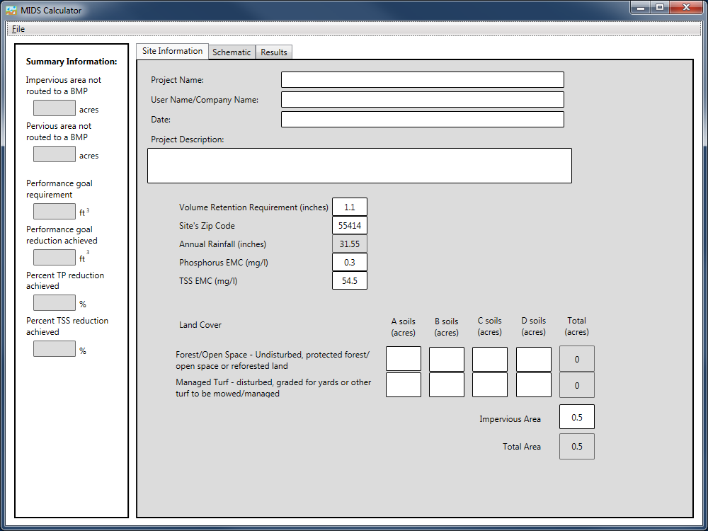

Slide 93
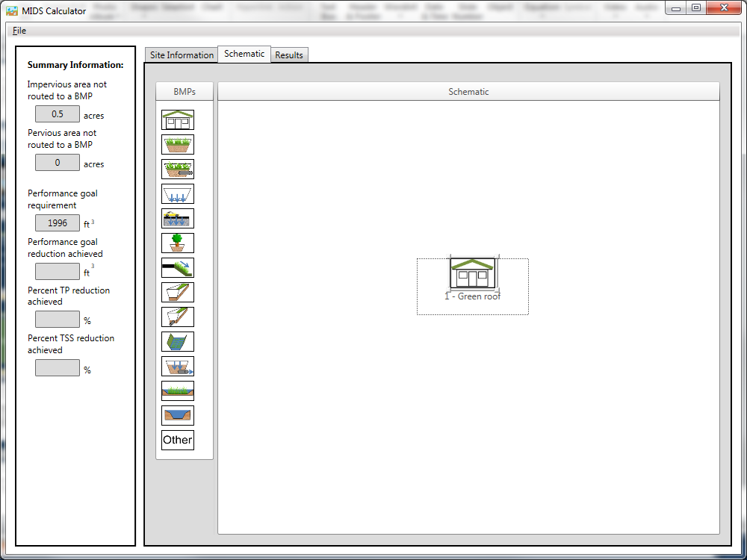

Slide 94
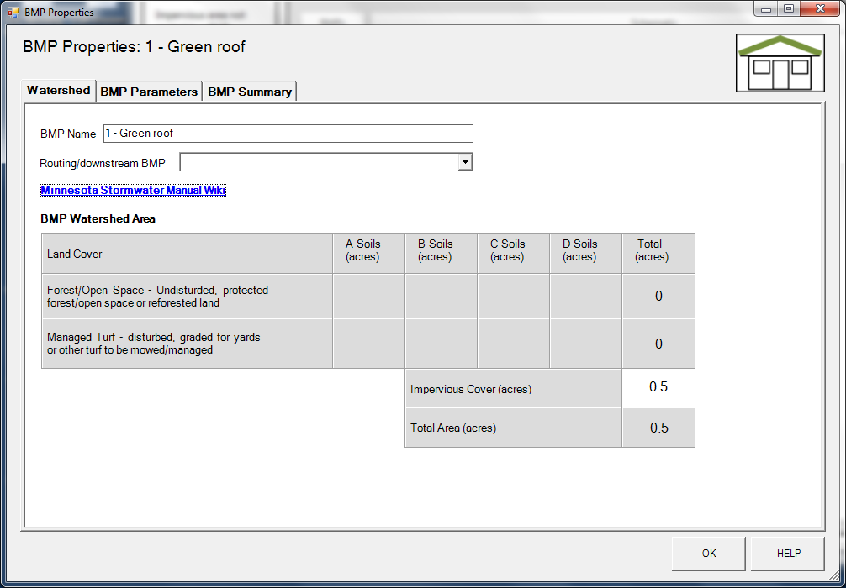
Can only enter impervious area into watershed area for green roof
Green roof area is included as impervious cover

Slide 95
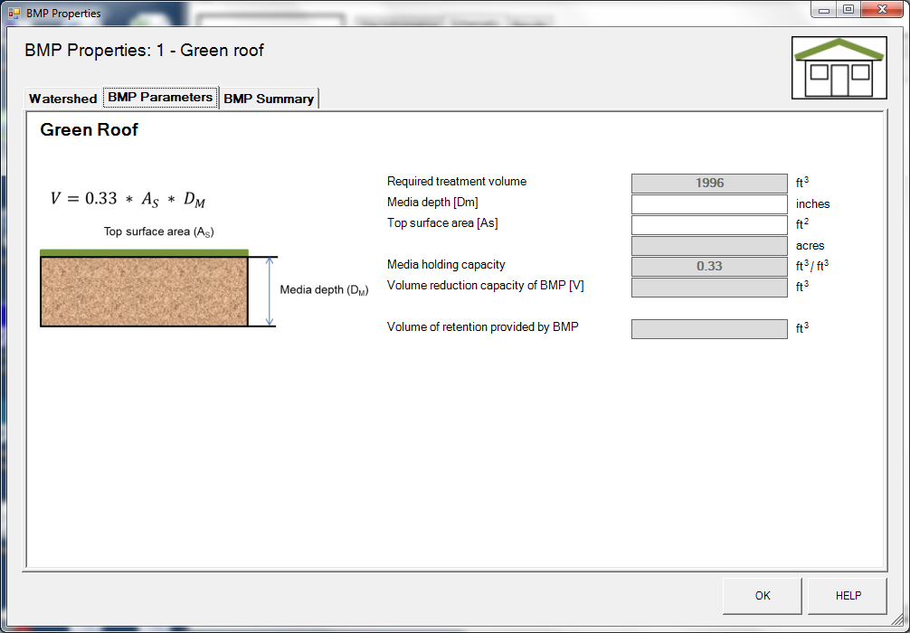

Slide 96
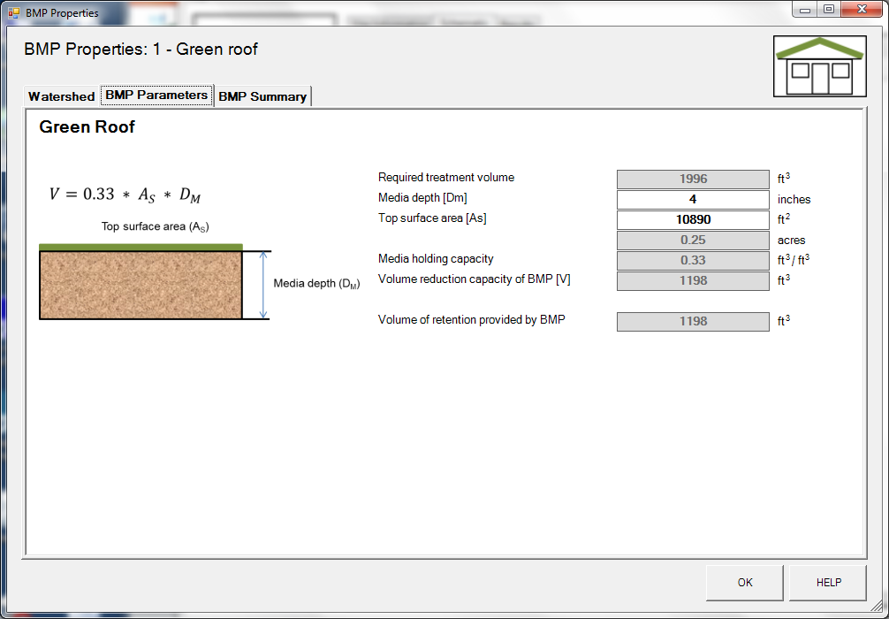

Slide 97
Annual Pollutant Load Reduction
Zero TP load reduction even through volume loss
Outflow TSS EMC (event mean concentration) always equal to 2.25 mg/l.

Slide 98
Design Requirements & Water Quality Note
Green roof media depth cannot be > 4 inches
Green roof area cannot be greater than the total impervious area routed to the green roof
Total impervious area (other contributing areas + green roof area) to green roof area ratio cannot exceed 2:1
Green roofs do not provide phosphorus load reduction

Slide 99
Non-Volume Reduction BMPs
Calculated from performance curves

Slide 100

Exercise 5: Several BMPs in Series
Zip Code: 55418

Slide 101
Exercise 5: Givens

Slide 102
Exercise 5: Givens

Slide 103
Exercise Steps
Enter Site information
Put all 6 BMPs into schematic window
Route all BMPs
Start entering BMP information.

Slide 104
Exercise 5: Assignment/Questions
Does the site meet the performance goal for new sites without restrictions?
Are any BMPs oversized or undersized?
Extra Time?:
Modify BMPs to optimize design (volume retention).

