Slide 1
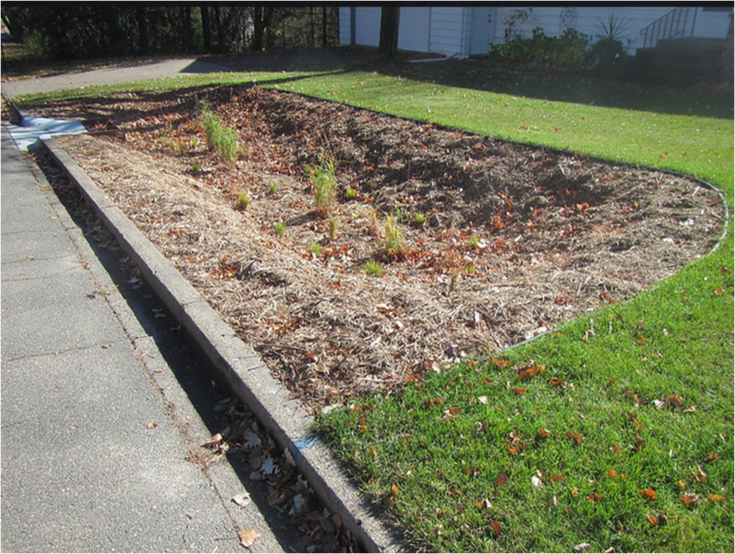

Engineered /Bioretention Media Webinar
Wednesday, May 26, 2021
Minnesota Pollution Control Agency

Slide 2
Speakers
Dr. Andy Erickson (University of Minnesota)
  Research on bioretention media
  Compost
Ed Matthiesen (Wenck Environmental Consulting and Engineering, now a part of Stantec) - Biochar
Dr. Keith Pilgrim (Barr Engineering) - Spent lime in permeable barriers
Curt Coudron (Dakota County) - Layered systems
Dr. Meijun Cai (University of Minnesota Duluth) - Peat, taconite

Slide 3
Some logistics
Webinar is being recorded
1.5 PDH offered
Please put questions in the chat box; will likely defer questions to the end
Everyone is muted; we can unmute if necessary
Everything will be posted in the Minnesota Stormwater manual on the page called Stormwater Manual webinars

Slide 4
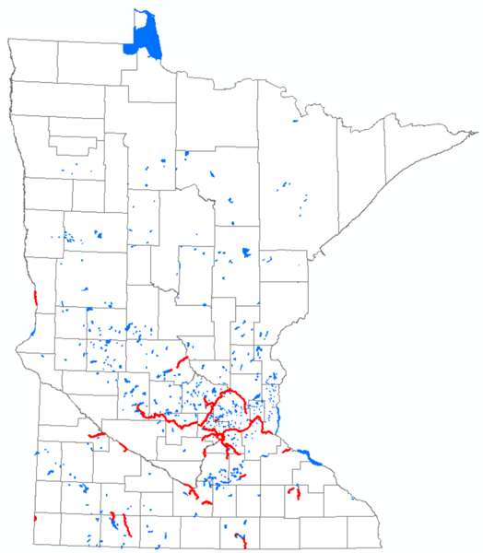
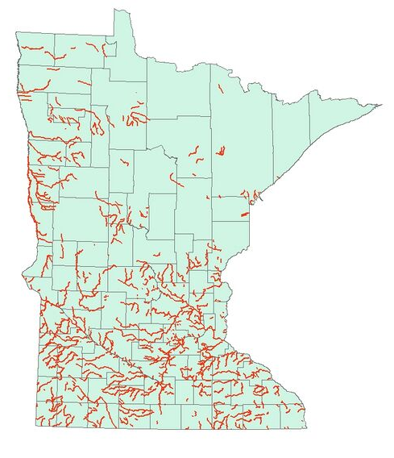
Why the focus on engineered media
Minnesota – The Land of XXX Impaired Lakes
“Traditional” BMPs often can’t get us all the way back to restored water quality
We are seeing a wide variety of amendments and designs
Phosphorus impairments
Bacteria impairments

Slide 5

Andy Erickson: University of Minnesota
Research on bioretention media

Slide 6

Ed Matthiesen (Wenck Environmental Consulting and Engineering, now a part of Stantec)
Biochar

Slide 7

Keith Pilgrim: Barr Engineering
Spent lime in permeable barriers

Slide 8

Curt Coudron (Dakota County)
Layered systems

Slide 9

Meijun Cai (University of Minnesota Duluth)
Peat, taconite

Slide 10
Andy Erickson: University of Minnesota
Compost

Slide 11
Other neat stuff
Amendments to ponds (lime, iron)
Iron in ditch checks
Coir, wood chips, Al- and Fe- water treatment residuals
Etc., etc.

Slide 12
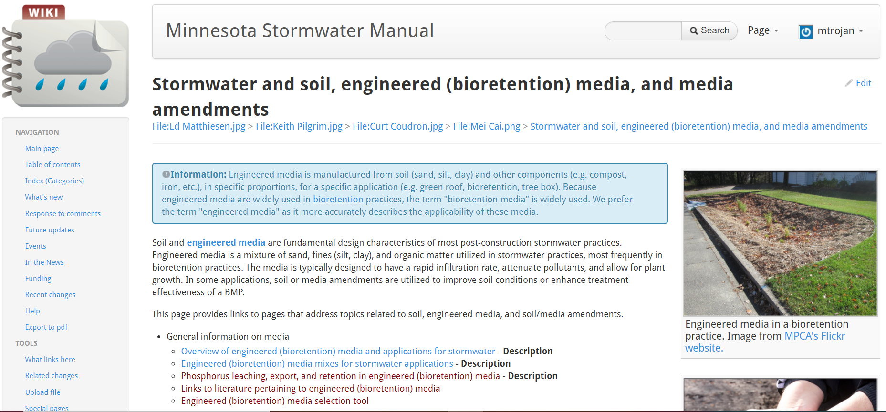
Stormwater and soil, engineered (bioretention) media, and media amendments

Slide 13
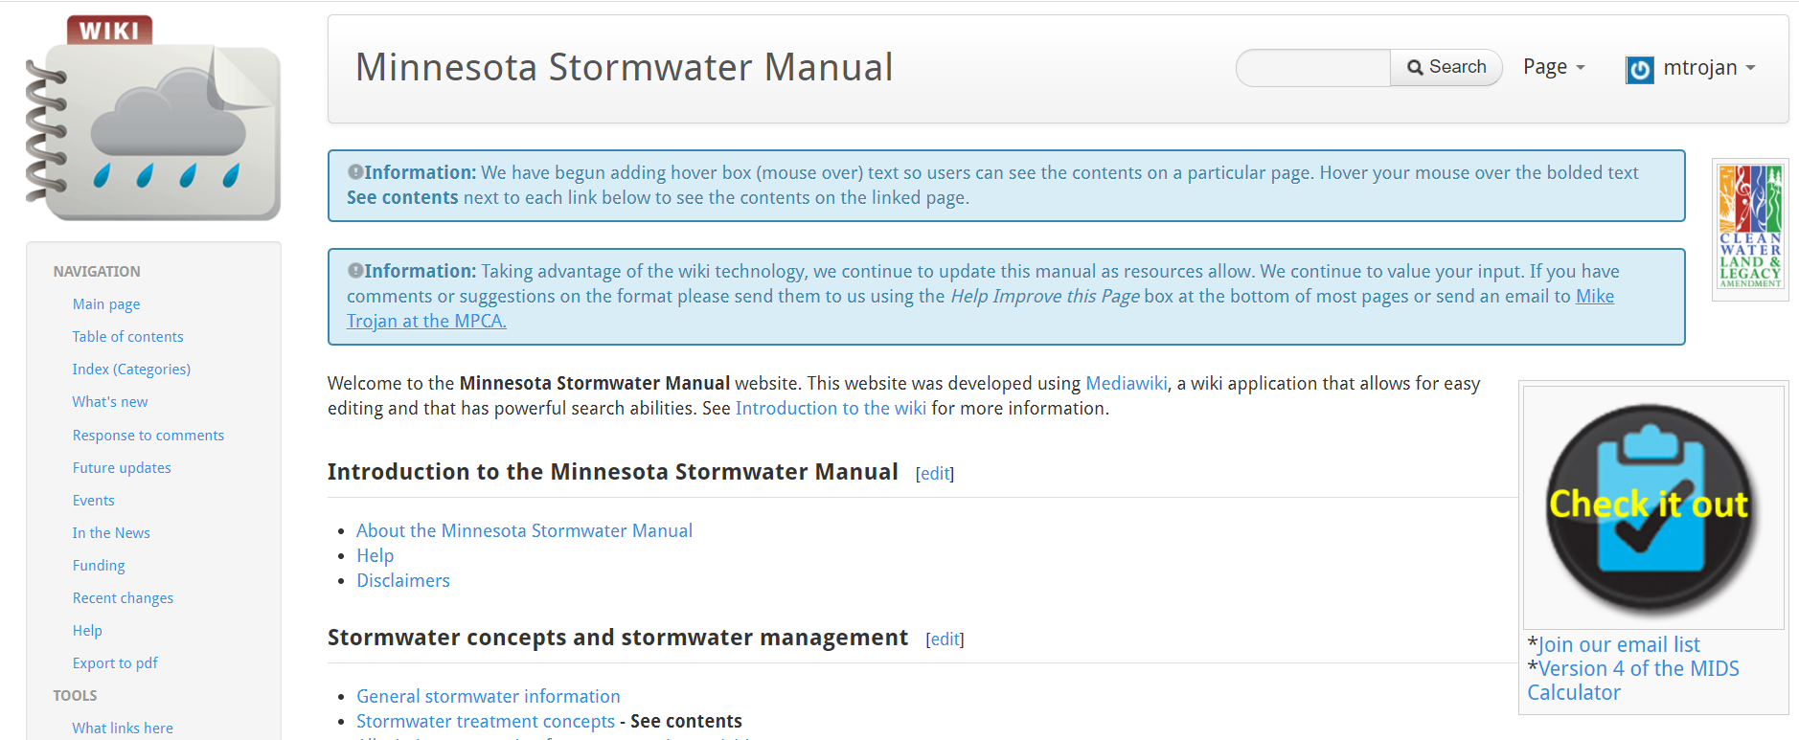
Some shameless self promotion
If interested, join our email list

Slide 14

Stormwater Manual links
Webinar info and pdh certificate located on page called Stormwater Manual webinars
See Stormwater and soil, engineered (bioretention) media, and media amendments (gradually being populated)
Mike.trojan@state.mn.us

