Slide 1

Infiltration at sites with potential contamination
Mike Trojan - MPCA
February 27, 2019

Slide 2
Note: this webinar was requested of MPCA by stakeholders. We encourage you to ask questions during the webinar so that we can clarify issues as we go through the material

Slide 3
Please submit questions using text box
If you have joined by phone and have a question that is complicated and/or is likely to require conversation, please request to be unmuted and we can interact via a phone conversation

Slide 4
The presenter is likely to move between Ppoint, the internet, an Excel spreadsheet, etc. during the webinar

Slide 5
We have received some specific questions and we’ll address those sometime during the webinar

Slide 6
Materials and answers to questions will be posted in the Stormwater Manual wiki on the page called Stormwater Manual webinars (https://stormwater.pca.state.mn.us/index.php?title=Stormwater_Manual_webinars)

Slide 7
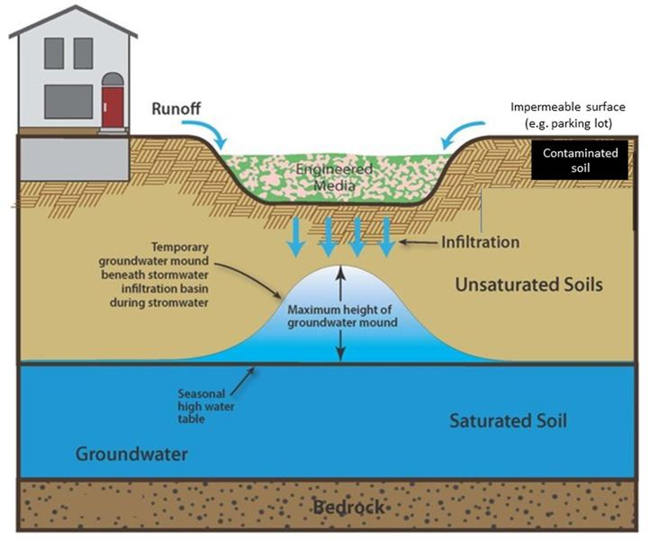
Content
Permit overview
Overview of screening checklist and guidance
Calculating separation distances
Navigating the guidance
Examples
Sites with likely or known contamination
Questions

Slide 8
Permit language
This permit prohibits permittees from constructing infiltration systems where infiltrating stormwater may mobilize high levels of contaminants in soil or groundwater. Permittees must either complete the MPCA's contamination screening checklist or conduct their own assessment to determine the suitability for infiltration. Permittees must retain the checklist or assessment with the SWPPP.
For more information and to access the MPCA's "contamination screening checklist" see the Minnesota Stormwater Manual.

Slide 9
I’m pretty sure my site has contamination. Why do I have to fill out the checklist?
When feasible, infiltration is the desired treatment practice because of water quality and hydrologic benefits
There are often places at a site with contamination where infiltration is feasible
Clean soils
Contaminated groundwater
Contaminated soils

Slide 10
I’m pretty sure my site is not contaminated. Do I have to fill out the checklist?
Not if you infiltrate and meet the volume requirement in the permit, but you might want to anyway because of liability concerns.
A person or party becomes liable when a release (MN Stat 115B.03) occurs
If a site is contaminated but no release occurs, liability assurances can be given

Slide 11
A question we received
What do we do with geotech reports that focus on construction issues instead of possible contamination?
Screening assessment should be completed before moving forward on the site

Slide 12
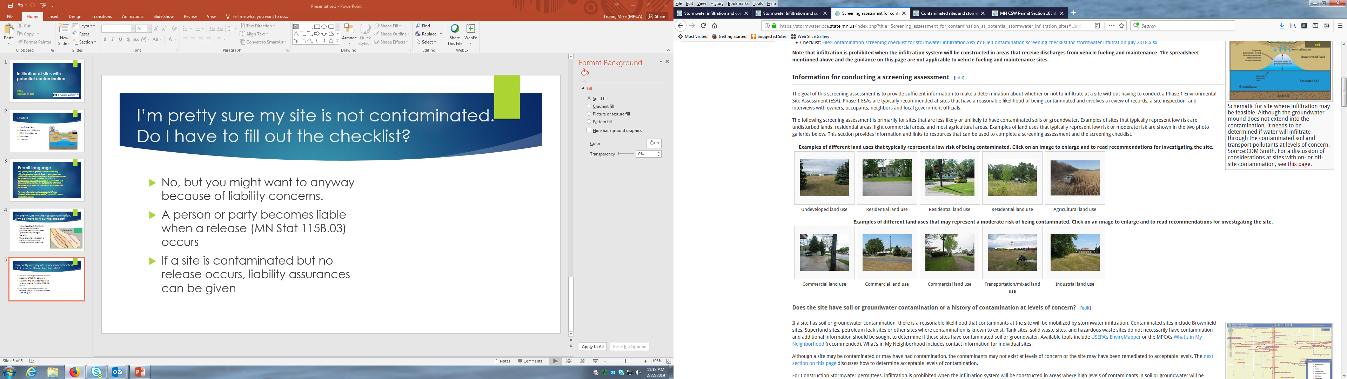
Lower risk sites
Higher risk sites

Slide 13
Contamination screening checklist for stormwater infiltration
We attempted to develop a method that does not require rigorous site investigation or sampling but does require some justification for not infiltrating
Likely provides conservative results (i.e. is more protective of groundwater)
https://stormwater.pca.state.mn.us/index.php?title=Screening_assessment_for_contamination_at_potential_stormwater_infiltration_sites

Slide 14
On-site assessment: Boxes 3 through 14

Slide 15
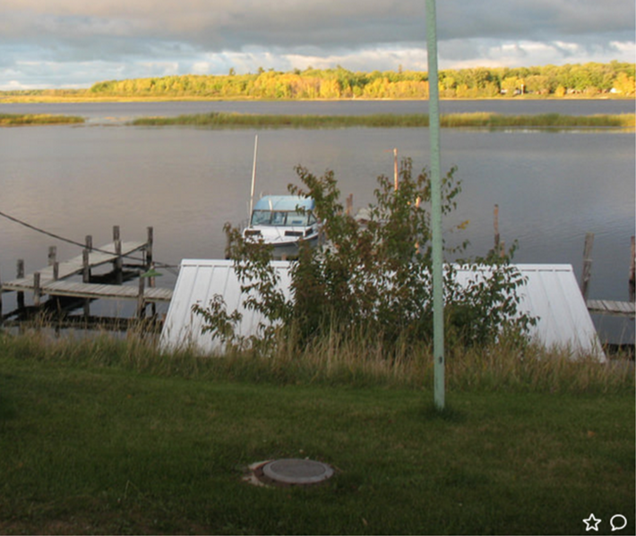
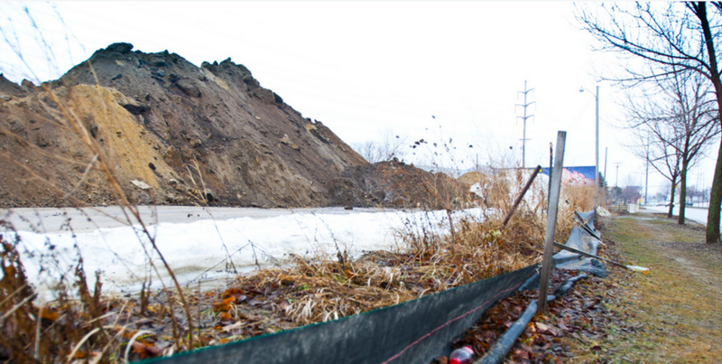
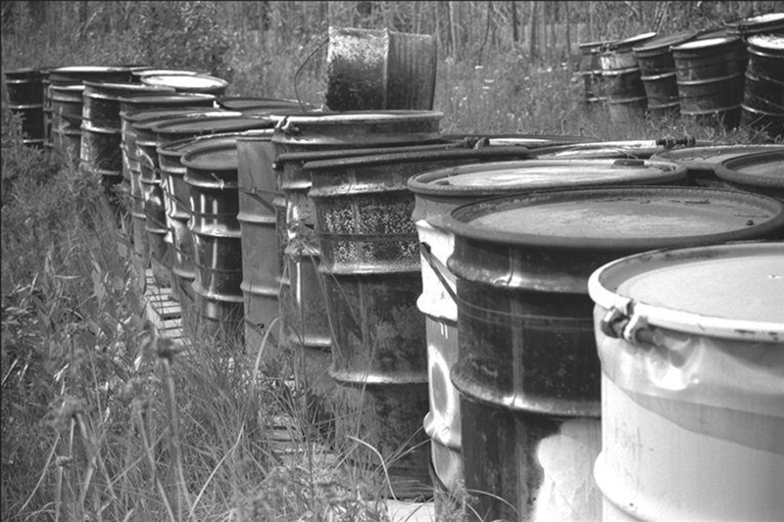
Check the appropriate box if this is present on site
Underground tank vent/fill port
Monitoring well
Covered soil piles
Stained soil or vegetation
Unusual odors
Mismanaged drums or containers
Excavations not backfilled with clean material
Presence of debris that may harbor contaminants
Site is a confirmed hotspot

Slide 16
If you checked any box 4-12 and can’t clarify if it is a concern, determine if you can achieve separation from the feature

Slide 17
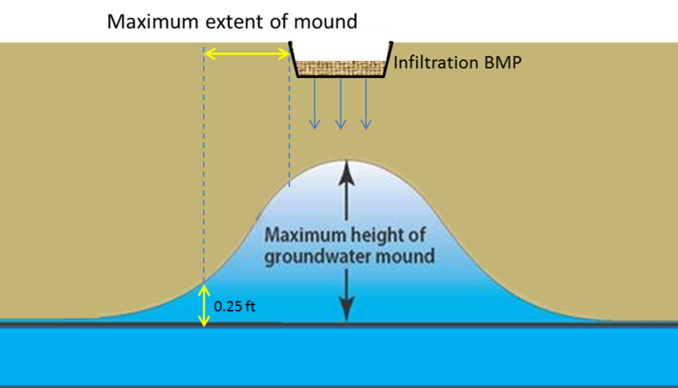
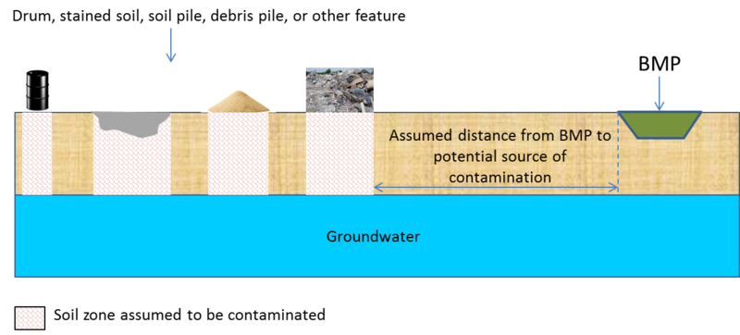
What is separation or an influence zone?
The distance from a BMP at which a groundwater plume from the BMP would not intersect contamination

Slide 18
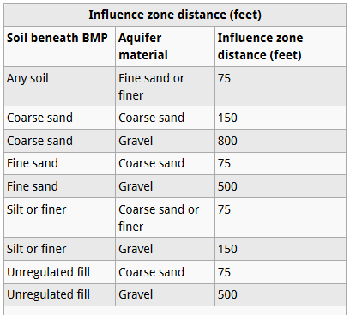
How do I calculate separation or the influence zone?
Use the default values in the Minnesota Stormwater Manual
Calculate using the USGS mounding calculator referenced in the manual (will go through example later)
Calculate using another acceptable method

Slide 19
If you have no features of concern on the site or can achieve separation, move on to Box 15

Slide 20
Off-site assessment: Boxes 15 through 28
Note: the only concern with an adjacent property will be mobilization of contaminants in groundwater, but the assessment considers the same features as boxes 3-14. The reason is that these features could be sources of groundwater contamination. The assumption throughout the checklist is that a feature could be a source of groundwater contamination.

Slide 21
Some features of the checklist
You must go through on- and off-site assessments before being able to infiltrate
You may choose not to infiltrate anytime there is a feature that might contribute to groundwater contamination
The decision to infiltrate is based on separation from these features (or features not being present)

Slide 22
Calculating a separation distance (influence zone) using the USGS spreadsheet
Infiltration rate of soil at site
Aquifer specific yield
Aquifer hydraulic conductivity
Length and width of the infiltration BMP basin
Duration of infiltration
Initial thickness of the aquifer
https://stormwater.pca.state.mn.us/index.php?title=Screening_assessment_for_contamination_at_potential_stormwater_infiltration_sites

Slide 23
What if my site is/was contaminated?
Boxes 1 and 2 in the spreadsheet address this situation

Slide 24
I failed the screening assessment – now what?
You are not required to infiltrate under the CSW permit
Document your decision and keep on record
There may be local requirements more stringent than the CSW permit
You may choose to further investigate. Presence of one or more of the features in the checklist does not prove contamination exists.
You may choose to conduct a Phase 2 investigation, which includes sampling

Slide 25

Example 1
UST
UST
Two USTs but no documented release
Former structures demolished but uncertain how material was disposed
Fill soils present
Possible wells and/or septic system present
Parking

Slide 26
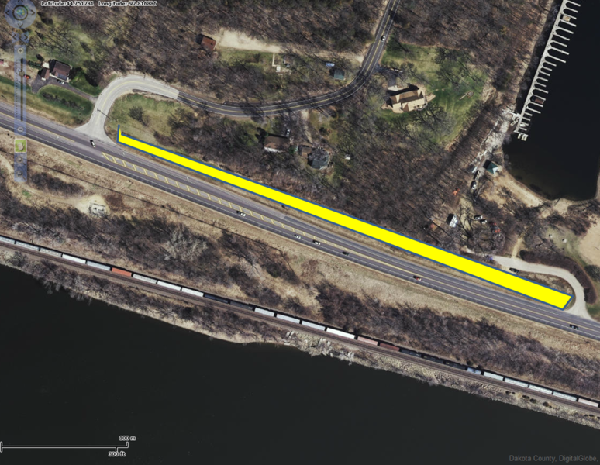
Example 2
200 feet
Proposed swale with check dams over B soils
No current or past history of contamination
Aboveground fuel tank nearby
Stained soils along the railroad
Separation distance = 200 feet (including safety factor of 2)
Site fails screening assessment but we want to pursue infiltration

Slide 27

We want to pursue infiltration so we conduct borings
Concentration (mg/kg) | DTW (ft) | SLV – Cu (mg/kg)
6500 | 3 | 2810
7951 | 3 | 2810
2684 | 3.5 | 3160
597 | 3.5 | 3160
58 | 4 | 3510
29 | 5 | 4210
104 | 5 | 4210

Slide 28

Scenario 3: Off-site contamination may be impacted
Usually groundwater down-gradient of or very near the site
Could also be contaminated soil near the water table
Need to build in safety factor or sample to determine groundwater flow and location and concentration of contaminants in soil and groundwater
Infiltration practice
Contaminant
X
Mound
< 0.25 feet

Slide 29
Some questions we’ve received
What do we do with geotech reports that focus on construction issues instead of possible contamination?
How do we address spacing when we have insufficient information about the location of the contamination, the way in which the plume is moving or changing, and groundwater flows?
How much expense is reasonable to expect or demand for an accurate delineation of a contamination plume?
How do we balance the prudent urge to avoid any possible contamination with the regulatory pressure to infiltrate stormwater?

Slide 30
Some questions we’ve received
The guidance on this page recommends creating a groundwater model if there is known contamination near a desired infiltration site. What about collecting empirical / monitoring data? How does that play into your recommendations?
Do you have technical guidance on how that modeling or empirical data collection should be done and questions that need to be addressed? Spatial and temporal resolution? Number of years of data collection or analysis required? How should one define baseline conditions (to show they're not making things 'worse')? Should the analysis be performed for a variety of hydrologic regimes? How are those defined?

Slide 31
Some questions we’ve received
If there is no technical guidance available, who can we contact to discuss these topics and gain insight on developing a monitoring / modeling plan?
If you follow the guidance on this page and it results in an outcome showing that infiltration practices are not expected to negatively impact contamination are you still liable if something happens?
Is this process regulated? Who is the regulatory contact to define what level of analysis is required at a site to ensure things are OK? (City, State or other)

Slide 32
Taking a tour of the guidance in the manual
https://stormwater.pca.state.mn.us/index.php?title=Stormwater_infiltration_and_contaminated_soils_and_groundwater

Slide 33
mike.trojan@state.mn.us Stormwater infiltration and contaminated soils and groundwater

