Slide 1
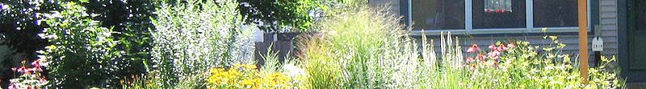
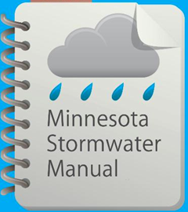




Updates to the Minnesota Stormwater Manual
Stormwater and Rainwater Harvest/Use
January 25, 2017

Slide 2
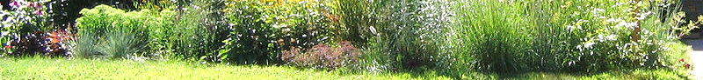
Questions?
Please use the chat box if you have questions.
We will try and answer during the webinar
All Q&A will be posted in the manual

Slide 3
Professional development hours
1.5 PDHs offered
Access to certificate will be posted on the Stormwater manual webinars page.
This power point presentation and other information will be available on this page.
Notes:
Or will this be a link in the manual for a certificate? Explain that we keep a record of attendees-that’s the only way you can get PDH’s. We have to show proof.

Slide 4
Survey
Please fill out the survey after the webinar is finished. It will appear on your screen. We appreciate your feedback and welcome ideas on how to make improvements.
Notes:
Polls or survey?

Slide 5
Upcoming webcasts
Mid March: Updates to the Minimal Impact Design Standards Calculator
Let us know what topics you are interested in

Slide 6
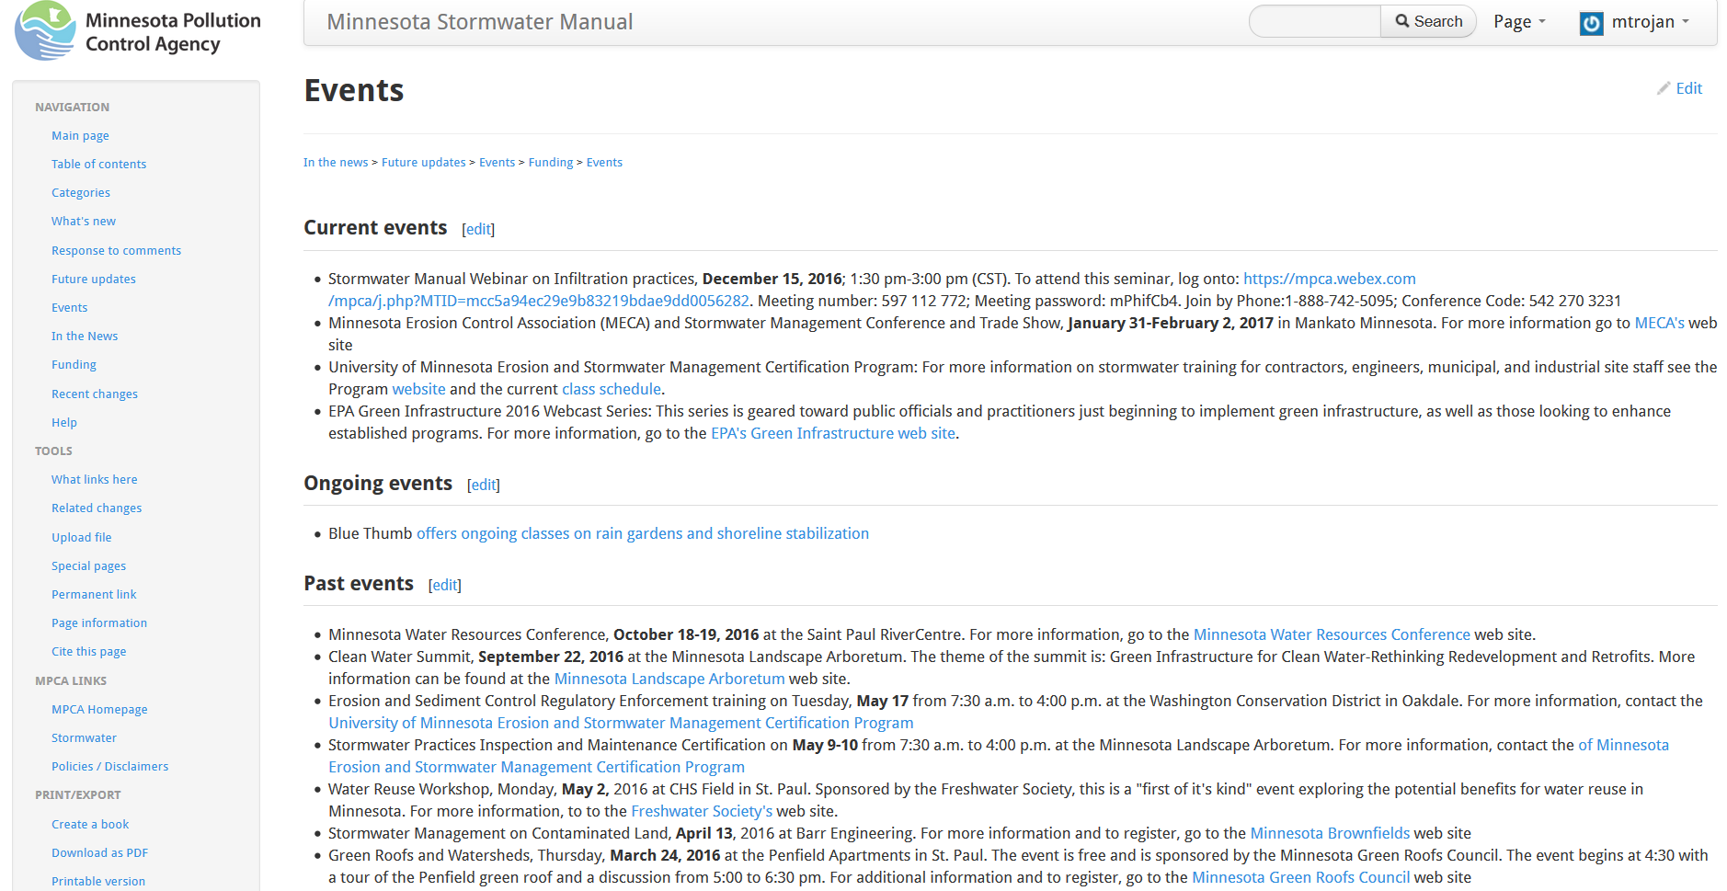

Slide 7

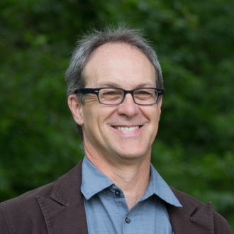

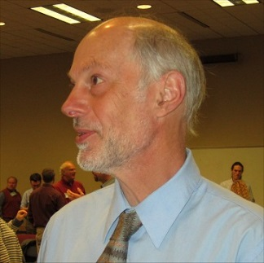
Presenters
Meghan Funke and Brett Emmons, Emmons & Olivier Resources
Anne Gelbmann, Minnesota Pollution Control Agency
Mike Trojan, Minnesota Pollution Control Agency
Contact information
Mike.Trojan@state.mn.us
MN Stormwater Manual – (easier to find with a Google search) http://stormwater.pca.state.mn.us/index.php/Main_Page

Slide 8
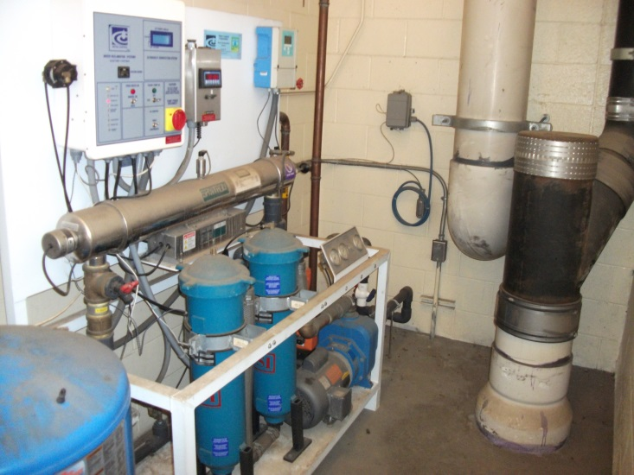
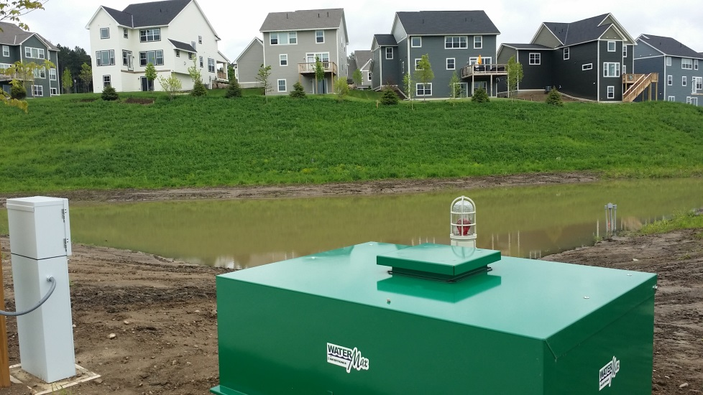
The MPCA executed a work order with the following objectives
Provide an overview; definitions, uses, applicability, benefits, limitations.
Guidance on design elements
Construction sequence
Operation, maintenance and monitoring
City of Shoreview
Inver Grove Heights

Slide 9
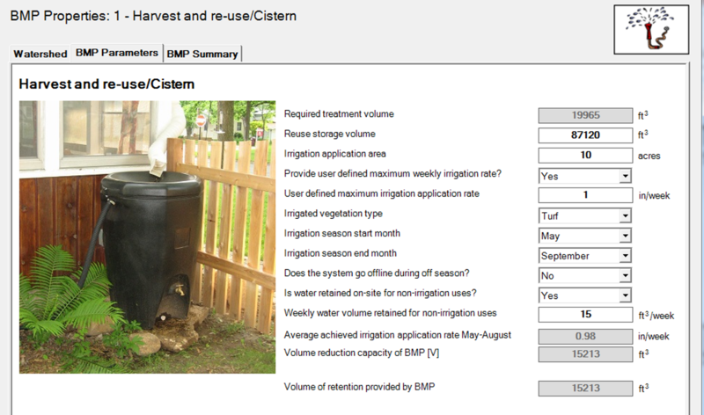
Work order objectives (continued)
Water quality considerations
Environmental concerns
Costs
Calculators – in progress
Credits (MPCA)
Case studies (MPCA)
Notes:
Change photos

Slide 10
Contractor: EOR
Meghan Funke, PhD
Brett Emmons, PE
Derek Lash, PE
Steve Pellinen, PE
Paula Kalinosky
Britta Hansen
MPCA Project Manager: Anne Gelbmann
Notes:
Add EOR staff

Slide 11
Technical Support team
Anita Anderson, MN Department of Health
Tina Carstens, Ramsey Washington Metro Watershed District
Brian Davis, Metropolitan Council
Sharon Doucette, City of Woodbury
Stephanie Johnson, Mississippi Watershed Management Organization
Paul Moline, Carver County
Wes Saunders-Pearce, City of St. Paul
Dave Stark, Rainwater Management Solutions
Todd Smith, MN Pollution Control Agency
Mark Zabel, Dakota County
Nate Zwonitzer, Capitol Region Watershed District

Slide 12
Other Contributors
Tim Malooly and Rich Koechlein, Water in Motion, Eagle Valley Golf Course Stormwater Harvest and Irrigation System
Dan Curley and Mark Maloney, City of Shoreview, Maintenance Facility Rainwater Harvesting and Toilet Flushing System
Kristen Asher, City of Richfield

Slide 13
Presentation outline
Summary of information
Tour of harvest use/reuse section in the manual-links throughout the webinar
Harvest and use in the MIDS calculator
Breaks for Q&A
Notes:
MIDS Calculator???

Slide 14
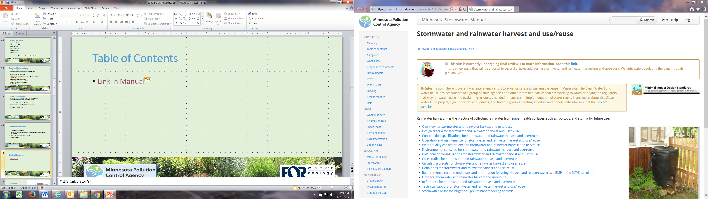
Table of Contents
Q & A
Link
Q & A
Q & A
Q & A
Q & A
Notes:
MIDS Calculator???

Slide 15
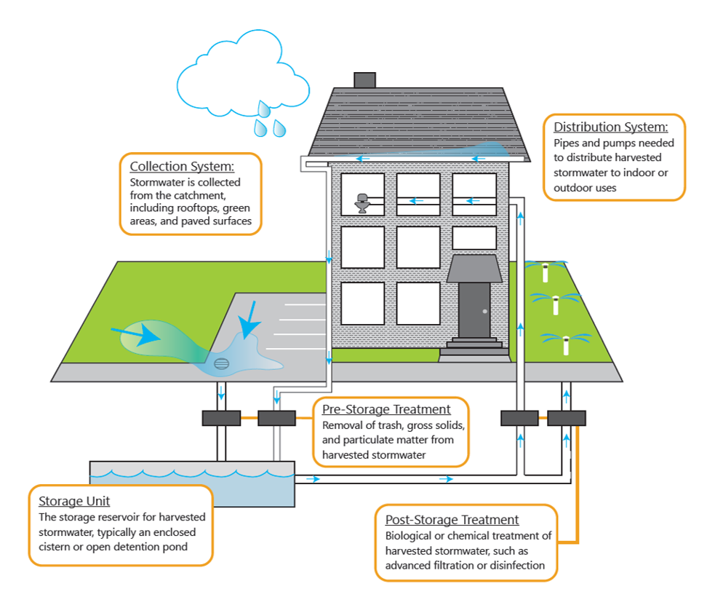
Overview
Definitions
Beneficial uses
Outdoor uses
Indoor uses
Benefits
Codes and standards
Considerations
Link in Manual

Slide 16
Design Criteria
Overview of phases
Feasibility phase
Pre-design phase
Design phase
Implementation phase
References
Link in Manual

Slide 17
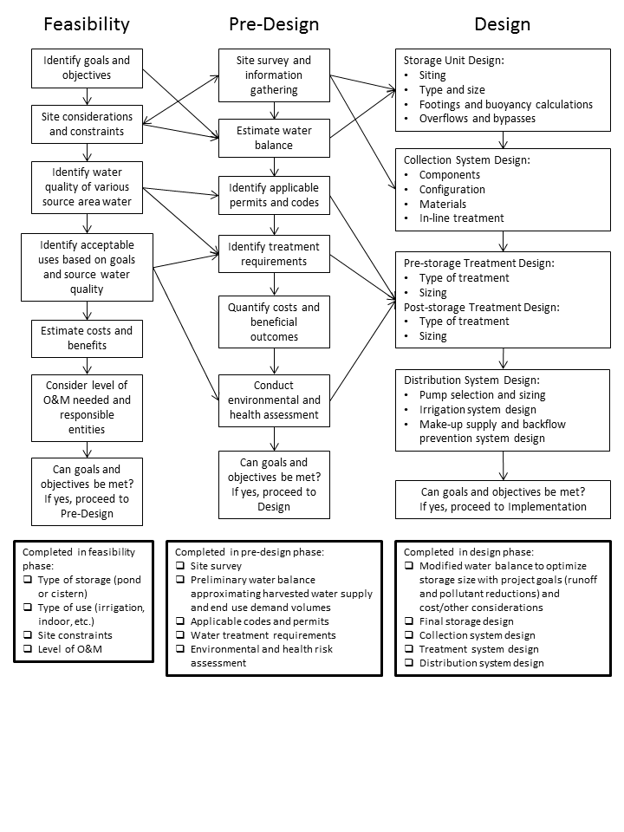
Design Phases
Feasibility phase
Pre-design phase
Design phase
It’s an iterative approach!
Link in Manual

Slide 18
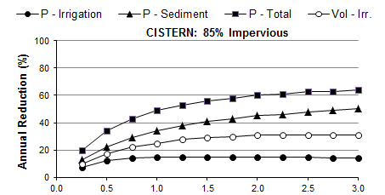
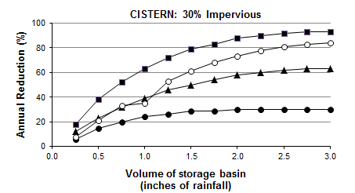
Design phase
Storage Unit: tank/pond
Link in Manual

Slide 19
Design phase
Storage Unit: tank/pond
Collection System: roof/ground
Treatment Systems: pre-/post-
Distribution System
Make-up supply & backflow
Link in Manual

Slide 20
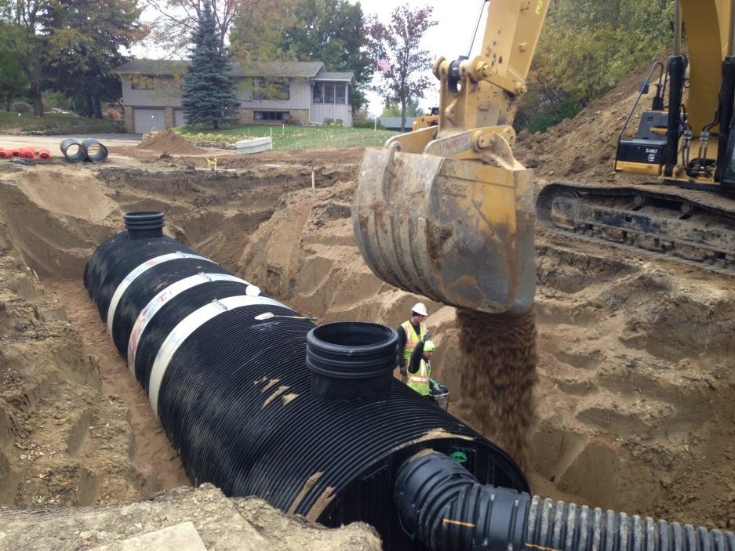
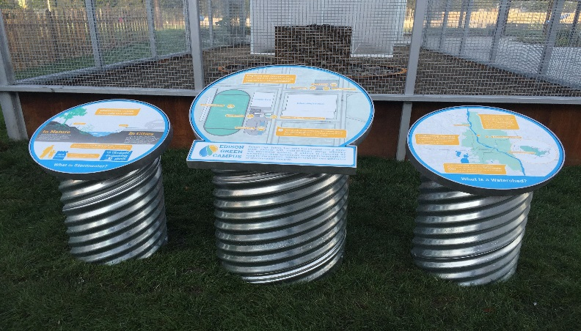
Implementation phase
Preconstruction meeting
Construction activities
Permitting
Signage & safety features
Testing & commissioning
O&M and monitoring plans
Cooperative goals (education/outreach)
Link in Manual
EOR

Slide 21
Questions?
Use chat box

Slide 22
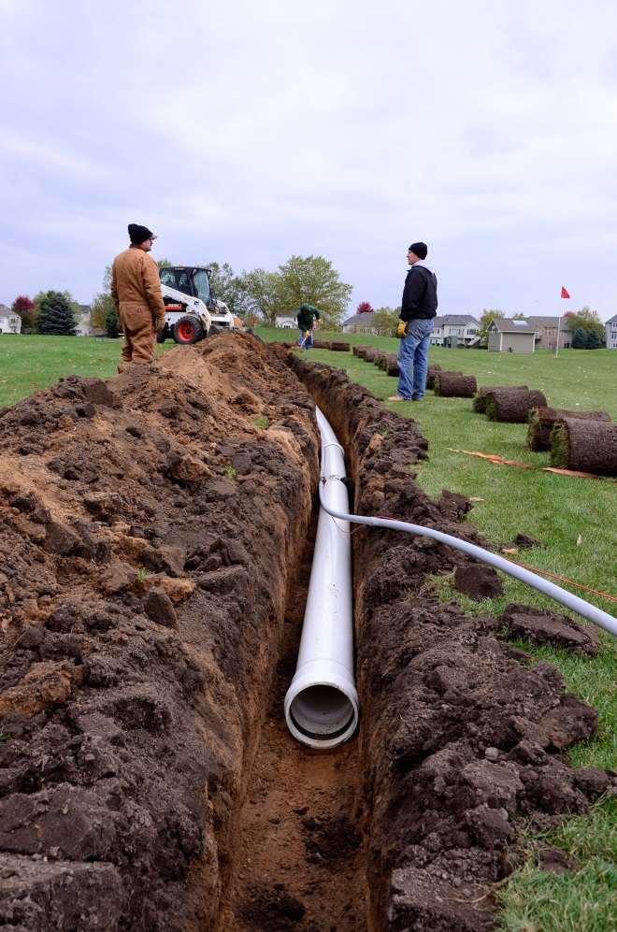
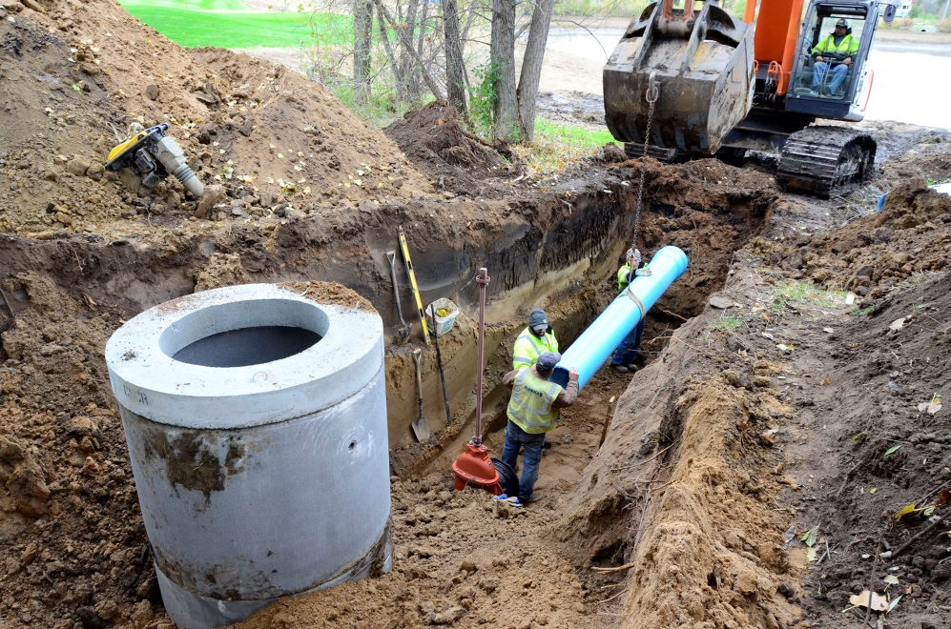
Construction Sequencing
Step-by-step sequence
Sample inspection report
Link in Manual
Water in Motion
Water in Motion
Notes:
Fix photo and provide link to manual

Slide 23

Operation and Maintenance
Agreements (responsible party)
O&M Activities
Winter Decommissioning
Tracking (record keeping)
Sample forms
Summary table
Link in Manual
City of Shoreview Maintenance Facility
Notes:
Link to table in O&M summary, winter decommissioning and forms/checklists

Slide 24
Questions?
Use chat box

Slide 25
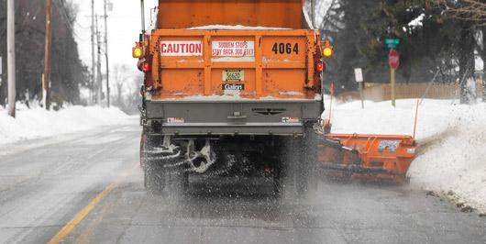
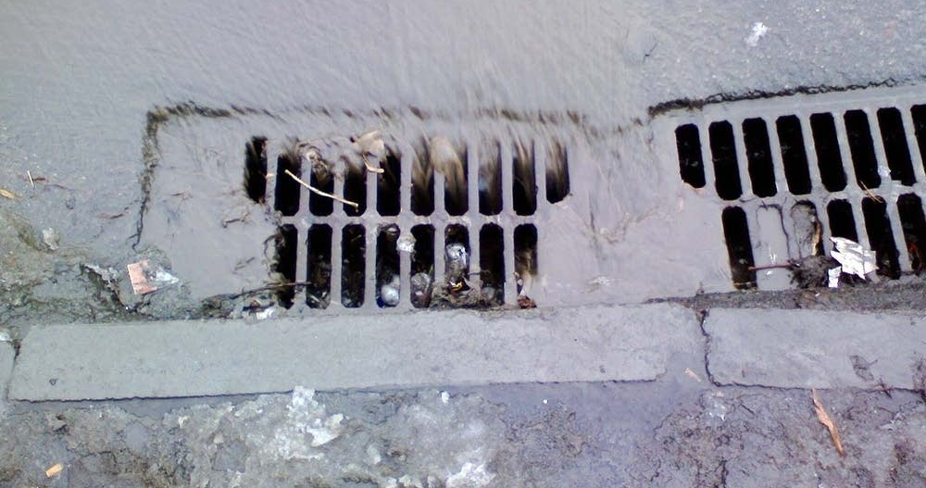
Water Quality Considerations
Pollutants in harvested water
Seasonal considerations
Treatment requirements
National Water Research Institute Advisory Panel
Minnesota Plumbing Code (effective Jan. 23, 2016)
Link in Manual
MPCA
MPR
Notes:
Pollutants by source table; plumbing; emphasize new terms: pre and post storage

Slide 26
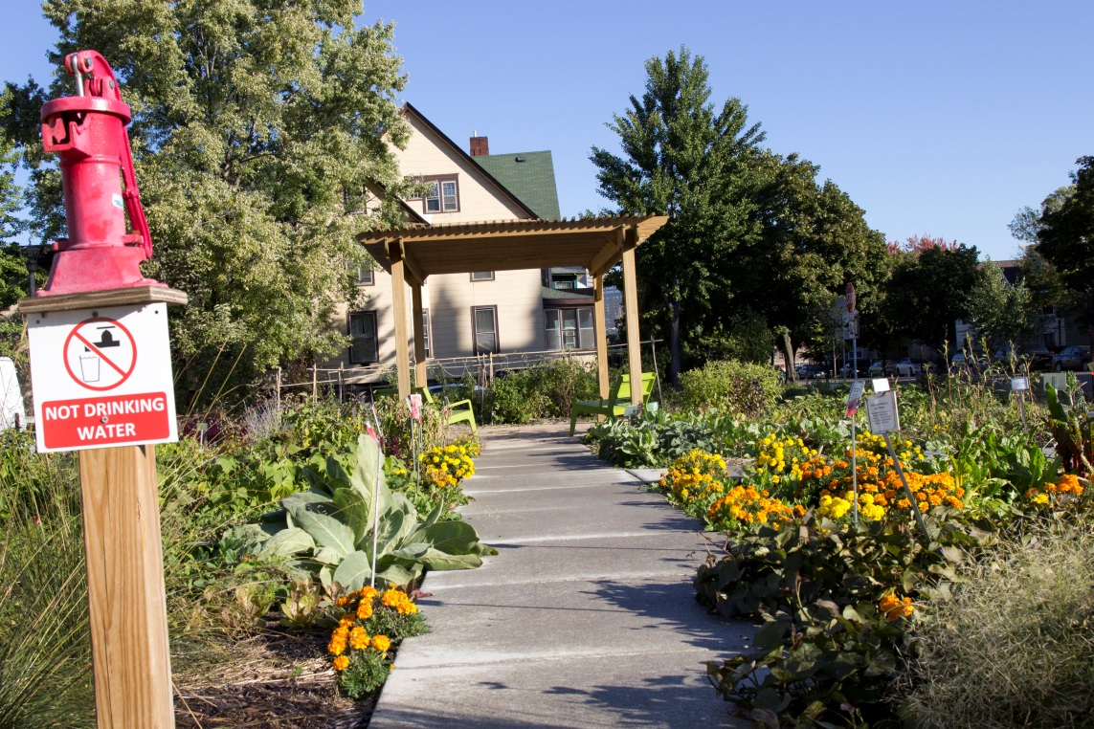
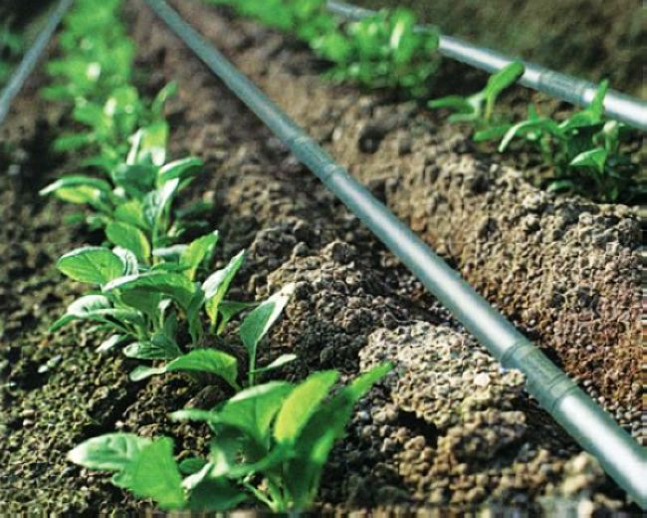
Environmental Concerns
Risk Assessment
Human health risks
Ecological risks
Managing risk
Table showing elements of system
that address potential risks
Link in Manual
EOR – The Rose
Notes:
Potential exposure; managing risk table

Slide 27
Questions?
Use chat box

Slide 28
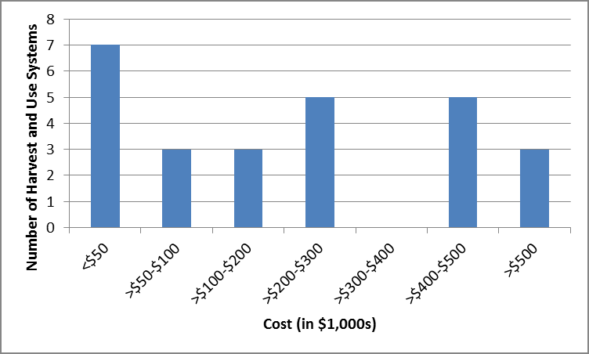
Cost-benefit Considerations
Total system costs
Itemized component costs
Example contractor bids
Funding sources
Financial incentives/benefits
Link in Manual
Notes:
Potential exposure; managing risk table

Slide 29
Case studies - Link
Mississippi Watershed Management Organization
More to come!!
We are always looking for good case studies. If you have a good case study, contact us and we can discuss.
We are always looking for good photos. Send them to us with the proper source crediting.

Slide 30
Questions?
Use chat box

Slide 31
MIDS calculator
Calculates daily potential evapotranspiration (PET). A user can also enter a daily maximum rate of use. The calculator uses the smaller of these two values to calculate the volume credit.
Users can enter a weekly volume used for non-irrigation purposes. This volume is credited toward the performance goal.
For A soils, the user can specify a weekly application rate of up to two inches per week.
If precipitation on a given day is less than the daily use (for irrigation and non-irrigation), the difference between daily use and precipitation is credited, if water is available in storage.
Notes:
Mike will do this-need new screen shots

Slide 32
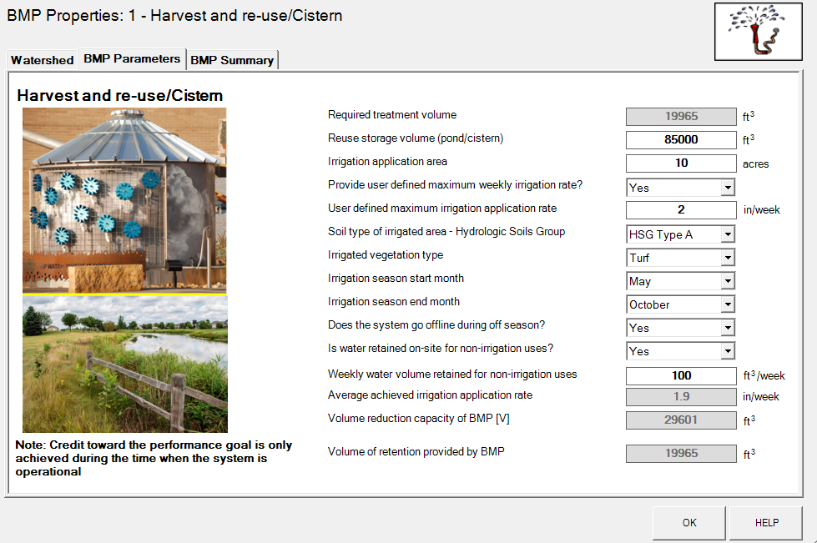
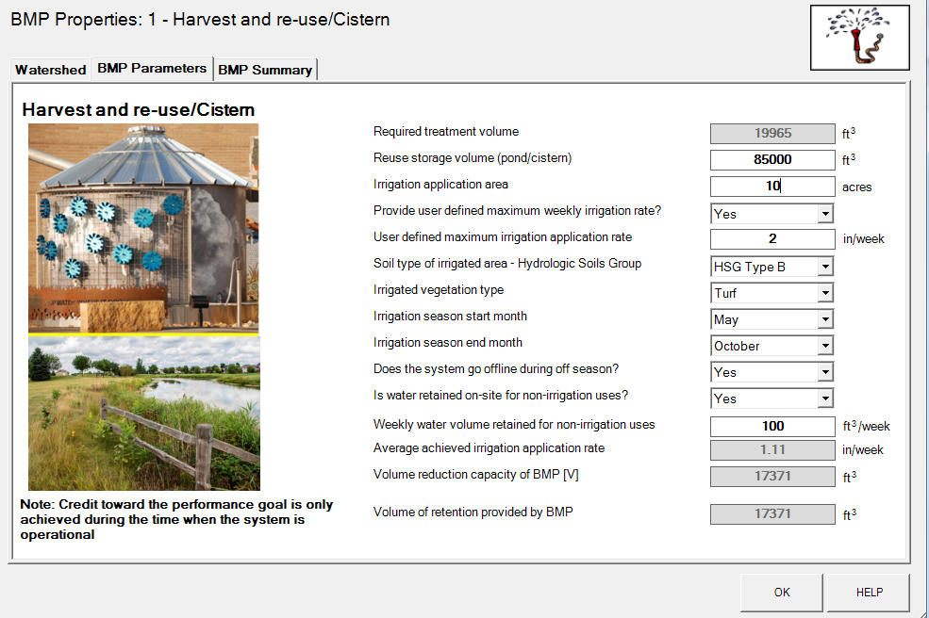
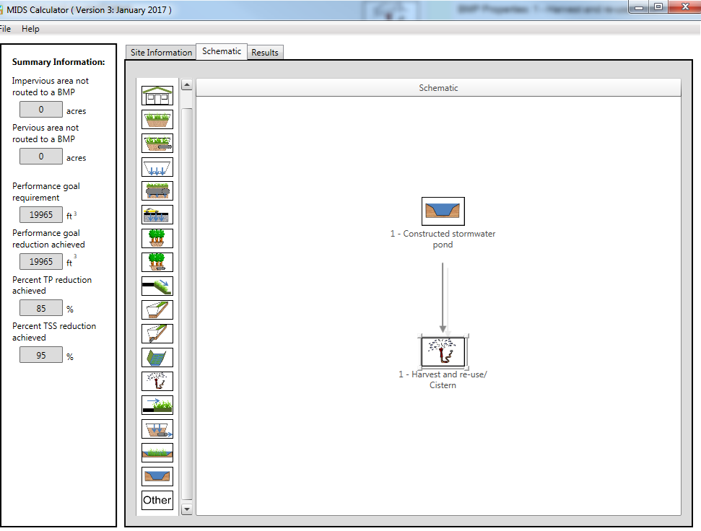
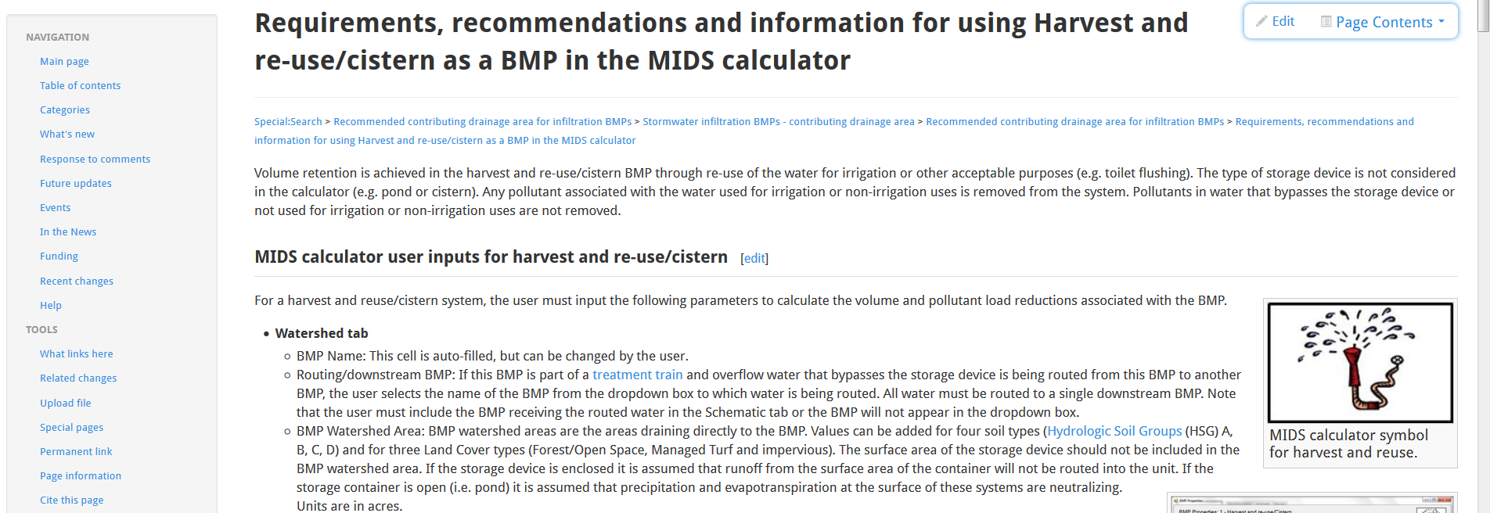
HELP takes you to this page

Slide 33
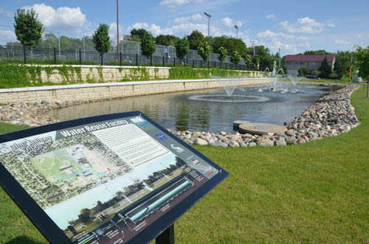
Questions?
Use chat box

Slide 34
Upcoming webcasts
Mid March: Updates to the Minimal Impact Design Standards Calculator
Let us know what topics you are interested in

Slide 35
Survey/PDH’s
Survey will appear after webinar-please fill it out.
PDH certificate will be posted here

