Slide 1
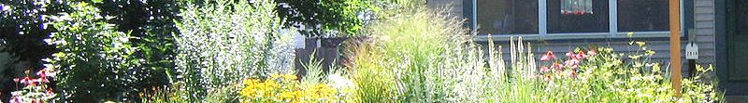
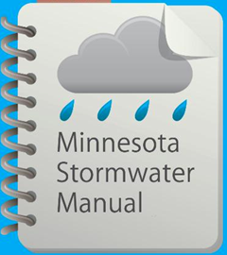



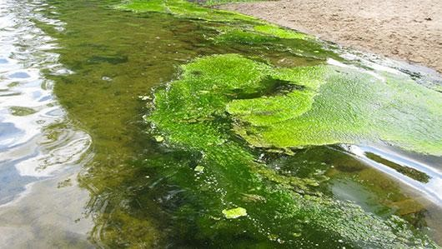
Maximizing stormwater BMPs for Phosphorus Removal
January 9, 2018

Slide 2
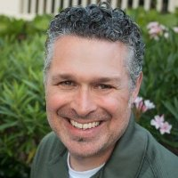
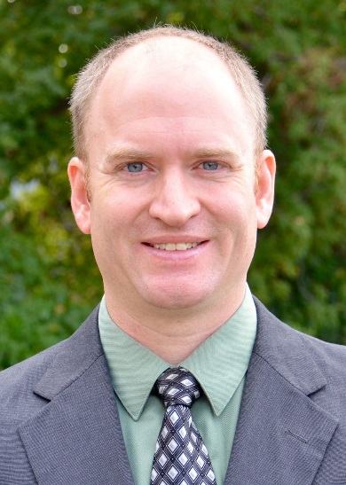
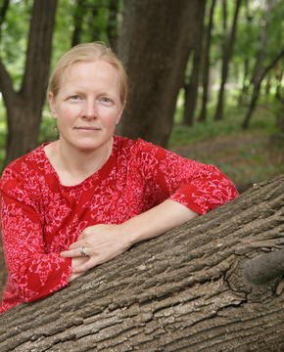
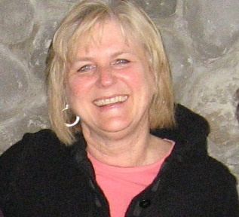
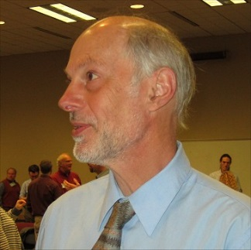
Presenters
Joe Bischoff - Principal Aquatic Ecologist; Wenck Associates, Inc.
Dr. Andy Erickson - Research Associate; St. Anthony Falls Laboratory; University of Minnesota
Dr. Sarah Hobbie – Professor; Ecology, Evolution, and Behavior; University of Minnesota
Anne Gelbmann – moderator
Mike Trojan - Intro
Contact information
  Mike.Trojan@state.mn.us
  MN Stormwater Manual – (easier to find with a Google search) http://stormwater.pca.state.mn.us/index.php/Main_Page

Slide 3
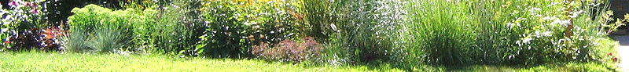
Questions and other stuff
Please use the chat box if you have questions.
We will try and answer during the webinar
All Q&A will be posted in the page called Stormwater Manual webinars
Webinar is recorded and will be posted in the manual
This PPoint will be posted in the manual

Slide 4
Professional development hours
2.0 PDHs offered
Access to certificate will be posted on the Stormwater manual webinars page

Slide 5
Topics for today’s webinar
Brief overview of phosphorus impairments in Minnesota
Understanding how 3 BMPs have often not effectively worked for P removal but can be designed to be more effective
  Constructed wet ponds
  Biofiltration (bioretention with an underdrain)
  Street sweeping/tree litter management

Slide 6
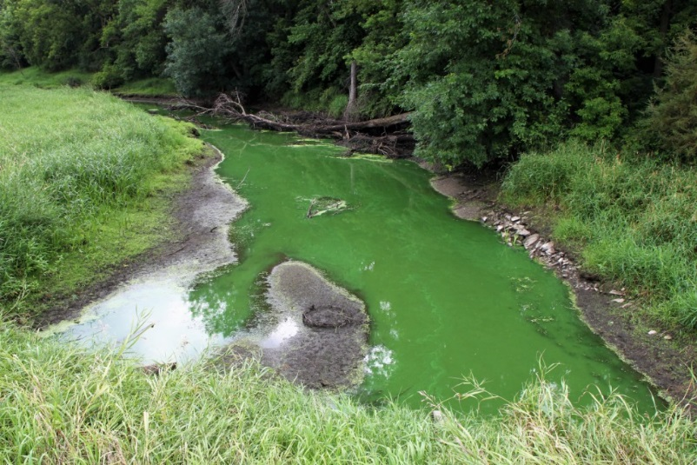
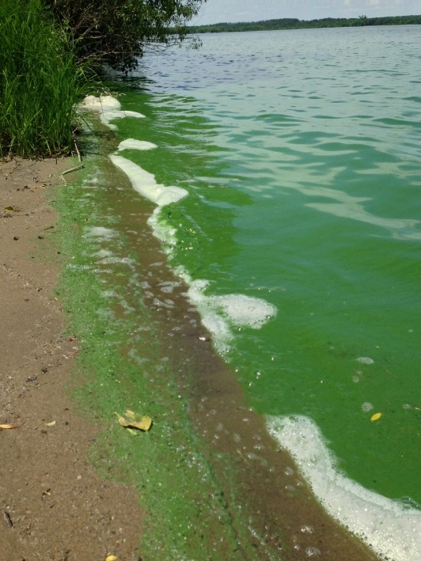
Why we care about phosphorus (P) in lakes and streams
Minnesotans love their lakes and streams
P is the primary driver of algal growth and attached periphyton
Limits recreational opportunities
Contributes to production of blue-green algae
  Potential for increased toxic algal blooms
Swings in oxygen concentrations can lead to fish kills

Slide 7
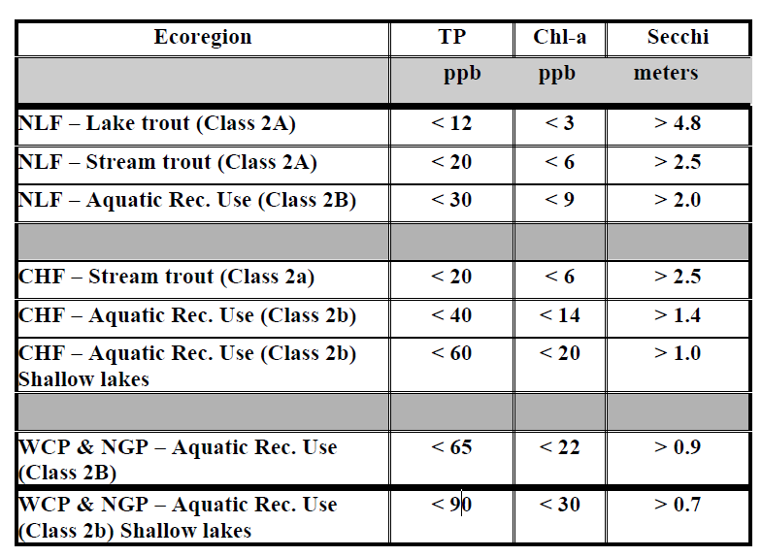
Lake Eutrophication Assessments
Need minimum of 8 samples, collected June through September, spanning a minimum of 2 years
Assessments utilize surface data (3 meters or less in depth)
Phosphorus must exceed AND either Secchi or chlorophyll-a must exceed for an impairment to be determined
Typical concentrations of TP in urban stormwater are 200 to 300 ppb

Slide 8
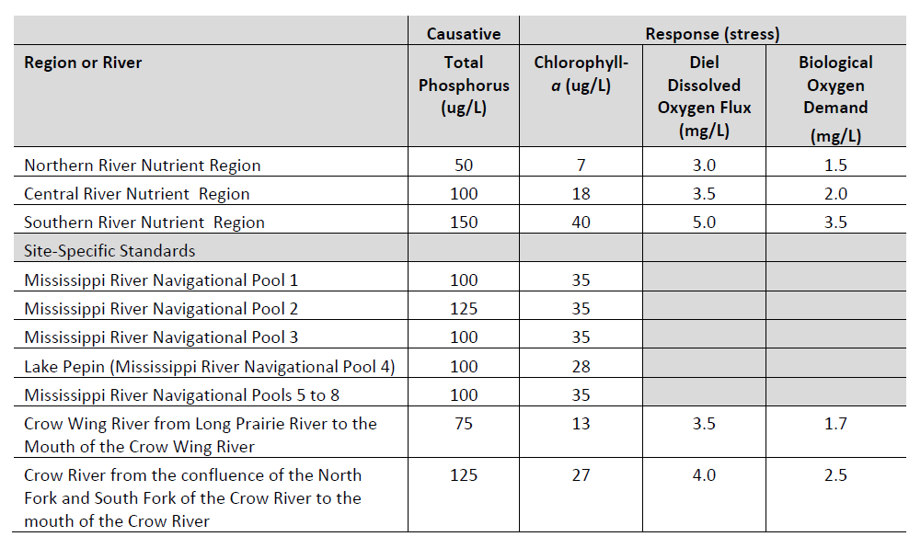
River Eutrophication Assessments
Need minimum of 12 samples, collected June through September, spanning a minimum of 2 years, and 2 separate deployments for continuous DO in separate years
Phosphorus must exceed AND either chlorophyll-a, BOD, dissolved oxygen flux, or pH must exceed
Direct measures of periphyton may also be used to determine impairment
Typical concentrations of TP in urban stormwater are 200 to 300 ppb

Slide 9
Extent of Lake Impairments for Eutrophication
First used for the 2002 Impaired Waters List
596 impairments through the 2016 Impaired Waters List
50 additional eutrophication impairments proposed for the 2018 list

Slide 10
Extent of River/Stream impairments for Eutrophication
42 impairments identified on the 2016 impaired waters list
6 additional impairments proposed on the 2018 impaired waters list

Slide 11
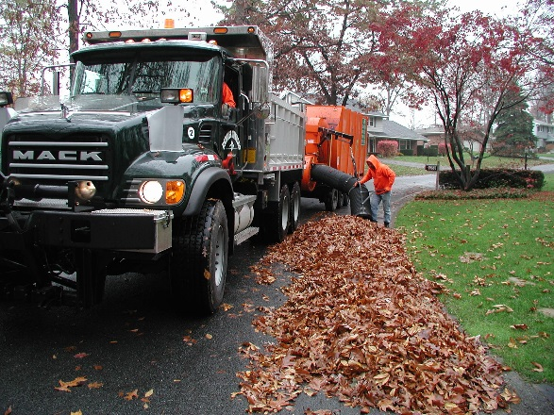
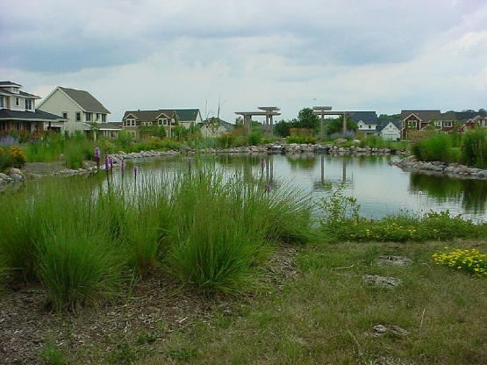
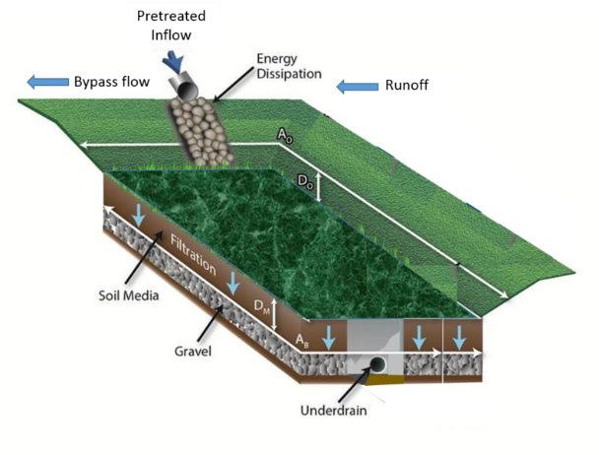
Three practices that can be very effective in reducing P are wet ponds, biofiltration, and management of vegetative litter
Unfortunately, these practices have not always been as effective as we would like

Slide 12
Some links in the manual related to today’s presentations
Wet ponds [1]
Biofiltration [1]
Trees, street sweeping, yard waste management [1], [2], [3], [4]
Phosphorus in stormwater and lakes [1], [2]
Media and amendments to attenuate P [1], [2], [3],

Slide 13
Upcoming webcasts
Spring – constraints to infiltrating stormwater
Let us know what topics you are interested in

Slide 14
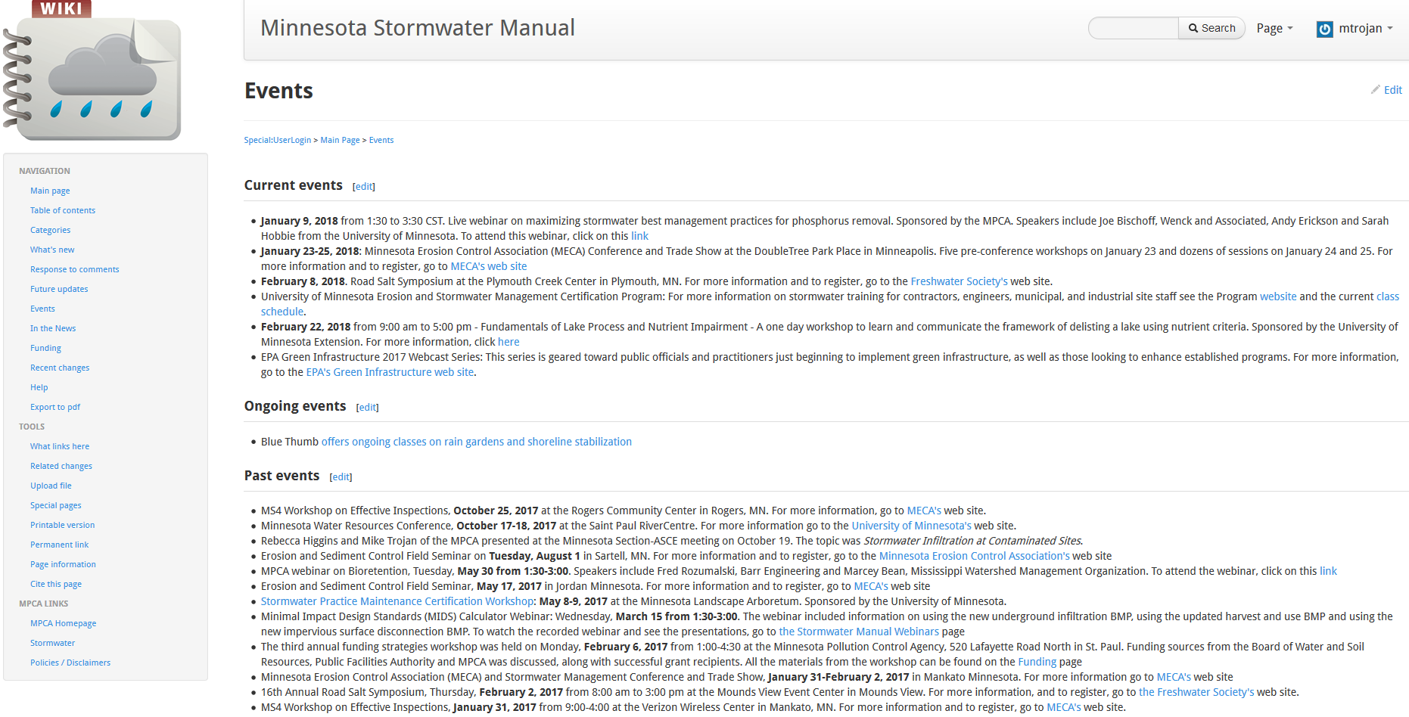

Slide 15
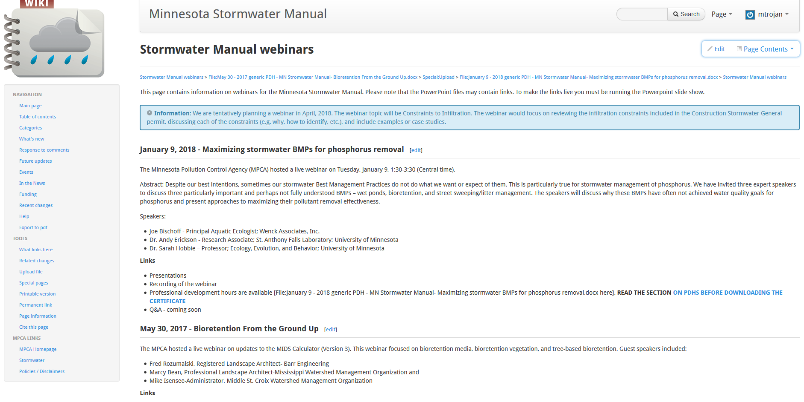
Materials will be posted in the SW Manual
Info on webinar
PowerPoint
Video
Q/A
PDH certificate
Note: past webinars are also posted on this page

