Slide 1
Introduction to the Importance of Stormwater Pretreatment
John A. Chapman
January 19, 2022

Slide 2
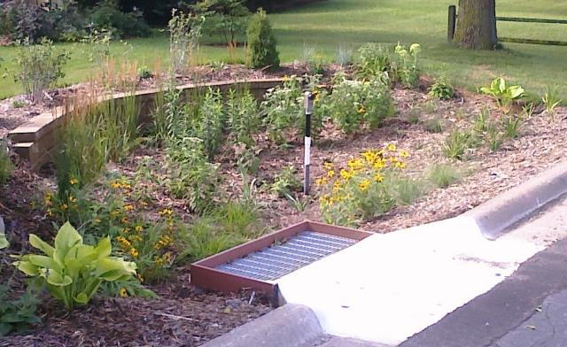
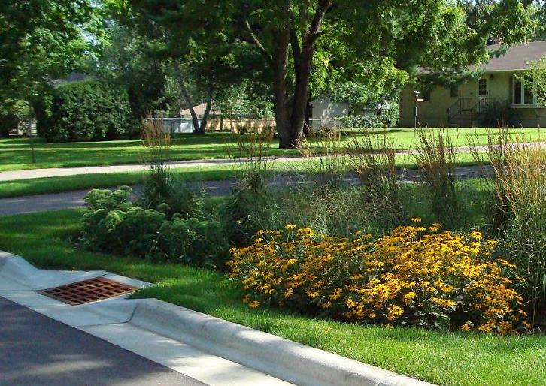
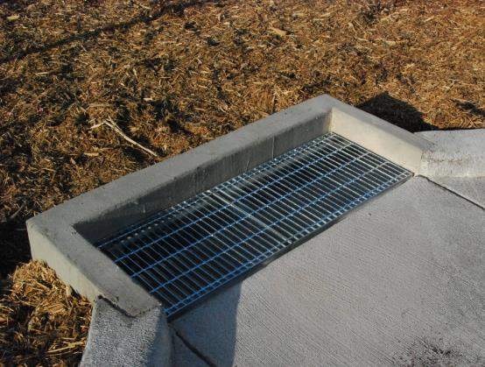

Slide 3
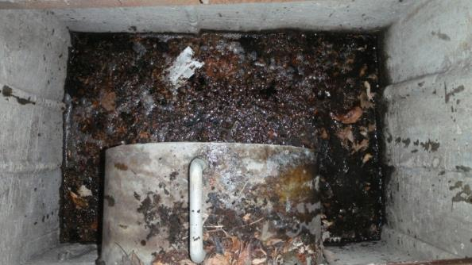
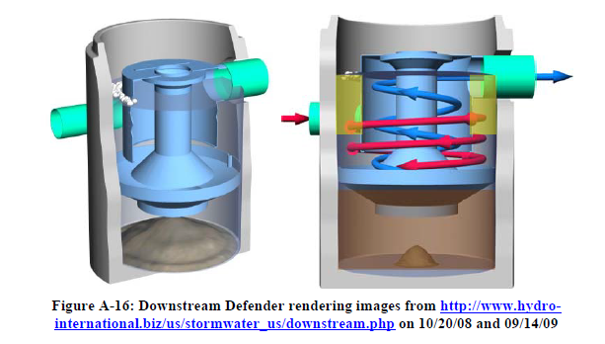
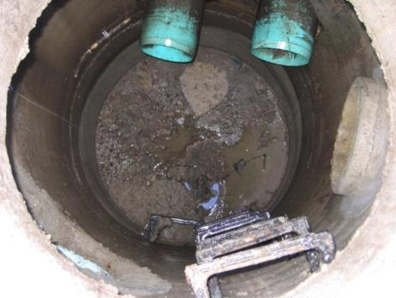
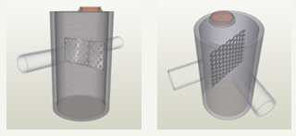

Slide 4
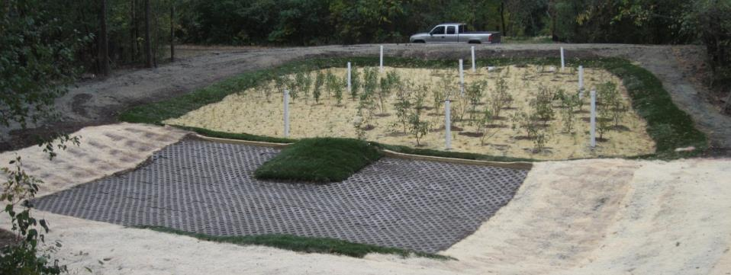

Slide 5
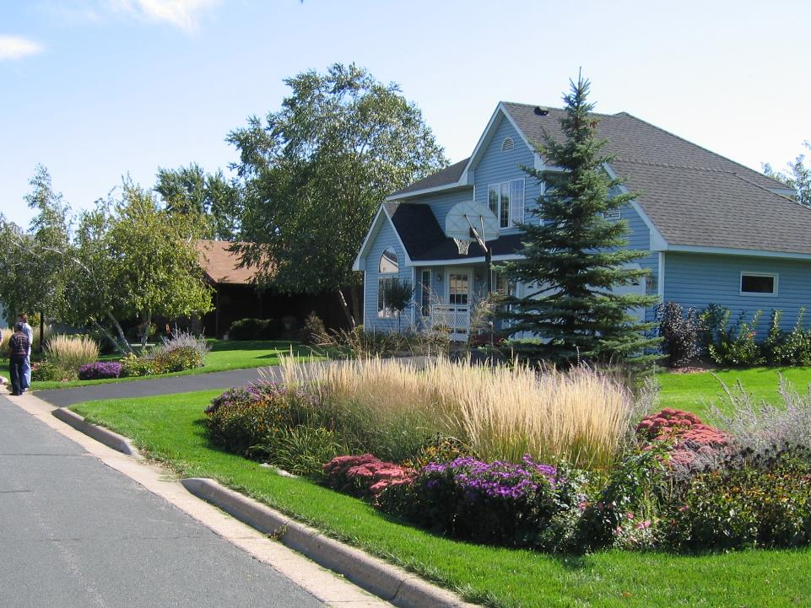

Slide 6
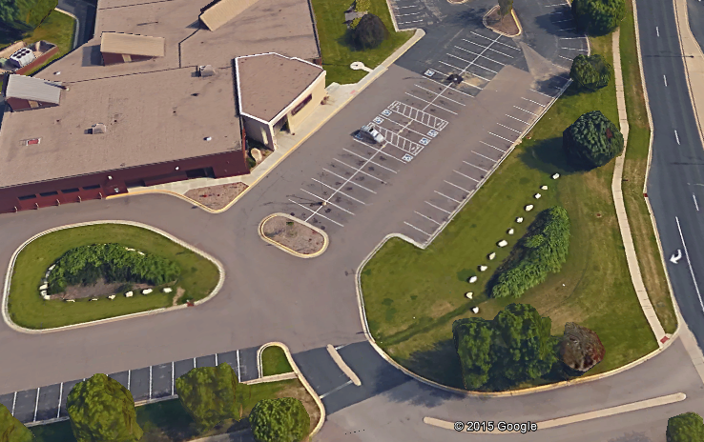

Slide 7
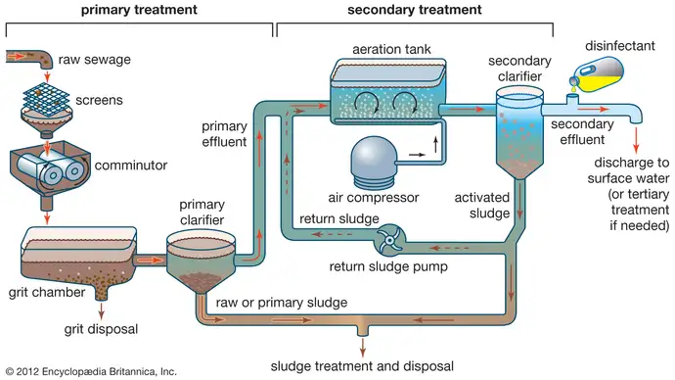
Active Treatment WWTP

Slide 8
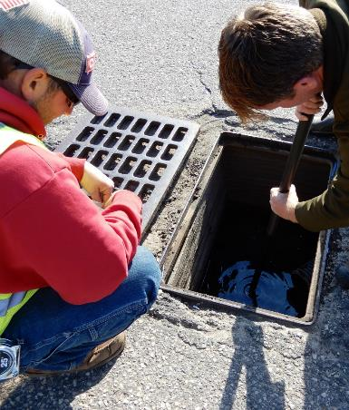
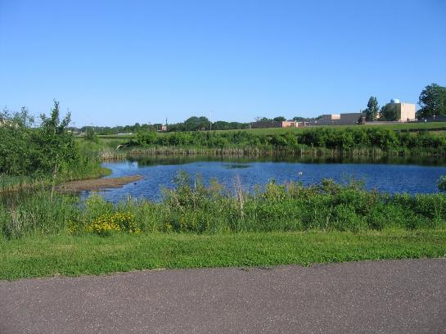
Active Treatment WWTP

Slide 9
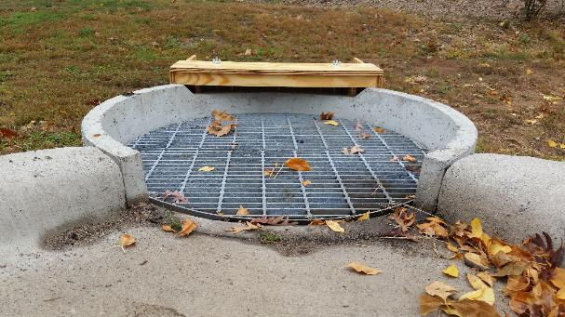
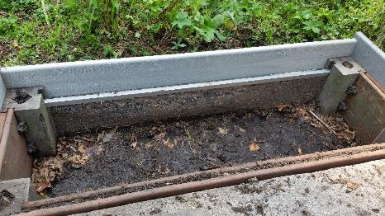
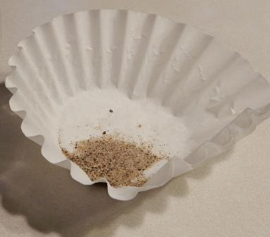

Slide 10
What is the proper size for pretreatment? How do we optimize it?

Slide 11
Cost Data Range (2007 U of M report)
 | Construction |  |  |  | Annual O & M
 | Low Cost | WQV | High Cost | WQV
Dry Detention | $0.30/cf | 2 m/cf | $4/cf | 3000/cf | (1-3%)
Wet Detention | $0.35/cf | 4M/cf | $3/cf | 11000/cf | 2-10%
Constructed Wetlands | $0.20/cf | 5/cf | $1.10/cf | 7000/cf | 2-14%
Infiltration Trenches | $5/cf | 30000/cf | $10.50/cf | 400/cf | 5-120%
Bioinfiltration Filter | $9/cf | 900/cf | $10/cf | 30000/cf | (1-10%)
Sand Filters | $3/cf | 200000/cf | $80/cf | 100/cf | 1-13%
Grass Swales | $9/lf | 10 ft wide | $25 / lf | 22 ft wide | 4-178%

Slide 12
Costs over the Pond Life (MCWD)
 | Long Lake | Twin Lake | Cedar Meadows | SW Calhoun
Cost of 1 Maintenance Excavation | $16,578 | $19,945 | $41,574 | $57,417
Total Life-Cycle Project Cost | $136,186 | $178,497 | $701,561 | $2,347,381
Annualized Project Cost | $11,873 | $15,561 | $46,626 | $156,007
Cost per lb of TP Removed | $79 | $76 | $307 | $611
Cost per c.y. of Sediment Removed | $79 | $117 | $168 | $268
2004 Minnehaha Creek Watershed District Presentation by Jim Hafner and Mike Panzer

Slide 13
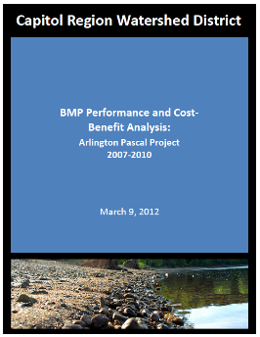
 | $/CF volume per year | $/lb. P per year | $/lb. TSS per year | $/lb. Solids per year
U.G. Vault | $0.05 | $782 | $4.29 | $0.87
Pond | $0.05 | $504 | $1.74 | $0.29
Trenches | $0.07 | $1,307 | $7.23 | $0.82
Bioretention | $0.04 | $1,129 | $4.98 | $0.89
Projected annual removal per acre
 | Volume | P | Solids
UG Vault | 11,322 | 0.71 | 641
pond | 6,846 | 0.70 | 1234
trench | 15,288 | 0.80 | 1288
bioretention | 17,266 | 0.64 | 819

Slide 14
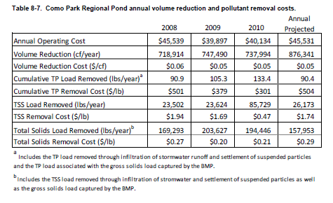
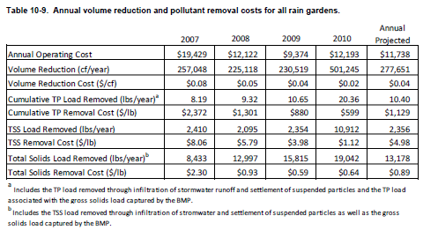
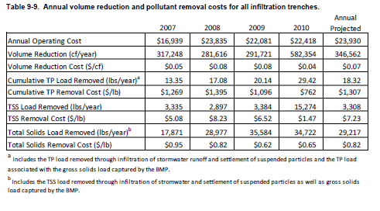
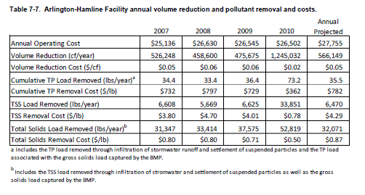

Slide 15
Do we have numbers on pretreatment?

Slide 16
Pretreatment
Field monitoring
Controlled experiments

Slide 20
Conclusions of this study
All of these work,
filter boxes and sumps are easier to maintain
Sod requires reinstallation (replacement), which is OK.
Rip rap requires reinstallation (or replacement), which is awful.

Slide 21
Historical data
Field sampling
Modeling

Slide 22
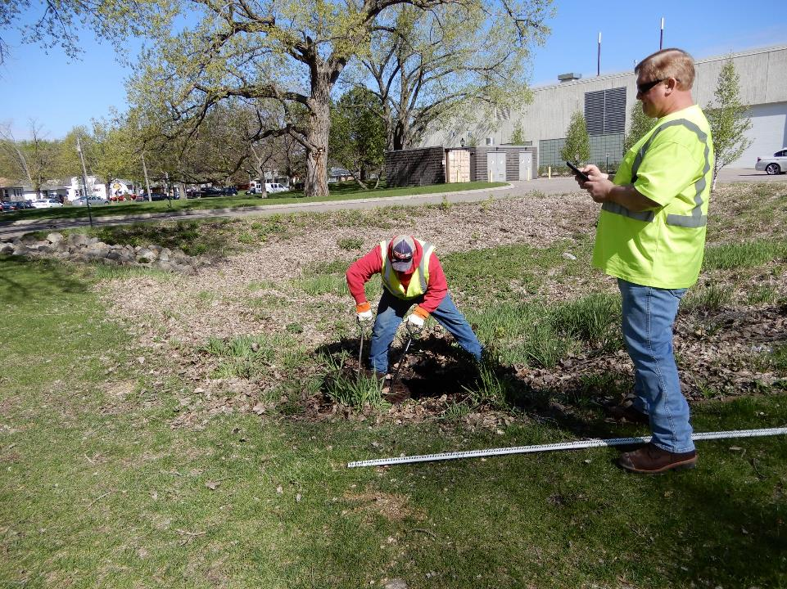

Slide 23
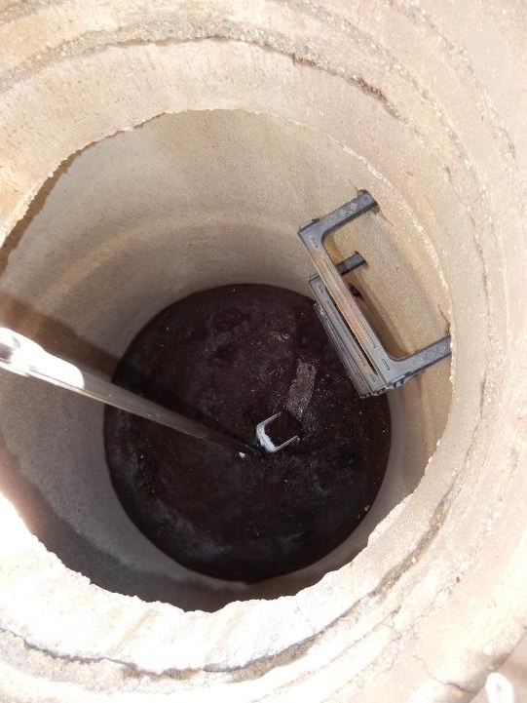

Slide 24
Conclusions from this study
Inspections and clean out of sumps twice a year will more likely remove sediments captured
When modeling, a PSD coarser than NURP50 may be needed to represent your urban site
A sediment concentration of 400 mg/l may also better represent urban sites.

Slide 25
Inspection records show
Annual inspection with cleaning to follow
$140 per structure per year
$618 per C.F. sediment removed
0.23 C.F. of sediment captured per structure per year
1.68 C.F. of sediment captured per acre per year
3.08 C.F. of sediment generated per acre per year
Half of sediment is lost

Slide 26
I would recommend:
Inspections and cleanout twice per year
Greater chance of full sediment capture
With annual inspection goal, 23% of the structures were inspected every other year

Slide 27


Funding provided by
Minnesota Stormwater Research Council
University of Minnesota Water Resources Center
This project was supported by the Minnesota Stormwater Research and Technology Transfer Program administered by the University of Minnesota Water Resources Center through an appropriation from the Clean Water Fund established by Minnesota Clean Water Land and Legacy Amendment and from the Minnesota Stormwater Research Council with financial contributions from: Capitol Region Watershed District, Comfort Lake-Forest Lake Watershed District, Mississippi Watershed Management Organization, Nine Mile Creek Watershed District, Ramsey-Washington Metro Watershed District, South Washington Watershed District, City of Edina, City of Minnetonka, City of Woodbury, and, Wenck Associates, Minnesota Cities Stormwater Coalition

Slide 28
What do the numbers suggest?

Slide 29
Pretreatment
Manhole sump $142/yr or $5.15/lb/yr
Sod replacement $0.09/lb/yr*
Infiltration shallow sumps $0.36/lb/yr*
Treatment (from earlier slides)
Pond $0.29/lb/yr
Infiltration $0.89/lb/yr
* with many assumptions – we need more data

Slide 30
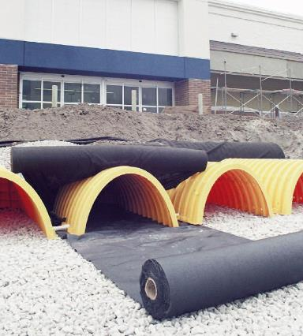
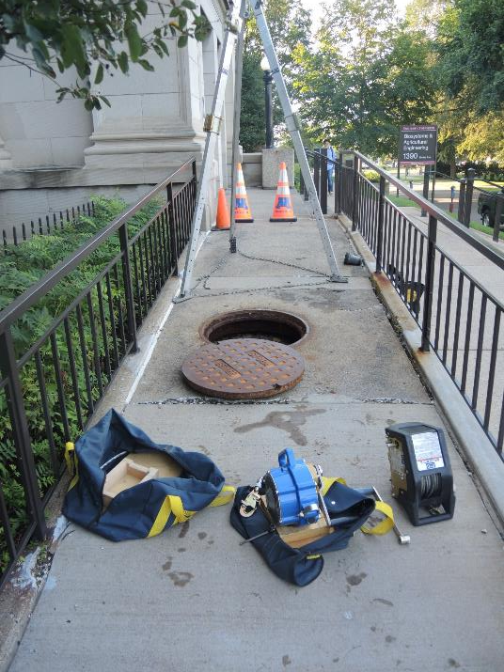

Slide 31
Why Pretreatment?
Cheaper
Systems work better
More maintainable
Some systems have “replacement” for maintenance – making pretreatment critical.

Slide 32
Thank you
John A. Chapman
chapm155@umn.edu

