Slide 1
MIDS Calculator Fundamentals

Slide 2

MIDS Calculator Fundamentals

Slide 3
Presentation outline
Review MIDS performance goals
Volume reduction conformance calculations
Pollutant removal calculations
Pollutant load reduction calculations
Other calculator notes and functions
Notes:
Calculator can be used for other goals as well. For example, a more strict local goal or a less strict goal for projects not requiring a permit. Or perhaps a TMDL application. Doesn’t need to be restricted to the “1.1” goal.

Slide 4
MIDS calculator
Primary function of calculator is to evaluate site conformance to MIDS performance goals
MIDS performance goals vary depending on site characteristics
MIDS “Flexible Treatment Options” include
Volume retention requirements
% annual phosphorus removal requirements
Notes:
Calculator can be used for other goals as well. For example, a more strict local goal or a less strict goal for projects not requiring a permit. Or perhaps a TMDL application. Doesn’t need to be restricted to the “1.1” goal.

Slide 5
A simplification of Flexible Treatment Options…
“Primary” Performance Goal:
Retain 1.1 inch x Impervious Surface Area
Good Infiltration
YES
NO
Slow Infiltration
Limited space, but some available
YES
Retain 0.55 inch x Impervious Surface Area
AND
75% Annual TP Removal
NO
No Infiltration
Restrictions (clay, contaminants, etc.) but space for BMP
YES
Volume retention to maximum extent possible
AND
60% Annual TP Removal
NO
Offsite Mitigation
Notes:
Calculator can be used for other goals as well. For example, a more strict local goal or a less strict goal for projects not requiring a permit. Or perhaps a TMDL application. Doesn’t need to be restricted to the “1.1” goal.

Slide 6
MIDS calculator
Evaluates site conformance to MIDS performance goals, including
Volume reduction
% Annual Pollutant Removals (TP, DP, TSS)
No rate control
Can be used to evaluate conformance to other goals (more/less stringent rules, TMDLs, etc.)
Estimates annual runoff volume and pollutant load reductions
Notes:
Calculator can be used for other goals as well. For example, a more strict local goal or a less strict goal for projects not requiring a permit. Or perhaps a TMDL application. Doesn’t need to be restricted to the “1.1” goal.

Slide 7
MIDS Calculator
Calculator ensures crediting method(s) consistent with underlying assumptions of performance goal development modeling

Slide 8
Jargon
Performance goal: Stormwater standard/rule
Credit: Quantity of stormwater volume or pollutant reduction achieved by an individual BMP or cumulatively with multiple BMPs
Volume retention/reduction = volume infiltrated or evaporated instead of leaving site as runoff
TP: Total Phosphorus
DP: Dissolved Phosphorus
TSS: Total Suspended Sediment
Notes:
SW Manual definition of Credit:
There is no universal definition for the term stormwater credit. As used in this manual, credit refers to the quantity of stormwater or pollutant reduction achieved either by an individual BMP or cumulatively with multiple BMPs. Examples include the following.
A rain garden infiltrates 50,000 cubic feet of water per year. The rain garden receives a credit of 50,000 cubic feet to be applied toward runoff reduction (volume control).
A rain garden results in the removal of 10 pounds of phosphorus per year from stormwater runoff. The rain garden receives a credit of 10 pounds to be applied toward pollutant load reduction.
Three rain gardens each remove 10 pounds of phosphorus per year. Each rain garden receives a credit of 10 pounds, resulting in a total credit of 30 pounds.

Slide 9
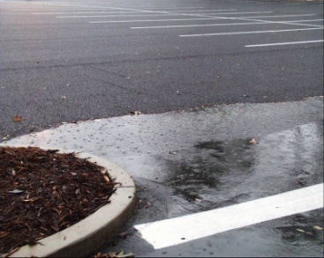
Calculating volume reduction conformance
For sites conducive to infiltration,
MIDS volume reduction performance goal:
Volume reduction goal can vary depending on site constraints
Required
Retention Volume
1.1 inch
X
=
Notes:
Note from MPCA: This is for most of the BMPs in the calculator but make some mention of the non volume BMPs like swales and how a different approach was needed

Slide 10
Development of performance goal
Continuous modeling analysis completed to establish 1.1-inch performance goal
- Simulated 35-years using 15-minute precipitation data
Modeling used to compare average annual runoff volumes from “native” conditions to runoff from developed conditions with infiltration BMPs of varying size
Notes:
Performance goal may seem simple, but there is detailed hydrologic and hydraulic analysis behind it (35-year continuous simulation using 15-minute precipitation data)

Slide 11
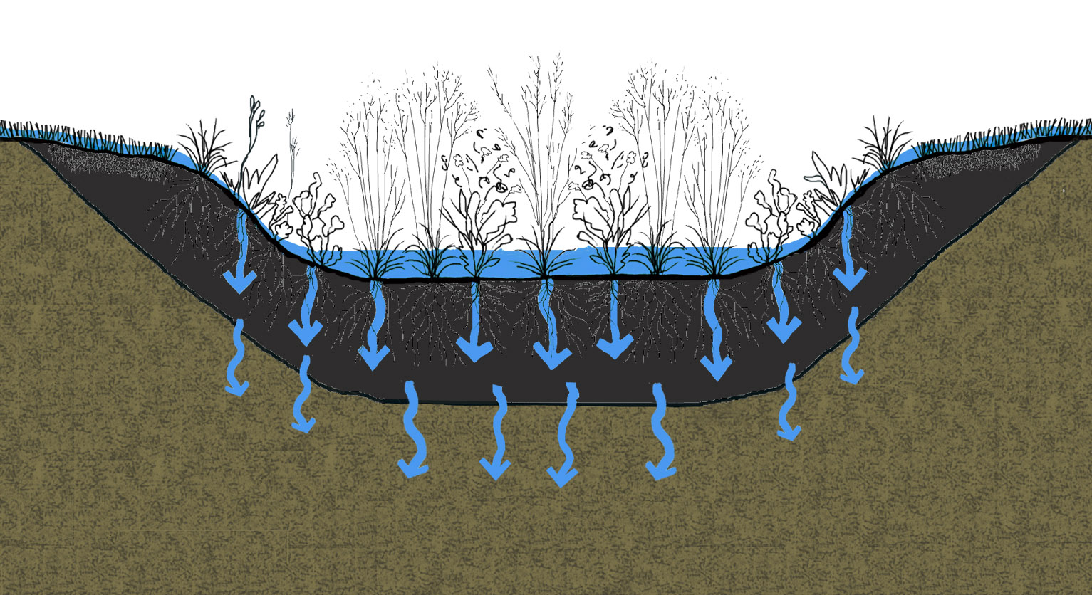
Development of performance goal
Goal not time dependent (instantaneous versus continuous or event-based)
“Kerplunk” method (Andy Reese terminology)
Notes:
Goal is not time dependent. Have to be ready for rain to happen instantaneously. Assume all stormwater runs off at once.

Slide 12
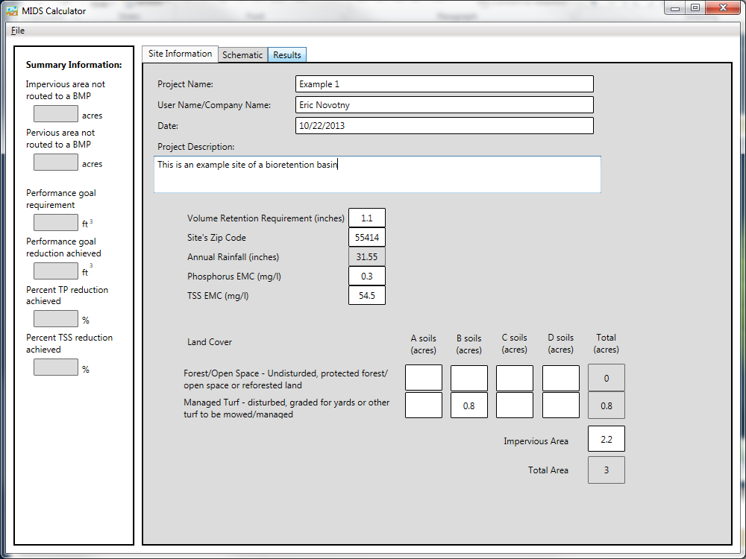
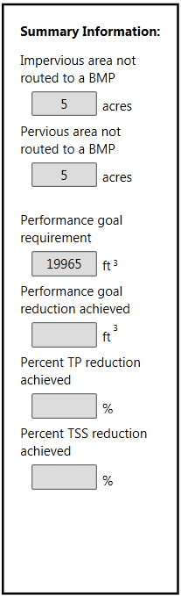
Calculates required volume retention
Performance goal
(1.1 inches * Impervious Area)
Notes:
Required volume retention calculated in cubic feet. So, for most BMPs, this represents the volume of water that needs to be captured by BMP.

Slide 13
Calculates required volume retention
For 10-acre site with 50% impervious,
required volume retention = 19,965 ft³
Notes:
Required volume retention calculated in cubic feet. So, for most BMPs, this represents the volume of water that needs to be captured by BMP.

Slide 14
Calculates Volume Retention Achieved
Calculates volume reduction achieved to meet MIDS performance goal
(based on entry of site BMP characteristics)
Notes:
Details on the calculation of volume reduction in later slides

Slide 15
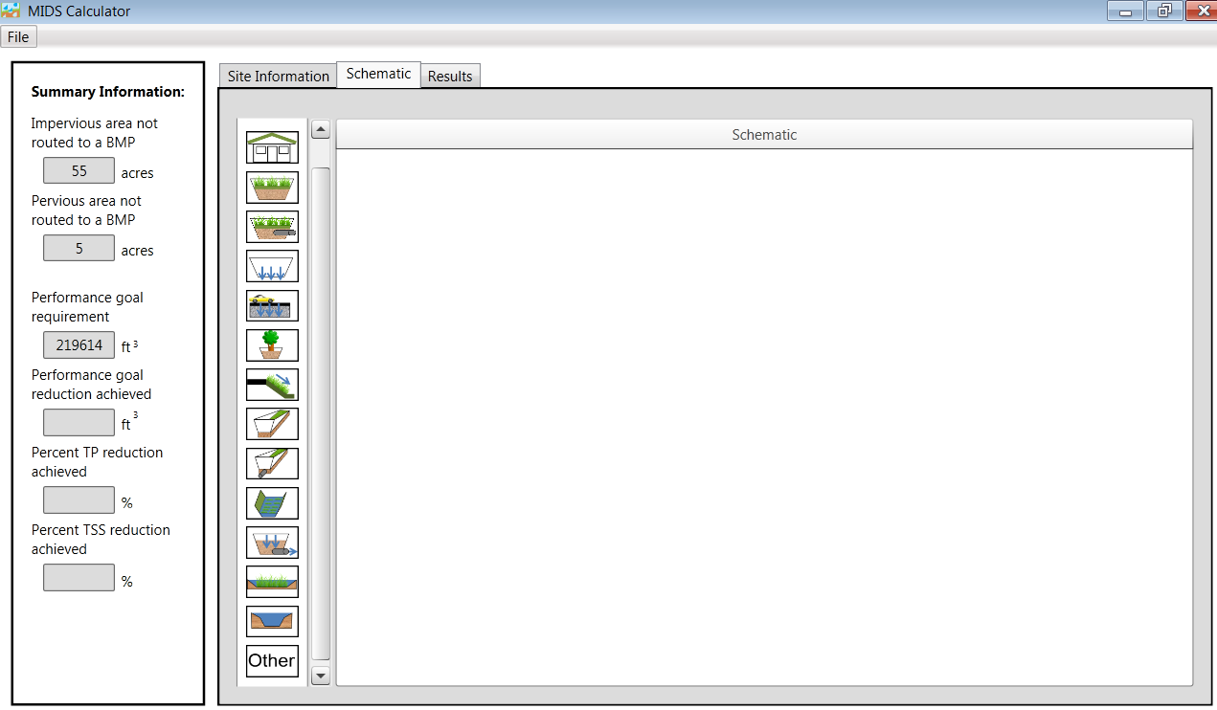
Variety of BMPs included in calculator

Slide 16
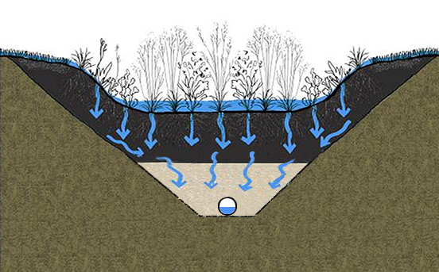
Calculating volume reduction conformance
Volume reduction conformance calculated differently for infiltration and filtration
Infiltration:
Filtration:
Permeable soil
Impermeable soil
Volume Captured in Basin =
Volume Infiltrated
Volume Captured in Basin ≠
Volume Infiltrated

Slide 17
Let’s start with infiltration…
For most infiltration-based BMPs (w/o under drains), MIDS volume reduction achievement based on “instantaneous” retention volume
Retention Volume
Permeable soil

Slide 18
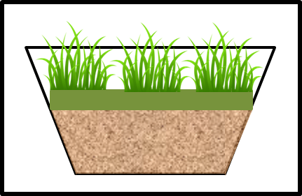
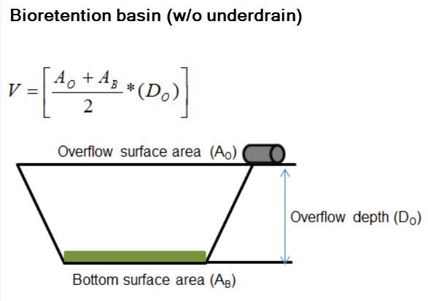
Calculating volume reduction
For 10-acre site with 50% impervious,
Required volume retention = 19,965 ft³
Retention Volume
Required drawdown = 48 hours
Notes:
For 10-acre site with 50% impervious,
Required volume retention = 19,965 ft³

Slide 19
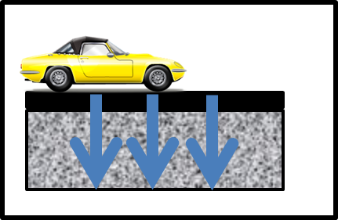
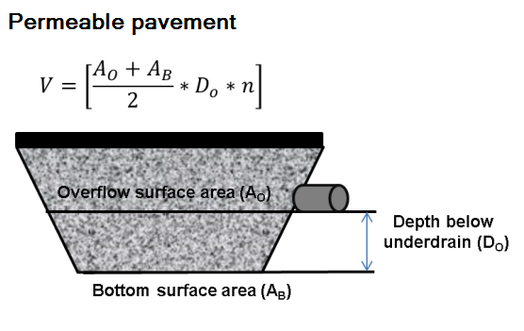
Calculating volume reduction
For 10-acre site with 50% impervious,
Required volume retention = 19,965 ft³
Retention Volume

Slide 20
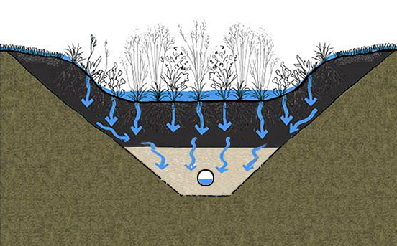
Let’s move on to filtration…
Two common filtration scenarios:
Under Drain at Bottom
Elevated Under Drain
Impermeable soil
Impermeable soil

Slide 21
Filtration BMPs with under drain at bottom
Significant volume discharged offsite through under drain
Impermeable soil

Slide 22


But there’s some volume loss, even with a under drain, right?
Volume Losses will occur via:
Infiltration (side slopes and bottom)
Evapotranspiration
Evapotranspiration
Infiltration
Infiltration

Slide 23
Filtration BMPs with under drain at bottom
For filtration BMPs with under drain at the bottom, MIDS volume reduction is calculated based on:
Infiltration from bottom and side slopes during required drawdown time (48 or 24 hours)
Evapotranspiration in 72 hours
Underlying design assumption- under drain should be designed to empty filtration basin in 24 - 48 hours (volume credits will be overestimated if basin drains too fast)
Notes:
User indicates whether 24- or 48-hour drawdown time is applicable

Slide 24
Example: Filtration BMP with under drain at bottom
Bioretention basin in B soils (no under drain needed)
Site:
10 acres, 50% Impervious
C soils (infiltration 0.20 in/hr)
Live storage = 1.5 feet
Filtration media depth = 3.8 ft
Area at overflow = 14,641 ft²
Media surface area = 11,881 ft²
Bottom surface area = 7,225 ft²
No tree; Mix C
Field capacity = 0.11
Porosity = 0.25
Evapotranspiration = 297 ft³
Infiltration = 2499 ft³
2,624 ft³
Impermeable soil
How does volume reduction conformance change with under drain at bottom?
Notes:
Site:
10 acres
D soils (assume underlying soils have infiltration rate of 0.06 in/hr)
50% impervious
Performance Goal:
inches * 10 acres * 50% impervious = 19,965 ft³
BMP: Filtration basin (drain tile at the bottom)
Live storage: 1.5 feet deep
4H:1V side slopes
Media depth: 3 feet
Square basin with top (at overflow) of 121 feet x 121 feet
Vegetation line 1.5 feet below overflow (109 feet x 109 feet)
Bottom of basin 3 feet below vegetation line (85 feet by 85 feet)

Slide 25
Example: Filtration BMP with under drain at bottom
Bioretention basin in B soils (no under drain needed)
Total volume retention “credit” with under drain at bottom =
= 2,499 ft³ + 297 ft³
= 2,795 ft³
Compared with volume retention “credit” without under drain = 19,965 ft³
Evapotranspiration = 460 ft³
Infiltration = 2,624 ft³
2,624 ft³
Impermeable soil
How does volume reduction conformance change with under drain at bottom?
Notes:
3084/19965= 15% performance goal

Slide 26
Example: Filtration BMPs with elevated under drain
With elevated under drain, credit is given for volume stored below under drain plus ET and side infiltration
Evapotranspiration (ET)
Impermeable soil
Infiltration = 2,624 ft³

Slide 27
Filtration BMPs with elevated under drain
Site:
10 acres, 50% Impervious
C soils (infiltration 0.2 in/hr)
Overflow depth = 1.5 feet
Media depth = 3.8 ft
Under drain 0.8 ft from bottom
Area at overflow = 14,641 ft²
Media surface area = 11,881 ft²
Area at under drain = 7,225 ft²
Bottom surface area = 6,178 ft²
No tree; Mix C
Field capacity = 0.11
Porosity = 0.25
Evapotranspiration = 297 ft³
Side Slope Infiltration = 890 ft³
Impermeable soil
Volume stored below under drain = 1,340 ft³
Bottom Infiltration = 1,734 ft³
Infiltration = 2,624 ft³
Notes:
I need to check numbers with Eric

Slide 28
Filtration BMPs with elevated under drain
Total volume retention “credit” with elevated under drain =
1734 ft³ + 890 ft³ + 1340 ft³ + 297 ft³
= 4,261 ft³
Compared with volume retention “credits”:
w/under drain at bottom = 3,084 ft³
without under drain = 19,965 ft³
Evapotranspiration = 460 ft³
Impermeable soil
Side Slope Infiltration = 890 ft³
Volume below under drain = 2,144 ft³

Slide 29
Questions on volume reduction conformance calculations?

Slide 30
Fundamentals of MIDS Calculator Pollutant Removal Calculations

Slide 31
A simplification of Flexible Treatment Options…
“Primary” Performance Goal:
Retain 1.1 inch x Impervious Surface Area
Good Infiltration
YES
NO
Slow Infiltration
Limited space, but some available
YES
Retain 0.55 inch x Impervious Surface Area
AND
75% Annual TP Removal
NO
No Infiltration
Restrictions (clay, contaminants, etc.) but space for BMP
YES
Volume retention to maximum extent possible
AND
60% Annual TP Removal
NO
Offsite Mitigation
Notes:
Volume Reduction conformance addresses primary MIDS goal (1.1” from impervious surfaces) and a portion of FTO #2. Other FTOs require calculation of pollutant removals.

Slide 32
Calculating annual pollutant removal
Calculator estimates % annual pollutant removal achieved
For each individual BMP
Cumulative % annual removal for site
Total Phosphorus (TP), Dissolved Phosphorus (DP), and Total Suspended Sediment (TSS)

Slide 33
Calculating annual pollutant removal
Why?
To show conformance with MIDS Flexible Treatment Options (FTOs) or other local requirements
- Reduction of TSS & P for TMDLs (Total Maximum Daily Loads)
- Information for grant applications

Slide 34
Basis of % annual pollutant removal calculations
For volume retained on site, assume 100% pollutant removal
For Volume NOT retained by BMP, assume 0% - 100% pollutant removal
Depending on BMP
Depending on if BMP is designed as a flow-through or bypass system
Notes:
Mike T didn’t understand the word ”retained”. Maybe say “retained on site”

Slide 35
Calculating % annual pollutant removal
Total
% Pollutant
Removal
%RVR
(100- %RVR) %PR
Where,
%RVR =
%PR =
% Annual Runoff Volume Retained Onsite
% Pollutant Removal

Slide 36
Annual pollutant load reduction
9 % Annual Volume
0% TSS, Particulate P (PP), and Dissolved P (DP) Reduction
91% Annual Volume Retained
100% TSS, PP, DP Reduction

Slide 37
Example calculating % annual pollutant removal from bioretention w/o under drain
Total
% TP
Removal
%RVR
(100- %RVR) %PR
91%
(100- 91) 0%
91%

Slide 38
Calculating % Pollutant Removal
Many BMPs achieve primary pollutant removal through other mechanisms
- Filtration
- Settling
Adsorption
Calculator applies % removal assumptions to portions of stormwater not infiltrated

Slide 39
Runoff and pollutant removal assumptions in calculator
Calculated from performance curves

Slide 40
Example calculating % annual pollutant removal from filtration basin w/under drain
If a filtration basin infiltrates 20% annual runoff volume,
Annual
% TP
Removal
%RVR
(100- %RVR) %PR
20
(100- 20) 0.25
40%

Slide 41
Calculating % annual volume retained
So, for a BMP designed to capture 1.1 inches of runoff from impervious surfaces, how does this translate to annual volume removal?
How does it vary by site imperviousness?
How does it vary by soil type?
How does it vary if your BMP is sized for less than 1.1 inches?

Slide 42

Making the connection: Performance goal to % annual pollutant removal
% Annual Removal
Required
Retention Volume
(cubic feet)

Slide 43
Making the Connection: “Performance Curves” used to Estimate % Annual Volume Retained
= 0.55 inch
= 1.1 inch
= 0.55 inch

Slide 44
Calculating % annual volume retained
Performance curves were developed to determine annual volume reduction (%RVR) for most volume-reduction BMPs in calculator
This approach allows flexibility for designers (not one size fits all)
Utilize modeling results to develop performance curves
Example BMPs: Bioretention, permeable pavement, infiltration trenches

Slide 45
Questions on pollutant removal calculations?

Slide 46
Calculating Pollutant Load Reductions in MIDS Calculator

Slide 47
Pollutant loading basics
=
H₂O
x
P
year
Pollutant
Load
[mass/time]
Runoff
Volume
[volume/time]
Pollutant
Concentration
[mass/volume]
Notes:
Often use the term ‘pollutant loading’
Pollutant Loading is a measurement of the amount (or mass) of pollutant generated over a given period of time.

Slide 48
Estimating pollutant load reductions in MIDS calculator
Estimate pollutant load from site using Simple Method
- e.g., How much phosphorus is being generated from your developed site before BMPs?
2. Apply % Pollutant Removal to estimate annual pollutant load reduction
- e.g., What phosphorus load reduction can be expected if your BMP removes 50% annual TP?
Notes:
This was confusing for us. Maybe just make the last point a #3. It feels like the third step in the process

Slide 49
Calculating annual pollutant load: the Simple Method
Equation developed by Tom Schueler in 1987
Estimates runoff volume and pollutant loads on an annual basis
Requires easily obtainable data

Slide 50
Calculating annual pollutant load: the Simple Method
Simplified runoff volume calculation based on the following inputs:
- Drainage Area
- Annual rainfall
- % Impervious, turf, and forest to calculate runoff coefficient
Pollutant concentration for TP and TSS based on literature values for stormwater

Slide 51
Estimating pollutant load reductions in MIDS calculator
Estimate pollutant load from site using Simple Method
2. Apply % Pollutant Removal to estimate annual pollutant load reduction
Total
% Pollutant
Removal
Annual Pollutant Load
Pollutant Load Reduction = x
y
Notes:
This was confusing for us. Maybe just make the last point a #3. It feels like the third step in the process

Slide 52
Questions on annual pollutant removal calculations?

Slide 53
MIDS Calculator Other Important Notes and Features

Slide 54
Calculator versus model
MIDS calculator does reasonably good job estimating and tracking volume and pollutant load reductions from common LID best practices
Volume reductions and pollutant load reductions based on detailed modeling and/or literature review
MIDS calculator is not a predictive model
Notes:
Allows up to 10

Slide 55
Does the MIDS calculator handle BMPs in series?
Yes, calculator allows for tracking volume and pollutant removal in treatment train
Discharge from BMPs can be routed to downstream BMPs
Calculator allows up to ten of each BMP type
TP, DP, and TSS tracked throughout BMP treatment train
Treatment train computations not as robust as those in common water quality models
Notes:
Allows up to 10

Slide 56
How does MIDS calculator compare to the EPA calculator?
EPA calculator
Uses SWMM methodology to calculate runoff volumes and reductions
Does not allow multiple soil types
Does not allow multiple BMPs of one type
Only includes volume reduction BMPs. Does not include swales.
Cannot be used to calculate MIDS performance goal requirement or conformance

Slide 57
How does MIDS calculator compare to common water quality models?
P8/WinSLAMM
More sophisticated runoff prediction
More sophisticated computations of pollutant build-up and wash-off (vary by soil type, land use, precipitation events)
More sophisticated BMP effectiveness simulation

Slide 58
Results comparison using Exercise 1
 | Percent of Performance Goal Achieved (1.1 inches off impervious surfaces) | Percent Annual Volume Reduction | Percent Annual TP reduction | Percent Annual TSS reduction
MIDS Calculator | 86% | 87% | 87% | 87%
EPA Calculator | N/A | 91% | N/A | N/A
P8* | N/A | 86% | 90% | 97%
WinSLAMM* | N/A | 81% | 71% | 79%
*Modeling conducted 1955 – 2004. Took out super storm of July 23-24, 1987.

Slide 59
Questions?

