Slide 1
MIDS Performance Goals

Slide 2
Jargon
Performance goal: Stormwater standard/rule
Flexible Treatment Option (FTO): Alternative performance goal used when conformance to the volume retention performance goal is not feasible or not allowed
TP: Total Phosphorus
LID: Low Impact Development
BMP: Best Management Practices
LGU: Local Government Unit

Slide 3
What is MIDS?
Four basic components:
Performance goals
Calculator to standardize and quantify (“credit”) the benefits of LID BMPs
Design specifications for a variety of LID BMPs (continuing in Stormwater Manual update)
A model MIDS ordinance package
Notes:
4 basic components to MIDS….
While today’s workshop is focused on #2/the MIDS calculator…you need to understand the performance goals (#1) when using the Calculator. I’ll give you a brief overview of the performance goals, a tool that is used to determine the performance goal—the Design Sequence Flow Chart, and introduce a couple of features of the MIDS Calculator in regards to the performance goals.

Slide 4
What are the Performance Goals?
Retain on site 1.1” of runoff from new and/or fully reconstructed impervious surfaces
Most Sites
Retain 0.55” of runoff from the new and/or fully reconstructed impervious surfaces AND
Remove 75% of the annual TP load
FTO 1: Clay, etc.
Achieve as much volume reduction as practicable AND
Remove 60% of the annual TP load
FTO 2: Contam-ination
Off-site mitigation
FTO 3

Slide 5
Why are there different Performance Goals? Site restrictions might require FTO
Different performance goal if site has “restrictions” (including, but not limited to):
zoning/land use requirements
karst
shallow bedrock
slow-draining soils
high groundwater
contamination
Notes:
So…why are there different performance goals?

Slide 6
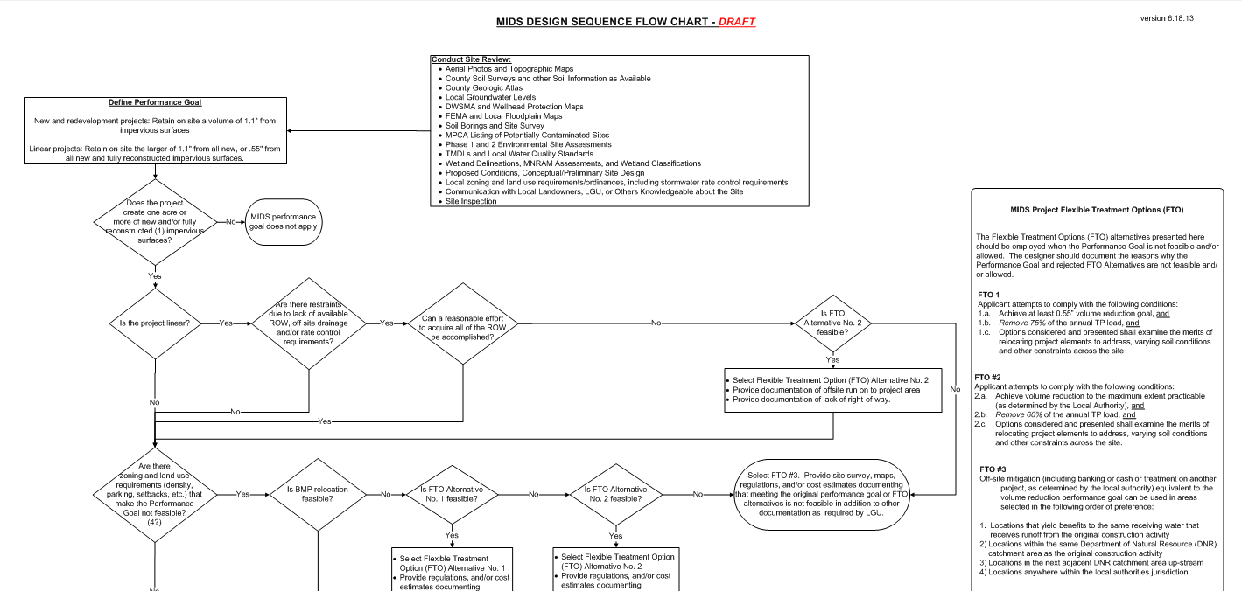
How do I know which performance goal applies?
Restrictions included in Design Sequence Flow Chart—Use it to Determine Performance Goal
Notes:
How do I know which performance goal applies?
The MIDS Redevelopment and Linear Subgroup with input from the MPCA developed the design sequence flow chart. The group wanted a tool that could be used by designers and regulators to be on the same page when looking at a site, considering various site features, and incorporating LID practices where they make sense. One regulator on the work group called this the “convince me” flow chart…meaning, if the permit applicant used this flow chart, it would convince her that the applicant has done a good faith effort to incorporate LID practices.
The Design Sequence Flow Chart is need to determine what Performance Goal applies to the site.

Slide 7
How is the Design Sequence Flow Chart related to the MIDS Calculator?
Use Flow Chart to define Performance Goal
Once Performance Goal is determined, MIDS Calculator can be used to show compliance

Slide 8
Flexible Treatment Options & MIDS Calculator Defining Performance Goal
Starting Performance Goals:
New, Nonlinear Developments and Reconstruction/Redevelopment Projects:
Retain on site 1.1 inches of runoff from the new and/or fully reconstructed impervious surfaces

Slide 9
Flexible Treatment Options & MIDS Calculator Defining Performance Goal
Starting Performance Goals:
Linear Projects:
Retain on site the larger of
0.55 inches of runoff from the new and fully reconstructed impervious surfaces
1.1 inches of runoff from the net increase in impervious surfaces

Slide 10
Flexible Treatment Options & MIDS Calculator Defining Performance Goal
FTO #1: Applicant attempts to comply with the following conditions:
1a Achieve at least 0.55” volume reduction goal, and
1b Remove 75% of the annual TP load,
and
1c Options considered and presented shall examine the merits of relocating project elements to address, varying soil conditions and other constraints across the site

Slide 11
Flexible Treatment Options & MIDS Calculator Defining Performance Goal
FTO #2: Applicant attempts to comply with the following conditions:
2a Achieve volume reduction to the maximum extent practicable (as determined by the LGU),
and
2b Remove 60% of the annual TP load,
and
2c Options considered and presented shall examine the merits of relocating project elements to address, varying soil conditions and other constraints across the site.

Slide 12
Flexible Treatment Options & MIDS Calculator Defining Performance Goal
FTO #3:
Off-site mitigation (including banking or cash or treatment on another project, as determined by the local authority) equivalent to the volume reduction performance goal can be used in areas selected in the following order of preference:
Notes:
Check out the re-worded FTO #3

Slide 13
Flexible Treatment Options & MIDS Calculator Defining Performance Goal
FTO #3 continued:
Locations that yield benefits to the same receiving water as that receiving runoff from the original construction activity
Locations within the same DNR catchment area as the original construction activity
Locations in the next adjacent DNR catchment area upstream
Locations anywhere within the local authorities’ jurisdiction
Notes:
Check out the re-worded FTO #3

Slide 14
Flexible Treatment Options & MIDS Calculator Defining Performance Goal
MIDS Calculator defaults to the 1.1 inch volume retention performance goal
User can change volume retention performance goal to 0.55 inches (or another goal); the calculator will provide warning that the value has been changed from 1.1
For water quality performance goals, user/reviewer needs to compare calculator results to performance goal
FTOs include pollutant reduction goals
MIDS Calculator quantifies annual pollutant removals

Slide 15
Question
What 4 values are noteworthy in regards to FTOs?

