Slide 1
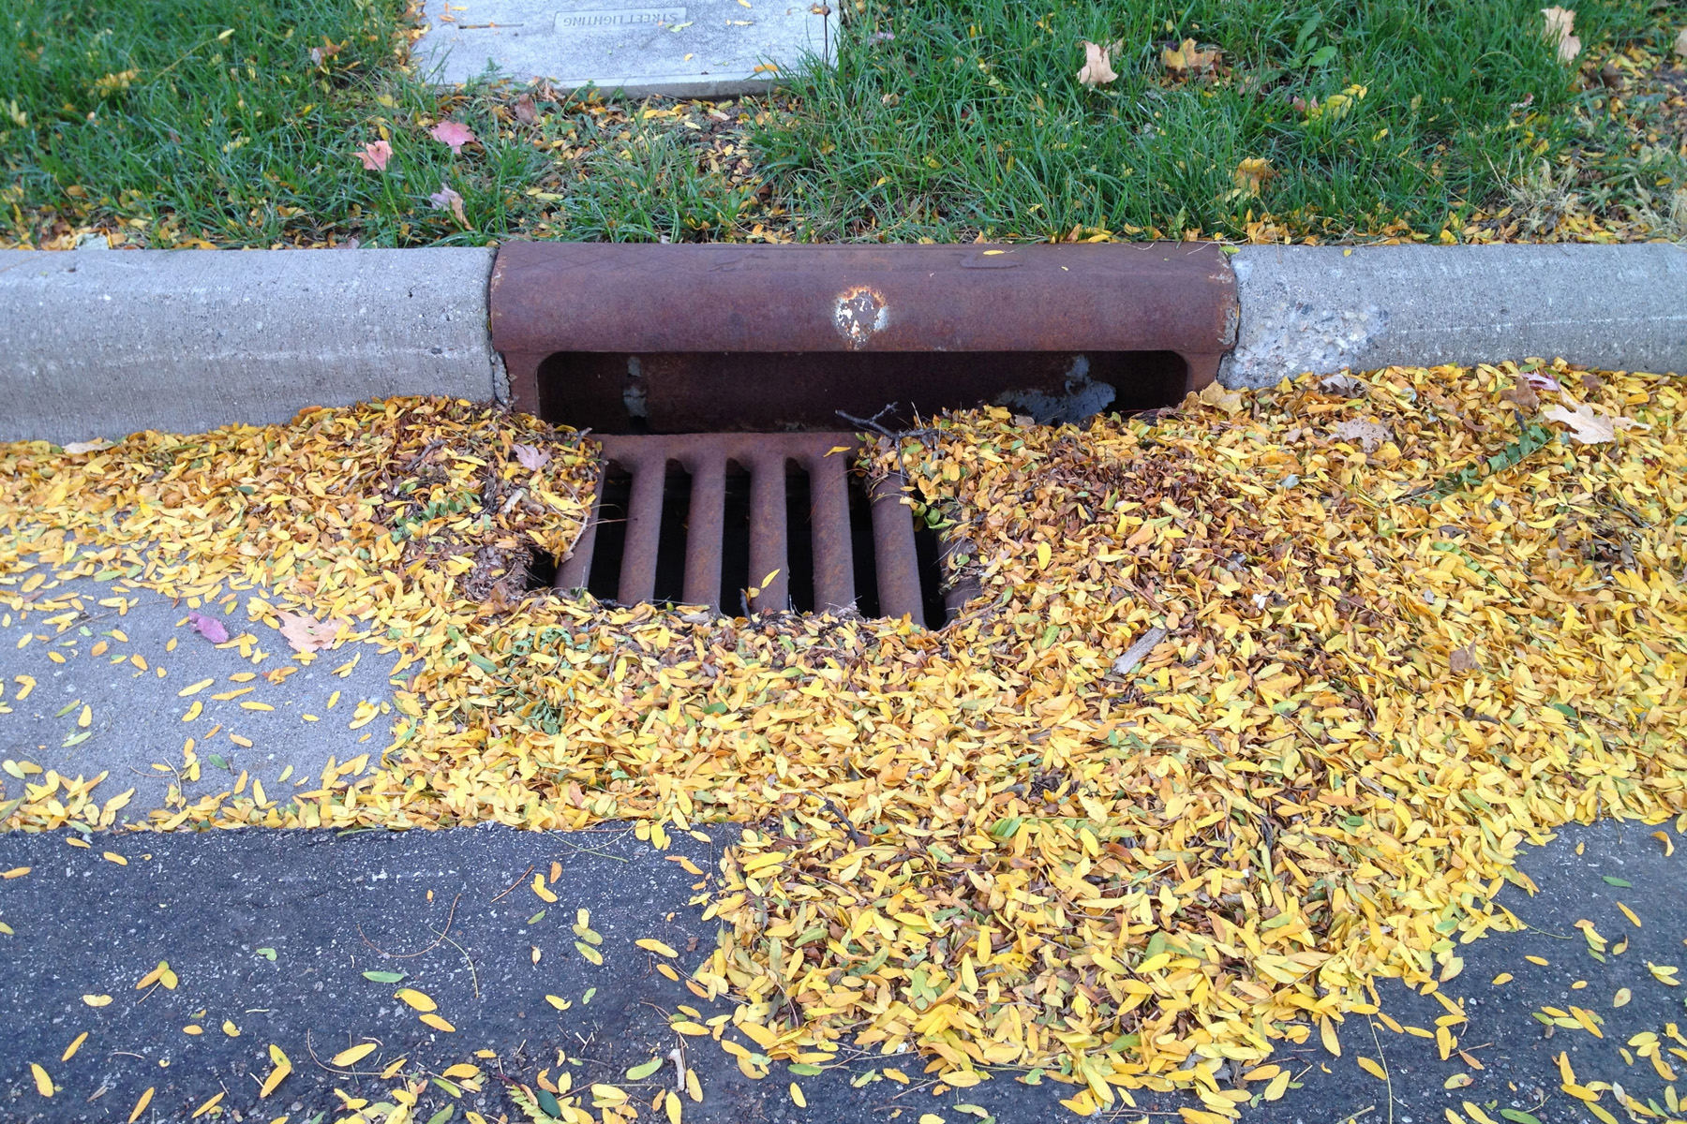
Trees as sources of phosphorus to stormwater
Sarah Hobbie, Dept. of Ecology, Evolution & Behavior, University of Minnesota
Notes:
On your own.

Slide 2
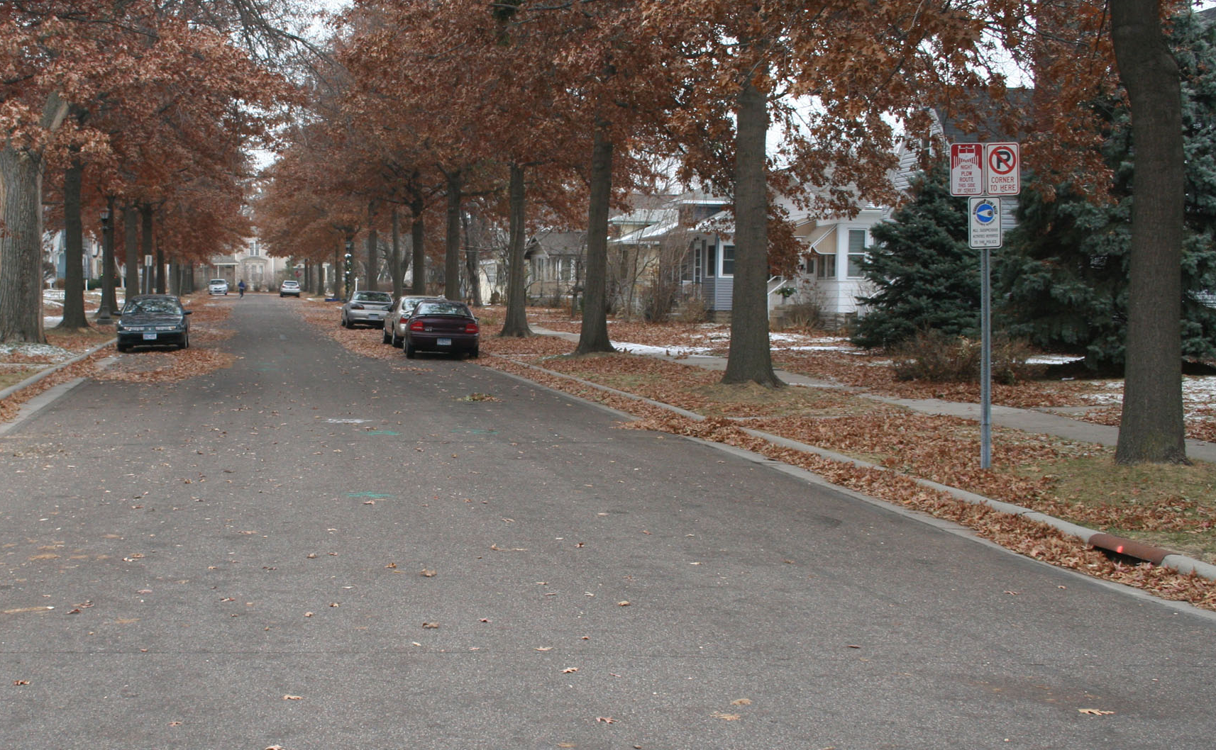
Potential sources of P to stormwater
LITTERFALL, THROUGHFALL
EROSION,
OVERLAND FLOW
ATMOSPHERIC DEPOSITION
Notes:
Figure XX. Sources of nutrients (N and P) to stormwater and urban lakes. Atmospheric deposition, lawn fertilizer, and pet waste contribute nutrients to yards and boulevards that can move into streets through erosion, runoff, and litterfall comprising flowers and seeds in spring and leaf litter in autumn. Atmospheric deposition directly to the street and soil erosion contribute additional nutrients to streets. Nutrients in the street move into stormwater(and ultimately into lakes) during rain events and snowmelt, both in solid forms (e.g., as litter fragments) and dissolved forms (e.g., after decomposing bacteria and fungi solubilize nutrients contained in dead leaves in the street). Dead leaves continue to be processed by decomposing microbes in catch basis, storm drains, and stormwater ponds and other best management practices (BMPs), releasing nutrients that can end up in urban lakes. Street sweeping removes nutrient delivered to the street in litterfall and erosion, preventing them from ever reaching urban waters.

Slide 3
Outline
Phosphorus in tree litterfall
Litterfall contributions to P in street sweepings
Contribution of litterfall P to stormwater P Loading

Slide 4
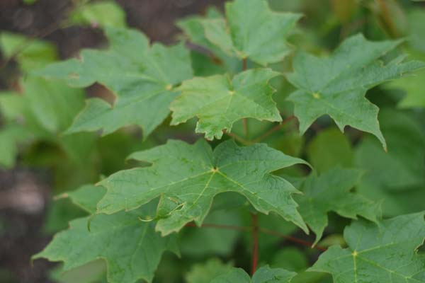

Slide 5
Nucleic acids
Phospholipids
Phytate
Orthophosphate
= Bioavailable P

Slide 6
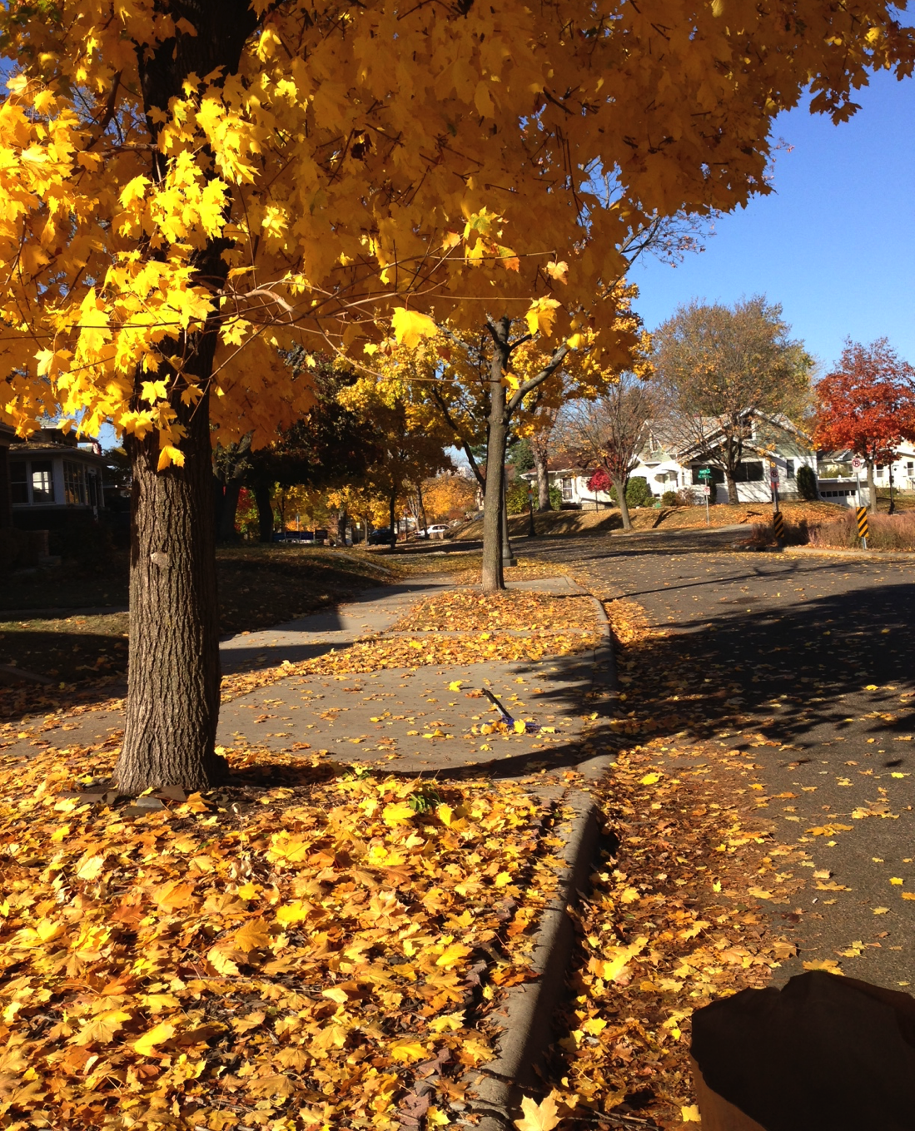
litterfall

Slide 7
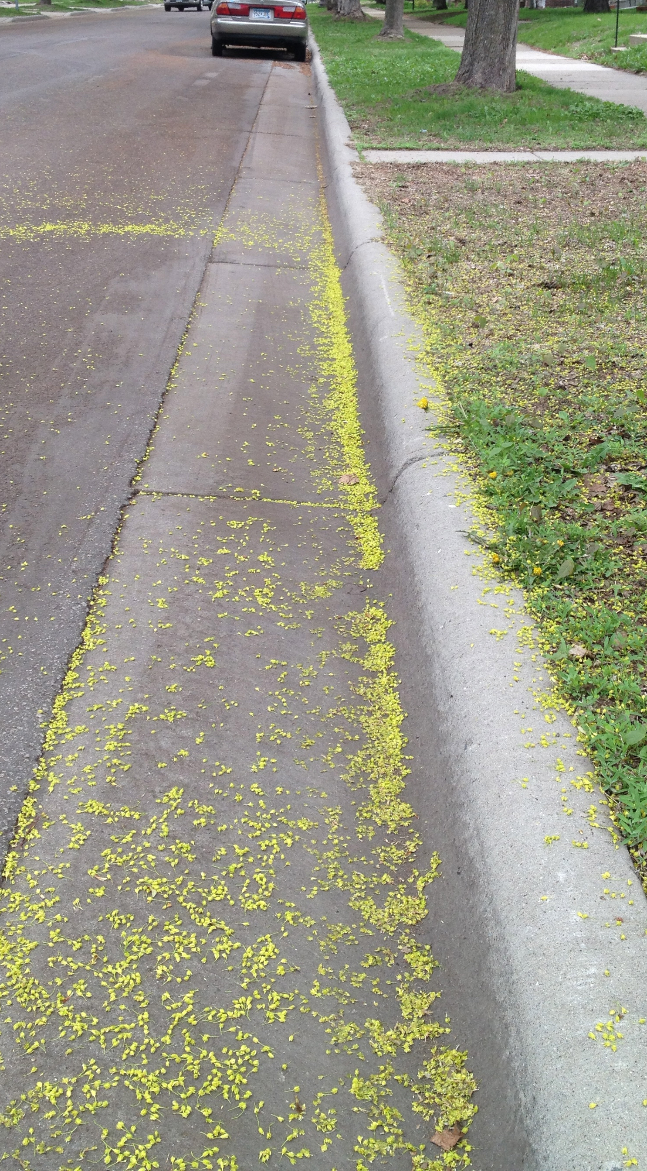
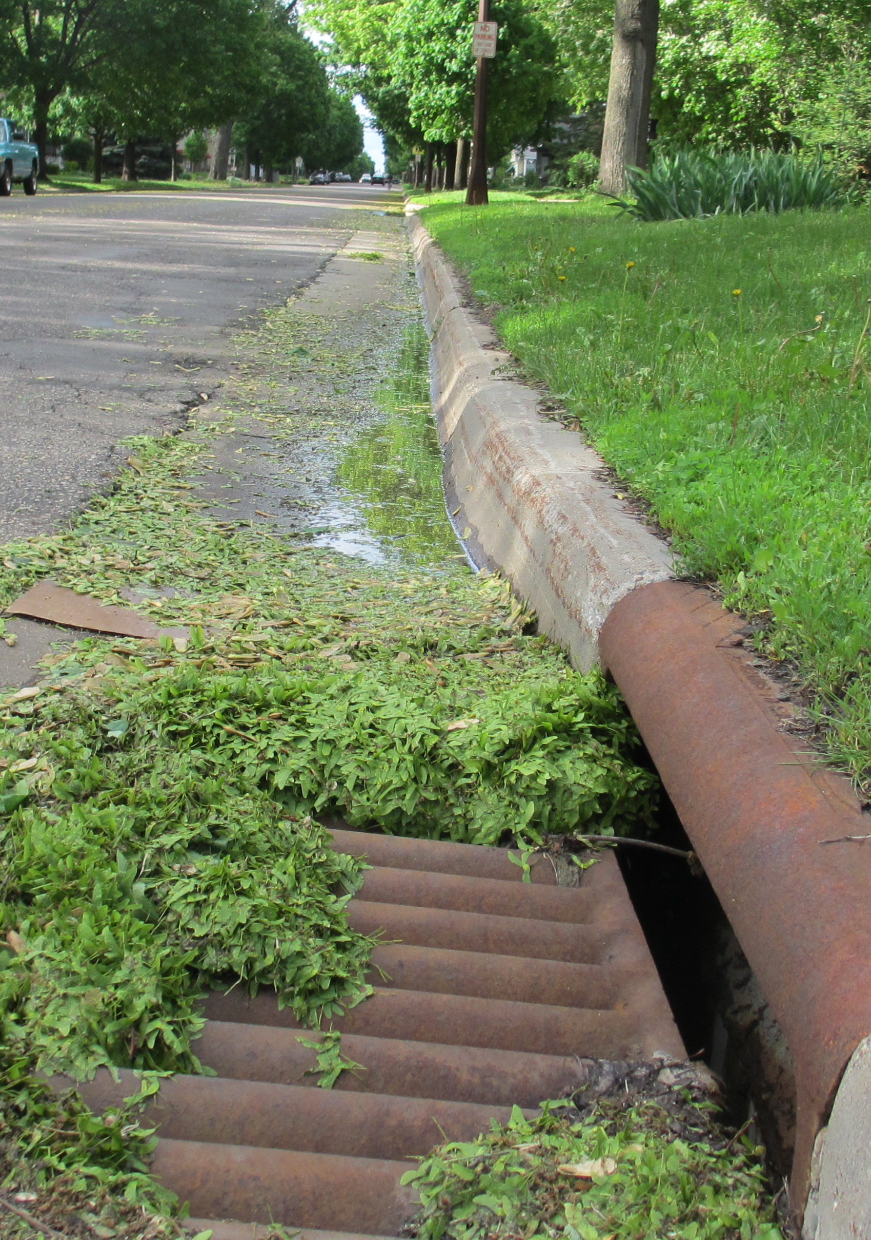
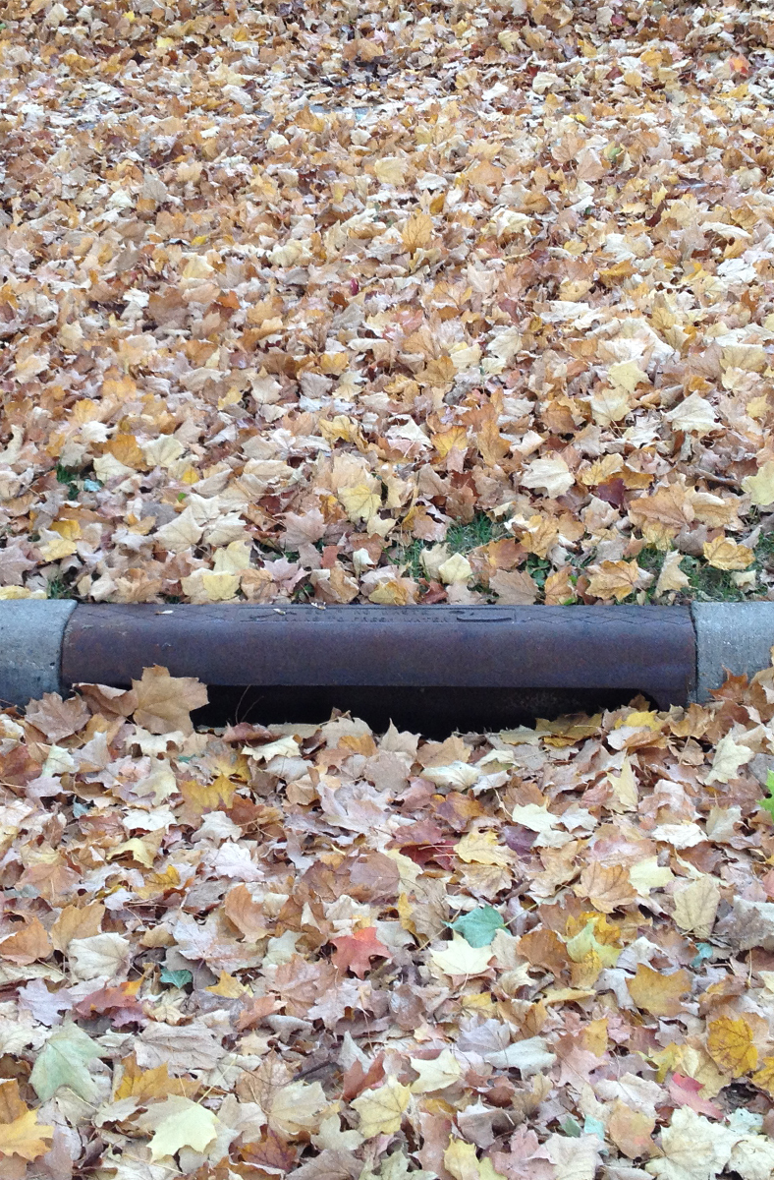
Spring
Summer
Fall

Slide 8
Litterfall contributions to P in street sweepings

Slide 9
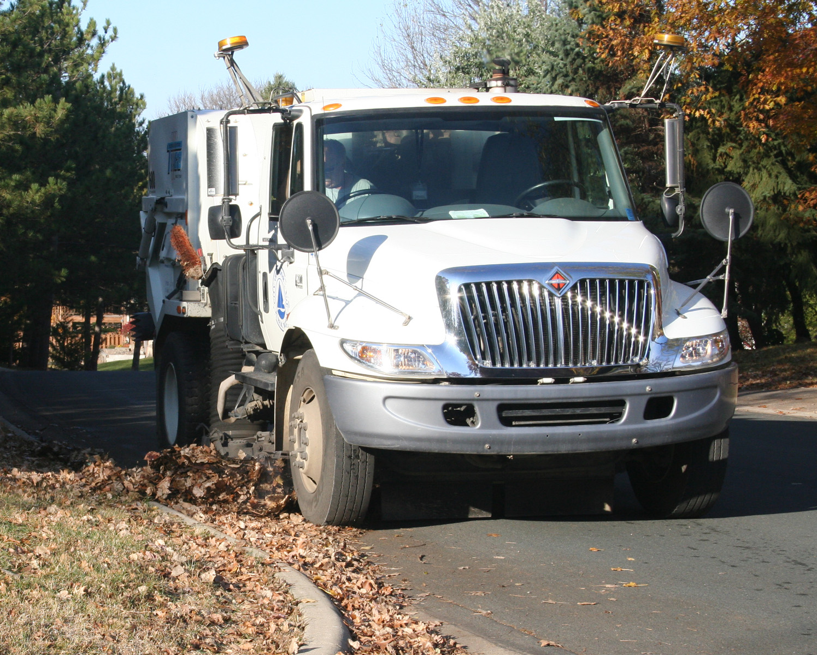
MSRC Street Sweeping Study

Slide 10
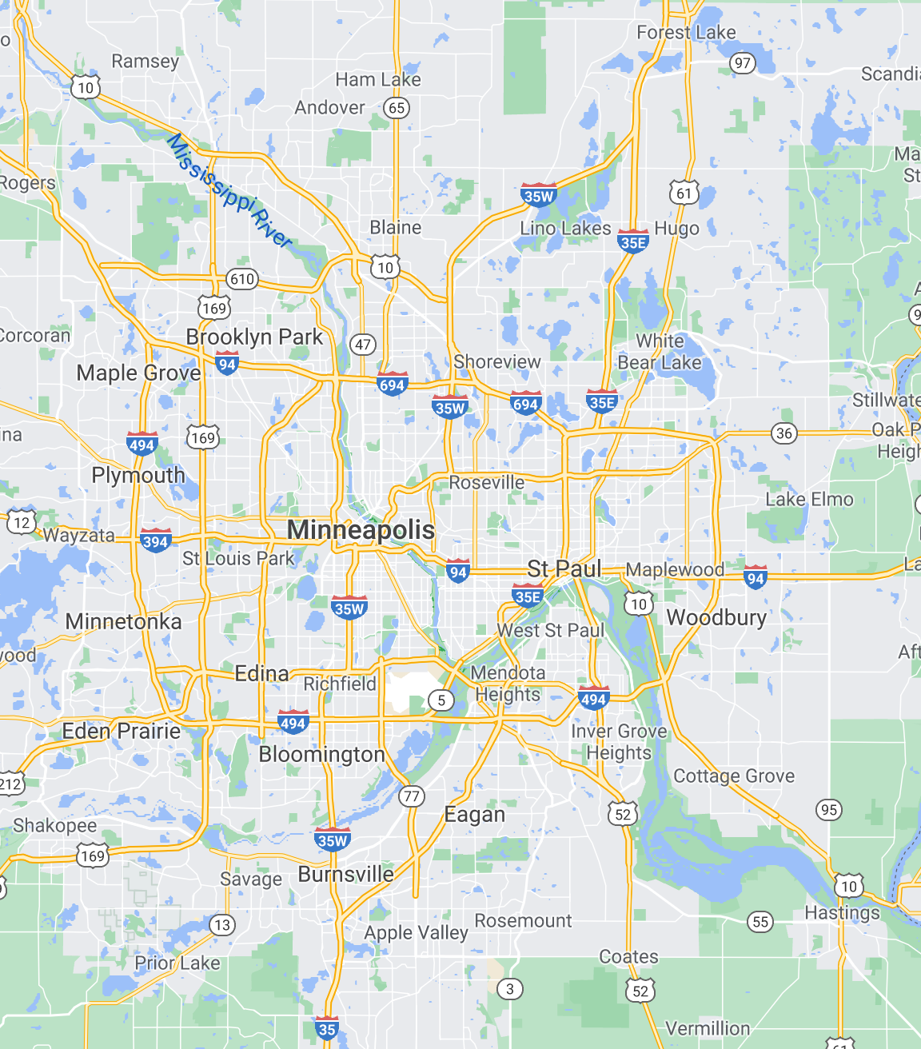

Slide 11
City | Study Years | No. routes | Route types | Canopy Cover (%) | Frequency (d) | Sweeper Type | Sweeping Period
Forest Lake | 2019 | 14 | Residential | 1-17 | 14-35 | Regen | Apr-Oct
Mpls | 2019 | 6 | Prkwys, residential, downtown | 0.75-37.5 | 29.2-35.5 | Regen + Mechan | June-Nov
Prior Lake | 2010-2012 | 9 | Residential | 0.1-19.3 | 9.8-37.5 | Regen | Year-round
Roseville | 2019 | 4 | Residential | 13.7-19.6 | 65.3-73.3 | Regen + Mechan | Apr-Nov
Shoreview | 2019 | 7 | Residential | 9.5-22.5 | 45.8-145 | Regen + Mechan | March-Nov

Slide 12
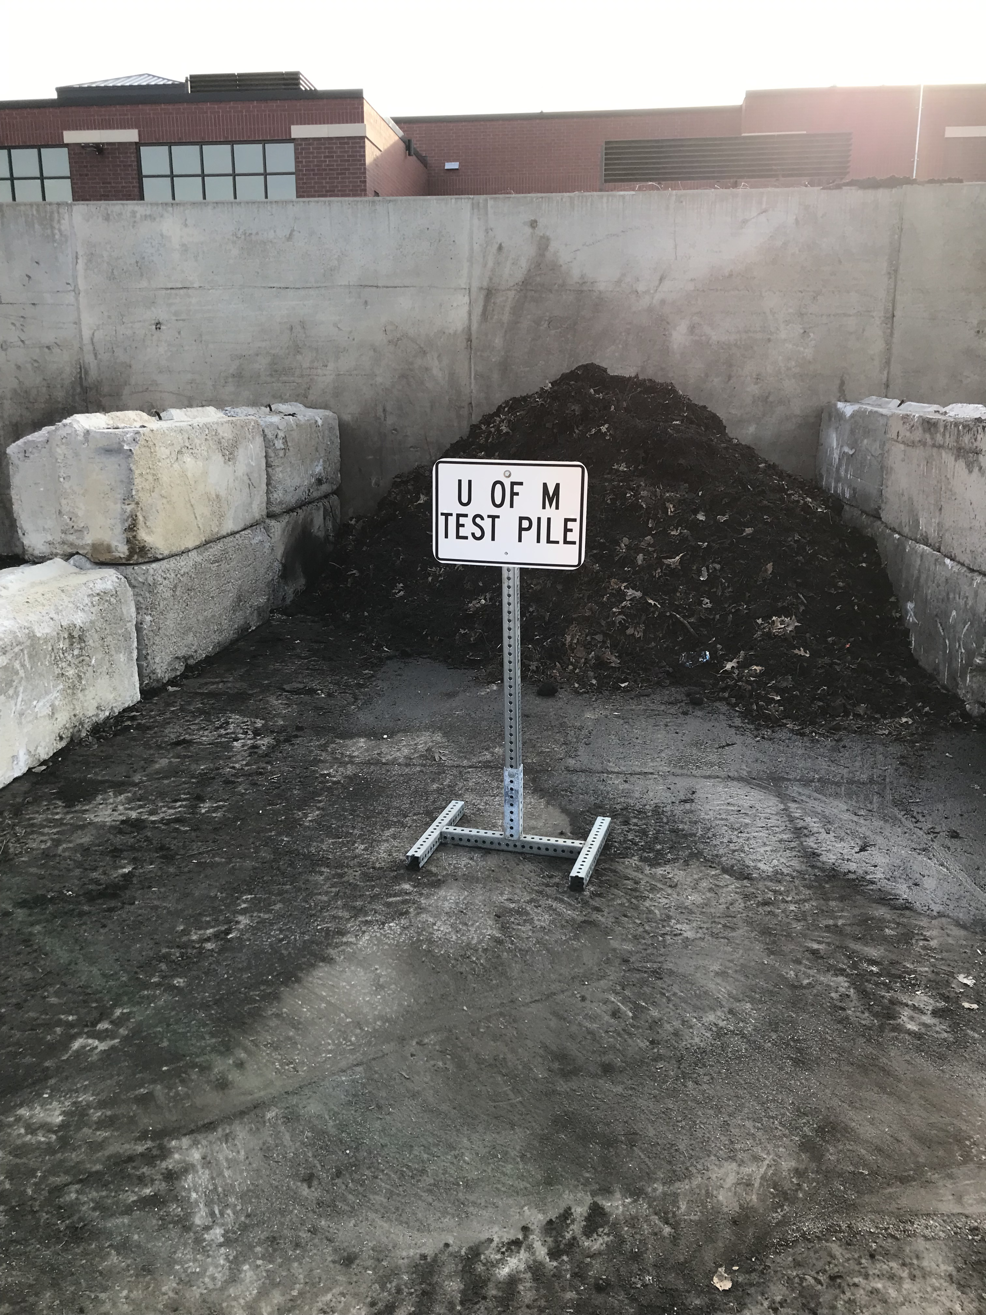
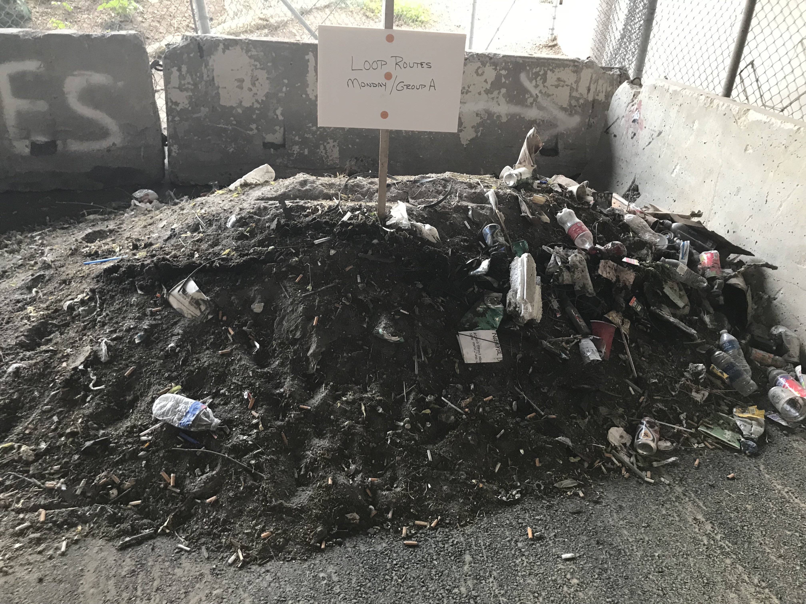
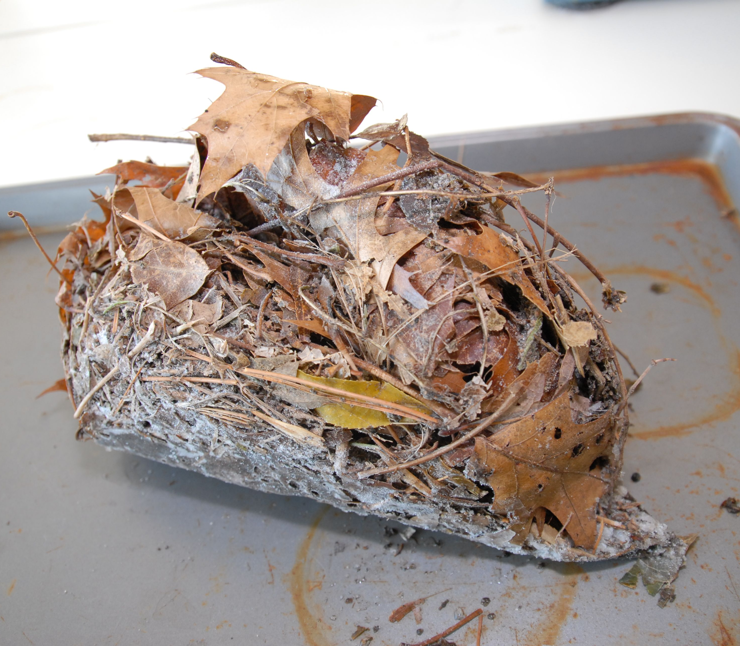
x4
Load wet mass
Minneapolis
Roseville
% moisture
Soluble | Fines (<2mm) | Coarse Organics (≥2mm) | Rocks
TP, TN, TOC
TS, TP, TN, TC, OM

Slide 13
x4
Load wet mass
Minneapolis
Roseville
% moisture
Soluble | Fines (<2mm) | Coarse Organics (≥2mm) | Rocks
TP, TN, TOC
TS, TP, TN, TC, OM
Data used in credit calculator

Slide 14
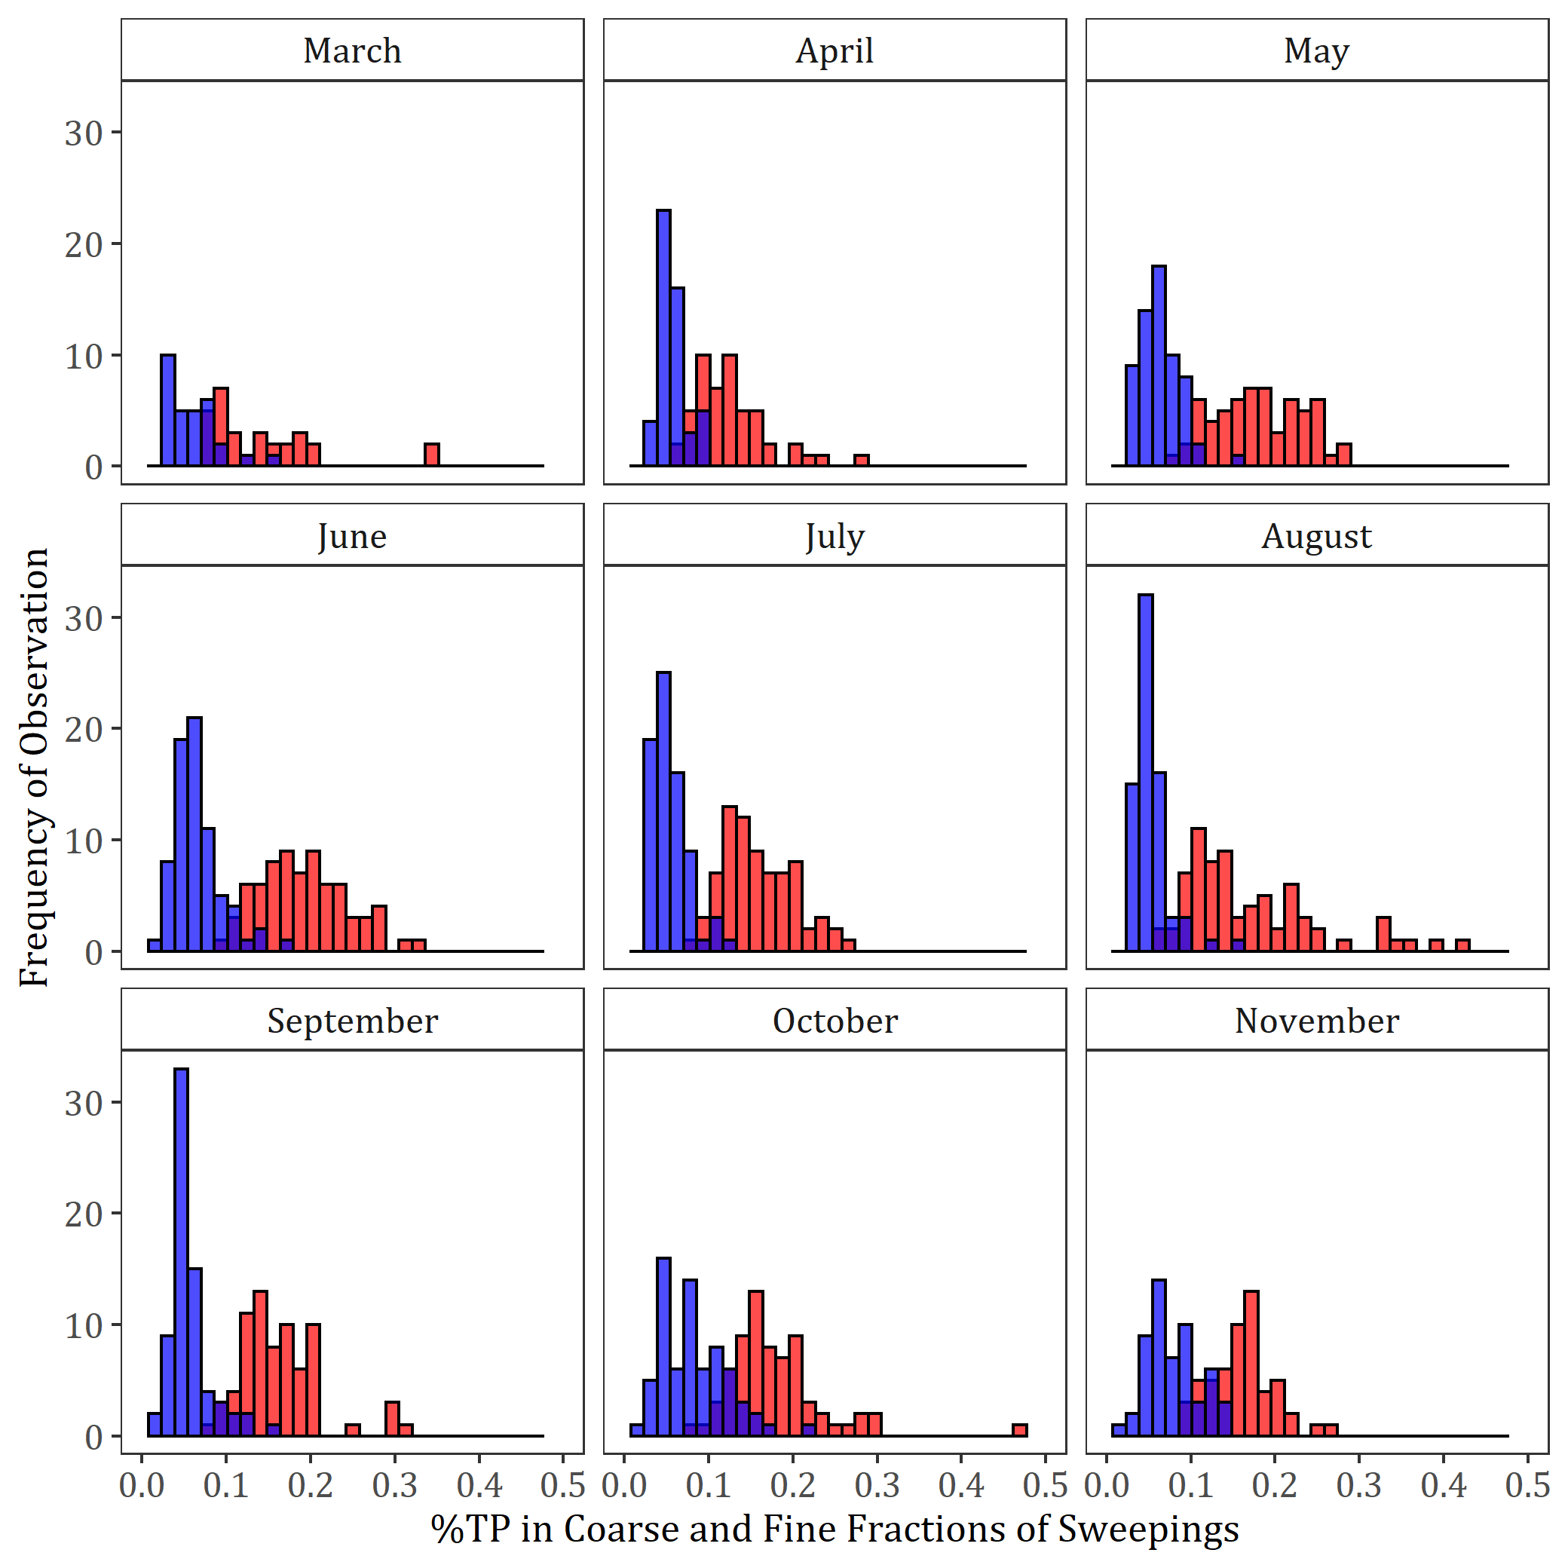
Litterfall has high P concentrations
Coarse material
Fine sediments

Slide 15
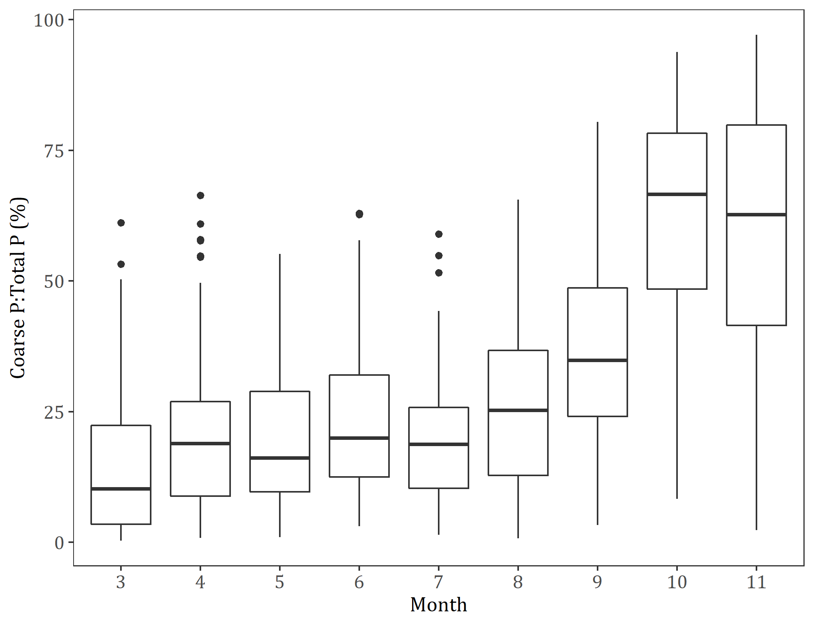
Litter contributes a high fraction of P to sweepings in fall
Percent of P in sweepings from coarse fraction

Slide 16
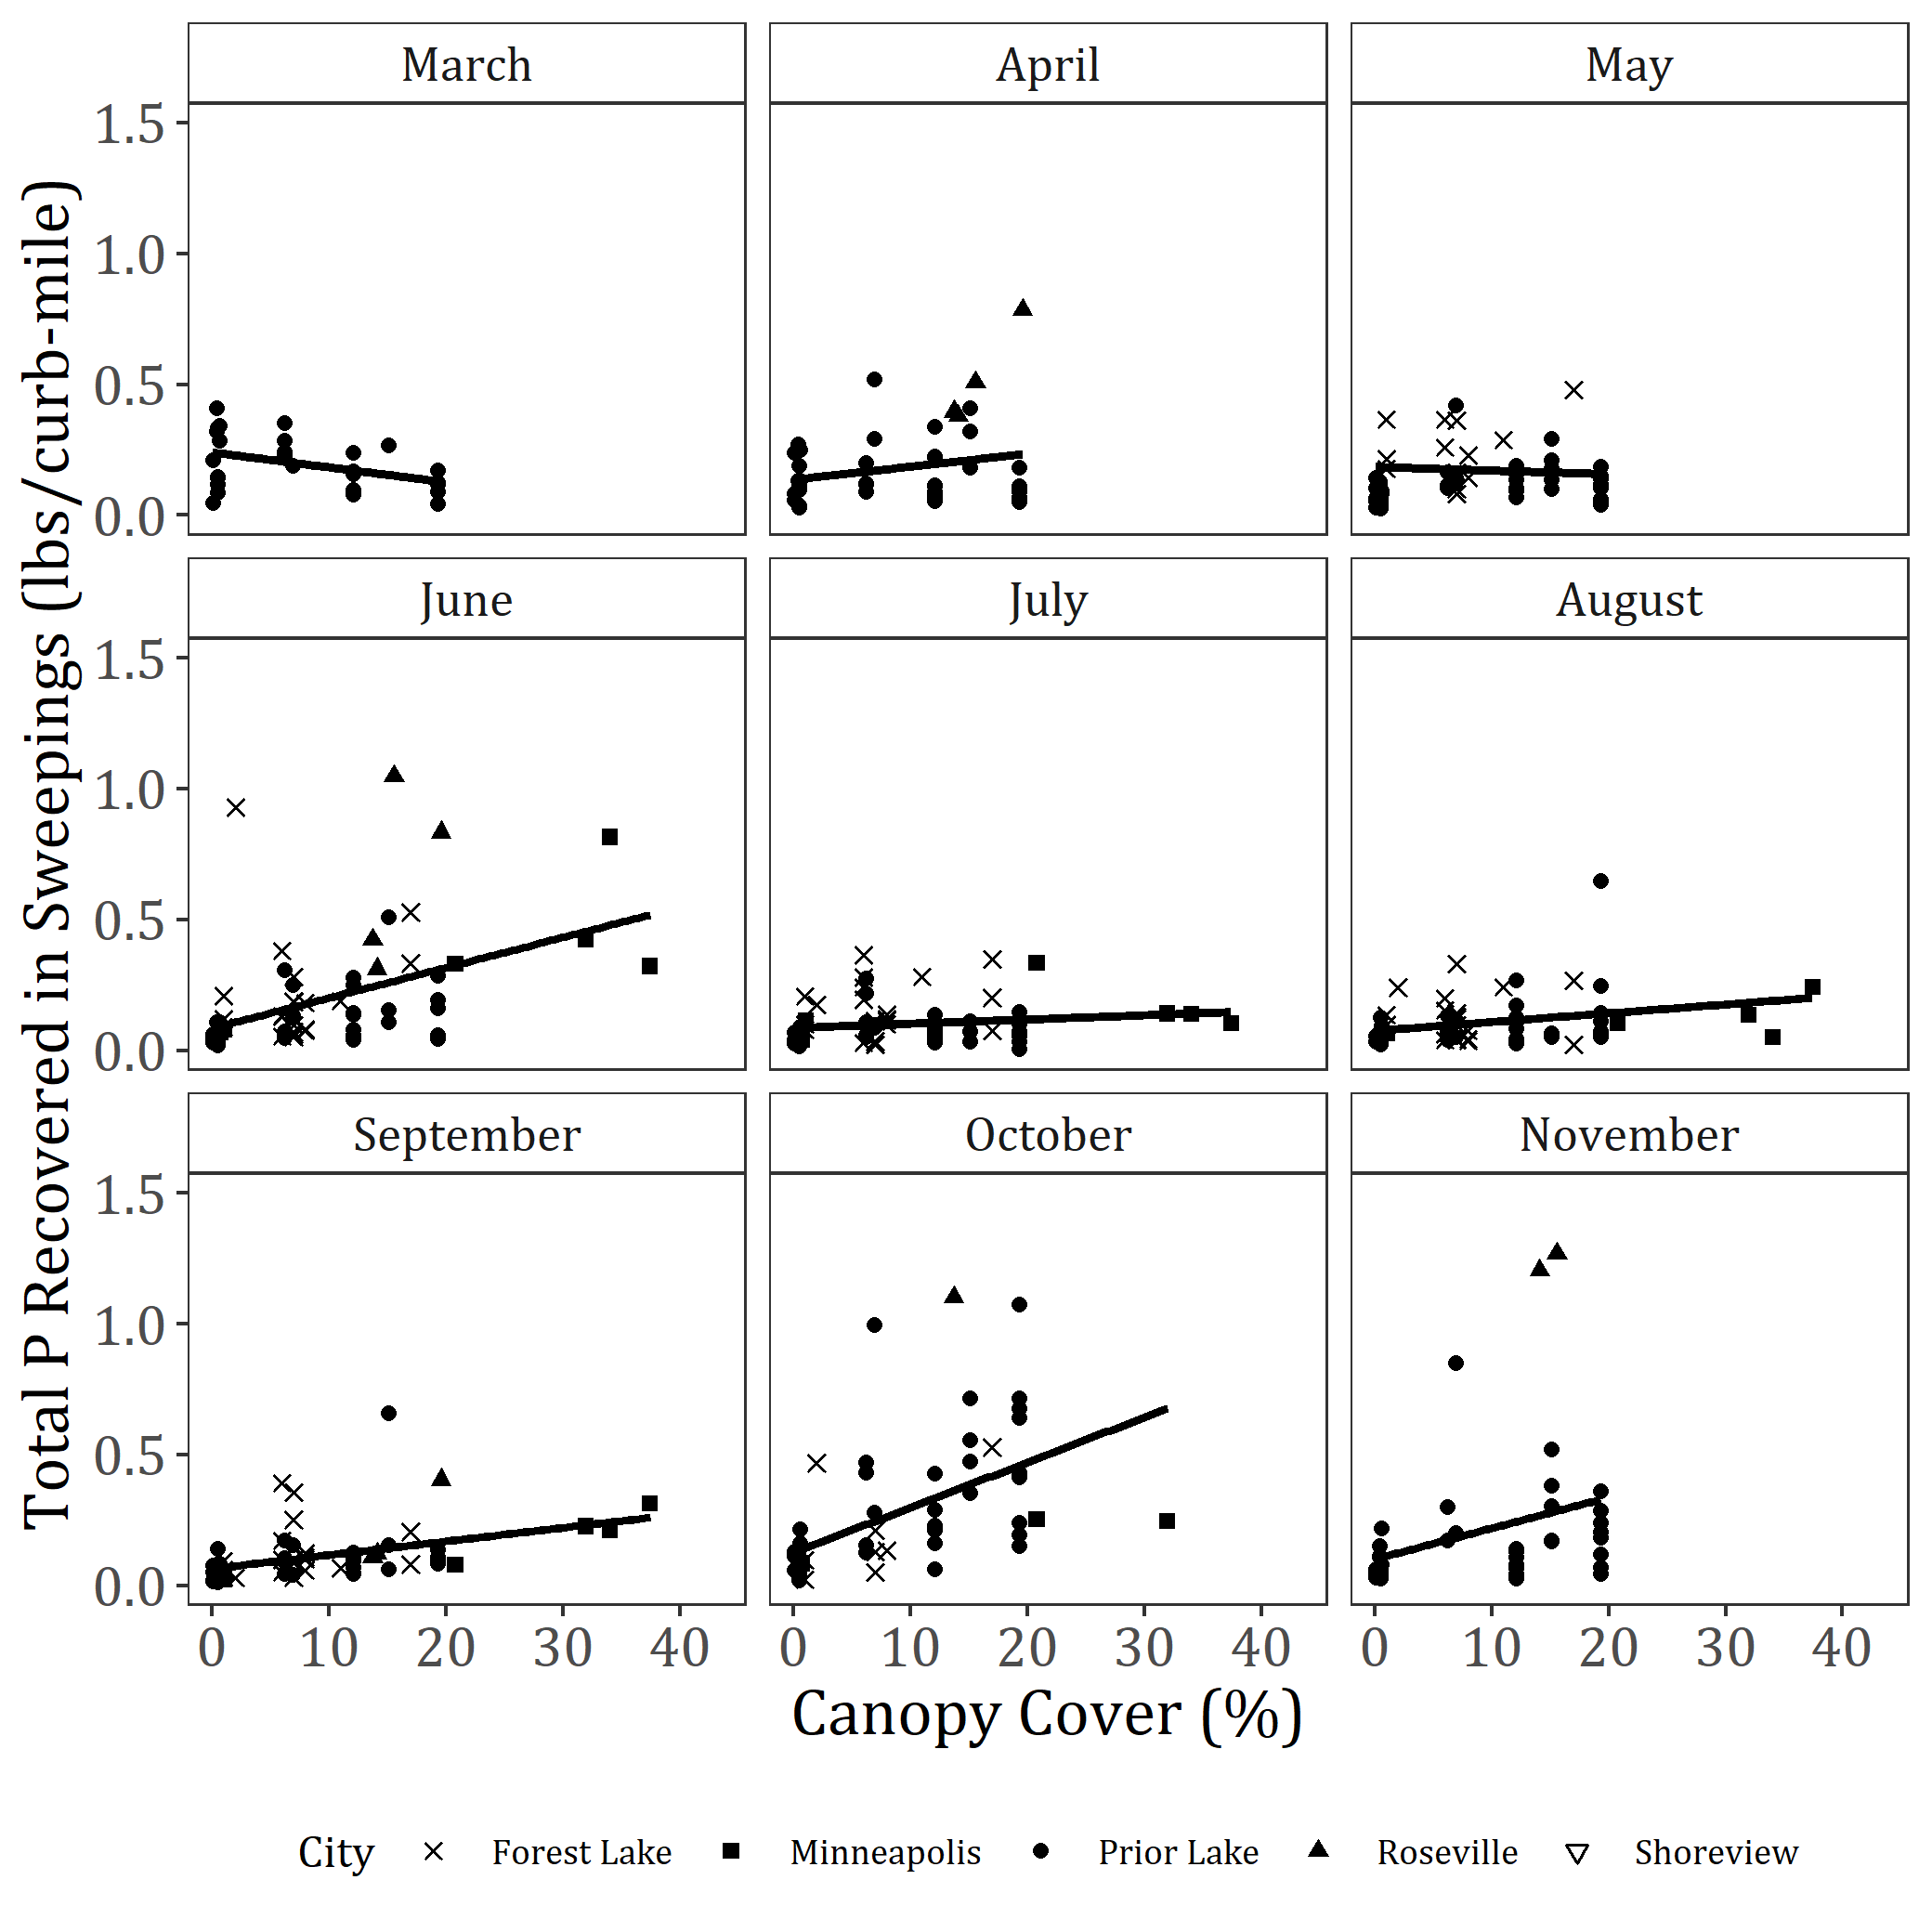
Total P Recovered in Sweepings is Highest where Canopy Cover is High

Slide 17
Contribution of litterfall P to stormwater P loading

Slide 18




Canopy Cover Study
WCD
Janke et al. 2017. Environmental Science & Technology

Slide 19
Across 16 watersheds, stormwater P concentrations increase with canopy cover
Janke et al. 2017. Environmental Science & Technology

Slide 20
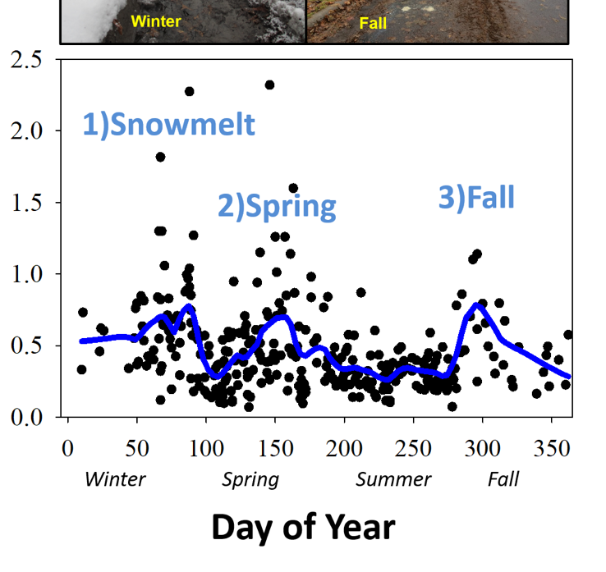
Within one watershed, across seasons, stormwater P matches tree phenology
2007-2016
Total phosphorus (mg/L)
Day of Year
Arlington-Hamline Underground Watershed, Capitol Region Watershed
Finlay et al. in prep.

Slide 21
How do litterfall P inputs to streets compare to stormwater runoff P yields?

Slide 22
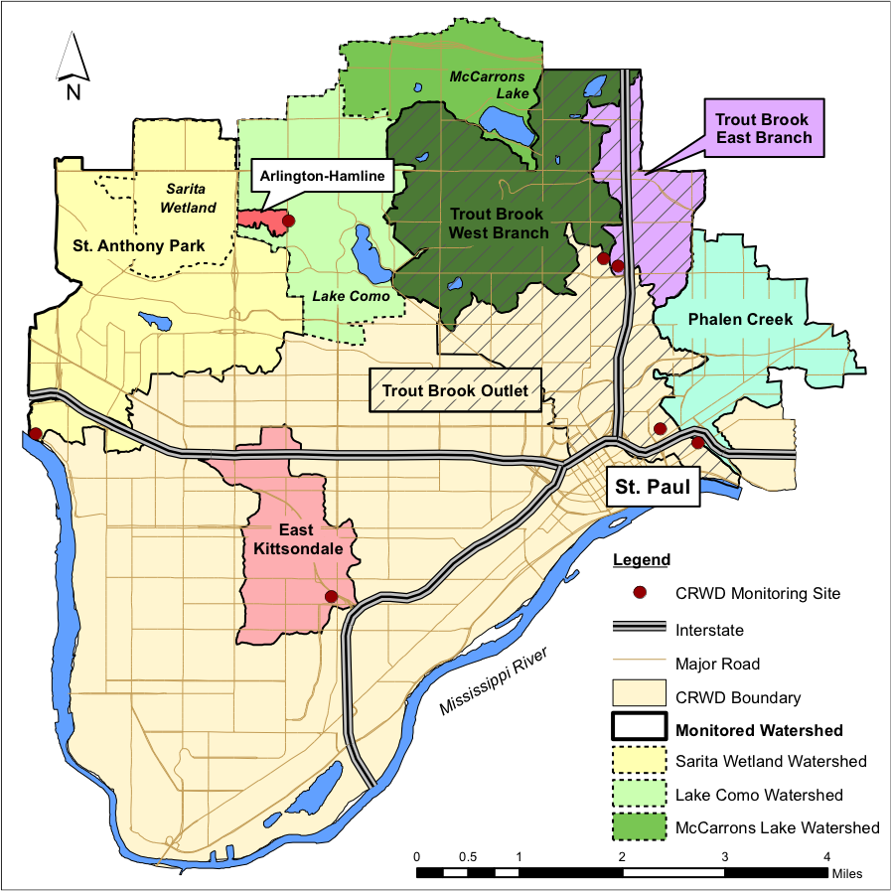
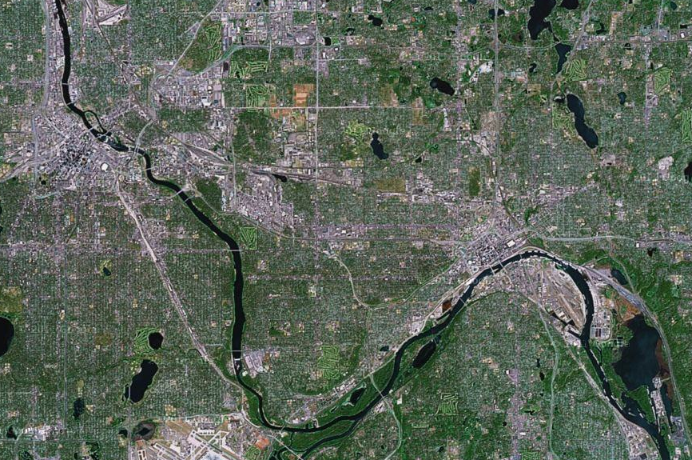
Urban, residential subwatersheds of the Mississippi River,
Saint Paul, Minnesota
Monitoring
Stations

Slide 23
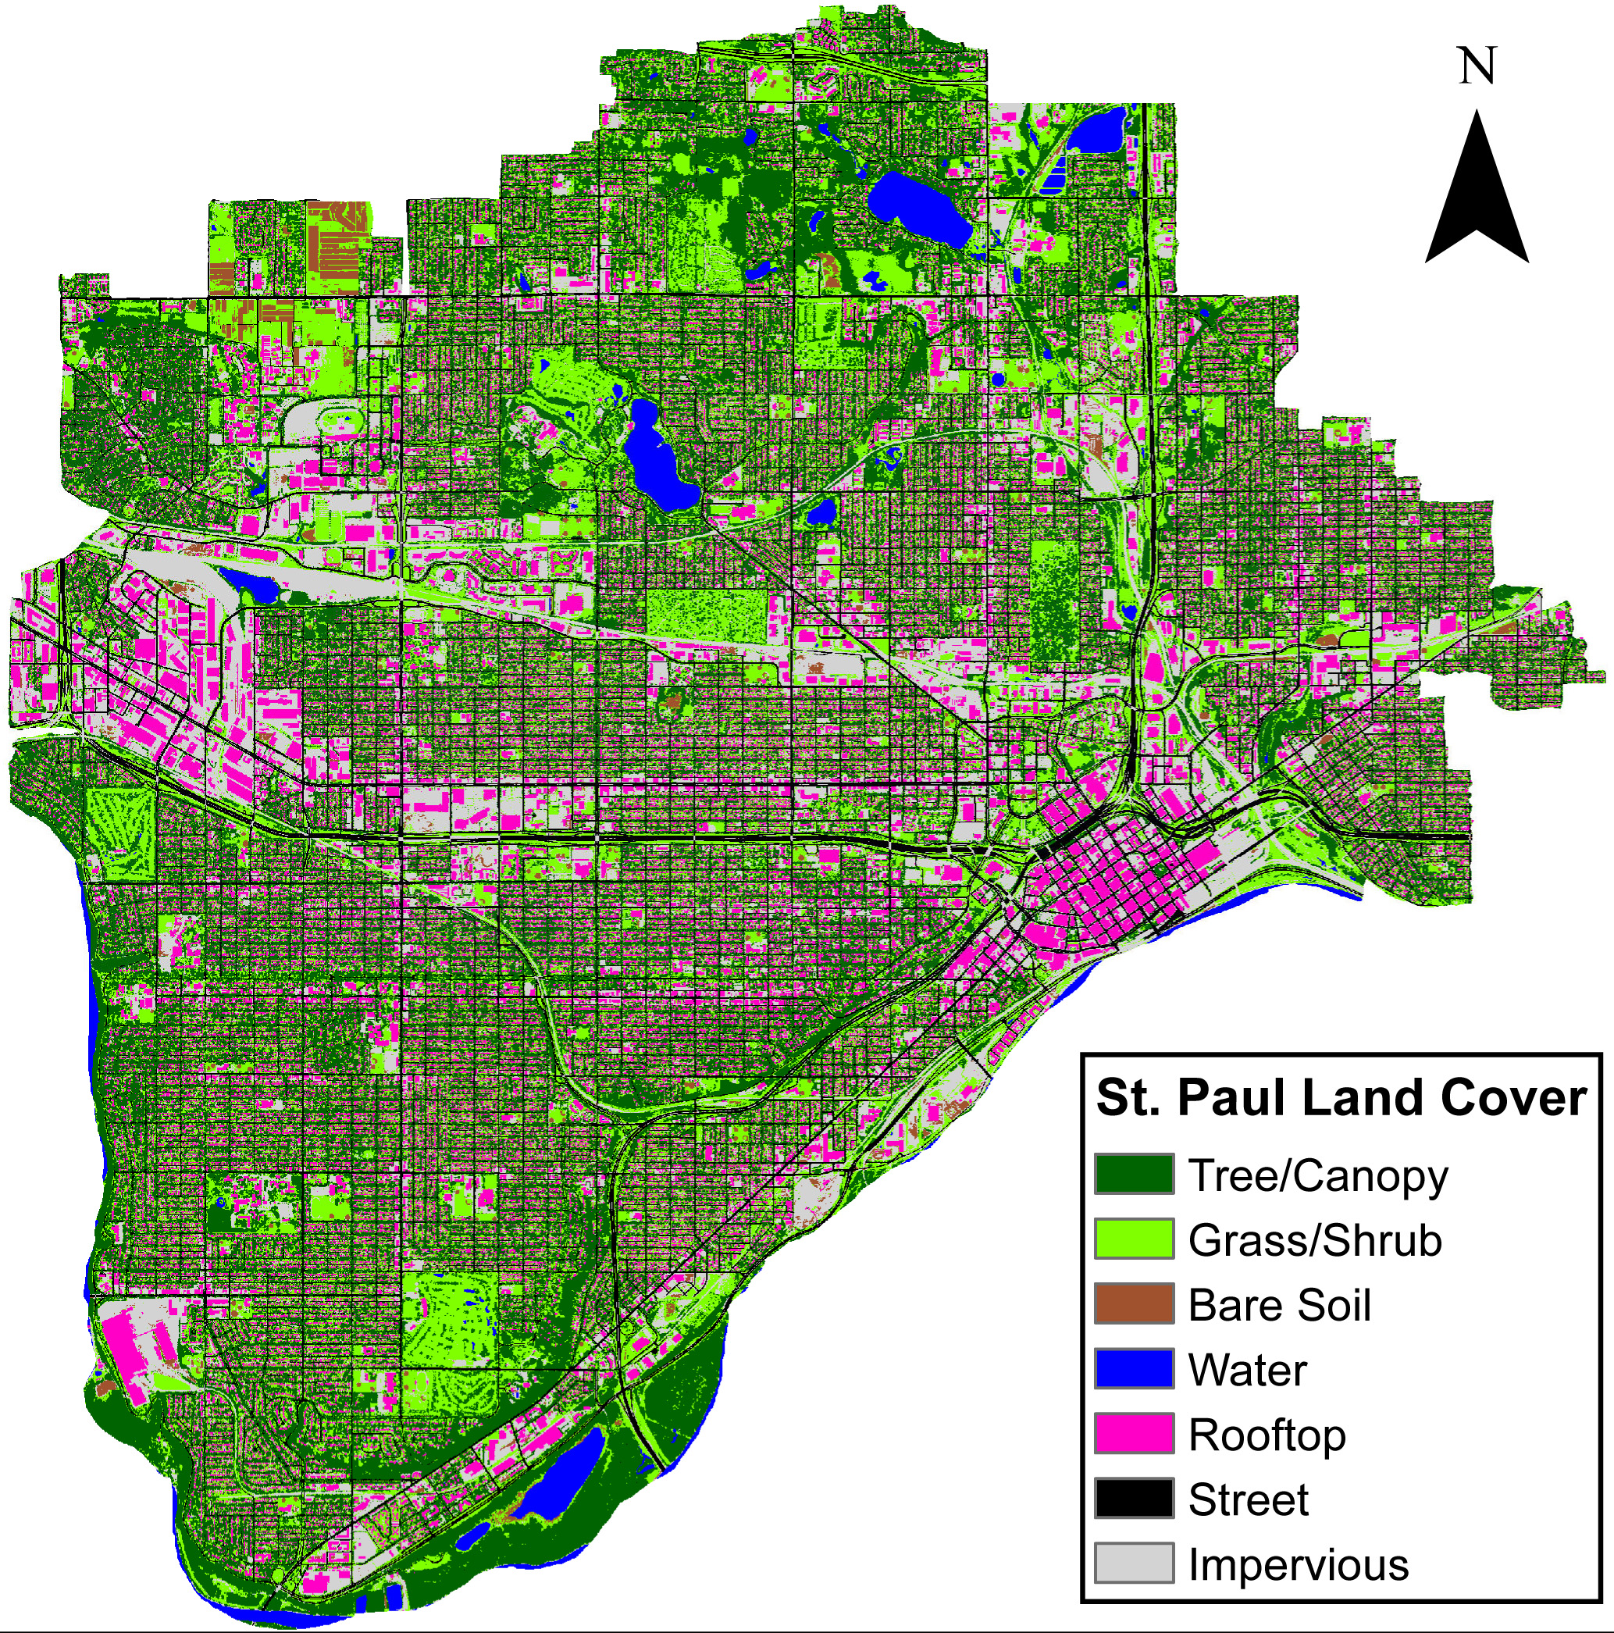
Land cover: Kilberg and Bauer 2011

Slide 24
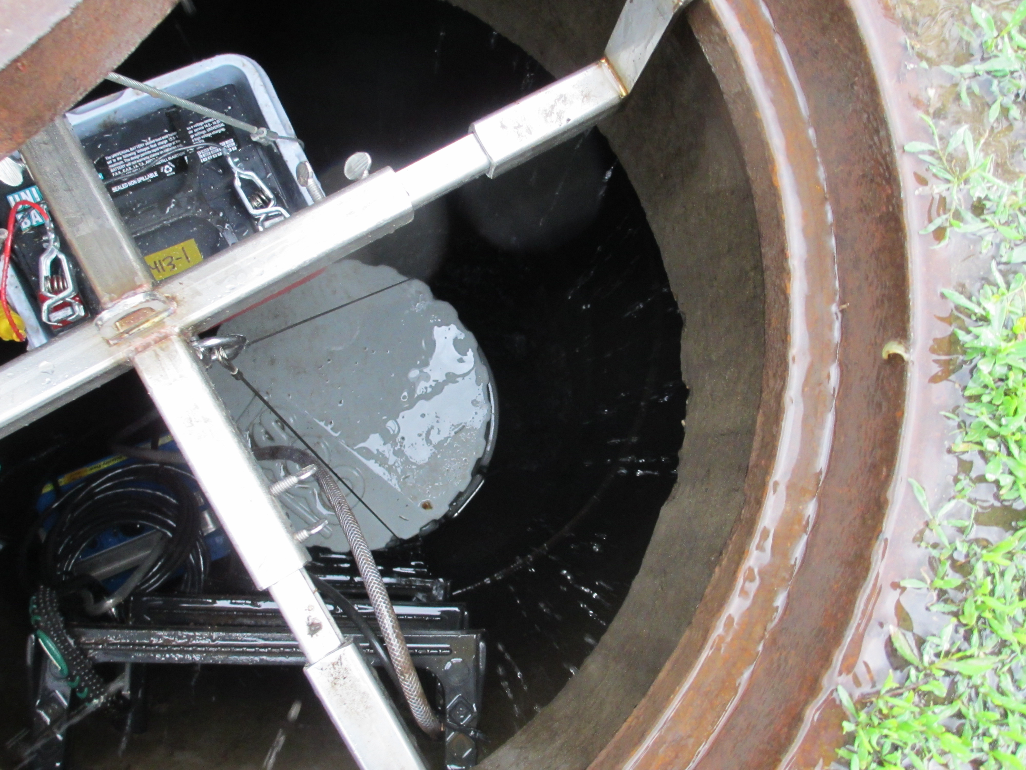


Ben Janke
Jacques Finlay

Slide 25
Litterfall P to streets is 37-64% of runoff P

Slide 26
Conclusions
Trees can contribute substantial bioavailable P to streets and stormwater
Street sweeping should reduce stormwater P loading

Slide 27
MSRC Street Sweeping Study
University of Minnesota
Sarah Hobbie, Dept. of Ecology, Evolution & Behavior
Larry Baker, Dept. of Bioproducts & Biosystems Engineering
Jacques Finlay, Dept. of Ecology, Evolution & Behavior
Rachel King, PhD student, EEB
Tessa Belo, technician, EEB
Minnesota Pollution Control Agency
Mike Trojan
David Fairbairn
Tetra Tech
Aileen Molloy
Jennifer Olson
Notes:
On your own.

Slide 28
Acknowledgments
Cities of:
  Forest Lake
  Minneapolis
  Prior Lake
  Roseville
  Shoreview
Funding Sources:
  Minnesota Stormwater Research Council
  Environmental Protection Agency
  City of Forest Lake
  Comfort Lake Forest Lake Watershed District

