Slide 1
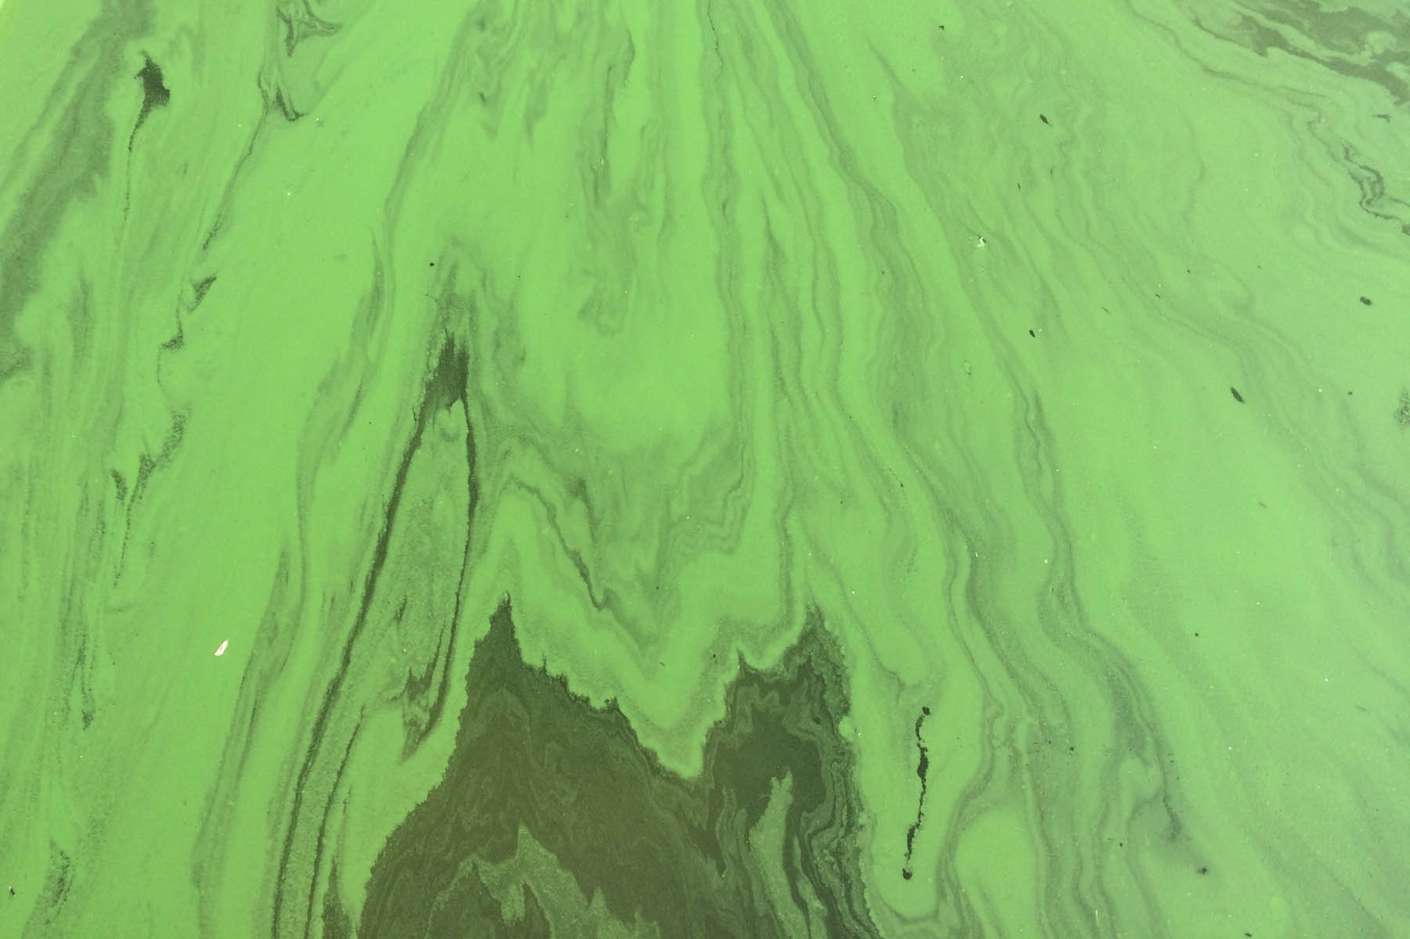

Trees as sources of nutrient pollution to surface water
Sarah Hobbie
Professor, Dept of Ecology, Evolution & Behavior
University of Minnesota

Slide 2
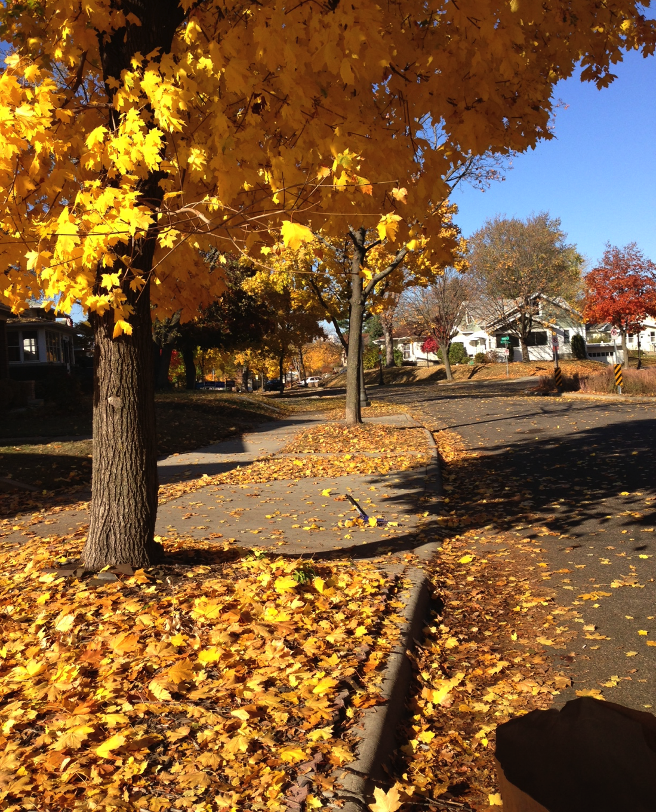
Reductions in stormwater volume
Increases in nutrient loading
interception
evapotranspiration
infiltration
litterfall

Slide 3
Increases in nutrient loading
litterfall

Slide 4
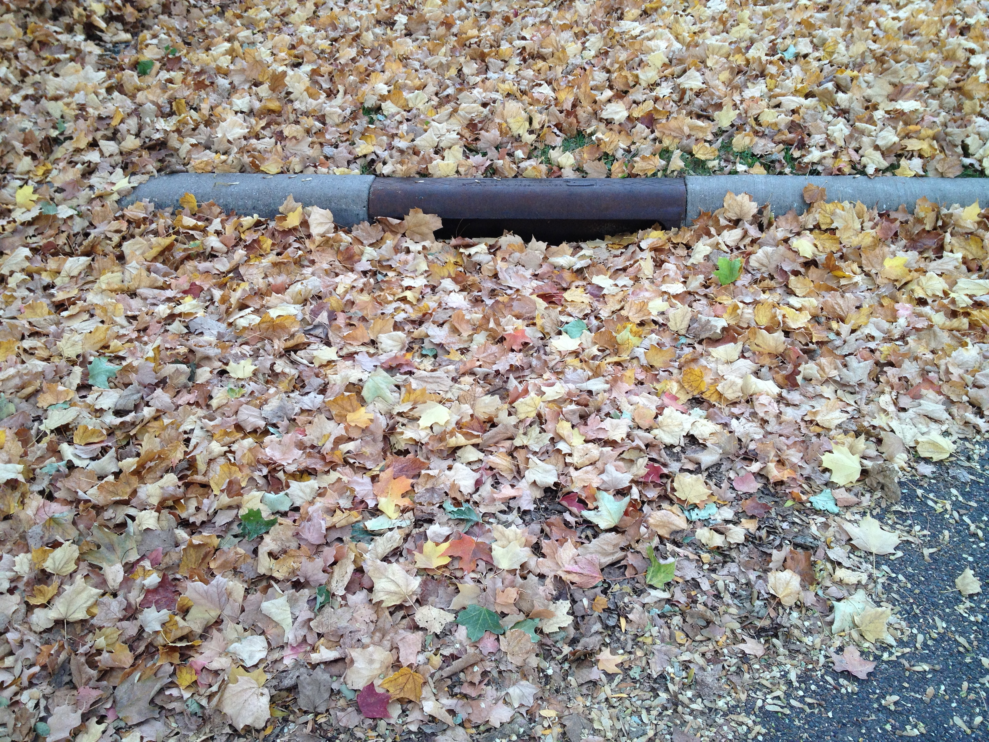

Slide 5
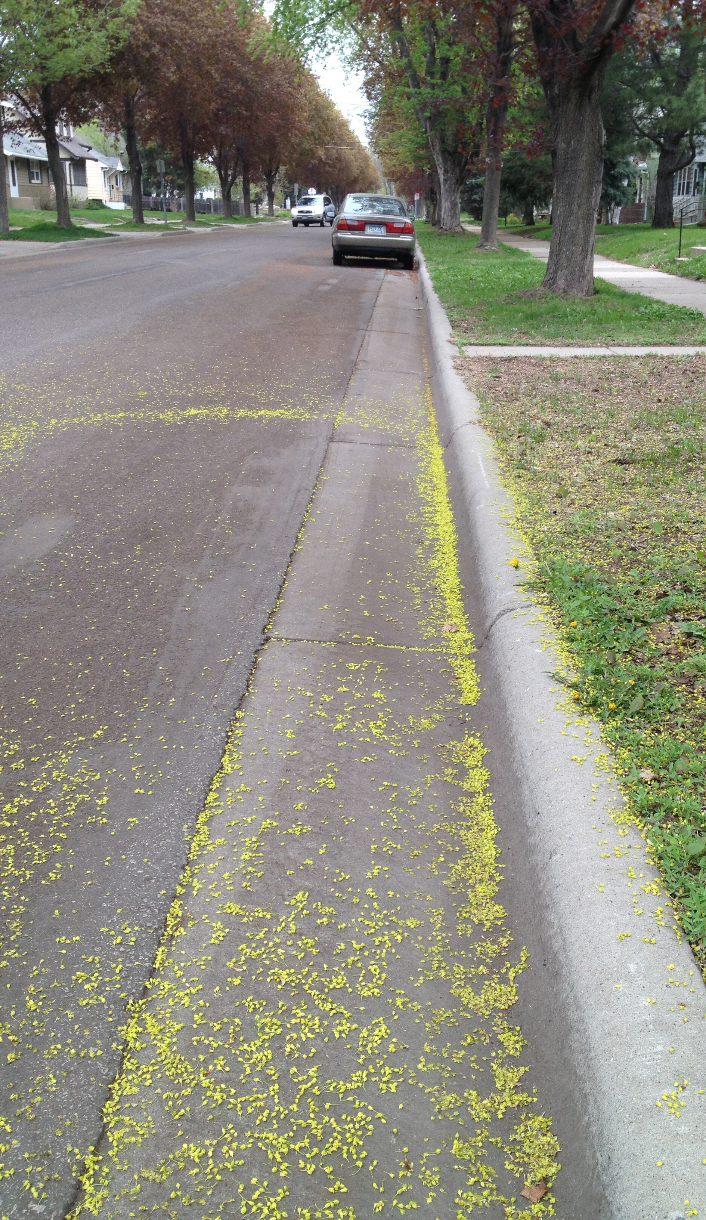
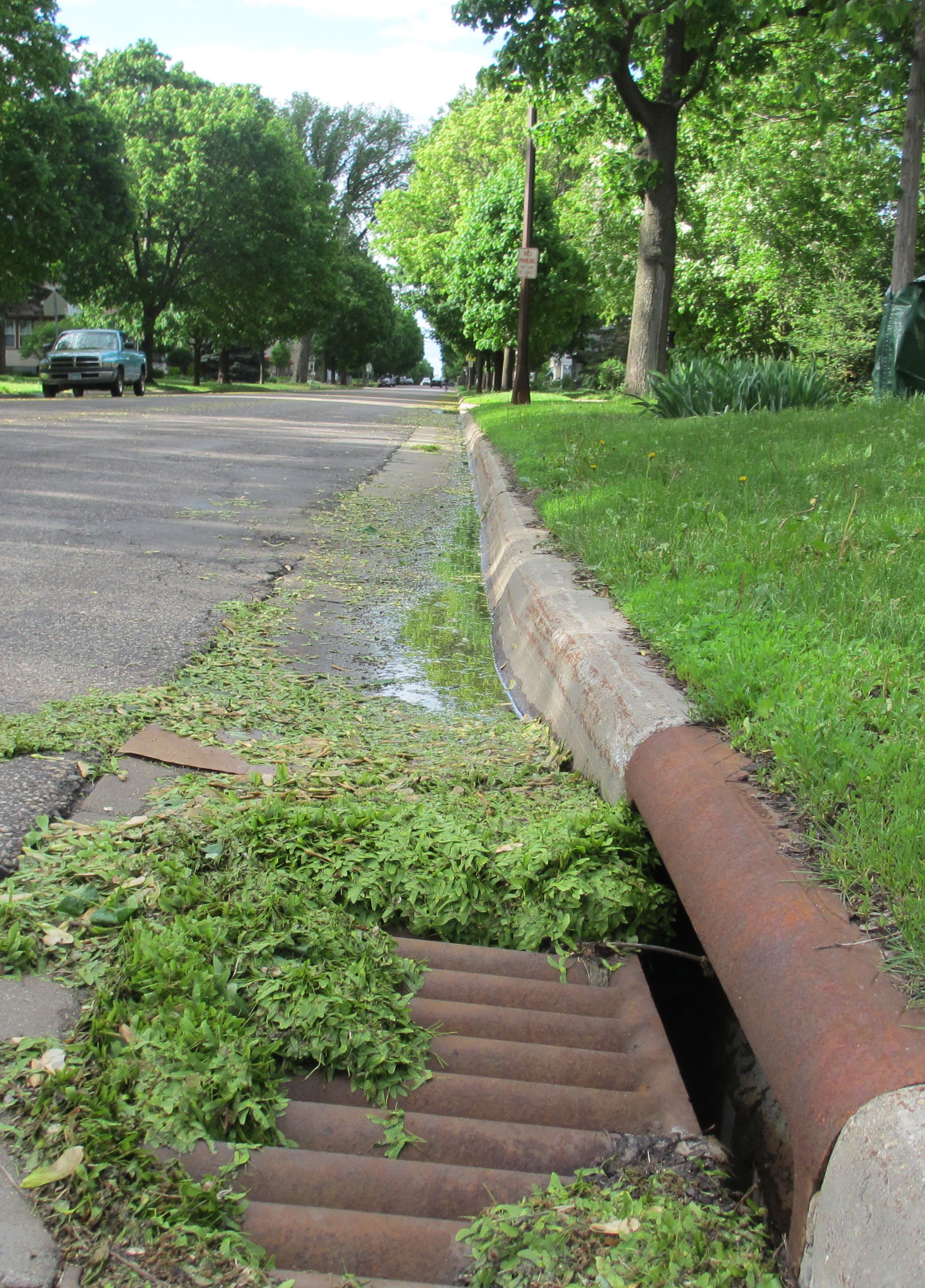

Slide 6
Trees as Sources of Nutrient Pollution
      Prior Lake Street Sweeping Study
      Canopy Cover Study
      Paired Catchment Study

Slide 7
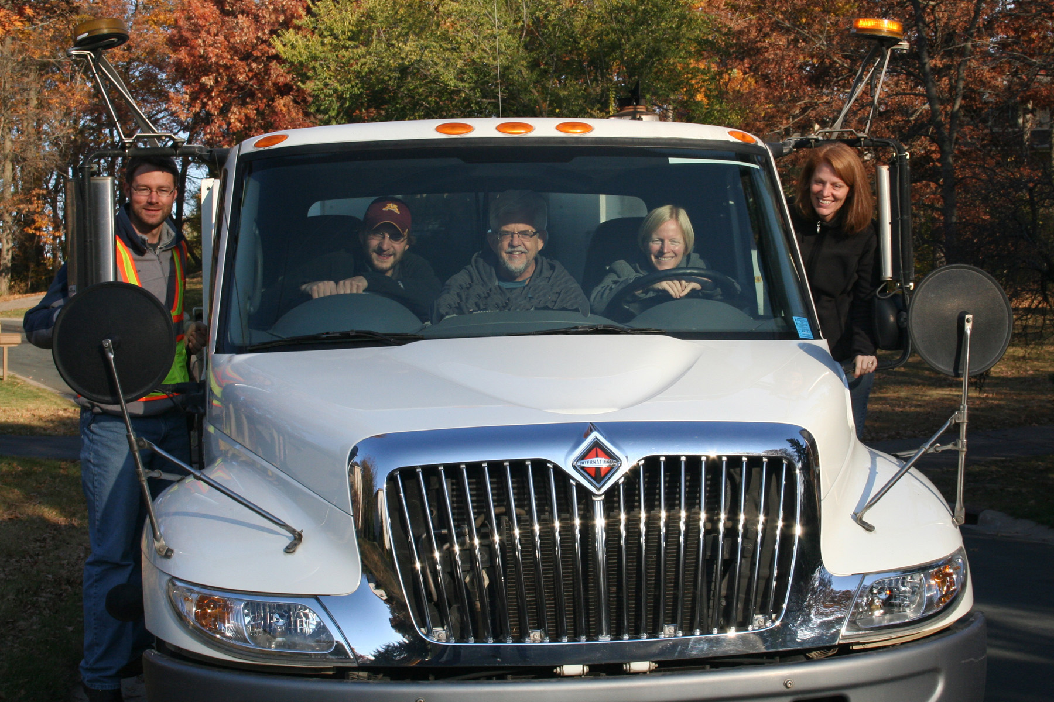
Prior Lake Street Sweeping Study
Ross Bintner, Chris Buyarski, Larry Baker, Paula Kalinosky

Slide 8
Novelty of Prior Lake Study
      Included entire snow-free period
      Included coarse material (litterfall)
      Quantified solids and nutrients in sweepings
      Compiled cost efficiency
      Multi-factor design

Slide 9
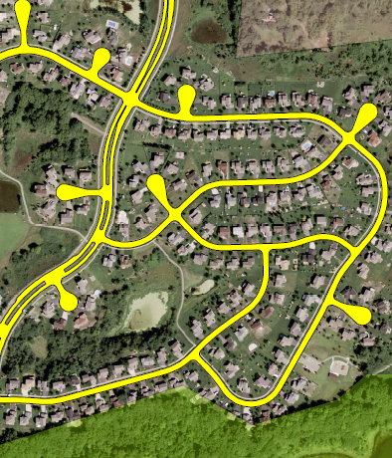
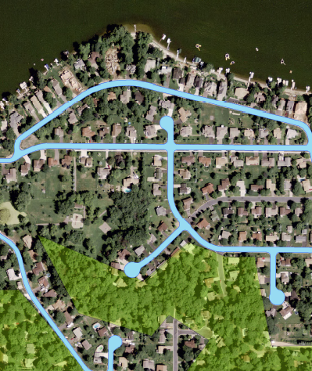
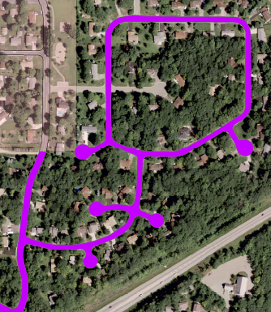
Study Design
Nine Study Routes
LOW Canopy |  | HIGH Canopy
 | 1X, 2X, 4X/month
400 sweepings over 2 years

Slide 10
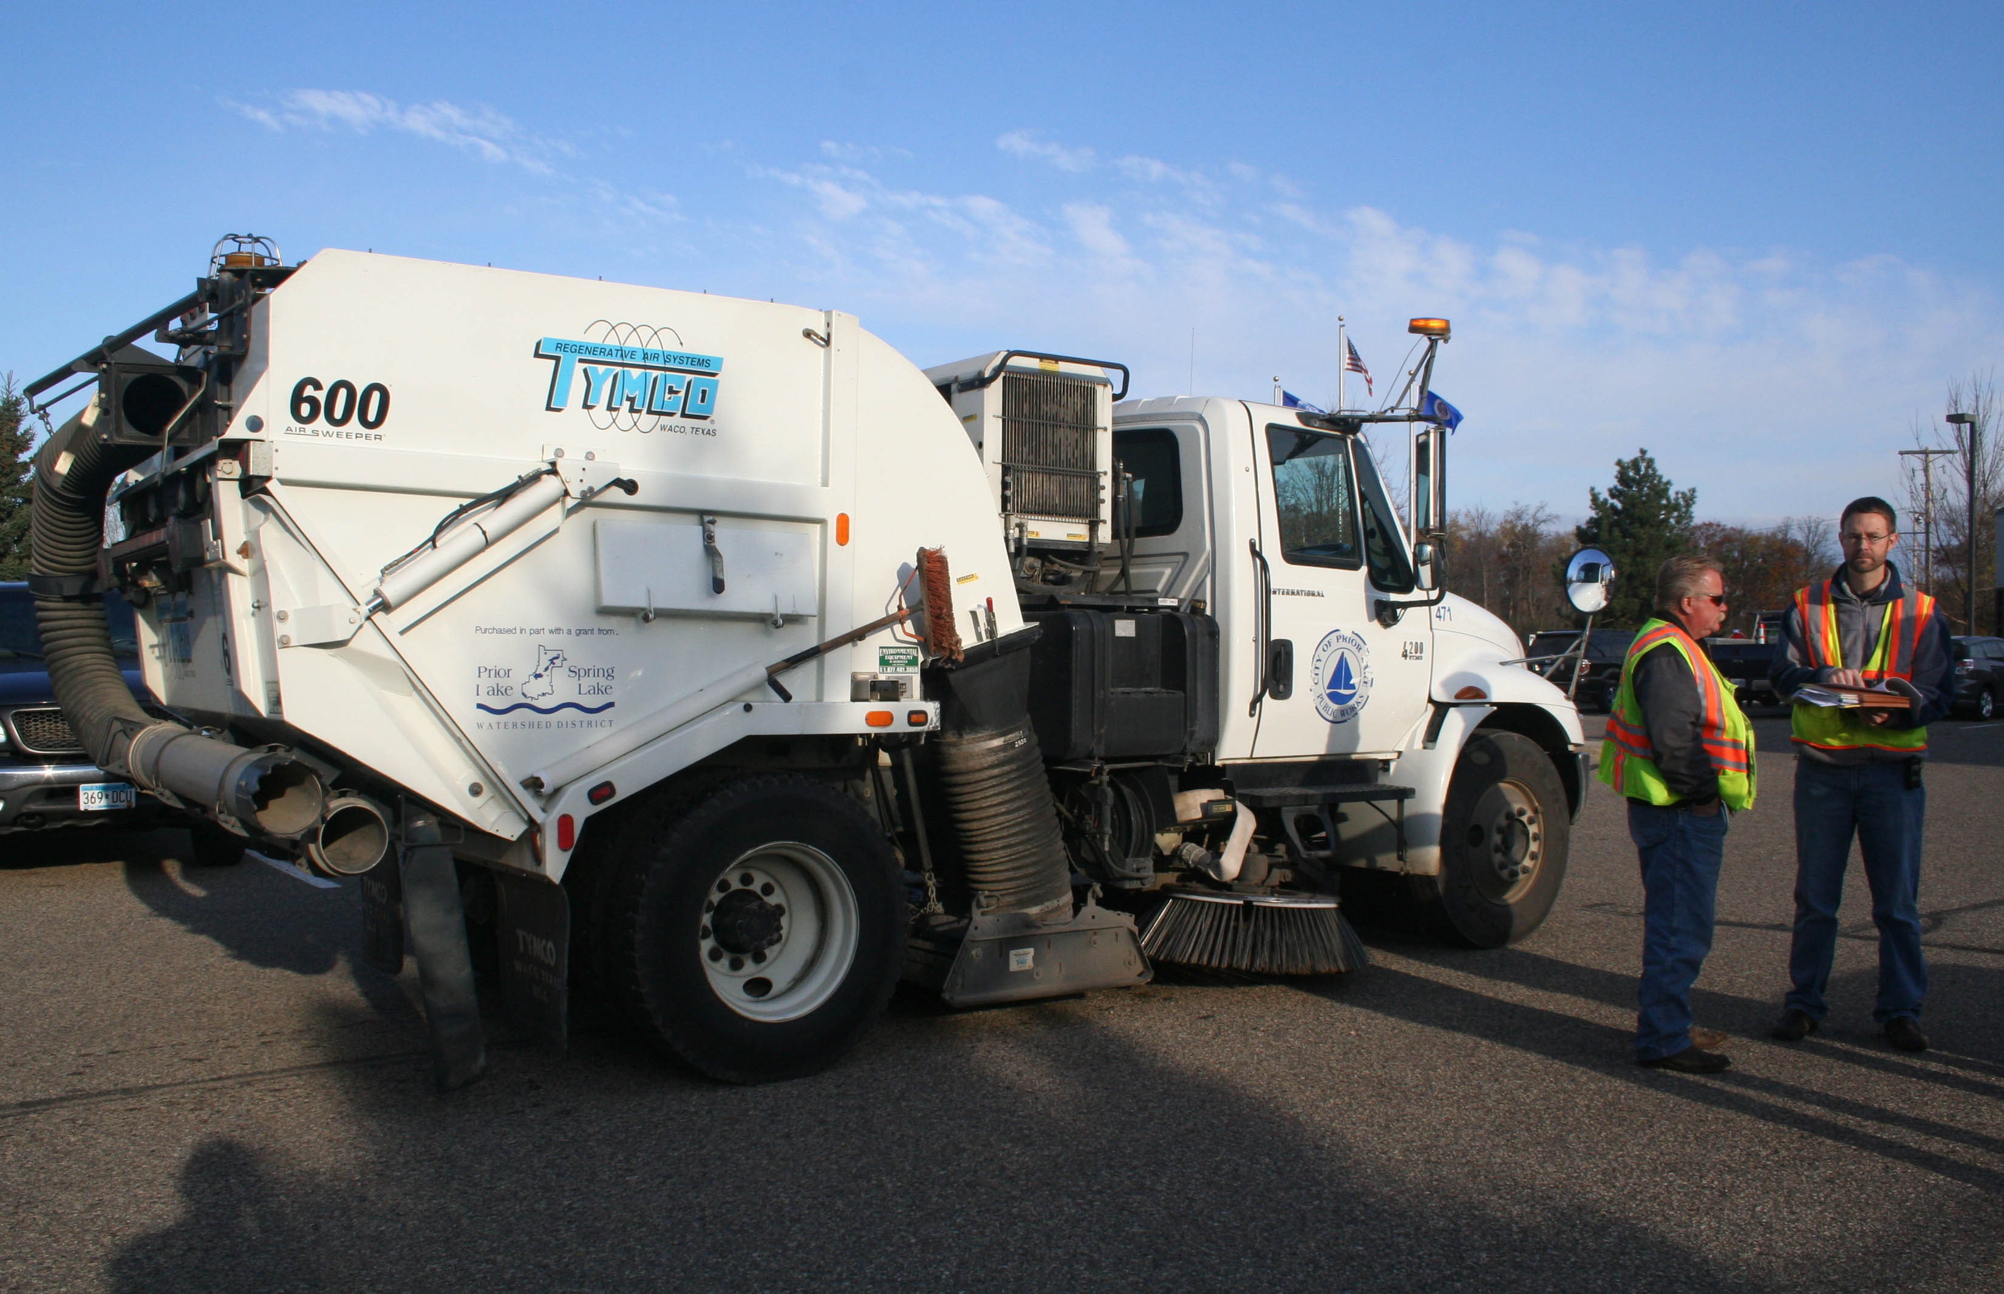
Tymco Model 400 Regenerative Air Sweeper

Slide 11
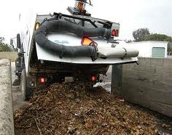
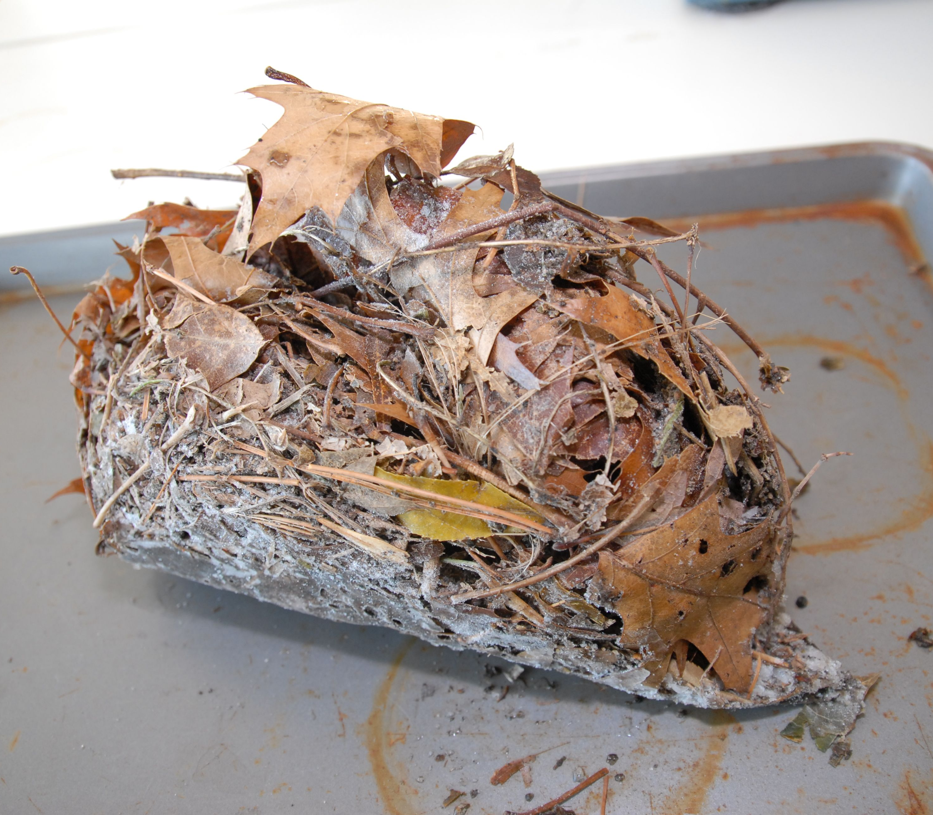
x4
% moisture
Soluble | Fines (<2mm) | Coarse Organics (≥2mm) | Rocks
TP, TN, TOC
TS, TP, TN, TC, % Organic
Notes:
Moisture content of fresh sample and dry mass of each fraction tracked during analysis. Trash content rarely over 1%, but rock content is not. Garbage, ave=0.2 +/- 0.1 % (SD=0.5%), rocks ave=9.4 +/- 0.8% (SD 7.9%). Labs – Soil & Litter TN, TOC – University of Nebraska Ecosystems Analysis Laboratory, all other at U of MN EEB Laboratories.

Slide 12
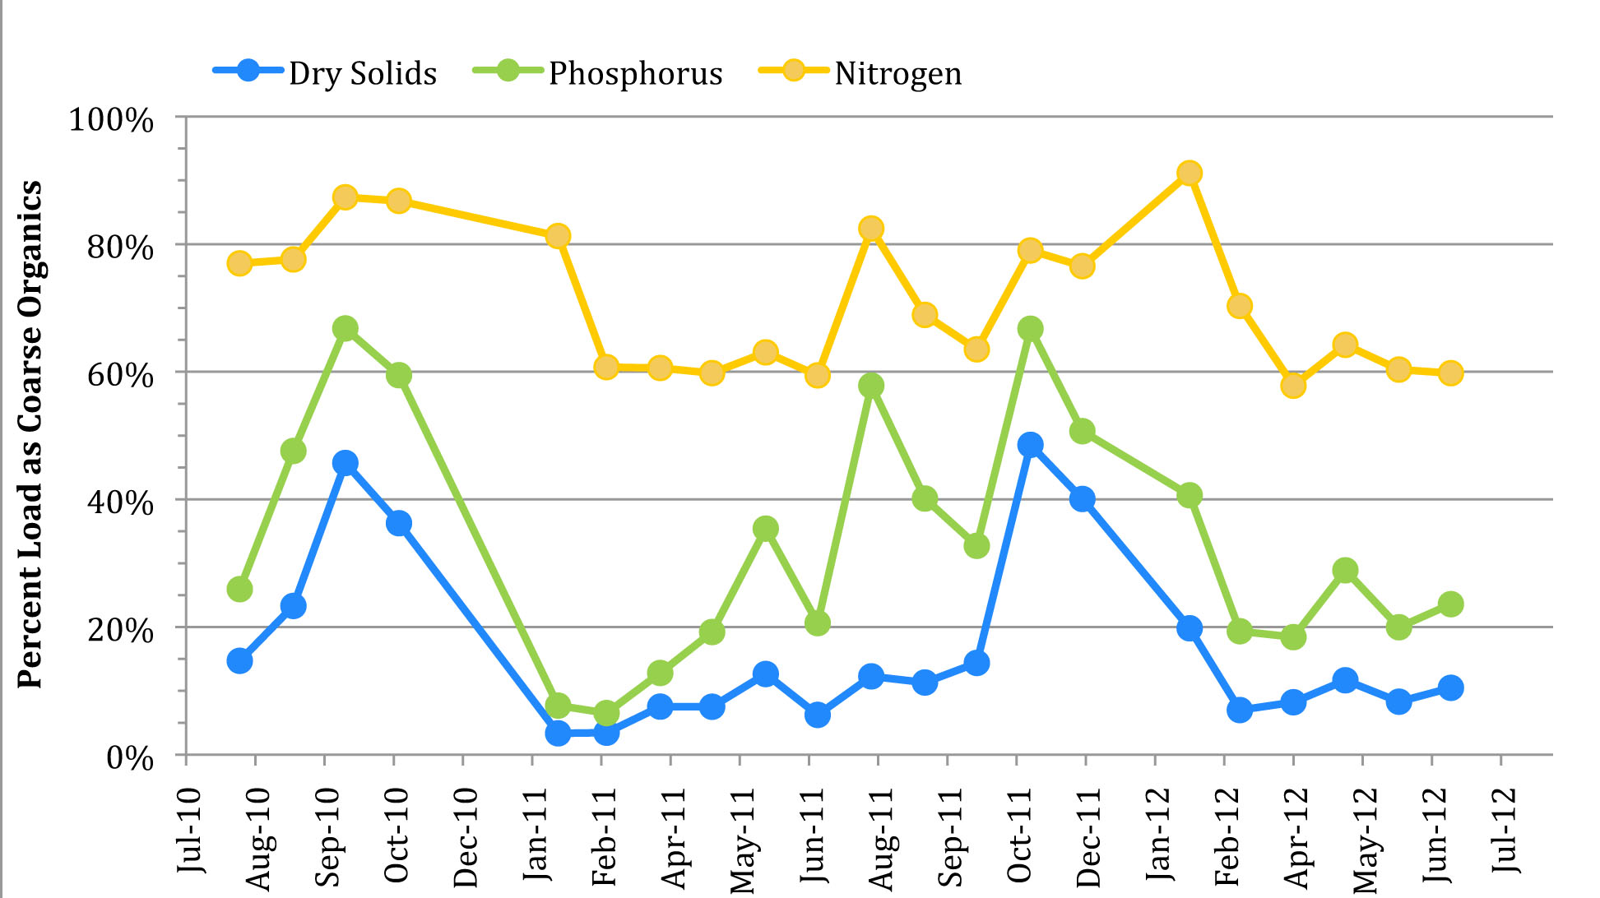
Coarse organics (i.e., litterfall) are high fraction of total dry solids, P, and N, especially in autumn
Contribution of coarse organics
(% of total sweeper load)
P. Kalinosky MS Thesis

Slide 13
10-fold more material coming into high-canopy streets
Note scale difference

Slide 14
How do litterfall nutrient inputs to streets compare to stormwater runoff nutrient yields?

Slide 15
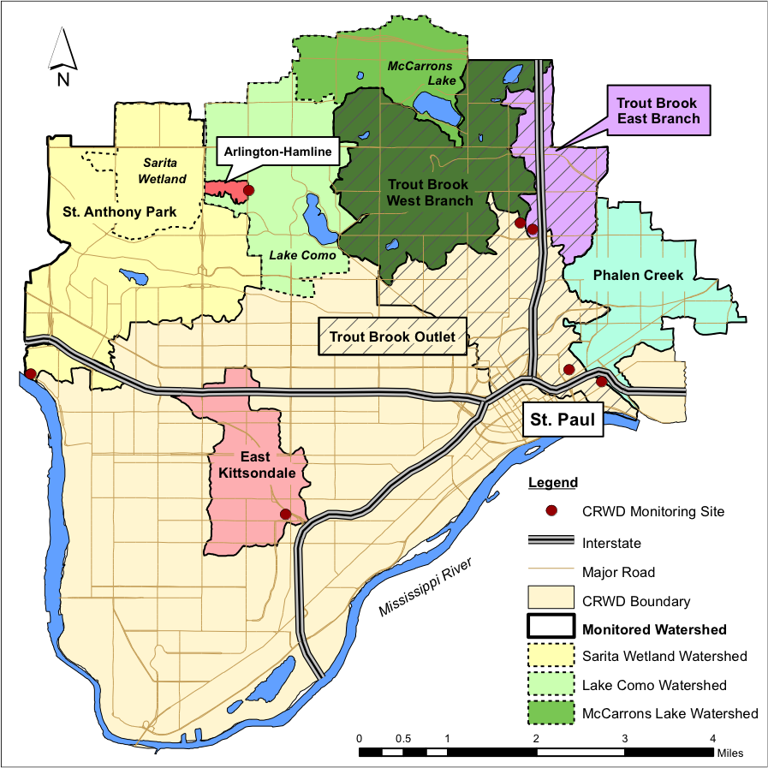
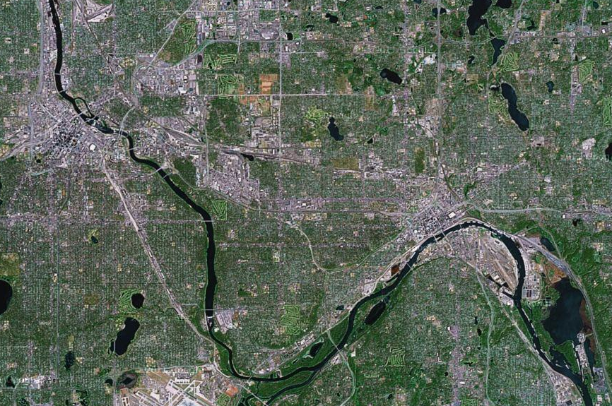

Urban, residential subwatersheds of the Mississippi River,
Saint Paul, Minnesota
Monitoring
Stations

Slide 16
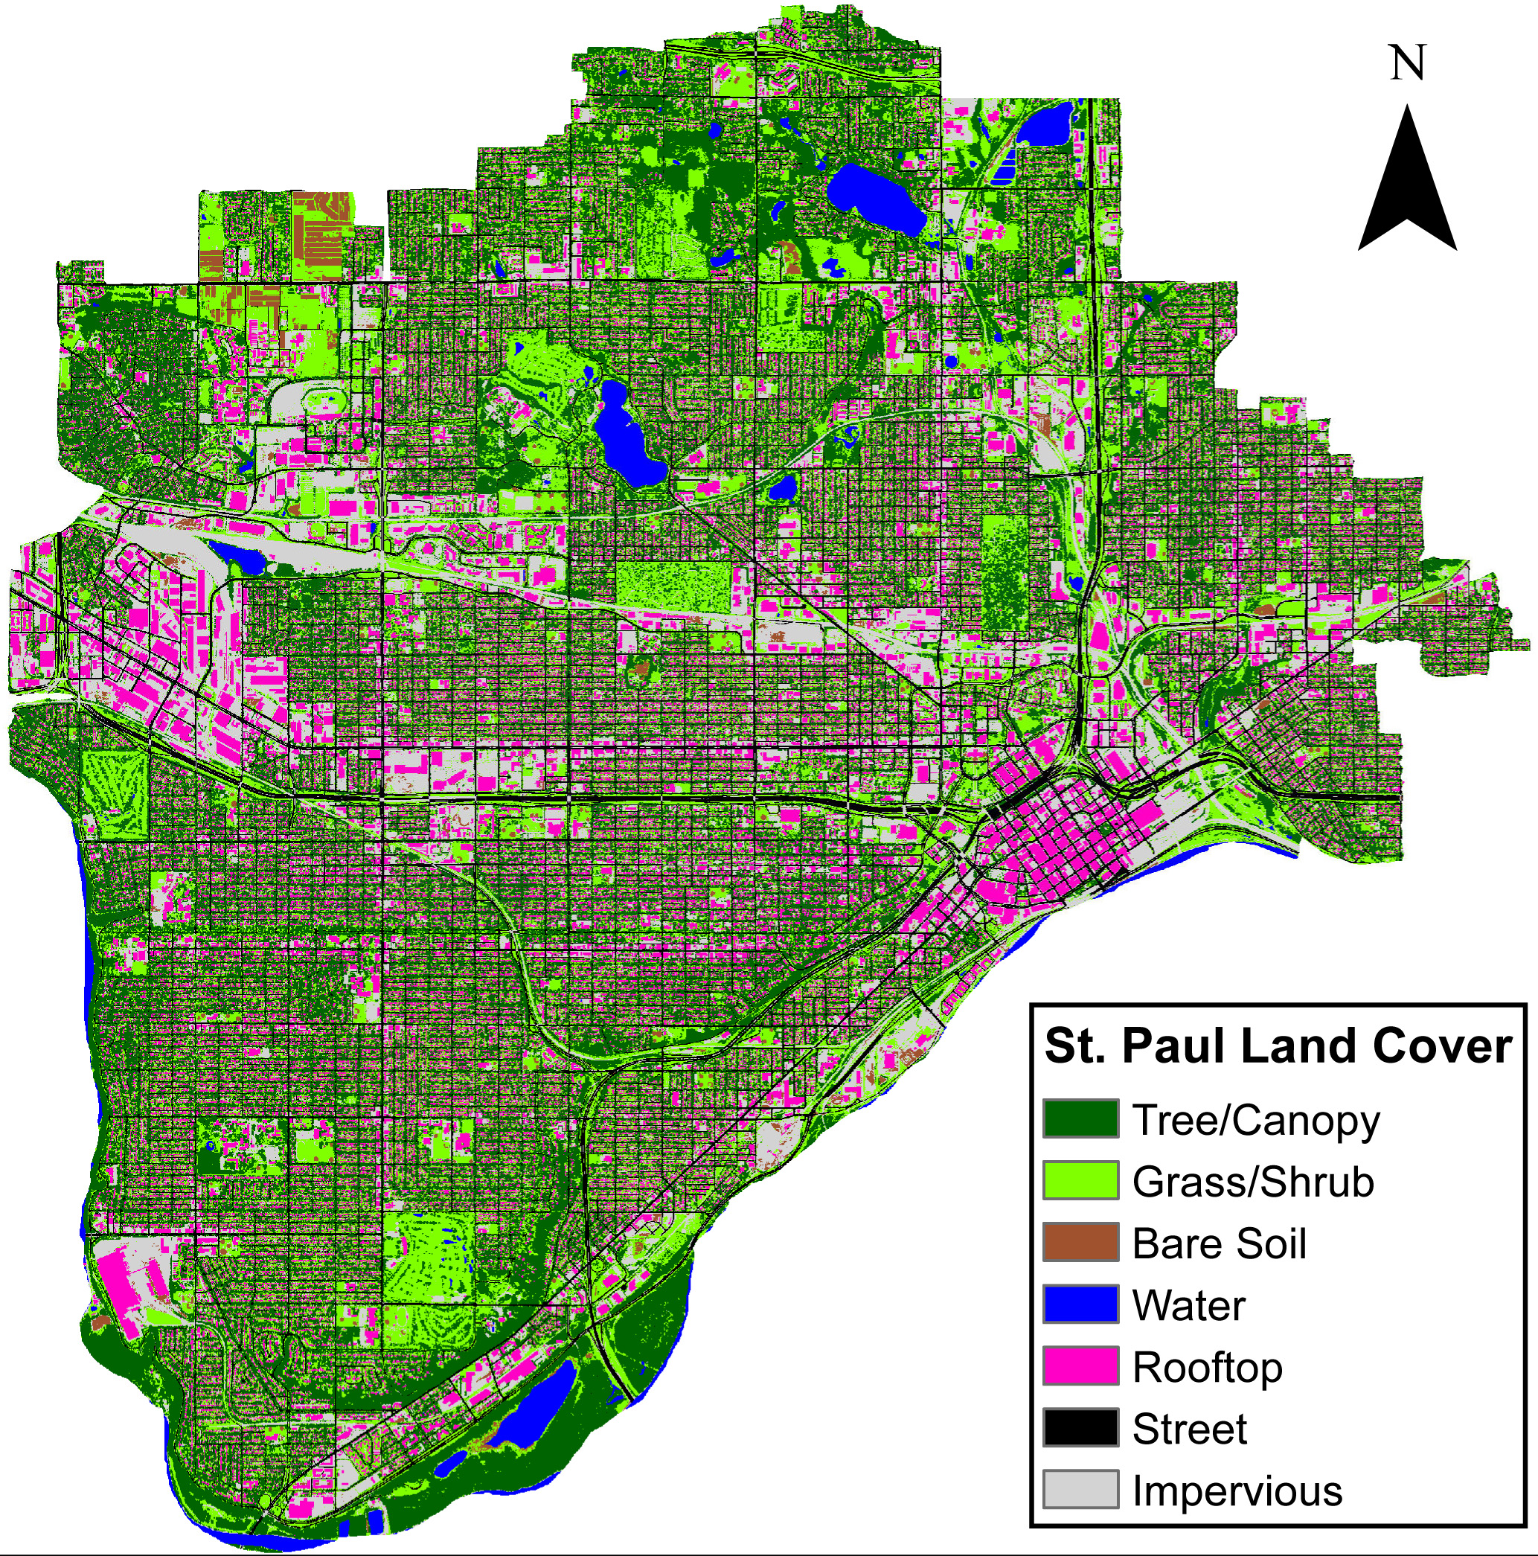
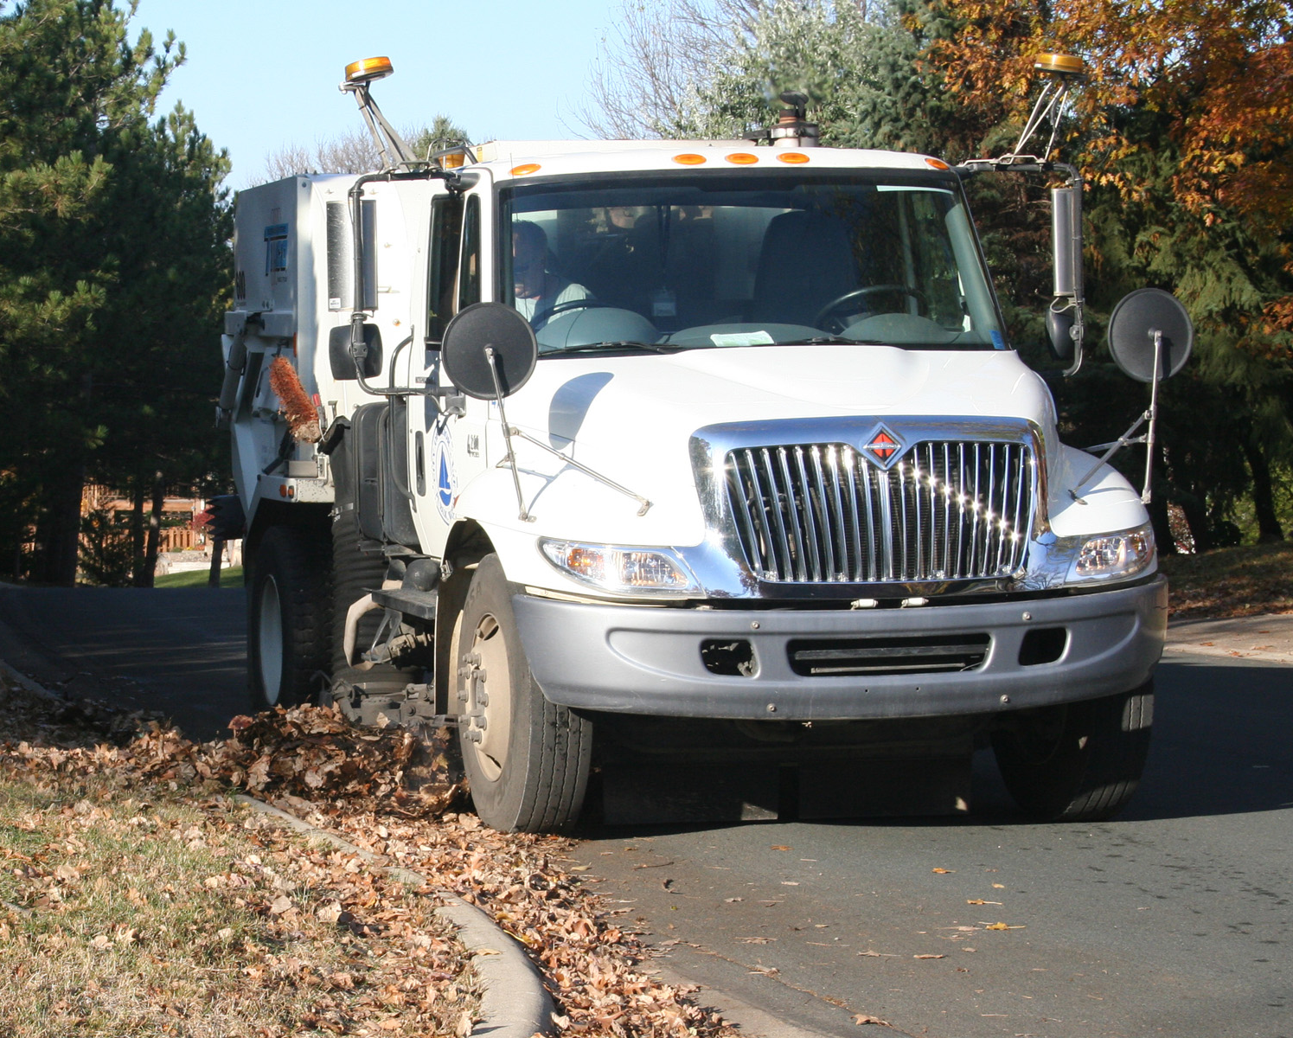
Land cover: Kilberg and Bauer 2011

Slide 17
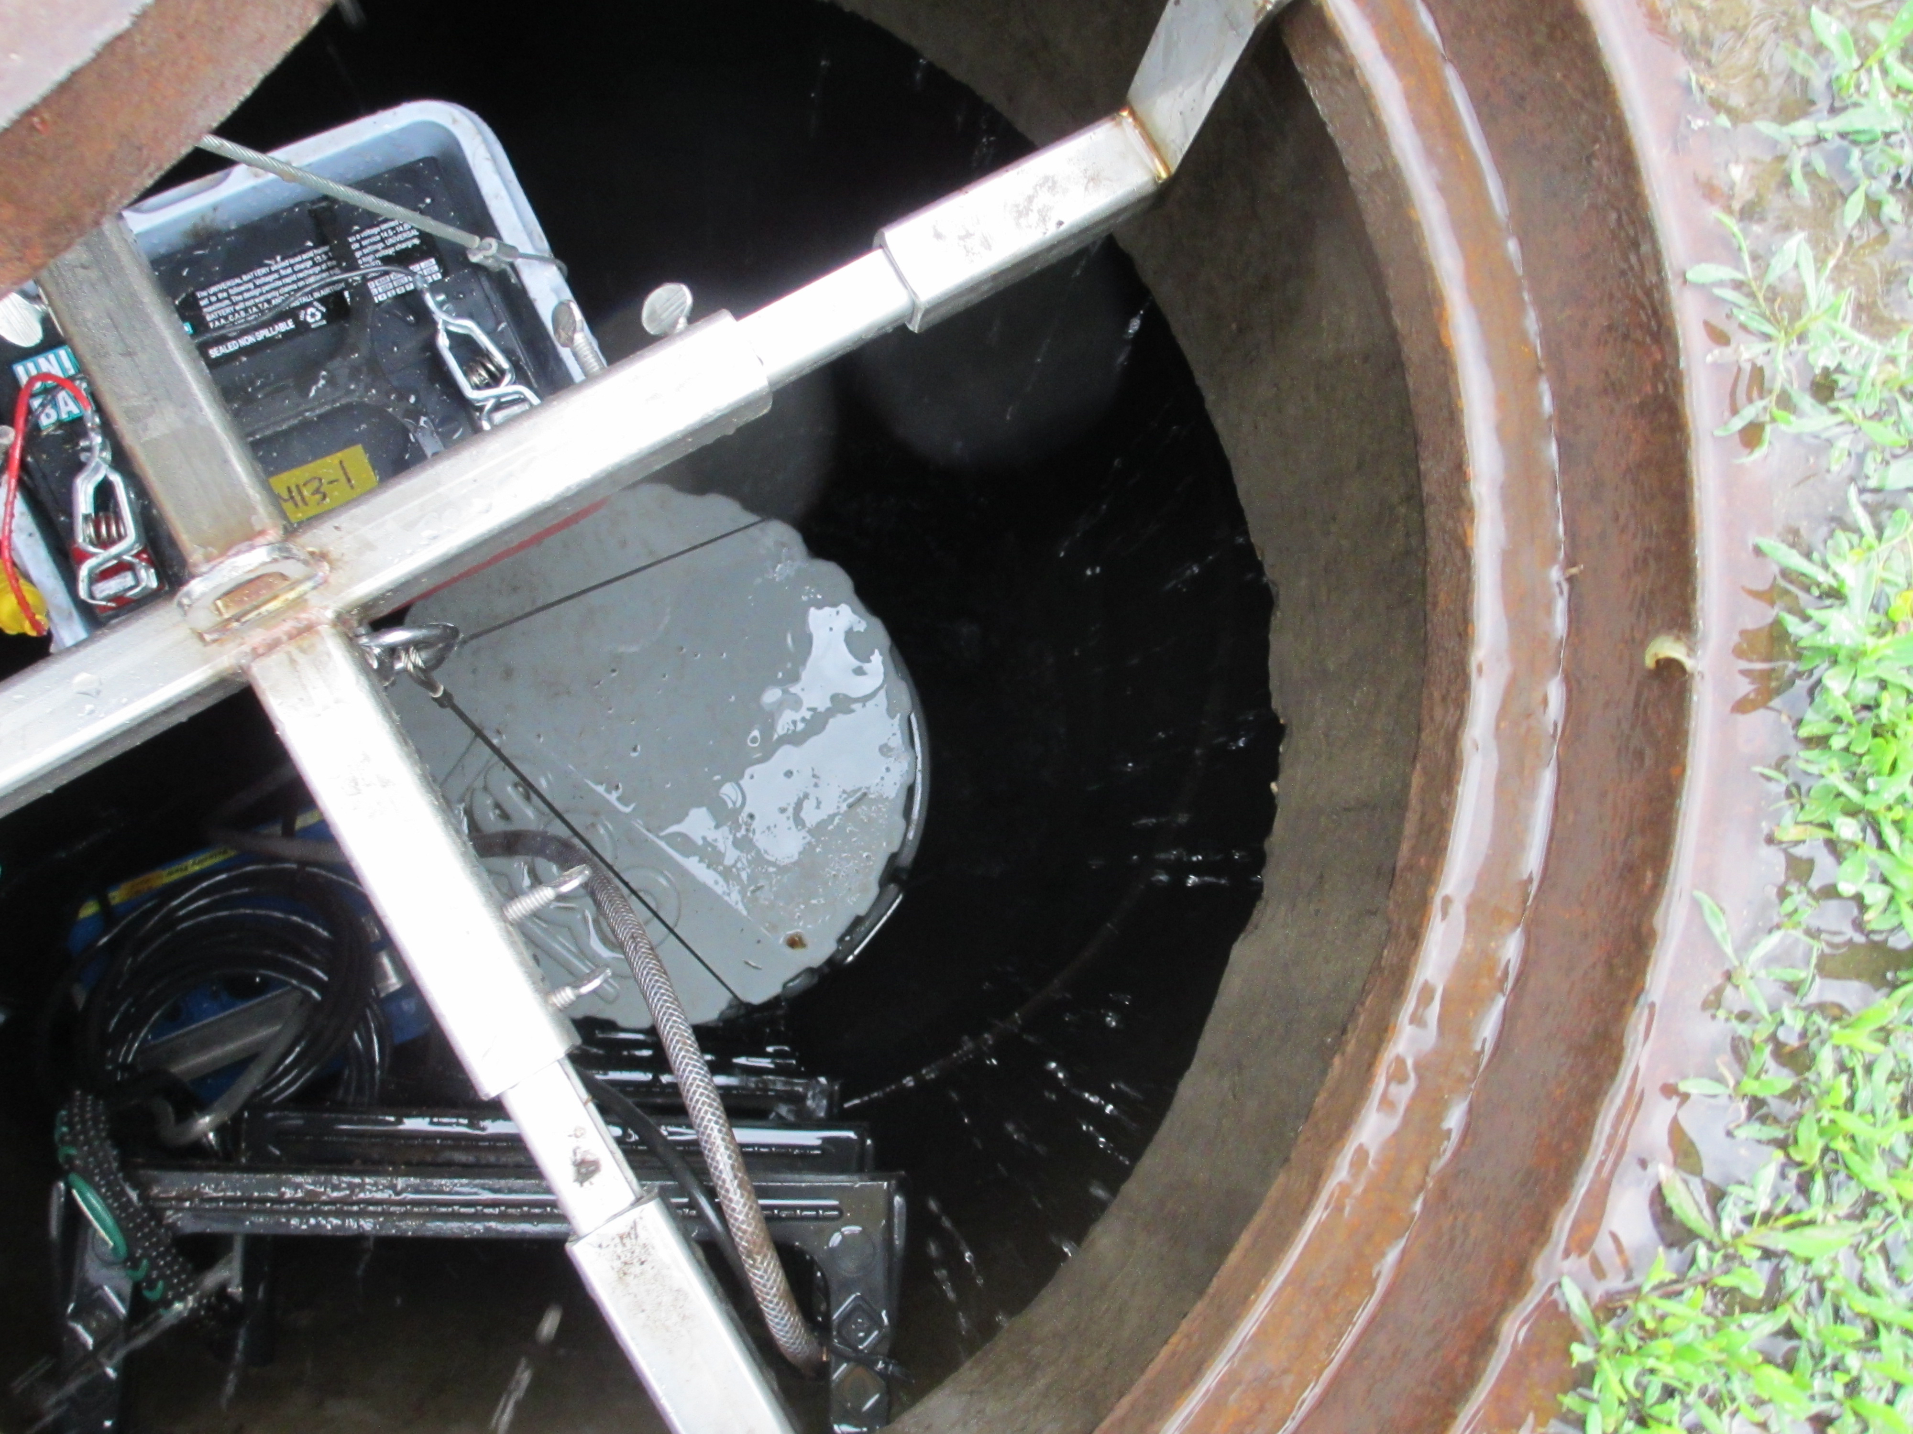

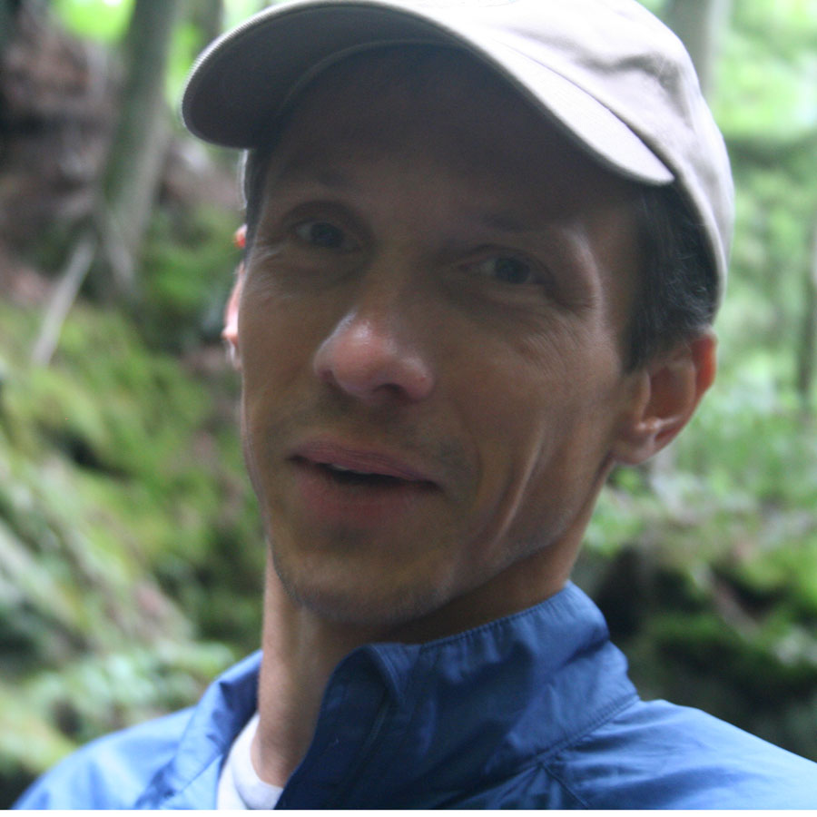
Ben Janke
Jacques Finlay

Slide 18
Litterfall P to streets is 37-64% of runoff P

Slide 19



Canopy Cover Study
WCD
Ben Janke, Jacques Finlay
Notes:
5 watershed management organizations
16 sites selected based on availability of monitoring data

Slide 20
Across 16 watersheds, stormwater N and P concentrations increase with canopy cover
Janke et al. 2017. Environmental Science & Technology
Notes:
No trend in Nox, NH4, or TSS vs street canopy
SRP conc is also significant, and is small portion of TP (~19%)
Regressions with metrics of near-street canopy (buffered roads) produced slightly weaker correlations – big boulevard trees important
Elevated well above rainfall nutrient levels

Slide 21
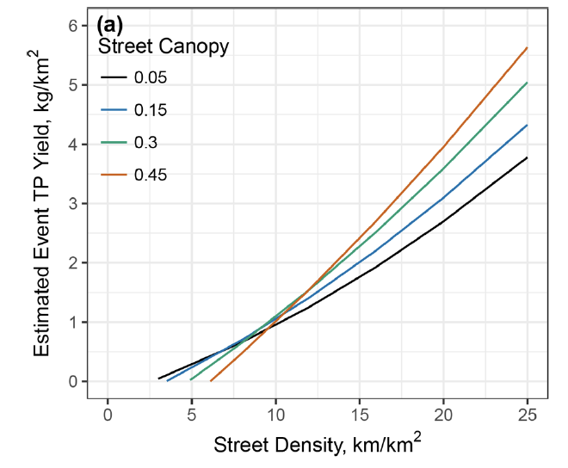
Higher tree canopy increases P yields except at low street density
Janke et al. 2017

Slide 23
Within one watershed, stormwater P matches tree phenology across the seasons
5-year average
Leaf Drop
Snowmelt
Leaf Out
Finlay et al. in prep.

Slide 24
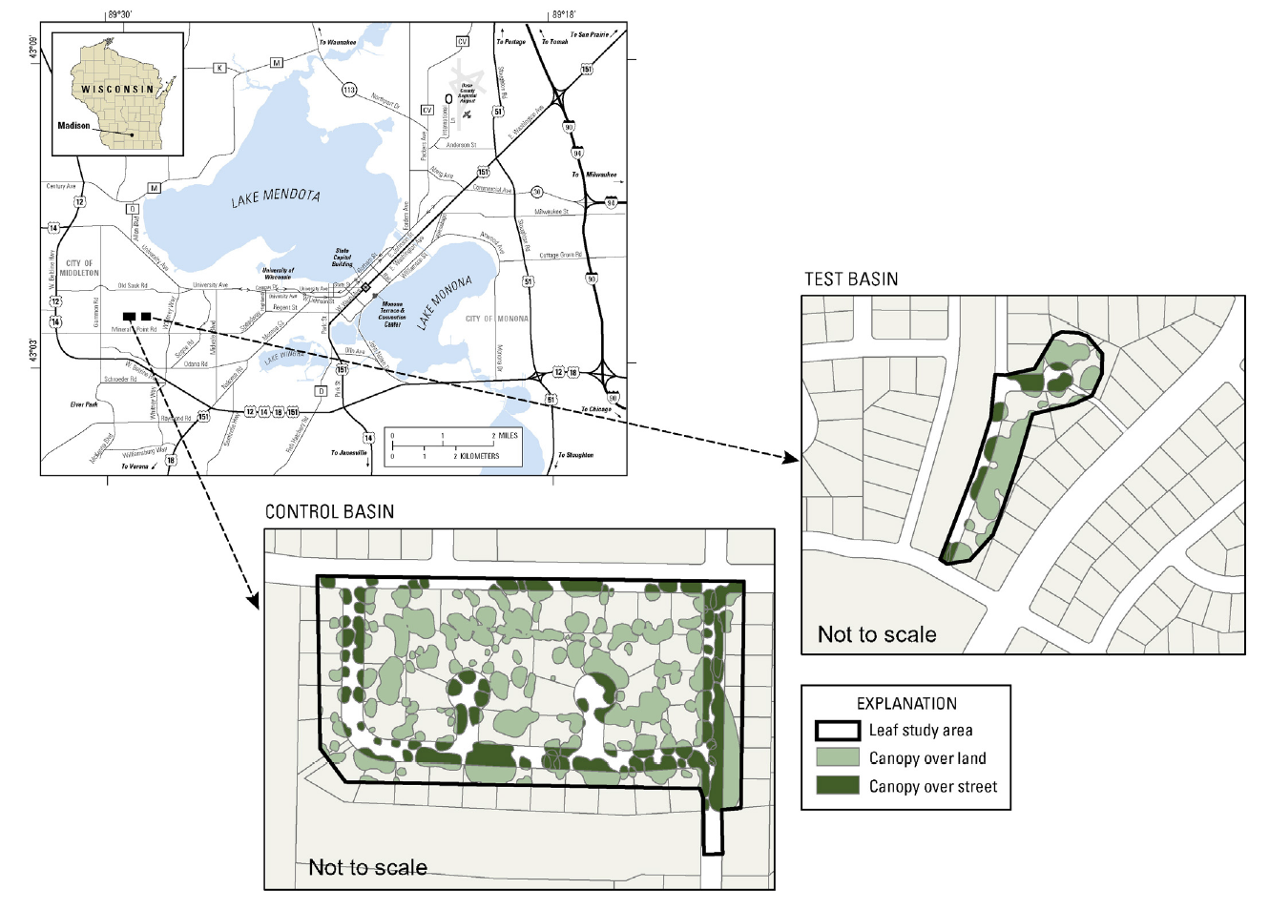
Paired Catchment Study, Madison, WI
17% canopy cover over streets
Test Catchment: weekly sweeping and leaf removal, Apr-Nov
Control Catchment
WCD
Bill Selbig, USGS, Middleton, WI
Notes:
5 watershed management organizations
18 sites selected based on availability of monitoring data

Slide 25
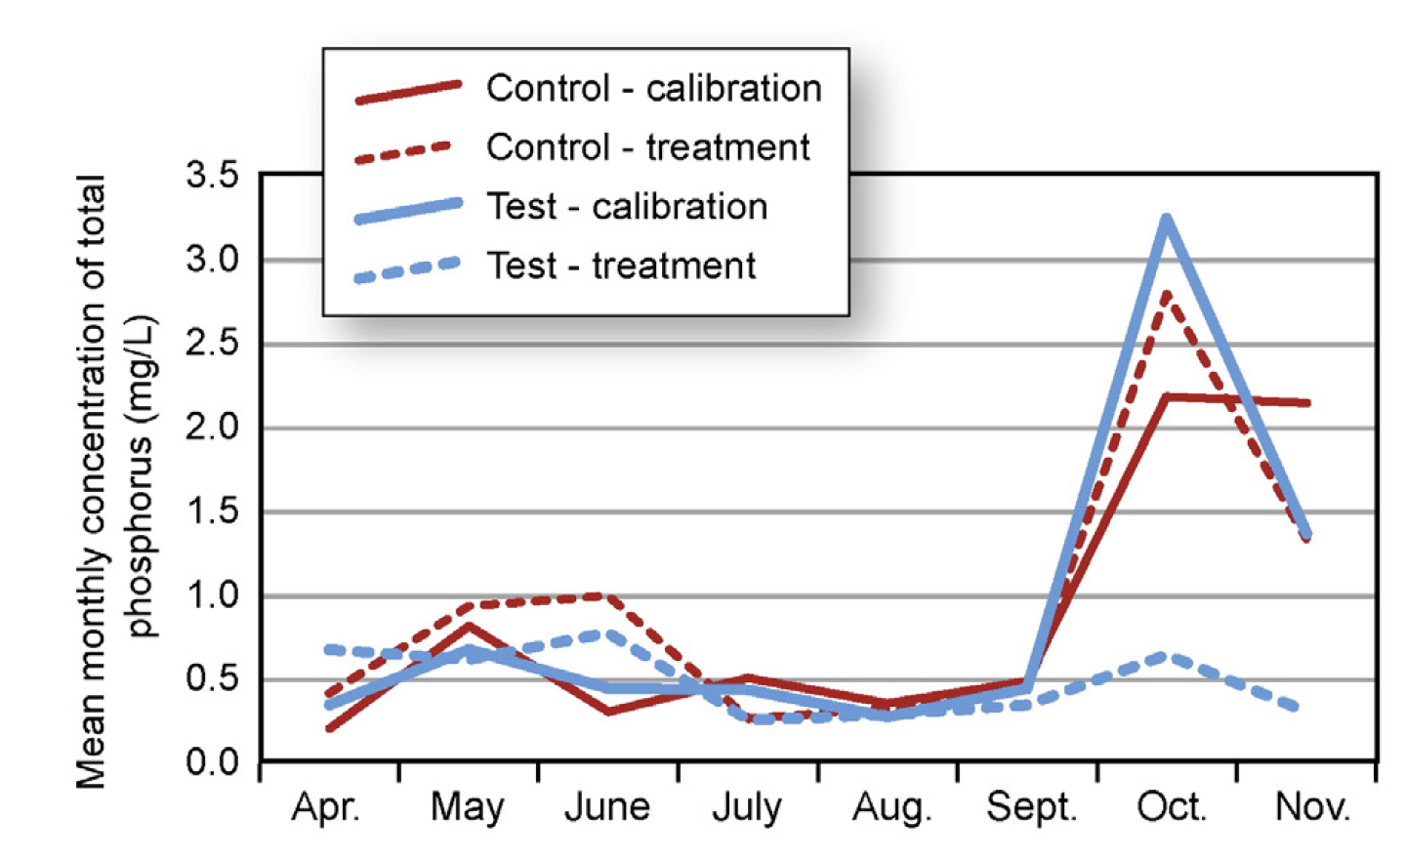
Treated (swept) catchment has lower runoff P concentrations than control (unswept) catchment
Selbig 2016 Science of the Total Environment

Slide 26
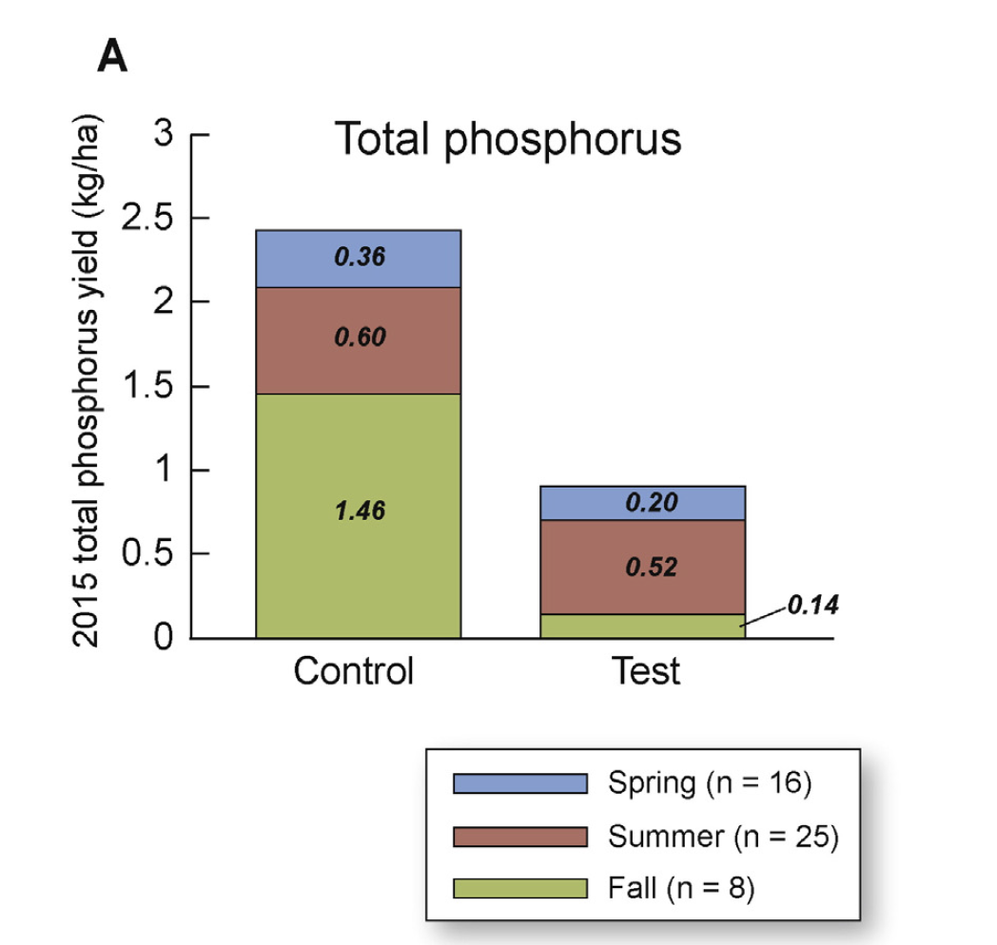
Treated (swept) catchment has lower runoff P yield
Control
(no street sweeping
or leaf removal)
Treatment
(weekly sweeping and leaf removal, Apr-Nov)
Selbig 2016 Science of the Total Environment

Slide 27
Solutions:
      Municipal
      Neighborhood
      Individual

Slide 28
Solutions:
      Municipal: Enhanced Street Sweeping
      Neighborhood
      Individual

Slide 29
Street Sweeping Calculator Tool
for Public Works & Streets Departments
Enables user to estimate cost and mass of solids and nutrients removed in user-defined sweeping scenarios.
Typical questions:
  1. How much solids and P can I remove for a given budget?
  2. What is the lowest cost to achieve a specific P load reduction goal?

Slide 30
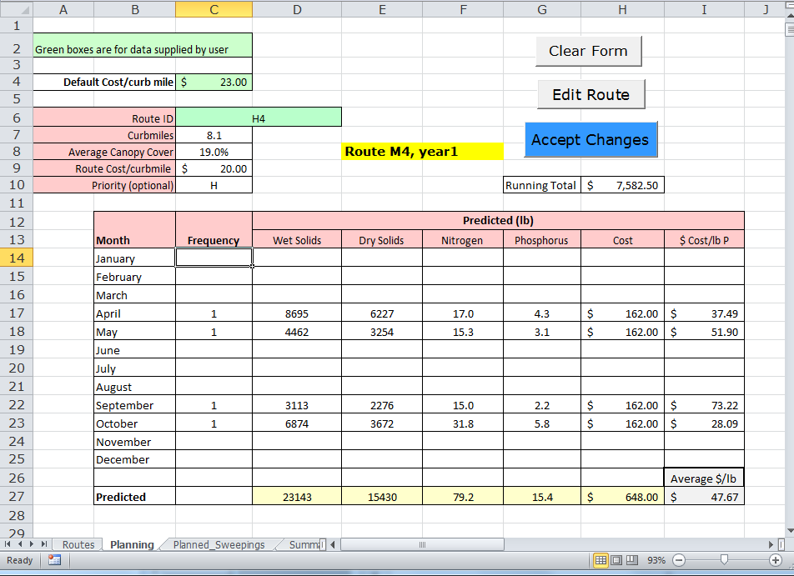

Slide 31
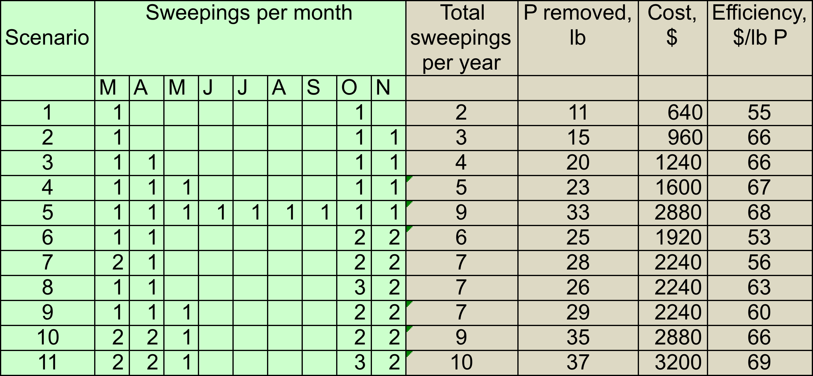
Example of output from Street Sweeping Calculator Tool
Route: 10 curb-miles; 20% canopy cover
Sample application #1:
What is the lowest cost to remove 35 lb P/yr? Scenario #10
Sample application #2:
What is the most P that can be removed for $2,000? Scenario #6

Slide 32
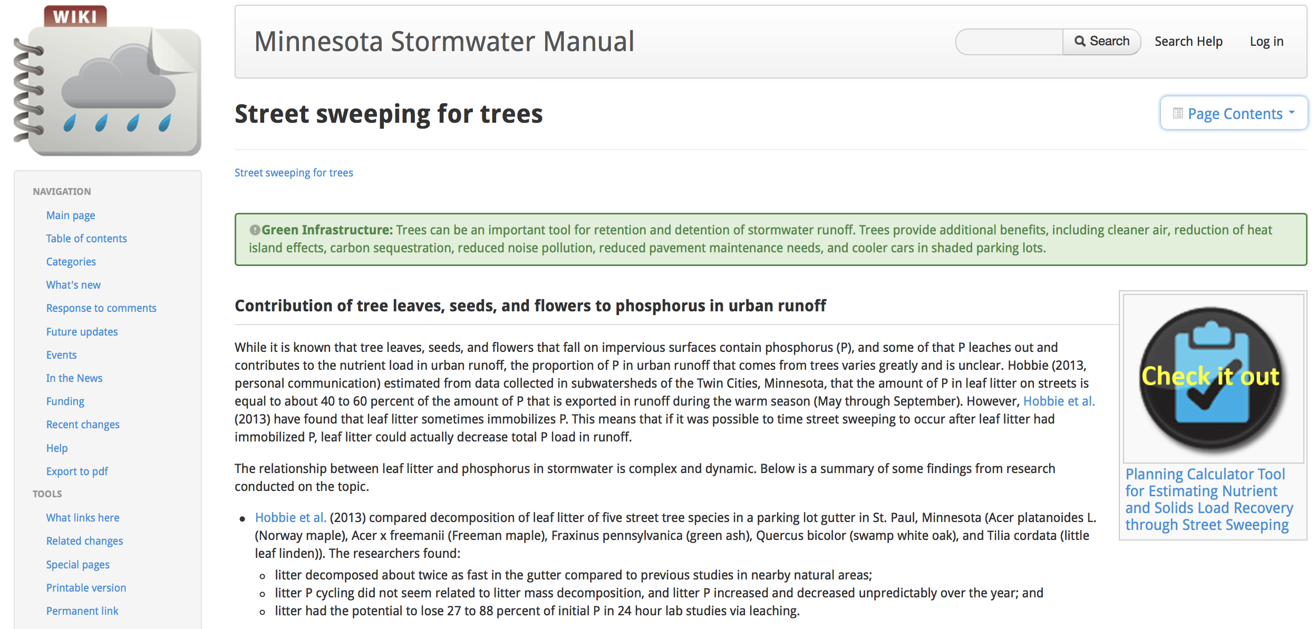
https://stormwater.pca.state.mn.us/index.php?title=Street_sweeping_for_trees

Slide 33
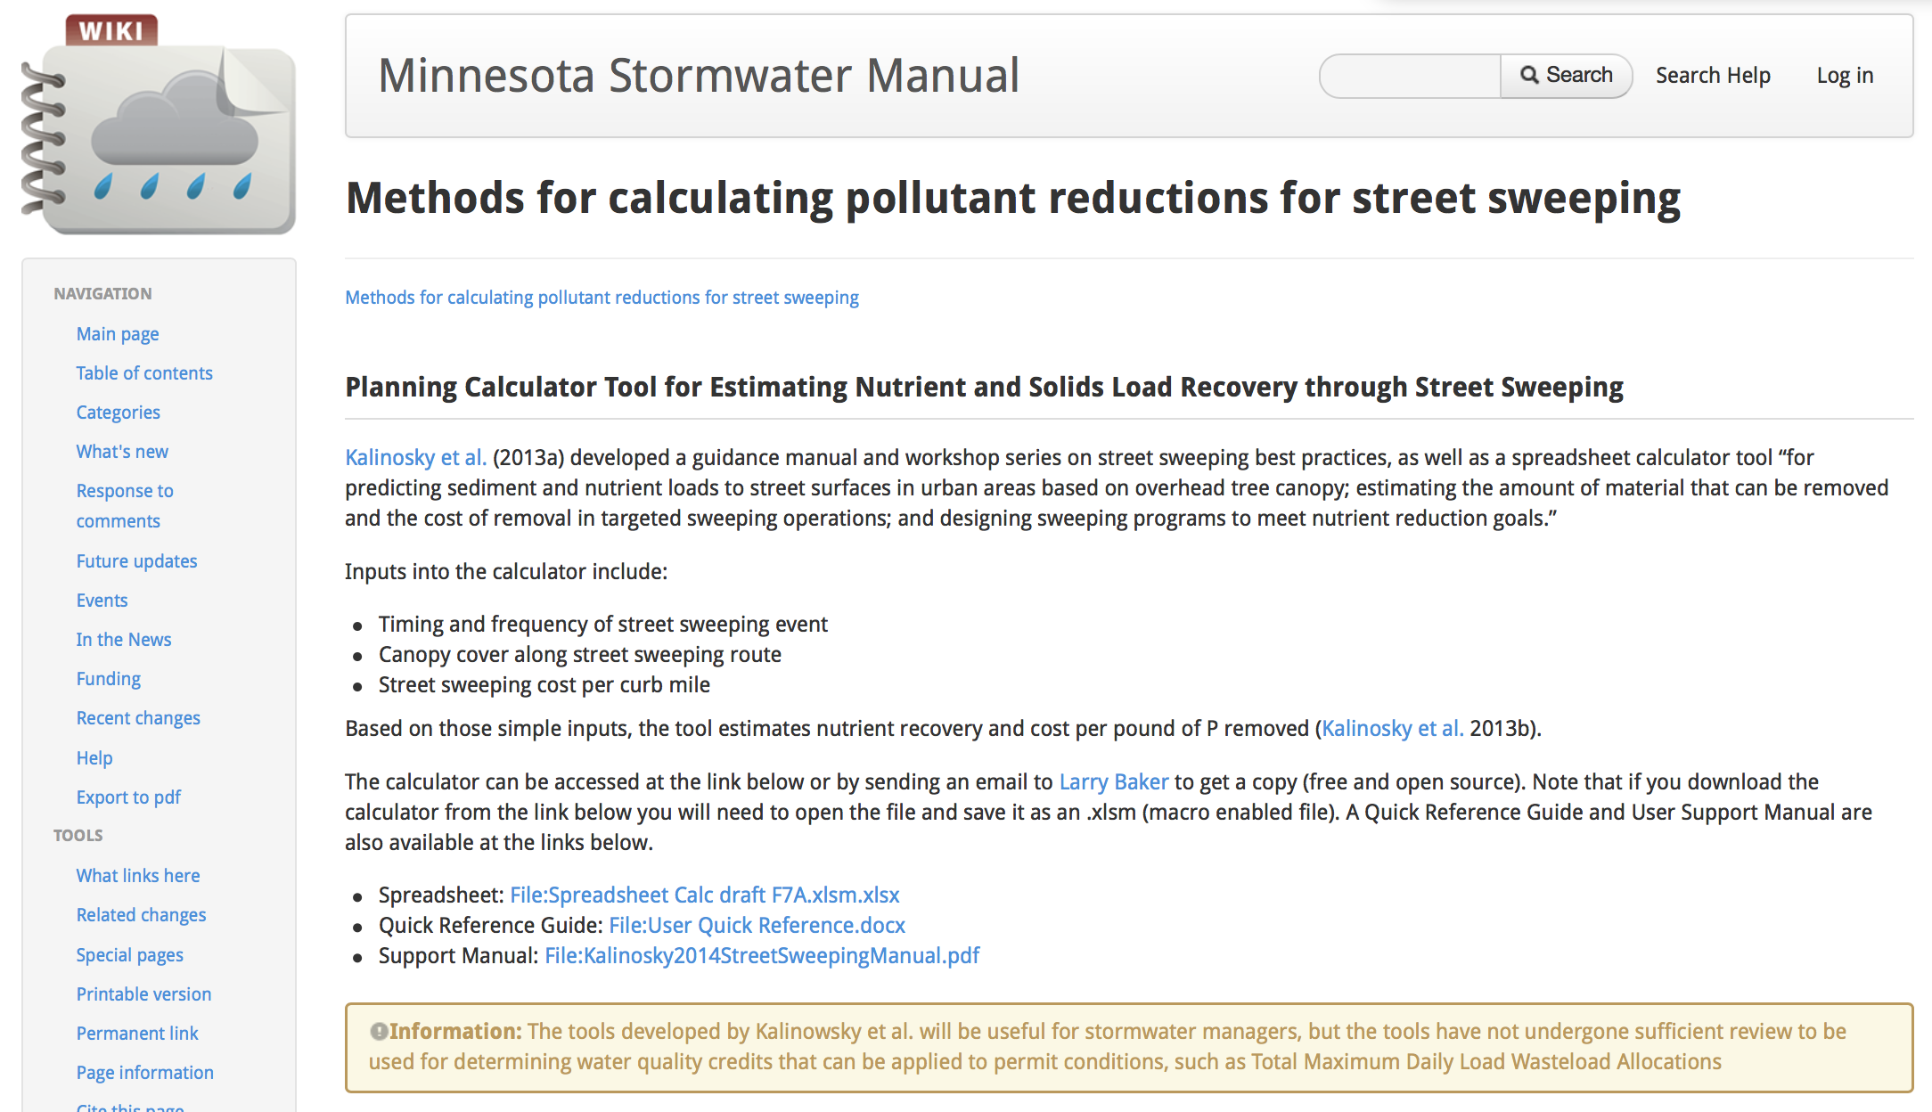
https://stormwater.pca.state.mn.us/index.php?title=Methods_for_calculating_pollutant_reductions_for_street_sweeping

Slide 34
In high canopy areas, P can be recovered for
less than $100/lb

Slide 35
Crediting for P Recovery
Five-Fold Cross-Validation for Simple Prediction Measurements | P (lb) | % error
Measured Recovered Phosphorus | 505
Estimate based on measured:
Curb-miles Swept (predicted recovery) | 525 | (+4.0%)
Fresh Load (lb) | 524 | (+3.7%)
Dry Load (lb) | 516 | (+2.1%)
Notes:
Soil P = year 1 and 2 combined, ave = 0.106 , med = 0.08 (H-F)
From random ½ data set, ave=0.107 , med = 0.117.
M-Su, combined, ave = 0.078, med = 0.067
From random, Ave =0.067, med = 0.079
In 7 of 13 metric the median soil Pcame out high in the random assignment, in the full data set 2 of 13 times. (litter P 1 X compared to none.)
260 is error of +25%

Slide 36
Typical twice/year sweeping only removes 8% of litterfall P inputs to streets

Slide 37
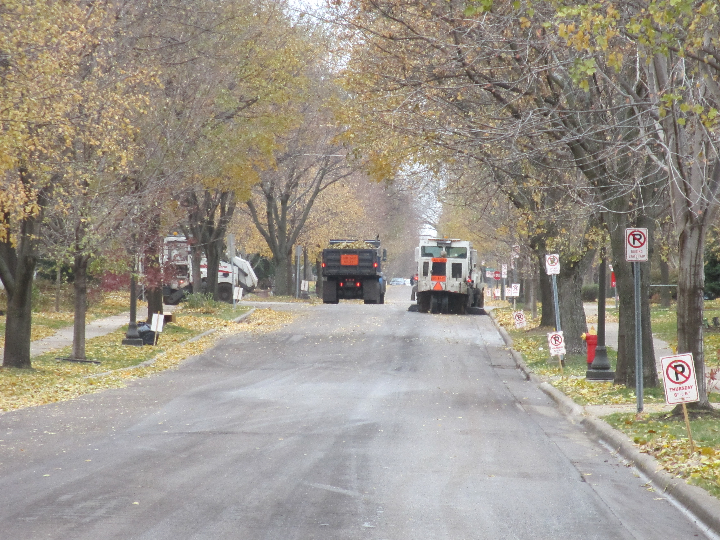

Slide 38


Phenology

Slide 39

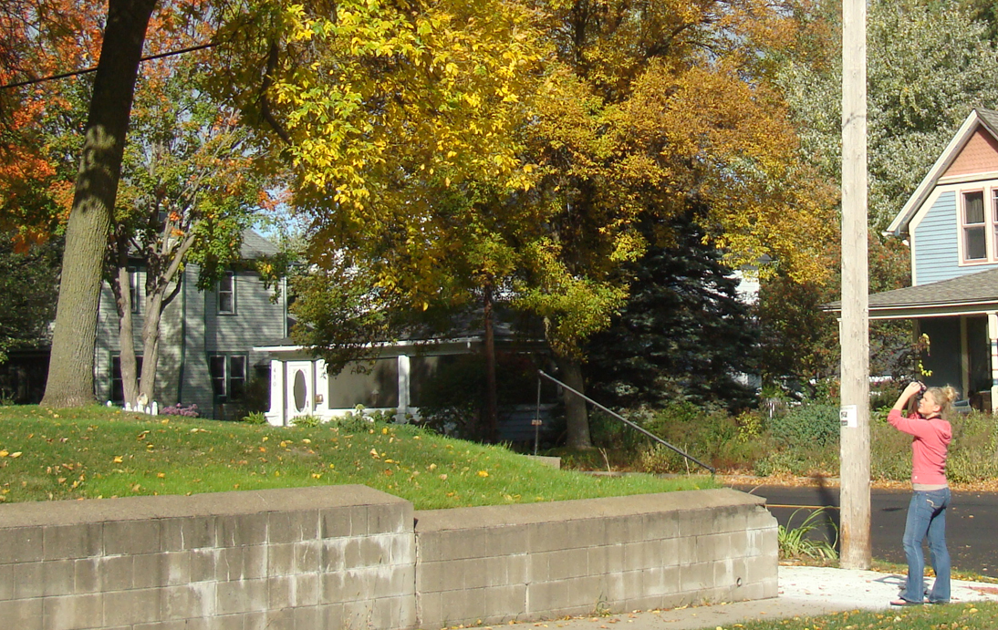

Slide 40
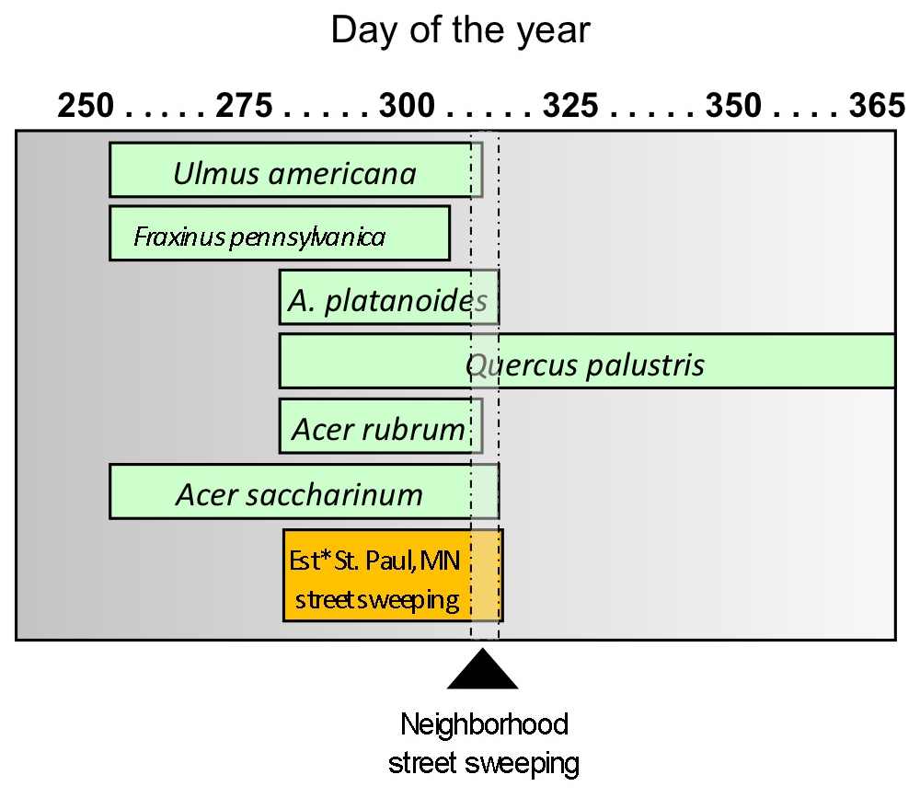
Citizen scientist phenology data vs. street sweeping, 2013
Sept 7
Oct 2
Oct 27

Slide 41
      Municipal: Enhanced Street Sweeping
Pros: | Cons:
Cost-effective if targeted appropriately | Hard to time
Reduces solids loading downstream & BMP maintenance needs | Requires capital investment
 | Inconvenient for residents

Slide 42
Solutions:
      Municipal: Enhanced Street Sweeping
      Neighborhood: Coordinated Leaf Removal
      Individual

Slide 43
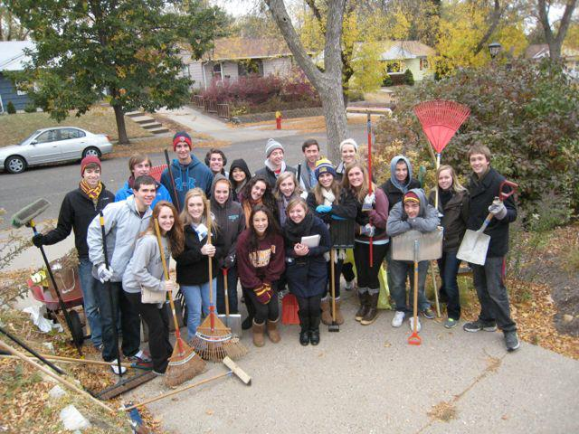
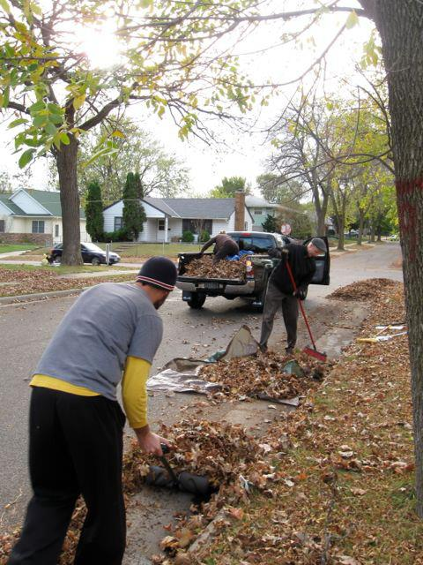
Como Active Citizen Network
Janna Caywood, Lindsay Schwantes, Jessica Bromelkamp
Photos courtesy of Janna Caywood
Notes:
Phenology research has informed neighborhood leaf pickup events

Slide 44
Lessons learned:
      Central management is unsustainable
      Shift from top-down management to network organizing
      Shift from educating to inviting
http://www.capitolregionwd.org/wp-content/uploads/2012/09/Final_Community-Led-Cleanup-Report_Model.pdf

Slide 45
      Neighborhood: Coordinated Leaf Removal
Pros: | Cons:
Cost-effective | Hard to control
Nimble | Participant fatigue
Engages citizens | Scalable?

Slide 46
Solutions:
      Municipal: Enhanced Street Sweeping
      Neighborhood: Coordinated Leaf Removal
      Individual: Adopt-a-Drain Programs

Slide 47

Metro Watershed Partners
www.capitolregionwd.org
Notes:
In a more formal way – influence others by creating new neighborhood norms.

Slide 48
      Individual: Adopt-a-Drain
Pros: | Cons:
Cost-effective | Hard to control
Nimble | Hard to assure quality
Engages citizens | Participant fatigue
 | Scalable?

Slide 49
Research needs:
      Barriers to enhanced street sweeping
      Mechanisms for crediting P removal
      Cost-effectiveness of street sweeping vs. downstream BMP maintenance
      Extension of Prior Lake study to high-canopy (>20%) neighborhoods
      Effectiveness of neighborhood/individual efforts

Slide 50
Conclusion:
      Enhanced street sweeping can be effective tool for improving water quality if implemented appropriately
      Neighborhood and individual efforts likely effective if sustained, implemented at scale

