Slide 1

MS4 IDDE Training
For City Field Staff
Tuesday, January 30th 2018

Slide 2
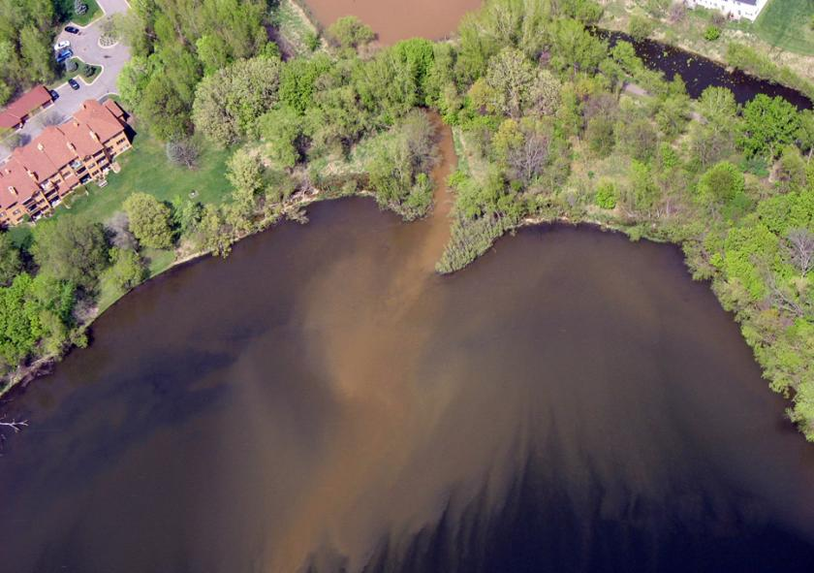

Slide 3
MS4 Permit
The Municipal Separate Storm Sewer System (MS4) Permit requires permittees to maintain an operations and maintenance program to prevent or reduce pollutant discharges from municipally owned or operated properties. This includes:
Employee training addressing the importance of protecting water quality and describing MS4 requirements
Why are we doing this?
Required by state and federal permitting
Protect our natural resources
Big Lake is a Level 2 MS4
Outline of Training
Recognize > Report > Respond

Slide 4
Illicit Discharge Detection and Elimination (IDDE)
What is the pure IDDE definition?
“…any discharge into the stormwater system that is not composed entirely of stormwater…”
I like to apply common sense, so think of it in terms of a “Discharge beyond an established grass yard or established prairie grass.”
Recognize → Report → Respond!

Slide 5
Inspection of Stormwater Controls
BMPs
Silt fence, inlet protection, temporary construction entrance/exit, proper wash out area, hydromulch, biologs, trash coverage
BMPs can be damaged
Rainstorms
Construction activities
At a minimum, inspections should include:
All areas where stormwater typically flows
All discharge points
All areas where stabilization has been implemented
Check to see if controls are implemented and functional
Check for conditions in which controls may be necessary
City inspection
Big Lake Permit Requirements
City Code

Slide 6
What is a BMP?
Best Management Practices
A practice, or combination of practices, that is determined to be effective and practicable by being broadly used
A means of preventing or reducing the amount of pollution generated to a level compatible with water quality goals.
Silt fence, bio logs, straw blankets, bales, rock entrance, inlet baskets, etc.
Do you see a BMP failing?

Slide 7
Sources of Stormwater Pollution
Pollutants
Excess nutrients (nitrogen and phosphorus)
Hydrocarbons (petroleum compounds)
Heavy metals
Pathogens
Toxic chemicals
Debris, trash, and litter
Intentional or accident or neglect? Hmmm…

Slide 8
Look Out For…
Unusual colors and odors
Cloudy or murky appearance
Suds, trash, or debris
Unnatural or excessive vegetation
Leaks, spills, or dumping
Barrels, buckets, 55 gallon drums

Slide 9
Where should I look?
Construction sites
Dumpsters behind buildings
New home building
Curb lines
Alleyways and parking lots
Loading docks and outdoor storage areas
Near our lakes and rivers
Driveways
City Owned Facilities too!

Slide 10

MPCA MS4 Training for Parks Maintenance & Stormwater Protection

Slide 11
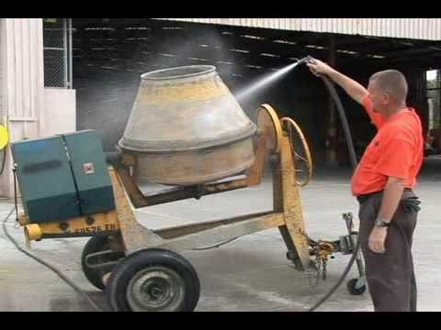
On the Lookout for Illegal Discharges Part 1 – detection

Slide 12
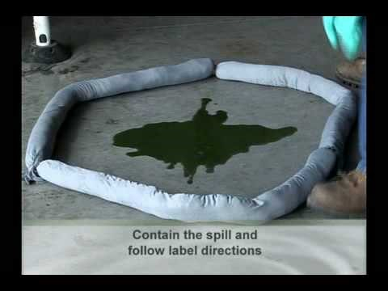
On the Lookout for Illegal Discharges Part 2 – document and report

Slide 13
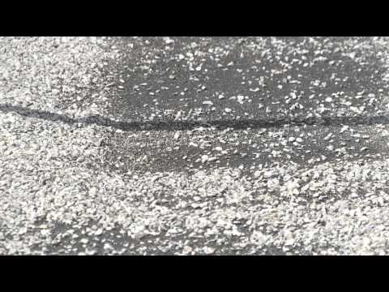
MS4 Stormwater Pollution Prevention

Slide 14
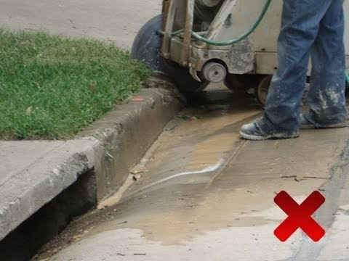
How to Spot an Illicit Discharge

Slide 15
The Good, The Bad or the Ugly? YOU MAKE THE CALL!

Slide 16
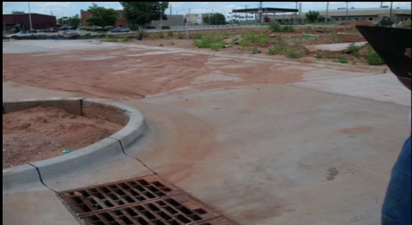

Slide 17
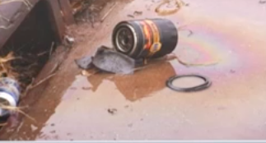

Slide 18
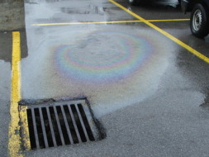

Slide 19
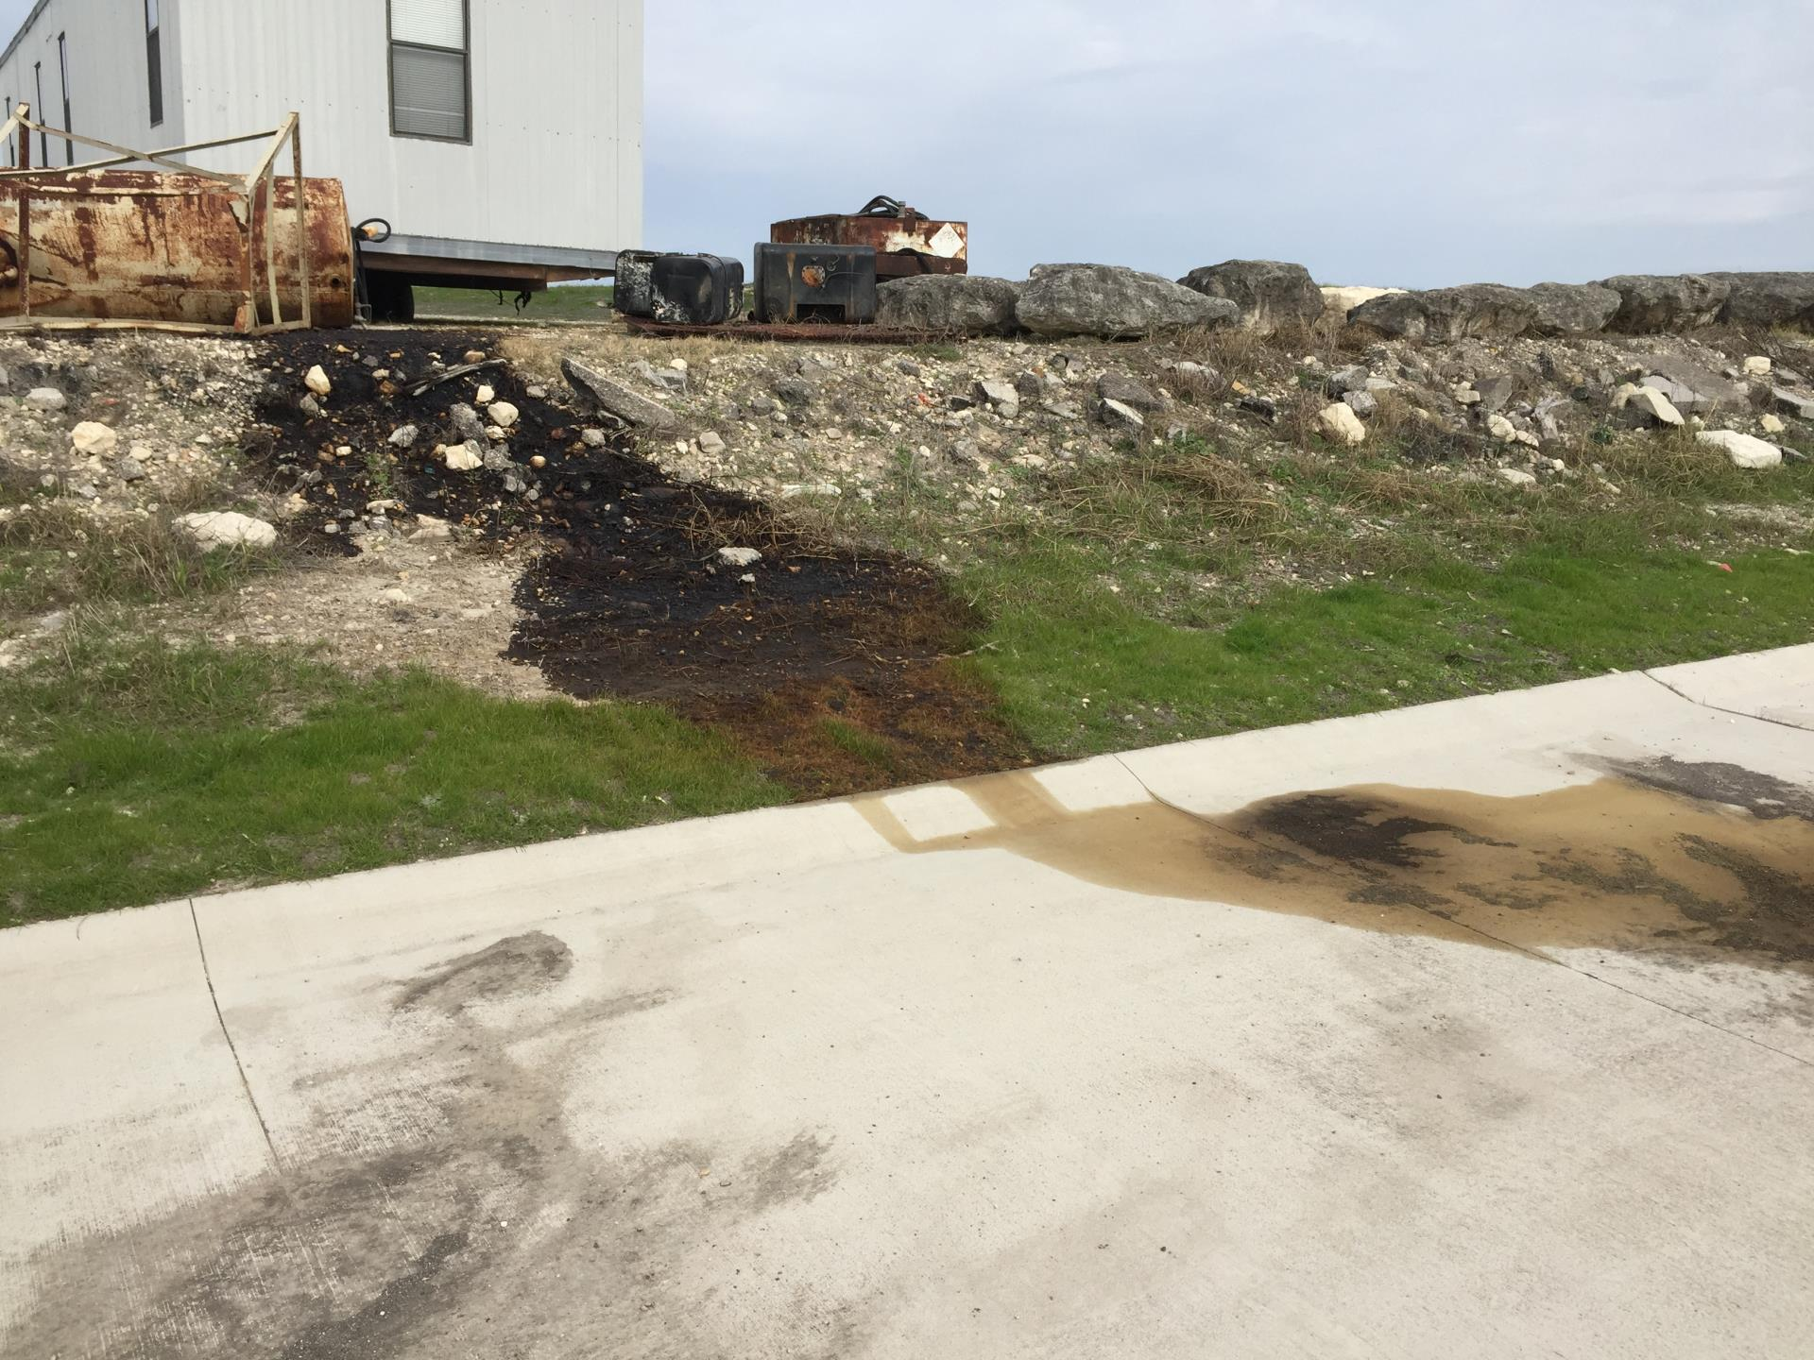

Slide 20
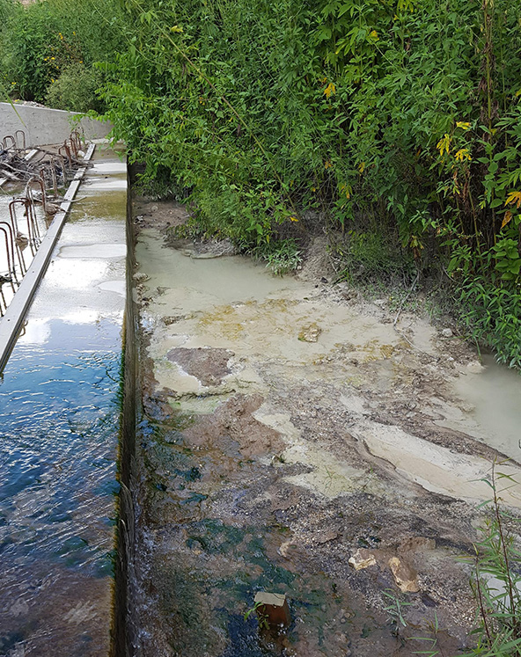

Slide 21
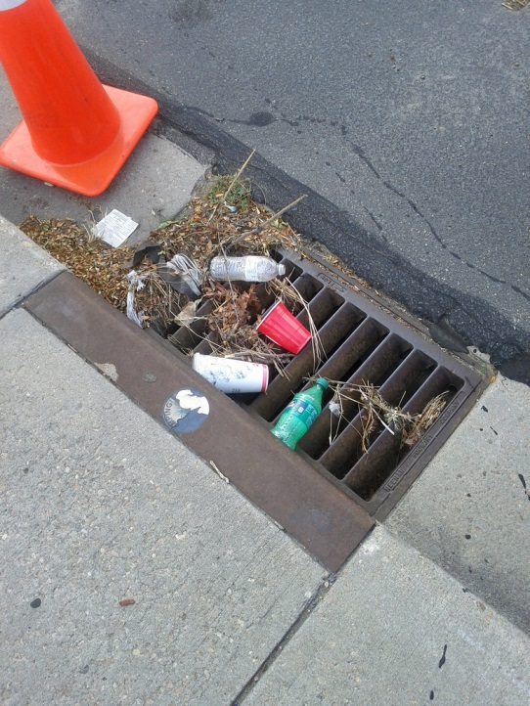

Slide 22
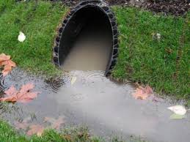

Slide 23
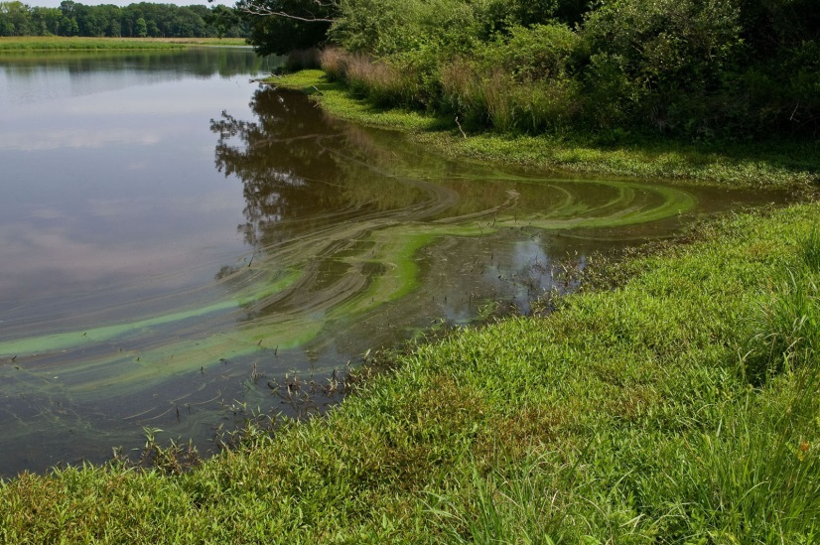

Slide 24
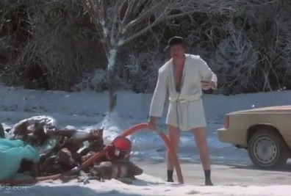

Slide 25
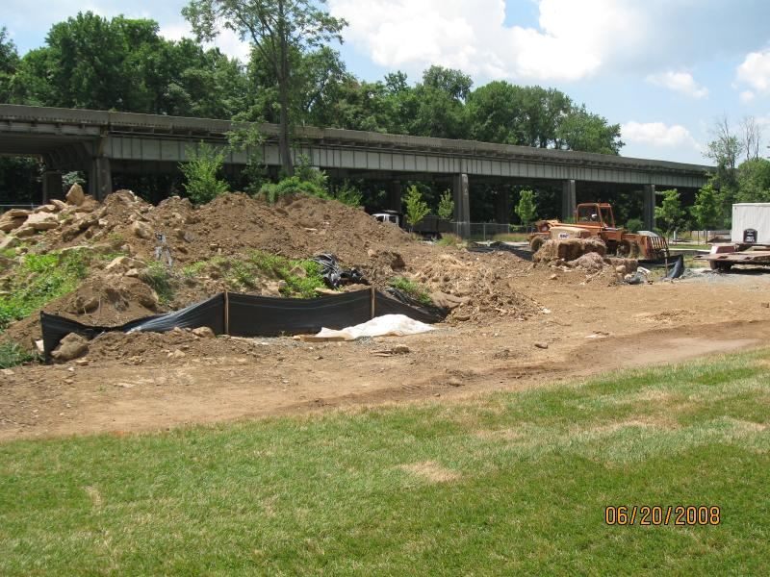

Slide 26
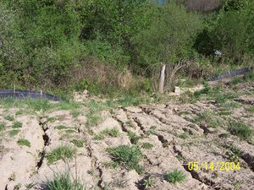

Slide 27
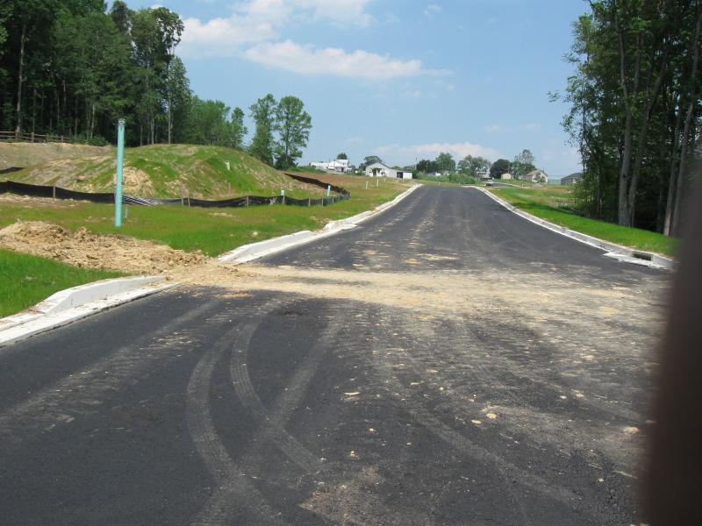

Slide 28
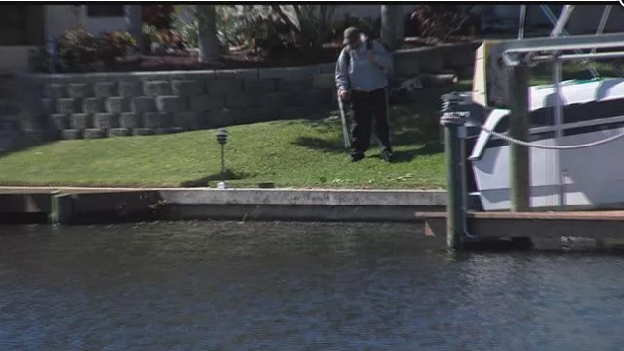

Slide 29
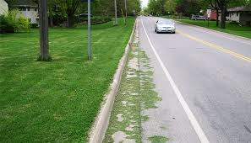

Slide 30
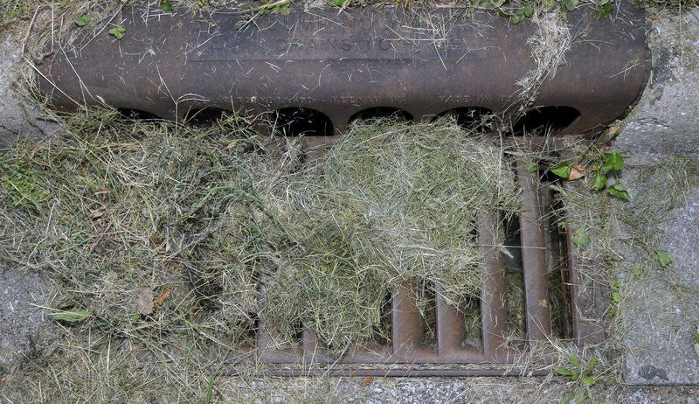

Slide 31
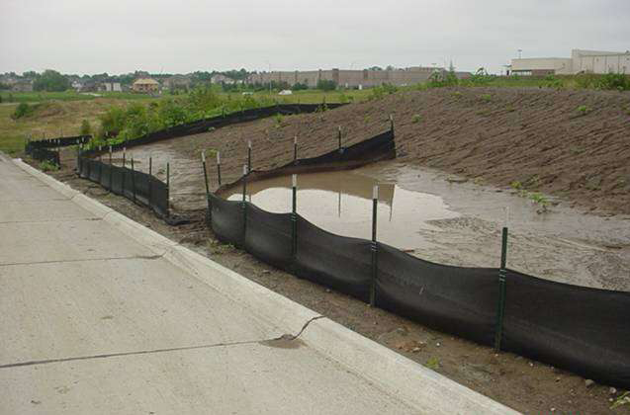

Slide 32
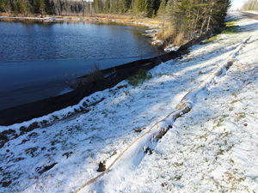

Slide 33
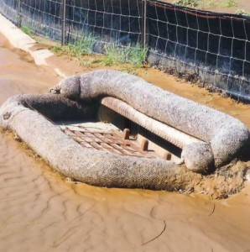

Slide 34
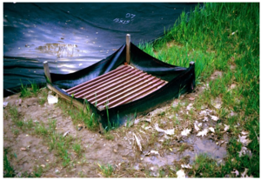

Slide 35
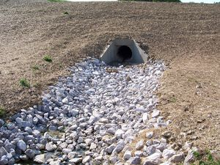

Slide 36
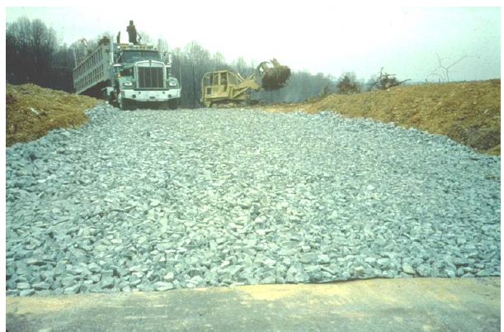

Slide 37
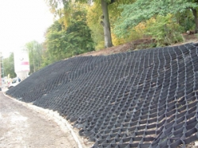

Slide 38
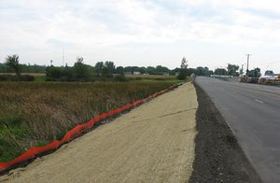

Slide 39
How Will Our Actions Affect Big Lake?
Property Owners
Lakes
Wetlands
The Elk River
Someday the Mississippi River

Slide 40
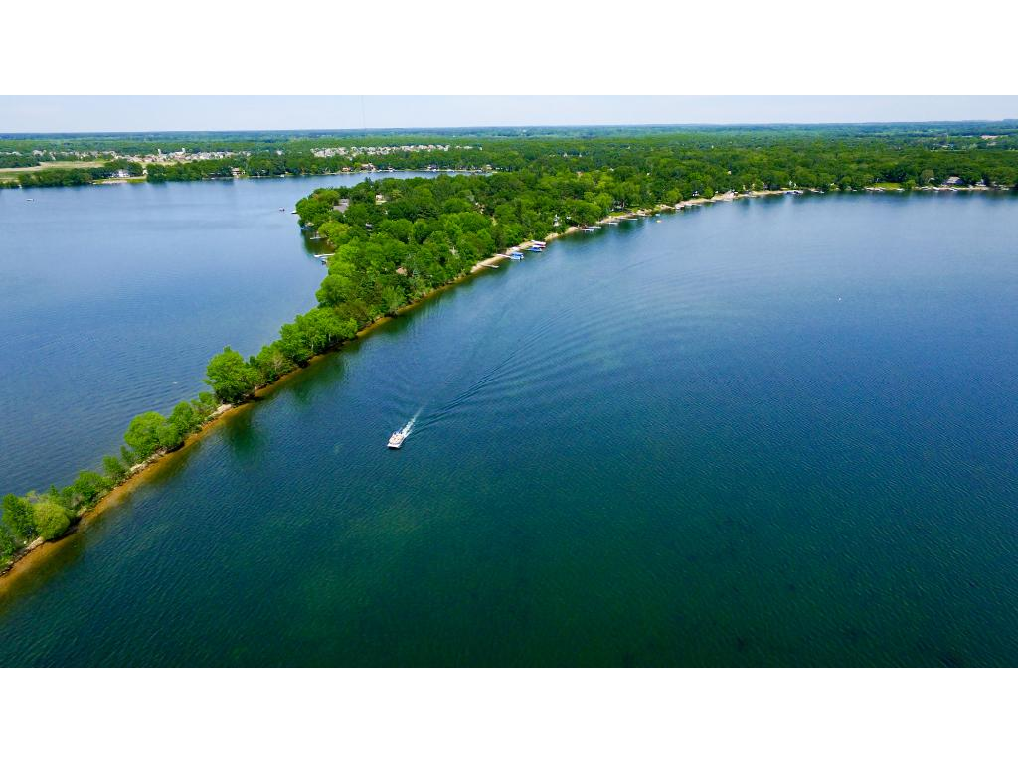
You Can Help Prevent IDDE
Recognize → Report
Big Lake’s legacy of beautiful lakes, wetlands, and rivers

Slide 41
What to Do
If you see something that looks wrong…
Report it to your supervisor or Mike Goebel
Do not confront the person causing the illicit discharge
If you can’t reach Mike or your supervisor, contact Layne Otteson
Last resort: if it is a spill with immediate health and safety concerns, call the State Duty office to report and discuss options
Number: 1-800-422-0798
Recognize and Report!!!

Slide 42
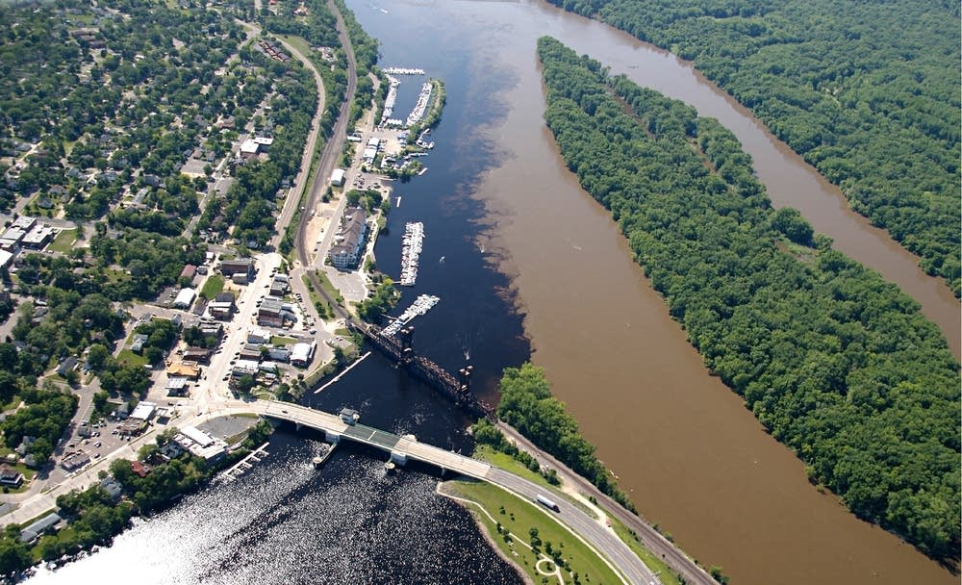

Slide 43
Questions or Comments?
Layne Otteson, City Engineer
763-251-2984
lotteson@biglakemn.org

