Slide 1
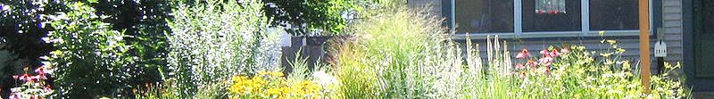
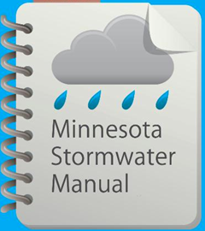



Updates to the Minimal Impact Design Standards (MIDS) Calculator
March 15, 2017

Slide 2
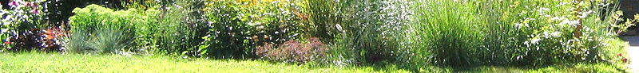
Questions and other stuff
Please use the chat box if you have questions.
We will try and answer during the webinar
All Q&A will be posted in the (page called Stormwater Manual webinars)
Webinar is recorded and will be posted in the manual
This PPoint will be posted in the manual

Slide 3
Professional development hours
1.5 PDHs offered
Access to certificate will be posted on the Stormwater manual webinars page
This PowerPoint presentation and other information will be available on this page
Notes:
Or will this be a link in the manual for a certificate? Explain that we keep a record of attendees-that’s the only way you can get PDH’s. We have to show proof.

Slide 4
Tentative: upcoming webcasts
May and July. Some things we have seen in surveys:
  Infiltration
  Biofiltration/filtration/media
  Calculations/credits/pollutant reductions
  SWPPP/permit compliance
  Treatment
  Case studies
Let us know what topics you are interested in

Slide 5
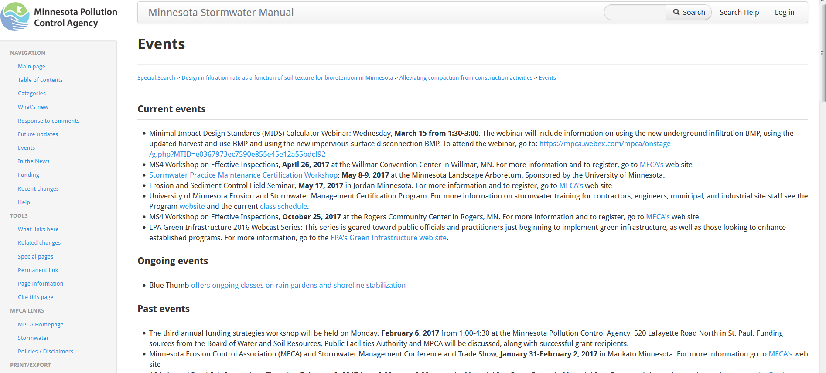

Slide 6

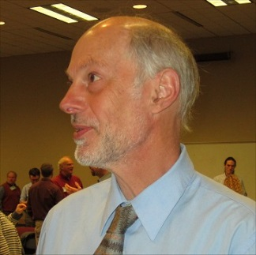
Presenters
Anne Gelbmann, Minnesota Pollution Control Agency
Mike Trojan, Minnesota Pollution Control Agency
Contact information
  Mike.Trojan@state.mn.us
  MN Stormwater Manual – (easier to find with a Google search) http://stormwater.pca.state.mn.us/index.php/Main_Page

Slide 7
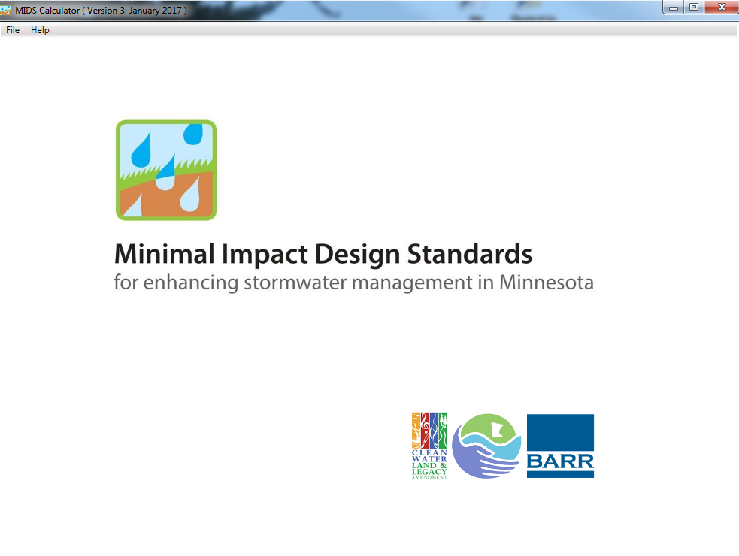
The MPCA executed a work order to update the Minimal Impacts Design Standards Calculator
Version 3 Released January 2, 2017
(about 700 downloads so far)

Slide 8
Contractor: Barr Engineering
Eric Novotny
John Hanson
MPCA Project Manager: Mike Trojan
Notes:
Add EOR staff

Slide 9
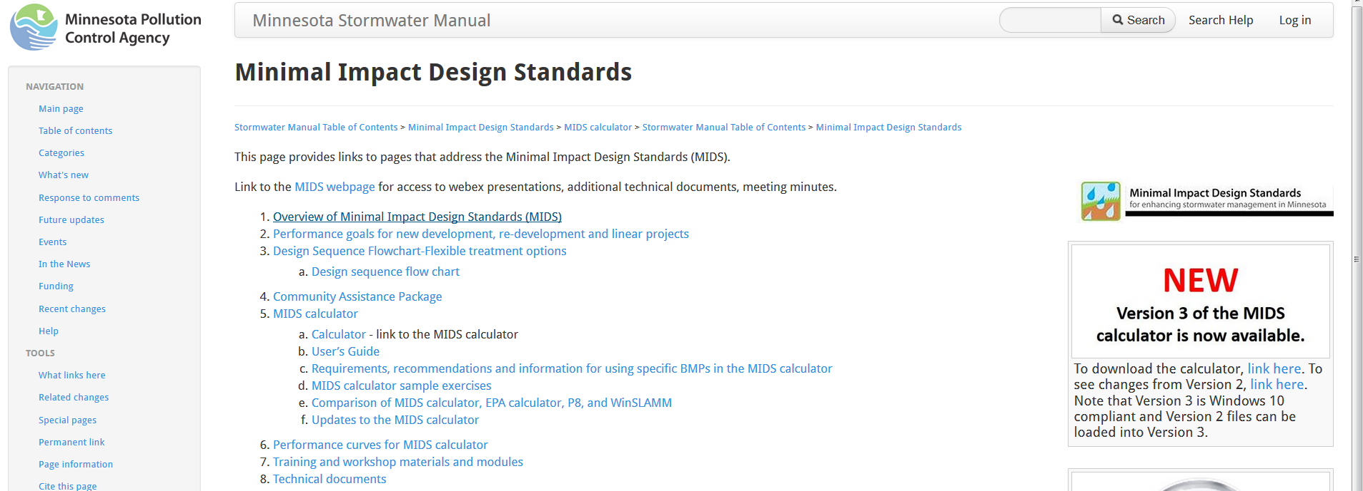
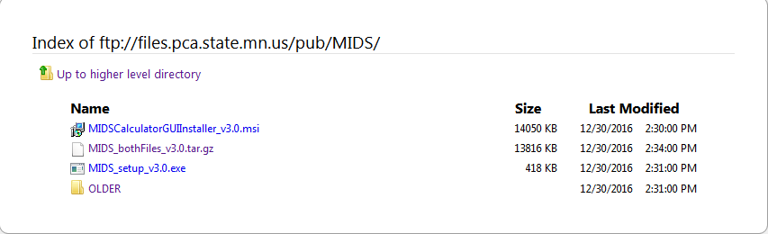
Where to download the Version 3 files

Slide 10
Topics covered today
Using Version 2 files in Version 3
Underground infiltration BMP
Harvest and use/reuse BMP
Impervious disconnection BMP
Iron enhanced sand filter
Other changes

Slide 11
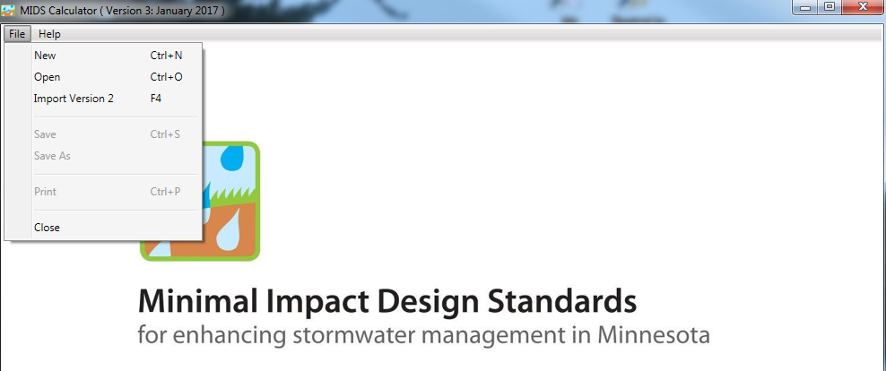
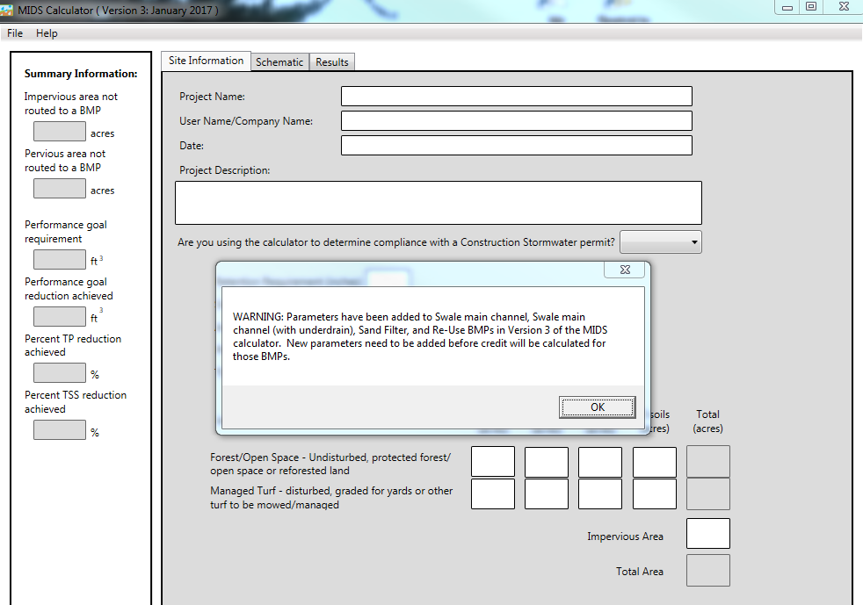

Version 2 files can be imported
You are asked to save the old file to a new Version 3 file
GO GET A CUP OF COFFEE
  the conversion may take a couple minutes depending on how complex the Version 2 file was
You will get a summary (WARNING) of changes to your Version 2 file – some BMPs may need to be modified

Slide 12
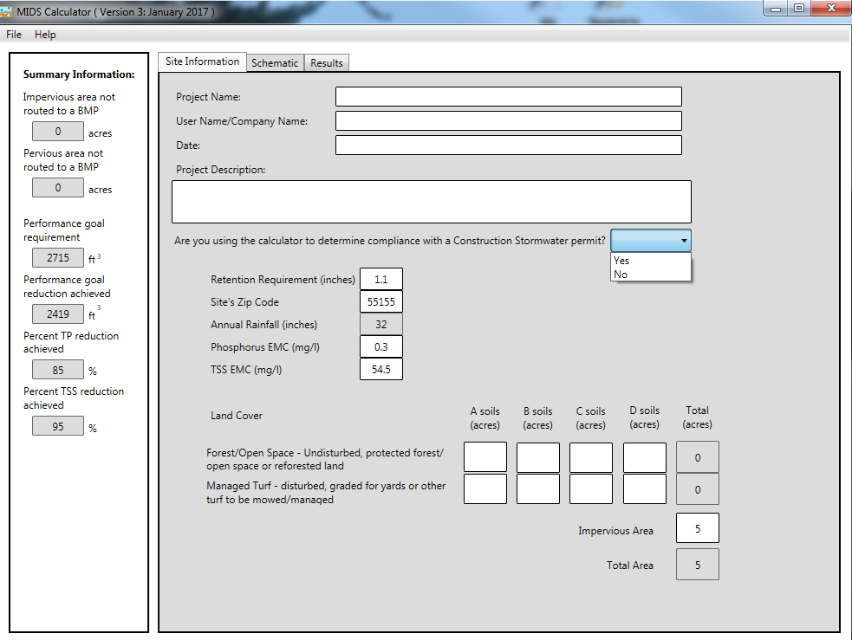
Required information on Main Screen
Zip code
Retention requirement, Annual rainfall, P EMC, TSS EMC (have defaults)
Impervious area
NEW: Compliance with CSW permit?

Slide 13
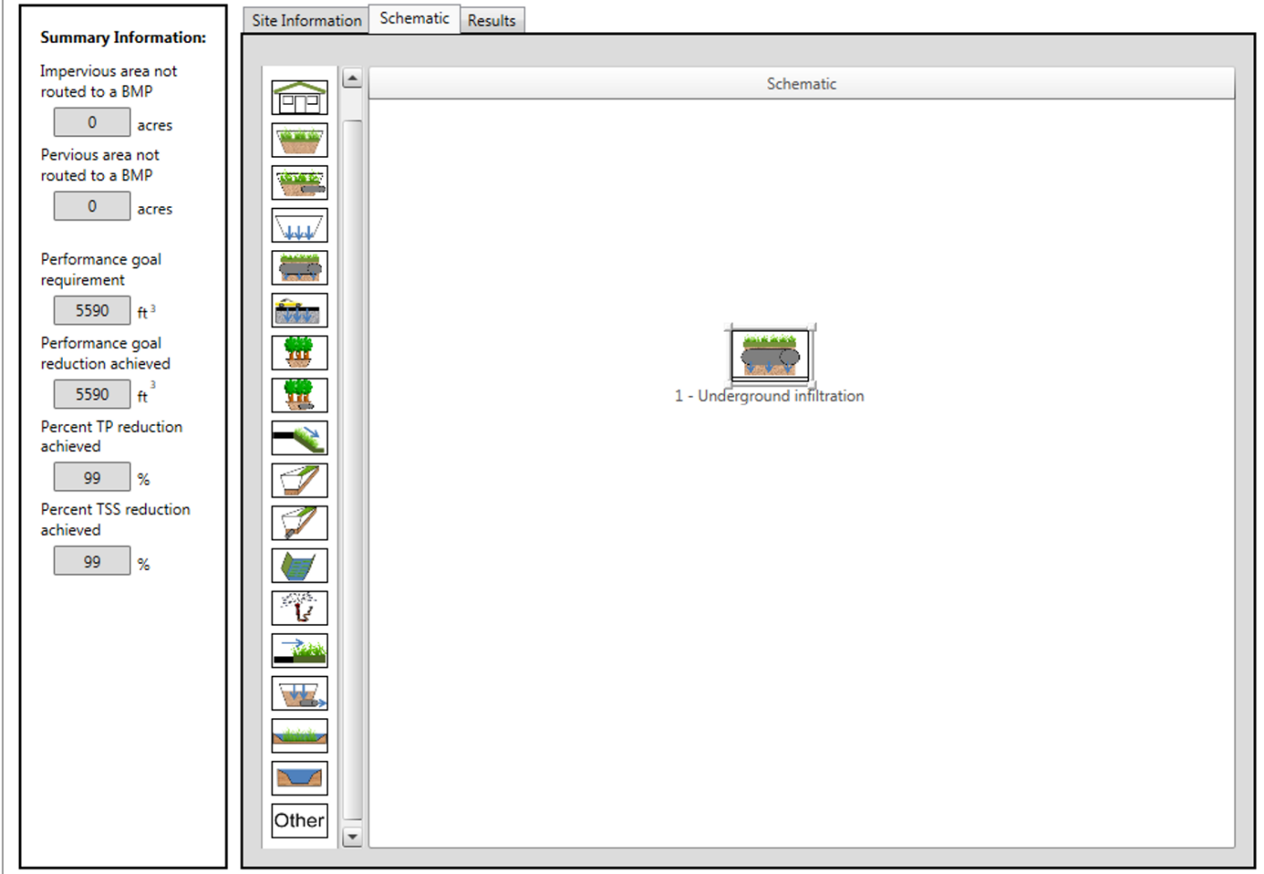
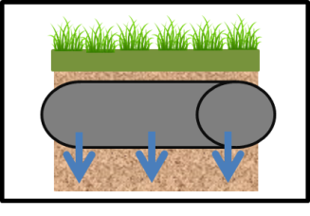
UNDERGROUND INFILTRATION

Slide 14
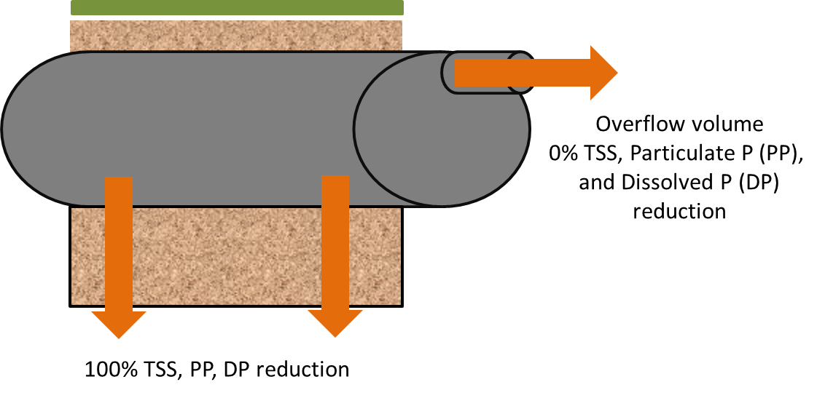
We added this BMP because the BMP stores water in both media and in pipes (previous infiltration trench BMP does not account for both)

Slide 15
Example
5 acres of impervious routed to an underground infiltration system
The underground system consists of 5 half-circle pipes, each 10 feet in diameter and 75 feet long
The basin in which the pipes sit is 65 feet wide and 100 feet long
There is 1 foot of engineered media beneath the pipes
Depth below the pipe outflow is 4 feet
HSG A soils

Slide 16


Plan view
Cross-sectional view
10’
65’
75’
100’
o
o
o
o
o
4’
1’
Overflow pipes
65’

Slide 17
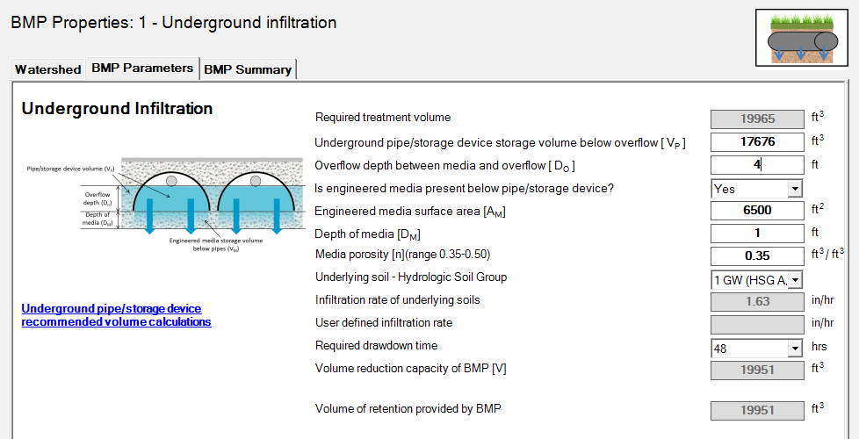
Because there are different pipe shapes and calculations are not “simple”, 2 inputs must be determined outside the calculator. These are V_{P} and A_{M}.
Click on the link to go to a spreadsheet to make these calculations

Slide 18
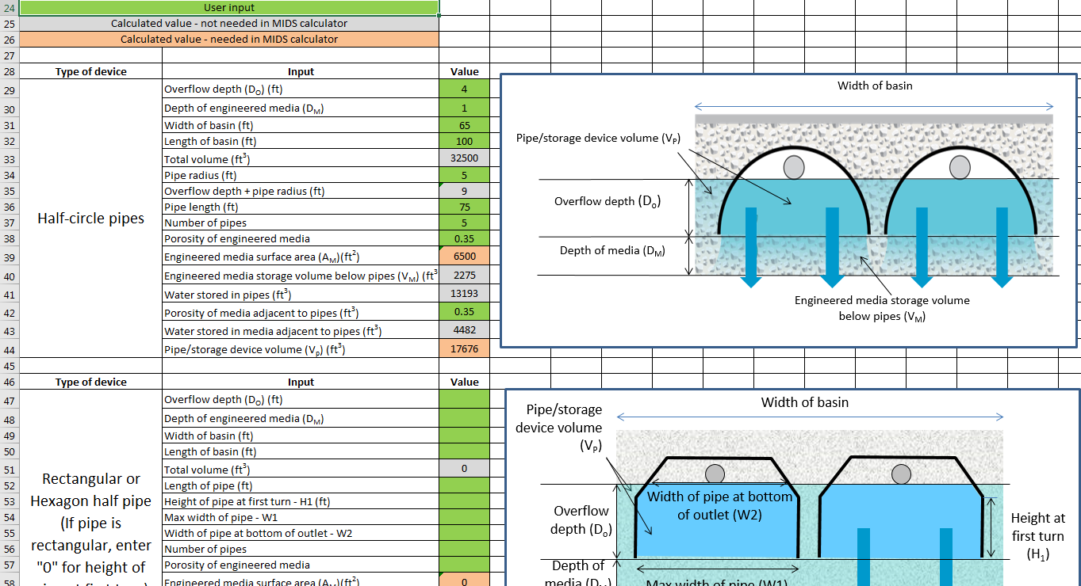
The 2 values in the salmon-colored boxes are input into the MIDS calculator

Slide 19
19951 cubic feet stored in this BMP
17676 cubic feet stored in pipes and media adjacent to pipes
o
o
o
o
o
2275 cubic feet stored in engineered media under pipes

Slide 20
Calculator demo

Slide 21
Questions?

Slide 22
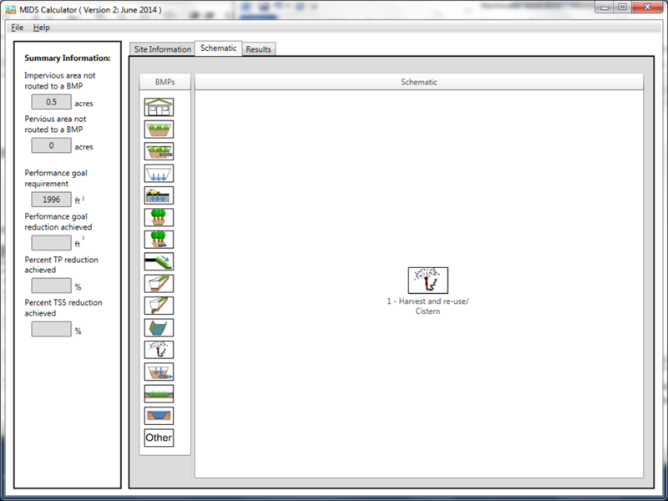
Harvest and re-use/Cistern

Slide 23
Summary of changes from Version 2
The calculation for water use utilizes a method for determining variable irrigation demand based on potential evapotranspiration (PET) from the irrigated area, adjusted for vegetation type
The daily maximum applied amount is the smaller of the irrigation demand or weekly rate. For A soils, user-input rates of up to 2 inches per week are allowed.
Water can only be applied if available in storage and daily irrigation considers precipitation that has fallen on that day.
Users can input a weekly volume retained for non-irrigation uses.
March irrigation is no longer allowed.

Slide 24
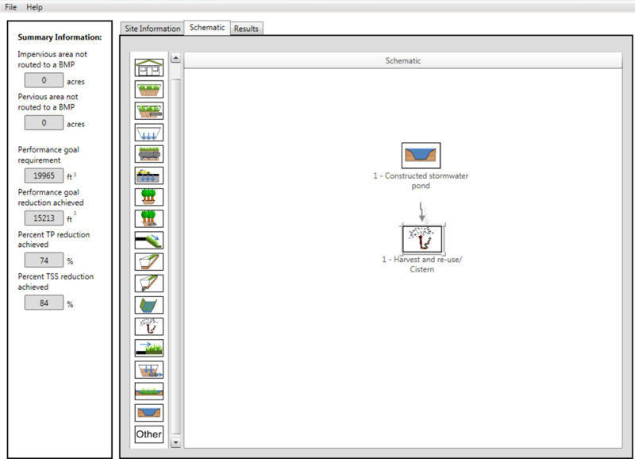
Example – pond used for irrigation
Remember to route the pond to the harvest BMP
Assume 1-acre pond with 2 feet of available water (87120 ft³)
Captures 5 acres of impervious
Irrigates a 6.5 acre ballfield on A soils
Irrigation is May-September
Since we are on A soils, we can irrigate up to 2 inches per week

Slide 25
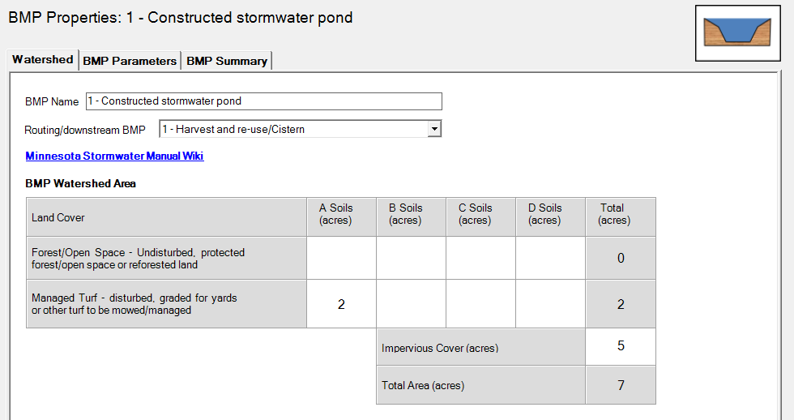
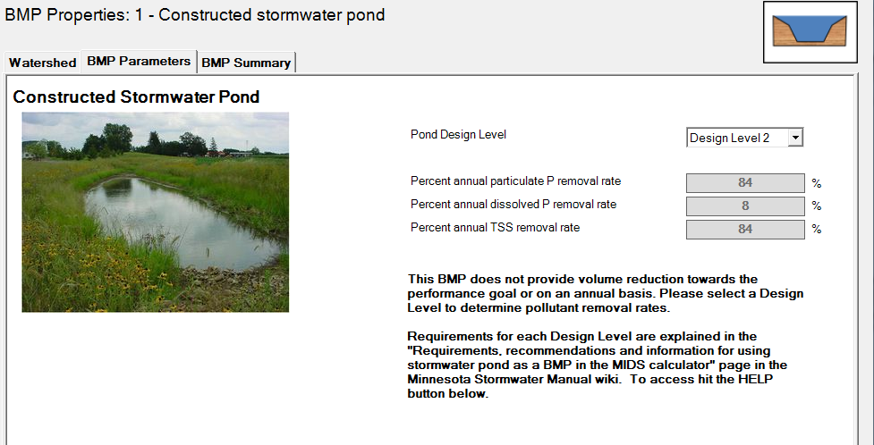
Pond inputs
Route runoff to the pond (not the harvest BMP) and then route the pond to the harvest BMP
Input the Pond Design Level (Level 2 for this example)
NOTE: No volume reduction for pond but increased P and TSS reduction

Slide 26
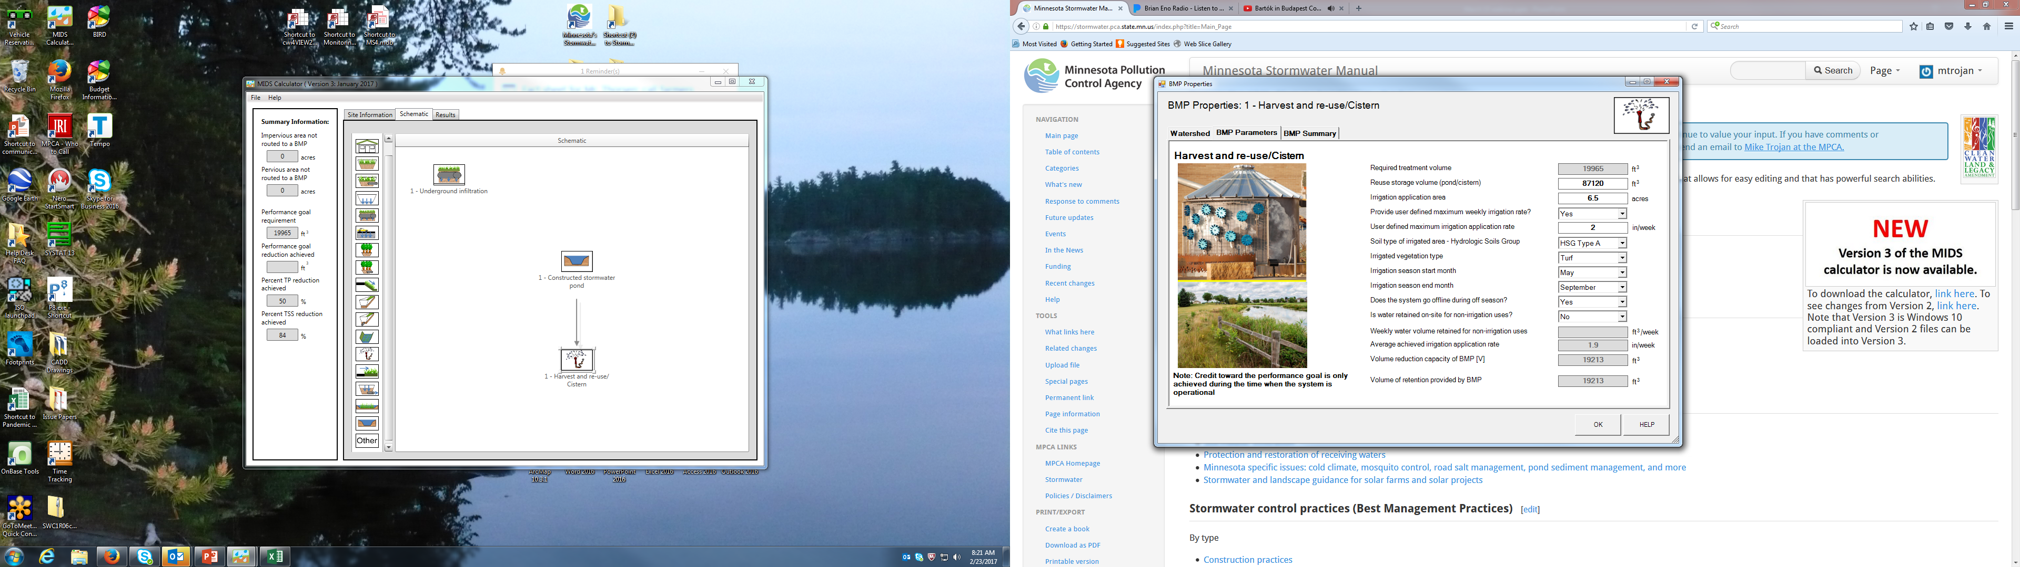
Harvest and reuse/Cistern inputs
Do not route any runoff to the BMP
Recommend having the system go off line during off season (annual volume calculations may be off otherwise)
Can retain non-irrigation water, but effect is likely to be minor

Slide 27
Calculator demo

Slide 28

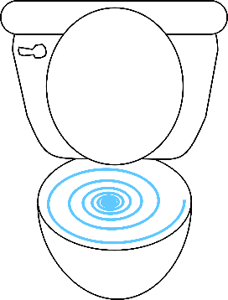
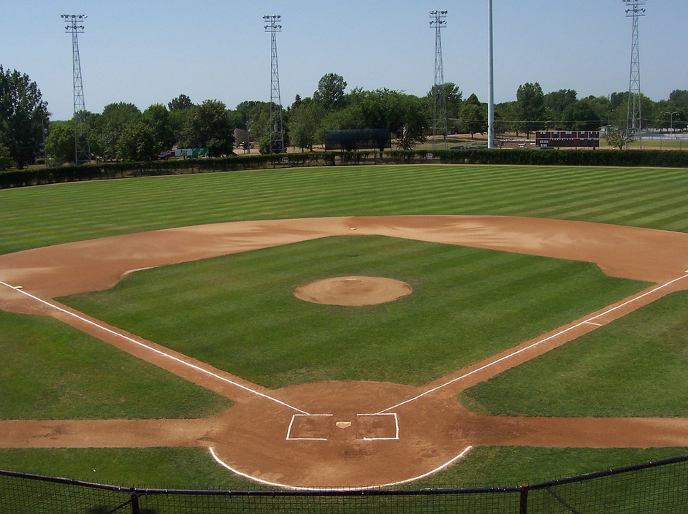
Example – cistern used for irrigation
Route the runoff to the harvest BMP
Assume 4000 ft³ storage (30,000 gallons)
Captures 1 acre of rooftop
Irrigates a 1 acre ballfield on A soils
Irrigation is May-September
A soils - irrigate up to 2 inches per week
Can take a credit for non-irrigation uses

Slide 29
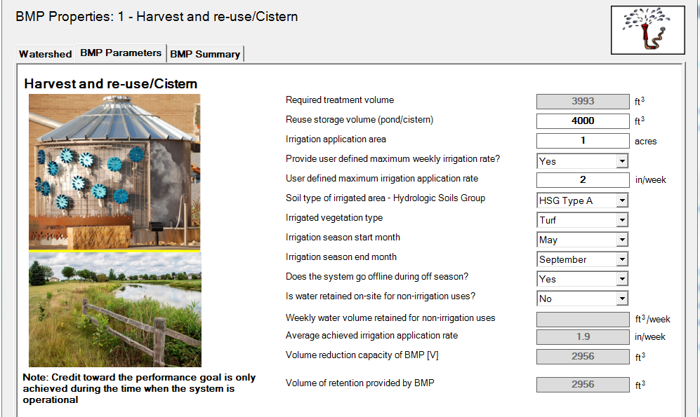
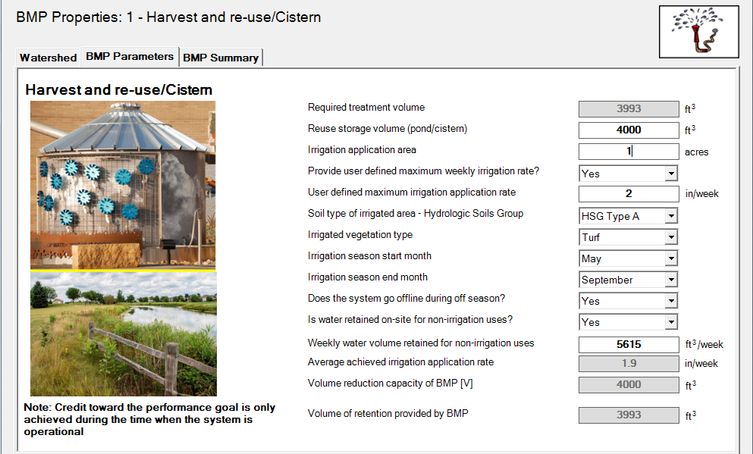
Without credit for non-irrigation uses, can’t achieve performance goal even with up to 2 inches per week
Accounting for toilet use we do meet the performance goal.
  Assumed 7000 people, 2 gallons per flush, 1 flush per person, 3 games per week
Typically, volume credit for a cistern is limited by the size of the cistern (unlike pond)

Slide 30
Calculator demo

Slide 31
Questions?

Slide 32

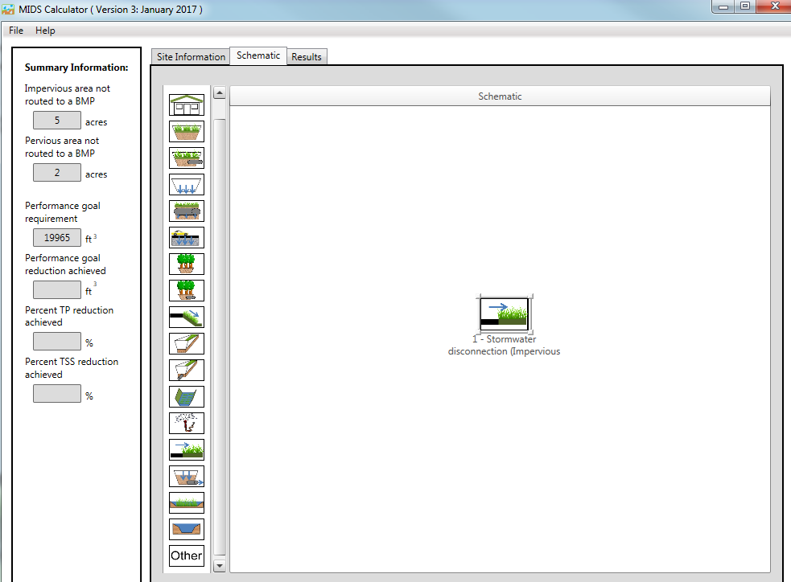
Impervious disconnection BMP
Runoff can be diverted from an impervious surface to a pervious surface (e.g. turf)
This BMP cannot be used for CSW permit compliance (isn’t available if user answers “Yes” to using the calculator for permit compliance)
Based on SWMM modeling

Slide 33
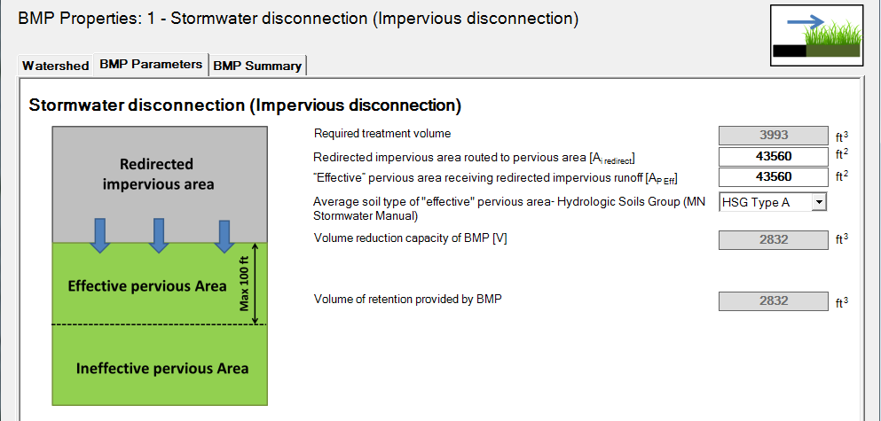
Inputs
Impervious area routed to pervious area
Pervious area receiving runoff from impervious area
  Limited to 100 ft width
Soil type

Slide 34
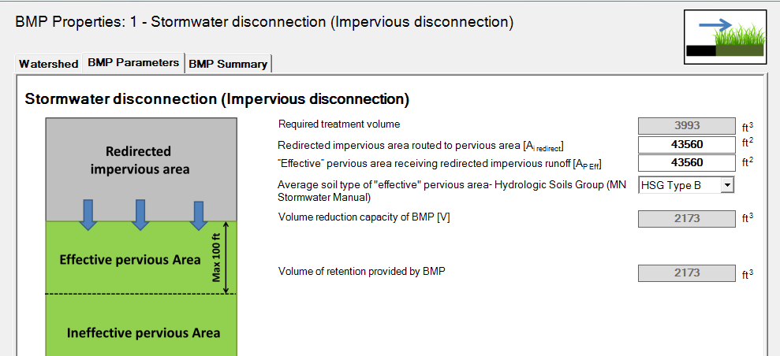
Example
1 acre of impervious drains to 1 acre of pervious
Soil types A and B
Infiltration is about 25% greater on A soils
Performance goal is not achieved
A soil
B soil

Slide 35
Calculator demo

Slide 36

A pointless slide to get your attention
(after Scheuler)

Slide 37
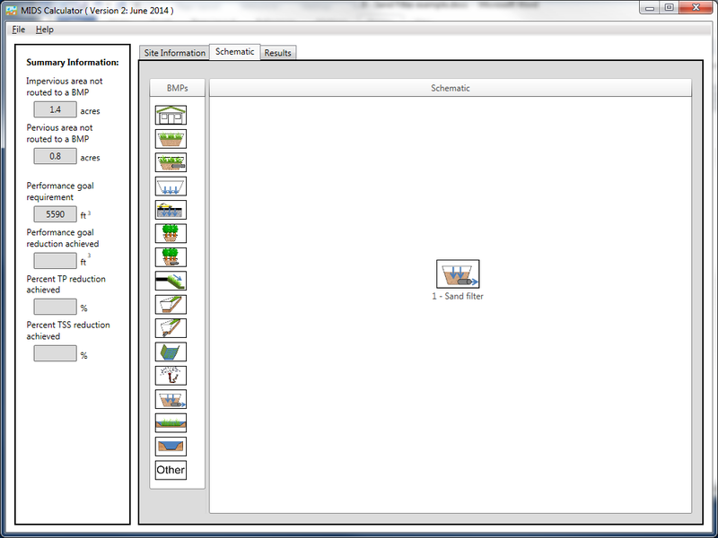
Iron enhanced sand filter
Same as previous sand filter BMP in calculator but asks if an amendment has been added to attenuate phosphorus

Slide 38
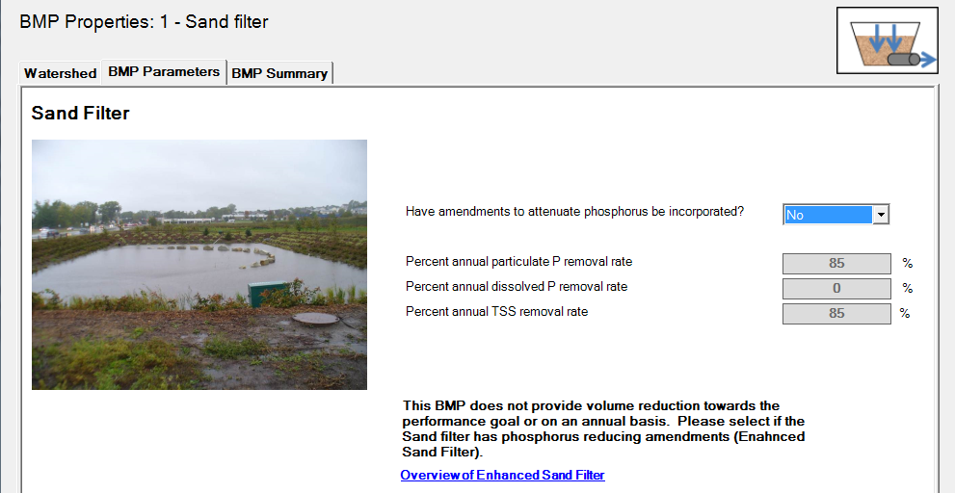
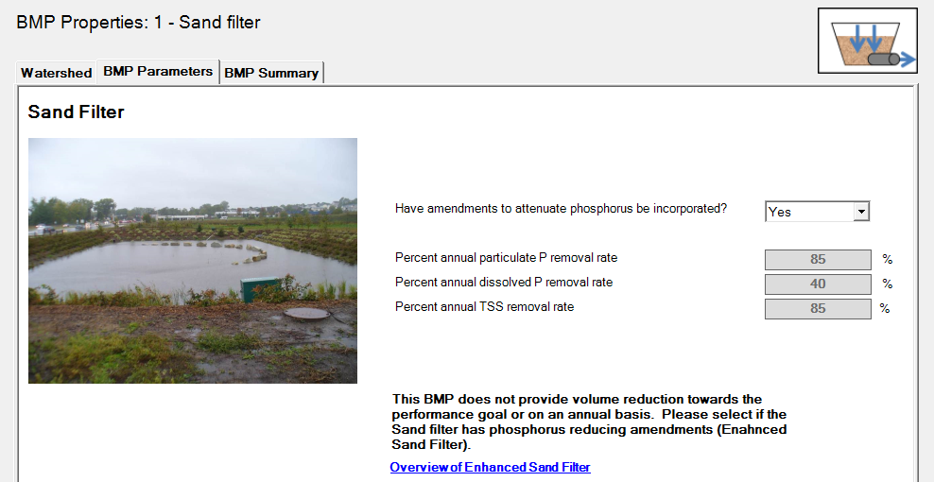
Example
1 acre of impervious draining to a sand filter
Sizing information not needed – follow guidance in manual
40% of dissolved P is removed with amendment vs. 0% with no amendment
NOTE: manual gives 60% credit for iron-enhanced sand filter

Slide 39
Calculator demo

Slide 40

Other changes

Slide 41
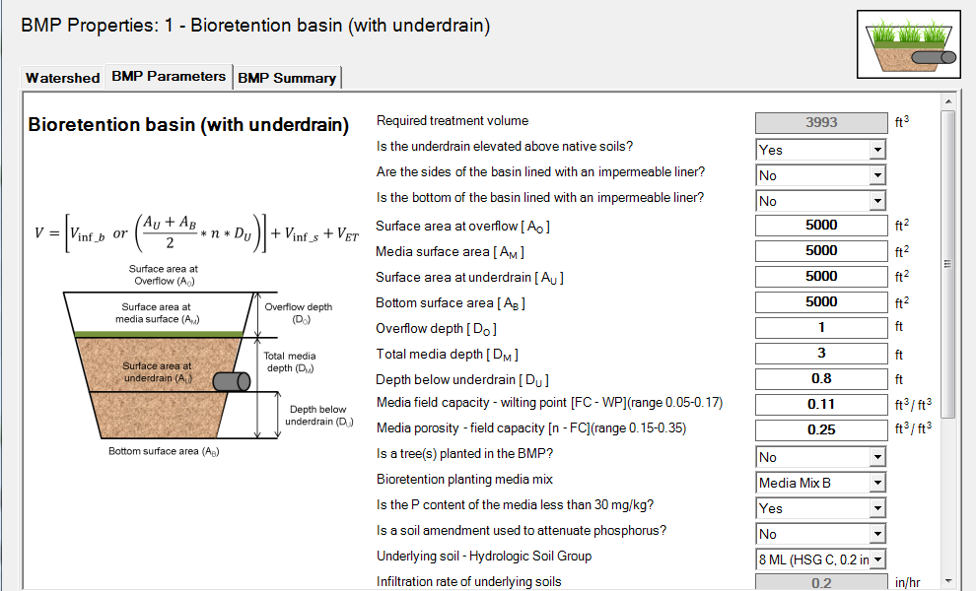
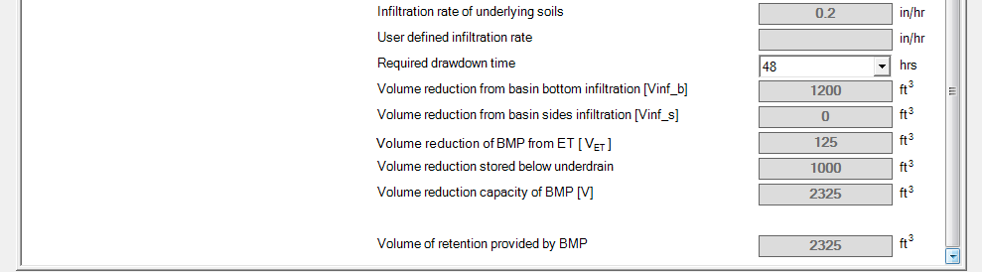
Bioretention with raised underdrain
Infiltration of water stored below underdrain
Infiltration through the bottom

Slide 42
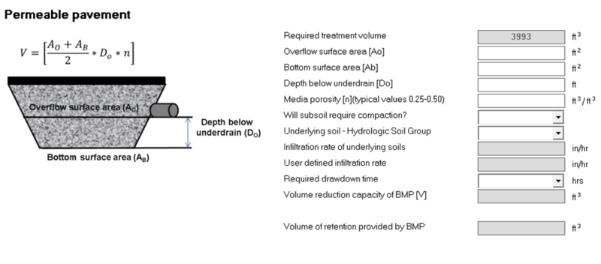
Permeable pavement with underdrain
If subsoil is not compacted, volume equals bottom surface area times 0.06 inches per hour over the drawdown time.
If subsoil is compacted, volume equals bottom surface area times 0.03 inches per hour over the drawdown time

Slide 43
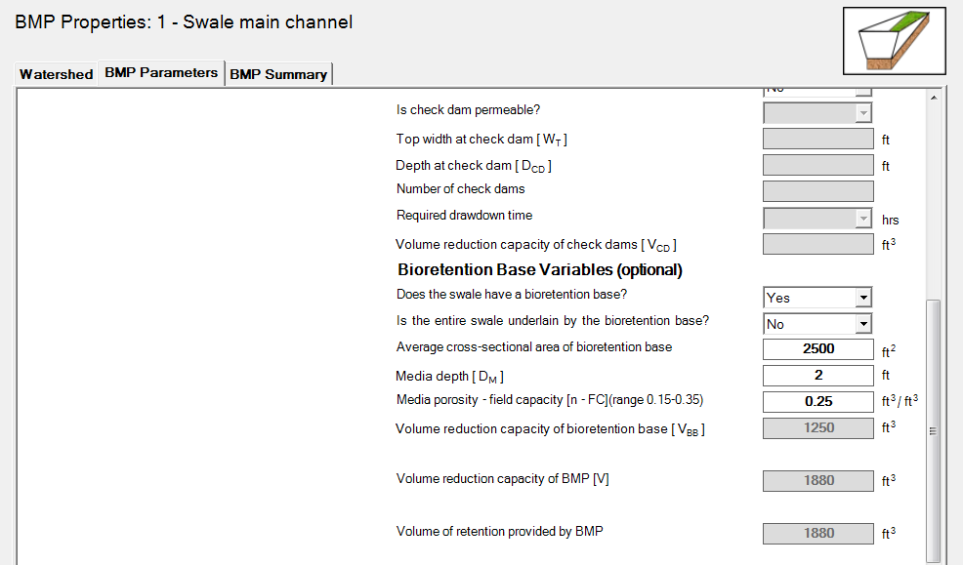
Swale with bioretention base
User asked if entire swale is underlain by bioretention base.
If YES, volume credit is swale area times media depth times media porosity
If NO, volume credit is X-sectional area of bioretention base times media depth times media porosity
Media depth limited to 3 feet

Slide 44

And finally ….
Bioretention and tree BMPs - particulate P credit changed from 45% to 80% for Soil Mix C or D or if soil P content is less than 30 mg/kg
Compatibility of the MIDS calculator with Excel 2013 was tested
Bioretention basin (with underdrain), if user answers “YES” to a raised underdrain, the question about a bottom liner defaults to “NO”
Version 3 is Windows 10 compliant

Slide 45
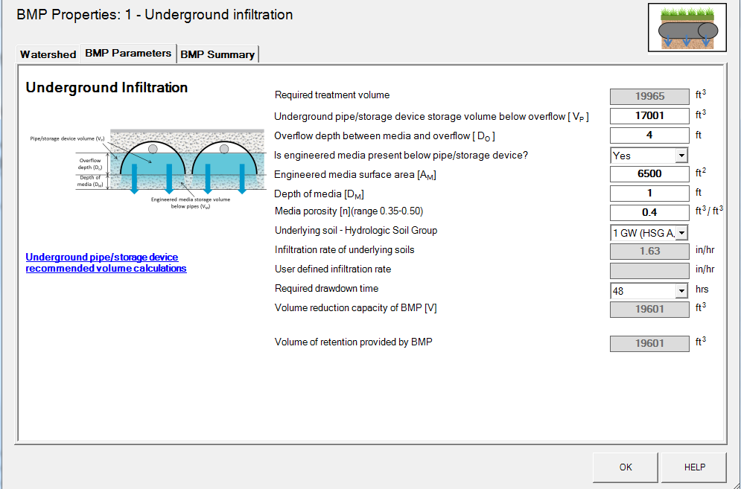
Where can I find guidance and help?
Contact me if you want an answer, but
If you want the correct answer …
Look for links in wiki or use HELP

Slide 46
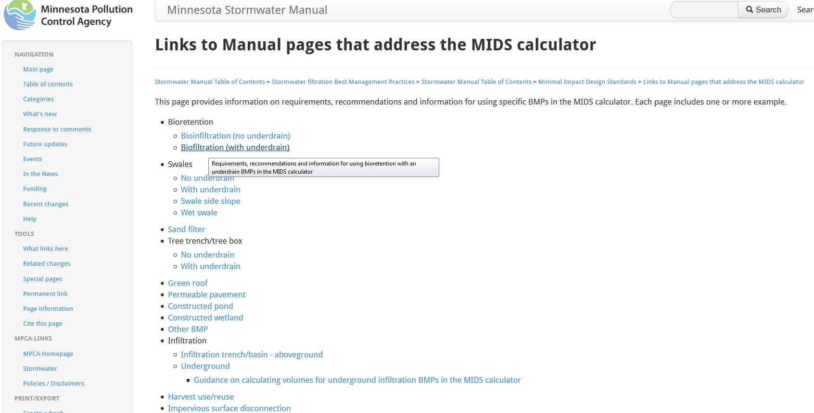
Help pages in the Manual
Go to a page called:
Links to Manual pages that address the MIDS calculator

Slide 47
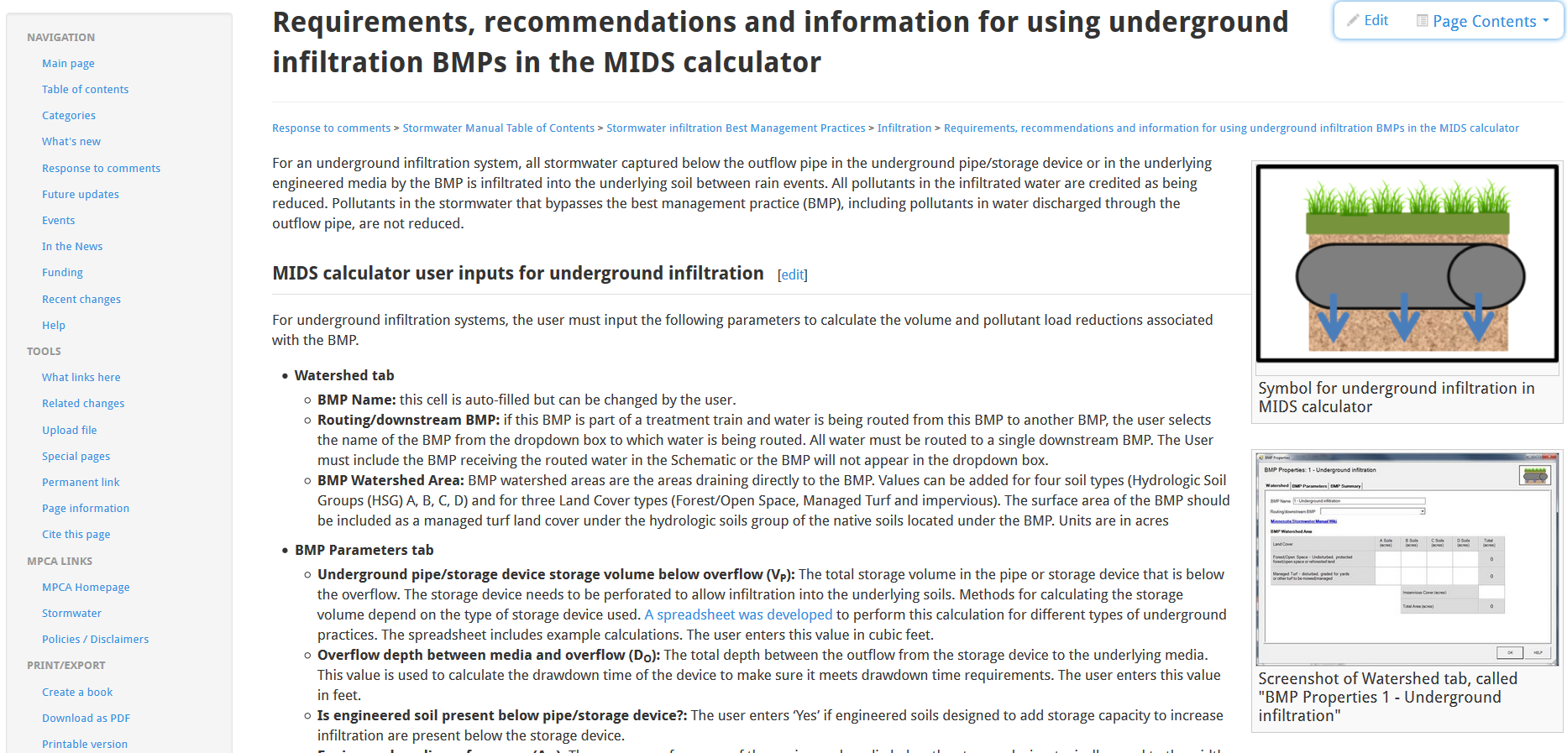
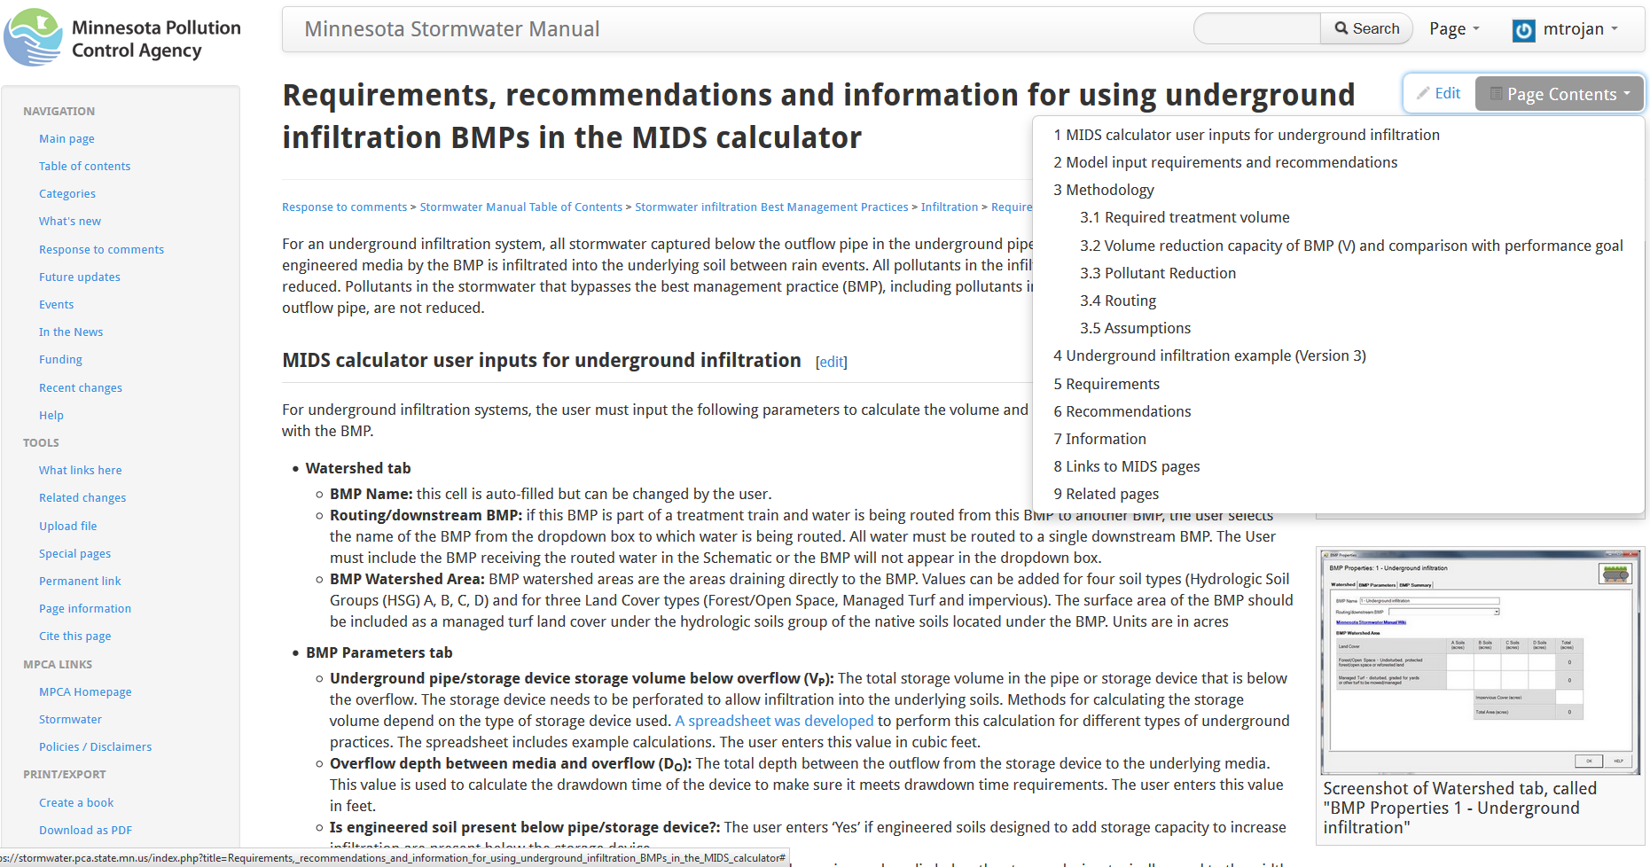

Slide 48
Questions?

Slide 49

PDH’s
PDH certificate will be posted in the manual wiki on the page called Stormwater Manual webinars

