Slide 1
Tree-Based Bioretention
Marcy Bean, PLA
Capital Projects & Stewardship Specialist
May 30, 2017

Slide 2
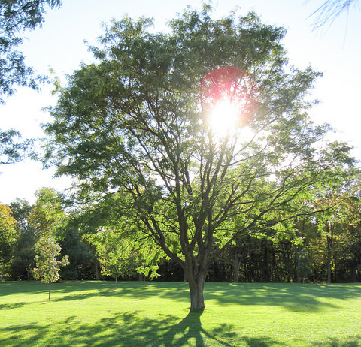
Tree-Based Bioretention
OVERVIEW
Trees + stormwater
Tree considerations
Stormwater design considerations
Tree-based technologies
Local case studies

Slide 3
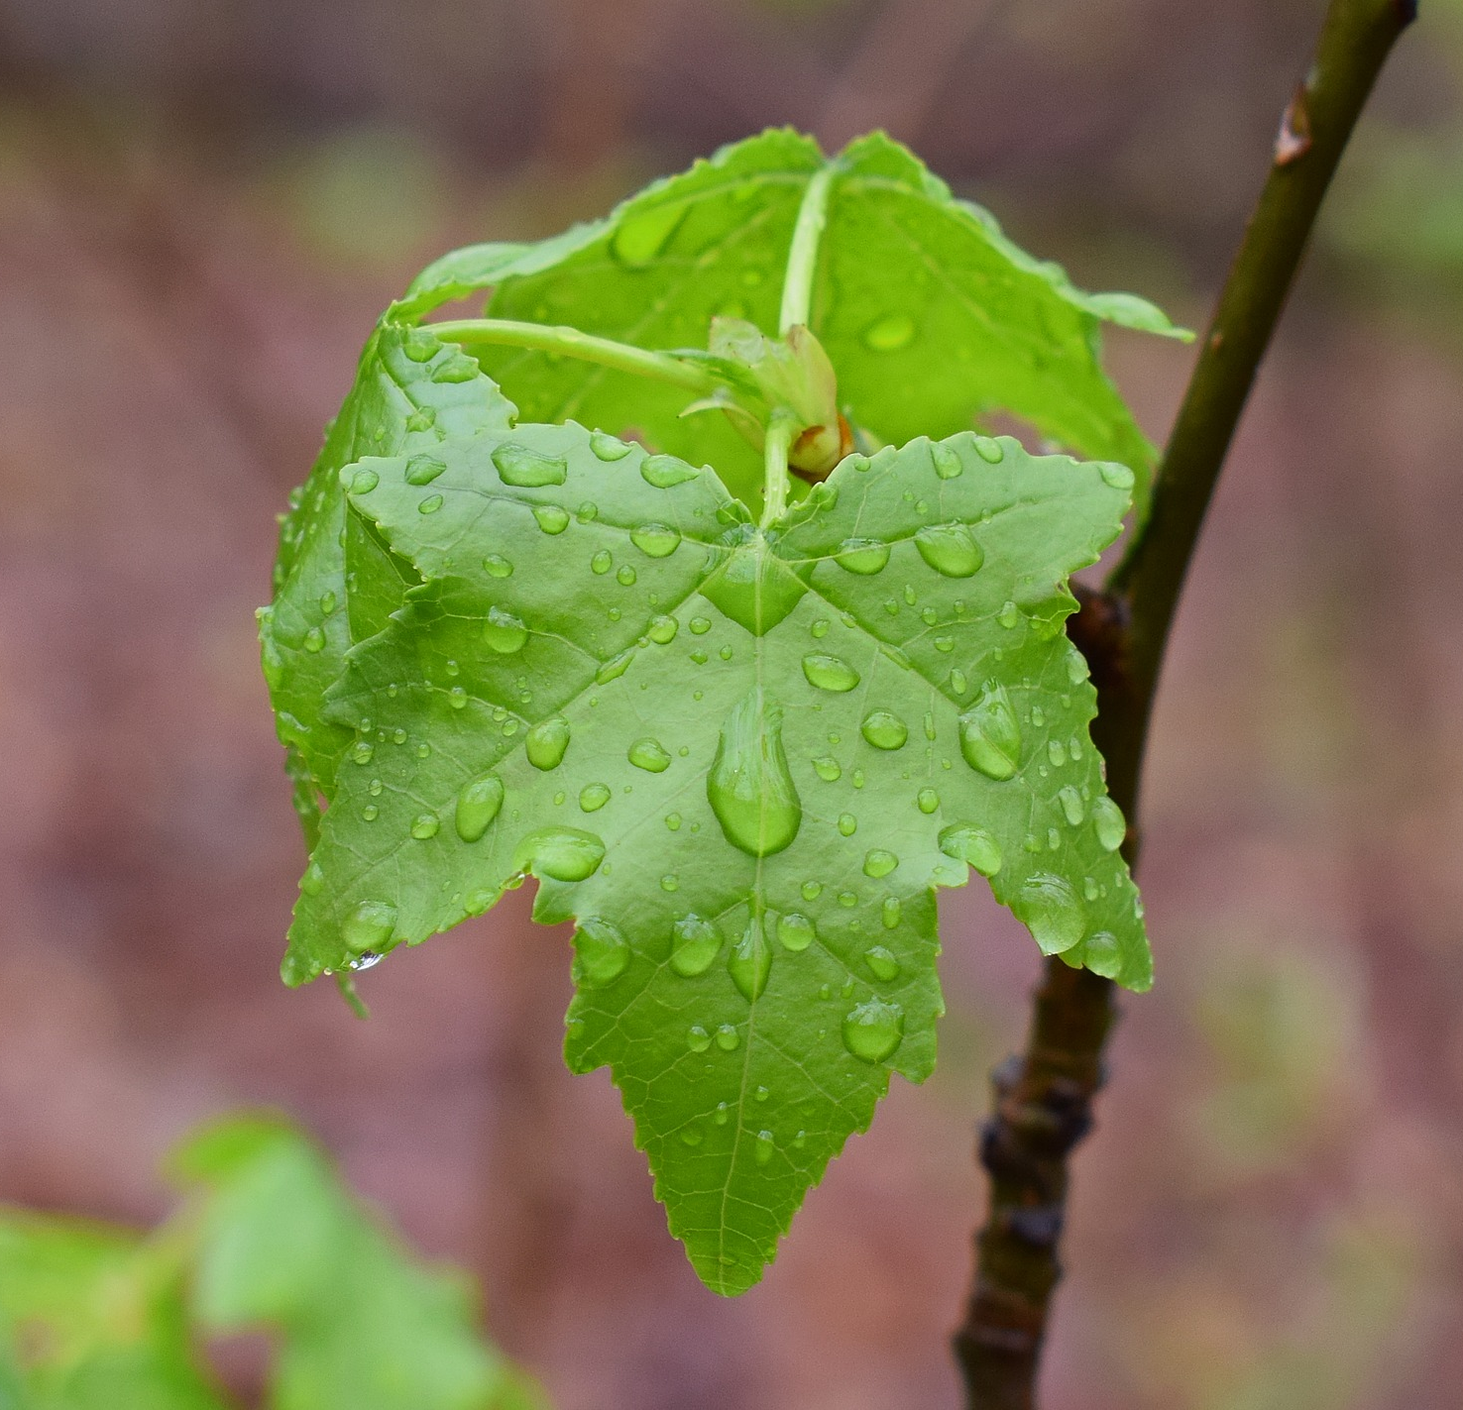
Trees + Stormwater
TREES + STORMWATER
Capture + store rainfall in tree canopy
Trees slow down runoff
Tree roots improve soil conditions to promote infiltration
Trees take up water from the soil and return to the atmosphere

Slide 4
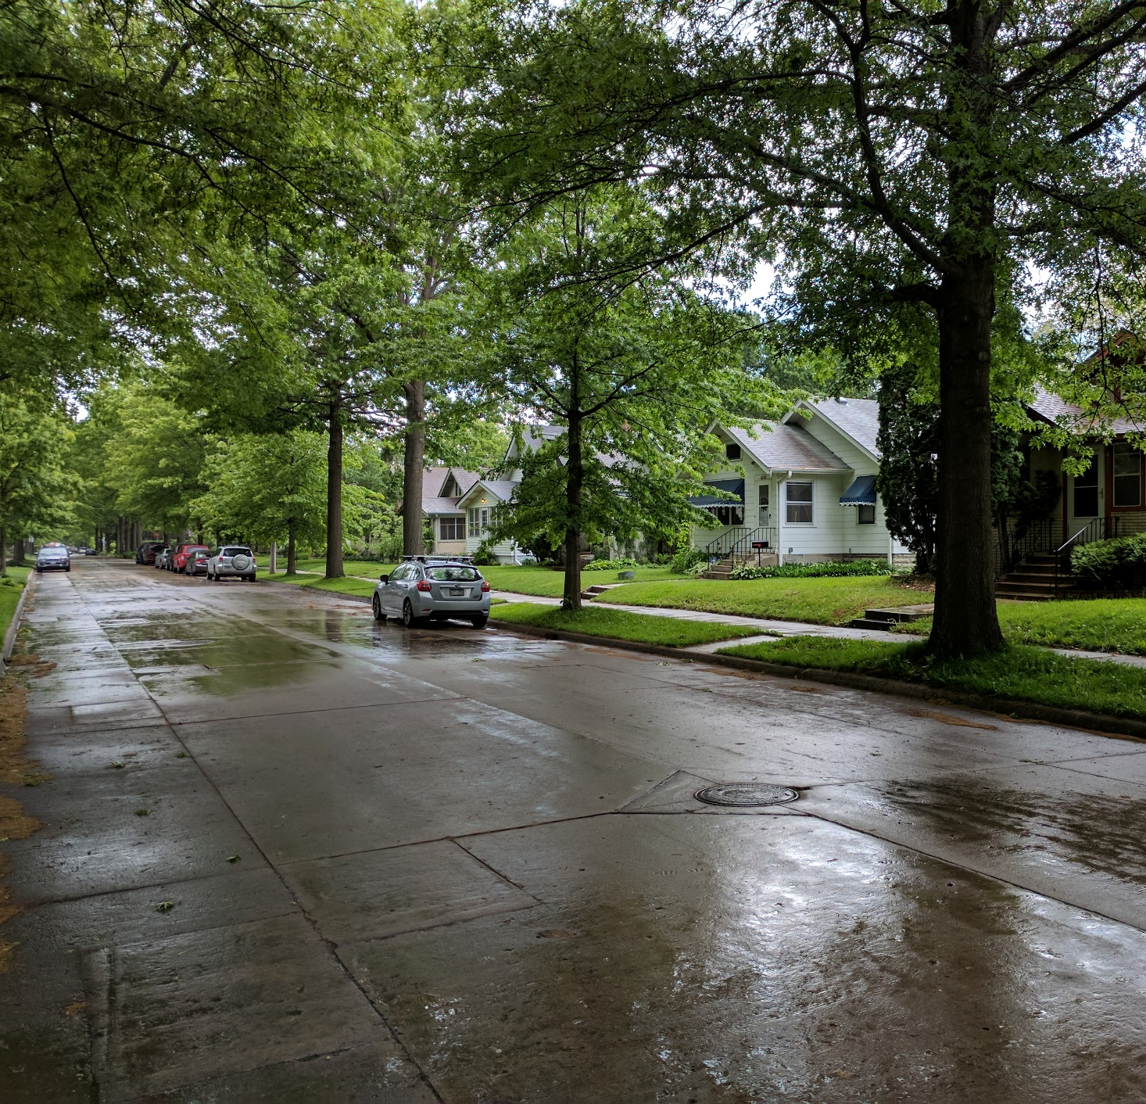
Trees + stormwater
TREES + STORMWATER
Trees can increase the effectiveness of grey + green infrastructure
Bigger trees = More stormwater benefit

Slide 5
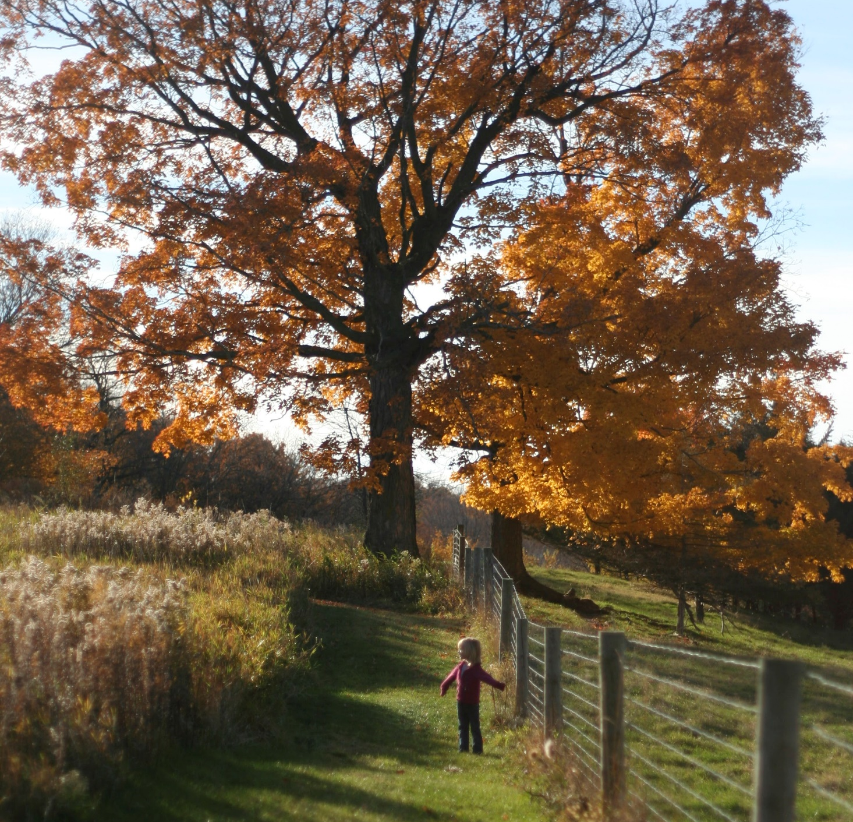
What do trees need?
TREE CONSIDERATIONS
Soil
  Type
  Uncompacted
  Volume
Water
  Irrigation
  Drainage
  Care
    Correct planting
    Establishment
    Maintenance
Notes:
A soil’s porosity, permeability, and infiltration rate are critical to the success of a street tree and its ability to absorb stormwater.

Slide 6
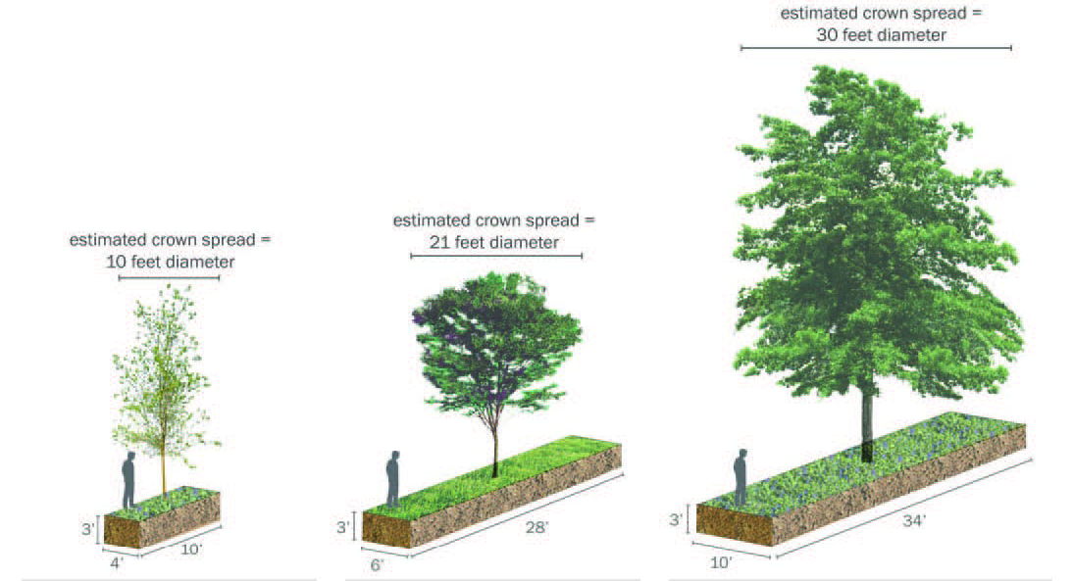
TREE CONSIDERATIONS
SOIL VOLUME
Graphic from Casey Trees, 2008
Notes:
Bigger trees = more soil

Slide 7
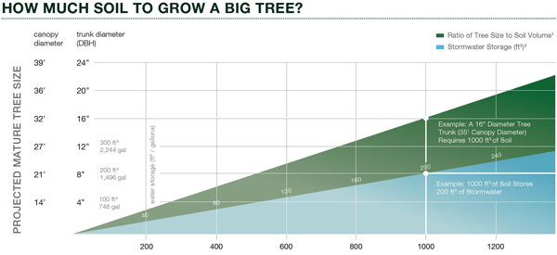
TREE CONSIDERATIONS
SOIL VOLUME
Graphic from DeepRoot
Notes:
More soil volume = more capacity to manage stormwater.
Does rock volume = loam soil volume? Some debate.

Slide 8
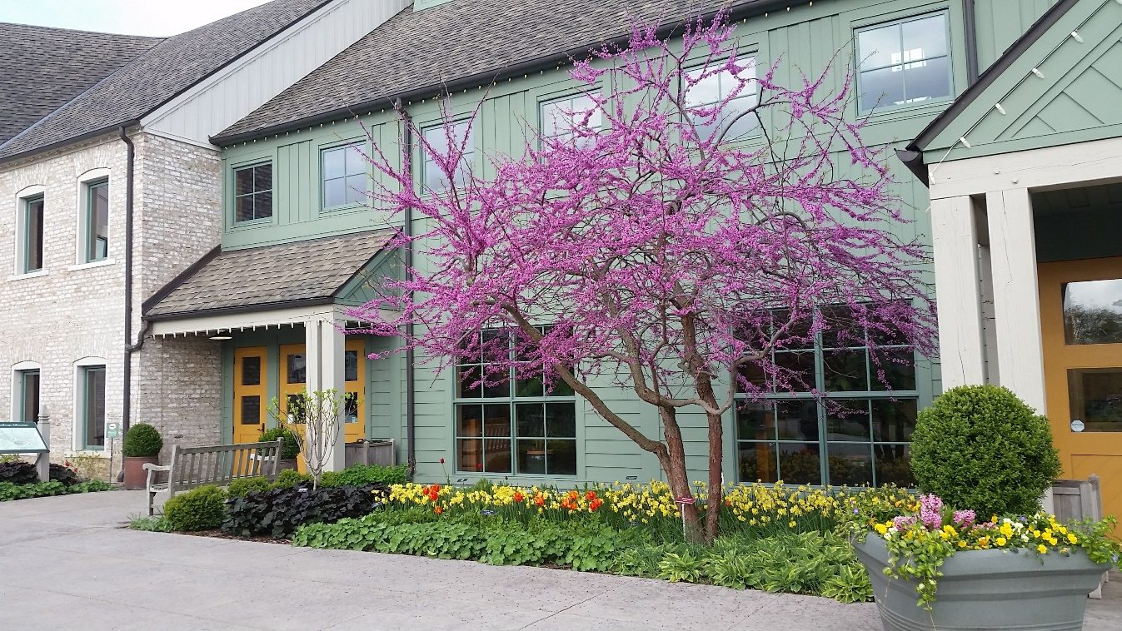
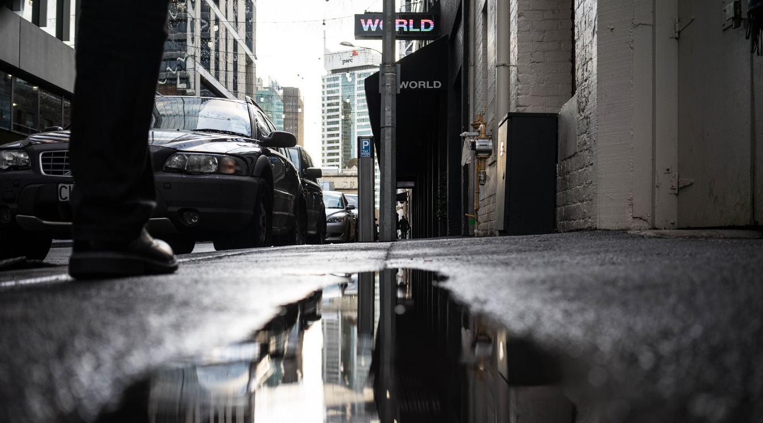
TREE CONSIDERATIONS
TOUGH SPECIES FOR TOUGH CONDITIONS
Aesthetics + Function
Tolerance
Right tree for the right place
Give the tree the ability to grow to its potential
Social benefits of trees
Climate changes
Tough conditions
Have all needs been provided for?

Slide 9
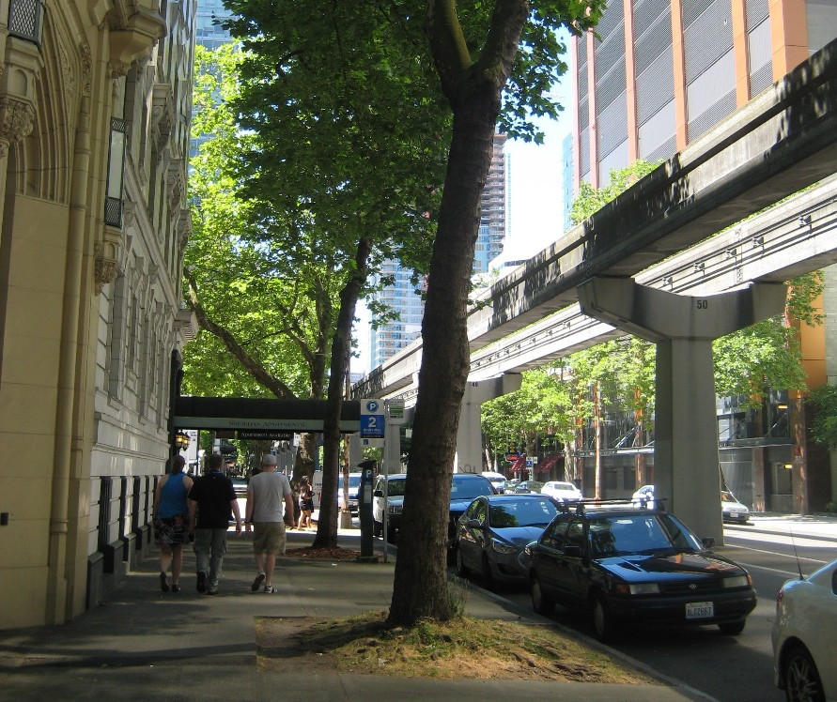
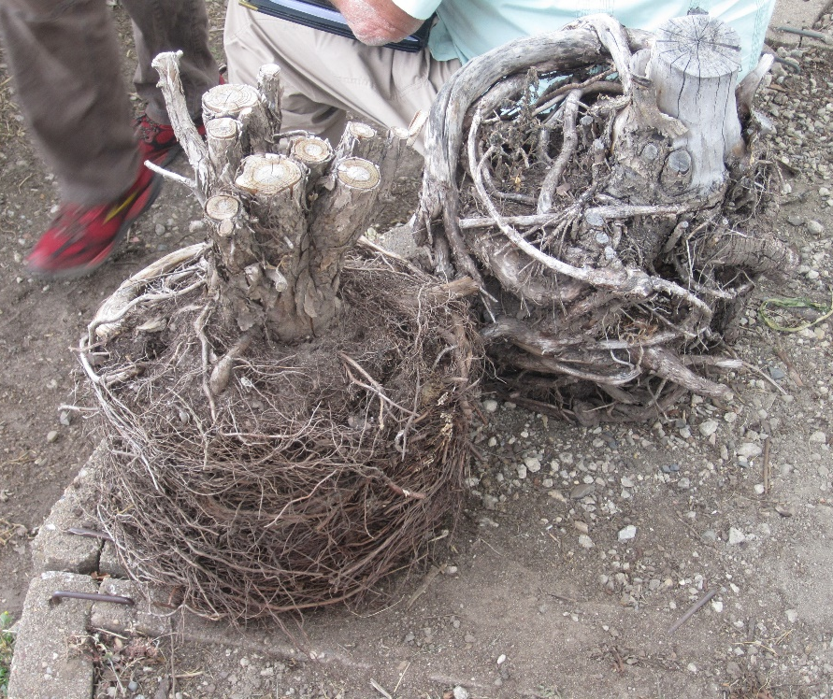
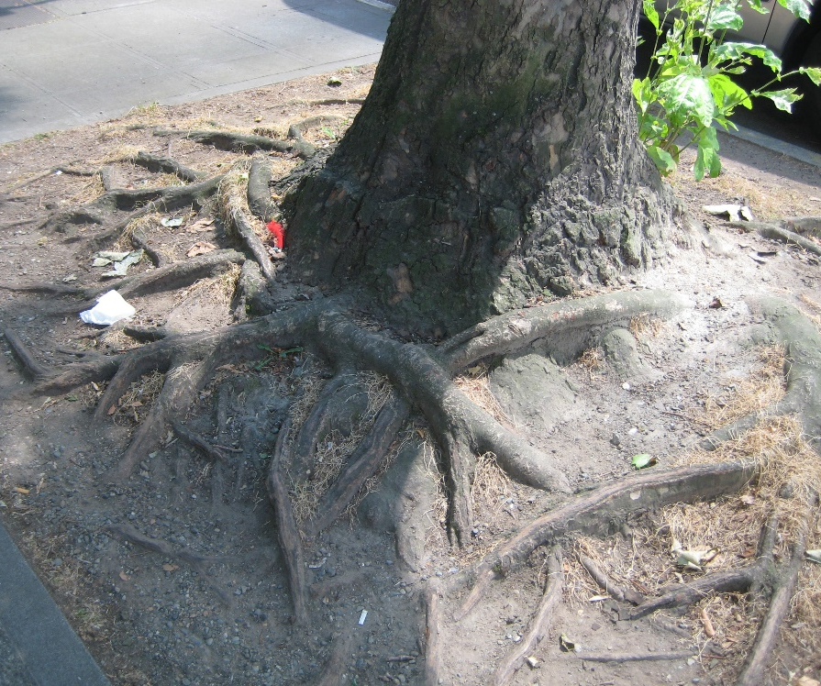
TREE CONSIDERATIONS
TOUGH SPECIES FOR TOUGH CONDITIONS
Conditions
Correct planting
Space to grow
Urban spaces (microclimates)
Extremes
Select trees
Fix nursery defects
Don’t plant too deep
What are we asking trees to adapt to?

Slide 10
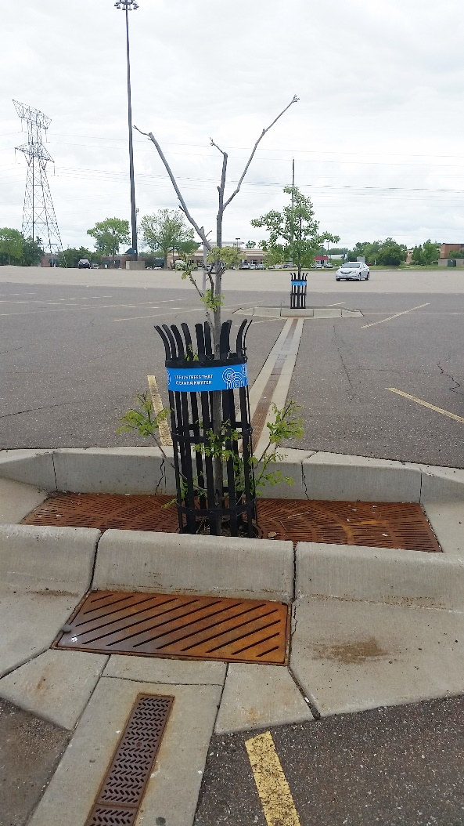
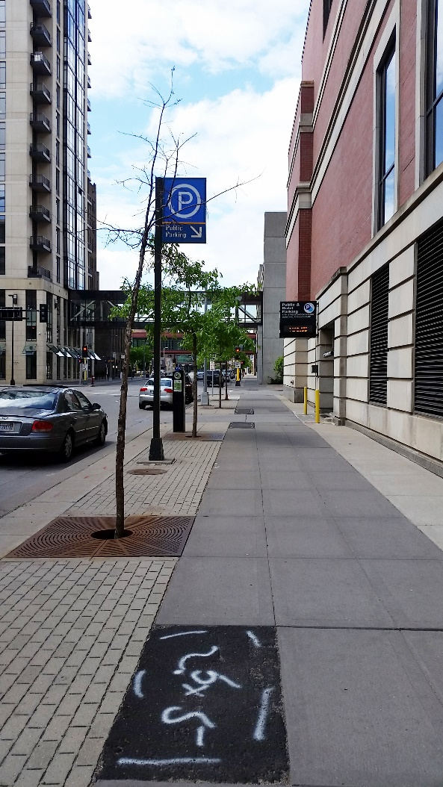
Trees are tough, but…
TREE CONSIDERATIONS
TOUGH SPECIES FOR TOUGH CONDITIONS
Trees are still living things
Still some risk of loss
Design best possible environment
They’re an investment
No system is perfect. Balance stormwater requirements with needs of the trees.

Slide 11
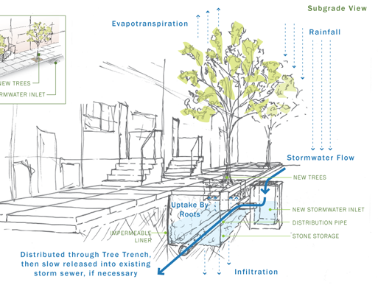
“Tree Trenches”
STORMWATER DESIGN
Tree planters
  Often linear
  Stormwater Management
  Water in + water out
  Volume = Soil volume for trees and storage volume for stormwater
  Find a balance
Graphic from City of Philadelphia
Notes:
Find a balance between using the system as a total gray infrastructure (it’s not just a pipe), and the needs of the trees and other plants.

Slide 12
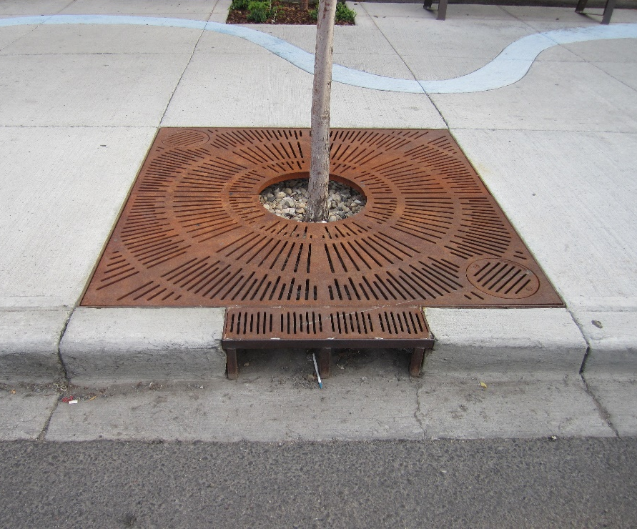
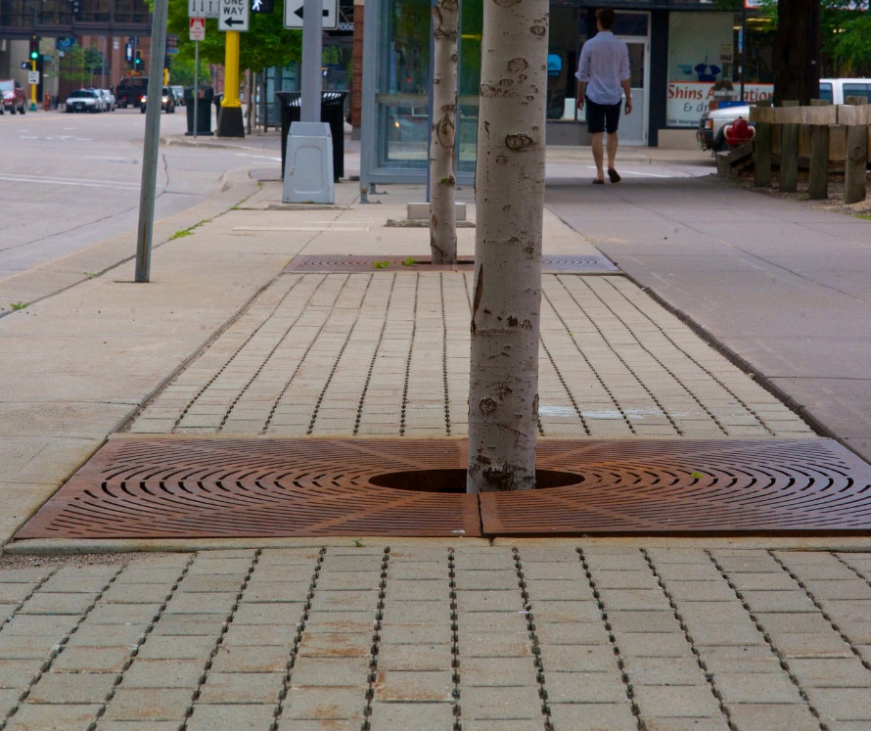
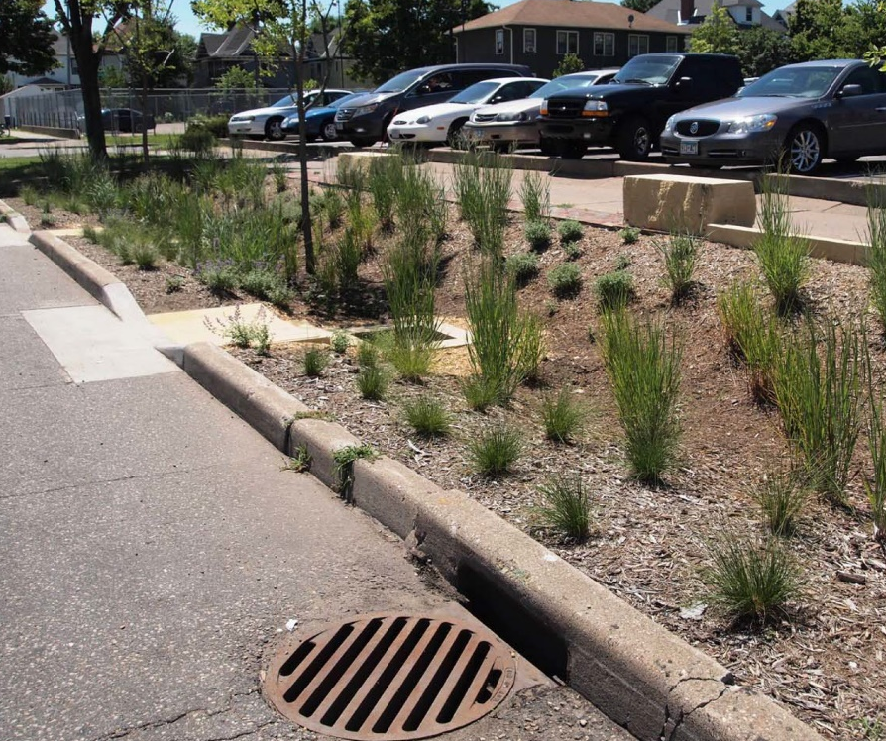
STORMWATER DESIGN
Image from DeepRoot
Image from Capitol Region Watershed District
Inlet
Outlet
Soil volume
Water source + volume
Pretreatment
Pre-plan for erosion (scour)
Ease of maintenance
Hold in the water for a short time.
Let the water drain so trees don’t drown.
The more the better.
Does so much more for stormwater than act as a pipe.
Deeper isn’t always better.
Notes:
All of these are pictures of inlets. Think through all the details. Lip that might capture sediment and then limit water entering? Will it scour when it hits the soil? Adding a pretreatment device (CB) allows to dissipate energy and for ease of maintenance later.
Find a balance between slowing down water, holding it, and not drowning the trees.

Slide 13
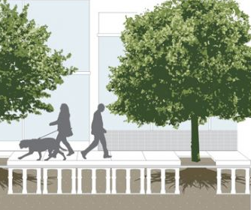
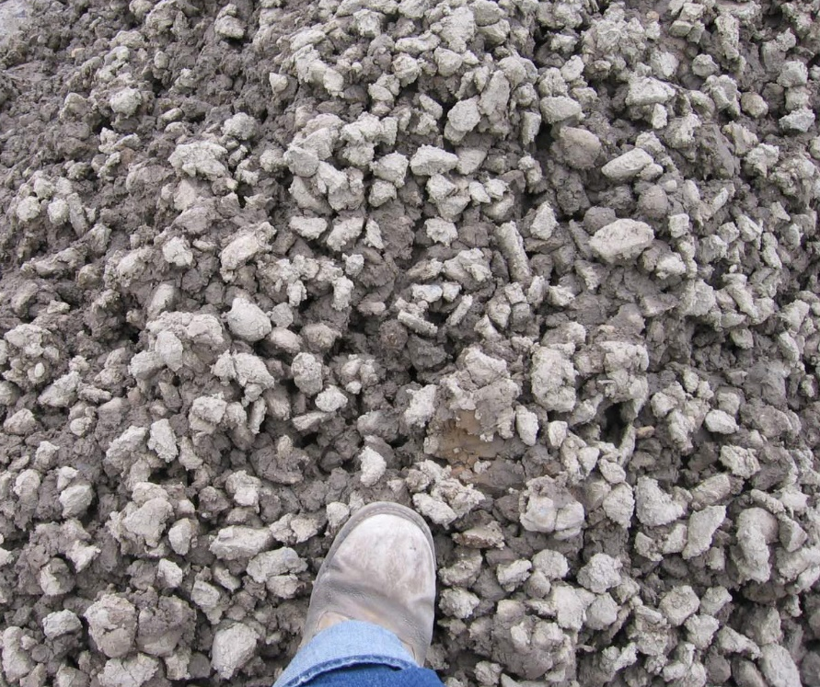
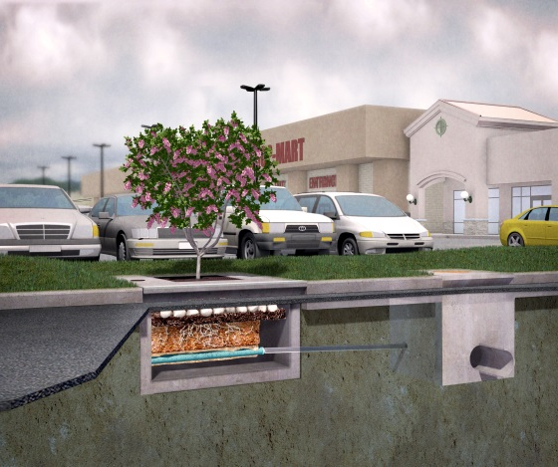
TREE-BASED TECHNOLOGIES
Image from Capitol Region Watershed District
Image from DeepRoot
Image from Contech
Structural Cells
Structural Soils
Concrete + Prefab
Structure to support pavement
Can use a variety of soils
Often more expensive, depending on volumes
Aggregate based
Less expensive as a volume
Aggregate volume vs. soil volume
Limited volume
Usually easy to maintain
Notes:
Tree sensitivity to pH, aggregate selection
Or, maybe just make your planters bigger!

Slide 14
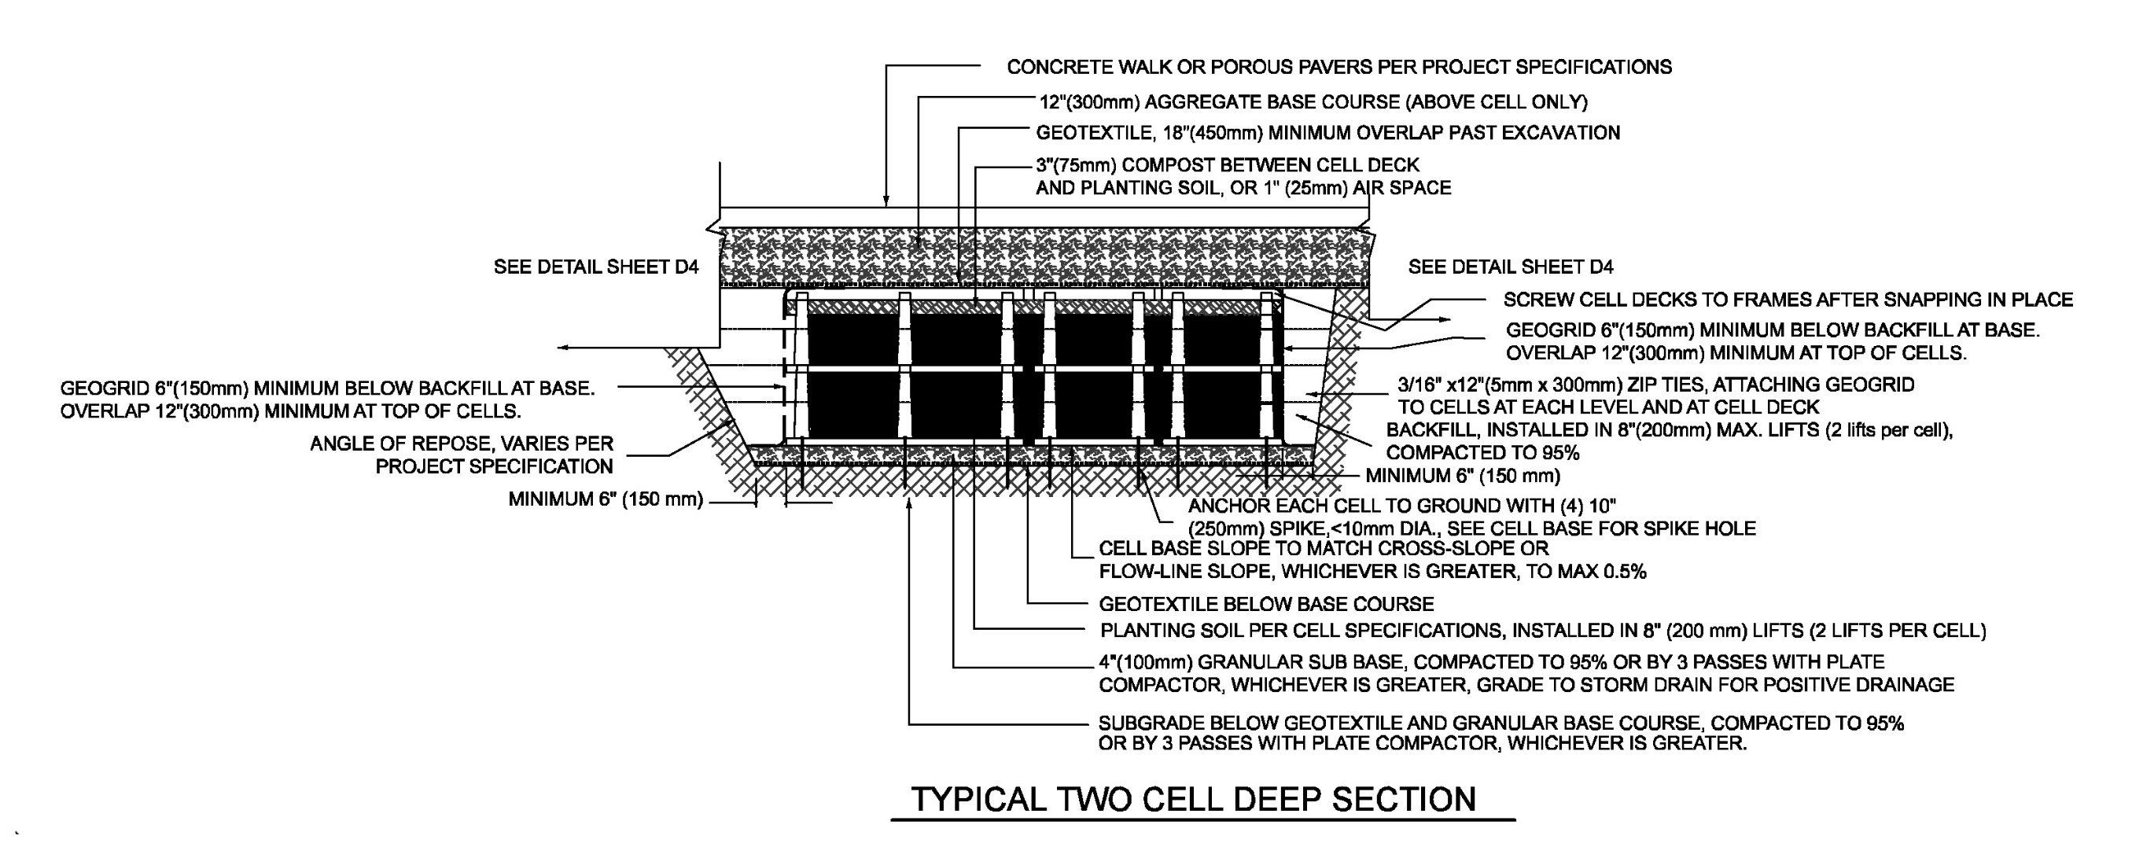
CASE STUDY /
MARQ2
Inlet:
Permeable pavers
Planting soil

Slide 15
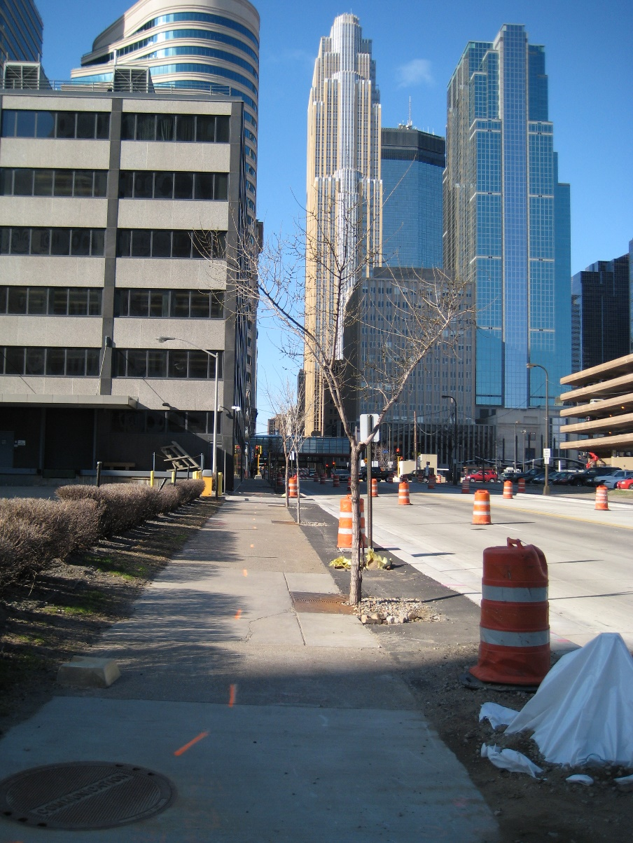
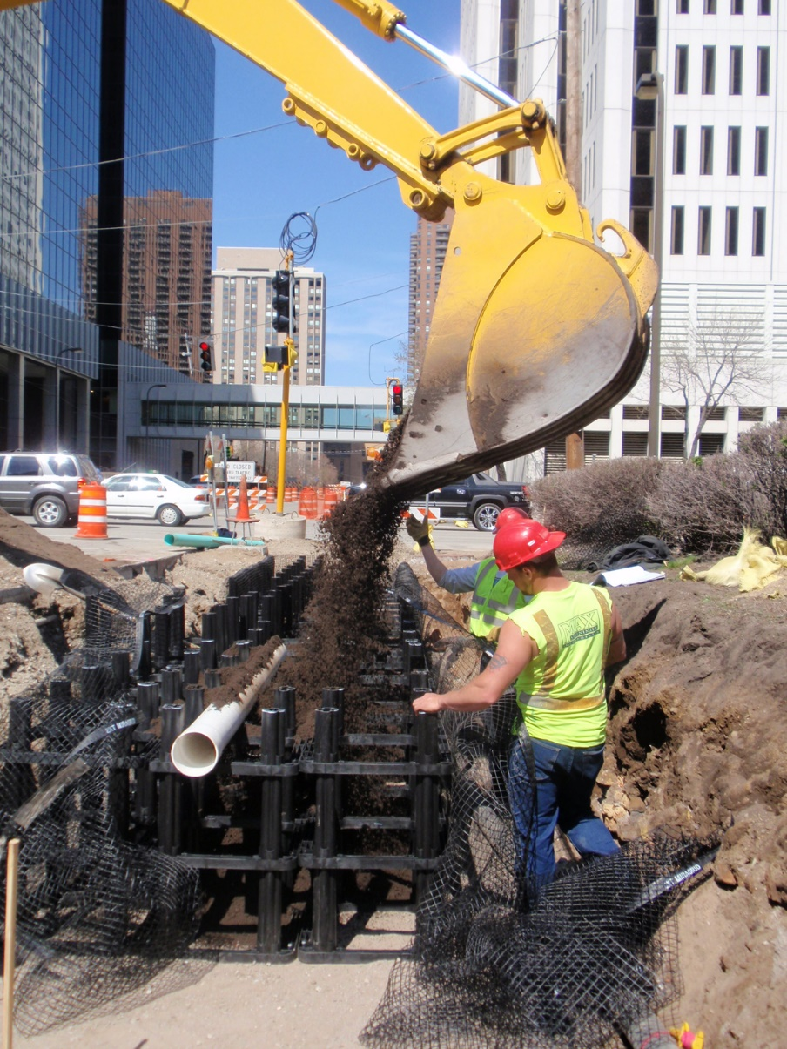
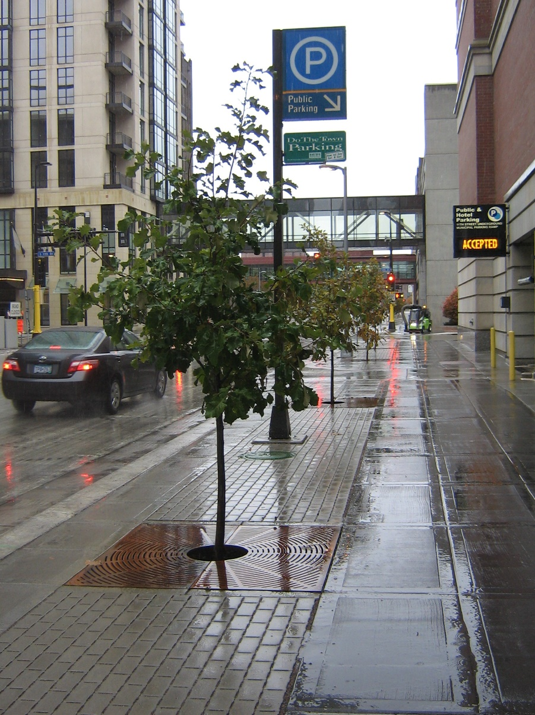
CASE STUDY /
MARQ2
BEFORE
DURING
AFTER
Images from City of Minneapolis

Slide 16
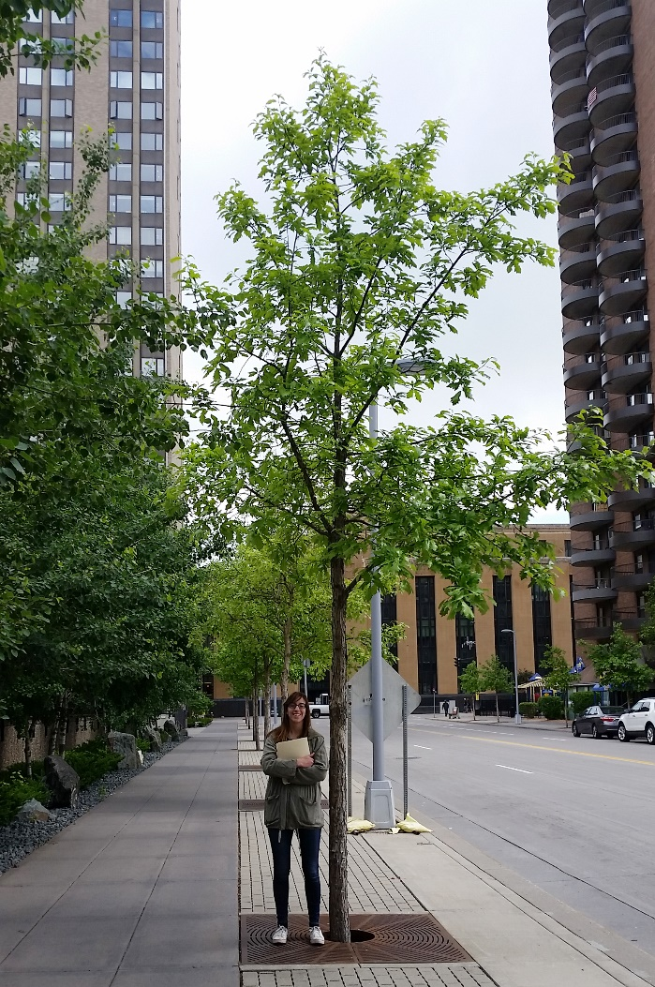
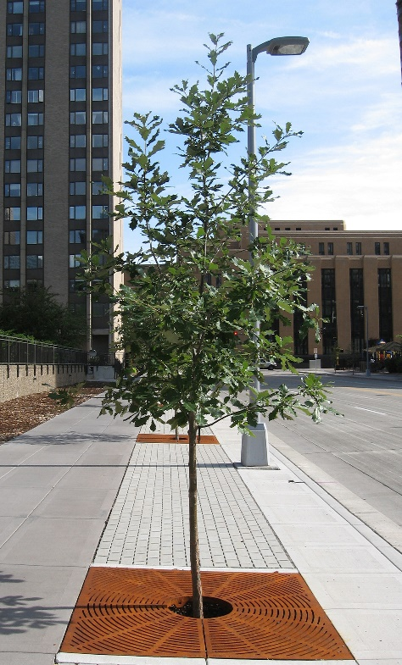
CASE STUDY /
MARQ2
Year constructed: 2009
Inlet type: Permeable pavers
Drainage area: Sidewalk only, 90% storm (1.03”) managed, 10% reduction in peak flows.
Number of trees: 167
Media type: Loam soil
Media volume per tree: ~580 cf
Species: Autumn Blaze Maple, Crimson Spire Oak, Emerald Lustre Maple, Skyline Honeylocust, Hophornbeam, Japanese Tree Lilac, Greenspire Linden, Swamp White Oak
Irrigation: Gator bags for first year +
2010
2017

Slide 17
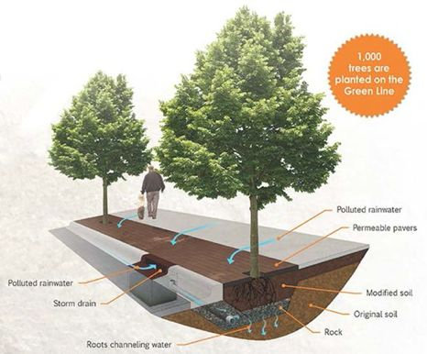
CASE STUDY /
CENTRAL CORRIDOR
Slide from Capitol Regional Watershed District
Year constructed: 2013
Inlet type: Permeable pavers + sump catch basins
Drainage area: Sidewalk + street runoff, 3-acre feet reduction per event from 103 acres of impervious surface
Number of trees: 1,250
Media type: CU Structural Soil
Media volume per tree: ~630 cf
Species: Many (see later slide)
Irrigation: N/A

Slide 18
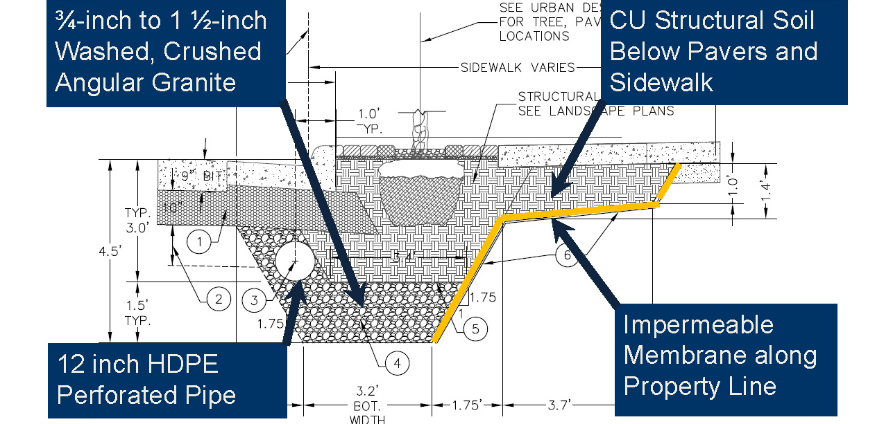
CASE STUDY /
CENTRAL CORRIDOR
Perforated pipes act as conveyance and as drainage
Slide from Capitol Regional Watershed District

Slide 19
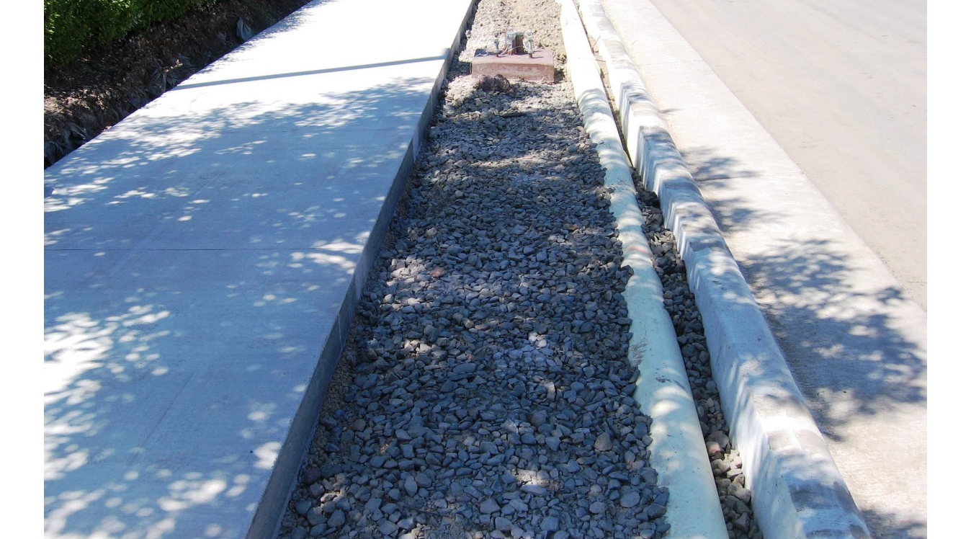

CASE STUDY /
CENTRAL CORRIDOR
Structural Soil
Structural Soil
6.8 miles of permeable pavers
5 miles of infiltration/tree trench
1,000 trees planted in structural soil
103 acres of impervious surfaces
Volume reduction achieved: 3.02 ac-ft
Images from Capitol Regional Watershed District

Slide 20
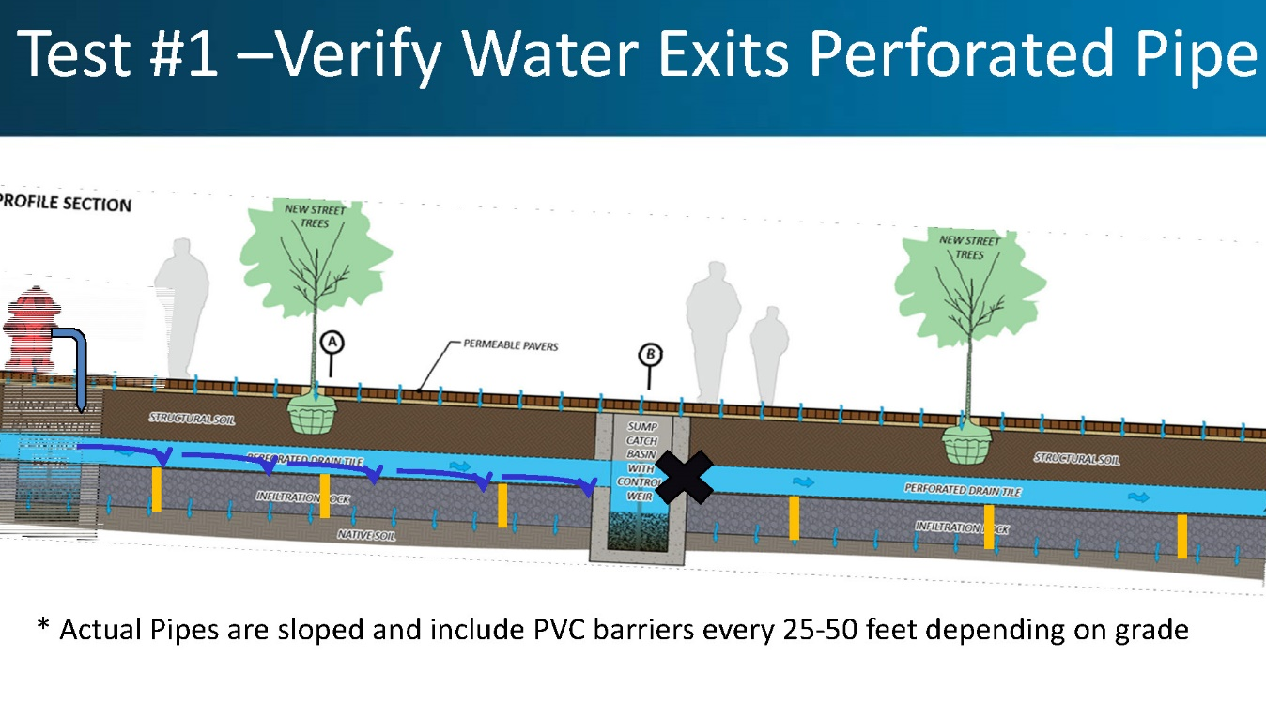
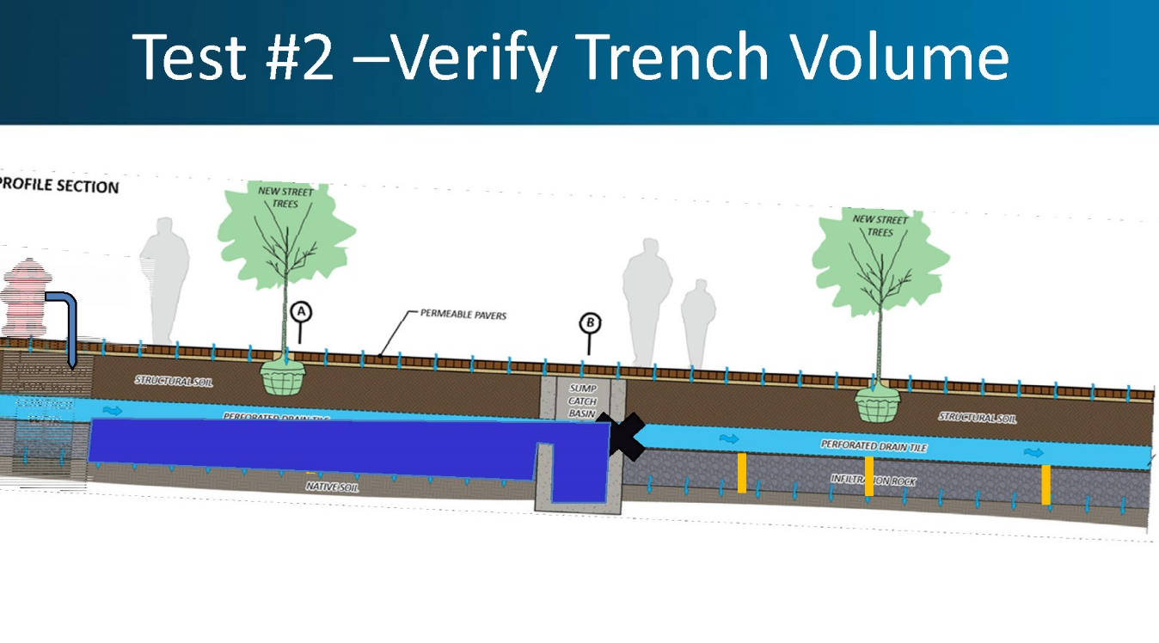
CASE STUDY /
CENTRAL CORRIDOR
Performance testing
Performance testing
Post-construction testing, falling head test
Very long length of perforated pipe, acts as both conveyance and drainage
Perforations designed at 1:00 and 4:00 to ensure water doesn’t bypass soils.
Modified CB’s to separate “pools”
Allowed for volume capacity with bypassing
Images from Capitol Regional Watershed District

Slide 21
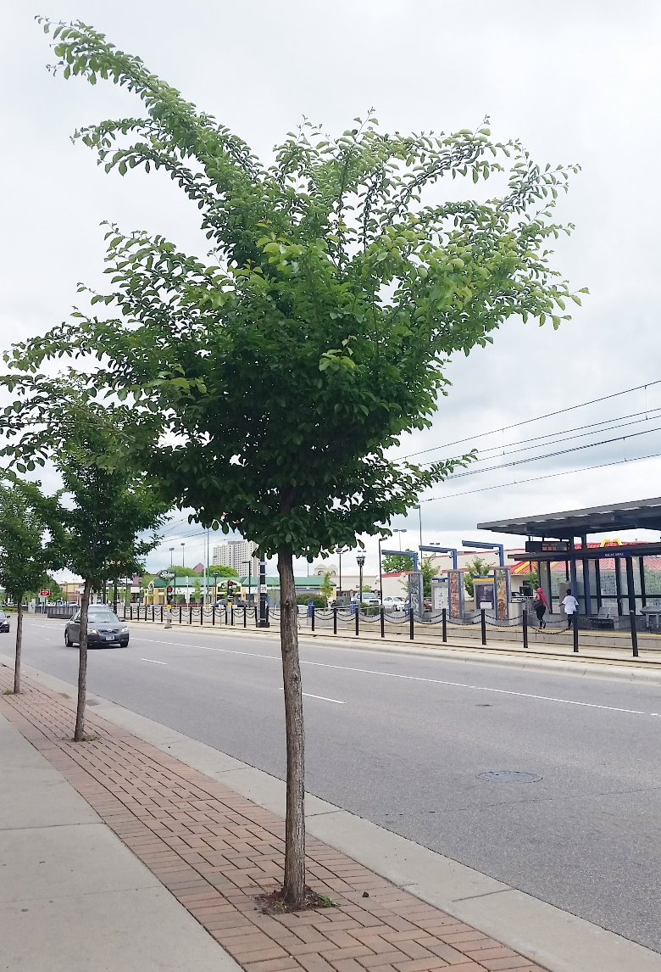
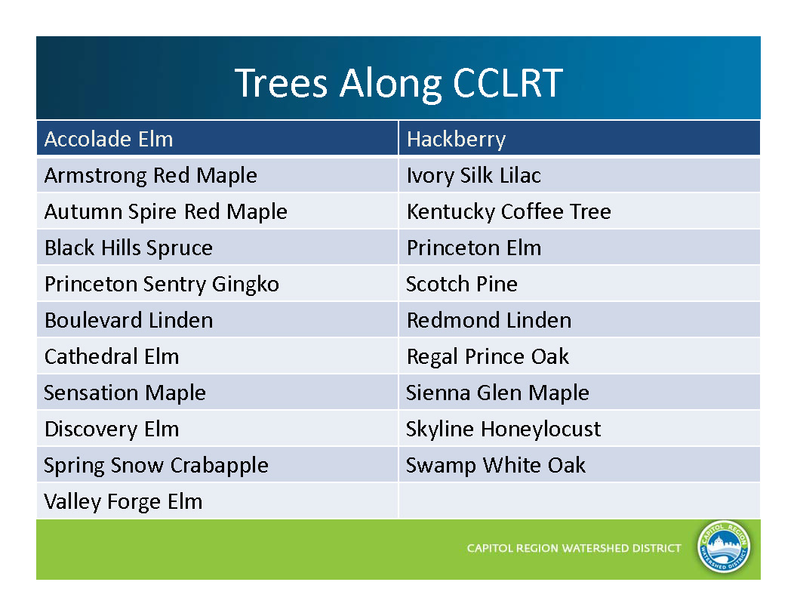
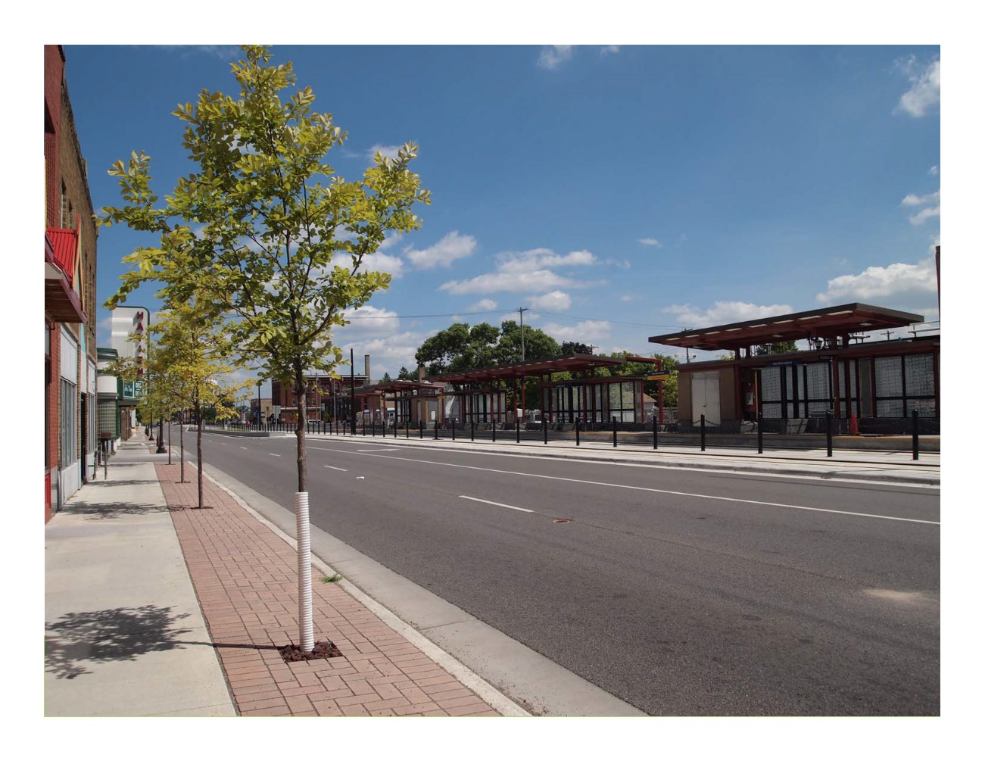
CASE STUDY /
CENTRAL CORRIDOR
2013
2017

Slide 22
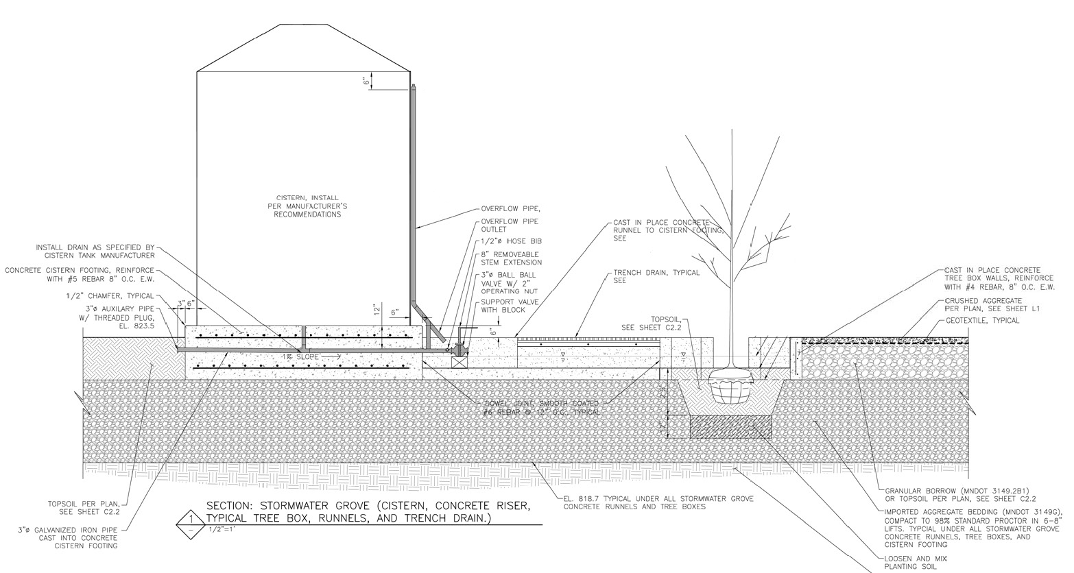
CASE STUDY /
MWMO STORMWATER GROVE
Cistern
Tree opening
Trench Drain
Topsoil
Planting soil
Aggregate bedding

Slide 23
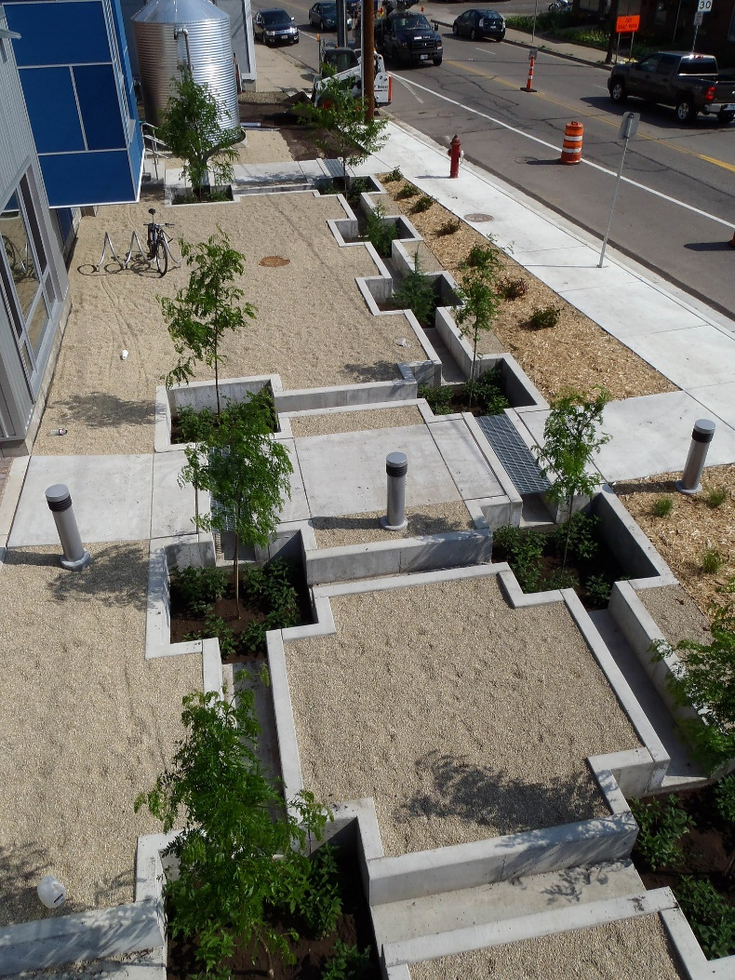
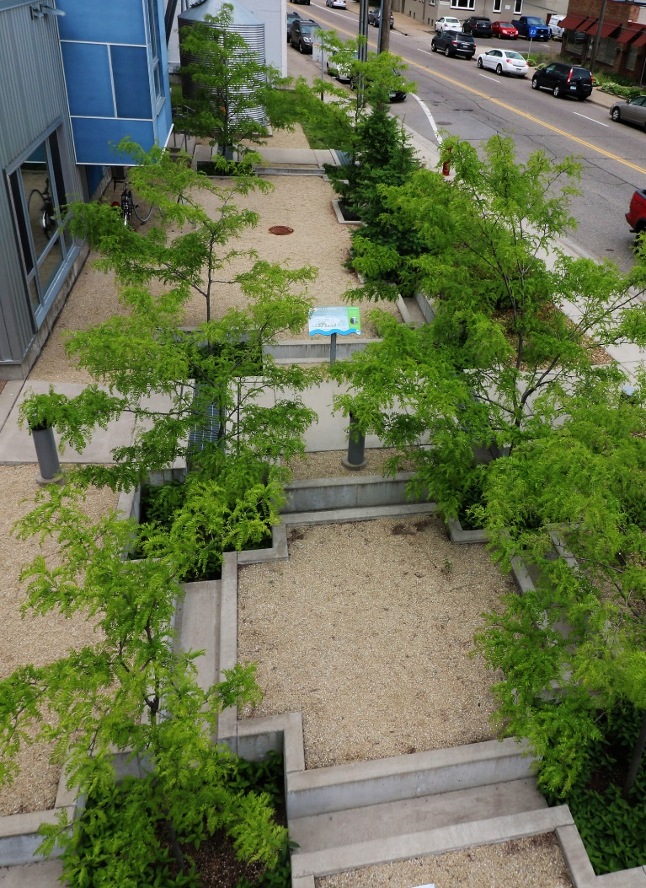
CASE STUDY /
MWMO STORMWATER GROVE
Year constructed: 2012
Inlet type: Sheet flow, overflow from cistern
Drainage area: ~12,000 sf, plus overflow from cistern. 425 cf storage
Number of trees: 12
Media type: Varies
Species: Honeylocust, Swamp White Oak, Tamarack
Outlet type: Infiltration, overflow to raingarden
Irrigation: Can open cistern to water
2012
2017

Slide 24
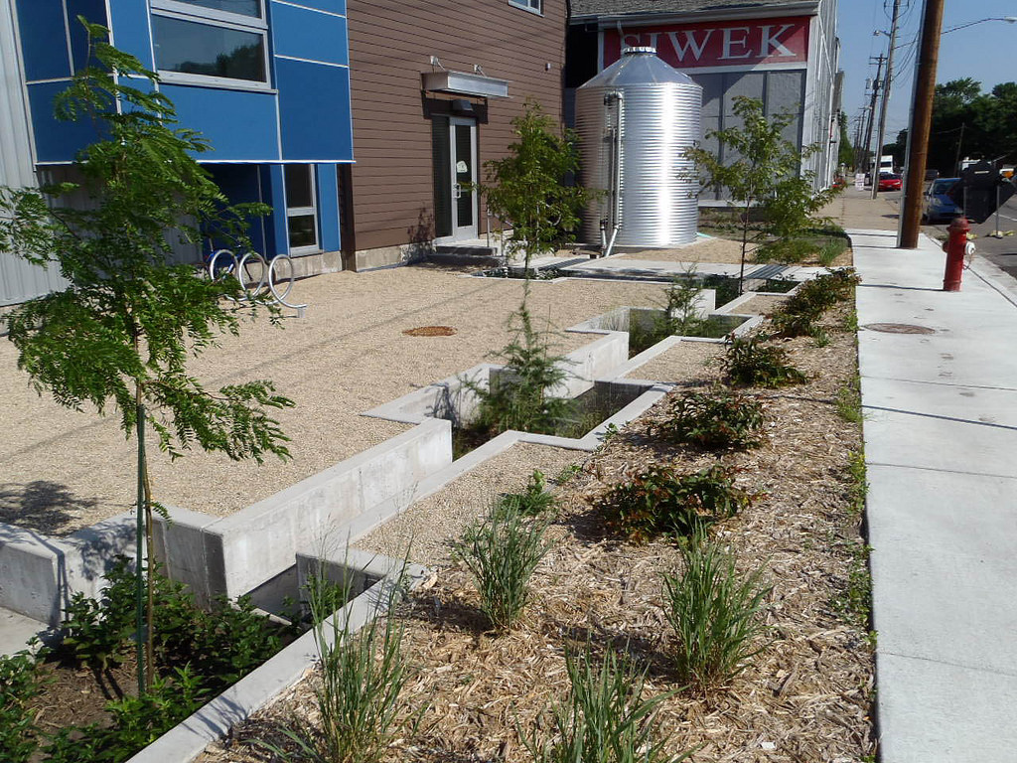
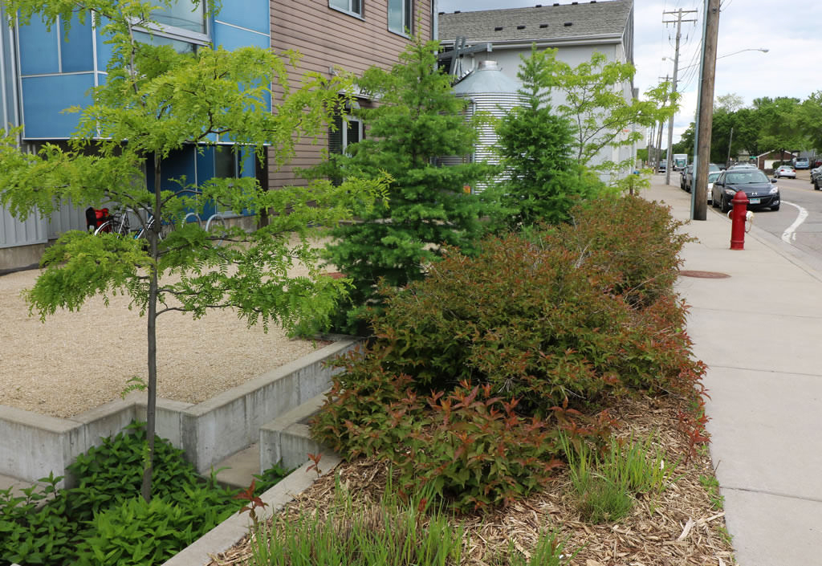
CASE STUDY /
MWMO STORMWATER GROVE
2012
2017
Observations:
We don’t water, only if cistern overflows
Sub soils infiltrate very well
Trees likely rooting into adjacent aggregate

Slide 25
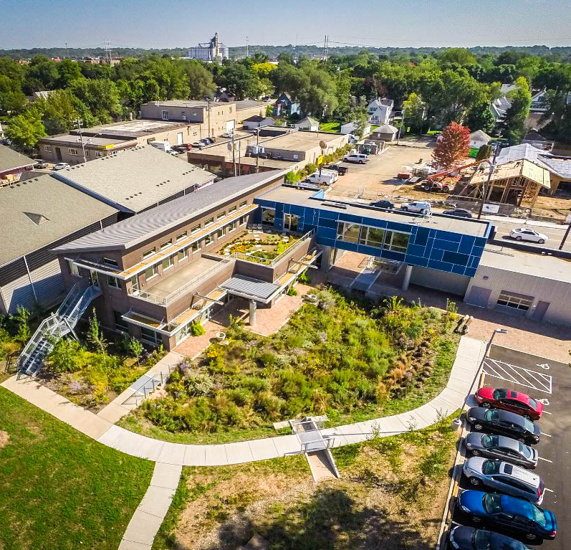
Stormwater Park
MWMO Stormwater Park & Learning Center
Living laboratory of stormwater BMPs
Riverfront access
Tours, exhibits
Northeast Minneapolis
Marcy Bean
Capital Projects & Stewardship Specialist
mbean@mwmo.org 612-746-4979

