Slide 1
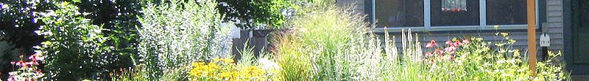
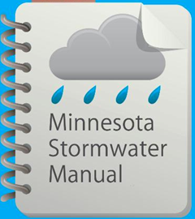


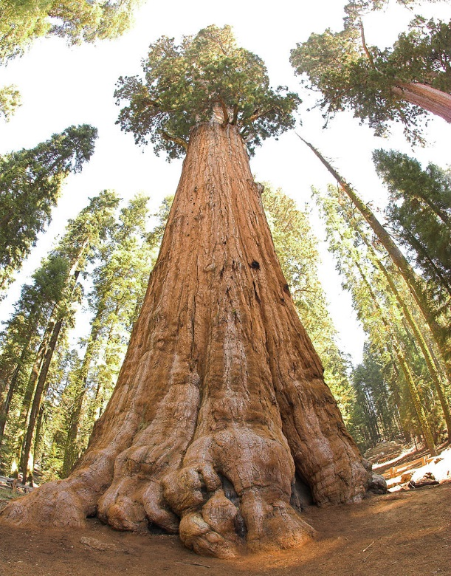

Bioretention from the ground up
May 30, 2017

Slide 2
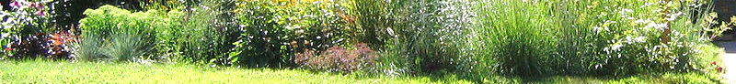
Questions and other stuff
Please use the chat box if you have questions.
We will try and answer during the webinar
All Q&A will be posted in the (page called Stormwater Manual webinars)
Webinar is recorded and will be posted in the manual
This PPoint will be posted in the manual

Slide 3
Professional development hours
1.5 PDHs offered
Access to certificate will be posted on the Stormwater manual webinars page
Notes:
Or will this be a link in the manual for a certificate? Explain that we keep a record of attendees-that’s the only way you can get PDH’s. We have to show proof.

Slide 4
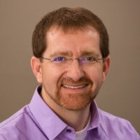
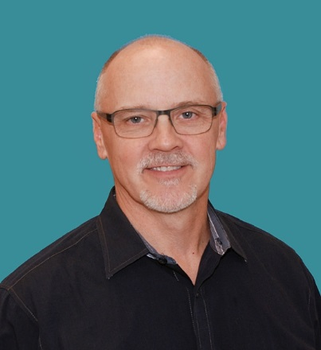
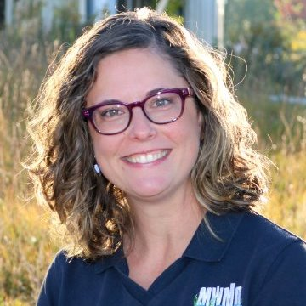
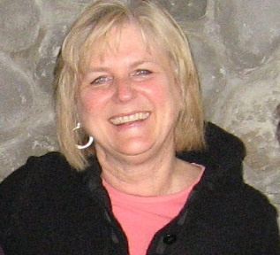
Presenters
Mike Isensee-Administrator, Middle St. Croix Watershed Management Organization
Fred Rozumalski, Registered Landscape Architect- Barr Engineering
Marcy Bean, Professional Landscape Architect-Mississippi Watershed Management Organization
Anne Gelbmann - moderator
Contact information
  Mike.Trojan@state.mn.us
  MN Stormwater Manual – (easier to find with a Google search) http://stormwater.pca.state.mn.us/index.php/Main_Page
Notes:
In reading bios, mention what topic they will be addressing
Mike – media
Fred – vegetation in bioretention
Marcy – tree-based systems

Slide 5
Objectives for today’s webinar
Bioretention media and vegetation - frequently account for failure of bioretention systems
Audience – exposure to information on topics that are often overlooked
MPCA - identify information that needs to be addressed in the MN Stormwater Manual
Notes:
2nd bullet – goal for our audience
3rd bullet – goal for us: we’re here to learn too

Slide 6
Upcoming webcasts - tentative
August, October
Bioretention O&M, Infiltration constraints including infiltration at contaminated sites
Let us know what topics you are interested in

Slide 7
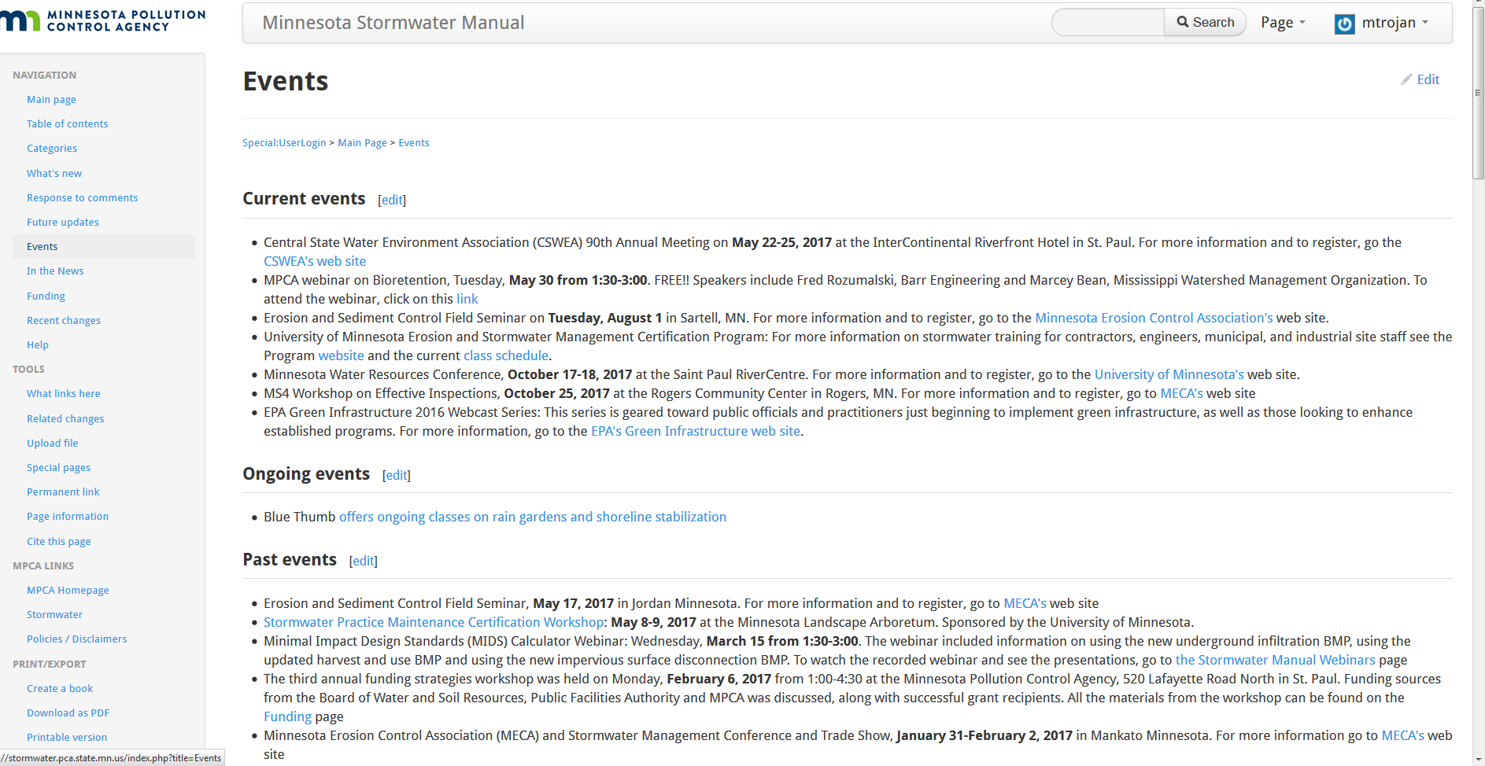

Slide 8
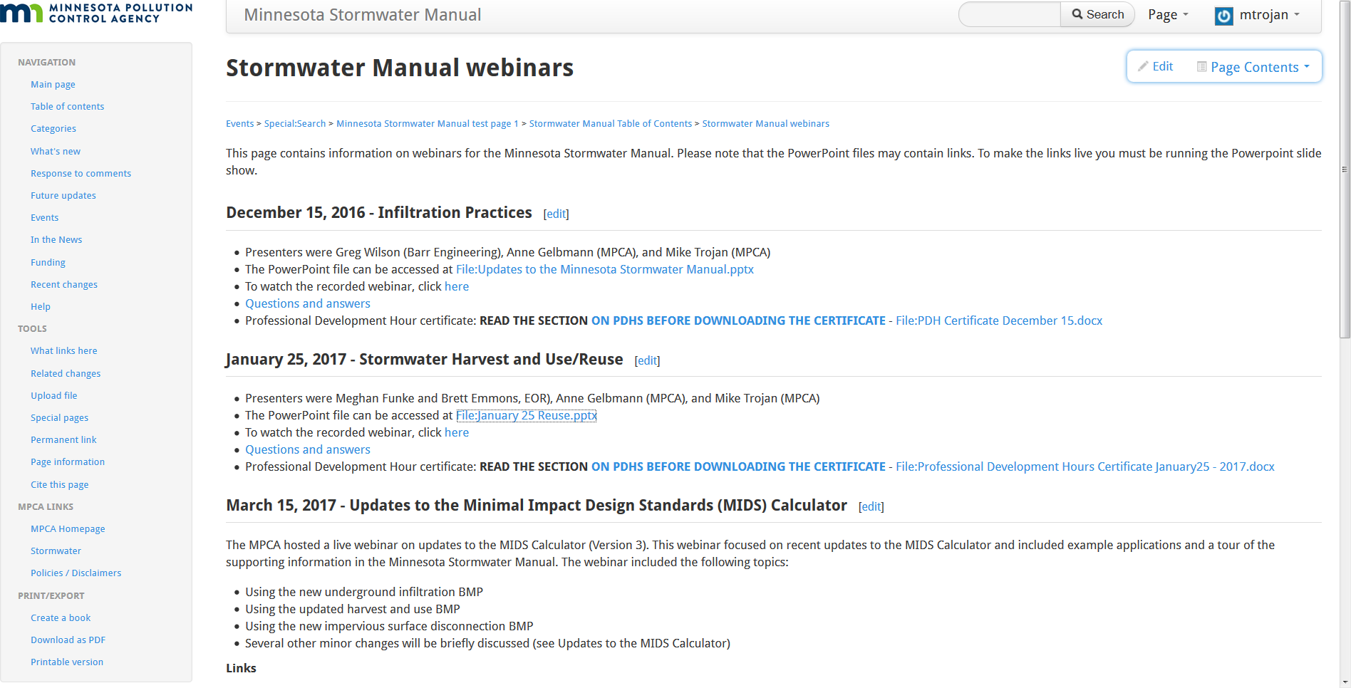
Materials will be posted in the SW Manual
Info on webinar
PowerPoint
Video
Q/A
PDH certificate
Notes:
Google search Stormwater Manual webinars

Slide 9
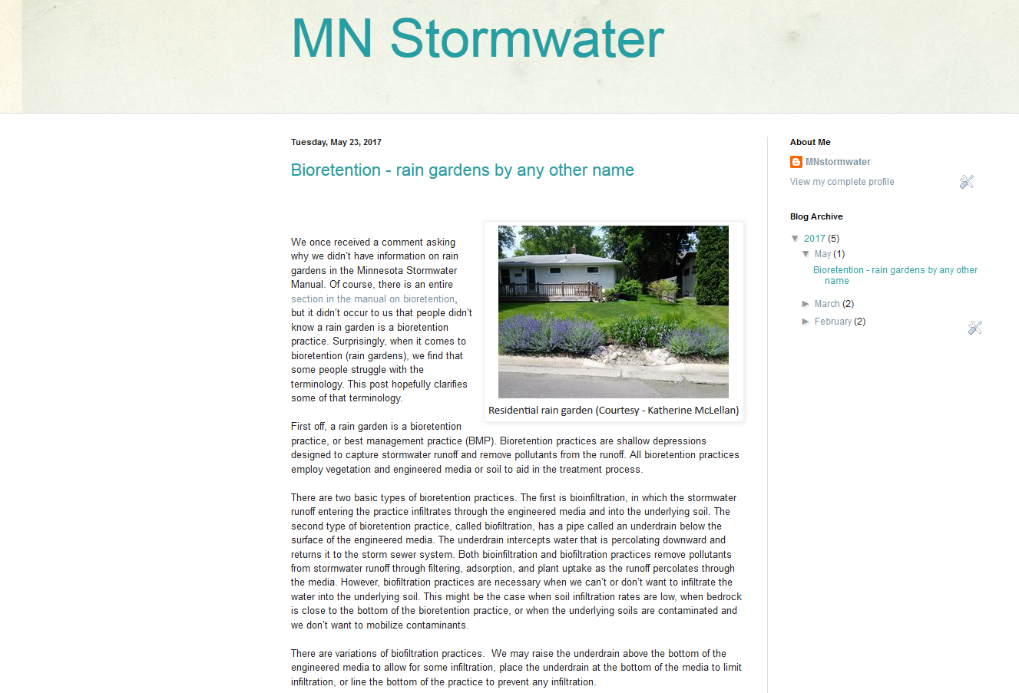
Visit our blog (MNStormwater) and give us a call if you want to post something in the blog
Notes:
Google search Stormwater Manual webinars

