Slide 1
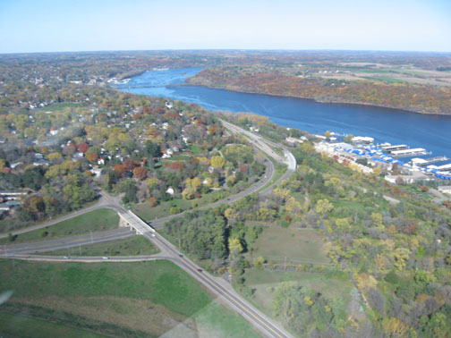


Bioretention media
Mike Isensee, CPESC
Middle St. Croix WMO
Washington Conservation District
Mike Isensee, CPESC
Middle St. Croix Watershed Management Organization
Washington Conservation District

Slide 2

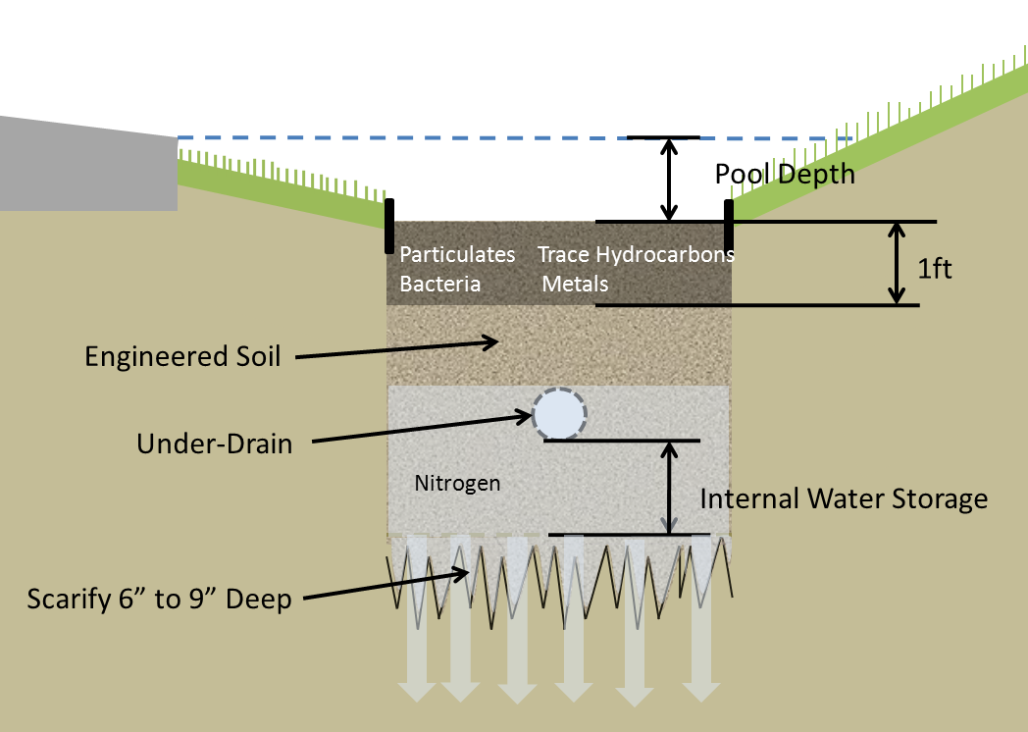
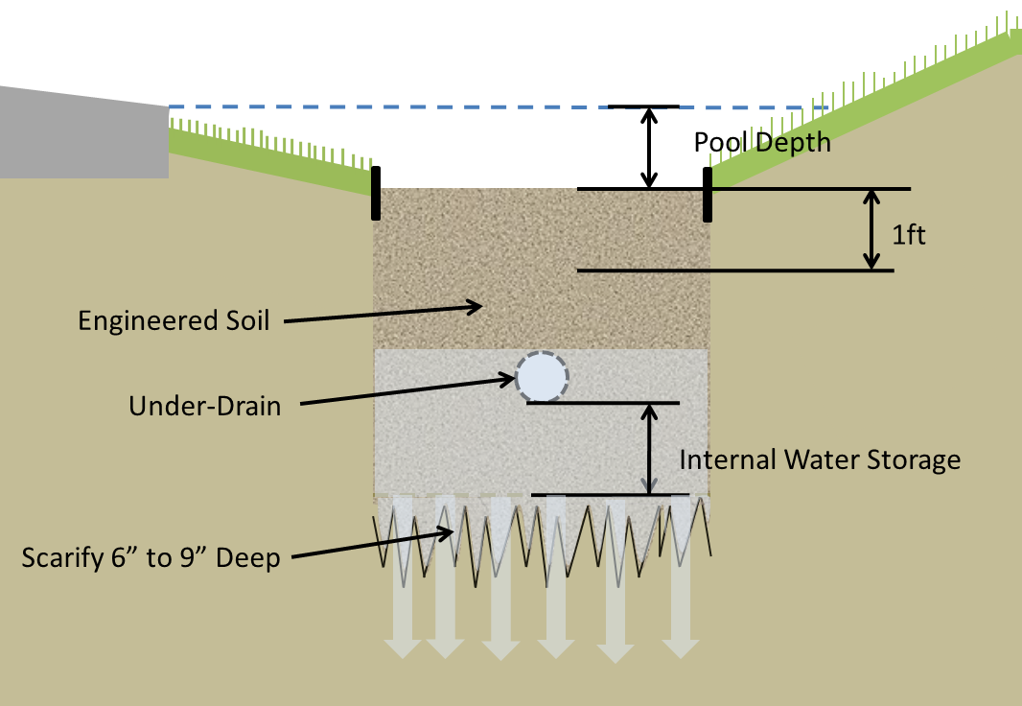

Slide 3
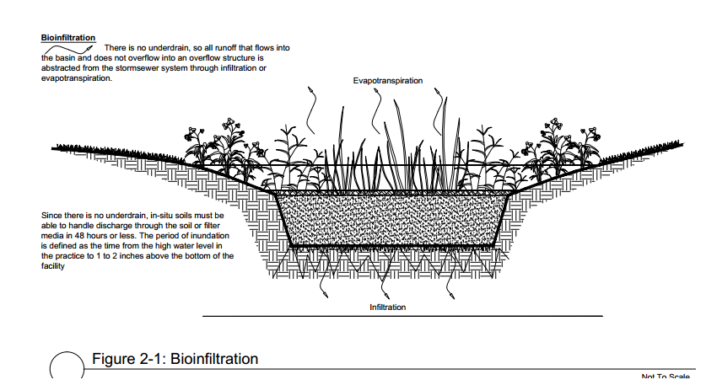
Infiltration –Use Compost

Slide 4
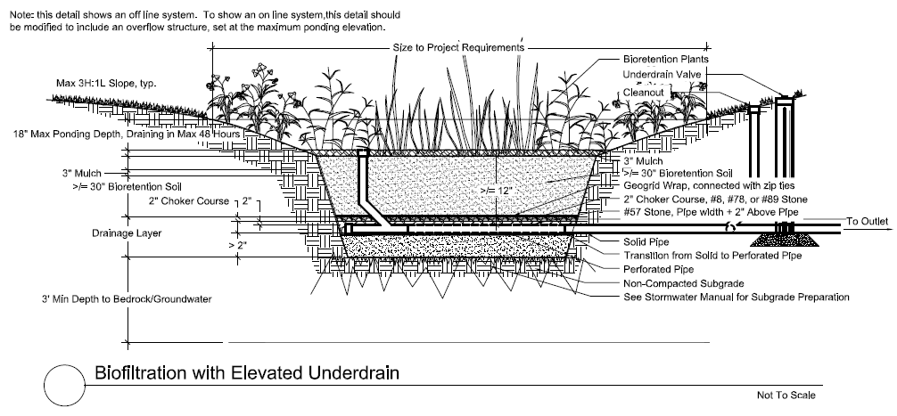
Filtration with Most Infiltration Credit (per MIDS Calculator)

Slide 5
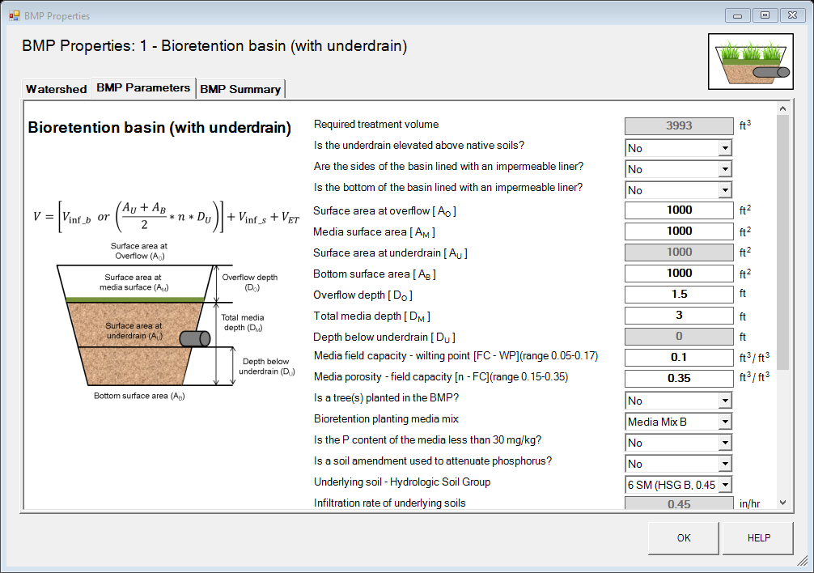
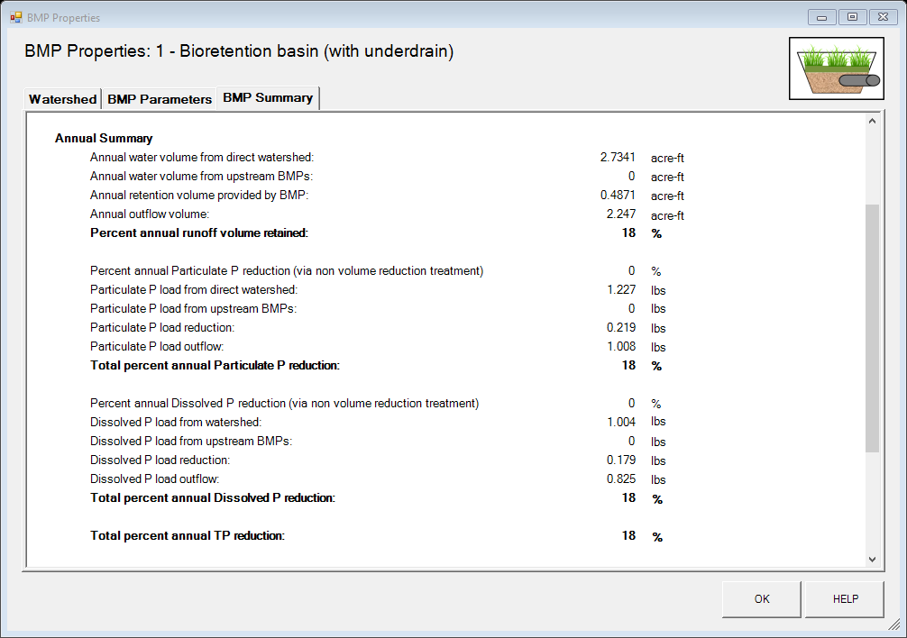



Slide 6
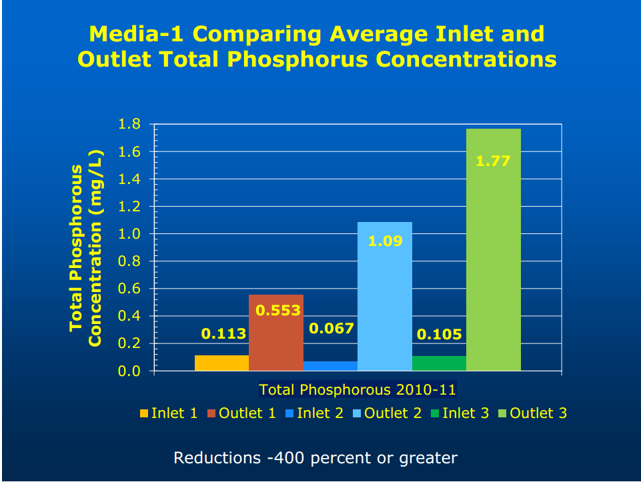
Engineered Media
P
P
P
P
P
P
P
P
Compost
P
P
P
P
P
P
P
Bannerman 2013

Slide 7
Engineered Media
1.Ensure Media Mixture to a P content between 12-30 mg/kg (and supports vegetation).
2. Incorporate a soil amendment to facilitate absorption of P (and does not kill vegetation).

Slide 8
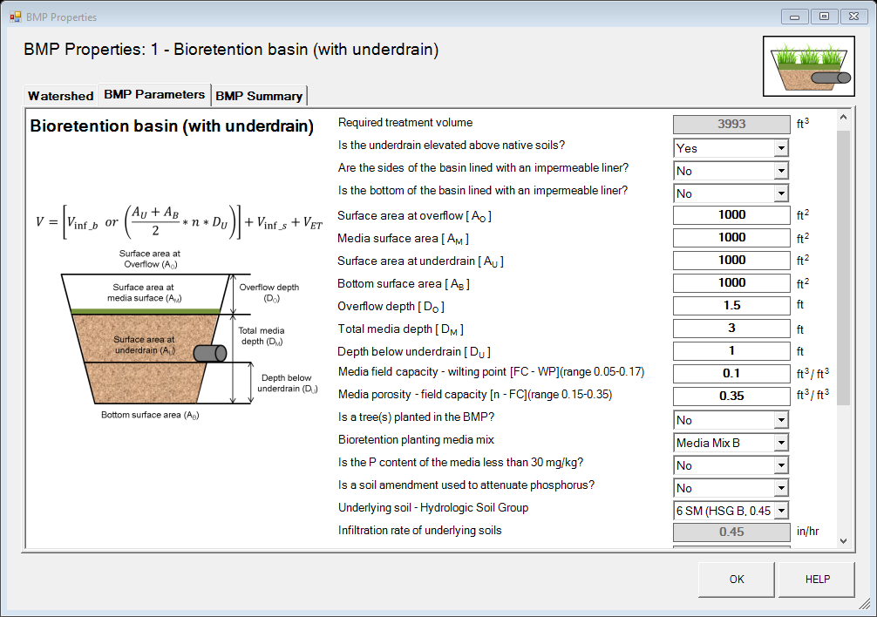

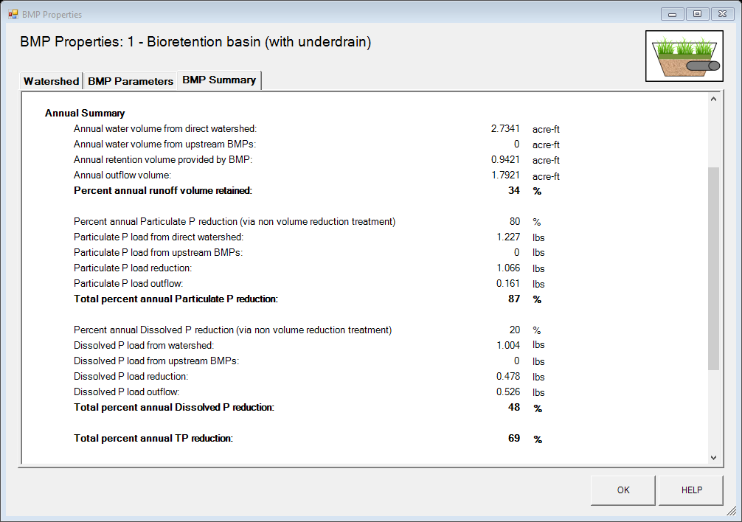

Slide 9
MN Stormwater Manual Mixes
 | Mix A: Water quality blend | Mix B: Enhanced filtration blend | Mix C: NC State water quality blend | Mix D | Mix E: MnDOT 3877.2 Type G 'Filter Topsoil Borrow' | Mix F: Custom Infiltration Basin Planting Soil
Fine aggregate for Portland Cement Concrete |  |  |  |  | 60-80%
Construction Sand | 55-65% | 50-70%
Sand |  |  | 85-88% | 60-75%
Loamy Sand |  |  |  |  |  | 75%
Topsoil | 10-20%
Silt and Clay |  |  | 8-12%
Organic Matter | 25-35% | 30-50% | 3-5%
MnDOT grade 2 compost |  |  |  | 20-40% | 20-40% | 25%
Growing media must be suitable for supporting vigorous growth of selected plant species.
The pH range (soil/water 1:1) is 6.0 to 8.5
Soluble salts (soil/water 1:2) should not to exceed 500 parts per million
All bioretention growing media must have a field tested infiltration rate between 1 and 8 inches per hour.

Slide 10
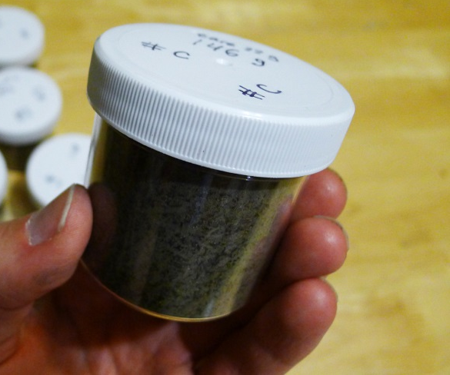
Required Testing
Soil media test results and a soil sample must be submitted at least 14 days prior to material delivery.
Analysis | ($) | Standard Turnaround Time | Sample Amount Needed
9045 pH Soil | 21 | 4 Hours | 50 grams
ASTM D2974 Organic Matter | 42 | 2 Days | 50 grams
Phosphorous (Bray) | 75 | 2 Days | 60 grams
365.1 Total Phosphorous | 32 | 2 Days | 20 grams
CEC | 93 | 3 Days | 200 grams
Grain Size | 177 | 5 Days | 200 grams

Slide 11
Date | Media | Olsen P | Bray P | Melich3
 |  | ppm | ppm | ppm
9/1/2015 | 60/40 Sand/Peat | 22 | 26
9/15/2015 | 60/40 Sand/Peat |  | 10
6/9/2015 | 70/30 Sand/Sphag. Peat |  |  | 6
6/1/2015 | 80/20 Sand/Sphag. Peat |  |  | 12
6/1/2015 | 70/30 Sand/Sphag. Peat |  |  | 6
6/1/2015 | 80/20 Sand/Compost |  |  | 68
6/1/2015 | 70/30 Sand/Compost |  |  | 114
4/1/2014 | 70/30 Sand/Compost |  | 66
4/1/2014 | 70/30 Sand/Reed Sedge Peat |  | 12
4/1/2014 | 70/30 Sand/Sphag. Peat |  | 11
7/1/2013 | 60/40 Sand/Sphag. Peat |  |  | 10

Slide 12
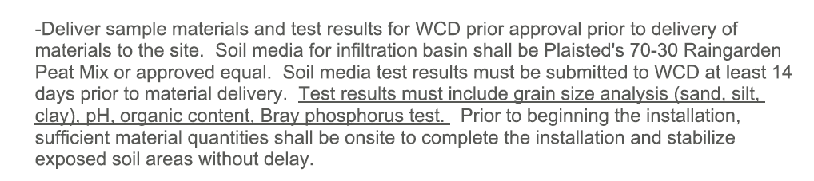
Current Standard
70/30 Sand/Sphagnum Peat
Test Results Required

Slide 13
1.Ensure Media Mixture to a P content between 12-30 mg/kg (and supports vegetation).
2. Incorporate a soil amendment to facilitate absorption of P (and does not kill vegetation).

Slide 14

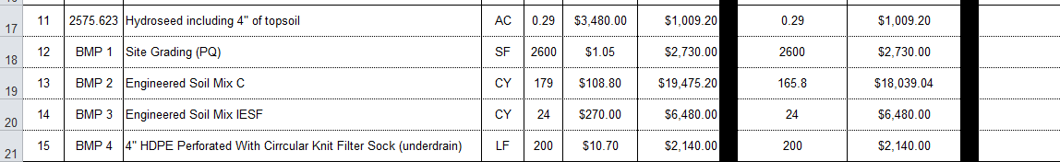
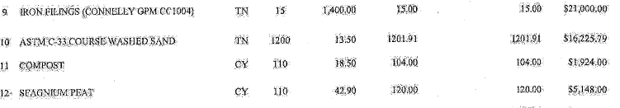
Iron Enhanced Sand
95% ASTM C-33 Coarse Wash Sand and 5% Iron Aggregate by weight (1,485 lbs. Connelly GPM Inc., ETI CC 1004 or approved equal).

Slide 15
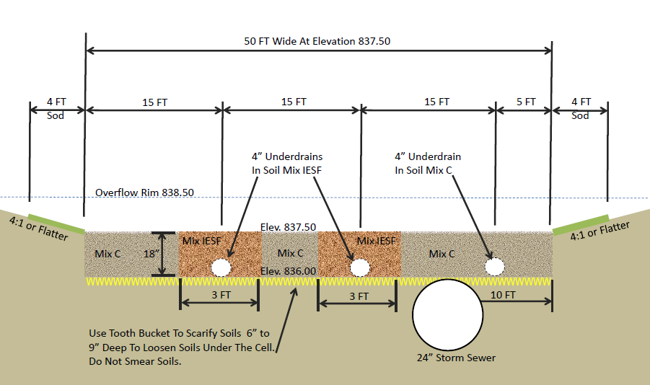
Key Design Considerations
IESF is Exposed to the Air
Extra Underdrain (w/ gate valve)

Slide 16
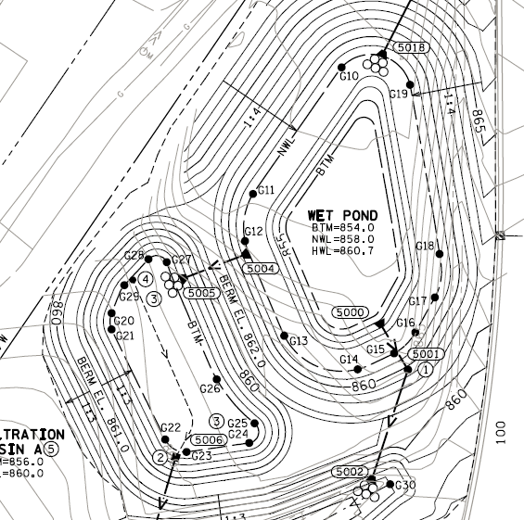
Key Design Considerations
High Flow Bypass
Maximize filtration prior to discharge to the IESF
Iron Sand Filter

Slide 17
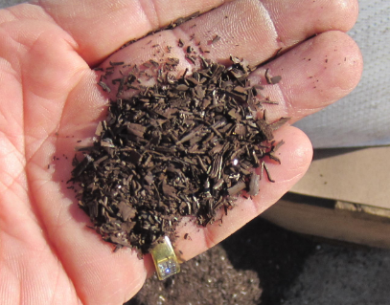
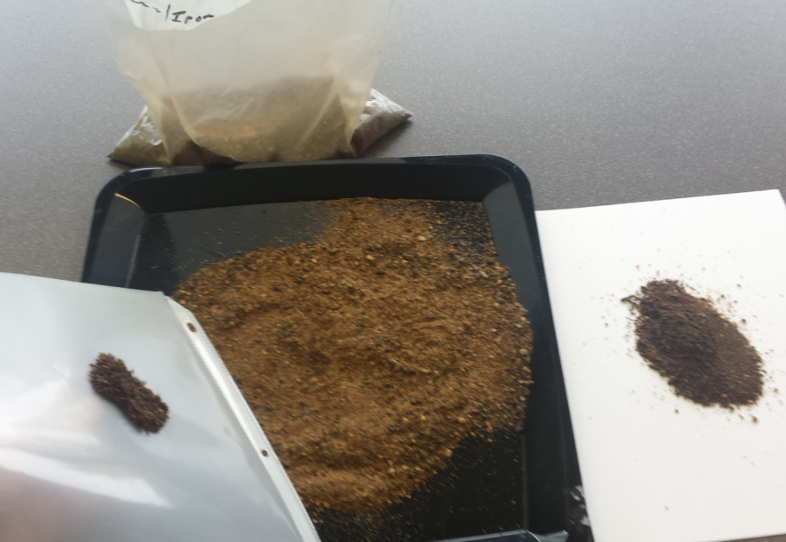
Quality Control
5% Iron filings (dry weight)?
Oven Dry
1,000 Gram Media Sample (approximately 2 cups)
Separate the sample with a magnet
Weigh abstracted Iron
Repeat
Iron
Sand & Iron
Magnet
& Iron
Iron

Slide 18
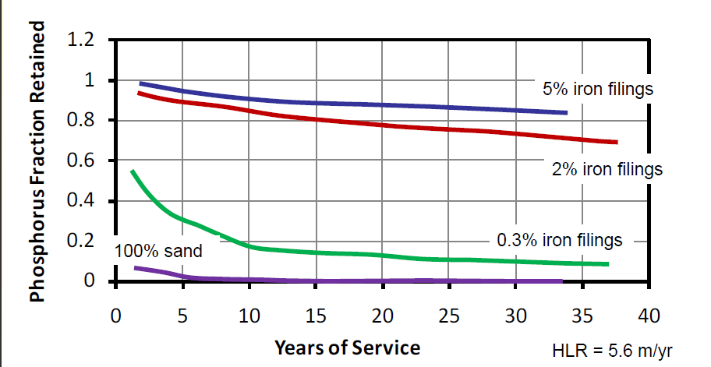
Erickson, A.J., J.S. Gulliver, and P.T. Weiss. 2007. "Enhanced sand filtration for storm water phosphorus removal, Journal of Environmental Engineering." 133 (5): 485-497.
Erickson, A.J., J.S. Gulliver, and P. T. Weiss. 2012. “Capturing Phosphates with Iron Enhanced Sand Filtration,” Water Research, 46(9), 3032–3042.

Slide 19
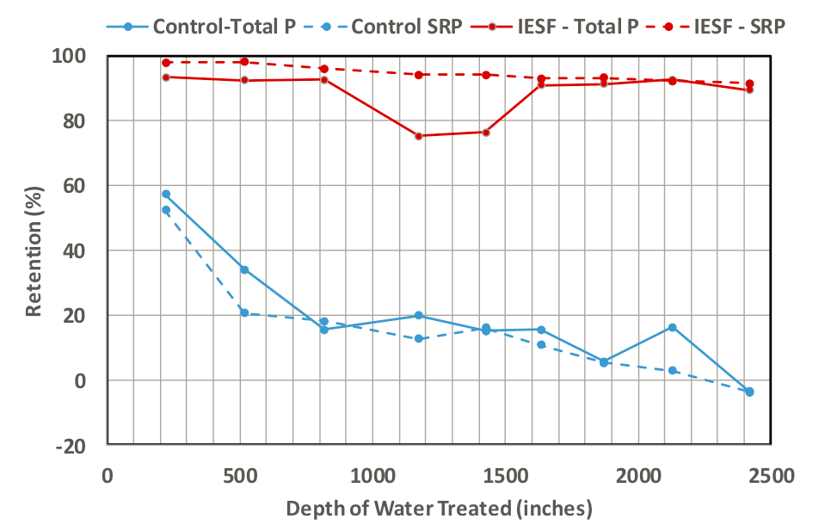
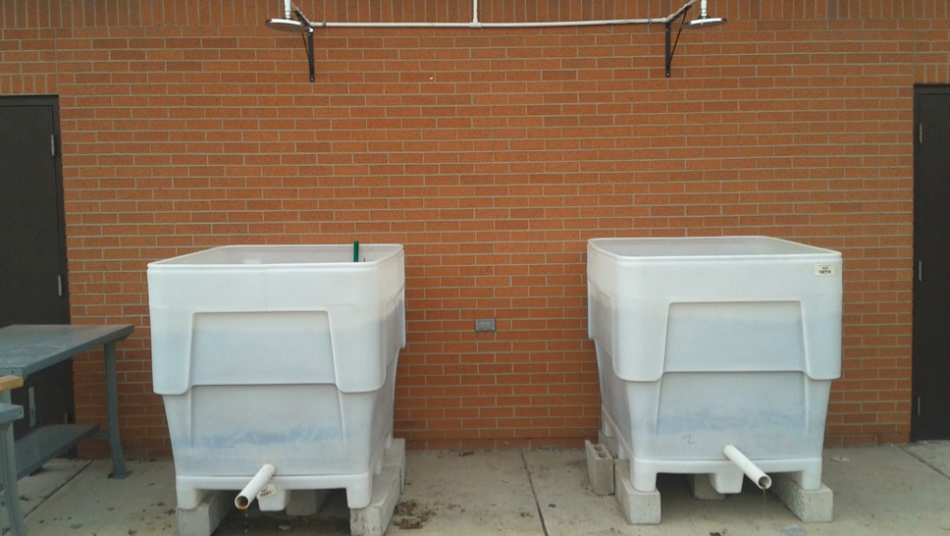
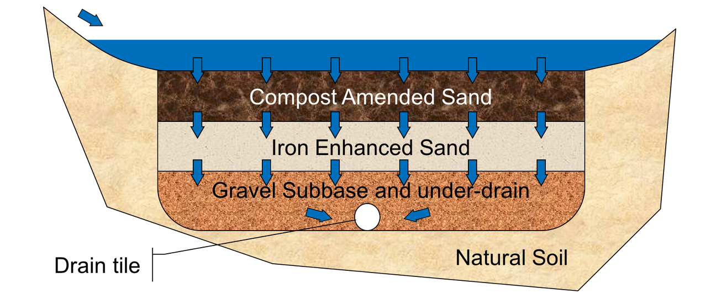
Weiss, P., Aljobeh, Z., Bradford, C., and Breitzke, E. (2016) An Iron-Enhanced Rain Garden for Dissolved Phosphorus Removal. World Environmental and Water Resources Congress 2016: pp. 185-194. doi: 10.1061/9780784479889.020

Slide 20
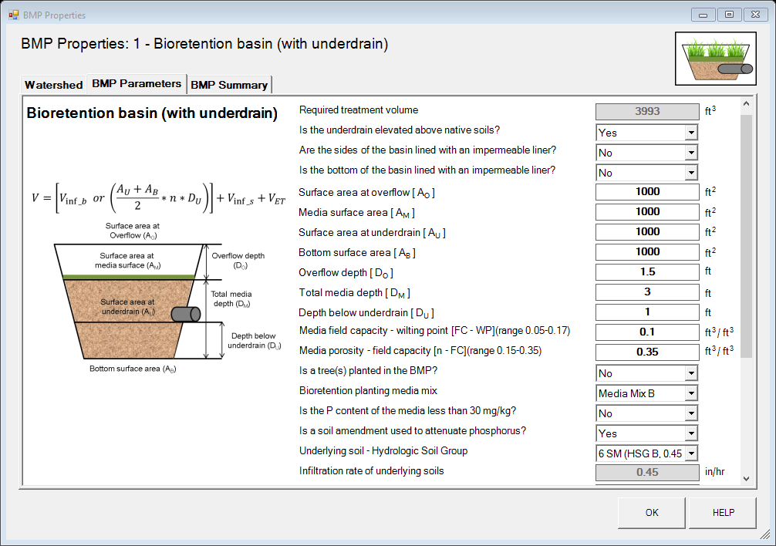


Slide 21



Slide 22
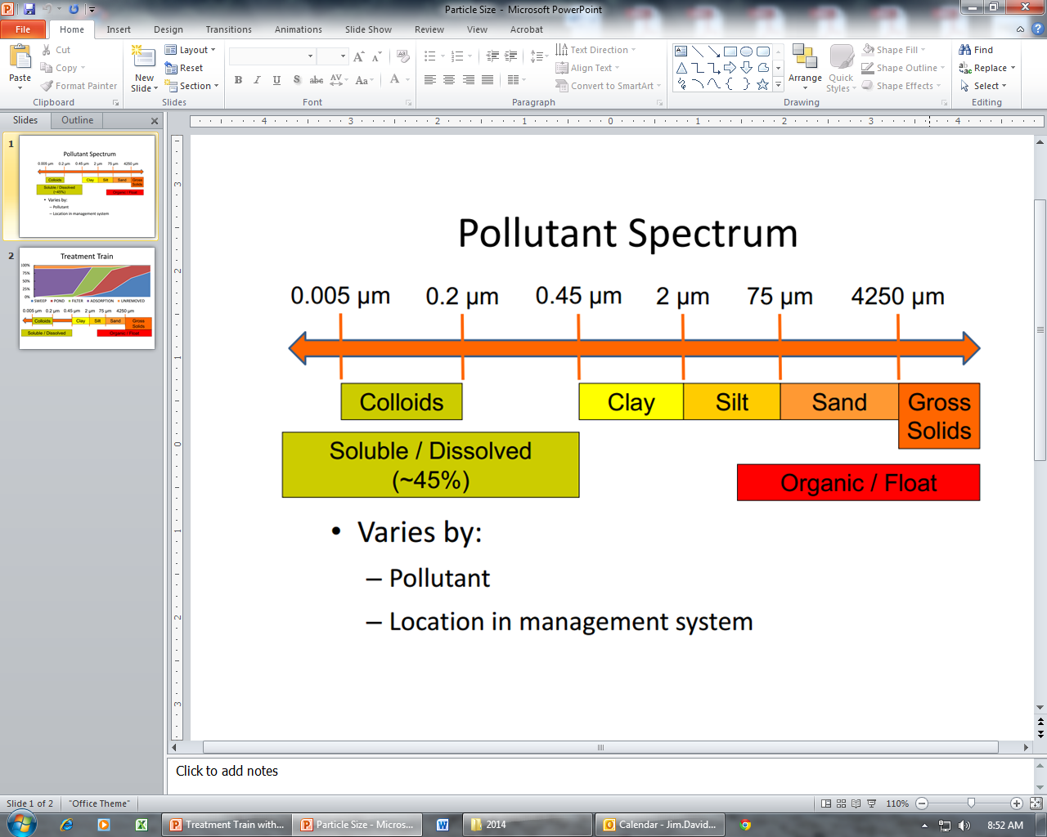
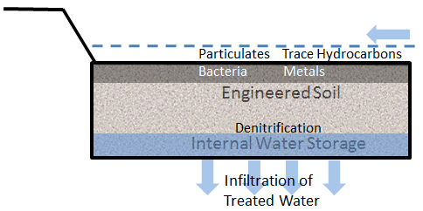


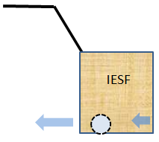
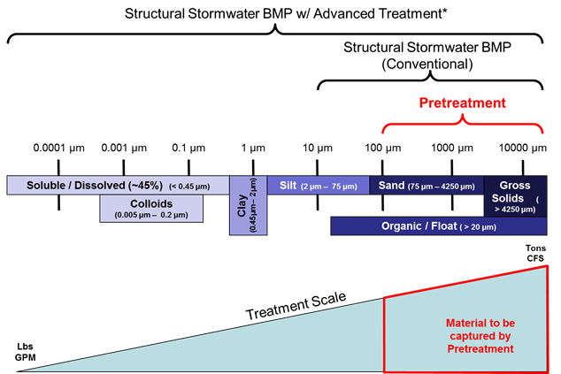
Targeting Stormwater Pollutants
Chemical
Sorption
Biological
Filtration
Bacterial Degr.
Settling
Physical
Infiltration
Sump
Forebay
Pond
Weeper
Weir
Skimmer
Bioretention Cell
Reactive Sand Filter

Slide 23
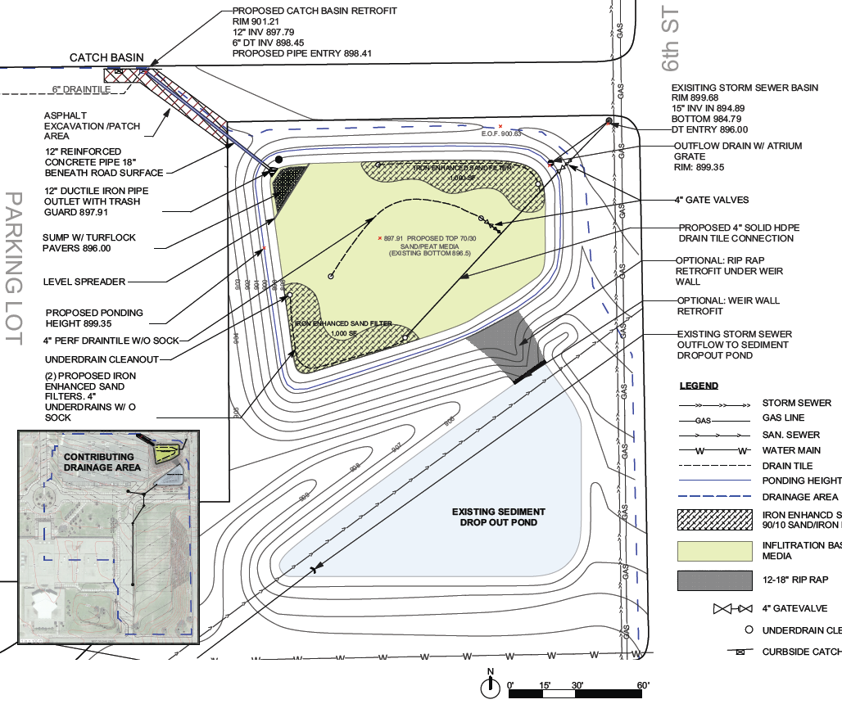
Lake St. Croix 2017
12.75 Acres Total Watershed
1,440 cubic feet IESF
Binding capacity 40 lbs.
Total Annual Load = 12.46 lbs. P
Annual Dissolved P Reduction = 2.1 lbs. P
City of Stillwater 2017 Eng. Estimate $96,000

Slide 24
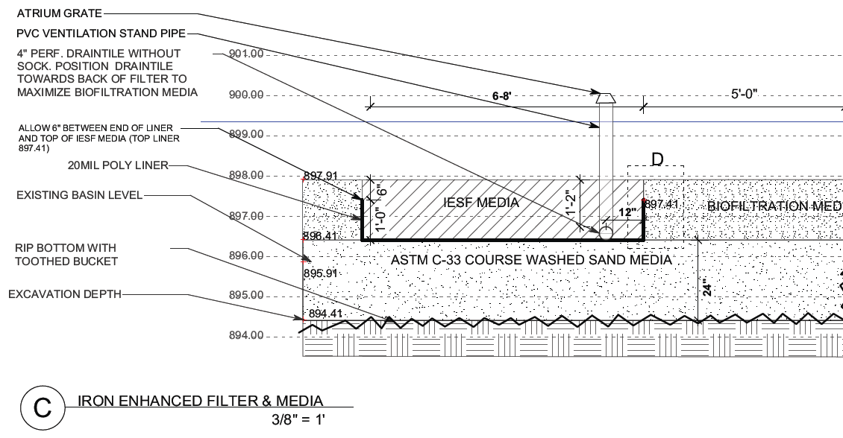
Engineered Media

Slide 25



Questions?
Mike Isensee, CPESC
Administrator MSCWMO
misensee@mnwcd.org
Thank You!
Andy Erickson, Researcher, St. Anthony Falls Laboratory, University of Minnesota
Bryan Pynn, Senior Water Restoration Technician
Jim Davidson, CPSWQ, CPESC, Urban Conservationist
Curt Coudron, CPESC, Senior Resource Conservationist
New Bioretention
Media Mixes &
testing standards
Mike Isensee, CPESC
Watershed Specialist
misensee@mnwcd.org

