Slide 1
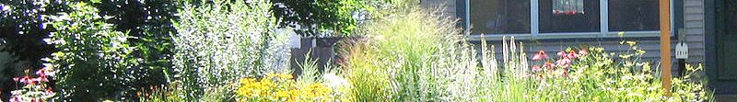
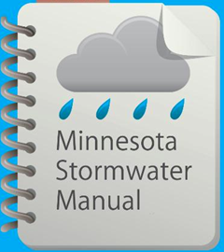



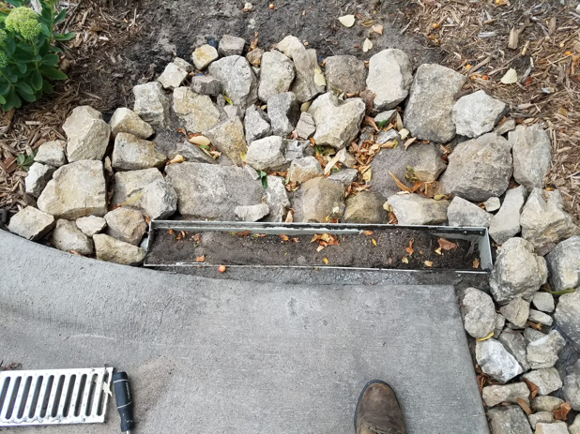
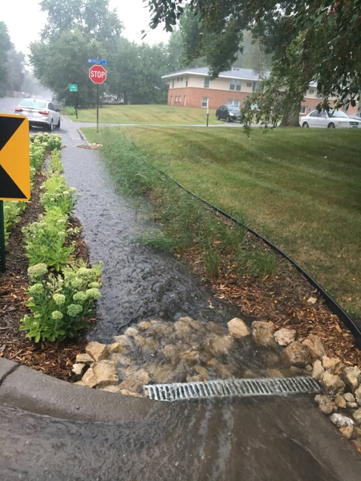
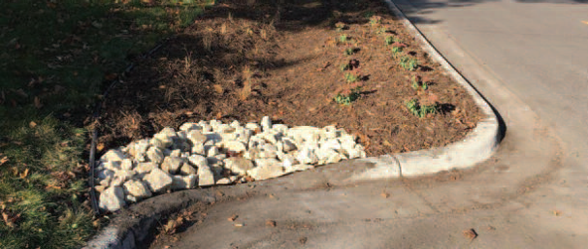
Minnesota Stormwater Manual updates on Stormwater Pretreatment Practices
June 18, 2019
Images courtesy, City of Fridley

Slide 2
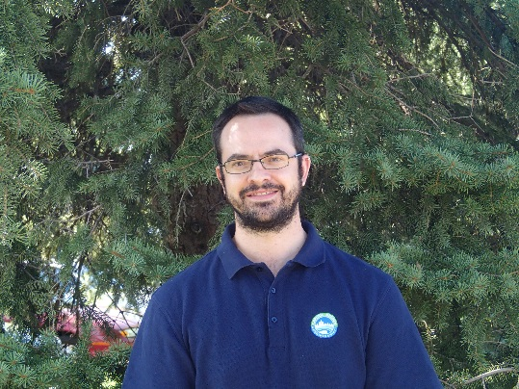
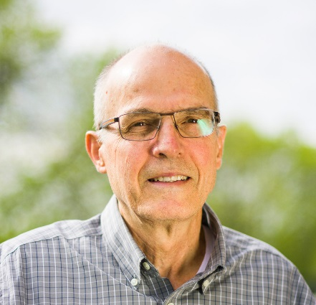
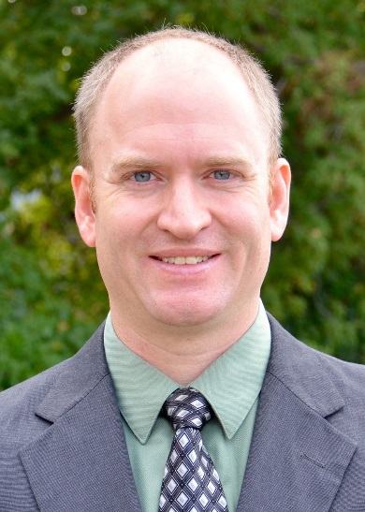

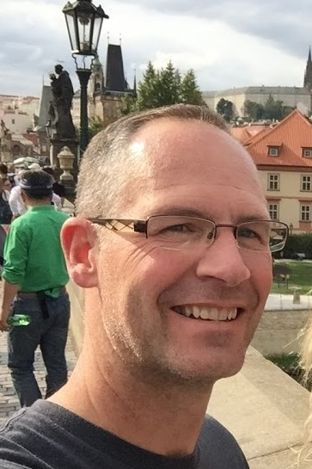
Presenters
Forrest Kelley, P.E., Capitol Region Watershed District
Dr. John Gulliver - St. Anthony Falls Laboratory; University of Minnesota
Dr. Andy Erickson - Research Associate; St. Anthony Falls Laboratory; University of Minnesota
Katy Thompson, P.E., Respec
Dr. Scott Struck, Geosyntec
Mike Trojan – moderator and Intro
Contact information
  Mike.Trojan@state.mn.us
  MN Stormwater Manual – (easier to find with a Google search) http://stormwater.pca.state.mn.us/index.php/Main_Page

Slide 3
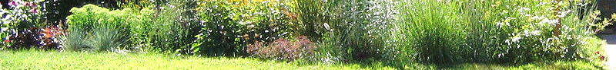
Questions and other stuff
Please use the chat box if you have questions
We will try and answer during the webinar
All Q&A will be posted in the page called Stormwater Manual webinars
Webinar is recorded and will be posted in the manual
This PPoint will be posted in the manual

Slide 4
Professional development hours
1.5 PDHs offered
Access to certificate will be posted on the Stormwater manual webinars page

Slide 5
Topics for today’s webinar
Local perspective on pretreatment – Forrest Kelley
Pretreatment filter strips – Dr. Erickson
Pretreatment practices – Dr. Struck
Pretreatment selection tool – Dr. Struck
Pretreatment sizing recommendations – Dr. Gulliver
Pretreatment case studies – Katy Thompson

Slide 6
Thanks to our Tech Team members
Jesse Carlson – City of Savage
Jon Lennander – City of Fridley
Ross Bintner – City of Edina
Joe Mulcahy – Metropolitan Council
Noah Czech – City of St. Cloud
Forrest Kelley, Capitol Region Watershed District
Haley Bauer (MPCA Project Manager)

Slide 7
Why Pretreatment?
Pretreatment reduces maintenance frequency, severity and cost
Inadequate pretreatment a likely cause of poor performance by primary BMP
Pretreatment information in the Manual was lacking

Slide 8
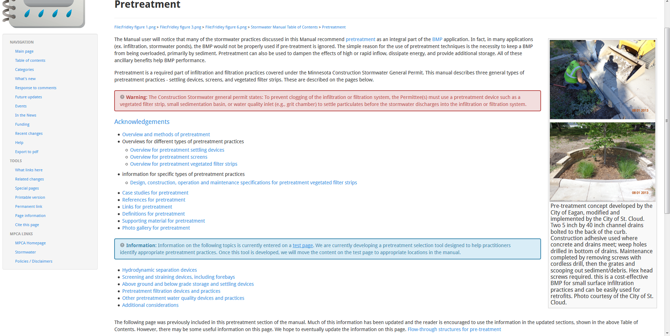
In the Manual – do a Google search on Pretreatment
NOTE: Current work order ends July 1

Slide 9
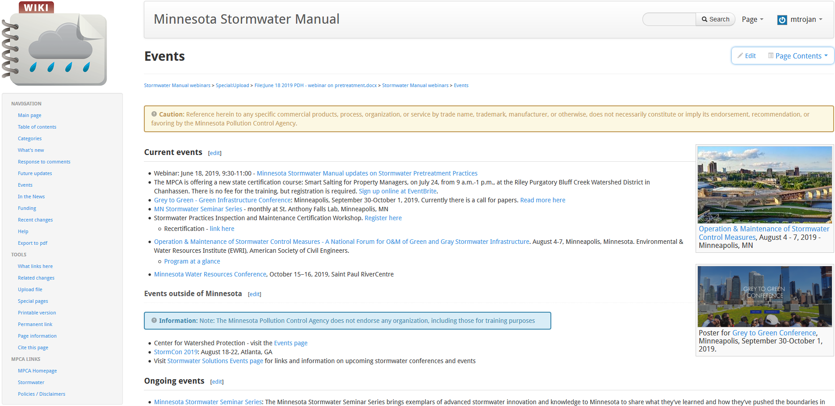

- What’s New
- Future updates
- Events

Slide 10
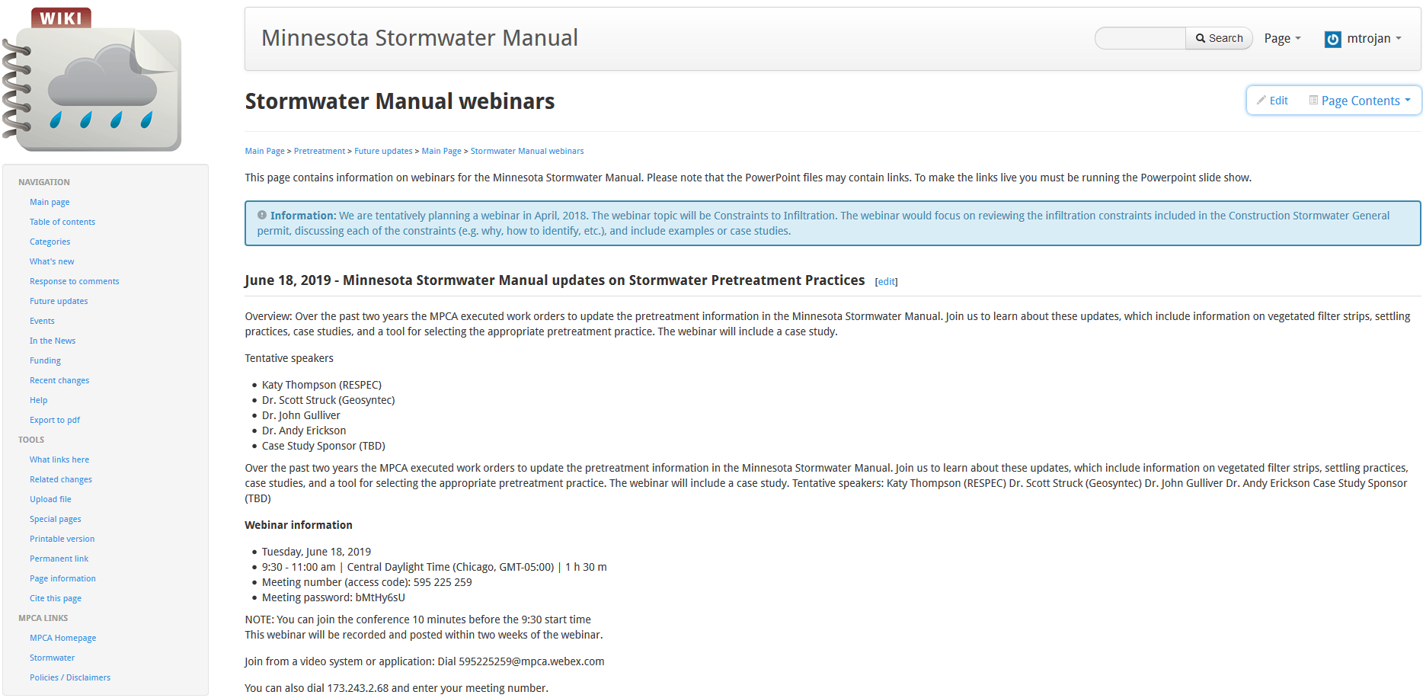
Materials will be posted in the SW Manual
Info on webinar
PowerPoint
Video
Q/A
PDH certificate
Note: past webinars are also posted on this page

