Slide 1
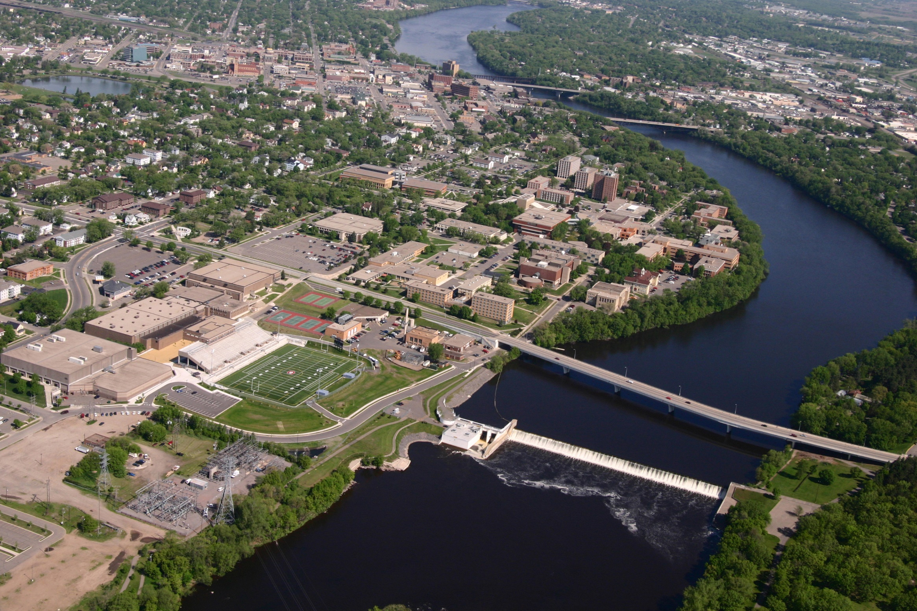

Pretreatment practices
Selection implementation maintenance
Noah Czech > Stormwater Compliance Specialist
noah.czech@ci.stcloud.mn.us
ST. CLOUD GREATER

Slide 2
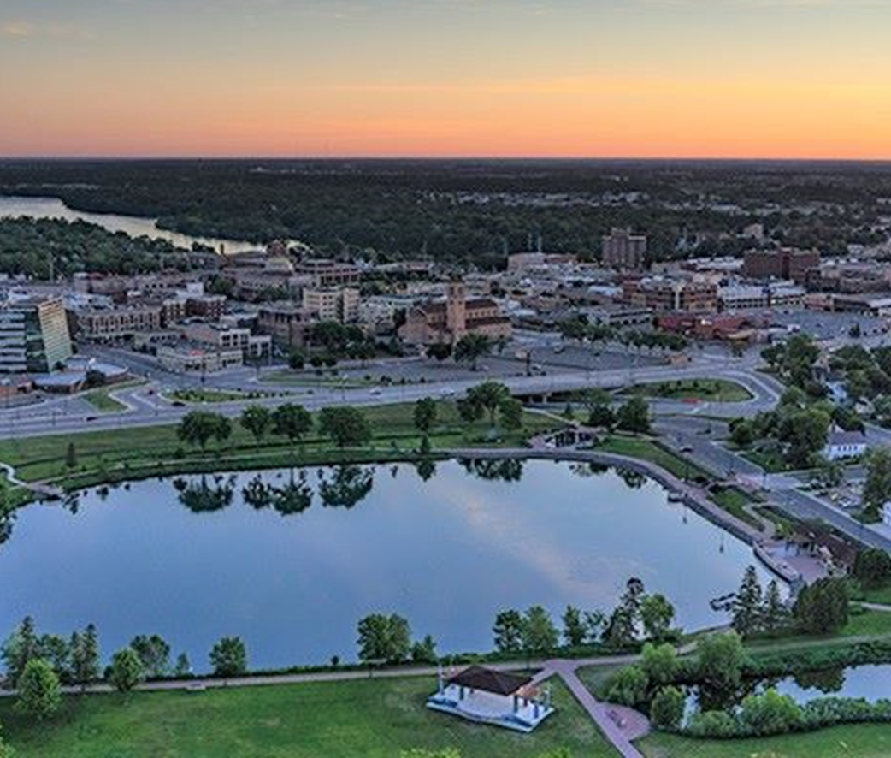
Pre-Treatment Considerations
What is the pre-treatment protecting
Cost-benefit considerations
Watershed characteristics
Design for maintenance
Set pre-treatment goals
Expected pollutants
Drainage Area
Observations
SW Manual
Practices used to reduce, eliminate, or alter pollutants in stormwater, primarily sediment, before they are discharged into structural stormwater BMPs. Pretreatment practices include settling devices, screens, and pretreatment vegetated filter strips.

Slide 3
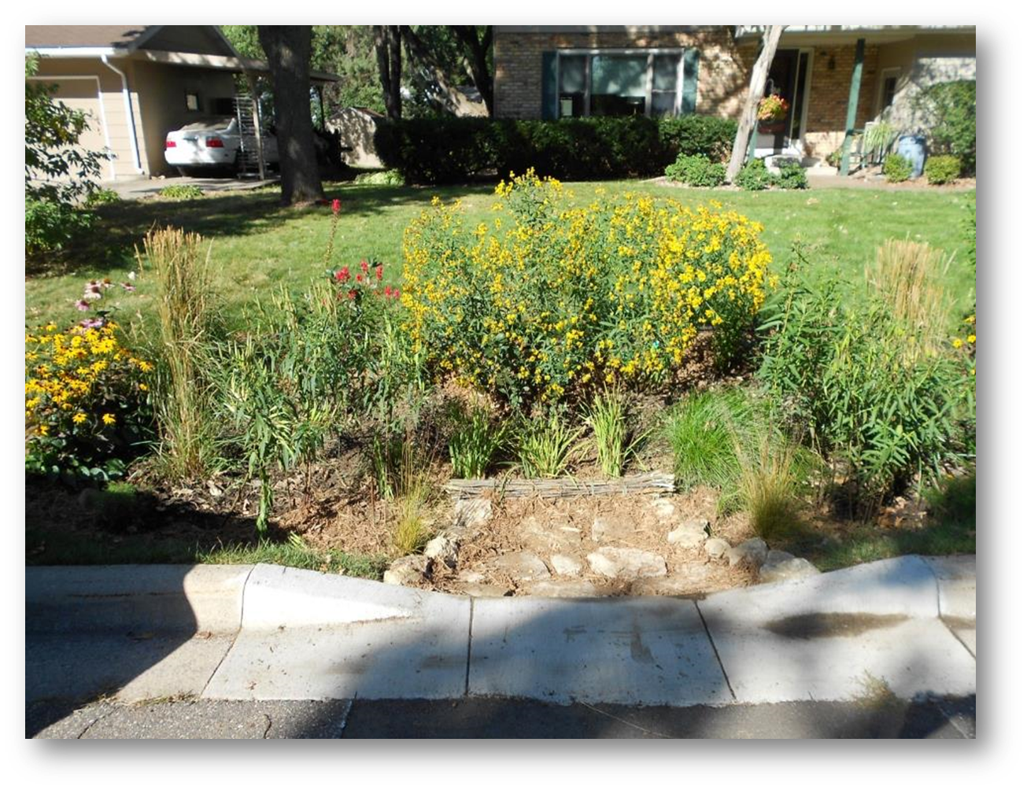
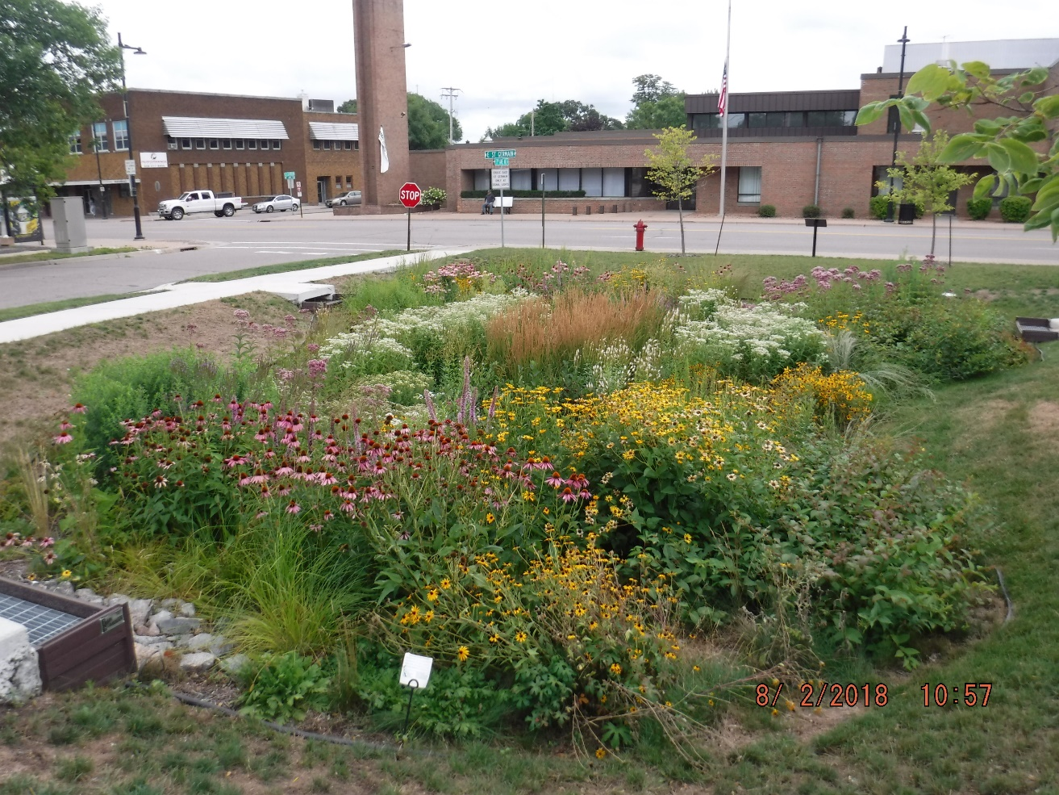


212 Surface Infiltration Systems

Slide 4
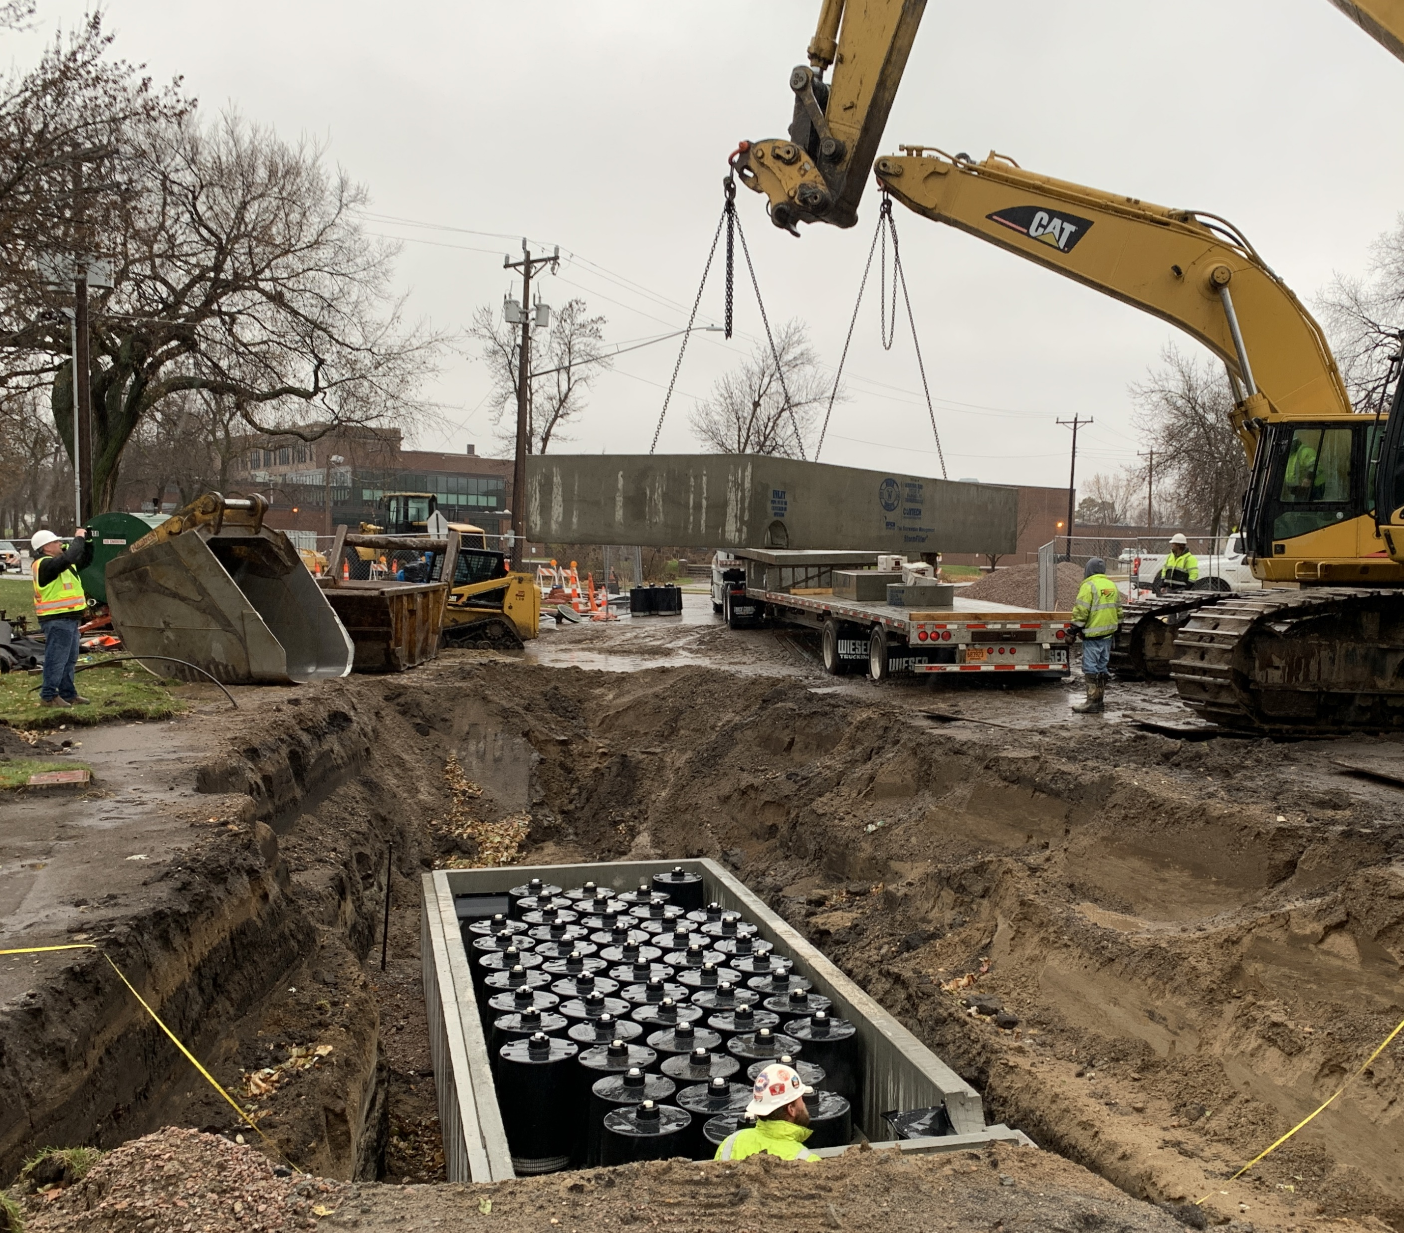
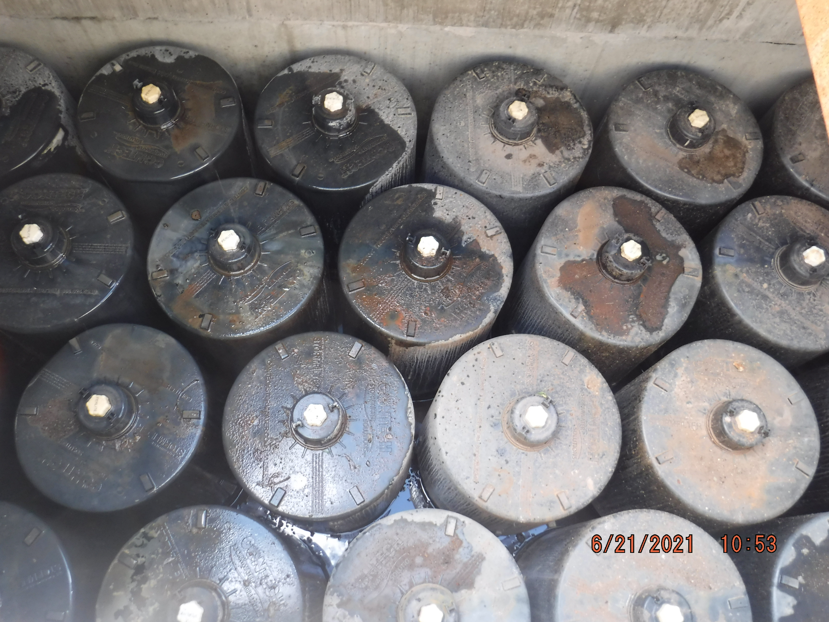
1 Underground Filtration System
St. Cloud Public Library

Slide 5
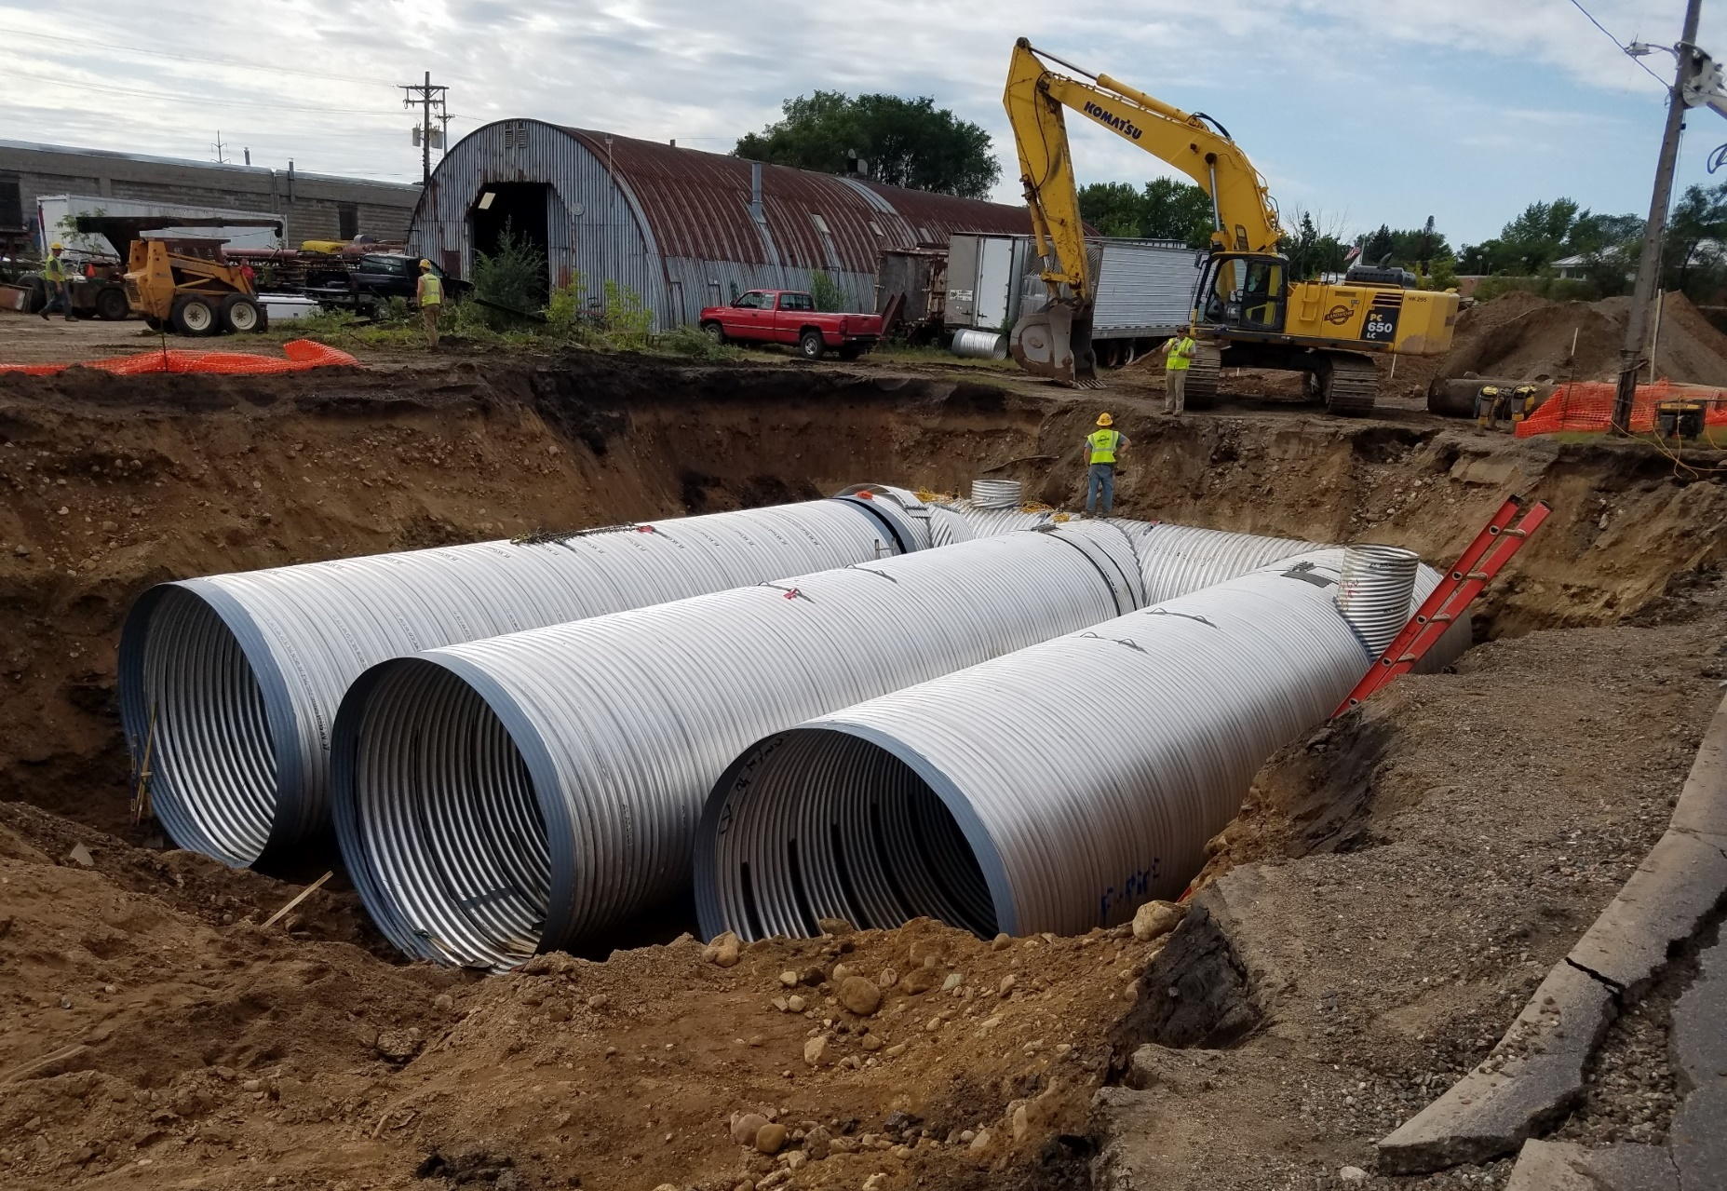
5 Underground Detention Systems

Slide 6
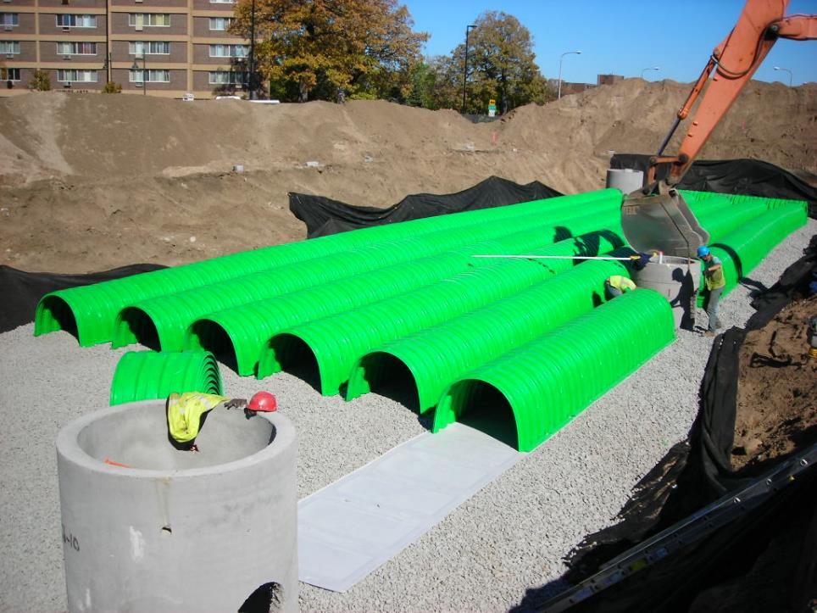
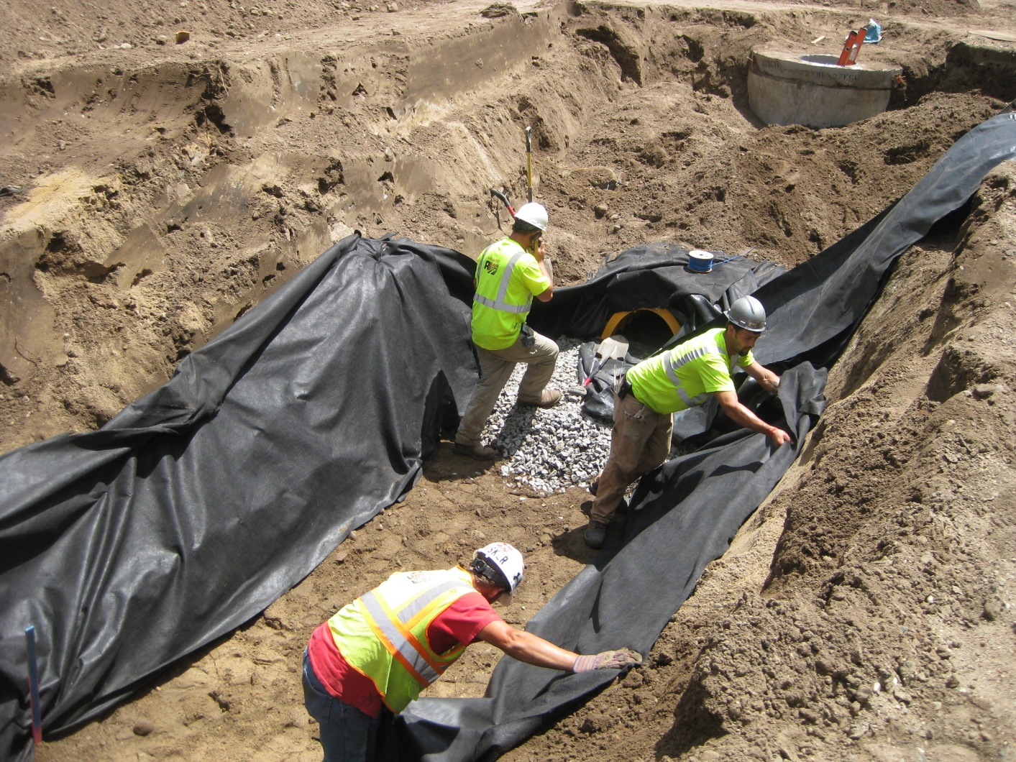
180 Underground Infiltration Systems

Slide 7
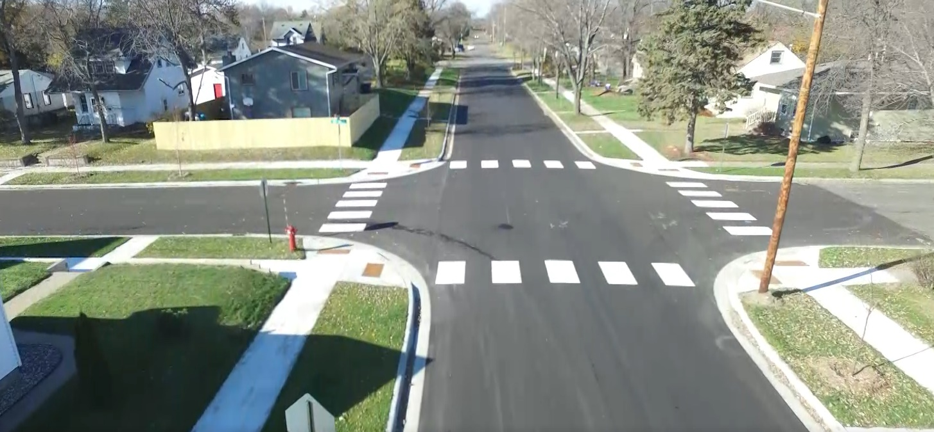
What is the pre-treatment protecting
Cost-benefit considerations
Watershed characteristics
Design for maintenance
Set pre-treatment goals
Expected pollutants
Drainage Area
Observations
SW Manual
Catch basin
Underground Infiltration
Pre-Treatment
Catch basin

Slide 8
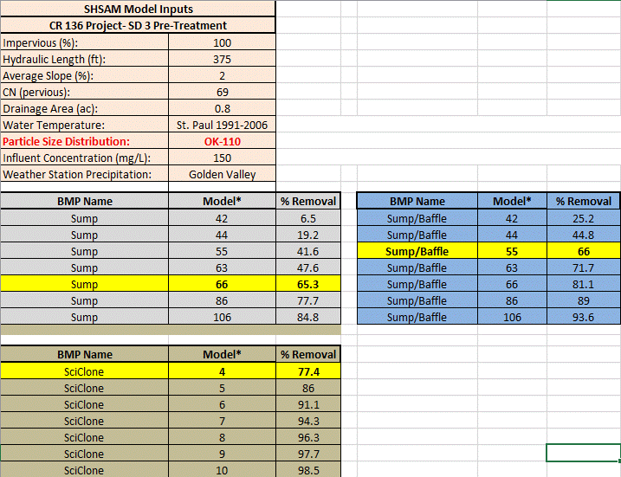
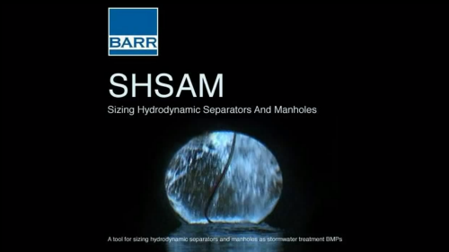

Slide 9
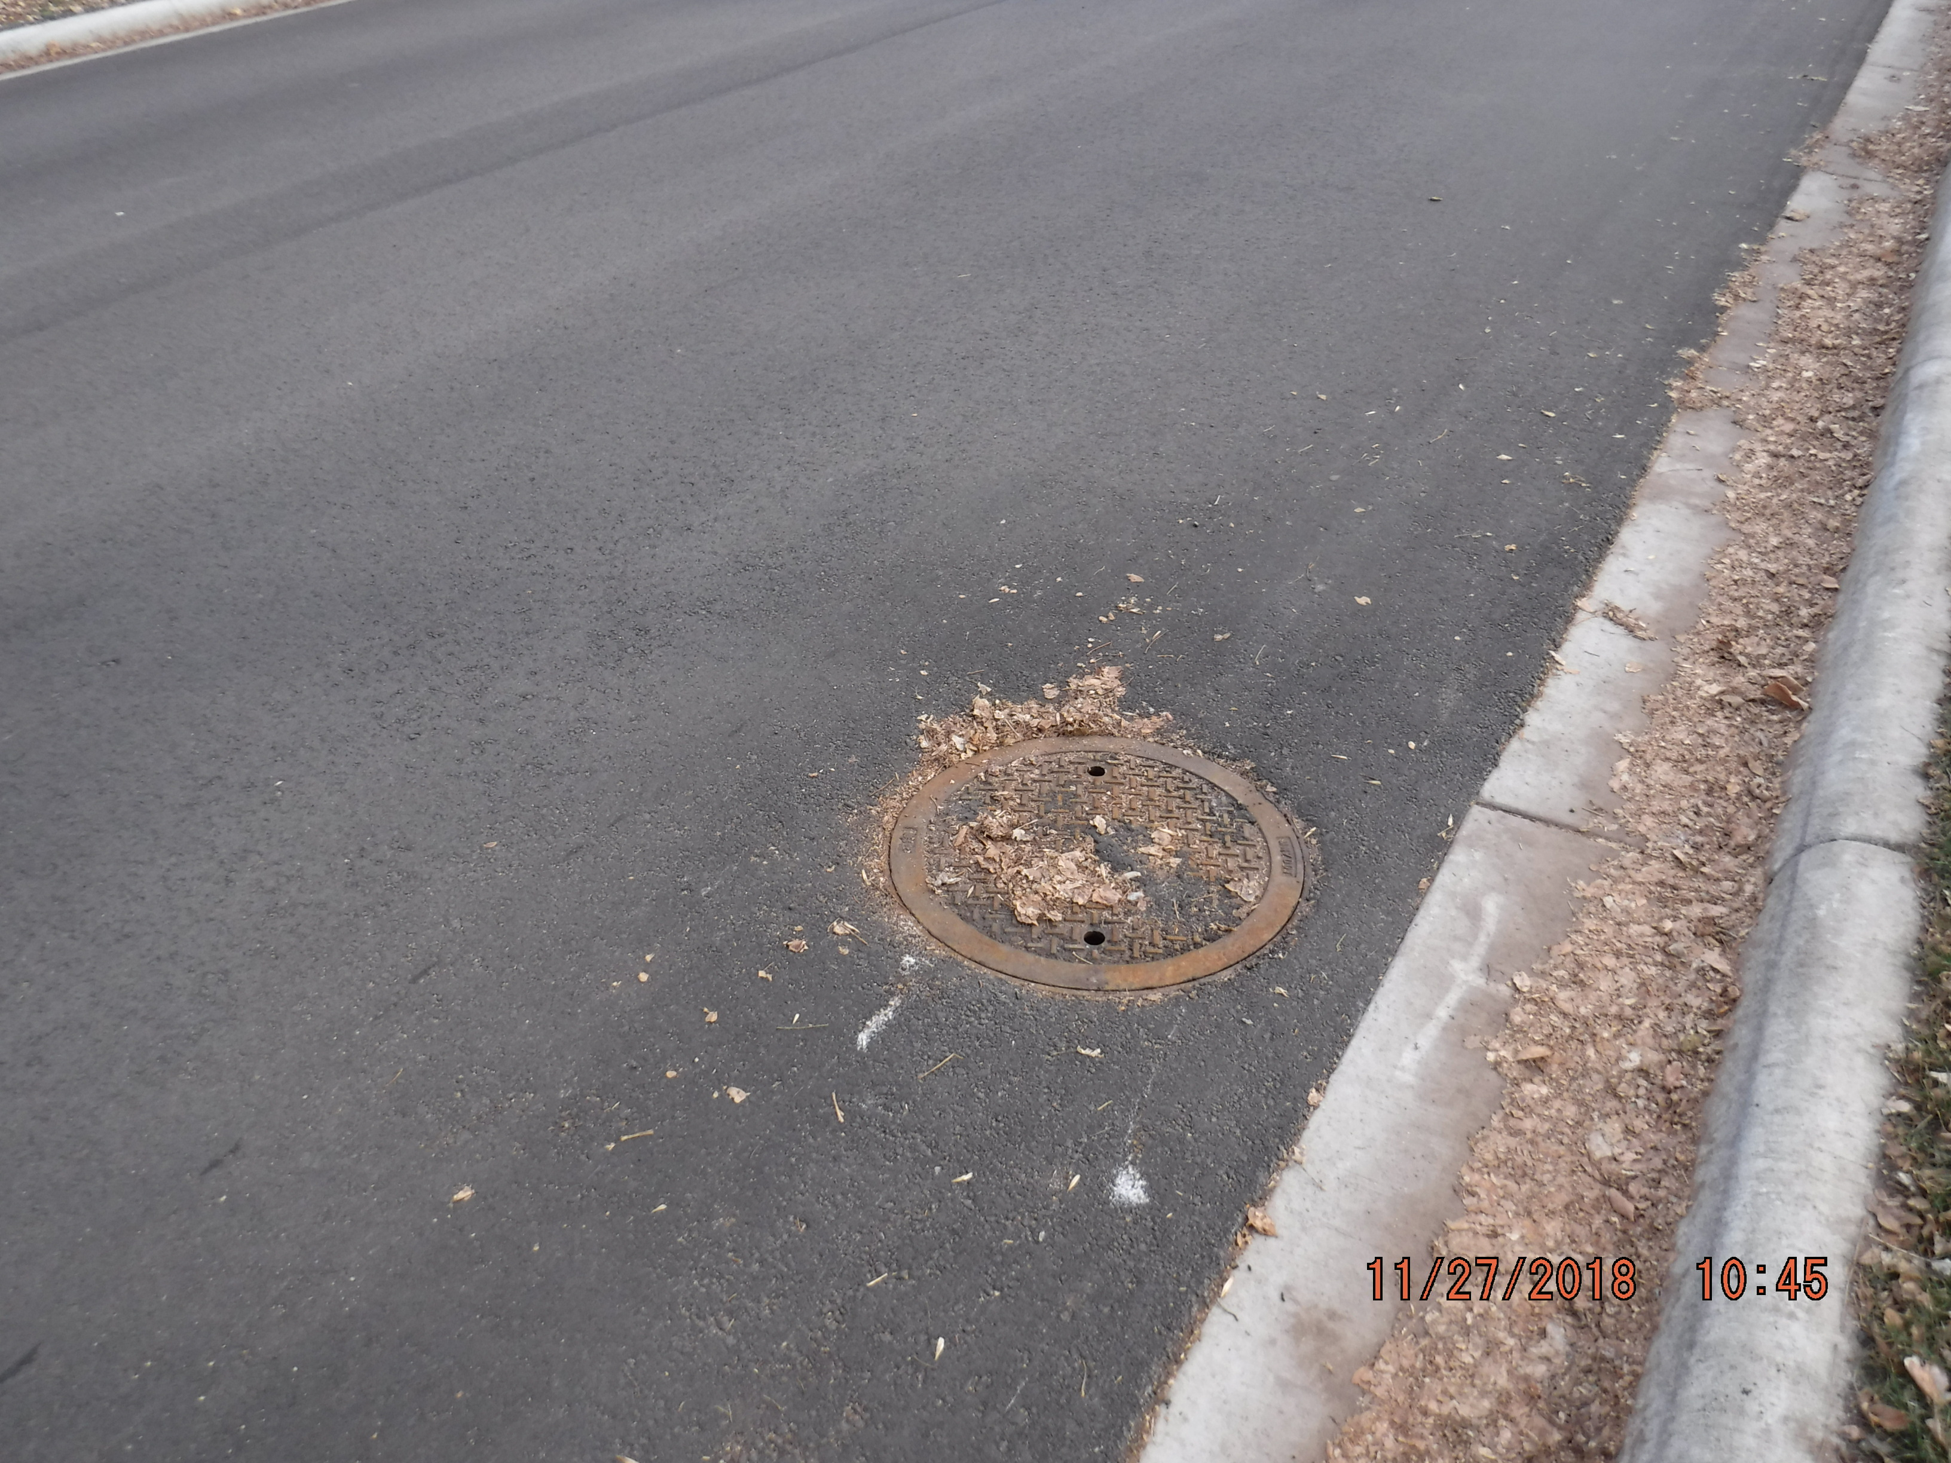
SUMPS: DESIGN FOR WATER QUALITY

Slide 10
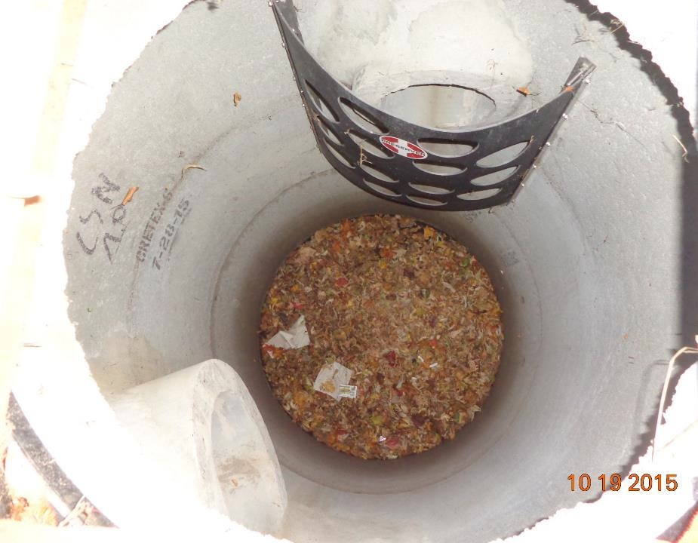
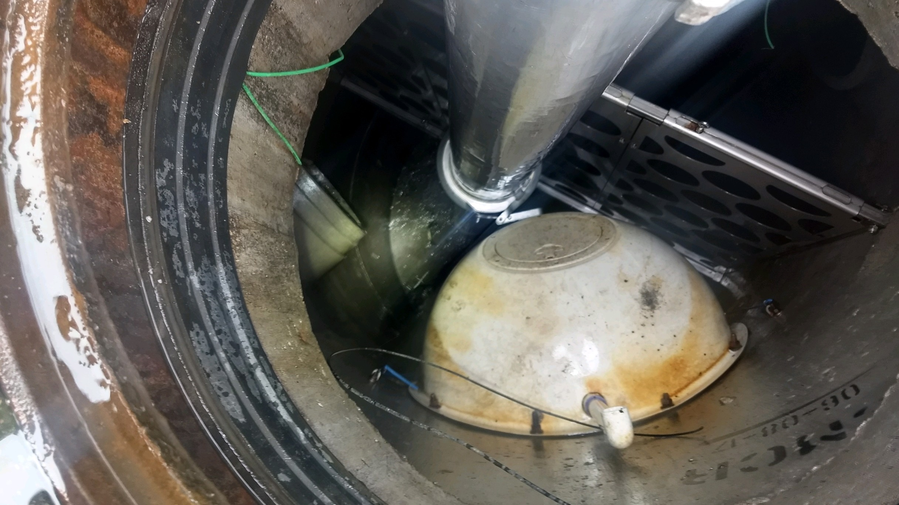
285 Sumps/Hydrodynamic Separators

Slide 11
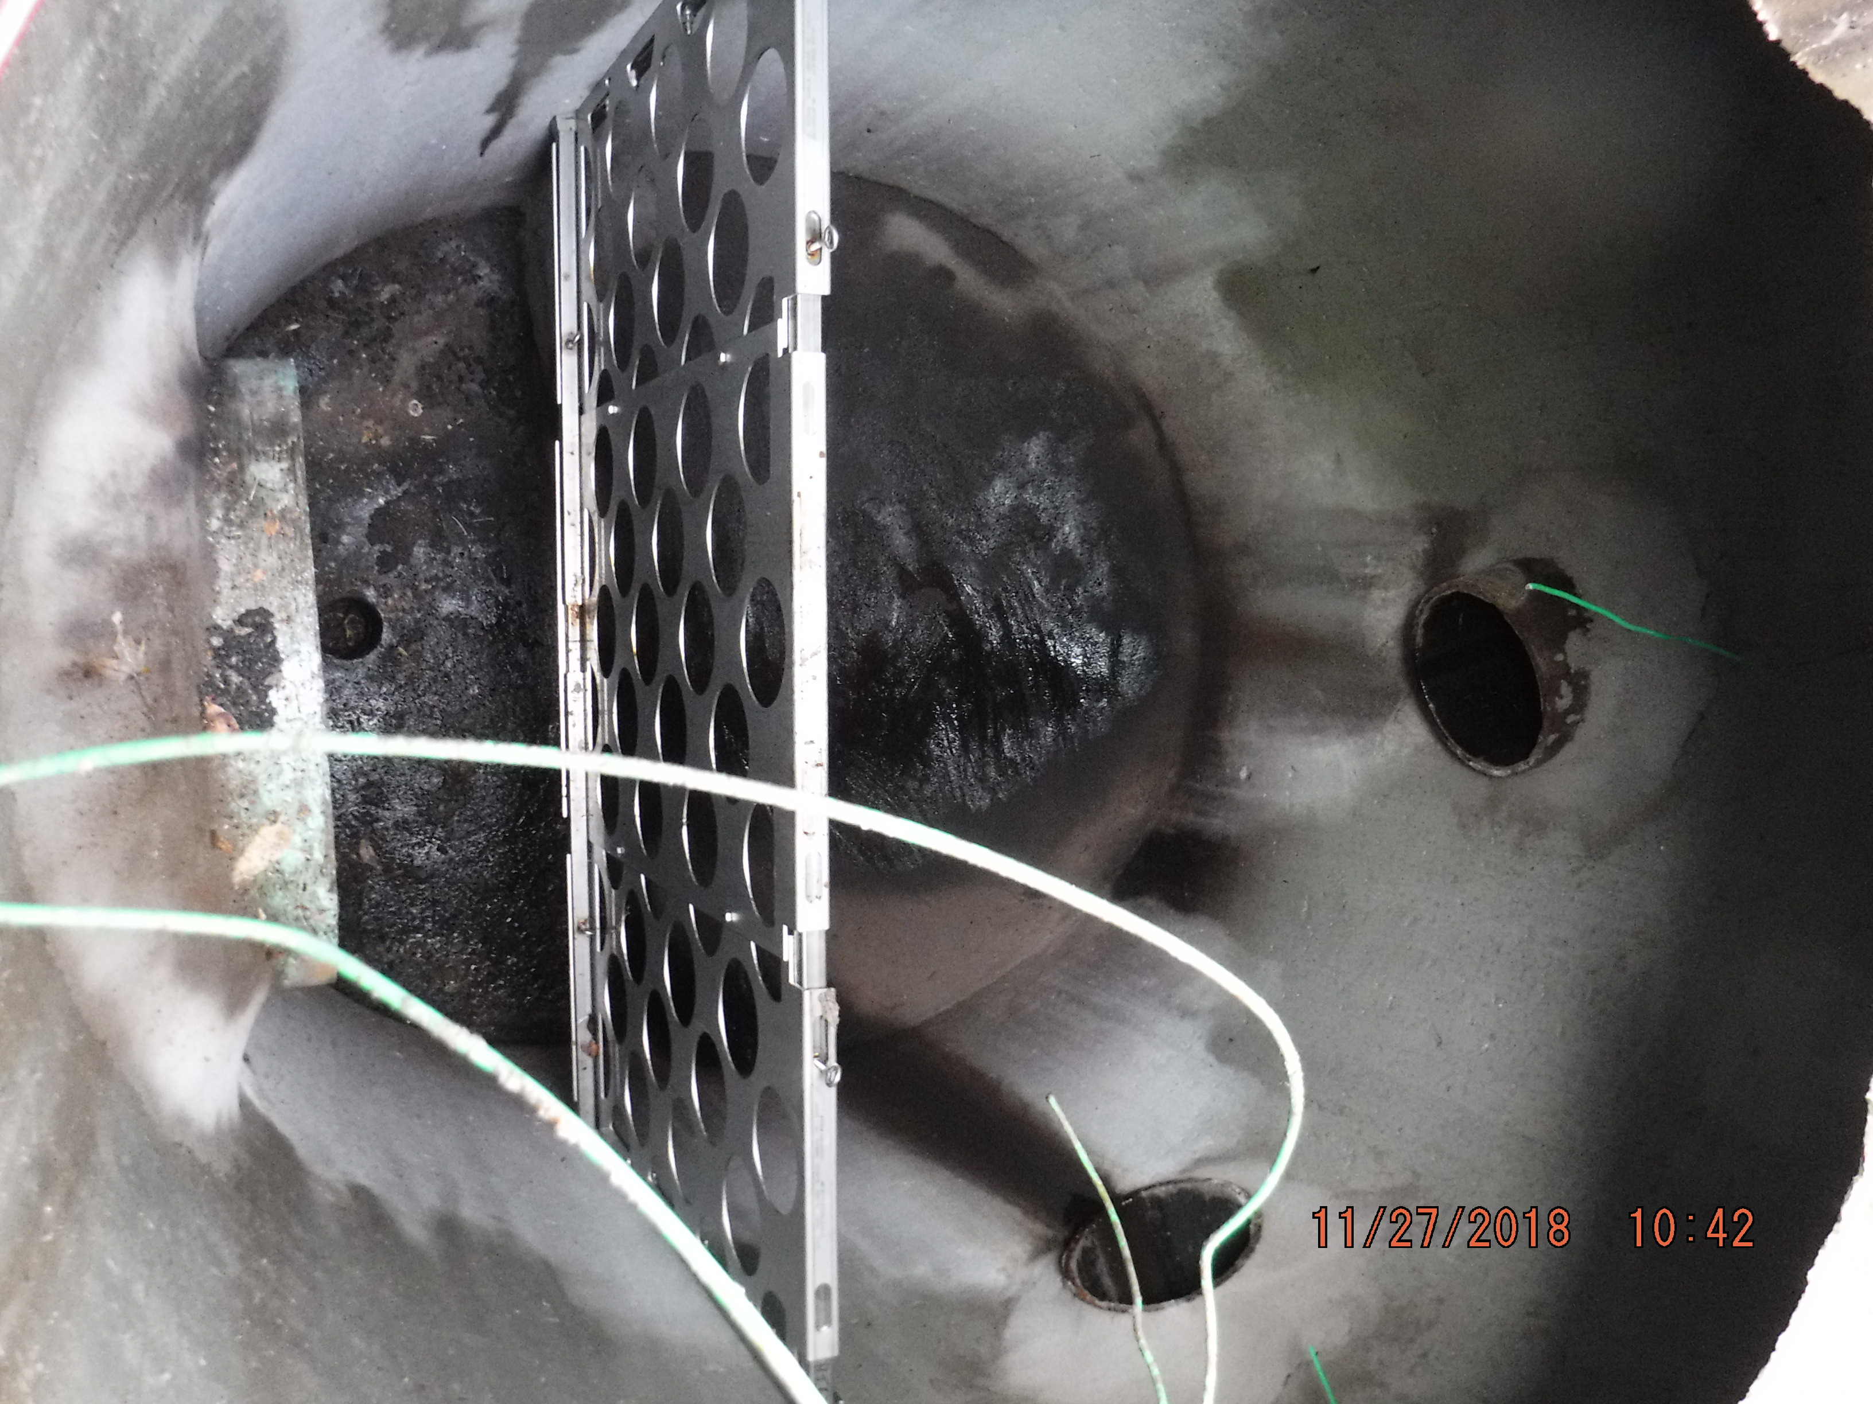
Design for Maintenance
-Shop drawing review
-Access opening
-Equipment
-Efficiency

Slide 12
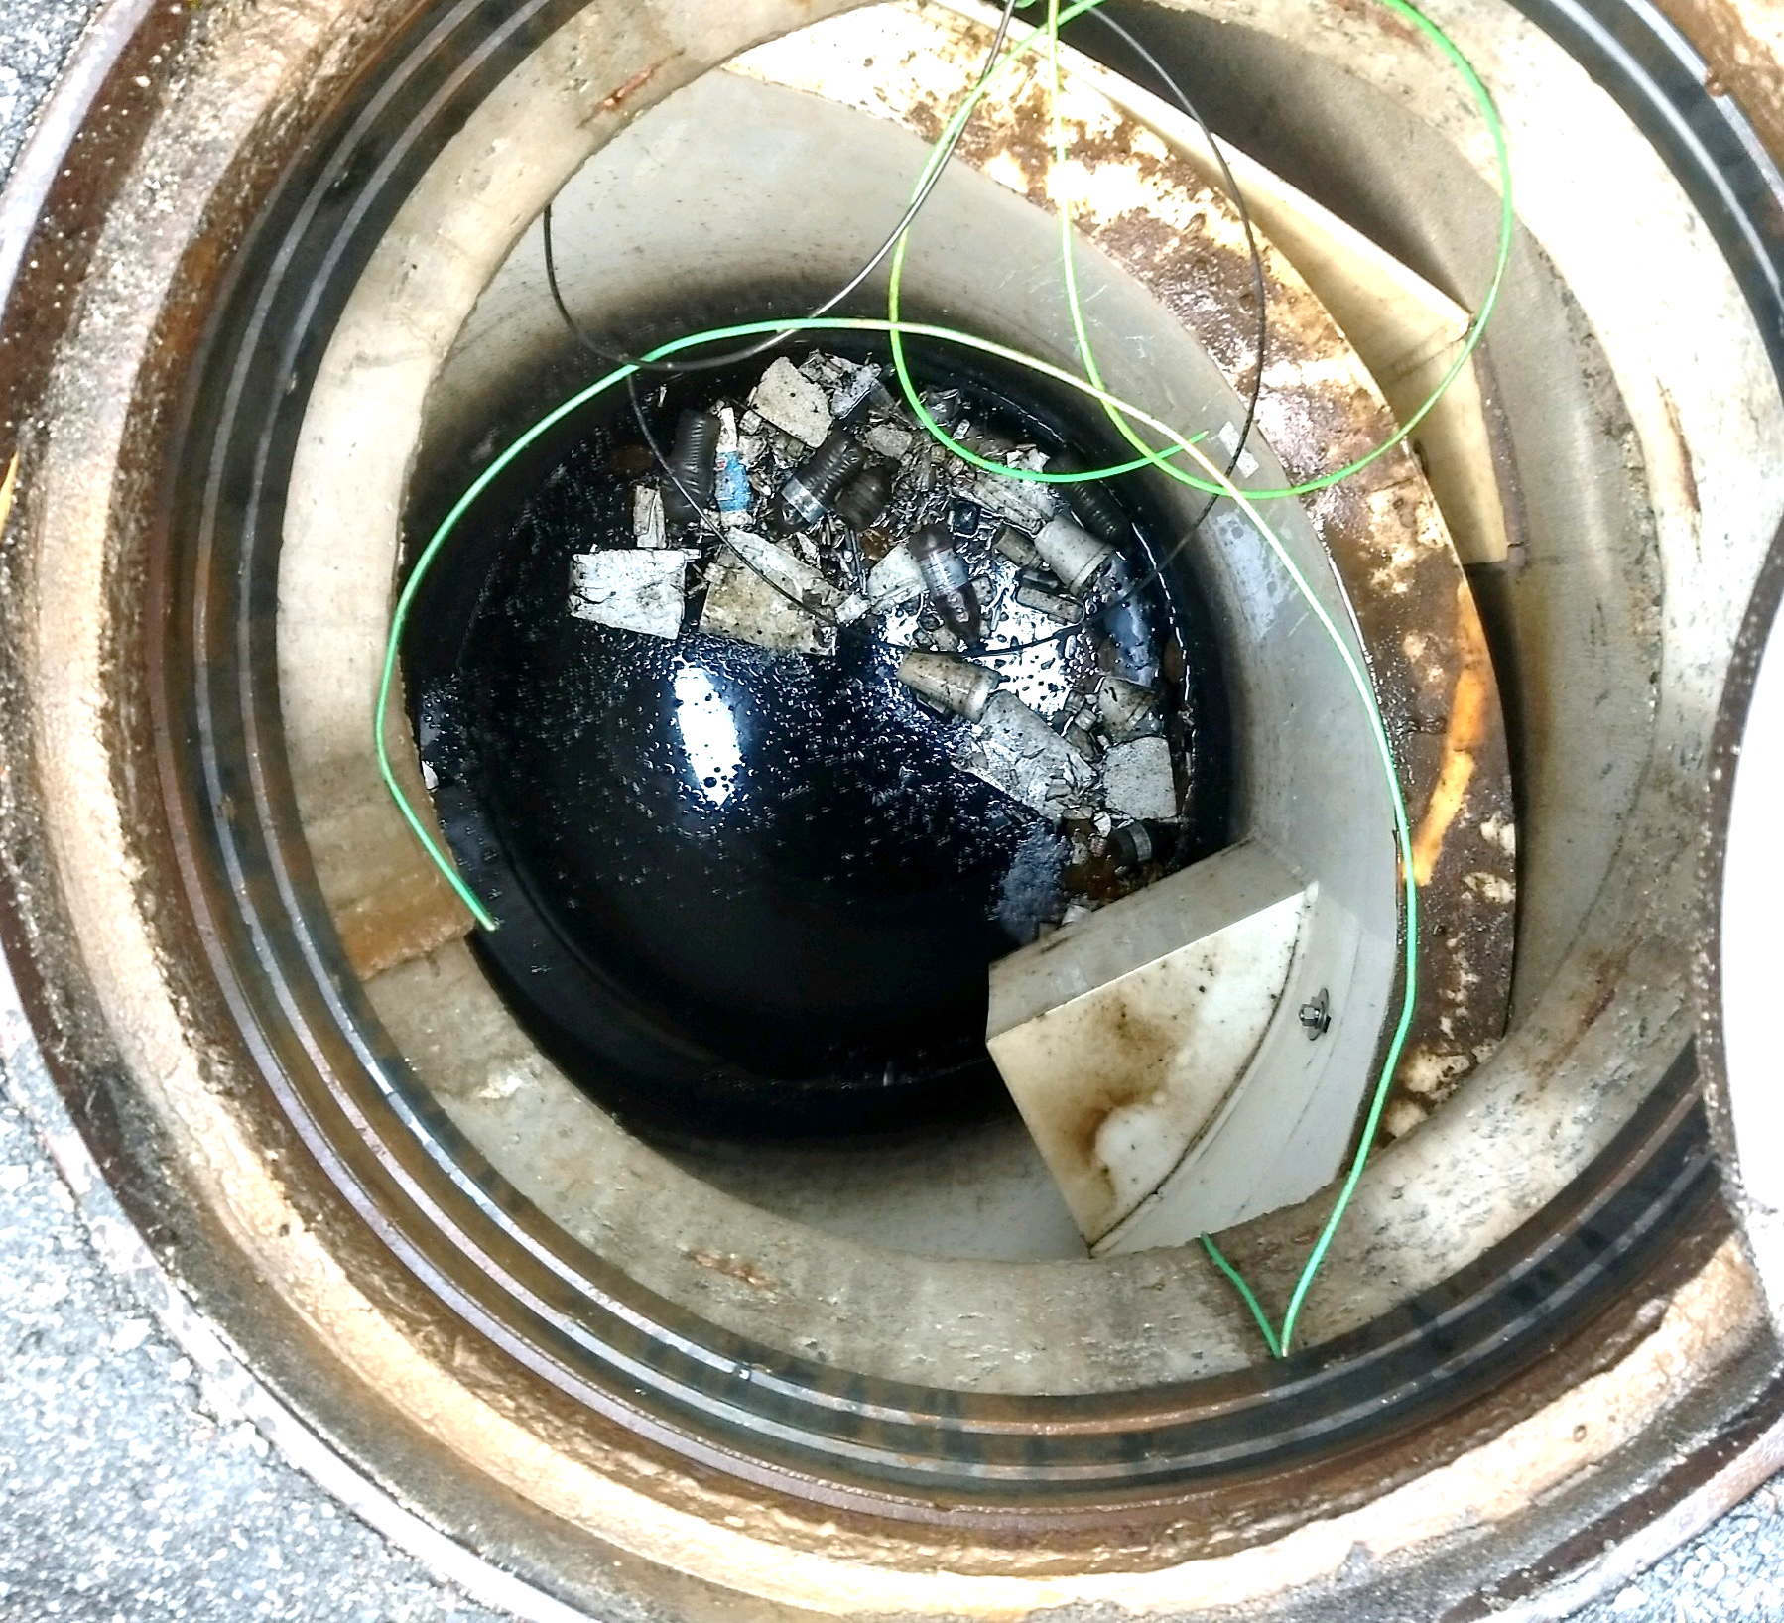
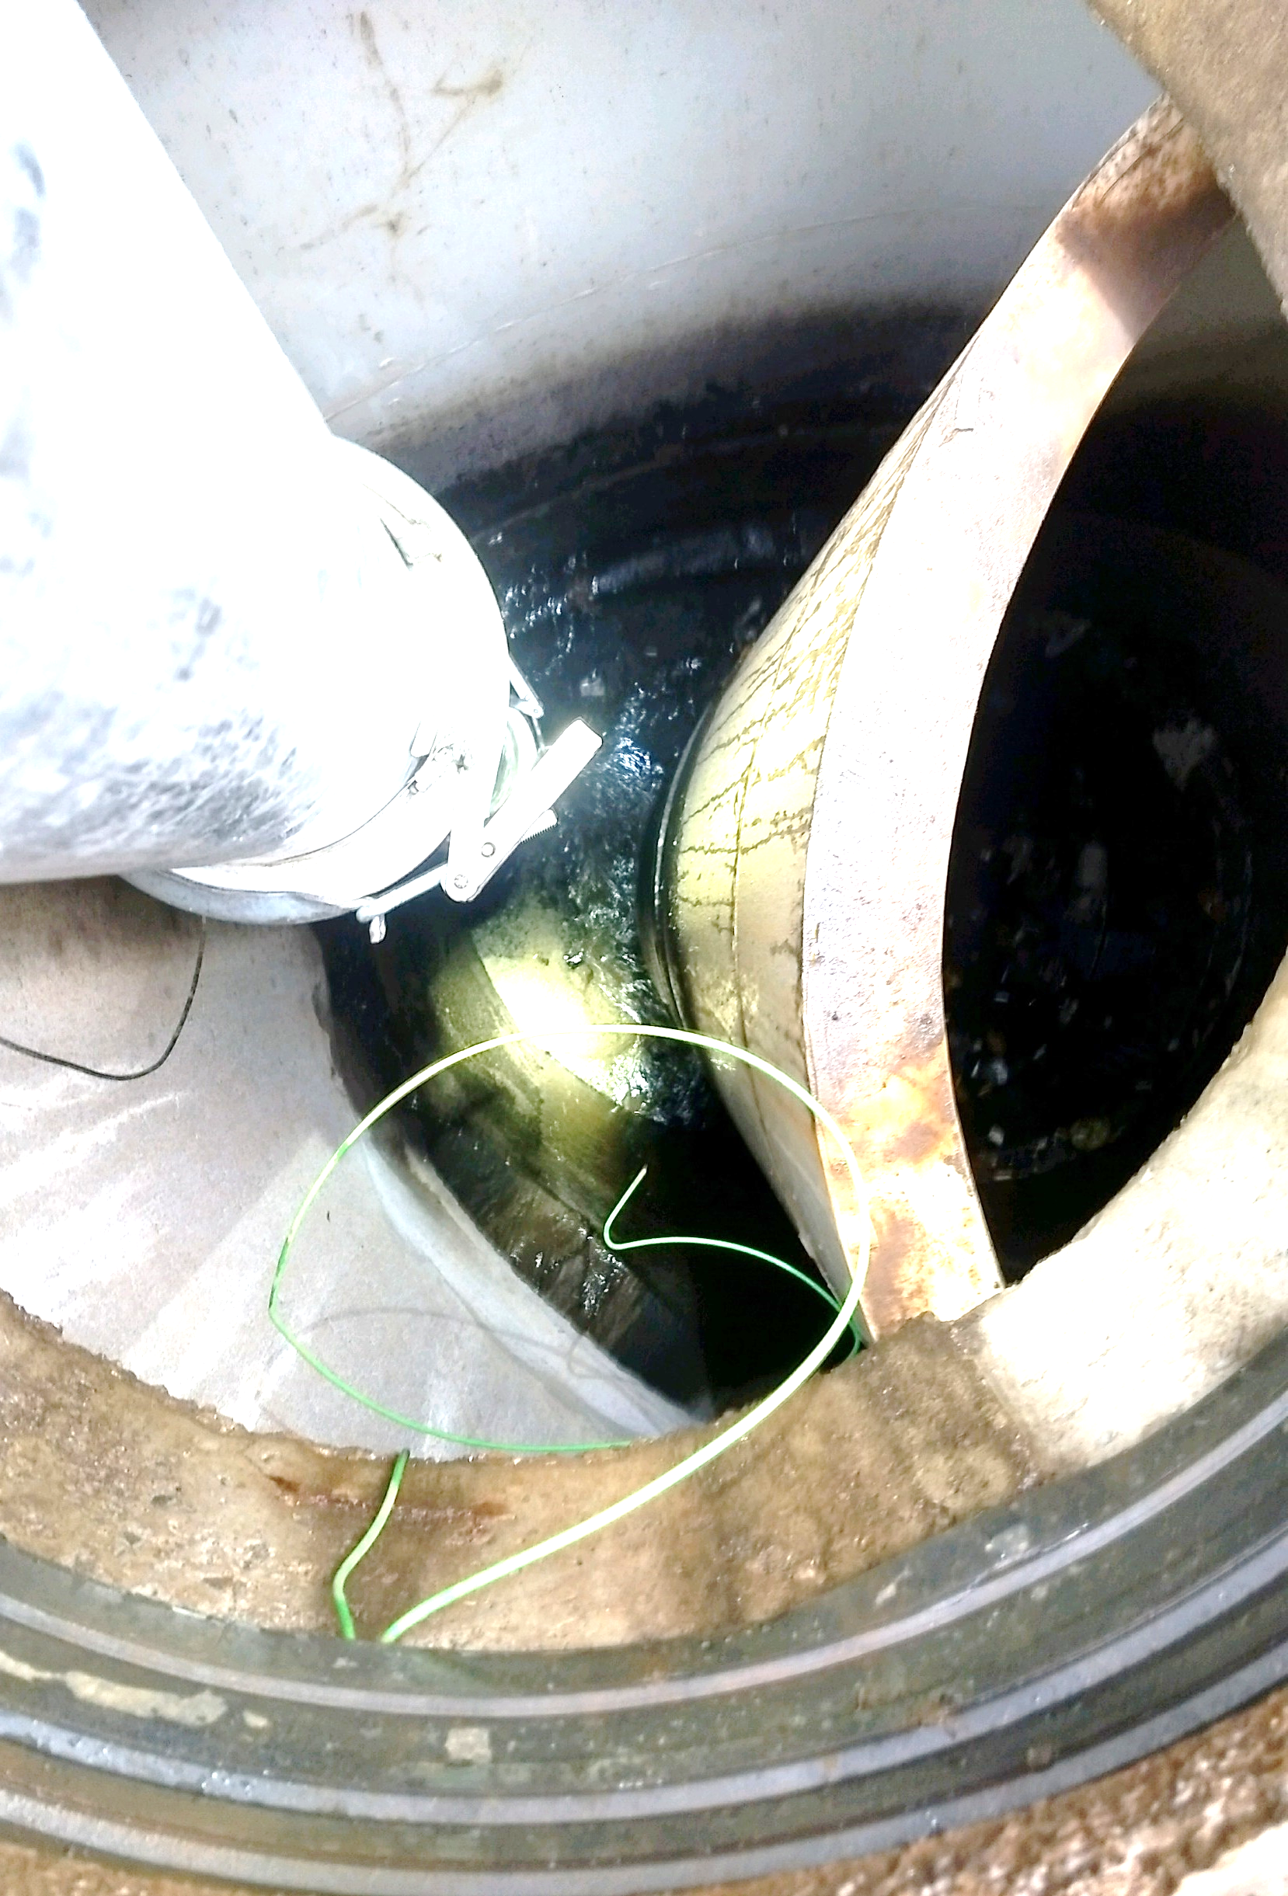

Slide 13
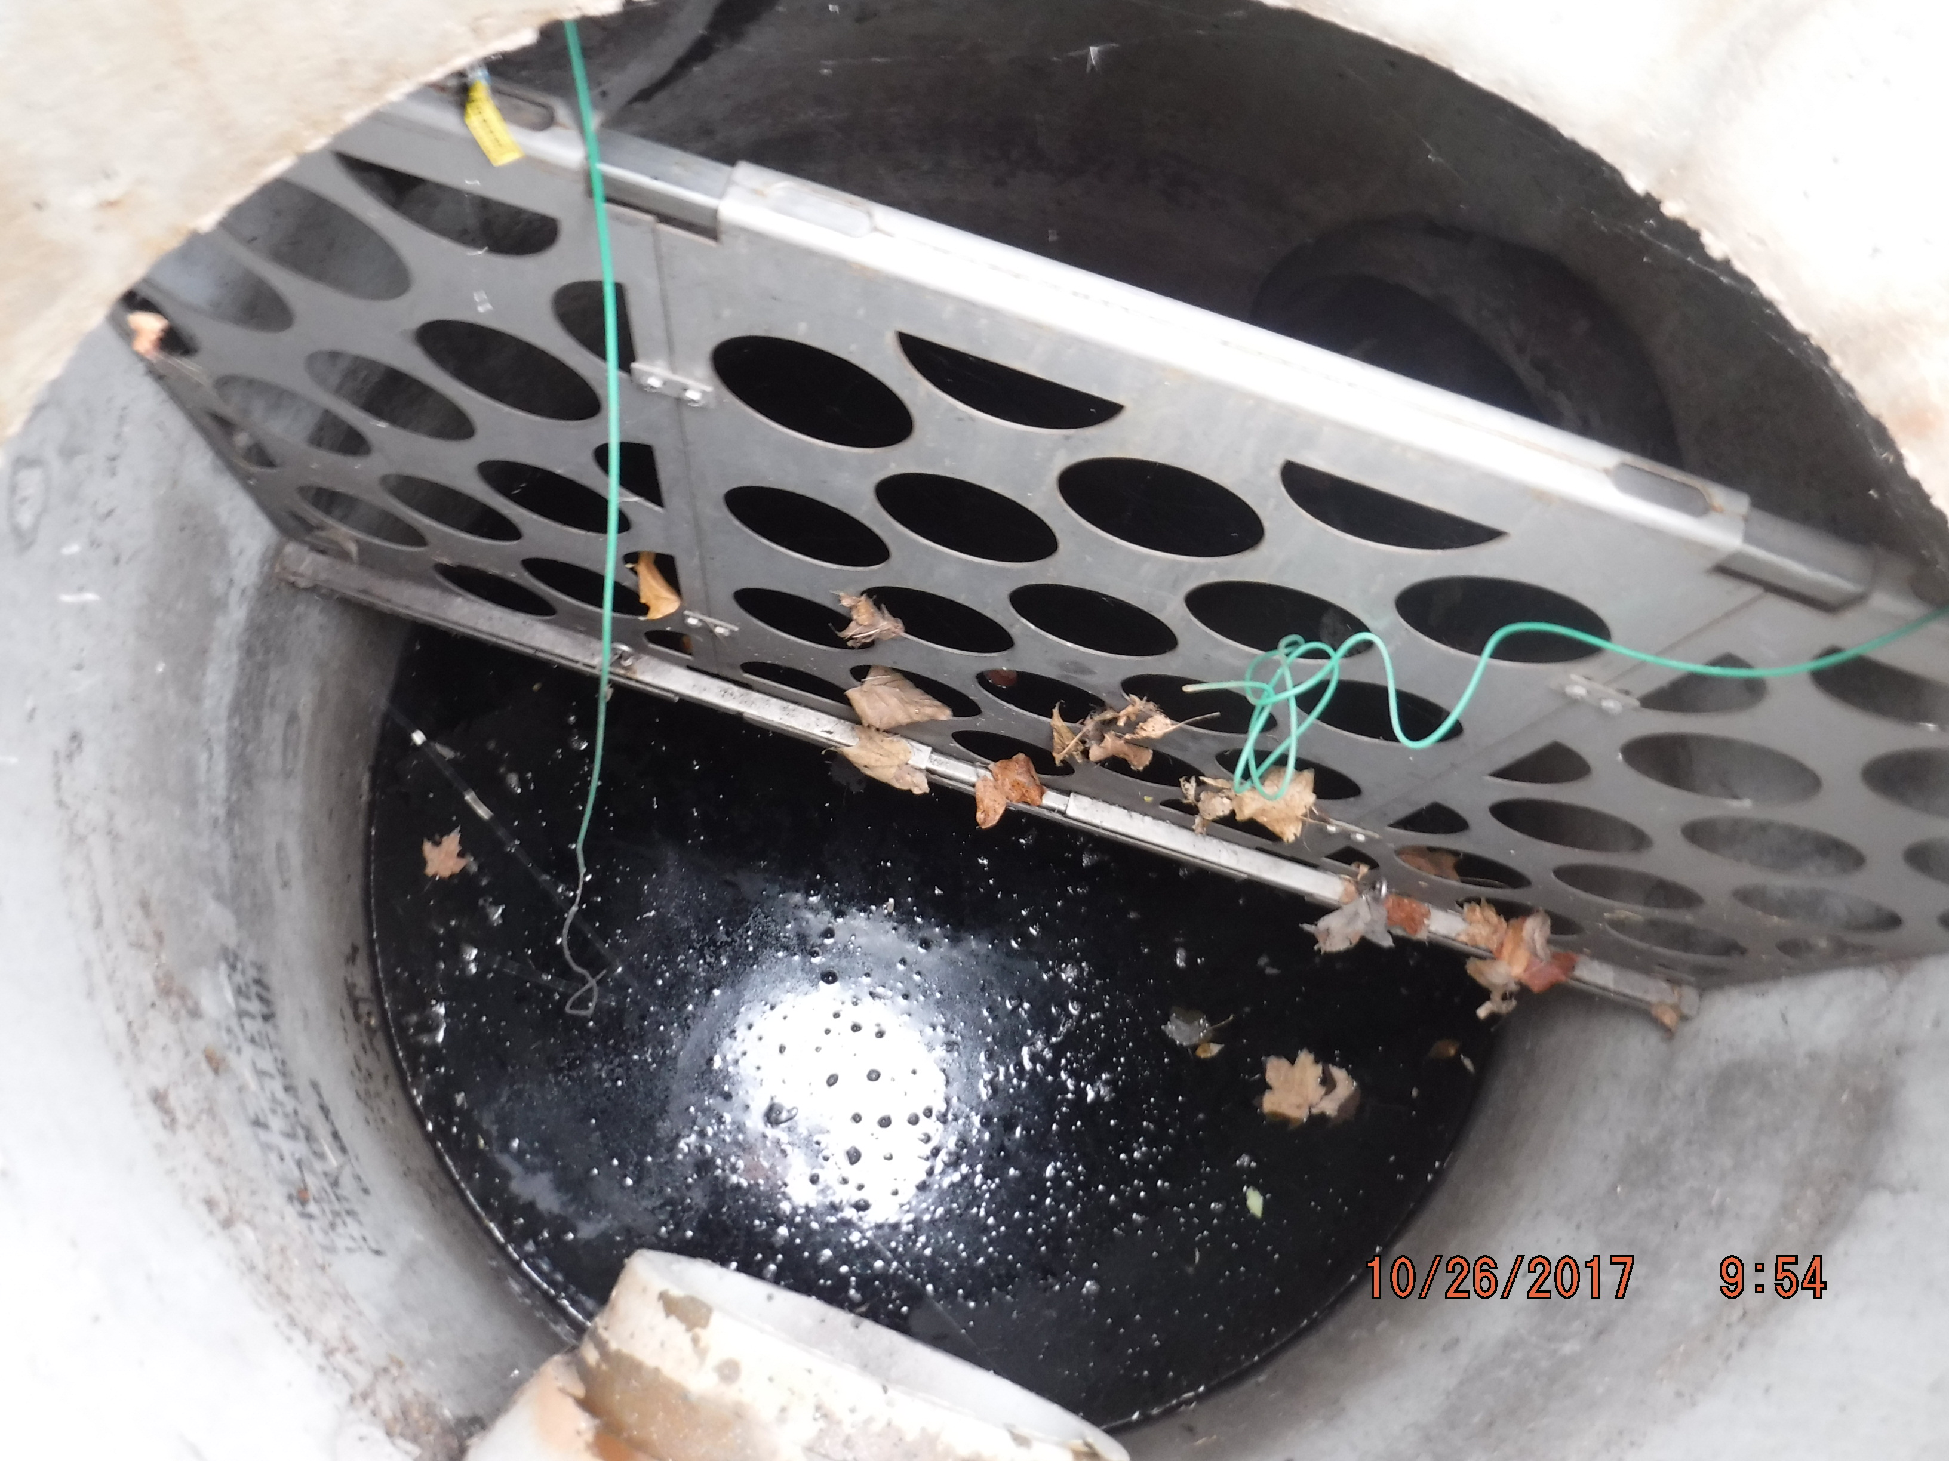
Maintenance Row

Slide 14
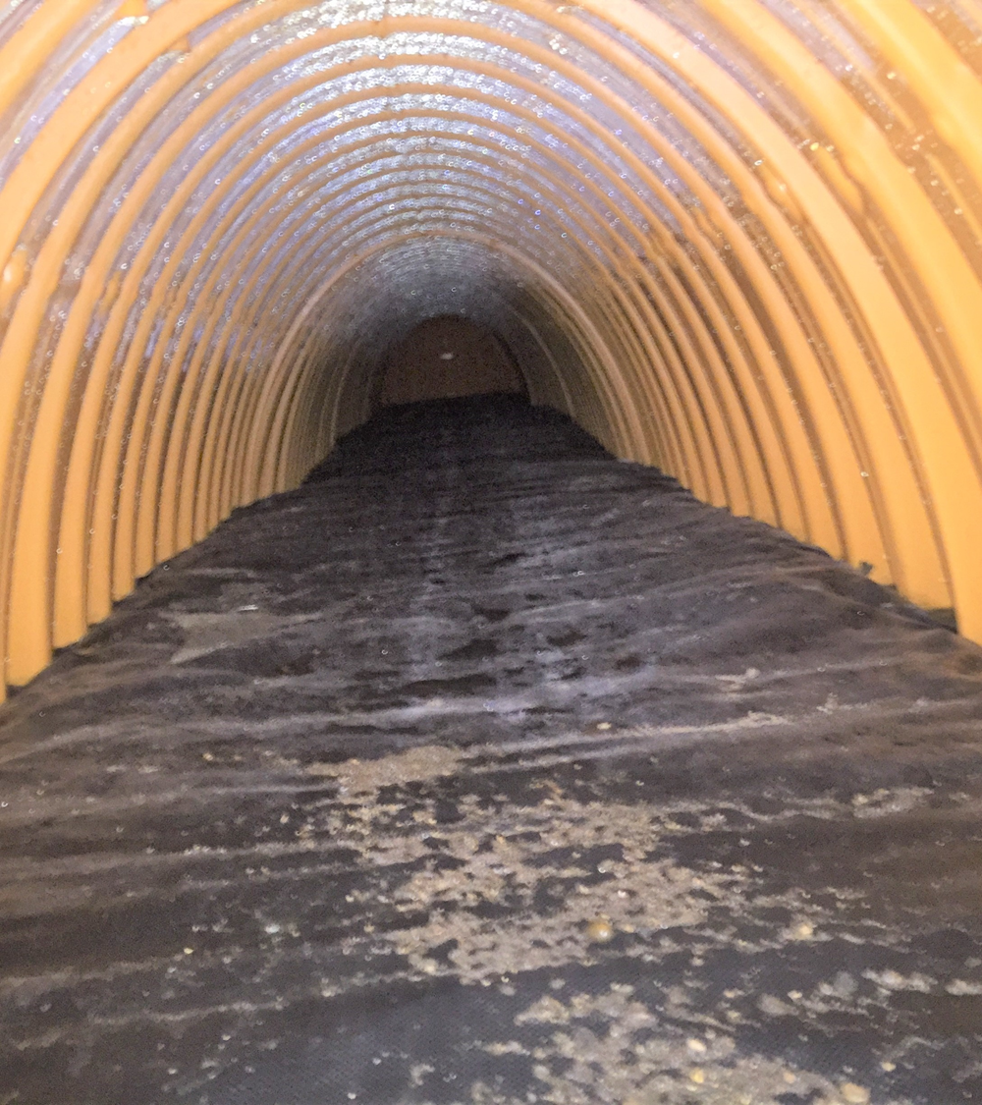

Slide 15
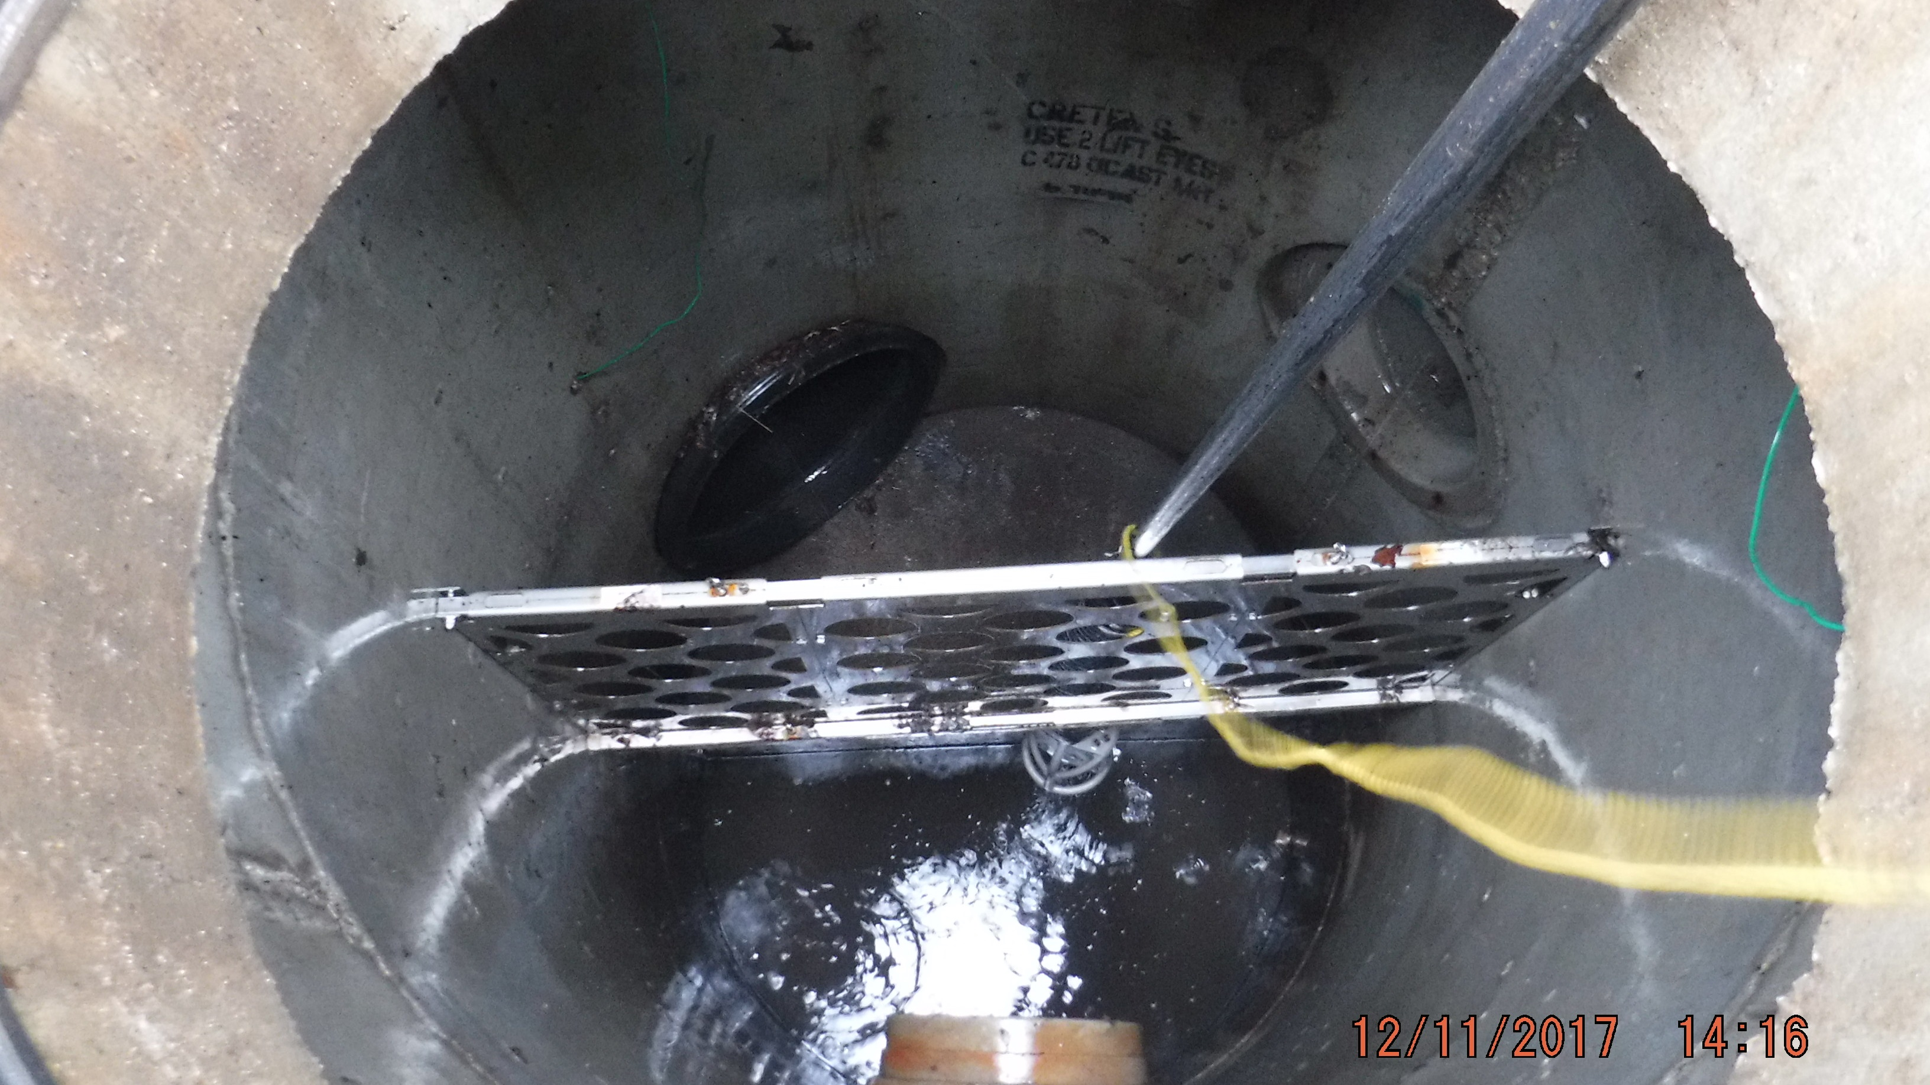
Maintenance Row

Slide 16
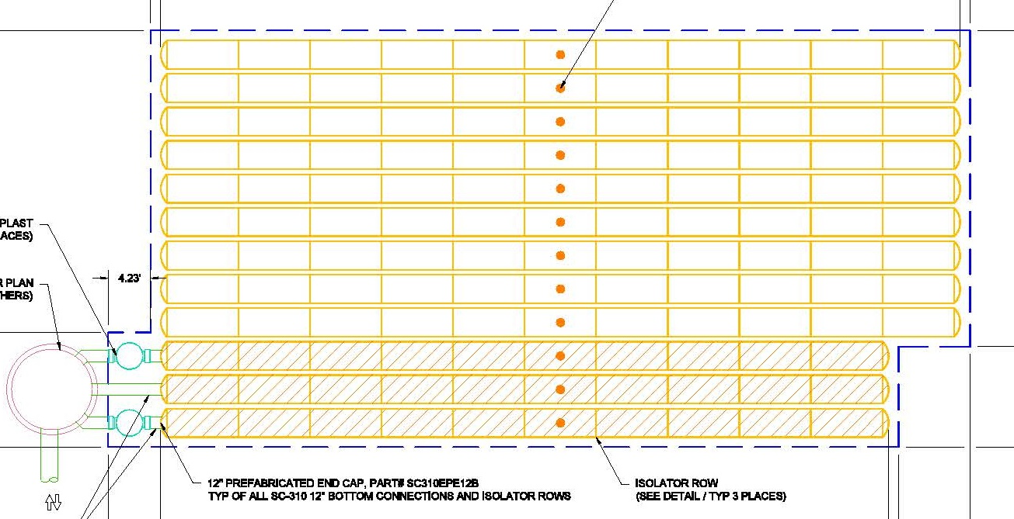
Sump

Slide 17
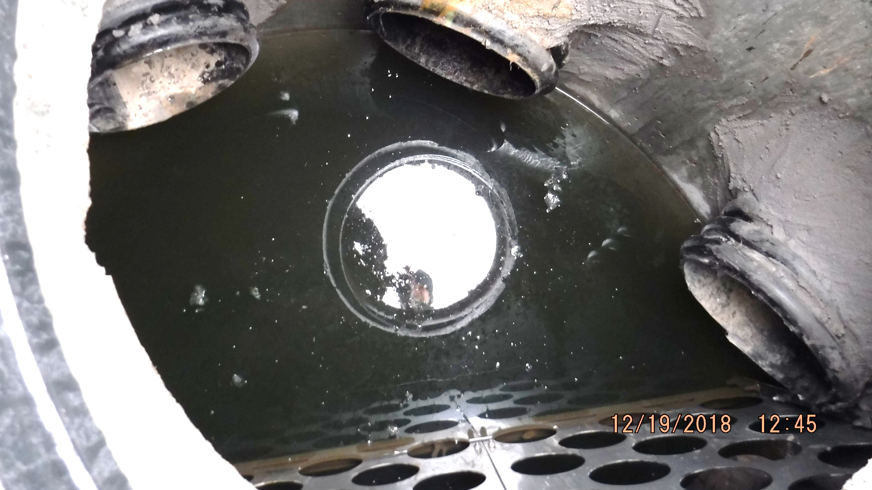

Slide 18
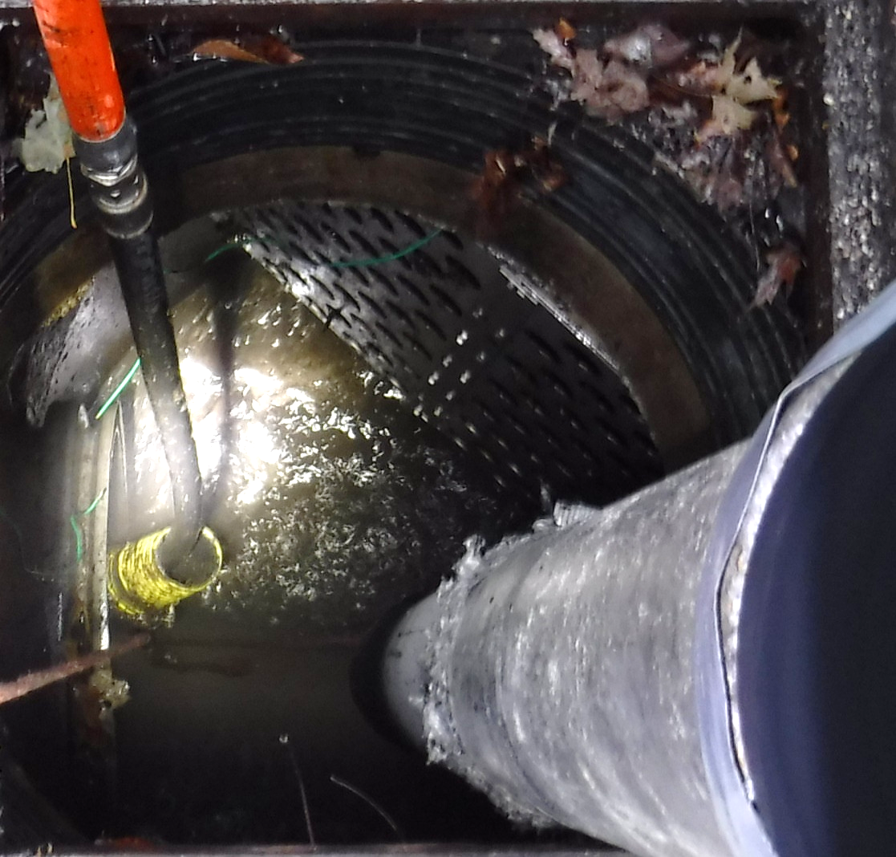
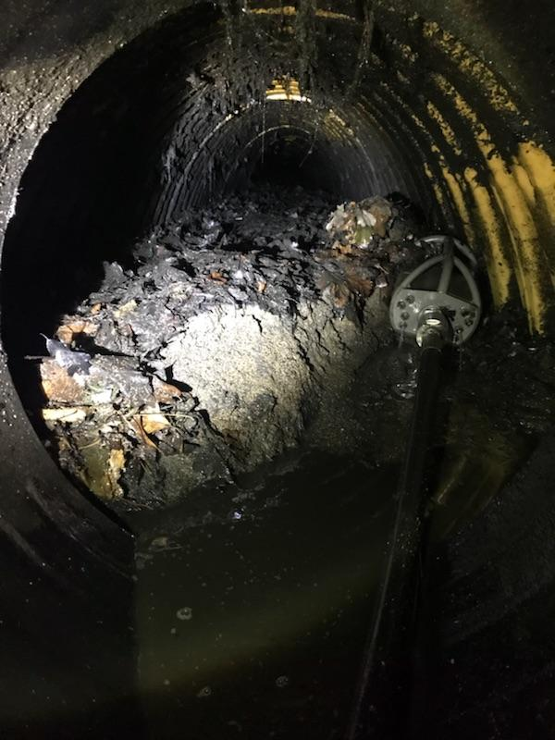

Slide 19
