Slide 1
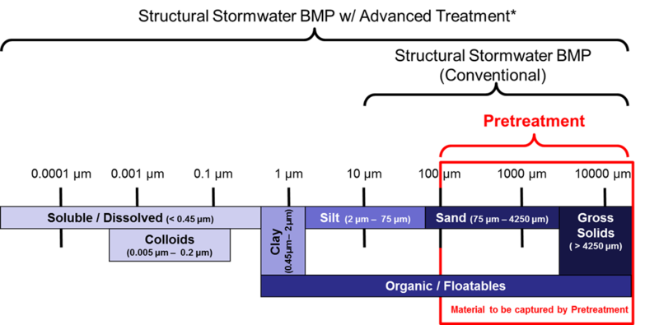

Pretreatment – How can we do better?
Wednesday, January 19, 2022
Minnesota Pollution Control Agency
Image courtesy: A. Erickson, R. Bintner, J. Gulliver, and RESPEC

Slide 2
Speakers
Dr. John Chapman, University of Minnesota: Introduction to and importance of pretreatment
Noah Czech (City of St. Cloud), Mike Isensee (Carnelian Marine St. Croix Watershed District): Examples of selection, implementation and efficient maintenance of pretreatment practices
Chris French, Bio Clean Environmental: Observation of pretreatment practices

Slide 3
Some logistics
Webinar is being recorded
1.5 PDH offered
Please put questions in the chat box; will likely defer questions to the end
Everyone is muted; we can unmute if necessary
Everything will be posted in the Minnesota Stormwater manual on the page called Stormwater Manual webinars

Slide 4
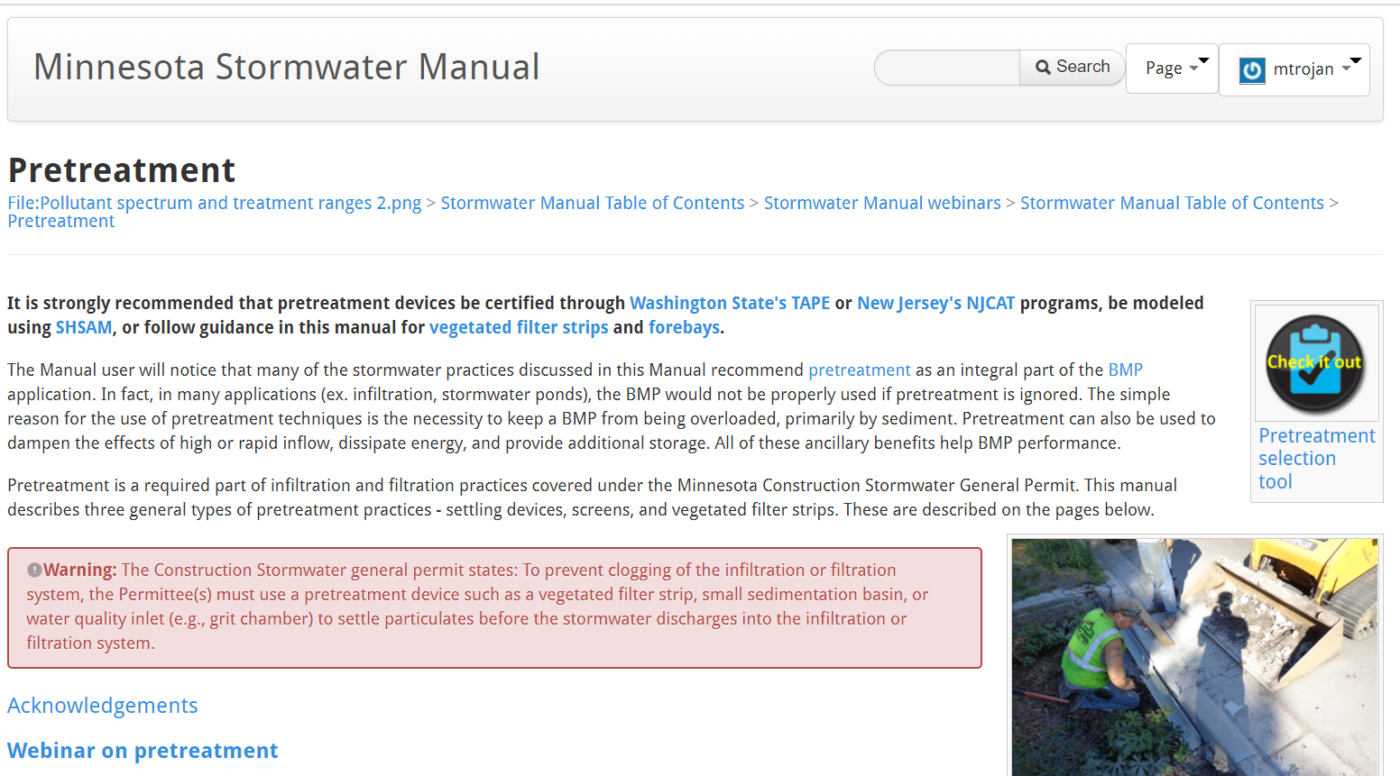
Why a webinar on pretreatment?
We gave a webinar on pretreatment in June, 2019
The Minnesota Stormwater Manual (wiki) has extensive information on pretreatment
Despite this, we continue to see inadequate or incorrect implementation of pretreatment

Slide 5
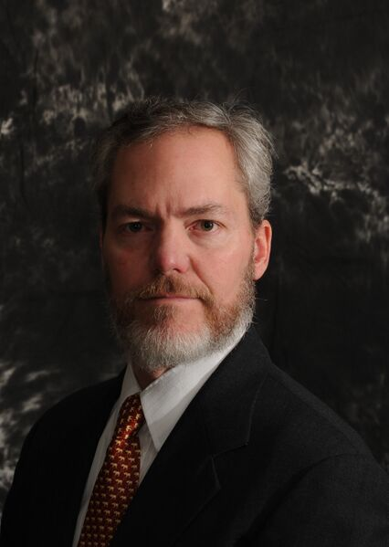
Dr. John Chapman University of Minnesota
Introduction to and importance of pretreatment

Slide 6
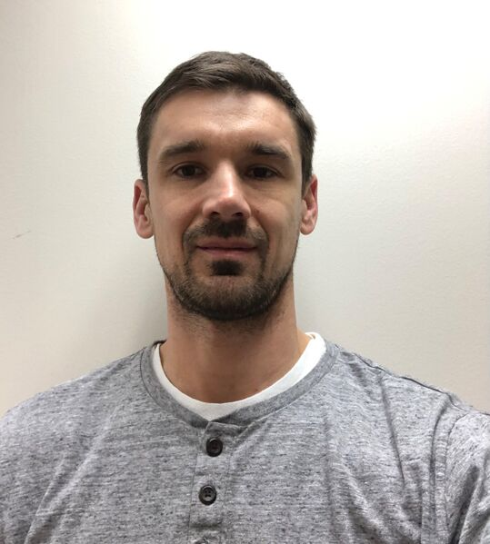
Noah Czech
City of St. Cloud
Examples of selection, implementation and efficient maintenance of pretreatment practices

Slide 7
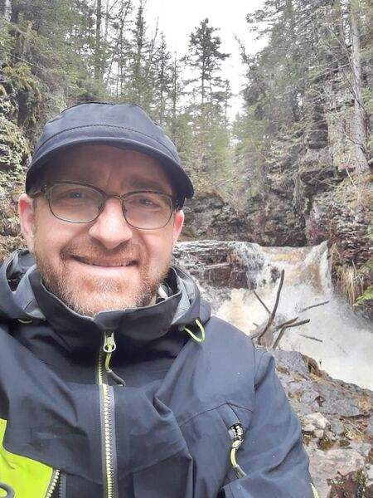
Mike Isensee
Carnelian Marine St. Croix Watershed District
Examples of selection, implementation and efficient maintenance of pretreatment practices

Slide 8
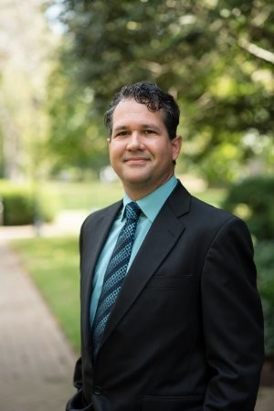
Chris French
Bio Clean Environmental
Observation of pretreatment practices

Slide 9
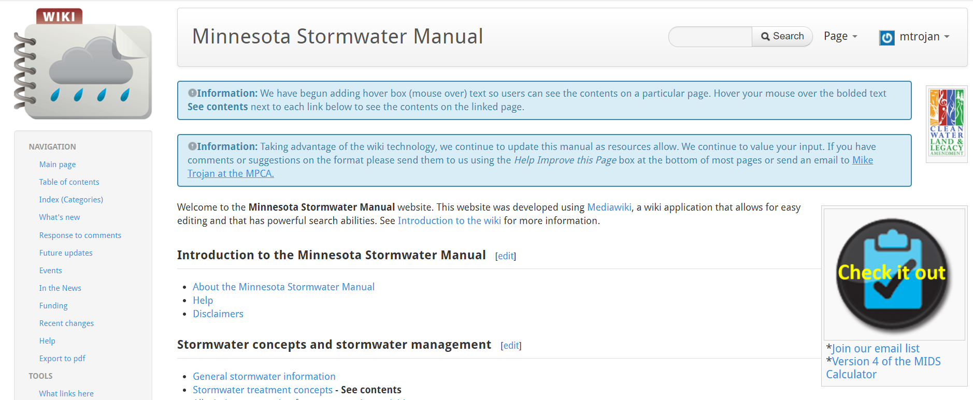
Some shameless self promotion
If interested, join our email list

Slide 10
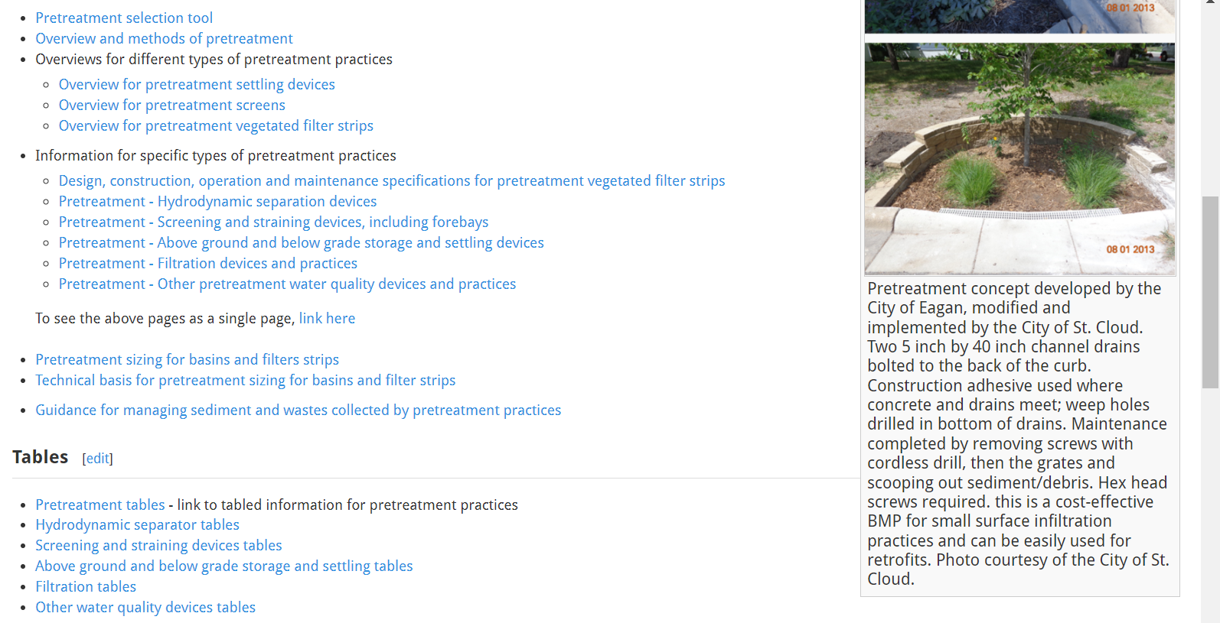
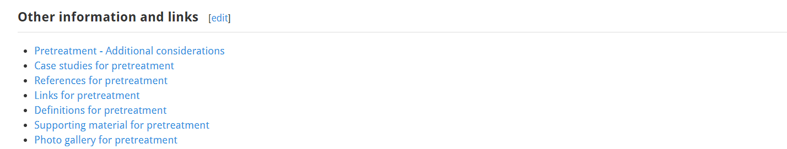

Slide 11
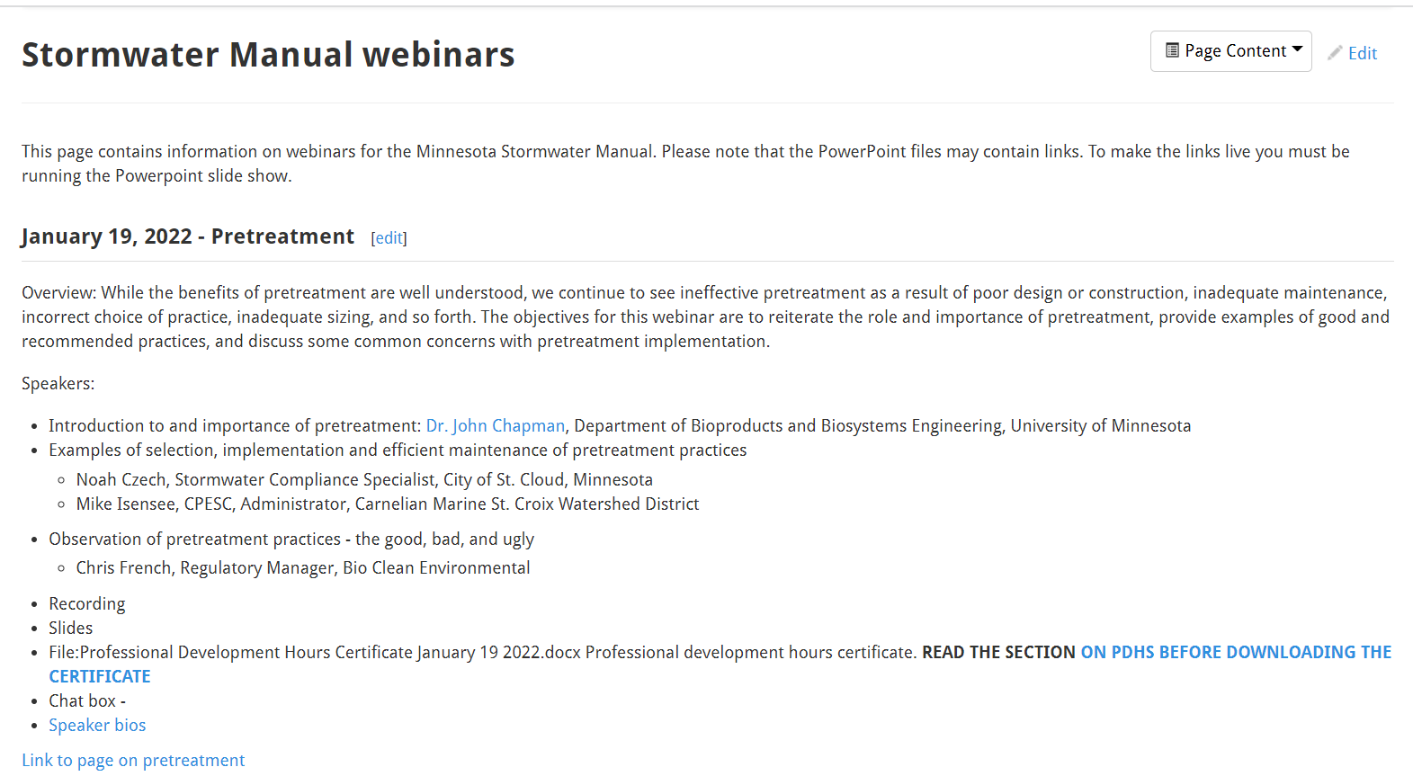
Stormwater Manual links
Webinar info and pdh certificate located on page called Stormwater Manual webinars
All the info on pretreatment is on a page called Pretreatment
Mike.trojan@state.mn.us

